Slide 1
Become
an IFLA Member
Join the most international
library organisation in the world

Slide 2
PART 1
About IFLA
PART 2
Our History
Presentation
Outline
PART 3
Our Vision
PART 4
Why Join
PART 5
Membership Categories

Slide 3
About IFLA
IFLA is the global voice of libraries, representing the interests of the profession and working to improve services worldwide.
We benefit from a strong membership, a vibrant professional community, and close collaboration with partners.

Slide 4
Our History
Throughout its long history, IFLA has championed the work of libraries, librarians, and library associations around the world.
Founded on 30 September 1927 at the Annual Meeting of the UK Library Association in Edinburgh, Scotland, IFLA officially began in 1929 with 15 members from 15 countries.
We now have over 1700 Members and Affiliates from over 140 countries worldwide.

Slide 5
Our Vision
Our vision is a strong and united library field powering literate, informed and participative societies.

Slide 6
Why join
Join a strong united network of over 1700 members from over 140 countries worldwide.
Becoming a member of IFLA affirms your commitment to delivering exceptional library services and promoting the core values of library and information work.
Our members are our greatest strength, working together to help define the agenda of the international library and information community.

Slide 7
Regional Divisions
The Regional Division Committees focus on advocacy issues and needs specific to their region.
As a member, you will be registered with the relevant Regional Division according to the country/territory in which you live.
IFLA works with six Regional Divisions.

Slide 8
Regional Divisions
Latin America
and the Caribbean
Asia and Oceania
Europe
Middle East and
North Africa
North America
Sub-Saharan Africa

Slide 9
Benefits of IFLA membership
Connect and collaborate with our international network, within your sector and across the field​.
Participate at reduced rates in the IFLA World Library and Information Congress​.
Receive free Section membership and develop close links with experts in your particular field of interest.
Participate in IFLA’s decision-making​ and nominate and elect IFLA’s leaders​
Receive the IFLA Journal and Annual Report as well as discounts on IFLA Publications.
Strengthen the global voice of libraries and information services and help set the course of the profession.
Access dynamic professional development opportunities.
Be part of one of IFLA’s Regional Divisions, working with us to improve advocacy and build capacity.

Slide 10
Section Membership
IFLA has a range of Sections whose Standing Committees work on issues particular to that aspect of librarianship. They develop activities or create resources needed by the field in that area.​
​
Depending on the membership category, members are entitled to free registration in a certain number of Sections. You can add additional Sections to your membership at a price.

Slide 11
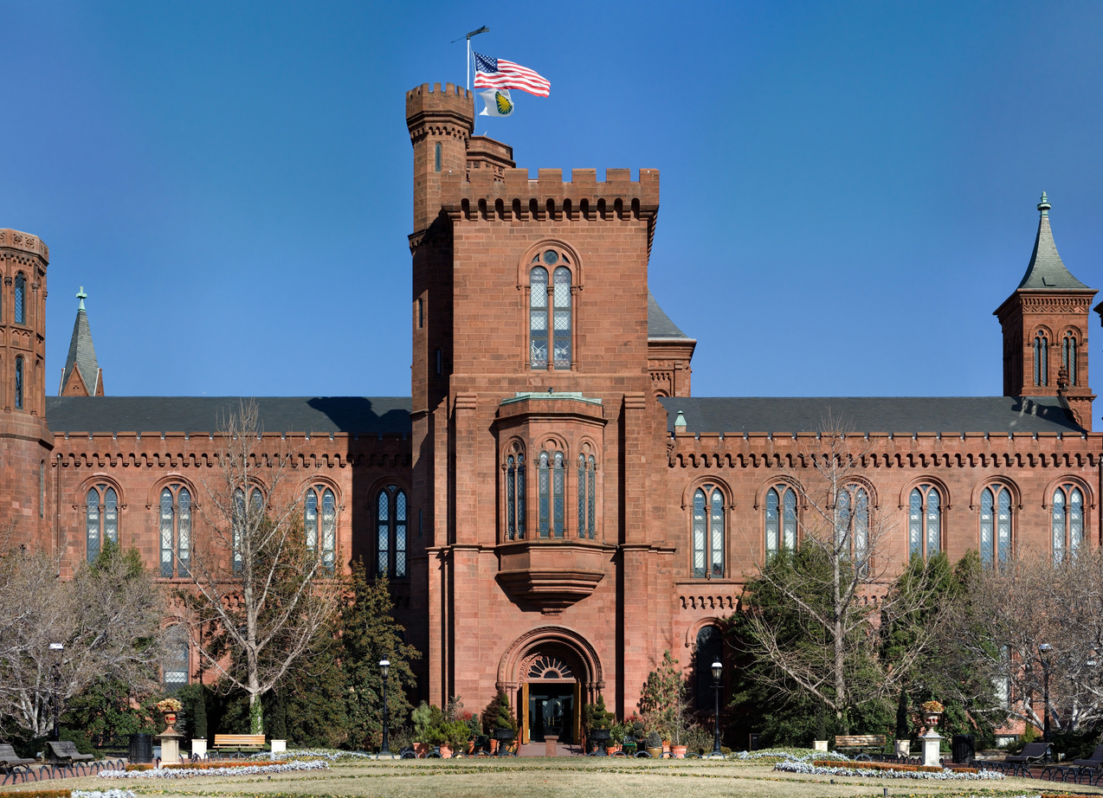
Membership categories
Associations
Institutions
Individuals
National Associations
International Associations
Other Associations
Association Affiliates
Institutions
Institutional Sub-units
One-person Library Centres
School Libraries
Personal Affiliates
Student Affiliates
New Graduate Affiliates
Non-salaried Affiliates
Notes:
Depending on the membership category, members are entitled to:​
Voting Rights on Key Issues ​
Voting Rights in IFLA Elections

Slide 12
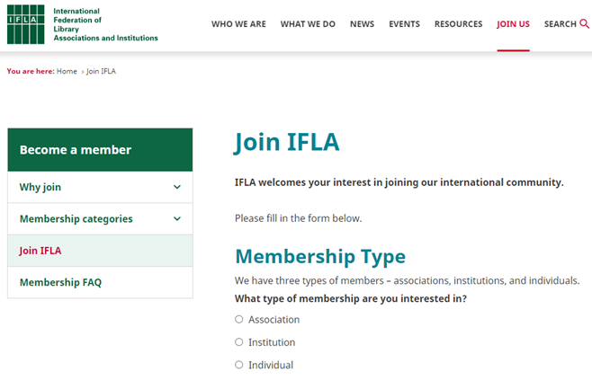
How to
join IFLA
Joining IFLA is easy! ​
​
Visit www.ifla.org/join

Slide 13
Payment Methods​
Other payment options include UNESCO Coupons and electronic invoices via PEPPOL or ChorusPro.
Contact membership@ifla.org if you have difficulties with payments or need further assistance; they are happy to help out and discuss options.
Notes:
You can pay with Credit Card
Bank Transfer

Slide 14
Phone Number
Questions?
Feedback?
Contact Us
+31 70 3140884
Email Address
membership@ifla.org
Website
www.ifla.org

Slide 15
#WeAreIFLA

Slide 16
© IFLA Membership 2024

