Slide 1
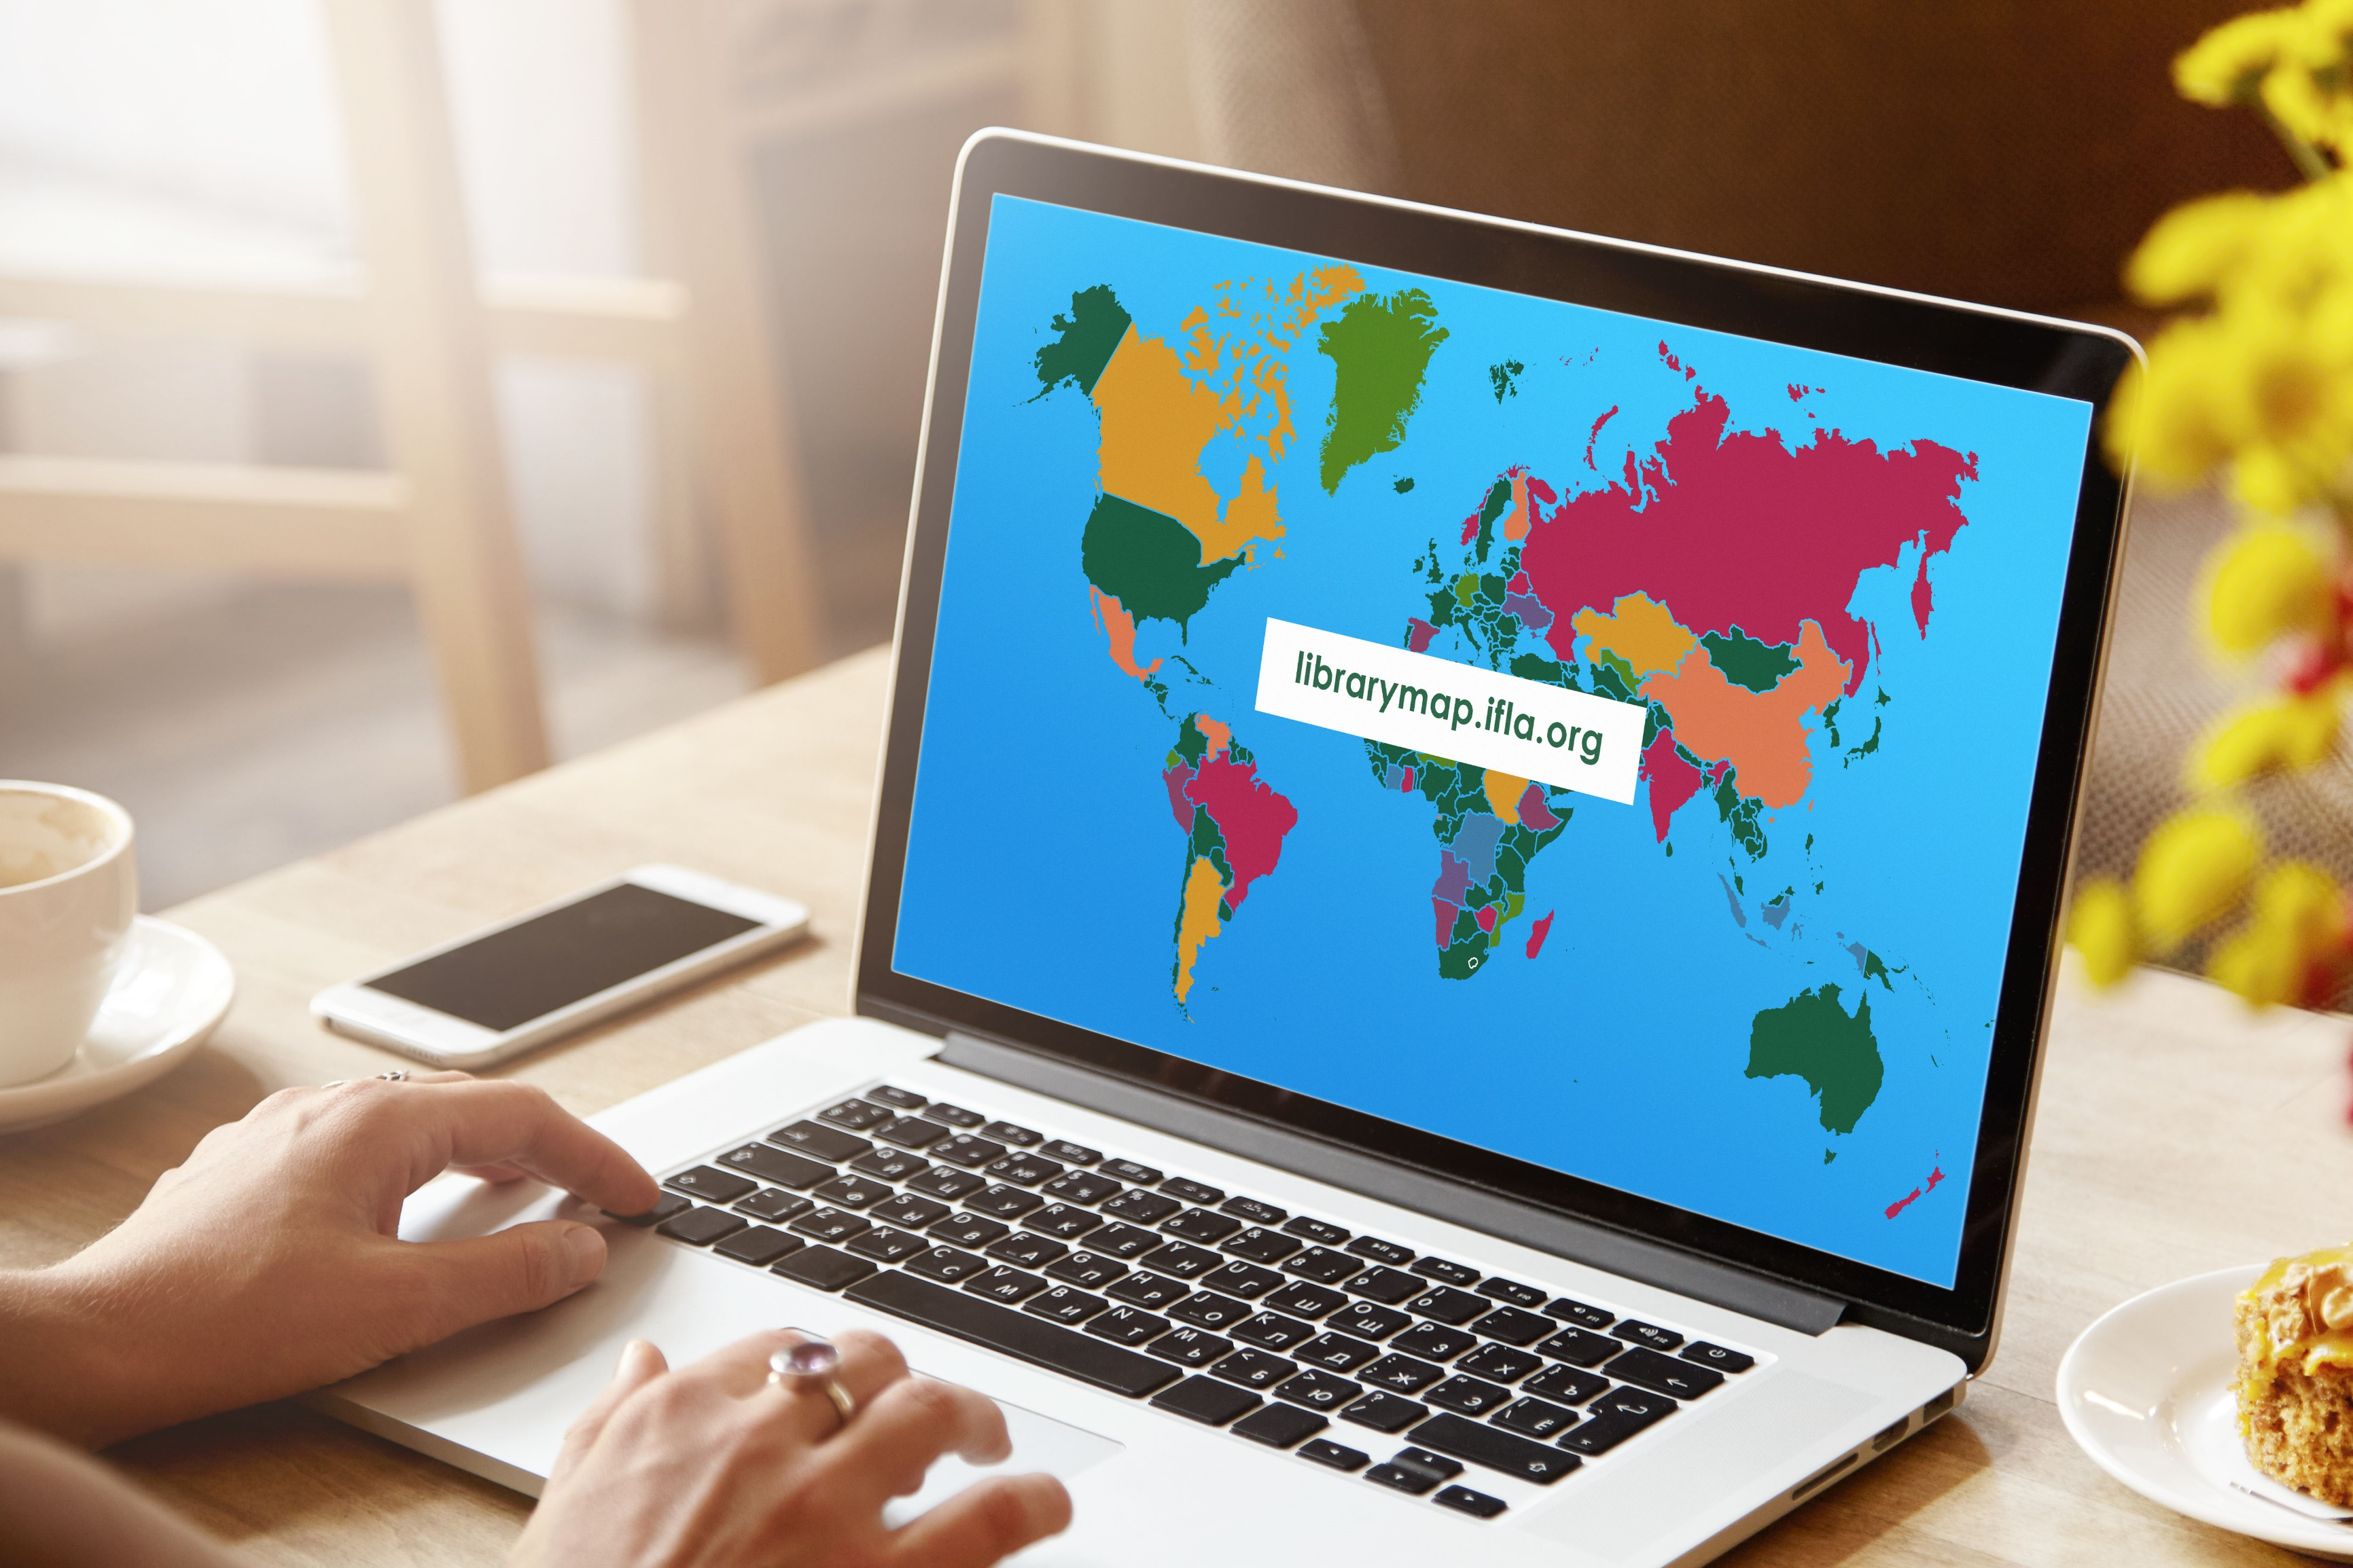
Library Map
of the World
Bookmark the Library Map of the World as your essential advocacy tool!

Slide 2
PART 1
Library Map of the World –
contents and contributors
PART 2
Presentation
Outline
Library data
PART 3
Country profiles
PART 4
SDG stories
PART 5
Resources for advocacy

Slide 3
librarymap.ifla.org
Library Map of the World –
Data – a source of country-level library statistics covering all library types,
Country profiles – a source of information about the library environment, organisations and institutions, policy and legislation, education, and events in each country,
SDG stories – a collection of inspiring stories about impactful library programmes contributing to achievement of the UN Sustainable Development Goals.

Slide 4
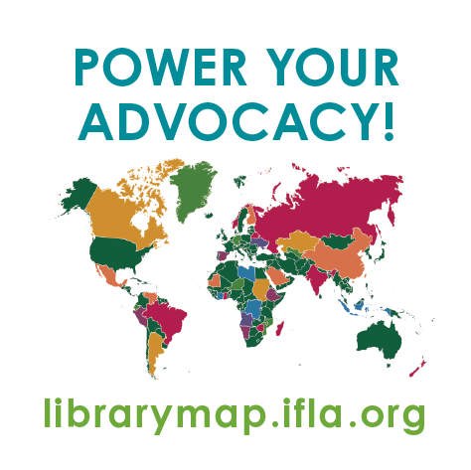
Library Map of the World contents
LIBRARY DATA
134
countries
SDG STORIES
53
stories
COUNTRY PROFILES
26
countries
Numbers as of February 2022

Slide 5
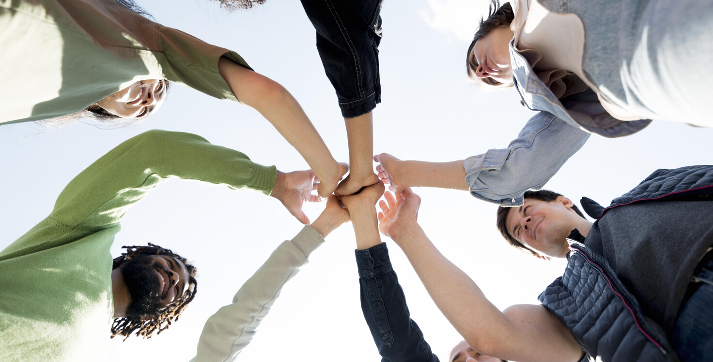
Main contributors
Main contributor – an organisation (national library association, national library or other institution) which committed to contributing data and/or country profile.
Each engaged country has one or two main contributors which:
Take responsibility for collaboration with local partners and stakeholders in their country during data gathering and preparation of content for their country profile,
Act as key contact for the Library Map team during data and content submission and curation.
We now have over 190 established main contributors from around 170 engaged countries and territories worldwide.

Slide 6
Our main contributors
Numbers as of January 2022

Slide 7
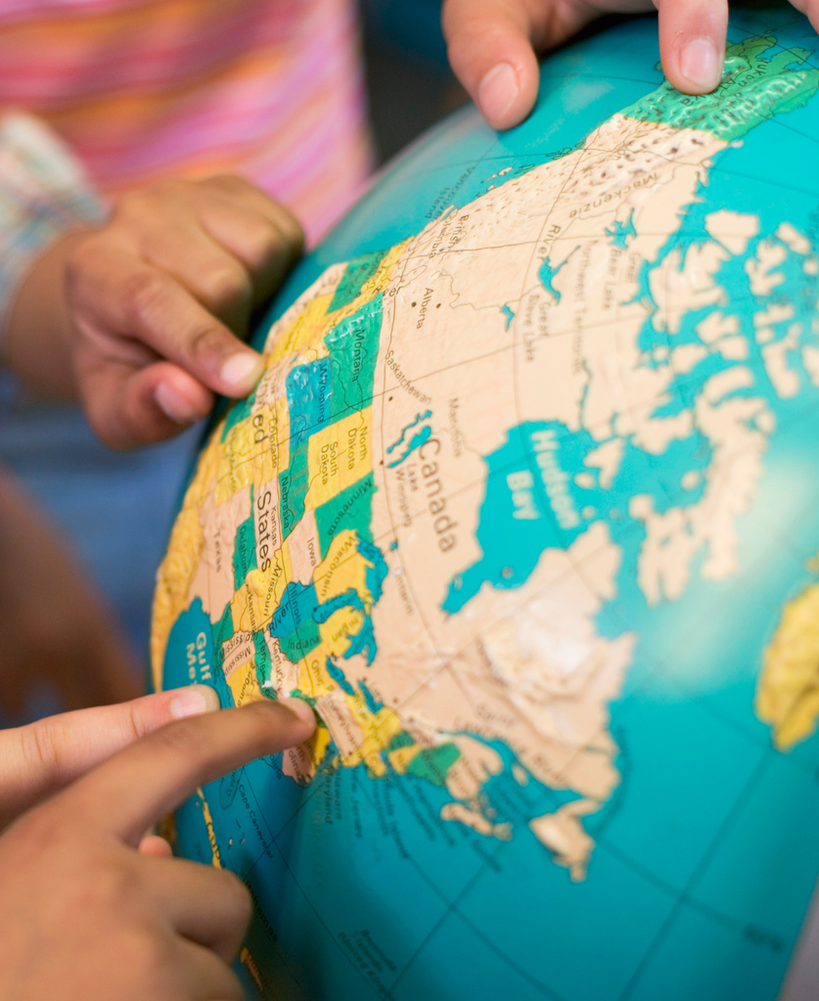
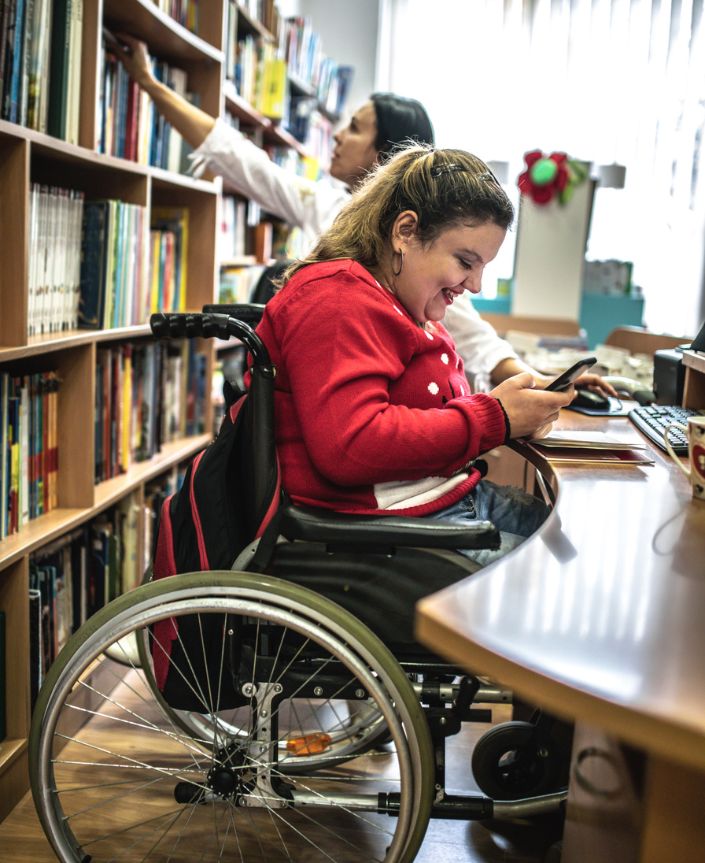
SDG Story contributors
SDG Story contributor – each individual library or an organisation which submitted information for an SDG story and worked with the Library Map team during its curation.
We now have around 50 such contributors from over 30 countries with their SDG stories published on the Map.

Slide 8
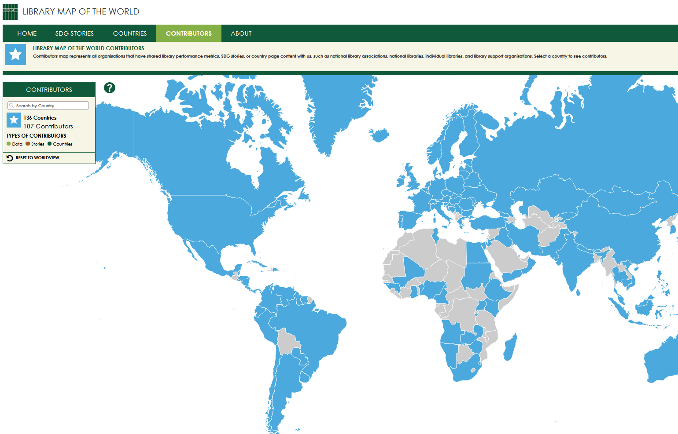
Find contributors
on the Library Map website
Contributors with published content (data, country profiles, stories) are listed by country on the Contributors page of the Library Map of the World website.
Search by country or click on the Map
to find out who are contributors
from your country!

Slide 9
Library data
Country-level library statistics
Updated throughout the year in collaboration with main contributors
Eight basic performance metrics –
Number of libraries
Libraries with Internet access
Staff and volunteers
Registered users and physical visits
Physical and electronic loans
All library types –
National libraries
Academic libraries
Public libraries
Community libraries
School libraries
Other libraries

Slide 10
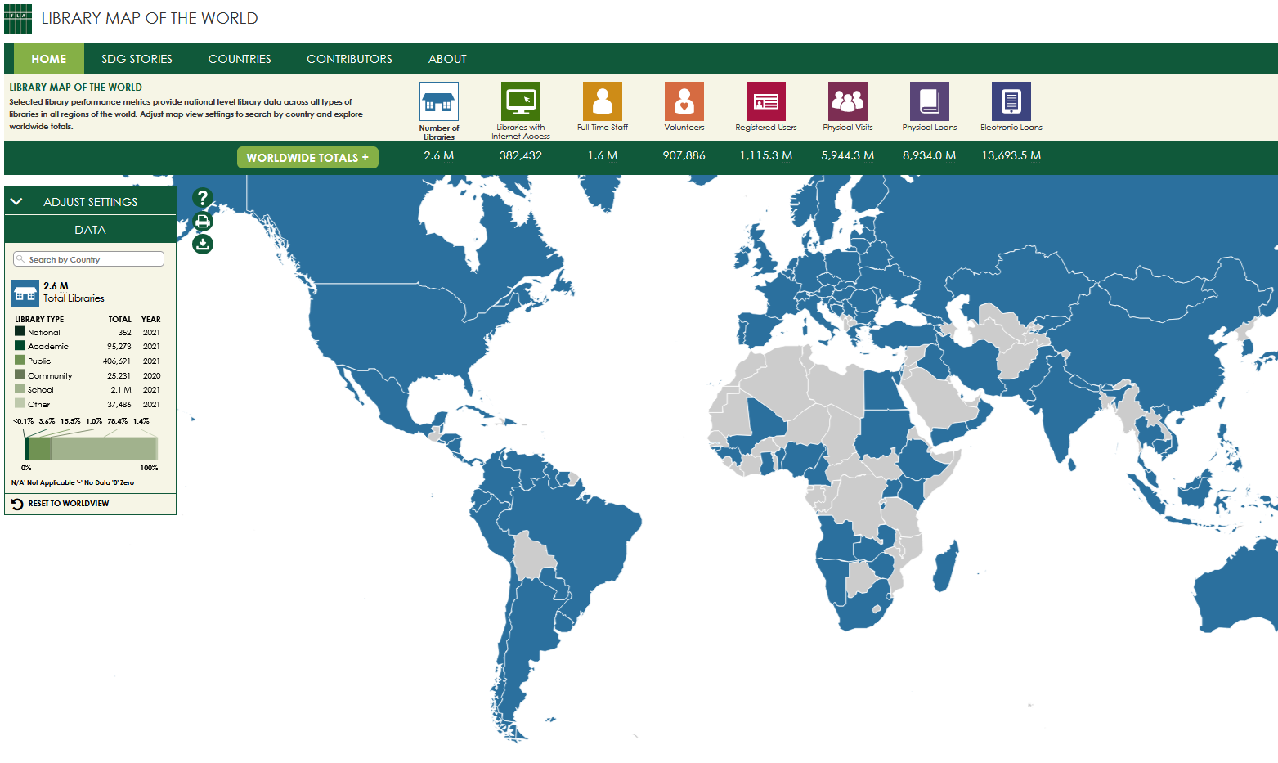
Find data on the Home page
of the Library Map website
Search by country or click on the Map to see your country’s data
Explore worldwide and regional totals
Download the full dataset in csv and make your own data analysis

Slide 11
Country profiles
Overview of the library environment – library system, facts and features of different library types, governance and funding models, development and policy priorities, role of library association, recent achievements in the library field.
Links to library location resources – maps maintained by other organisations containing individual library location data
Aggregated view of performance metrics and contextual indicators , including data on population and geography, information and infrastructure, poverty and employment, education and literacy, innovation and skills

Slide 12
Country profiles - continued
Information about organisations – national library associations, national libraries, policy making institutions, library support organisations
Links to national policy documents and legislation such as library law, legal deposit law, copyright and library exceptions
Information about education and events – professional qualification requirements, librarians’ education, links to professional publications and events
Links to country’s SDG stories

Slide 13
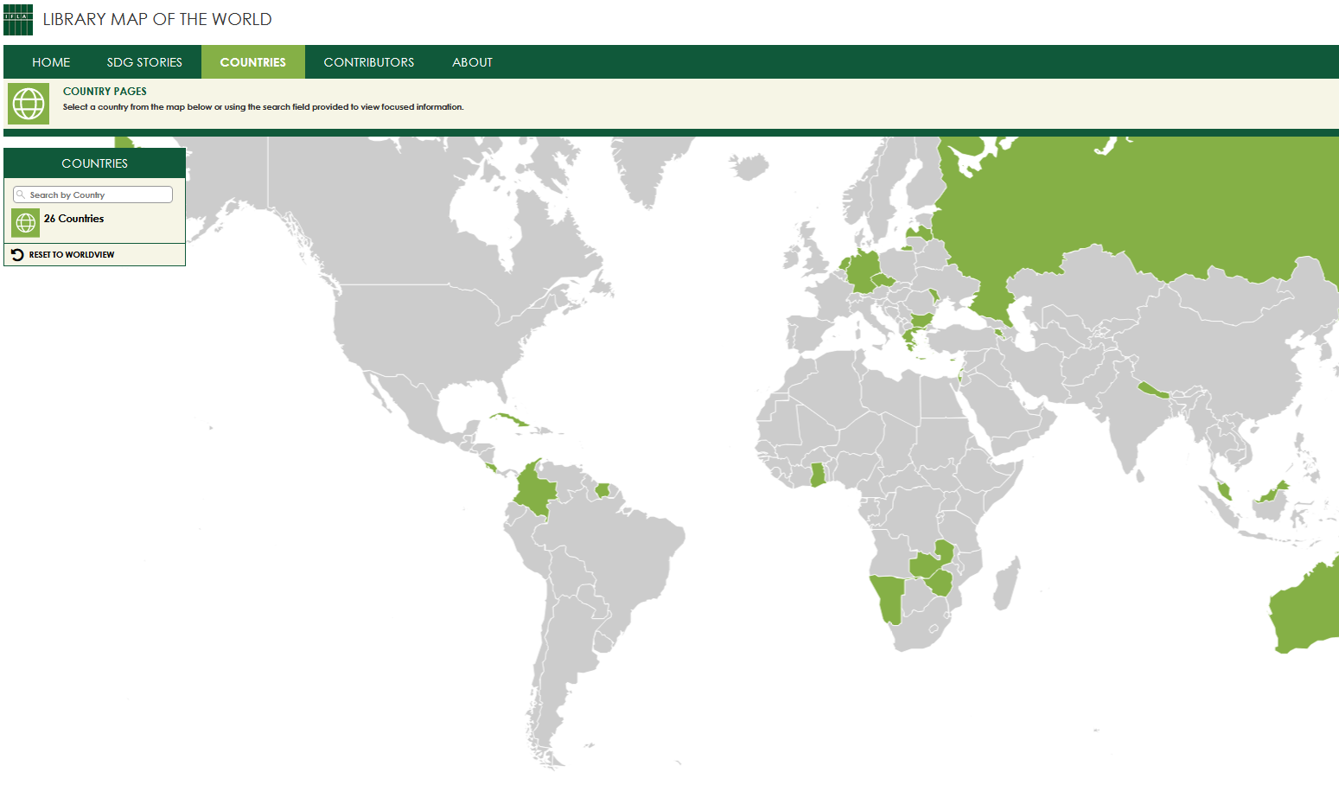
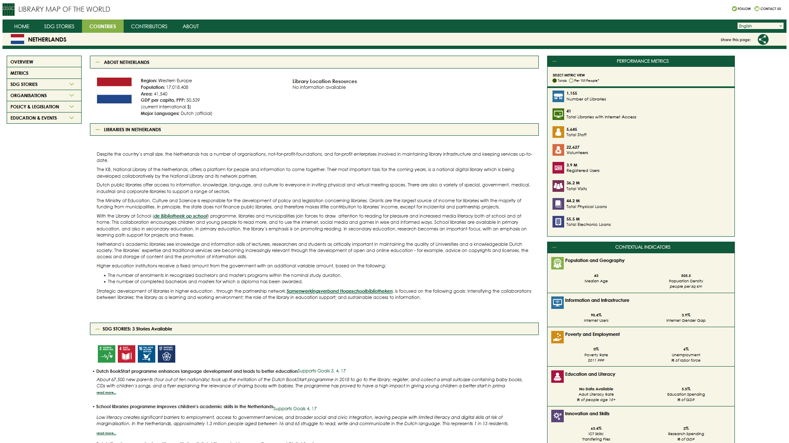
Explore Countries tab
of the Library Map website
Search by country or click on the Map to see country profile

Slide 14
SDG stories
SDG stories – stories about library activities, projects and programmes and their impact on people’s lives and communities that contribute to achievement of the United Nations Sustainable Development Goals (SDGs).
Check out requirements for stories in our:
SDG Storytelling Manual
SDG Storytelling Flowchart
Submit information for your own story:
bit.ly/submit-for-sdg-story

Slide 15
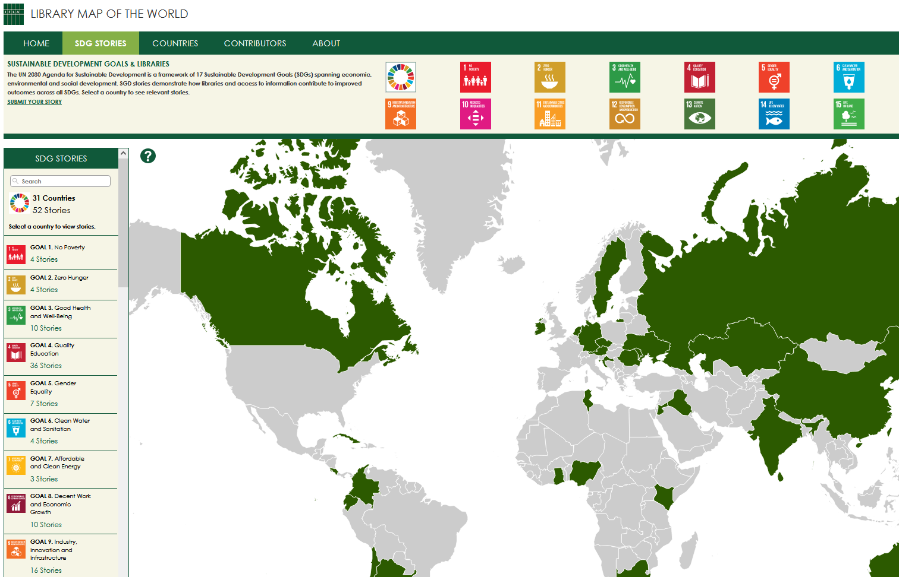
Explore SDG stories
on the Library Map website
Search by country or click on the Map to find stories from your country. Choose the SDG to see relevant stories.
We have stories for all 17 SDGs.
Numbers as of January 2022

Slide 16
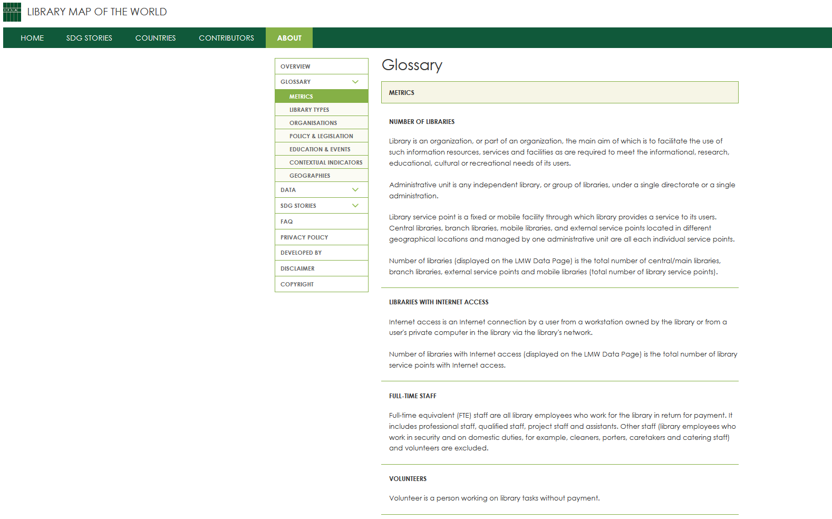
Explore About page
of the Library Map website
Definitions of data metrics, library types, and items on country profiles
Explainers and guides for data contributors
Instructions for country profile contributors
Resources for SDG storytelling

Slide 17
Power your advocacy!
LIBRARY DATA
134
countries
SDG STORIES
53
stories
COUNTRY PROFILES
26
countries
Use data in briefs, presentations and messages
Use stories to motivate, persuade, and inspire to act
Use country profiles to highlight priorities, issues, and achievements

Slide 18
Library Map data as development metric #LibraryStatOfTheWeek

Slide 19
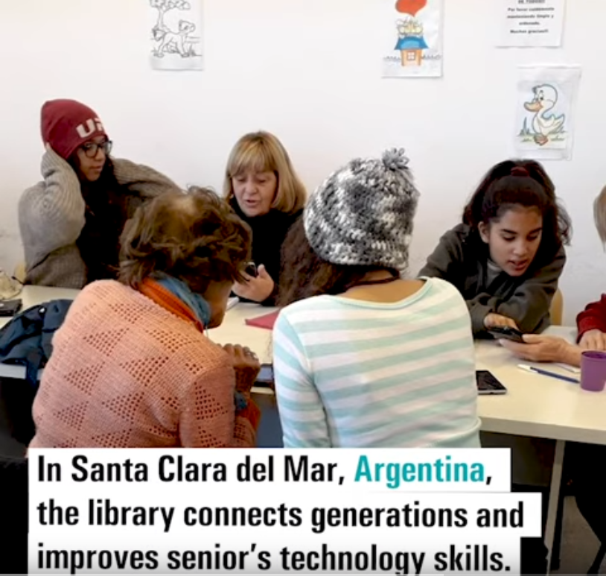
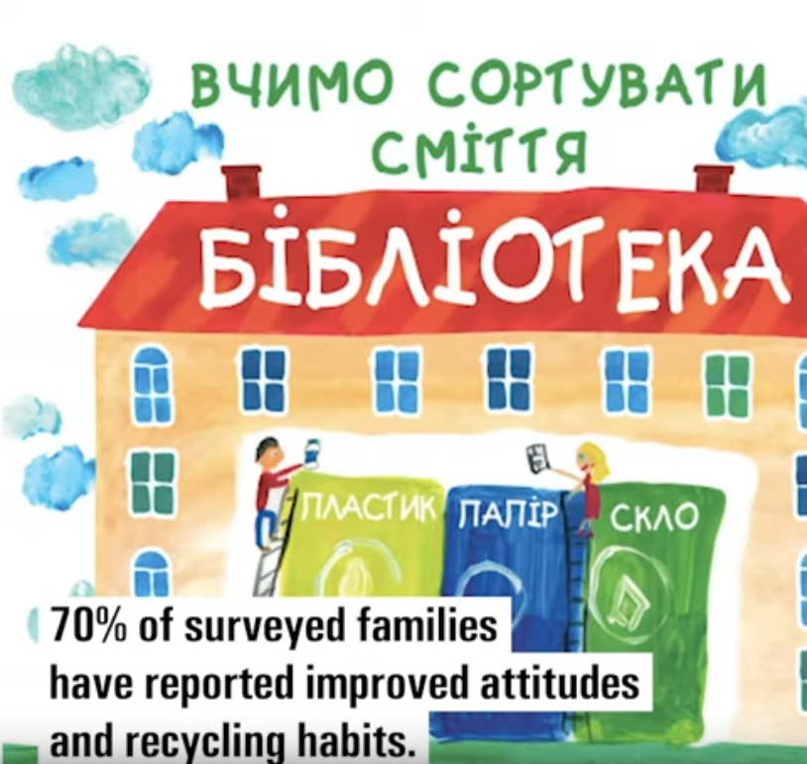
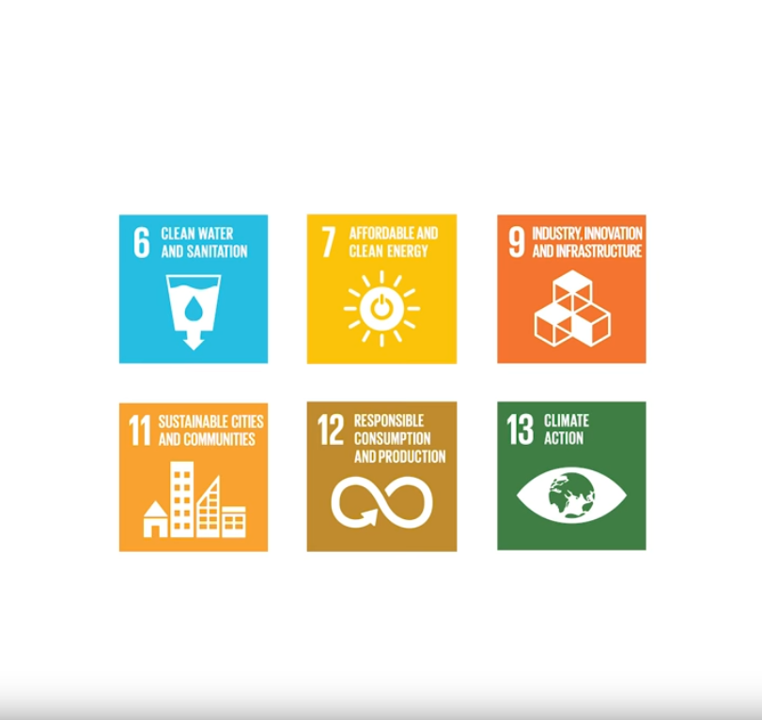
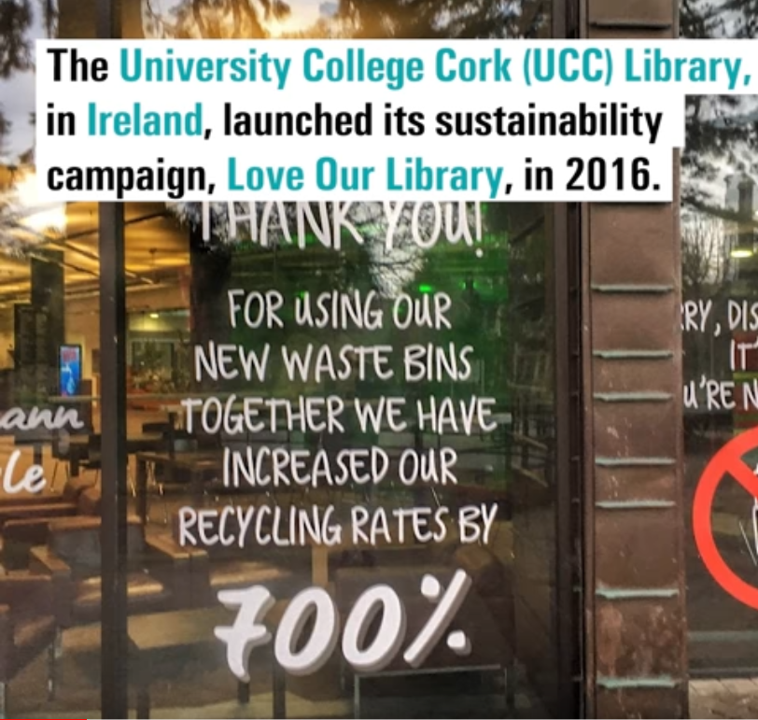
YouTube playlist – IFLA LMW SDG Stories

Slide 20
Country profile

Slide 21
Phone Number
+31 70 3140884
Questions?
Feedback?
Email Address
librarymap@ifla.org
Website
librarymap.ifla.org

Slide 22
#WeAreIFLA

Slide 23
© IFLA Library Map of the World 2021

