Slide 1


IFLA/UNESCO
Public Library Manifesto 2022
A support tool for libraries:
“Template for presentations in different countries”
Ulrike Krass, Ester Omella
February 2023
Notes:
- Welcome
- Announce Session objective. Example: present the New IFLA/UNESCO Public Library Manifesto 2022, which renews the mission of public libraries.
- Acknowledgments

Slide 2
SUMARI
Getting Started: three Fundamental Ideas
The story to date
Evolution of the Manifesto
Impact of the 1994 Manifesto
Rationale for updating the Manifesto?
Some sociological trends
Manifesto 2022
Development of the Manifesto: Global survey
Vision for public libraries: Key Topics
Main changes within Manifesto versions 1994-2022
The implementation of the Manifesto: a shared responsibility
Toolbox and references
Summary
Notes:
Suggested Summary:
4 parts (first: highlight the fundamental ideas; explain the contributions of the previous Manifesto from your Country, Explain the contents of the new Manifesto and the main changes and, at the end, refer to the importance of implementation, as a shared responsibility).

Slide 3
The current IFLA-Unesco Manifesto offers a shared international vision for public libraries, which can be interpreted locally.
Manifesto process:
1994: First version launched
2022: Consolidation of the library at the service of municipal and national policies
Getting Started: Three Fundamental Ideas
Toolbox for the Manifesto implementation, driven by global colleagues
More information: The IFLA-UNESCO Public Library Manifesto 2022 – IFLA
Notes:
Highlight the importance of renewing the Manifesto in the country. Briefly indicate the main ideas of the presentation, and toolbox available.
Barcelona Example:
It seemed essential to me to do some work on the recognition of what the previous Manifesto entailed. Over the last few days I have had very interesting sessions with the people who worked on the promotion of the previous Manifesto and with responsibility for its deployment in the libraries of our country.
Everyone agrees that the previous Manifesto of 1994 contributed to the promotion of the Public Library in our country, „identifying a mission and values, which were and have been shared by the whole library community. The document got the tone and content right. It connected.
The Manifesto helped us a lot to make an important leap towards the model of libraries we have today. Then came the Barcelona Library Plan. Today, the new Master Plan for Barcelona‘s libraries is being presented, which takes up this model.
Everyone agrees that the IFLA/UNESCO Manifesto of 1994 was approved at a time when intense work was being done on library development and that it laid the foundations that allow us to present today accessibility to culture, training and information, the essence of public library services as a manifestation of the principle of equality and respect for fundamental rights. The 2022 Manifesto reinforces this in the area of inclusiveness and civic participation. The importance of the community role of the library is highlighted.

Slide 4
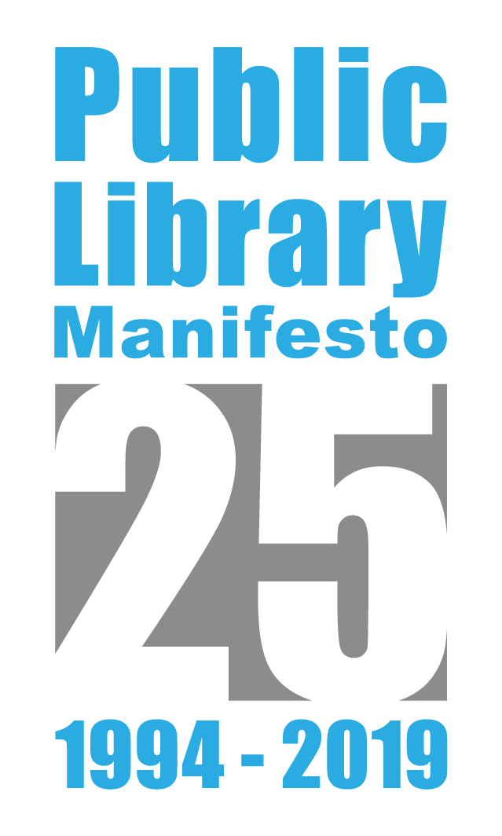
Evolution of Manifesto
1949: Original version of the Manifesto
1972 and 1994: Updates
2009: “10 ways to make a library work”
2019: 25th Anniversary
Notes:
Short overview about the evolution of the IFLA/UNESCO-Manifesto.
The original version dates back to 1949 soon after the creation of UNESCO.
Already this text points out the universal framework of public libraries as a living force for Popular Education in a democratic society.
In 1972 und 1994 there were revisions of the Manifesto.
The preamble expressed the general aim which public libraries should follow and what services must be developed to provide universal access to global information.
12 missions related to information, literacy, education and culture should be at the core of public library services.
Statements concerning funding, legislation, networks, operation and management are completing the text..
In 2009 the Public library section added 10 Points with additional recommendations to supplement the Public Library Manifesto. The objective was to empower public libraries to offer services like new technologies which developped since 1994.
In 2019 the Manifesto celebrated its 25th anniversary.
At this occasion the Public Library section was reflecting about the relevance of the Manifesto nowadays.
We learned that visits to the page of the Public Library Manifesto on the IFLA website have risen over the past few years, instead of falling or staying stable.
And the IFLA jubilee social media campaign showed how strong the Manifesto still is.
„Has it been 25 years?“ One librarian asked on Twitter. „The missions still feel fresh“ wrote another person.
IFLA received feedback that the Manifesto is still important, so the Public Library Section decided: Let´s work on an update. The goal of the revision was to address the ever-evolving role of public libraries, while also acknowledging the substantial technological advances that have changed how many people access, create and consume information.
To reflect this in an updated text was an excellent fundament for advocacy in the future.

Slide 5
Promoting the public library through a mission and values shared by the library community
Highlight the importance of the Public Library Service to the community via UNESCO
Where do we come from? Contributions of the 1994 Manifesto
The essence of the service: equal accessibility to culture, training and information
An essential document for positioning the Public Library on political agendas
Notes:
Indicate the contributions of the previous Manifesto to the library development of the country

Slide 6
Changes in both service provision and management needs. New Public Management Challenges
More active and participatory citizenship
Why was it necessary to update the Manifesto?
Sociological changes
Notes:
Why was it necessary to update the Manifesto?
We are living through moments of profound change, of a turning point in society, they are changes comparable to the era of Industrialization, they tell us. These changes are manifested in: Knowledge and information, which have become key concepts: the use of primary and massive materials to make decisions is a challenge for all professions and ours in particular is a central element The multiplication of sources of information, data, supports, misinformation, fake news. The different way of relating, of producing, of managing what happens in our environment. Citizens assume a more active role. Our society, in general, has changed a lot.

Slide 7

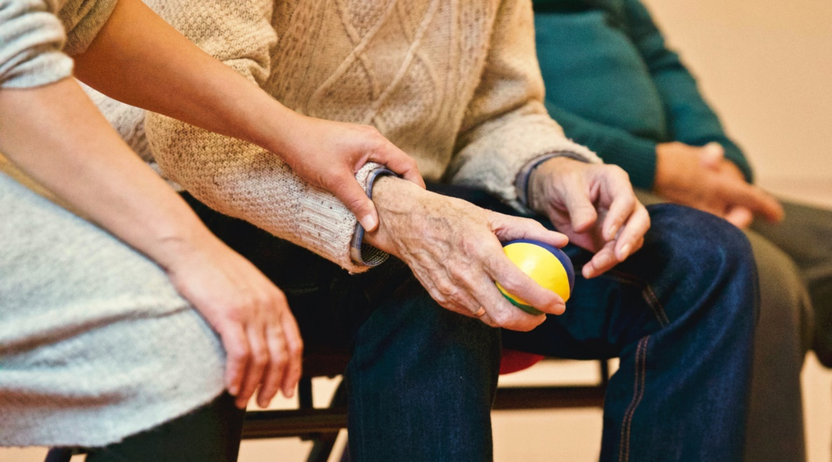

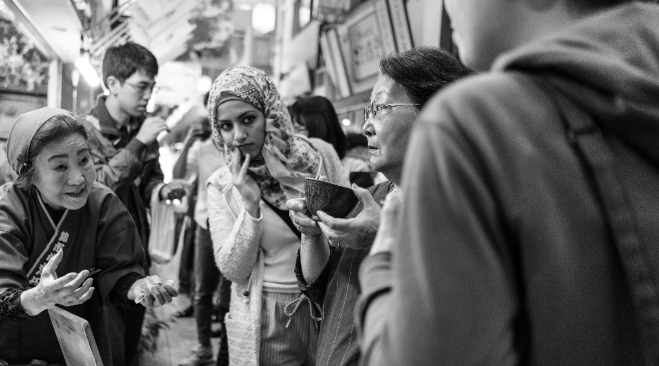
Some
sociological changes
Social inclusion and respect for the environment
Population aging
Digital inclusion
Cultural, functional and gender diversity
The Manifesto highlights the utility of the Public Library
Example of social value study:
https://www.diba.cat/documents/16060163/22275360/El+valor+de+les+biblioteques+p%C3%BAbliques+en+la+societat+E-LLIBRE.pdf/47985f87-05a6-4551-a9d9-53e17329fd9d
Notes:
Make reference to the main sociological changes in the country
If there are studies on the social value of the Public Library, indicate. Example: <https://www.diba.cat/documents/16060163/183807101/Valor_Public_XBM_english.pdf/921de76c-95d0-40ab-a04f-6d130d016ef4>.
Barcelona example:
As the Barcelona Provincial Council‘s Mandate Plan sets out, the main challenges for the deployment of public policies are:
- Inclusiveness and respect for the environment.
The new normality must be more socially inclusive and more respectful of the environment, guaranteeing economic dynamism in all towns and cities.
- Digital inclusion
New technologies are opportunities, but they require the ability to govern them: they entail changes in the world of work, in the sphere of privacy and in the relationship with institutions. The risk of a digital divide forces libraries to take a leading role.
- The ageing population
In 2030, one in three inhabitants of the province of Barcelona will be over 60. This brings with it major challenges at all levels: the digital divide, care for the elderly, unwanted loneliness, etc.
- Cultural, functional and gender diversity
Although the percentage of the foreign population is growing less sharply than a few years ago, there are very significant differences between municipalities and neighbourhoods that make it necessary to offer different approaches.
It was necessary to reflect these changes in the new Manifesto. For this reason, there is a concept that has been present throughout the drafting of the new Manifesto: the vocation of public libraries to serve the public.
In this sense, it is worth mentioning the document The value of public libraries in society, which highlights the usefulness of libraries through an analysis of the social, labour, educational, economic and reading context..., work that we will continue strategically next year.

Slide 8
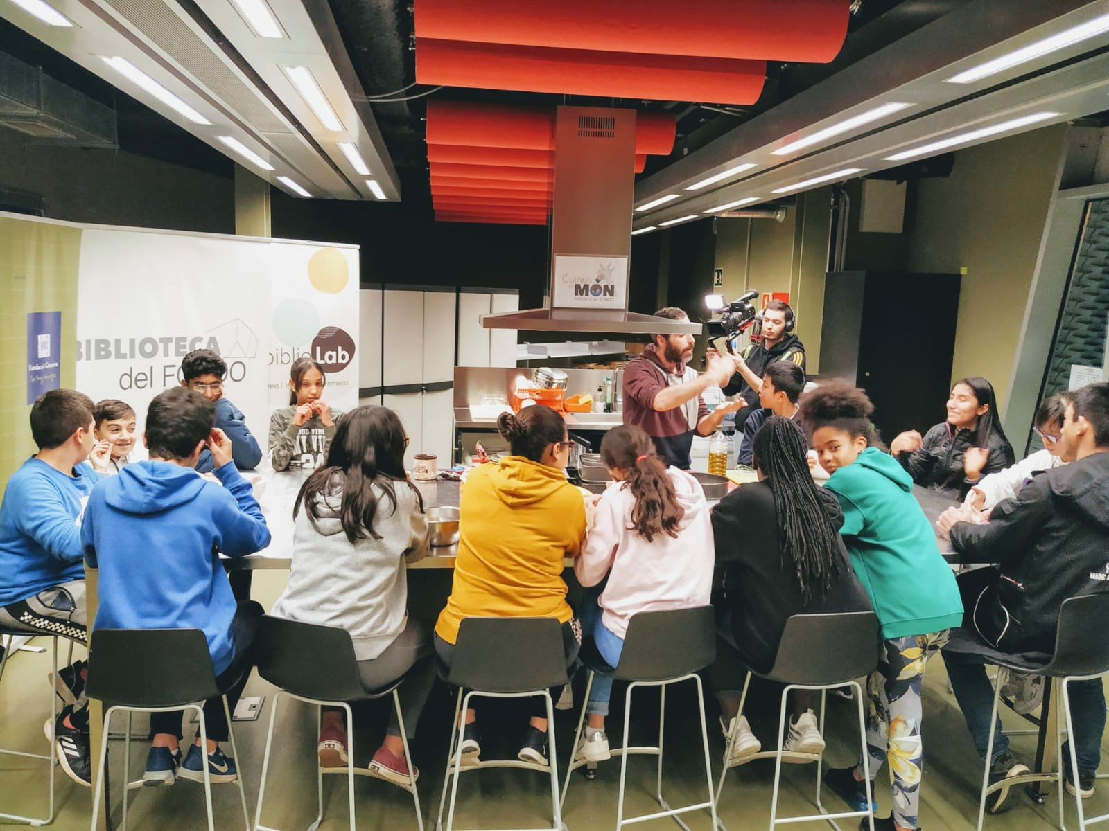
Developing the Manifesto 2022
Notes:
Background of the new Manifesto and Manifesto elaboration
How was it done?
With a global survey to gather professional opinion at an international level. The new Manifesto was intended to be useful and implementable.
As Xianhong Hu explained to you, once the IFLA Public Libraries Section produced the first draft, it was presented to UNESCO, which has adopted it, and it links to its cultural, educational and scientific policies. The new text has also been presented to the UN General Assembly, due to its relevance for lifelong education.
At the last IFLA Congress in Dublin 2022, a work session was presented and organized to collect implementation proposals and where visions from different territorial realities were presented.
It is an honor to be able to say that we are setting a date in the history of the Manifesto:
28th July 2022: presentation at IFLA-Dublin
17th September 2022: presentation at the UN assembly, New York.

Slide 9
Have you used the Manifesto?
Global Survey
39% have used the Manifesto to advocate and to lobby for their library
Notes:
To get input from as many as possible people the Public Library Section started a survey looking at the different ways in which the Manifesto from 1994 has been used around the world.
The survey has been translated into eleven languages to make it easier for everybody to understand and share their ideas. It worked well – there was a return of more than 1.100 answers.
The first question was: Did you use the Manifesto in the past? 39% of the respondents stressed out they have actively used the Manifesto to advocate and to lobby for their library.
Of those who responded in the negative, the most prevalent reason given was that they have not yet had an opportunity or were not included in relevant conversations with decision-makers.
To get an idea which benefit librarians have by using the manifesto from 1994 for their work, and for advocacy the survey asked these questions:
How effectively does the Manifesto reflect the missions of public libraries in nowadays and the future? And how relevant is it for decision makers?
Again the librarians said that the Manifesto is still important and relevant but there were a lot of answers to the key question!

Slide 10
How effectively does the current version of the Manifesto:
Global Survey
reflect the missions of public libraries in the modern age?
provide guidance to libraries?
provide guidance to decision-makers?

Slide 11
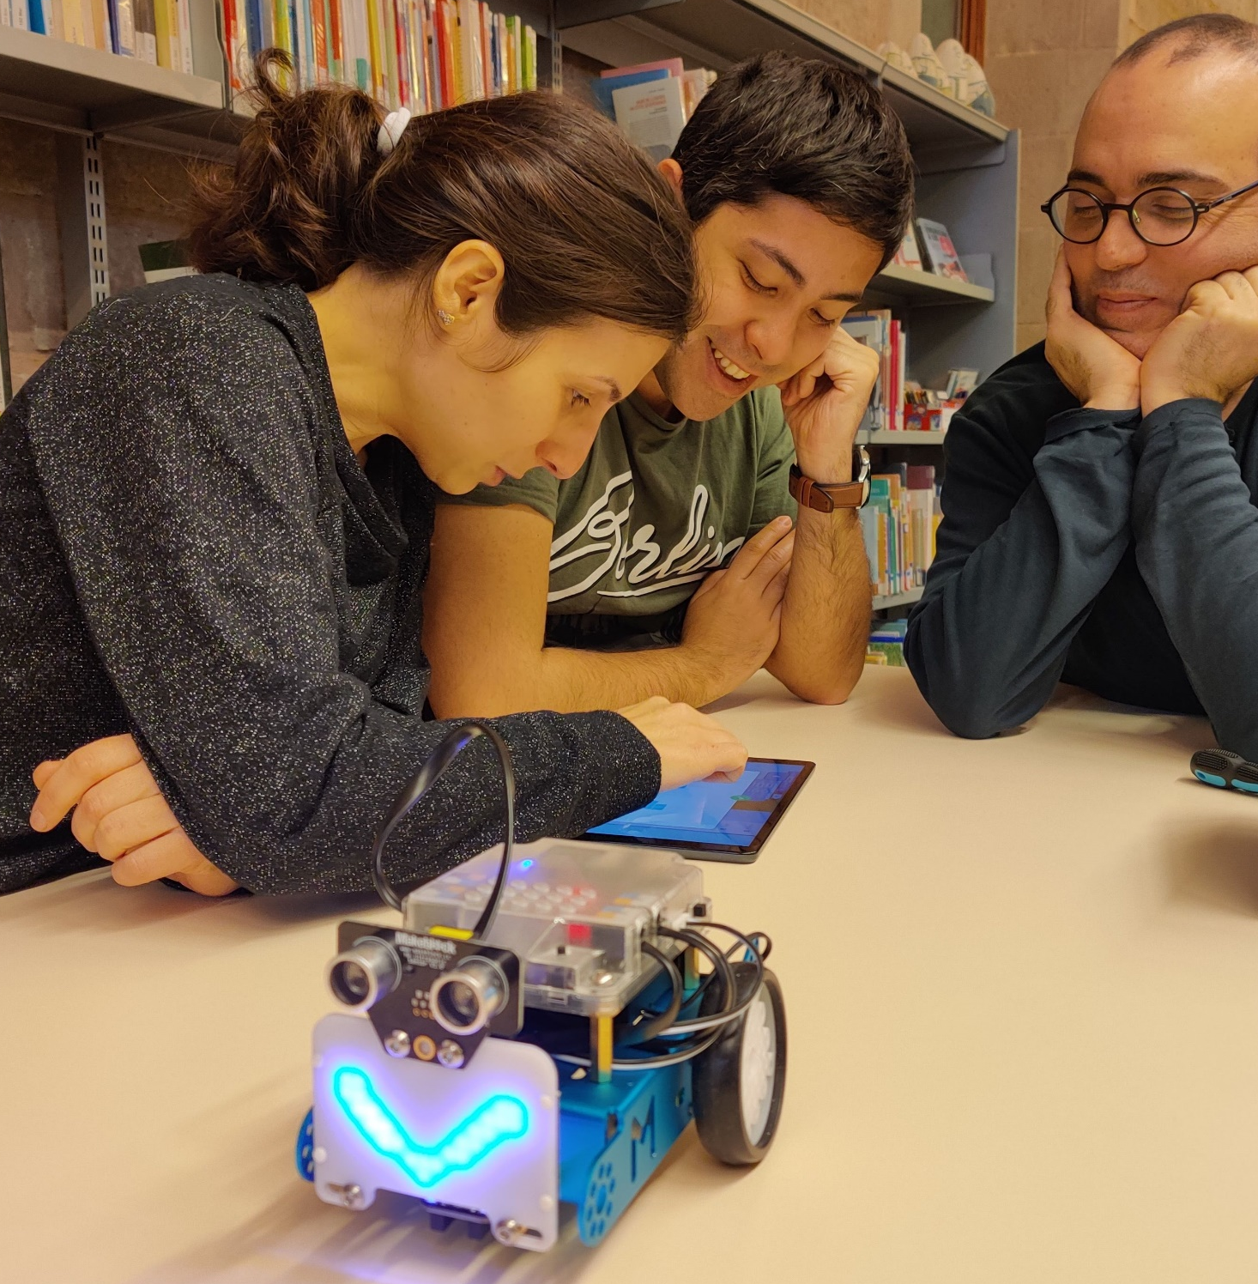
What does it include?
Notes:
Which public library reflects the Manifesto
Be based on the fact that there are two key axes: the library must look after the Knowledge Society and Sustainable Development.
Explain the "Key Topics" and give examples of Libraries in our country that reflect the Manifesto.

Slide 12
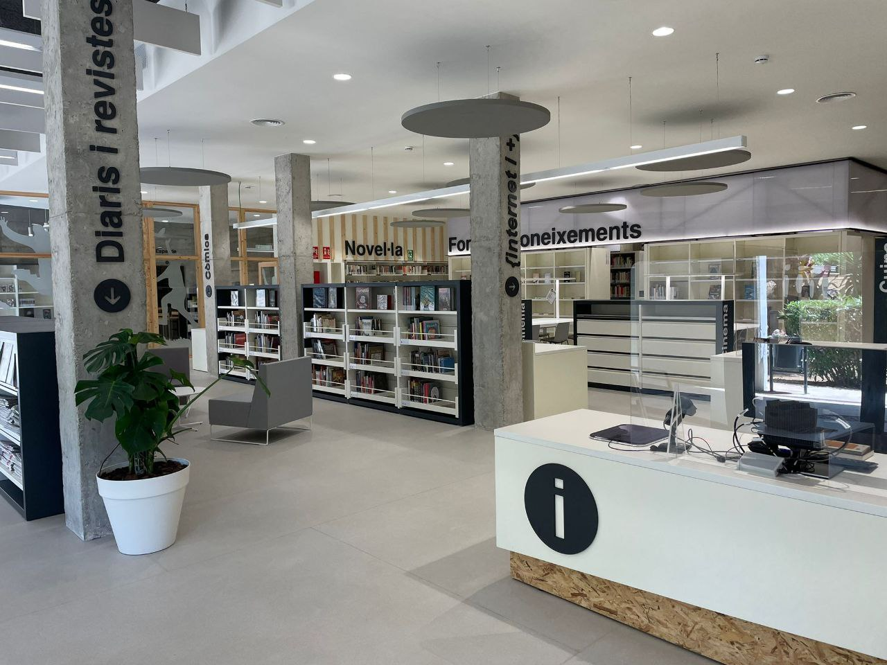
REFLECTS A LIBRARY THAT LOOKS AFTER...
Knowledge Society: accessing, producing, creating and sharing knowledge.
Sustainable Development
Notes:
I base myself on a document that has been made public by IFLA/UNESCO.
There are two key axes: the library must ensure the Knowledge Society and Sustainable Development.
Knowledge Society
The Manifesto in its updated version reflects the role of libraries in fostering knowledge societies, helping all members of society to access, produce, create and share knowledge.
This includes a greater emphasis on remote and digital access to information and materials and access to the skills and connectivity needed to bridge the digital divide. This includes the development of media and information literacy and digital skills with the will to create equipped, informed and democratic societies.
I briefly leave the script: for the XBM this concept is not new, as we have already explained the Library that facilitates discovery, lifelong learning, the generation of knowledge and the strengthening of communities, which maintains the essence, but innovating in concepts of public management, which places the user at the centre of services, making a commitment to co-creation and the generation of knowledge within the Library and linking it to the resolution of social challenges, knowing that this is the role that citizens are strongly asking us to play. Back to the script.
In the new Manifesto, the concepts of participation, empowerment, creation of communities, promotion of critical thinking appear strongly. The commitment is to a library centred on people, transforming the environment, open to the territory.
Sustainable development
The Manifesto states that, through their activities related to literacy, education and culture, libraries contribute to the United Nations Sustainable Development Goals and to building more equitable, humane and sustainable societies.
Barcelona Example: More than 100 years ago, the library project in Catalonia took into account that libraries were needed to build a better society.

Slide 13
Digitization
Knowledge Society
Proactive Role in Community
Key Topics
Digital Literacy
Sustainable Development
Partnerships
and many more!

Slide 14


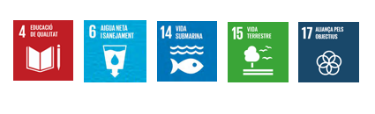
Examples of projects that reflect the idea of the Manifesto (Note: to be added local examples):
https://www.youtube.com/watch?v=HWSwbjEbSSI
Notes:
What do I mean? The PowerPoint presentation gives examples. It shows that Catalan libraries are very healthy in their work in their territory. Fortunately, most of the libraries in Catalonia are very well aligned with municipal strategies-
More information of good practices: <https://www.diba.cat/documents/16060163/303284652/Projectes+inspiradors_2023.pdf/c2593a0a-33bd-f419-22b3-bc9c9faab8a9?t=1677151823084>.
Note: to be added local examples

Slide 15
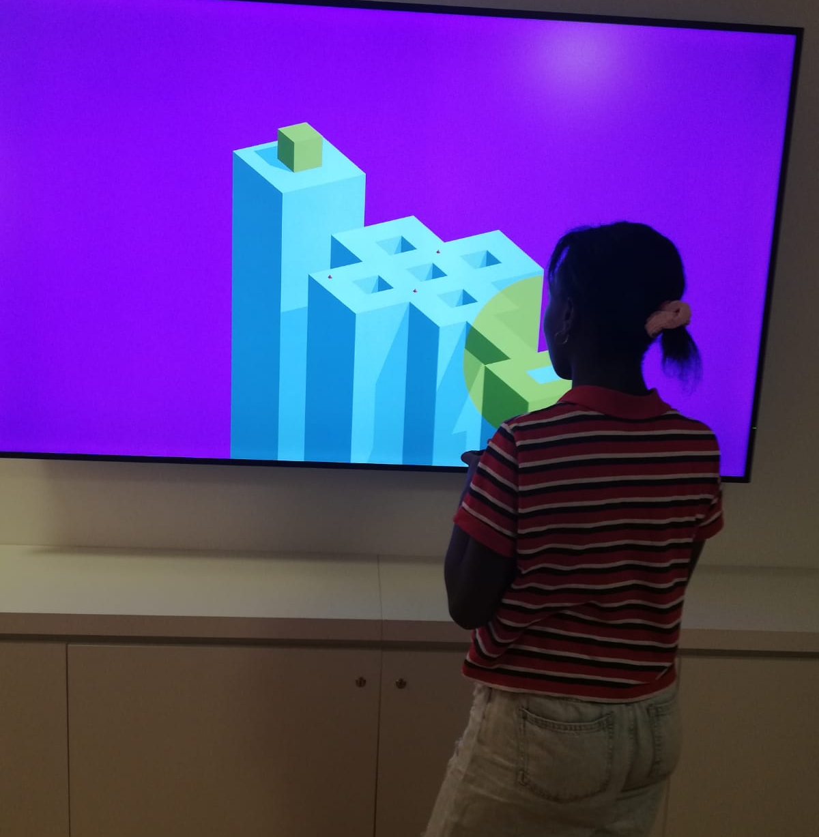
Main changes
Notes:
Main news
The background: it wants to become a useful instrument of the Library towards the public and by professionals for the defense of the public library.

Slide 16
Manifesto 1994 | Manifesto 2022
Stimulating the imagination and creativity of children and young people. | Providing opportunities for personal creative development, and stimulating imagination, creativity, curiosity, and empathy.
Creating and strengthening reading habits in children from an early age. | Creating and strengthening reading habits in children from birth to adulthood.
Access to information and material. | Providing services both in-person and remotely through digital technologies.
Awareness of cultural heritage, appreciation of the arts, scientific achievements. | Preservation of and access to cultural expressions and heritage, appreciation of the arts, scientific achievements, research and innovations, both traditional and digital.
Ensuring access to all sorts of community information. | Ensuring access to community information and opportunities for community organising.
Main changes

Slide 17
Manifiesto 1994 | Manifiesto 2022
Ensuring inclusivity, especially relating to marginalised communities. | Preservation of, and access to local and Indigenous data, knowledge, and heritage in an environment in which the community can take an active role in decision-making.
Awareness of scientific achievement. | Access to scientific knowledge, research and health information and enabling participation in scientific progress. .
Facilitating the development of information and computer literacy skills. | Initiating, supporting and participating in literacy activities and programmes to build reading and writing skills, and facilitating the development of media and information literacy and digital literacy skills for all people.
Main changes
Elaboration: Claire Mc. Guire, IFLA-HQ

Slide 18
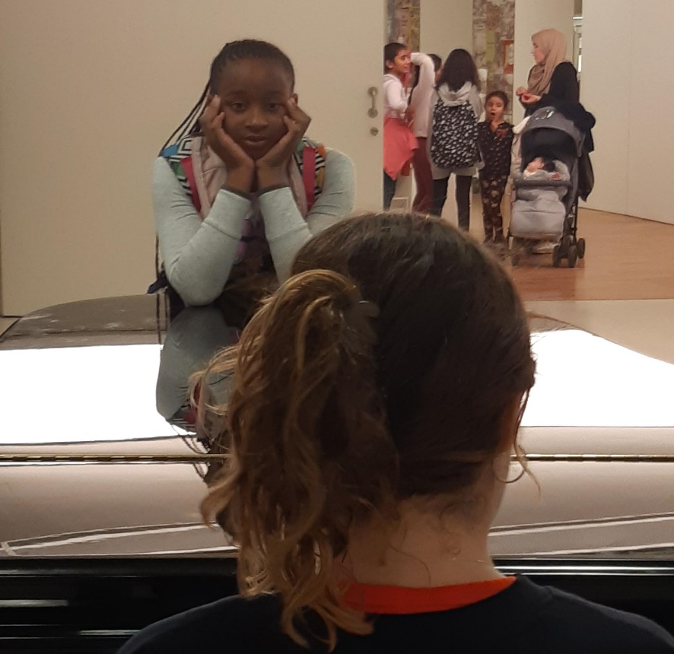
Manifesto Implementation: shared Responsibility!
Notes:
The implementation of the Manifesto. A shared responsibility.
Barcelona Example:
The Manifesto is a programmatic document that, in order to be of value, must be translated into action in your libraries/organisations.
I briefly go out of the script: when we explained the model in our Network, we emphasised that each project is specific, that it is built according to the environment of the municipal priorities, ...when we identified 15 potential benefits, we imagined that each Library and municipality would deepen in those more relevant or with more or more necessary ecosystems. Back to the script.
The Section's task is to accompany the translations with tools for implementation, which we have prepared for you. The idea is that you use the Manifesto to build your project (as they said in 1994), for your action plans, to support the construction of the city story.
Of the contributions made to me by the Culture technicians, with whom I have spoken over the last few days, the Manifesto offers us the opportunity to link libraries more closely to the rest of the municipal services.
The Manifesto places great emphasis on collaboration. Let us hope that it challenges the administrations that are managing the library service.
In the coming years we will have to show that we are committed to more effective coordination. And we should also feel challenged on management issues which, in other countries, have advanced more... It should help us to put back on the table the debate on the profiles and competencies of the professionals who will have to manage libraries in the coming years. And it raises the question of whether we will empower professionals sufficiently now to move towards this model. Perhaps the next roundtable will raise issues along these lines.
The Manifesto gives impetus to Cultural Rights: it challenges policy makers.
I would like to end with a reflection by Carme Mayol .... We think that the Manifesto reinforces a library model in which the principles of inspiring, learning, creating and sharing that we, as a collective, have assumed, take on greater authority. It should be a lever document of where we want to go. And to position the Library in public agendas. City councils and administrations must take advantage of the great human capital we have built up.

Slide 19
Political leaders:
Promotion
of cultural rights
Library professionals: implementation in the municipality
Administrations:
effective collaboration for the Public Libraries support
IFLA-UNESCO:
Support in the professional field
Manifesto Implementation: Shared Responsibility!
Notes:
The implementation of the Manifesto. A shared responsibility.

Slide 20
Tools
Manifesto in English and Translations in different languages
Version in easy language
The new Manifesto at a Glance. McGuire, Claire. The Mission of the Public Library of Today: What's new in the Public Library Manifesto
Video-Statement of Xianhong Hu (Representative of UNESCO, IFAP)
Video-Statement of Ulrike Krass
PowerPoint-Presentation Template (february 2023)
Example of Manifesto presentation in different countries
Good practices of Manifesto Implementation
Main changes to the Manifesto 1994/2022 (Claire McGuire)
More information: Web IFLA- PLS
Toolbox and references
Notes:
To end: detail of the toolbox that you have at your disposal soon in IFLA website.
Thank you very much!

