Slide 1


A Strong and Sustainable Library Field for Africa
IFLA HEADQUARTERS 2023
Nairobi – 16-18 October 2023

Slide 2


Opening and Welcome

Slide 3

By the end of this workshop, you should...
Have an understanding of what a sustainable library field means, and how you can apply this in your own work
Have new ideas about how you can engage with the United Nations and other international initiatives within your country and regionally
Be able to apply (IFLA) tools and references in your own strategic planning, in particular around gathering and applying data, assessing impact, partnerships and emerging
Be ready to work with us in shaping an IFLA ‘offer’ that responds to the needs of the region
Have built your own networks!

Slide 4
By the end of this workshop, we should...
Know you and your national library fields better
Have ideas from you about where there are possibilities to work with the United Nations and other potential funders
Understand better how we can support a sustainable library field in Sub-Saharan Africa
Have convinced you to extend your engagement in IFLA!

Slide 6
Made possible thanks to the financial support of:

Slide 7

Made possible thanks to the logistical support of:

Slide 8
Our Agenda (Day 1) - KNLS
Opening and welcome (almost over!)
Setting the scene and warming up
What do we mean when we talk about sustainability?
What do we need to do within our field to boost sustainability?
Planning for the future – bringing forward emerging leaders
Identifying, building and maintaining partnerships
Library tour
Welcome dinner

Slide 9
Our Agenda (Day 2) - KNLS
From priorities to plans
IFLA Strategy reminder
Evaluating and demonstrating value and impact
Library Map of the World – your advocacy tool
Introduction – why advocacy matters
Defining advocacy goals
Practicing advocacy skills
Dinner

Slide 10
Our Agenda (Day 3) – Trademark Hotel
Conference with UN speakers (different venue!)
Highlights and reflections
Certificates and closing

Slide 11
Roles
Vicki, Nthabi and Alejandro: IFLA GB
Sharon: IFLA Secretary General
Kristine and Stephen: Moderators, additional support
Table facilitators: Helping you through our programme
Esther: Keeping the show on the road
Despina Gerasimidou, Deborah Jacobs: here in spirit!
You: essential to the success of our time together!

Slide 12
Meeting rules and norms
Please bring your full attention to this process and to what others are saying
Please ask questions if you don’t understand
Let us know if we are speaking too fast – we will slow down
Be understanding and help each other out
Assume good intentions, do not immediately make a judgement
Step up if you have something to say. Step back if you’ve been doing a lot of talking to give others a chance
Use the parking lot to capture topics we may not be able to address in this workshop or in any particular segment
We have limited time, so feel free to make use of ‘all protocols observed’!

Slide 13
Note
You will sometimes be asked to think about your own experience, sometimes about your national experience, sometimes about your regional experience, and sometimes globally. Get ready for some mental gymnastics!
You’re not here representing your country or institution, but you should take the lessons from this workshop back to your own settings.
We’ll be using quite a lot of Mentimeter, so please make sure your device can work. Mentimeter does work well on smartphones!
We’ll be setting out commitments throughout the workshop, and will summarise these at the end

Slide 14

Setting the scene

Slide 15
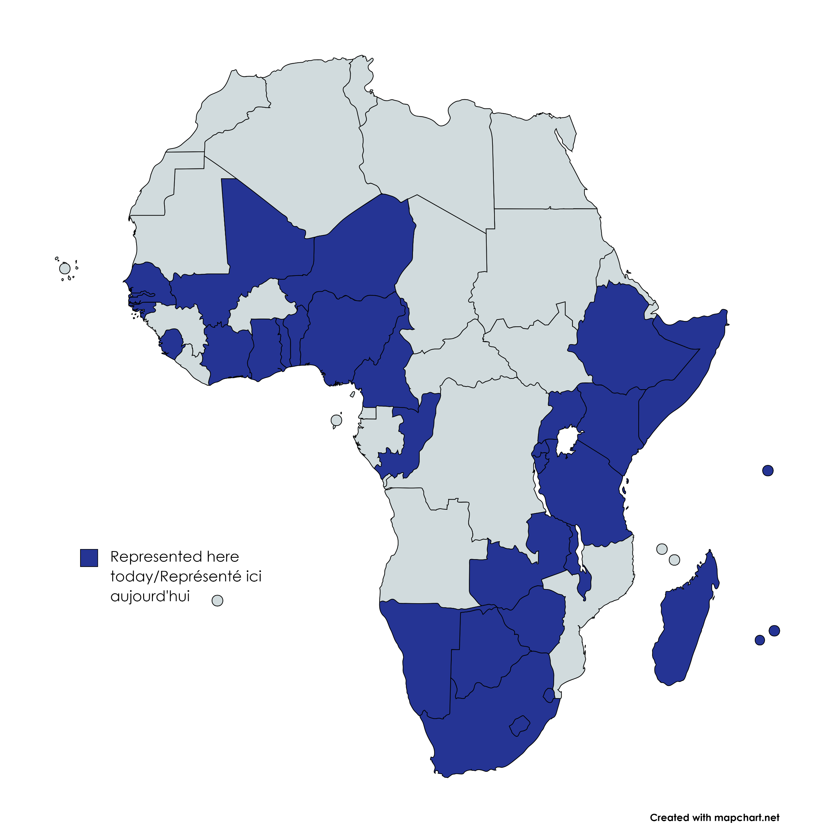
IFLA HEADQUARTERS 2023

Slide 16
Warming up
Have you ever…
Notes:
You might need to upload the bullet point picture, it is on the same folder as this presentation on Sharepoint. To change it, click on the right arrow in bullet list icon from the Home panel, then “Bulletpoints and Numbering”, and finally click “Picture” and upload the png.

Slide 17
Have you ever…
Been an IFLA volunteer?
Notes:
You might need to upload the bullet point picture, it is on the same folder as this presentation on Sharepoint. To change it, click on the right arrow in bullet list icon from the Home panel, then “Bulletpoints and Numbering”, and finally click “Picture” and upload the png.

Slide 18
Have you ever…
Attended an IFLA Congress?
Notes:
You might need to upload the bullet point picture, it is on the same folder as this presentation on Sharepoint. To change it, click on the right arrow in bullet list icon from the Home panel, then “Bulletpoints and Numbering”, and finally click “Picture” and upload the png.

Slide 19
Have you ever…
Nominated someone in an IFLA Election?
Notes:
You might need to upload the bullet point picture, it is on the same folder as this presentation on Sharepoint. To change it, click on the right arrow in bullet list icon from the Home panel, then “Bulletpoints and Numbering”, and finally click “Picture” and upload the png.

Slide 20
Have you ever…
Voted in an IFLA Election?
Notes:
You might need to upload the bullet point picture, it is on the same folder as this presentation on Sharepoint. To change it, click on the right arrow in bullet list icon from the Home panel, then “Bulletpoints and Numbering”, and finally click “Picture” and upload the png.

Slide 21
Have you ever…
Talked to someone else about IFLA?
Notes:
You might need to upload the bullet point picture, it is on the same folder as this presentation on Sharepoint. To change it, click on the right arrow in bullet list icon from the Home panel, then “Bulletpoints and Numbering”, and finally click “Picture” and upload the png.

Slide 22
What score did you get?

Slide 23
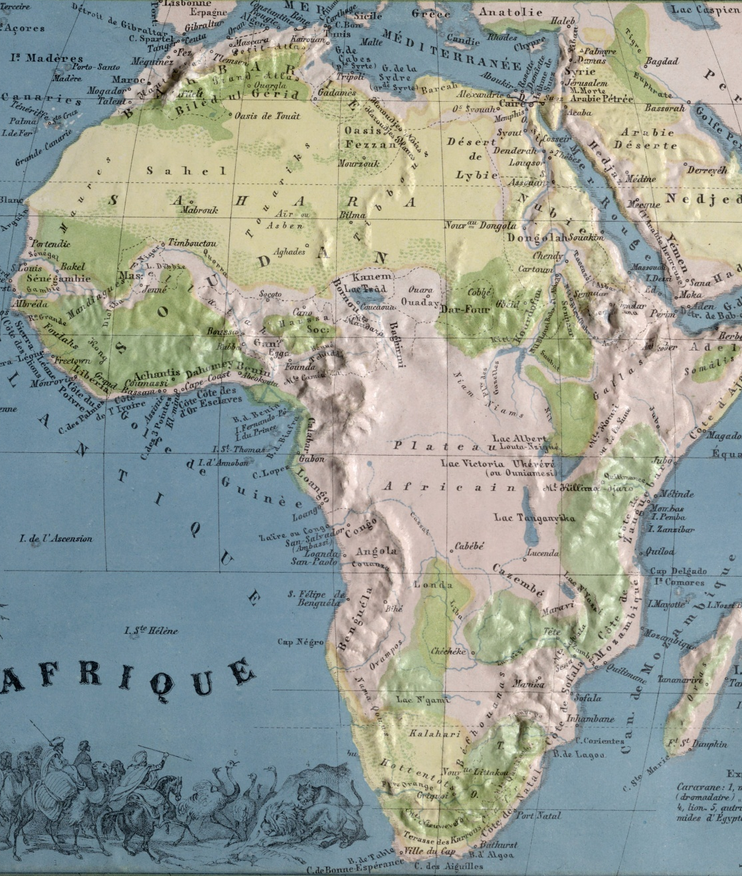
If you had to move to another country in Africa, which one would you choose?
Notes:
You might need to upload the bullet point picture, it is on the same folder as this presentation on Sharepoint. To change it, click on the right arrow in bullet list icon from the Home panel, then “Bulletpoints and Numbering”, and finally click “Picture” and upload the png.

Slide 24
Introduce yourselves to your table in 1 minute, saying:
Who you are
Your engagement with IFLA
What you want to get from this meeting!

Slide 25
The road to Nairobi

Slide 26
Where we’re coming from…

Slide 27
The leading international body representing the interests of library and information services and their users

Slide 28
Independent, non-governmental, not-for-profit organisation
1,669 active members in 147 countries worldwide
65 committees with >1,100 experts from 100 countries
Standards, guidelines, advocacy, support

Slide 29


IFLA HQ, Regional Offices, Language Centres
IFLA HEADQUARTERS 2023
IFLA HQ
Regional Offices
Language Centres

Slide 30
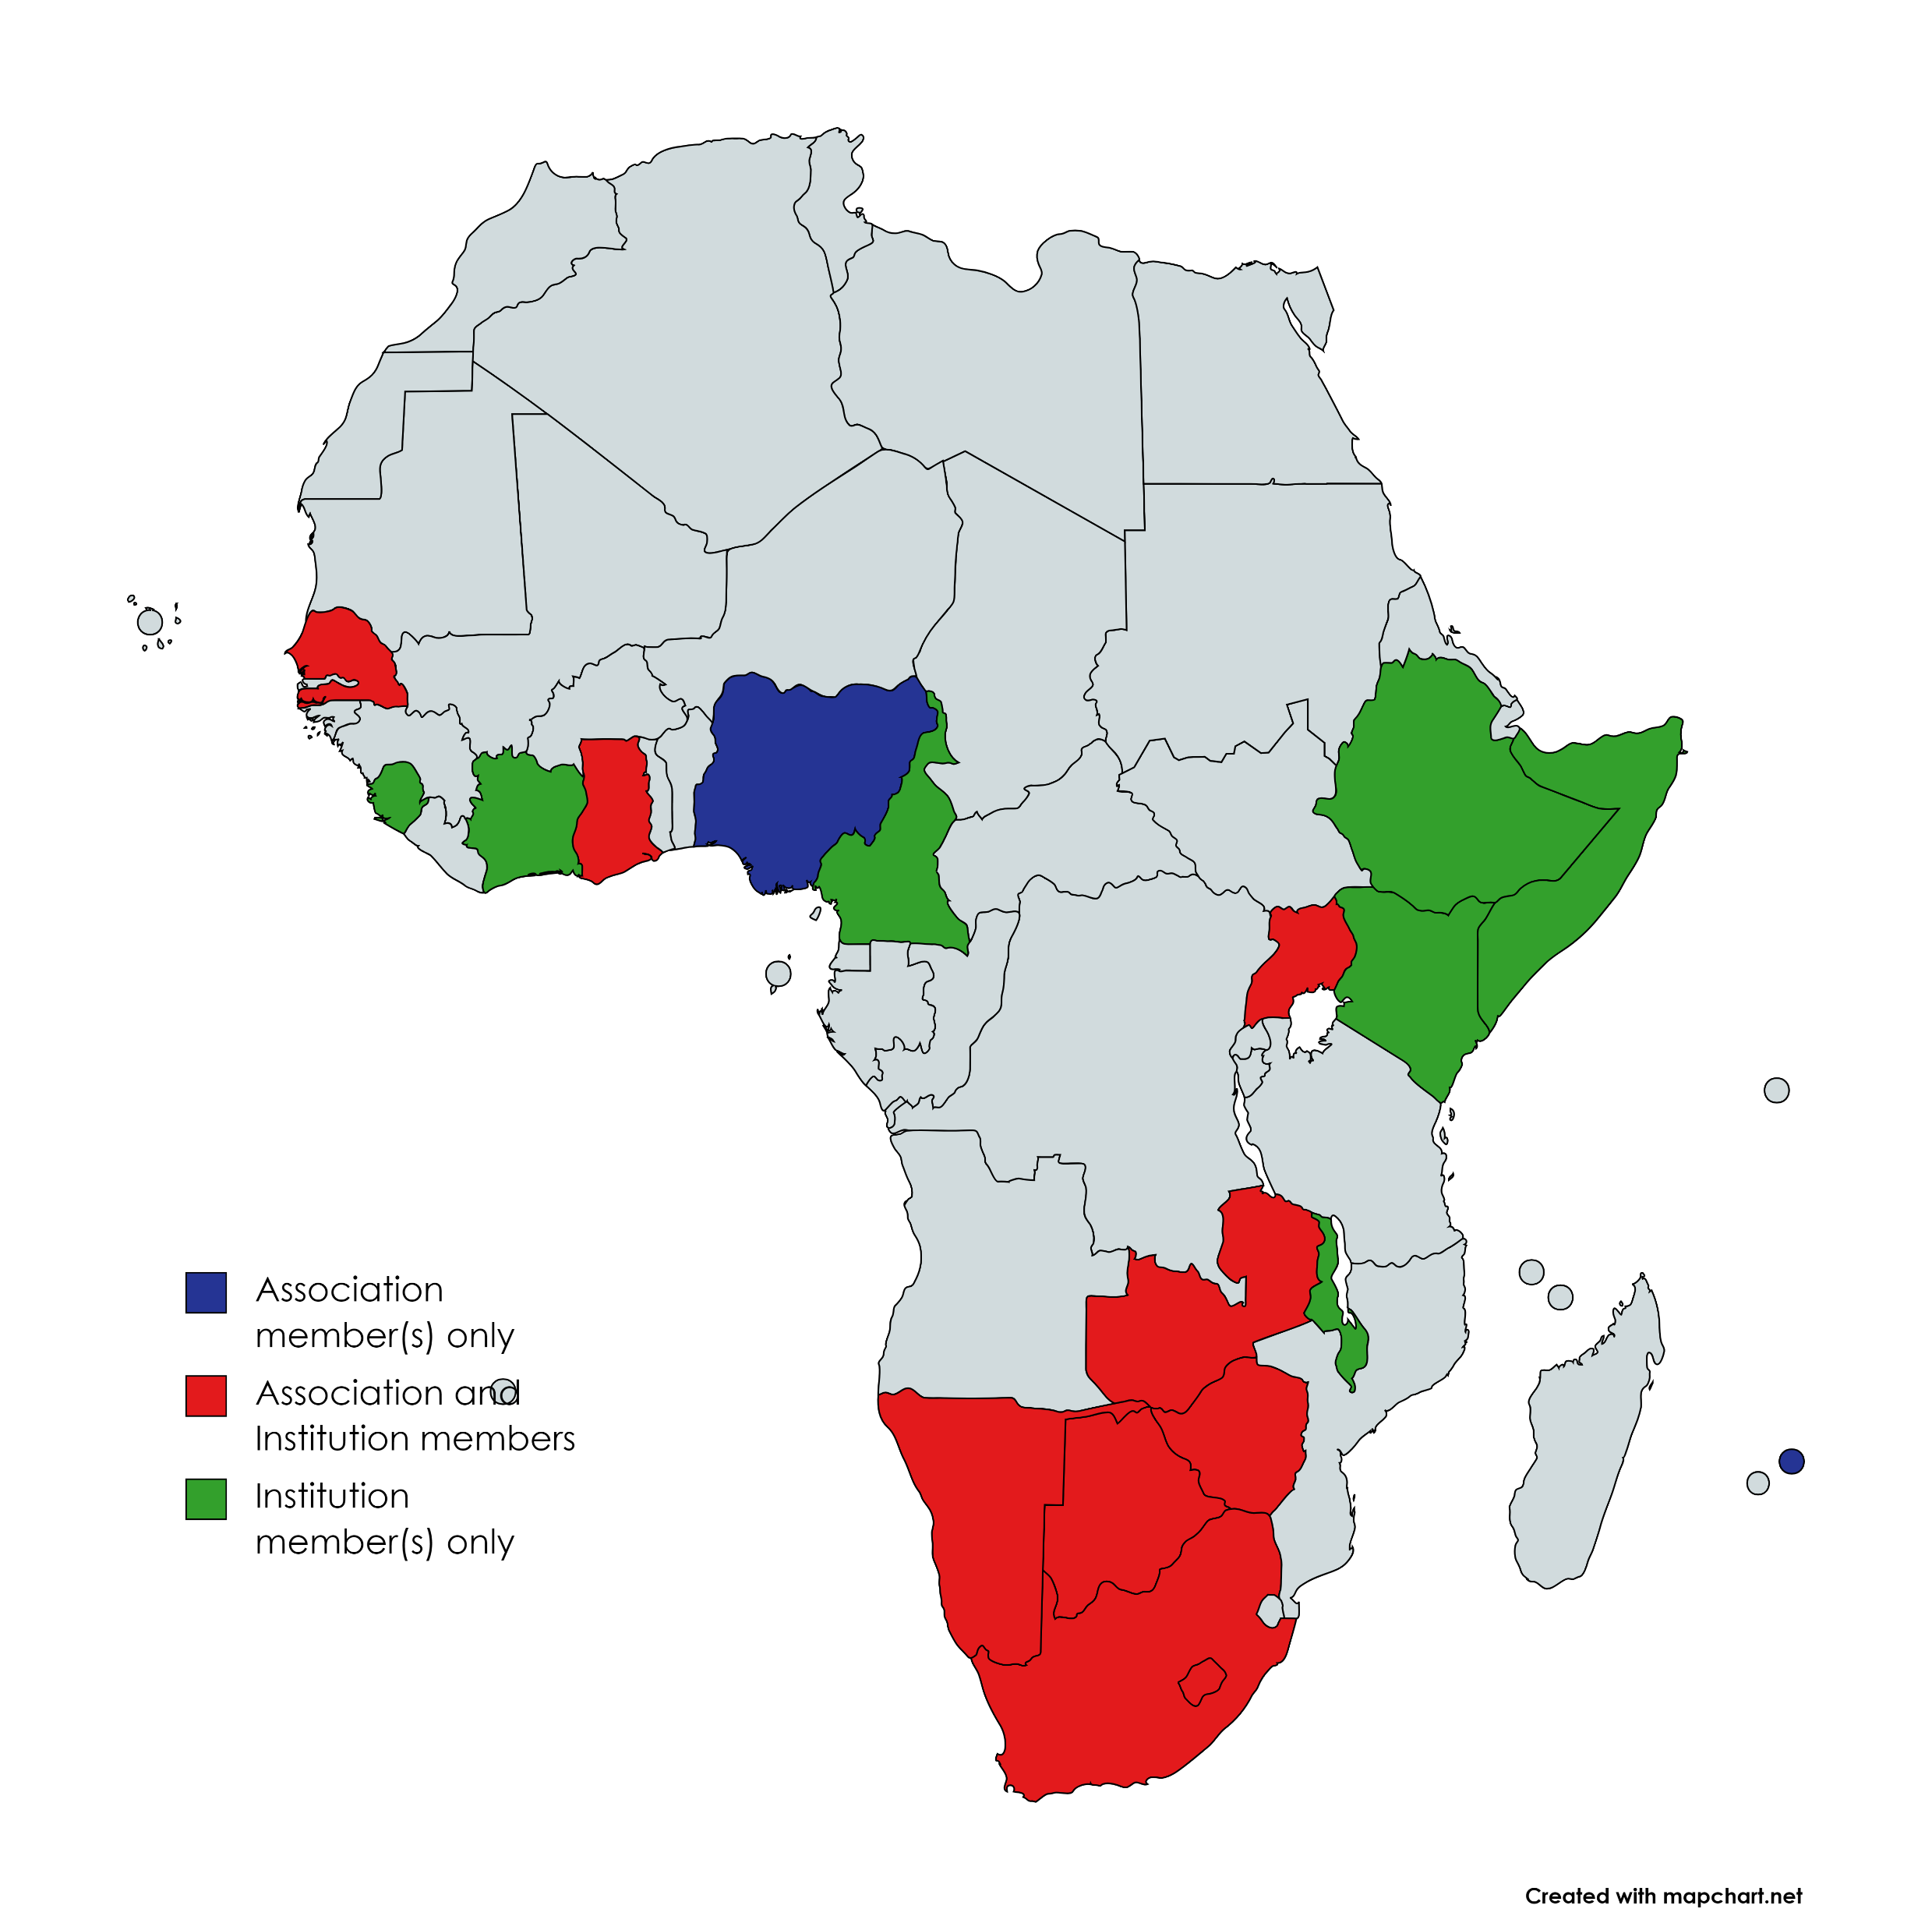

Slide 31
We’re international, but are we globally relevant?
Are we enabling libraries everywhere to thrive in a changing world?

Slide 32
From Vision to Strategy
2 global meetings
12 regional workshops
348 national and volunteer workshops, >10000 participants
>21 000 online votes, from 190 countries
>8000 ideas submitted to the Ideas Store

Slide 33
From Strategy to Action
IFLA’s own Strategy and its implementation (more on this later!)
Finding opportunities for alignment
Bringing out the voices and priorities of libraires globally

Slide 34
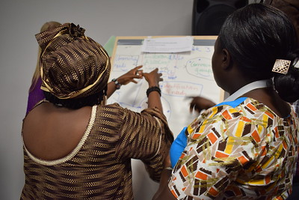
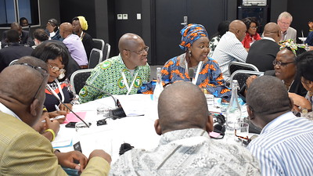
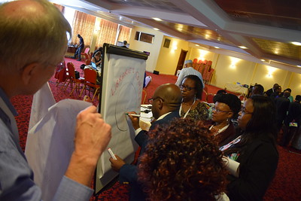
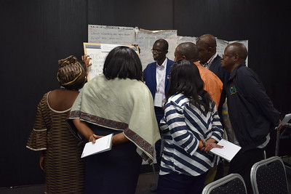

Slide 35

QUESTION
What did you take away from the Vision meetings?

Slide 36
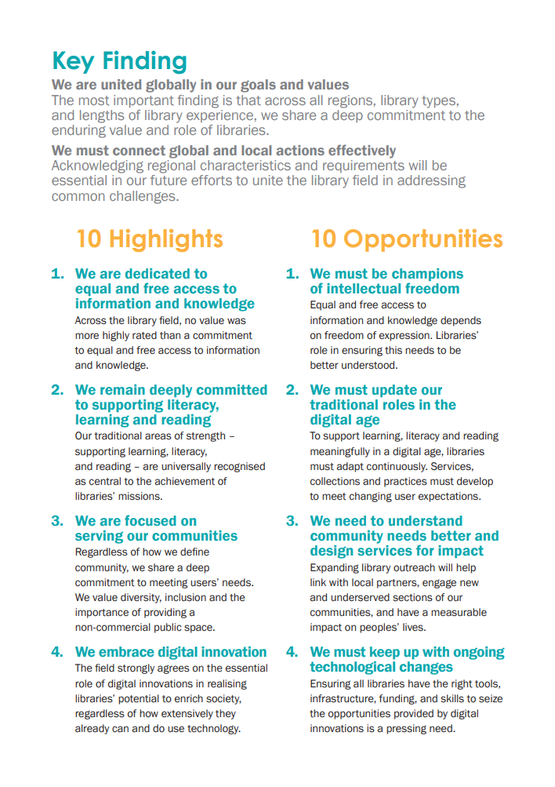
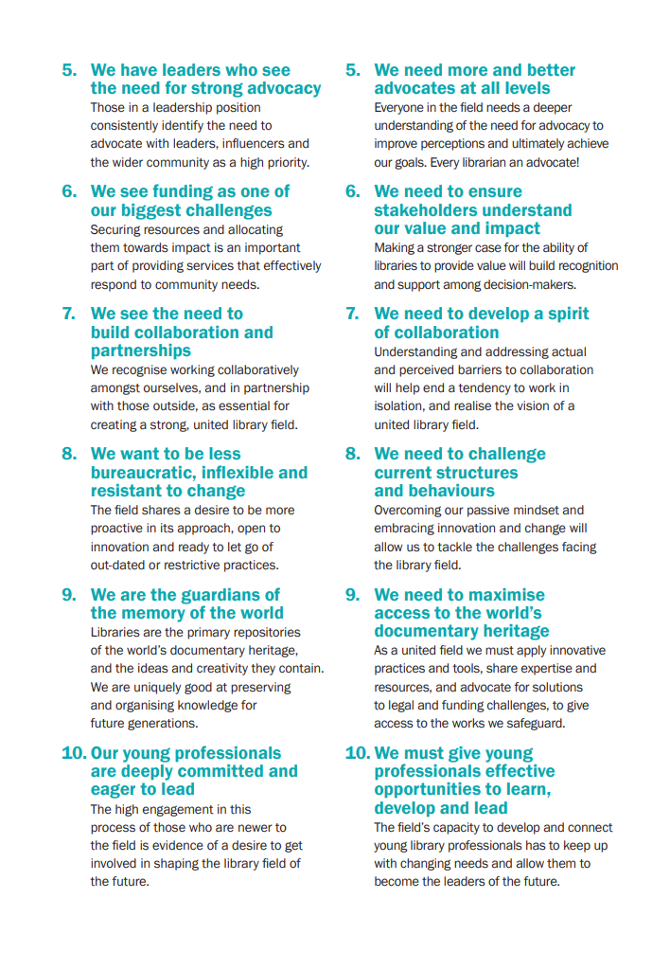

Slide 37
We are united globally in our goals and values
The most important finding is that across all regions, library types, and lengths of library experience, we share a deep commitment to the enduring value and role of libraries.
We must connect global and local actions effectively
Acknowledging regional characteristics and requirements will be essential in our future efforts to unite the library field in addressing common challenges.

Slide 38
We are dedicated to equal and free access to information and knowledge, but we must be champions of intellectual freedom
We remain deeply committed to supporting literacy, learning and reading, but we must update our traditional roles in the digital age
We are focused on serving our communities, but we need to understand community needs better and design services for impact
We embrace digital innovation, but we must keep up with ongoing technological changes
We have leaders who see the need for strong advocacy, but we need more and better advocates at all levels

Slide 39
We see funding as one of our biggest challenges, but we need to ensure stakeholders understand our value and impact
We see the need to build collaboration and partnerships, but we need to develop a spirit of collaboration
We want to be less bureaucratic, inflexible and resistant to change, but we need to challenge current structures and behaviours
We are the guardians of the memory of the world, but we need to maximise access to the world’s documentary heritage
Our young professionals are deeply committed and eager to lead, but we must give young professionals effective opportunities to learn, develop and lead

Slide 40
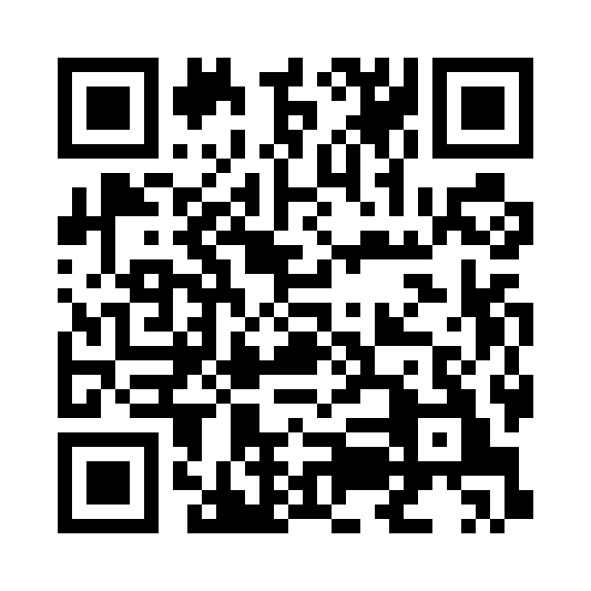

DOWNLOAD
www.ifla.org/global-vision-report-summary/

Slide 41
Which highlight/opportunity pairing resonates most with you?
Quelle paire de points forts et opportunités est la plus pertinente pour vous?
EXERCISE

Slide 42
EXERCISE: Which highlight/opportunity pairing resonates most with you?
Think for a couple of minutes yourself
Explain your choice to others on your table
Then think together about which is most important for the Sub-Saharan Africa region

Slide 43

Share your findings!
Photo: Matt Botsford on Unsplash, unsplash.com/photos/OKLqGsCT8qs

Slide 44
Key opportunities at our last meeting
3. We need to understand community needs better and design services for impact
5. We need better advocates at all levels
10. We must give young professionals effective opportunities to learn develop and lead
7. We need to develop a spirit of collaboration
4. We need to ensure stakeholders understand our value and impact

Slide 45

Break
Photo by Mike Kenneally on Unsplash, unsplash.com/photos/TD4DBagg2wE

Slide 46
What do we mean by a sustainable library field?

Slide 47
The library field is…
Library and information workers, institutions (of all types), associations, and the services and infrastructures that support them

Slide 48
Brundtland Report, 1987
Sustainable development is: “development that meets the needs of the present without compromising the ability of future generations to meet their own needs”

Slide 49
Brundtland Report, 1987
Sustainable development is: “development that meets the needs of the present without compromising the ability of future generations to meet their own needs”

Slide 50
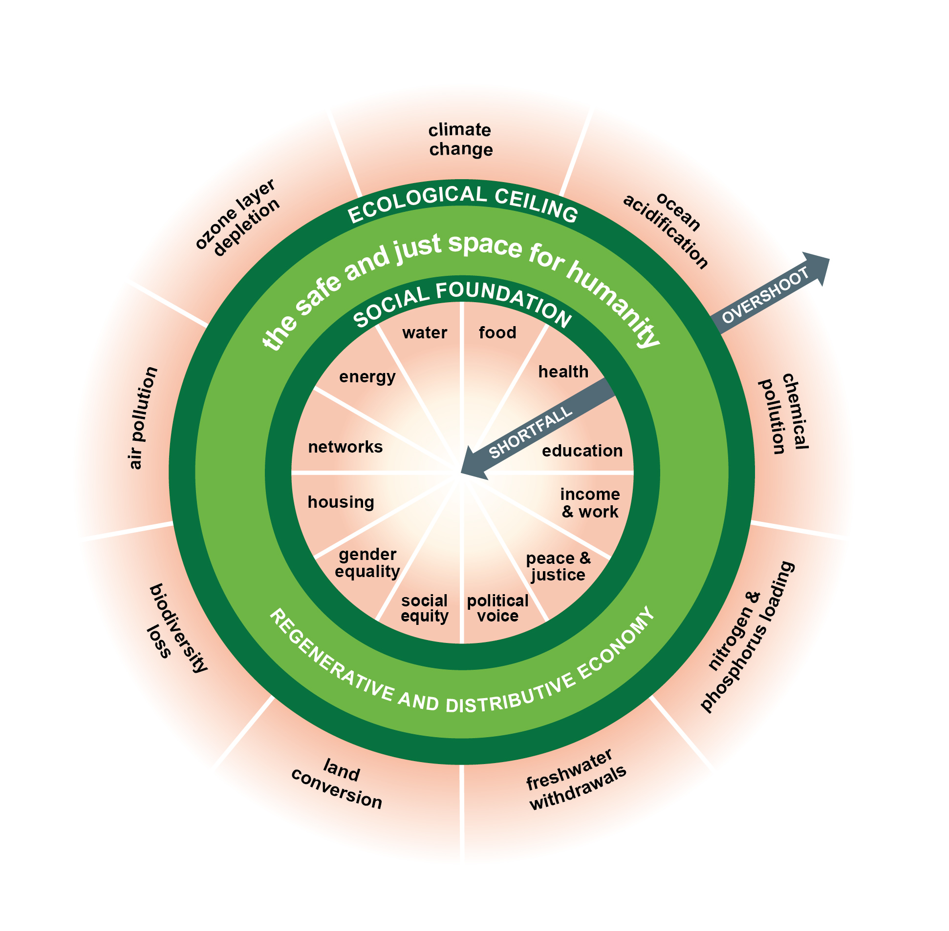
Doughnut economics and the limits to growth

Slide 51

Avoiding the under-supply of public goods
Photo by Ulvi Safari on Unsplash, unsplash.com/photos/tCj8uuABLBA

Slide 52
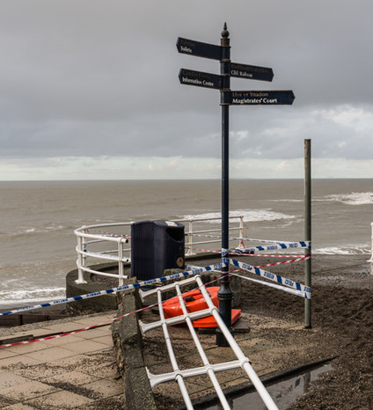
The importance of resilience
Photo: Ian Capper, CC-BY-SA 3.0, www.geograph.org.uk/photo/3804467
Photo by Ulvi Safari on Unsplash, unsplash.com/photos/tCj8uuABLBA

Slide 53
Strong and weak versions of sustainability
Weak: we can innovate our way to sustainability, i.e., do things better rather than cutting back
Strong: we have to make tough decisions if we want to preserve what matters and deliver what we need

Slide 54
The ‘pillarisation’ of sustainability – complements or competitors?
Environmental sustainability
Economic sustainability
Social sustainability
… and cultural sustainability

Slide 55

The UN Sustainable Development Goals
Transforming Our World: the 2030 Agenda for Sustainable Development, agreed in 2015
Includes:
Sustainable Development Goals
Resource mobilisation
Follow-up mechanisms

Slide 56
The SDGs are different because…
They are an agenda for all, not just developing countries
They define development broadly, including environmental issues
They take a holistic approach, focused on policy connections
They stress that everyone has a right to development (“Leave No-one Behind”)
They focus on partnerships
There are monitoring and follow-up mechanisms

Slide 57
We can talk about sustainability…
As an internal issue within our field
As an issue in our relationships with others (users, suppliers, supporters, partners)
As a global issue

Slide 58
EXERCISE
What does sustainability mean in the context of the library field?

Slide 59
EXERCISE: What does library sustainability mean for you?
Share the words you think are most relevant in defining what sustainability means for libraries in your country
Write down your own ideas as a tweet
Compare on your table, and write a shared definition on your flipchart (240 characters)
Swap with a neighbouring table, and note – on post-its – what you like, and what you’d add

Slide 60

EXERCISE
Define and apply a library field sustainability index

Slide 61
EXERCISE: Define and apply a library field sustainability index
Brainstorm the factors of sustainability
Combine your ideas to get to 4-8 factors in total
Assign weightings of 1-5 to these factors
Score your national field, and the region on each factor (1-5), and multiply by the weightings
Discuss your findings and what they mean

Slide 62
Example
(but for deciding where to go for dinner)
1) What matters for me (define my factors):
          Taste
          Quantity
          Atmosphere
          Price
          Service
          Can bring my dog

Slide 63
Example
(but for deciding where to go for dinner)
2) Assign weightings, i.e., how much they matter for me (1 = not important, 5 = essential)
          Taste (4)
          Quantity (3)
          Atmosphere (2)
          Price (4)
          Service (2)
          Can bring my dog (5)

Slide 64
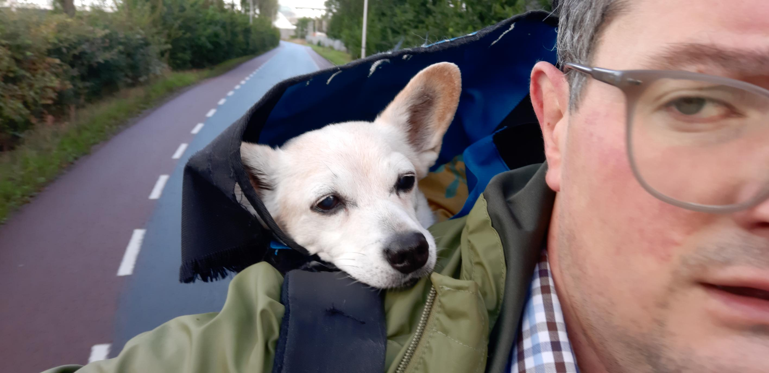

Slide 65
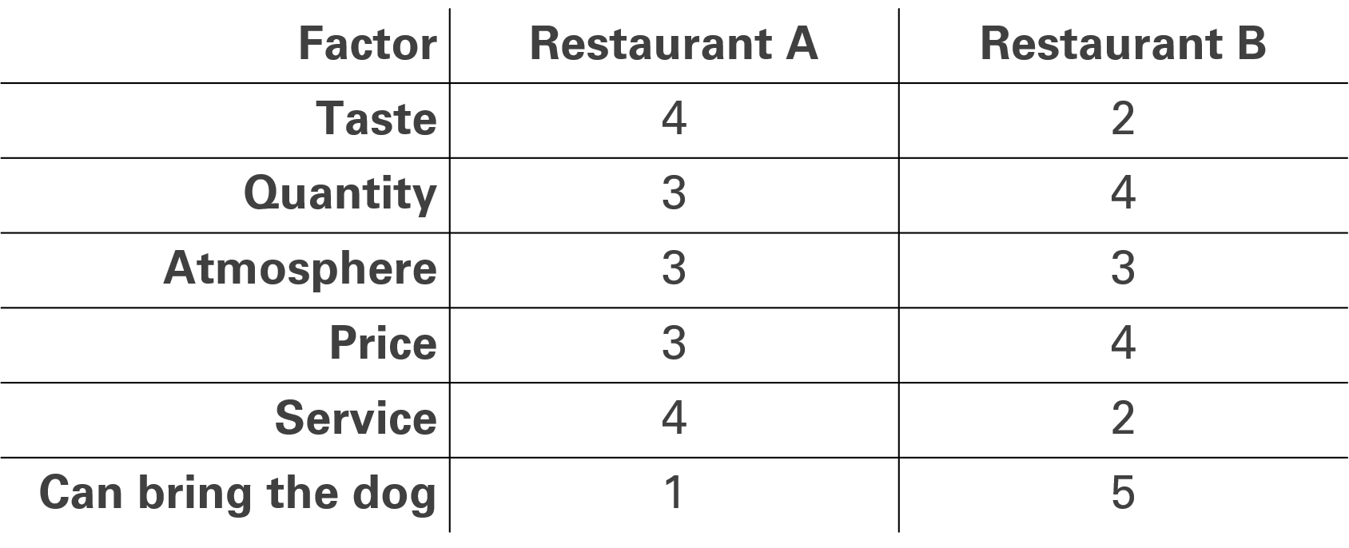
Example
(but for deciding where to go for dinner)
3) Rate restaurants A and B on the factors

Slide 66
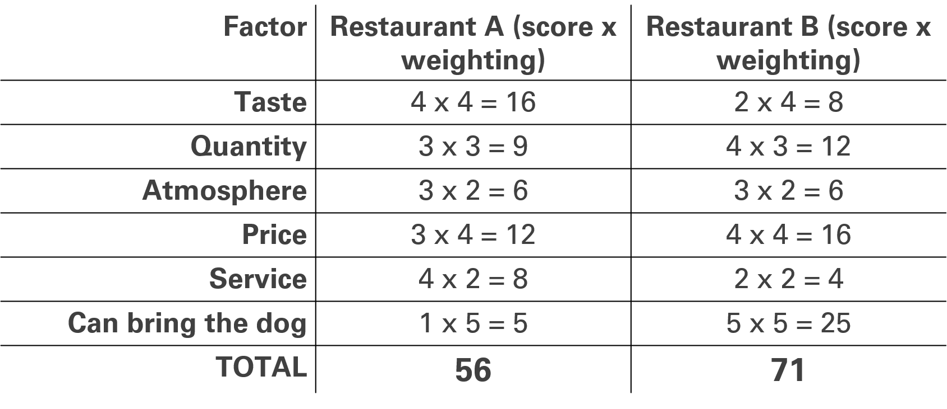
Example
(but for deciding where to go for dinner)
4) Apply your index: score x weighting, and add these up

Slide 67
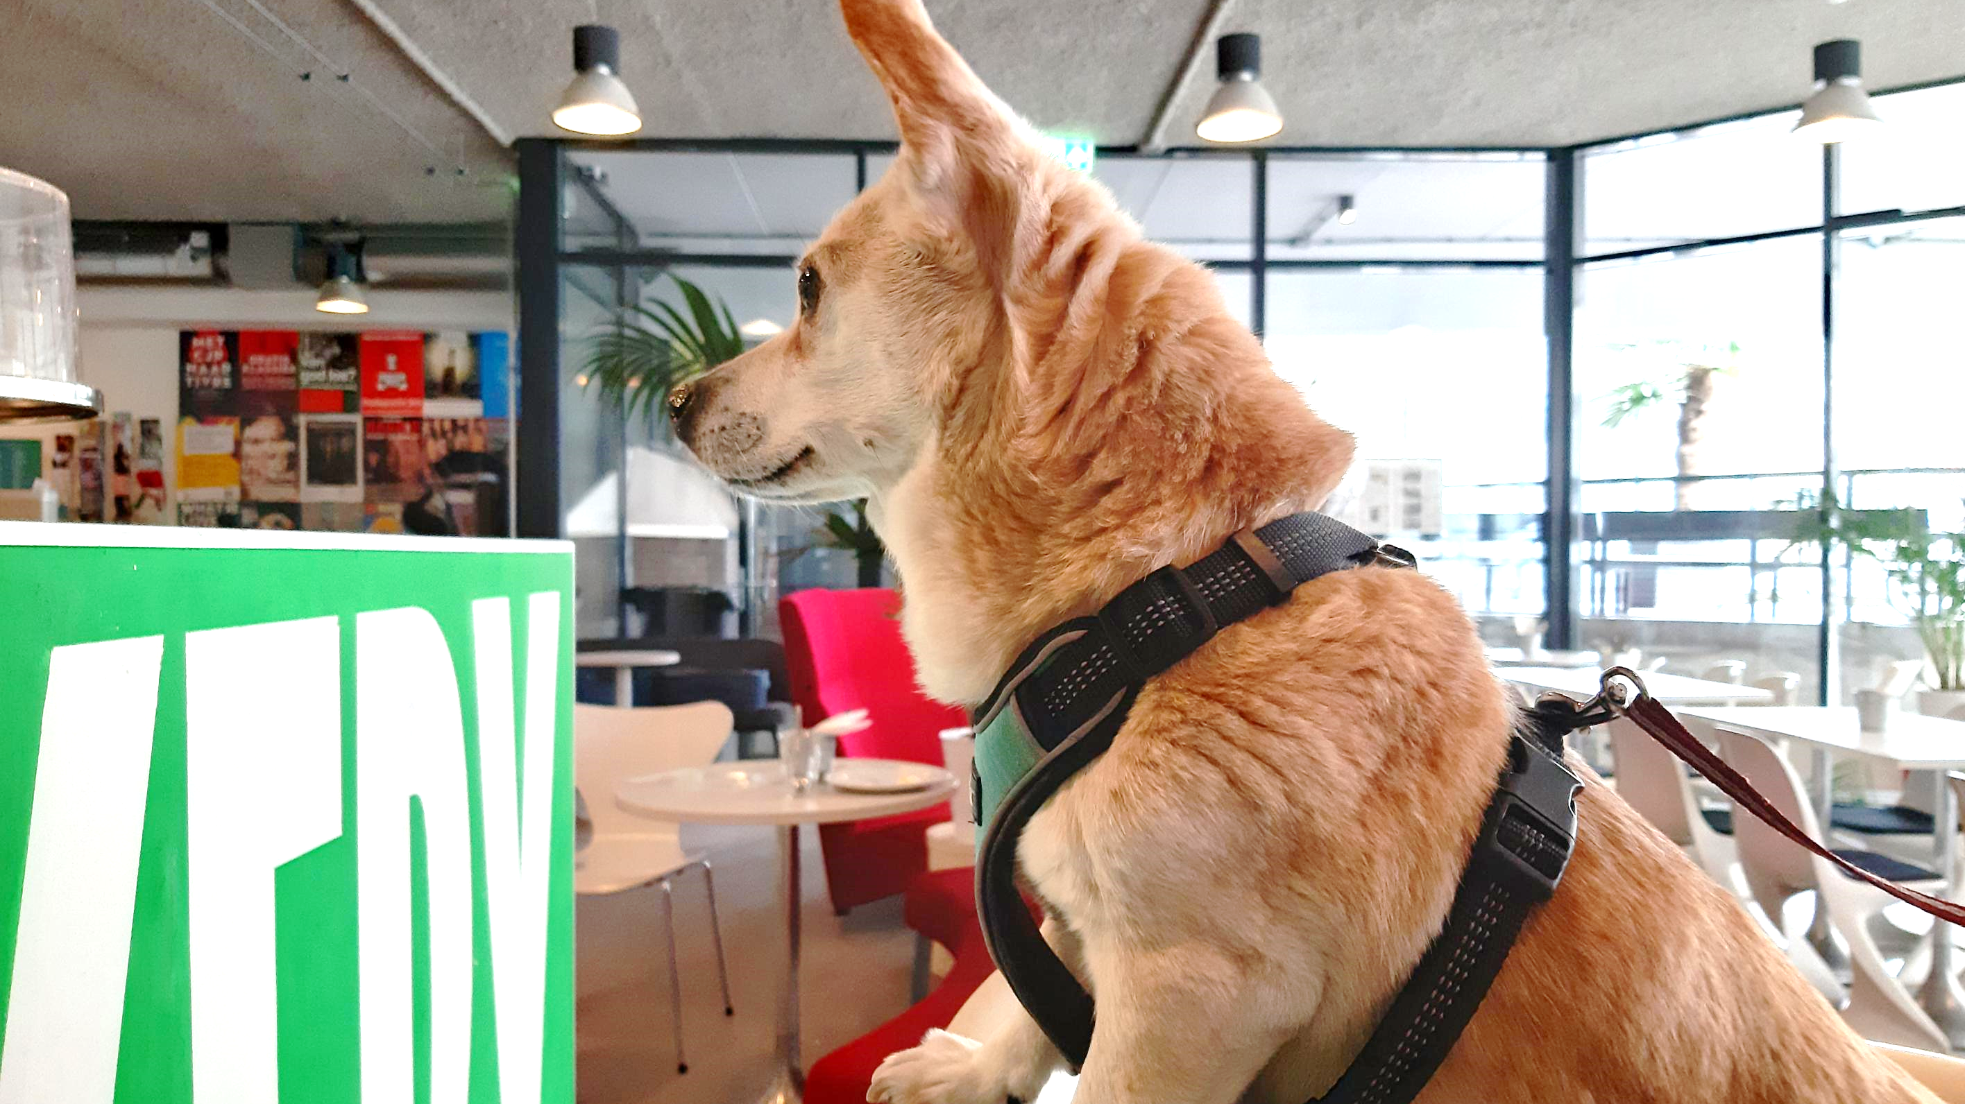

Slide 68
EXERCISE: Define and apply a library sustainability index
Brainstorm the ingredients of sustainability
Combine your ideas to get to 4-8 in total
Assign weightings of 1-5 to these factors
Score your national field, and the region on each factor (1-5), and multiply by the weightings
Discuss your findings and what they mean
Use the sheets handed out to you!

Slide 69
Template
Sustainability Factor | Weighting | Country Score (1-5) | Country Totals | Region Score (1-5) | Region Totals
A
B
C
D
 |  | TOTAL = |  | TOTAL =

Slide 70
Share your findings!
Photo: Matt Botsford on Unsplash, unsplash.com/photos/OKLqGsCT8qs

Slide 71

COMMITMENT
Carry out this exercise in your own national field – what results do you get?

Slide 72

Lunch
Photo: Keesha's Kitchen on Unsplash, https://unsplash.com/photos/_y325luZNUs

Slide 73
Planning for future – Bringing Forward Emerging Leaders

Slide 74

Support for emerging leaders as a pillar of sustainability
Photo: Ian Capper, CC-BY-SA 3.0, www.geograph.org.uk/photo/3804467
Photo by Ulvi Safari on Unsplash, unsplash.com/photos/tCj8uuABLBA

Slide 75
EXERCISE
Knowledge and assumptions about emerging leaders

Slide 76
EXERCISE: knowledge and assumptions about emerging leaders
Answer the following questions:
  How many years of experience do you have in the field?
  At what age did you get into librarianship?
  Can we give space to emerging leaders to develop without more established librarians making sacrifices?
  Do emerging leaders already enter the field with the skills they need to succeed?
  Do associations (nationally, regionally and internationally) have a role in supporting emerging leaders’ development?
  What one thing does an emerging leader need to succeed?

Slide 77
What one experience really helped you advance in your career?
What was your main frustration?
Have you experienced a successful leaders’ programme? What made it so good?
DISCUSSION

Slide 78
EXERCISE
From emerging to emerged – what CV?

Slide 79

EXERCISE: from emerging to emerged
Imagine a librarian who, within 15 years of joining the profession has just joined the board of their library association
On your table, think about what training, experience and other opportnities they have had in order to achieve this
Prepare a CV for them on a flipchart
Share it with the room!

Slide 80
DISCUSSION
What experiences are similar across groups?
Where can we help to find solutions regionally?

Slide 81
COMMITMENT
Identify at least one initiative you can take to support emerging leaders

Slide 82
Break
Photo by Mike Kenneally on Unsplash, unsplash.com/photos/TD4DBagg2wE

Slide 83
Identifying, building and maintaining partnerships

Slide 84

Stronger together
Notes:
Very simple approach – a partnership training session but hopefully a strategic tool to help you think about partnerships that can help you deliver goals and amplify your voice. And how YOU can help your partner.
Fundamental to advocacy: how you tell your story to those who don’t necessarily understand libraries’ contribution to society and SDGs
Key: you have to offer and not just ask. Listen before you tell. Tailor for your partner. But don’t undersell yourself. And focus.
Partnership is like a successful and happy relationship or marriage. It’s complementary, equal, mutually supportive, respectful, honest, and sometimes hard work but worth it in the end!

Slide 85


Slide 86


Types of partnerships
Transactional
Strategic
Notes:
Partnerships one of most overused words
Distinguish transactional and strategic.
Thoughts on what we mean by each?
Where on the spectrum?
Examples?
Some will remain transactional, others will move along the spectrum – recognize the difference and need

Slide 87
Effective & Sustainable Strategic Partnerships
Are not…
Are…
Dozens of open-ended MOUs that leaders love signing in front of photographers…
Driven just by finances (though they are important) or service delivery contracts
One-sided – contributions should be equally valued
Just friendly agreements between mates – they need due diligence, NDAs (non-disclosure agreements), risk assessments, formal agreements, GDPR etc… and should ALWAYS have an exit strategy.
Mutually beneficial – ‘win-win’
Flexible, resourceful and innovative
Respectful & equitable
Honest and underpinned by a commitment to joint learning.
Built on trust over time (but do your due diligence first and document it…)
Organised & Accountable (they are labour intensive and need a champion)
Regularly reviewed – stop, maintain, evolve?
Notes:
Focus on strategic
You will not have many of them…
Neither is superior
You need to analyse and understand your offer and listen to the priorities of partners. Listen (and do your research) first.
Always ask yourself: How can I help THEM? How can I be the partner of choice? And why should they partner with us?

Slide 88
EXERCISE
How strategic are your partnerships?

Slide 89

EXERCISE: how strategic are your partnerships?
Identify examples of partnerships that you already have
Place them on the transactional → strategic spectrum
Check them against the checklist!

Slide 90
Effective & Sustainable Strategic Partnerships
Are not…
Are…
Dozens of open-ended MOUs that leaders love signing in front of photographers…
Driven just by finances (though they are important) or service delivery contracts
One-sided – contributions should be equally valued
Just friendly agreements between mates – they need due diligence, NDAs (non-disclosure agreements), risk assessments, formal agreements, GDPR etc… and should ALWAYS have an exit strategy.
Mutually beneficial – ‘win-win’
Flexible, resourceful and innovative
Respectful & equitable
Honest and underpinned by a commitment to joint learning.
Built on trust over time (but do your due diligence first and document it…)
Organised & Accountable (they are labour intensive and need a champion)
Regularly reviewed – stop, maintain, evolve?
Notes:
Focus on strategic
You will not have many of them…
Neither is superior
You need to analyse and understand your offer and listen to the priorities of partners. Listen (and do your research) first.
Always ask yourself: How can I help THEM? How can I be the partner of choice? And why should they partner with us?

Slide 91
The 4 ‘I’s of Strategic Partnerships
INFLUENCE | INNOVATION
INCOME | IMPACT
Notes:
Now let’s look at a simple framework the four Is - to help you identify partnerships needs and also what your offer is.
Think in terms of ‘gap analysis’ – what do YOU need and what do your partners need.
What are your organizational needs/project requirements to achieve impact.

Slide 92
The 4 ‘I’s of Strategic Partnerships
INFLUENCE Partners with access to networks, decision-makers, media, business and others that can help us achieve our goals and create opportunities for new strategic partnerships Partners that help raise our profile and increase recognition of our contribution | INNOVATION Partners with the skills, knowledge, technology or platforms we don’t have and may be too costly or take too long for us to acquire Partners who strengthen our internal capacity - teach us new skills, accelerate learning, provide job shadowing and secondment opportunities etc.
INCOME Partners who provide funding (cash and/or in-kind) or who have access to funders Partners who build our capacity to write funding proposals or diversify and grow income | IMPACT Partners who have experience of delivering change with our target beneficiaries – e.g., hard-to-reach communities Partners and consortia who bring the other 3 ‘I’s (Influence, Innovation & Income) to amplify our work and achieve greater impact than we can alone.
Notes:
Now let’s look at a simple framework the four Is - to help you identify partnerships needs and also what your offer is.
Think in terms of ‘gap analysis’ – what do YOU need and what do your partners need.
What are your organizational needs/project requirements to achieve impact.
This works for advocacy – influence essentially that. And for any kind of project – SDGs a useful framework

Slide 93
Partnerships helping deliver EVERYONE’S goals
How can we work with partners to better achieve our goals and increase our impact? And what’s our offer?
INFLUENCE: How can we expand our networks of influence? How can be showcase our achievements and get decision-makers to see power of libraries? E.g., media partner, library associations, sister organizations, Education ministry etc.
INNOVATION: How can we provide access to learning to hard-to-reach communities? How can we ensure our staff have the required skills? E.g., Tech partner – Microsoft – Corporate partner etc.
INCOME: How can we find the resources to help refugees integrate? How can we bring together librarians in the south of the country? E.g., Aid agency, UN, EU, university with a conference center etc.
IMPACT: We did a small literacy project which we feel was successful but how can we increase our impact and benefit thousands rather than hundreds? E.g., ministry of education, university researcher and writer to analyze data and tell the story to funders and outreach partners,
Notes:
Will fit in with ToC and strategy sessions. Mutual benefit – win-win
Need to understand your assets and present your track record.
If working with your teams, how can you unpack your project/strategy and pose the right questions?
Key question in the centre:
Couple of minutes at tables to discuss other ideas based on your work – and also what YOU can offer here.
Flip chart and shout out examples

Slide 94
EXERCISE
Partnerships: gap analysis

Slide 95
EXERCISE: partnerships gap analysis
At your tables, agree on a country or organisation, and identify a relevant goal, asset and gaps
Think: who might you approach as a partner? How would you approach them?
What’s your offer?
Fill in a template
Notes:
I’ve put a couple of examples but you can choose a different and more relevant example or the SDGs
Focus for role play…

Slide 96
Strategic Goal (what difference will we make) | Children 0-5 have the literacy skills to succeed at school Government recognizes libraries contribution to SDGs
Targets | 75% of the children in Newtown participate in pre-school literacy programme Government of Ruritania include libraries in NVR of SDGs
Our assets / track record/ strengths & opportunities | Successful pilot in one district of Newtown resulted in children’s reading skills ahead of age at 5 5 public spaces in Newtown connected to internet Partnerships with local schools Literacy a priority for current government & Newtown mayor and major funder
Gaps – where we need help/ partnership | Influence? Innovation? Income? Impact? Few staff with media and communications skills Few relationships outside of education – especially amongst politicians IT hardware old and staff untrained on latest technology Lack of resources & funding No experience in producing funding proposals Lack of experience in collecting data and telling powerful stories of impact
Notes:
Simple framework – TOC will help more
This is a random example. Either use for exercise or use your own.
Do on a flip chart – facilitators help

Slide 97
Strategic Goal (what difference will we make) | Example: Children 0-5 have the literacy skills to succeed at school Government recognizes libraries’ contribution to SDGs Your own goal…
Targets
Our assets / track record/ strengths & opportunities
Gaps – where we need help/ partnership (Influence, Innovation, Income, Impact)
Notes:
Simple framework – TOC will help more
This is a random example. Either use for exercise or use your own.
Do on a flip chart – facilitators help
Think about your index and the really important factor to change

Slide 98
EXERCISE
Teamwork for partnerships success: role play

Slide 99

EXERCISE: Teamwork for partnerships success – role play
Half of each table should prepare the partnership pitch for the organisation/country
The other half plays the role of the partner being approached
Build a partnership!

Slide 100
Share your findings!
Photo: Matt Botsford on Unsplash, unsplash.com/photos/OKLqGsCT8qs

Slide 101
COMMITMENT
Within one month, I will…

Slide 102
IFLA membership
in Sub-Saharan Africa region

Slide 103

IFLA is the most international library organisation in the world.
Our vision – a strong and united global library field powering literate, informed and participatory societies – defines the world that we are creating.
We inspire, engage, enable, and connect the global library field.
IFLA – the global voice of libraries

Slide 104

Our members are our greatest strength, working together to help define the agenda of the international library and information community.
Becoming a member of IFLA affirms your commitment to delivering exceptional library services and promoting the core values of library and information work.
By being and IFLA Member or Affiliate you make what we do possible.

Slide 105
Asia-Oceania
Europe
Latin America and the Caribbean
31 Associations
154 Institutions
130 Individuals
68 Associations
409 Institutions
133 Individuals
14 Associations
45 Institutions
28 Individuals
Middle East and North Africa
North America
Sub-Saharan Africa
22 Associations
113 Institutions
341 Individuals
13 Associations
64 Institutions
19 Individuals
7 Associations
51 Institutions
27 Individuals
Membership statistics as of September 2023.
At the end of September, we have 1,669 Members and Affiliates in 147 countries.

Slide 107

Benefits of IFLA Membership
BEING A LIBRARIAN IS A MISSION. BUT BEING WITH LIBRARIANS IS ALSO AT THE HEART OF OUR PROFESSION. IFLA PROVIDES US WITH ENCOUNTER, DIALOGUE, AND KNOWLEDGE.
IFLA Personal Affiliate

Slide 108
Professional Sections
Regional Divisions
Discounts
Engage with experts in your field of interest. Save on each Section you are registered for free.
Free participation in the relevant Regional Division – engagement in advocacy for libraries.
Reduced rate at IFLA’s paid events. Discounts on IFLA Publications and member access to IFLA Journal.
Decision-making
Professional development
Networking
Nominate and vote in IFLA Elections and General Assembly.
Build knowledge and experience through dynamic professional development opportunities.
Connect and collaborate with our international network.
We provide tools and materials, a forum for discussion and learning, and advocating for libraries.
Check our events and news pages to see what IFLA is doing around the world and what are opportunities to engage.

Slide 109


Slide 110

EXERCISE
IFLA membership in your country

Slide 111
Wrap up

Slide 112
Thank you!

