Slide 1


Reshaping the ISBD: structure and ISBDM as a tool
Mikael Wetterstrom
Presented to the IFLA webinar “From ISBD to ISBDM”, 26 January 2023
IFLA Webinar
From ISBD to ISBDM
26 January 2023
Notes:
This presentation is based on a selection of screen shots of a website that demonstrates the potential content, layout and style of the ISBD for Manifestation as an online tool.

Slide 2
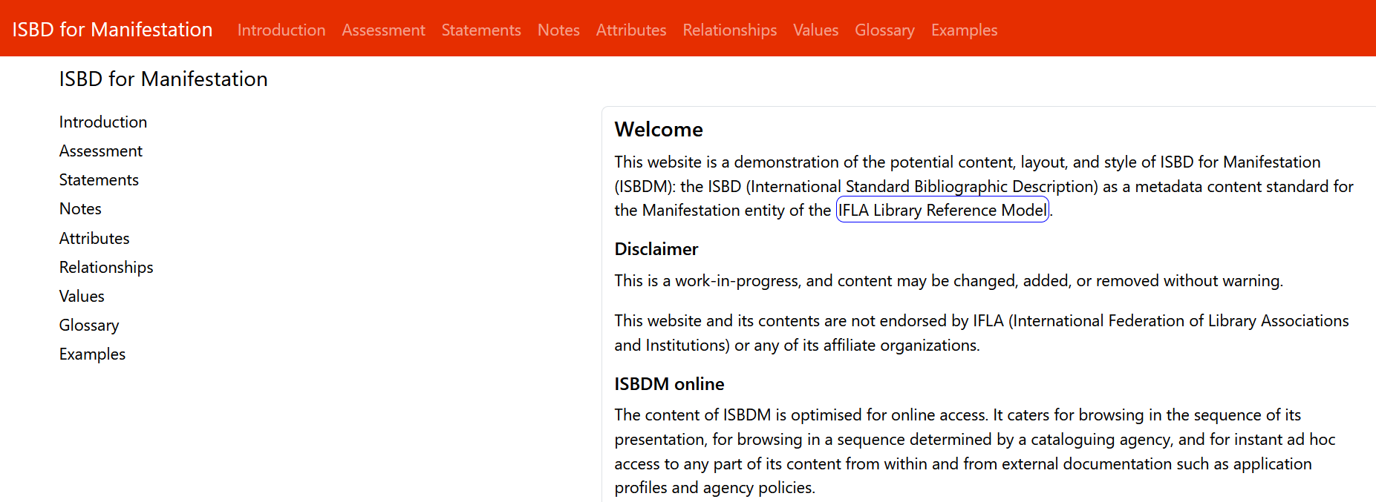
Basic ISBDM layout and structure
IFLA Webinar
From ISBD to ISBDM
26 January 2023
Notes:
Compared to the current ISBD, ISBD for Manifestation proposes a completely different structure and an entity based cataloguing environment approach. One factor that have a big impact on the new proposed structure is the introduction of relationships, compared to the current ISBD that is purely descriptive.
The draft ISBDM has a standard website navigation system with the main menu listed on the welcome page vertically on the left hand side, and then on every page as a horizontal menu. The main menu includes:
An Introduction section
A new section called Assessment,
4 sections on the elements: Statements, Notes, Attributes, and Relationships
A section on Values
A Glossary section, and an Examples section
This presentation will look at a selection of these sections, including some subsections. Starting with the Introduction

Slide 3
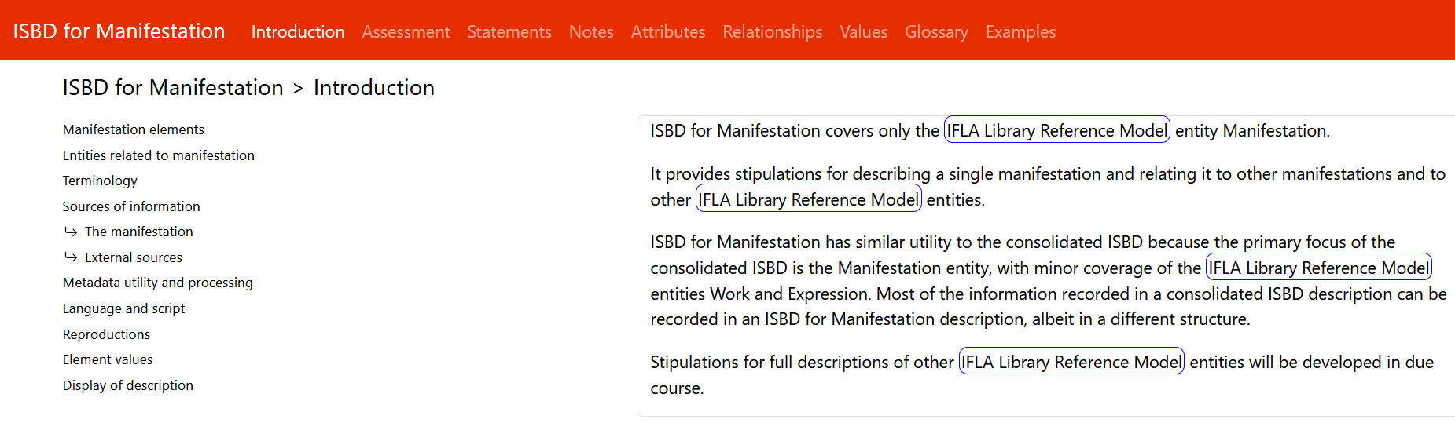
Introduction section
IFLA Webinar
From ISBD to ISBDM
26 January 2023
Notes:
The introduction section takes inspiration from the current introduction to ISBD, but removes large parts of it, and adds new information that is more relevant to an entity based manifestation content standard.

Slide 4
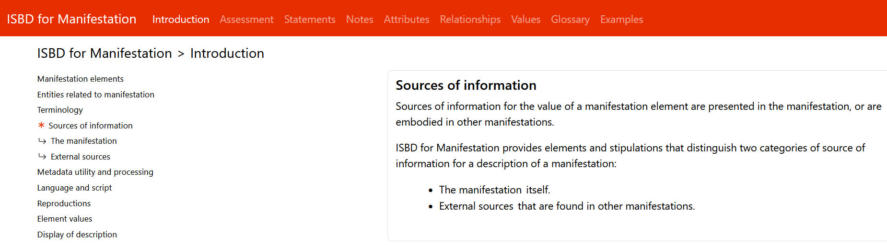
Introduction: Sources of information
IFLA Webinar
From ISBD to ISBDM
26 January 2023
Notes:
The ISBD Sources of information have been extensively analysed, and have been simplified compared to the current ISBD. The approach was to generalize the sources of information, and to rely more on cataloguer judgment than on a prescribed set of sources.
Therefore, sources of information have been split into just 2 sections:
The manifestation itself (which relates to the International Cataloguing Principle (ICP) “representation”)
External sources (other manifestations, reference sources)

Slide 5
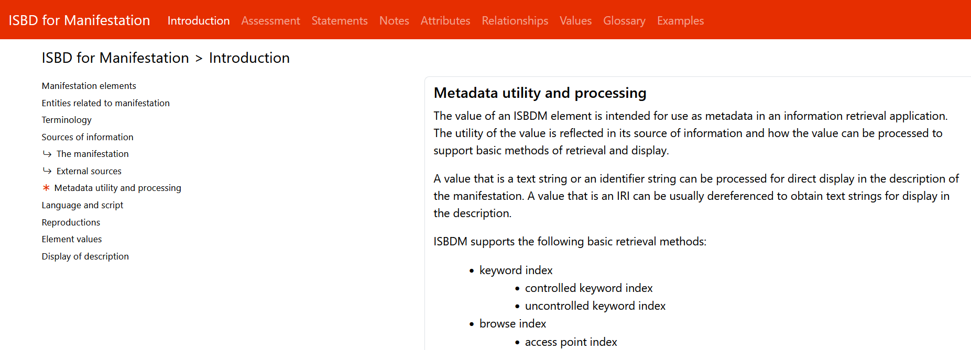
Introduction: Metadata utility and processing
IFLA Webinar
From ISBD to ISBDM
26 January 2023
Notes:
The Metadata utility and processing subsection provides context about what actually happens to the metadata that you create:
How is it used? How is it processed in modern information retrieval systems?
It is an attempt to give cataloguers a bit more context about the result of their work.

Slide 6
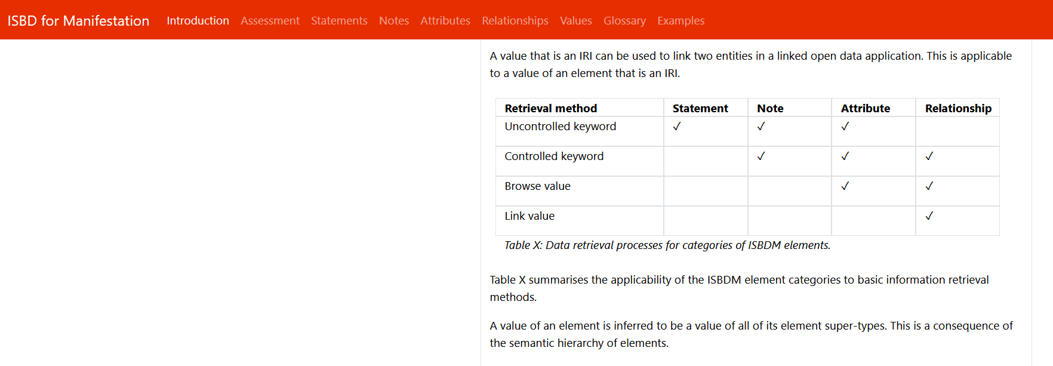
Introduction: Metadata utility and processing
IFLA Webinar
From ISBD to ISBDM
26 January 2023
The categories of Manifestation elements in the table indicate which retrieval methods are applicable to an element value
Notes:
For example, which retrieval methods are applicable to an element value?
This table shows that Statement values are useful for uncontrolled keyword indexing, while Relationship values are controlled and can be used for browsing and linking.

Slide 7
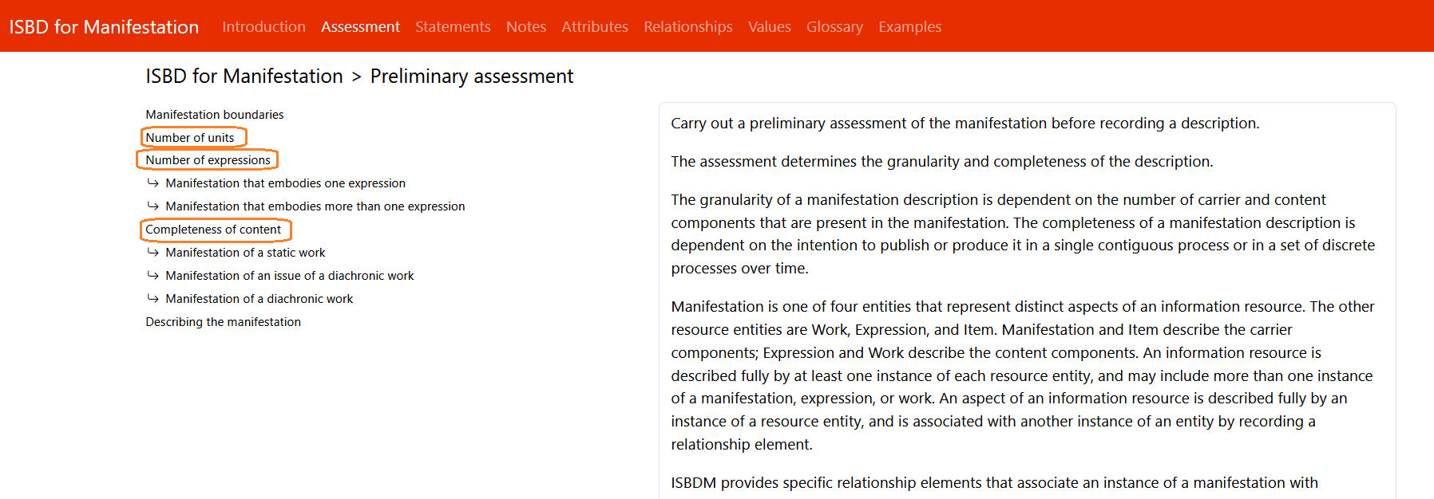
Preliminary assessment : 3 distinct characteristics
IFLA Webinar
From ISBD to ISBDM
26 January 2023
A manifestation may be published or produced in one or more units.
A manifestation may embody one or more expressions that realise one or more works.
A manifestation may embody the content of a work that is planned to be static or to change over time.
Notes:
The Assessment section that follows the Introduction section, recognizes that under the LRM, the structure of the manifestation is influenced by 3 distinct characteristics:
Number of units (The number of physical or logical parts that are in the manifestation)
Number of expressions (Determines whether the manifestation is treated as an aggregate or not: a manifestation that embodies only one expression is not an aggregate, but everything else is)
Completeness of content (This concerns Serial works. For consistency and compatibility, ISBDM suggests using the RDA terminology Diachronic works)

Slide 8
Preliminary assessment : 3 distinct characteristics
One of two mutually exclusive conditions:
A manifestation is either one unit or more than one unit
A manifestation embodies either one expression or more than one expression
A manifestation embodies expressions of works that are either static or planned to be embodied over time.
IFLA Webinar
From ISBD to ISBDM
26 January 2023
Notes:
The idea is that a number of decisions should be taken by a cataloguer before starting to create the metadata. So when assessing these characteristics:
A manifestation is either one unit or more than one unit.
A manifestation embodies either one expression or more than one expression.
A manifestation embodies expressions of works that are either static or planned to be embodied over time.
This translates into questions like:
Am I going to describe the whole manifestation, or am I going to describe one of its units, or all of its units, or just some of its units?
For aggregates, do I want to describe all embodied expressions, or just the main expression?
How complete is the manifestation that I am trying to describe? Am I describing a static issue of a serial or the serial that it belongs to? Special guidance and stipulations are needed for Diachronic works that are incomplete. This is not clear in the previous ISBD traditions.

Slide 9
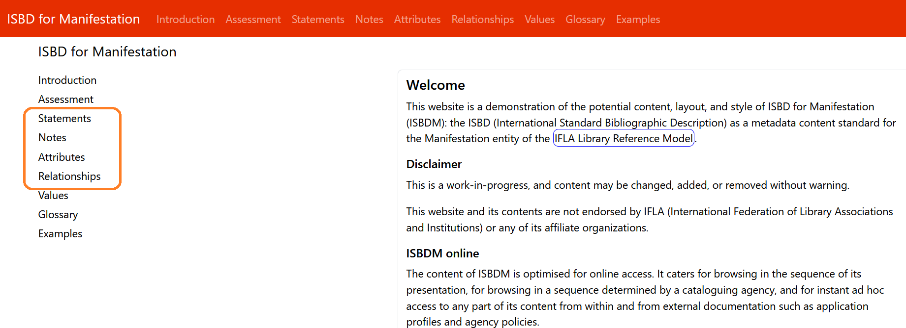
The Elements
IFLA Webinar
From ISBD to ISBDM
26 January 2023
Notes:
Following the Assessment section in the menu are the ISBDM elements. They have been categorized into the 4 distinct categories:
Statements (supporting the general ICP principle of "representation“)
Notes (these are quite familiar, not much has changed)
Attributes (mainly based on existing ISBD legacy elements, along with a comparison with RDA)
Relationships (these are brand new elements to ISBD)

Slide 10
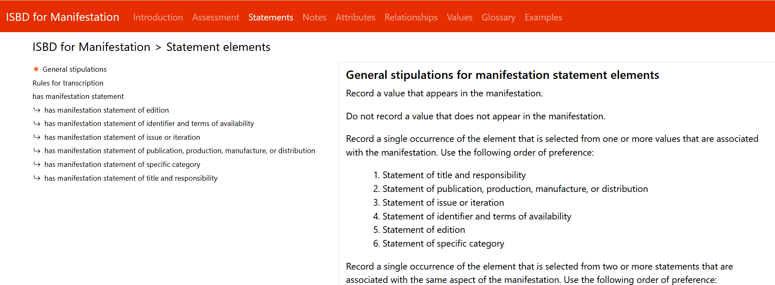
The Elements: General stipulations
IFLA Webinar
From ISBD to ISBDM
26 January 2023
Notes:
All elements start with a general stipulation section. These stipulations relate to all elements within the specific element category. Specific stipulations are then available for each sub-type element.

Slide 11
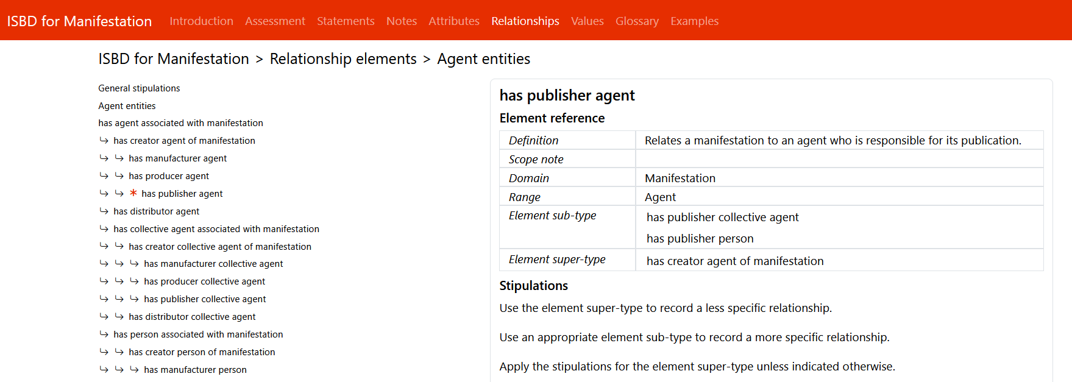
The Elements: Reference card
IFLA Webinar
From ISBD to ISBDM
26 January 2023
Notes:
All elements have a regular layout with element sub-types listed in the menu on the left hand side, and an element reference card on the right hand side.

Slide 12
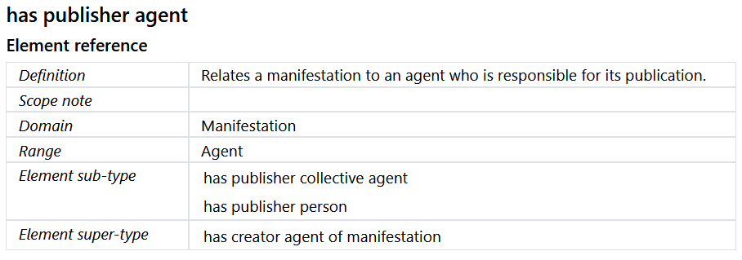
The Elements: Reference card
IFLA Webinar
From ISBD to ISBDM
26 January 2023
Notes:
The element reference card always has the same labels in the left hand side column:
Definition
Scope note
Domain
Range
Element sub-type
Element super-type

Slide 13
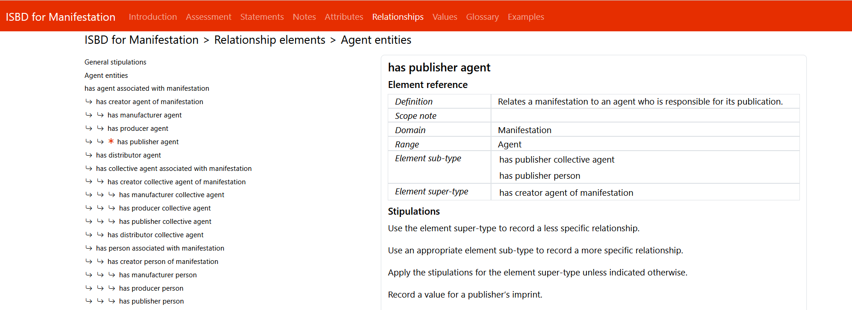
The Elements: Specific stipulations
IFLA Webinar
From ISBD to ISBDM
26 January 2023
Notes:
The element reference card is followed by additional information about how to apply the element and by specific Stipulations for sub-type elements.
If an element is a subtype element, there is a standard set of stipulations that always states to apply the general stipulations and to apply to the stipulations for the element super type unless they are overwritten by element sub-type specific stipulations.
This allows to avoid repetition of stipulations that apply to more than one element.

Slide 14
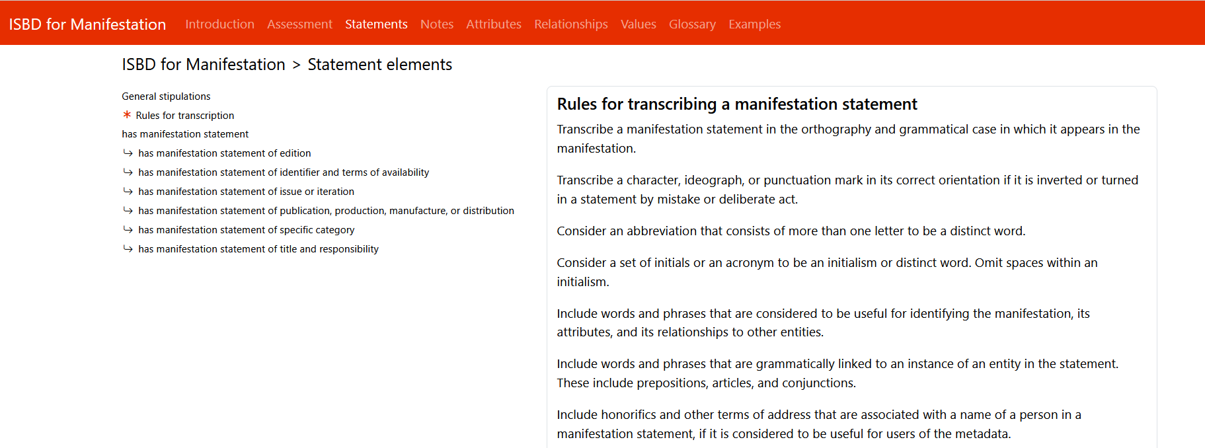
Statements: Values and transcription rules
IFLA Webinar
From ISBD to ISBDM
26 January 2023
Notes:
Statement elements are listed first in the menu. The value for statements is always a literal string. The value is transcribed and is uncontrolled, useful for keyword indexing. The source of information can only be the Manifestation itself due to the ICP principle “representation”.
Statement elements have a separate section on transcription rules in order to provide some normalization on how to get what is displayed on the manifestation into the metadata that you are creating.
This is still a work in progress, but the rules for transcription are so far based on the current ISBD rules, as well as RDA rules

Slide 15
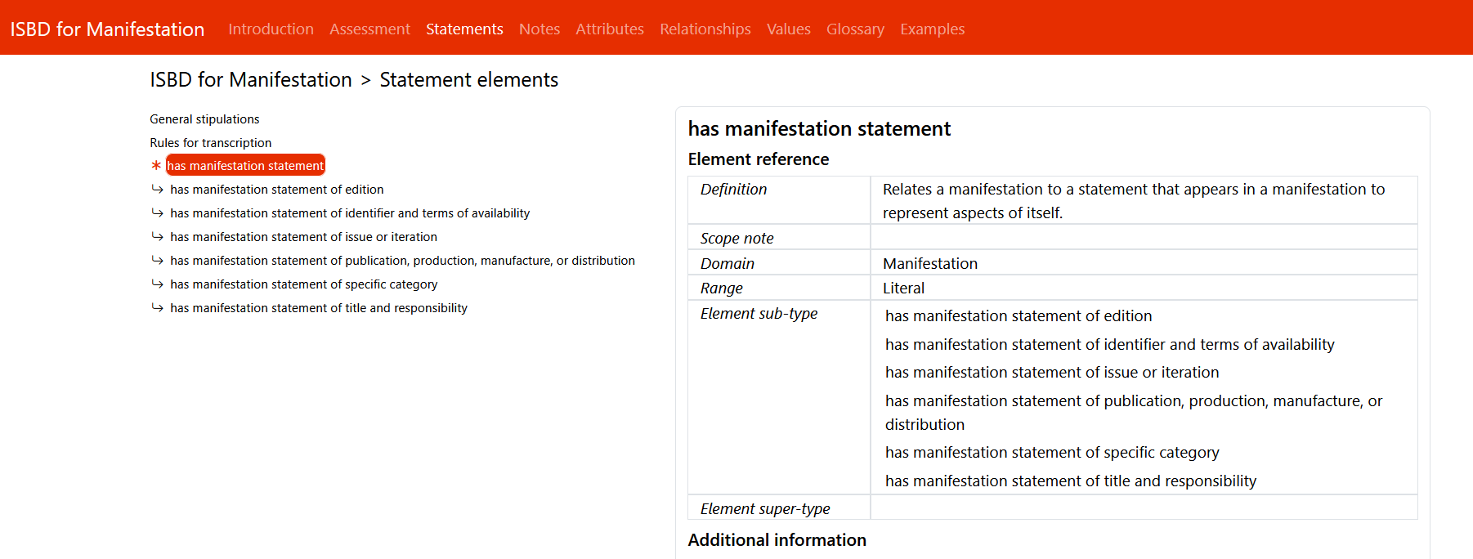
Statements: has manifestation statement
IFLA Webinar
From ISBD to ISBDM
26 January 2023
Notes:
The Manifestation statement is a super-type element and is intended to describe how the manifestation represents itself. It is pure ICP principle of “representation”.
Some of the element sub-types is where the old ISBD areas have evolved:
has manifestation statement of edition – old ISBD area 2
has manifestation statement of identifier and terms of availability – old ISBD area 8
has manifestation statement of issue or iteration – some of old ISBD area 6
has manifestation statement of publication, production, manufacture, or distribution – old ISBD area 4
has manifestation statement of specific category – some of old ISBD area 0 and 3
has manifestation statement of title and responsibility – old ISBD area 1
All statements contain uncontrolled values, that is, they are not controlled by the cataloguer, but by the publisher or the author of the manifestation. The principle of representation suggests that we should not change it, and that is why these are broader than before, because all you can do with the content other than display is keyword indexing.

Slide 16
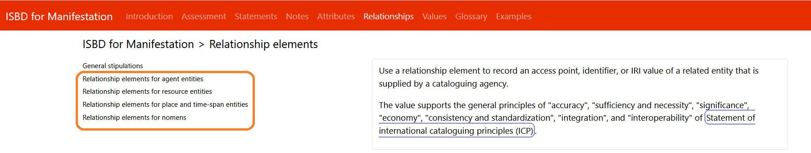
Relationships
IFLA Webinar
From ISBD to ISBDM
26 January 2023
Notes:
Relationships are new to the ISBD. They have element super- and sub-types for:
Agent entities
Resource entities (Work, Expression, and Item, and other related distinct Manifestations)
Place and time-span entities
Nomens (which according to LRM is “an association between an entity and a designation that refers to it” - name, title, access point, or identifier of an entity)

Slide 17
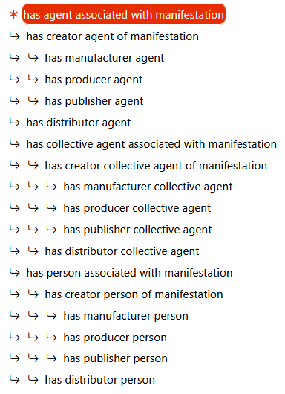
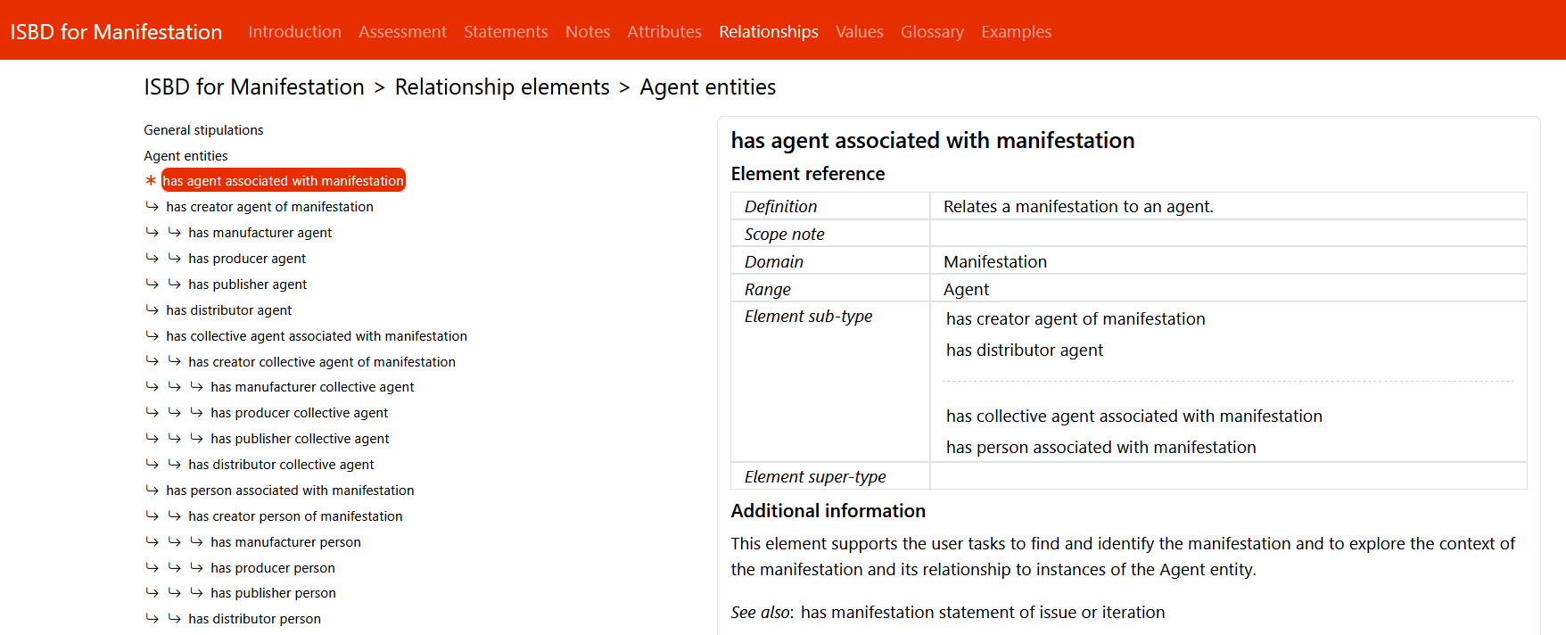
Relationship sub-types for the Agent entity
IFLA Webinar
From ISBD to ISBDM
26 January 2023
Notes:
Slide for reference

Slide 18
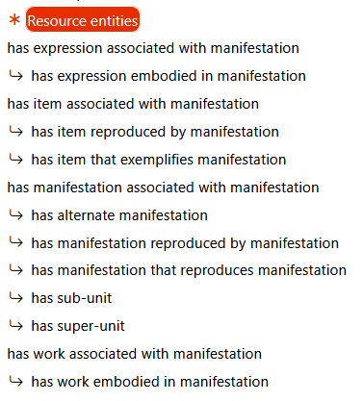
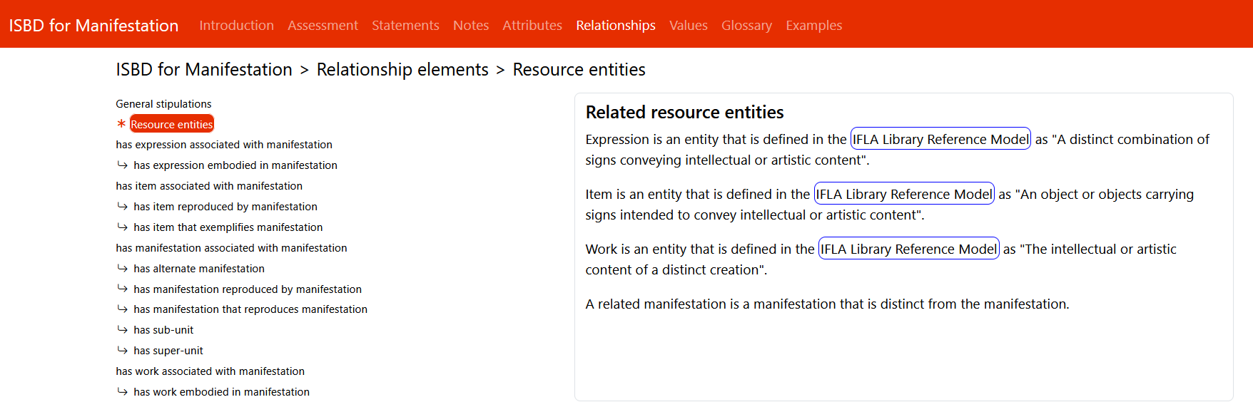
Relationship sub-types for Resource entities
IFLA Webinar
From ISBD to ISBDM
26 January 2023
Notes:
Slide for reference

Slide 19
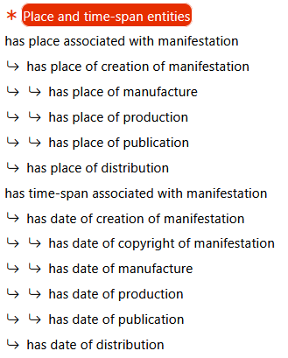
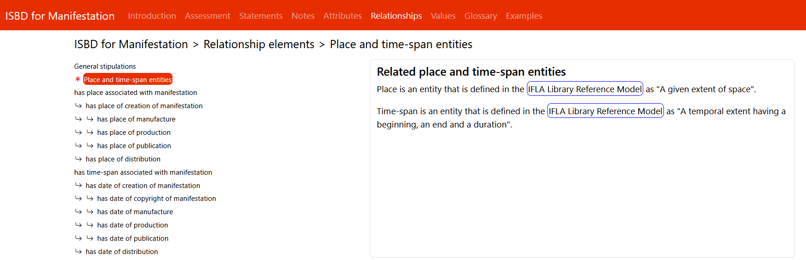
Relationship sub-types for Place and Time-span entities
IFLA Webinar
From ISBD to ISBDM
26 January 2023
Notes:
Slide for reference

Slide 20
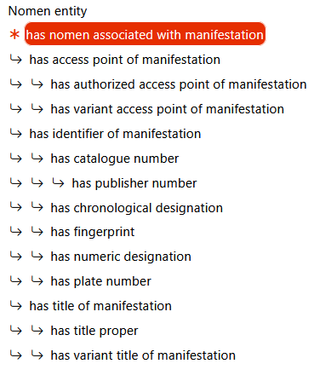
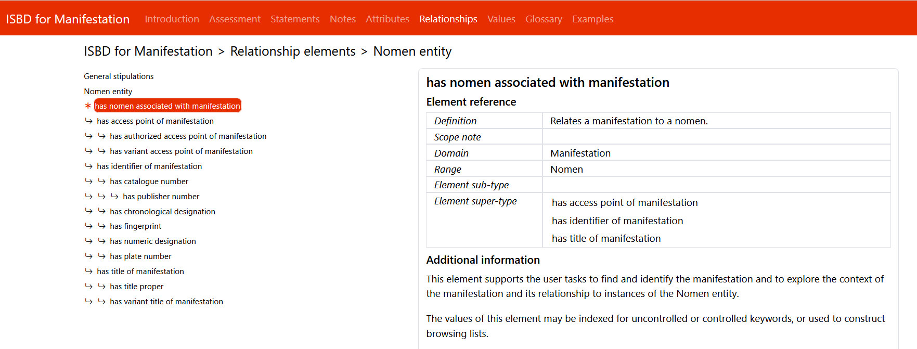
Relationship sub-types for the Nomen entity
IFLA Webinar
From ISBD to ISBDM
26 January 2023
Notes:
Slide for reference

Slide 21
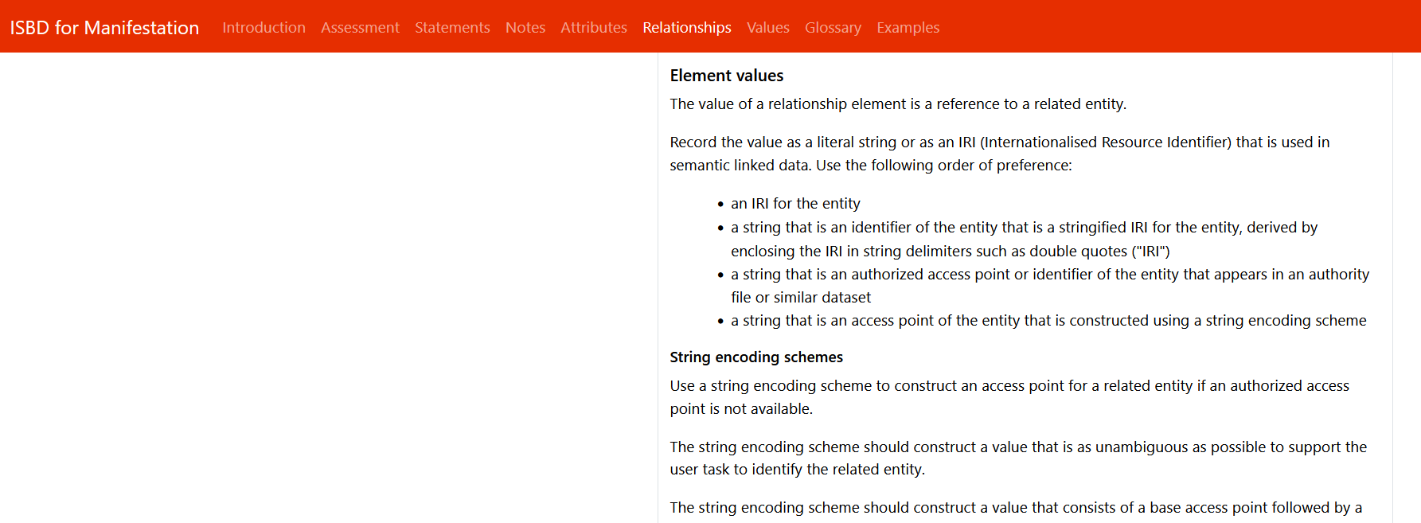
Relationships values
IFLA Webinar
From ISBD to ISBDM
26 January 2023
Notes:
Relationship elements are used to record values for an access point, identifier, or IRI of a related entity. These are controlled values that complement the uncontrolled values of the manifestation statement elements.

Slide 22
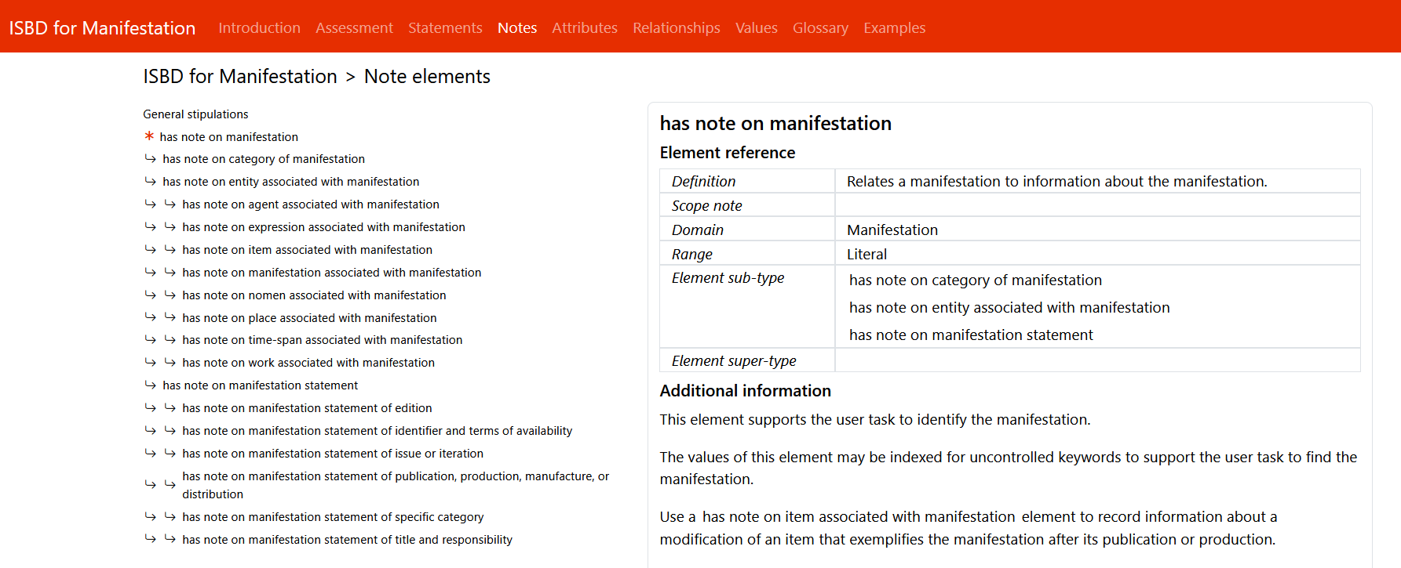
Notes
IFLA Webinar
From ISBD to ISBDM
26 January 2023
Notes:
Notes are familiar to the ISBD. There is a general super-type note element has note on manifestation which has sub-type notes for each manifestation statement sub-type element.
There is also has note on entity associated with manifestation, with sub-types for all LRM entities so that you can say something about all related entities even if you are not describing those entities.

Slide 23
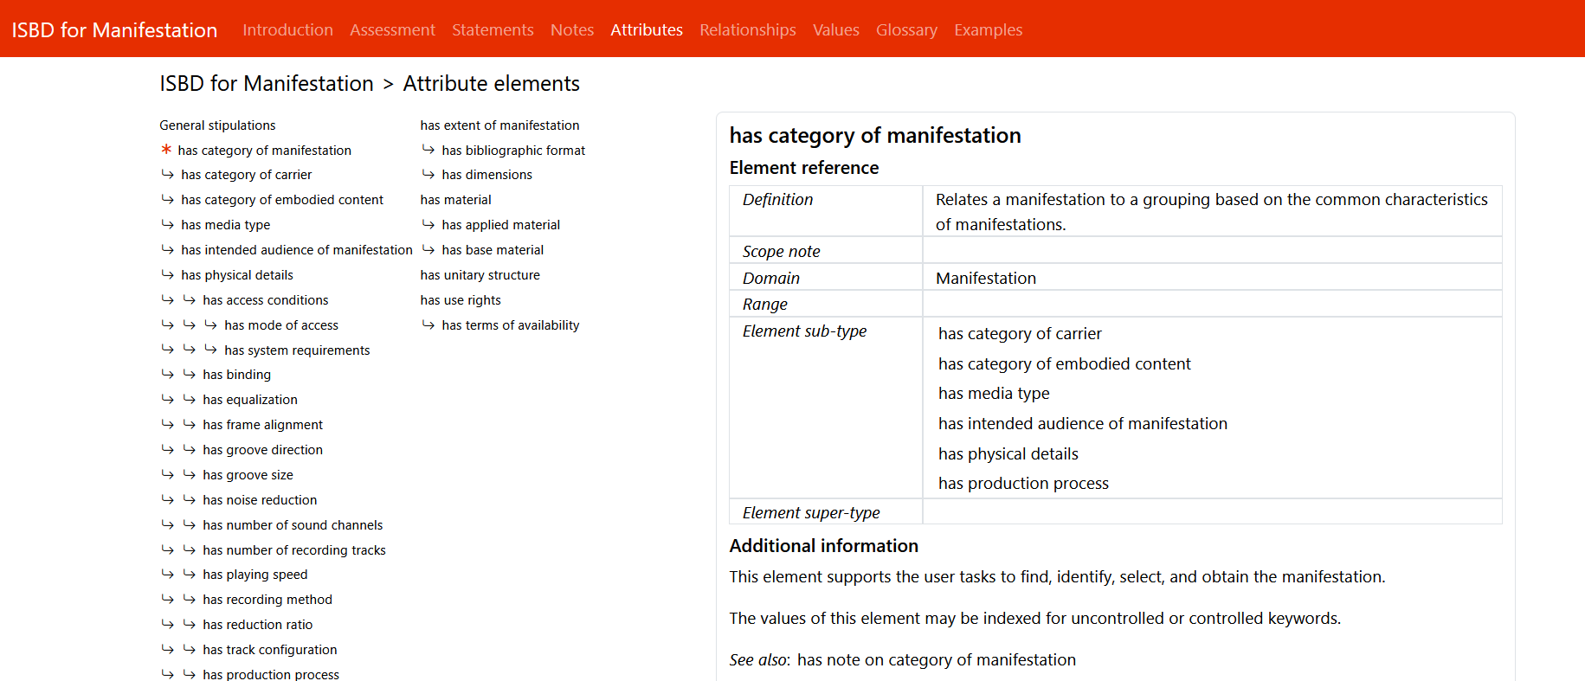
Attributes
IFLA Webinar
From ISBD to ISBDM
26 January 2023
Notes:
The attribute elements are mainly based on existing ISBD legacy elements, along with some RDA/Onix Framework.
An attribute element has a controlled or uncontrolled string value. Many of the attribute elements’ controlled values can be found in the ISBDM Values section.

Slide 24
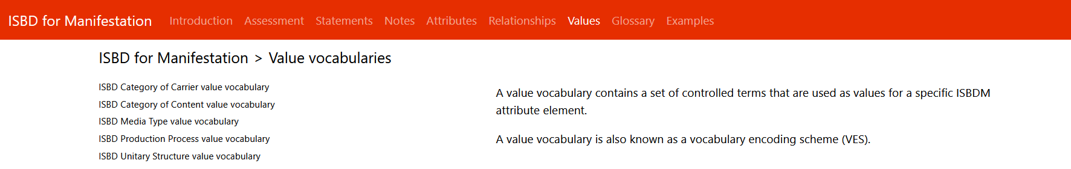
Values
IFLA Webinar
From ISBD to ISBDM
26 January 2023
Notes:
The Values section has a set of controlled terms that are used as values for a specific ISBDM attribute element. There are vocabularies for:
ISBD Category of Carrier value vocabulary (RDA Onix Framework)
ISBD Category of Content value vocabulary (RDA Onix Framework)
ISBD Media Type value vocabulary (RDA Onix Framework)
ISBD Production Process value vocabulary
ISBD Unitary Structure value vocabulary

Slide 25
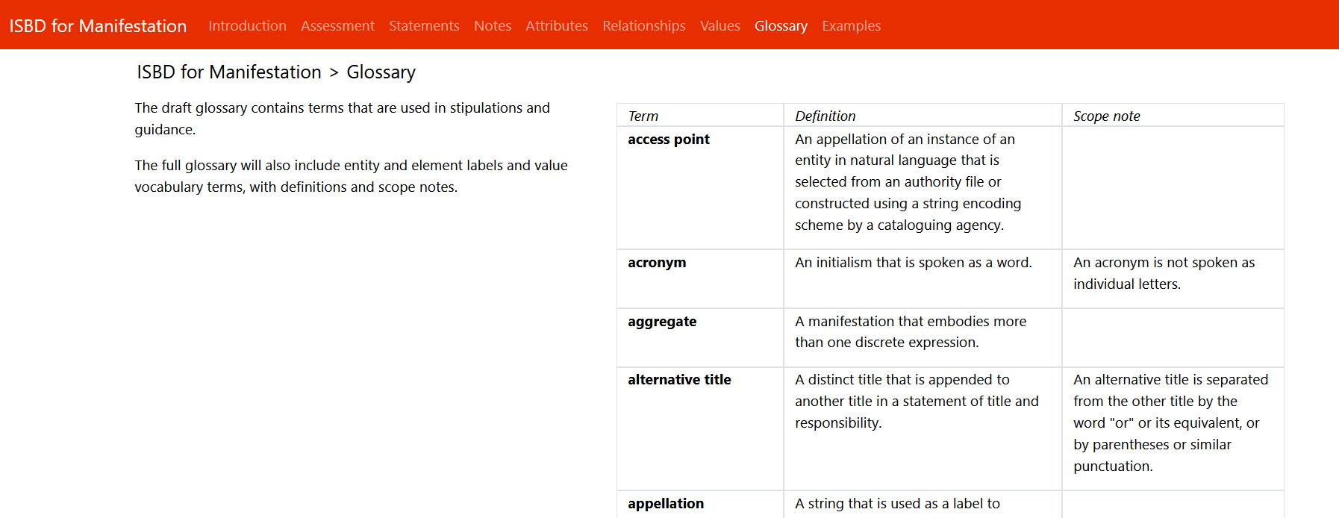
Glossary
IFLA Webinar
From ISBD to ISBDM
26 January 2023
Notes:
There is a Glossary which is a work in progress

Slide 26
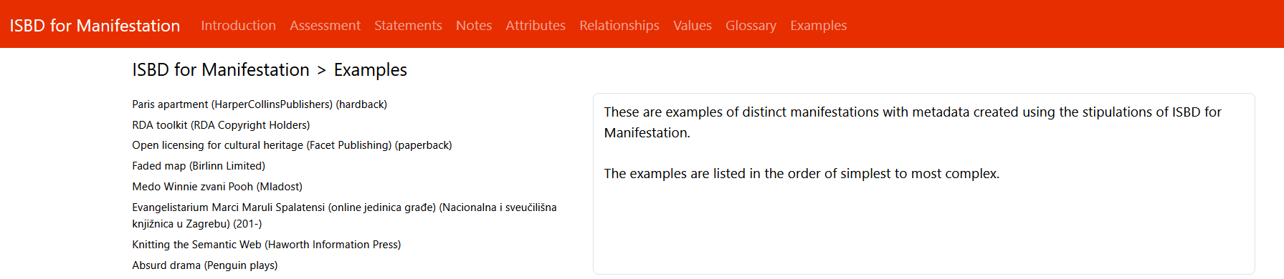
Examples
IFLA Webinar
From ISBD to ISBDM
26 January 2023
Notes:
Finaly there is an Examples section. The idea is that this section will contain full examples of ISBDM descriptions

Slide 27
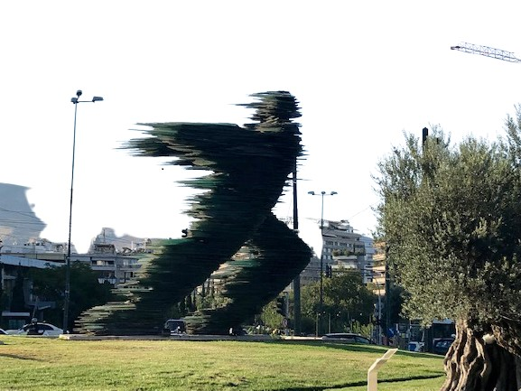
Thank you!
Mikael Wetterstrom
ISSN International Centre
mikael.wetterstrom@issn.org
"Dromeas" by Costas Varotsos , a blurred shape of a runner in motion.
Photo Mikael Wetterstrom
IFLA Webinar
From ISBD to ISBDM
26 January 2023

Slide 28
References
International Federation of Library Associations and
Institutions. 2017. Statement of International Cataloguing
Principles (ICP). 2016 Edition with minor revisions, 2017. https://www.ifla.org/wp-content/uploads/2019/05/assets/cataloguing/icp/icp_2016-en.pdf
Pat Riva, Patrick Le Boeuf, and Maja Žumer. 2017. IFLA Library
Reference Model, a Conceptual Model for Bibliographic
Information. https://repository.ifla.org/bitstream/123456789/40/1/ifla-lrm-august-2017_rev201712.pdf
IFLA Webinar
From ISBD to ISBDM
26 January 2023

