Slide 1


A Strong and Sustainable Library Field for Europe
IFLA HEADQUARTERS 2023
Brussels – 21-23 November 2023

Slide 2


Welcome back!

Slide 3

Share your experience!
Use #IFLAWorkshop
Tag @IFLA (Twitter) or @iflaglobal (Instagram)

Slide 4
Our Agenda (Day 2) - KBR
From priorities to plans
IFLA Strategy reminder
Evaluating and demonstrating value and impact
Library Map of the World – your advocacy tool
Introduction – why advocacy matters
Defining advocacy goals
Practicing advocacy skills
Dinner

Slide 5
A Challenge for Today…
If you haven’t spoken to the room yet, today is your chance!
… and a question
We would be keen to share e-mails – let us know if this is NOT OK with you!

Slide 6
From priorities to plans – defining impactful actions

Slide 7

DISCUSSION
Talk about your strategies

Slide 8
DISCUSSION: Talk about your strategies
What was the process for preparing it?
What did you think about when preparing it?
Does it define goals?

Slide 9
Defining impactful actions
Through your library sustainability indexes, you have an idea of where you may need to act in order to maximise library sustainability... now to define actions

Slide 10
Yesterday’s ideas (summarised)
Strong digital infrastructure
Community connection and public perceptions
Connection with policy-makers
Climate resilience
Strong, diverse and motivated workforce
Strong partnership base
Strategy, evaluation and leadership
Relevant and resilient collections
Accessibility to all
Healthy and open information environment
Strong democratic societies

Slide 11

How to define an effective action

Slide 12
Develop
Coordinate
Manage
Support
Upgrade
Create
Implement
Produce
Provide
Maintain
Oversee
Plan
Evaluate
Engage
…
S = Specific
What action will you take?
What are you trying to accomplish? Why?
Who needs to be involved?
Where and when does it need to happen?

Slide 13

M = Measurable
What does success of the action will look like?
What data and evidence will measure the goal?
How much? How well?

Slide 14

A = Achievable
Is it doable?
Do you have the necessary skills, resources and tools?
If not, how can you obtain them?
Do you have the motivation to achieve the goal?
Is the amount of effort required feasible with what the action will achieve?

Slide 15

R = Relevant
Who do you need to take this action now?
How does your action align with other things you do?
Why is result important for your community, library field?

Slide 16

T = Time-bound
What is the timeframe for accomplishing the goal of the action?
What are the deadlines and milestones?
Is it realistic?

Slide 17
SMART action – Example 1
Initial statement:
To produce a country profile for the Library Map of the World

Slide 18
SMART action – Example 1 – Specific
There is no information on the Library Map website about the library environment in my country. I will work together with partners and volunteers to prepare and submit the content by July 2024.

Slide 19
SMART action – Example 1 – Measurable
Creating content is time consuming, so I want to make sure the content is used. It’d like to have at least 500 visitors to our country profile within 12 months after its launch, to make sure that people are more aware about libraries in my country.

Slide 20
SMART action – Example 1 – Achievable
Compiling content requires human resources, time and English language skills. I will set up a team of volunteers and students and will manage them to achieve milestones; and I will keep everyone motivated.

Slide 21
SMART action – Example 1 – Relevant
The Library map is a hub of information about the library landscape in each country. It is important that my country is represented with up-to-date information, so that our achievements can be seen by stakeholders and inspire other librarians. This aligns with other actions we take to increase visibility of contribution of libraries to the sustainable development.

Slide 22
SMART action – Example 1 – Time-bound
In order to be able to submit the content by July 2024, I need to set up a team as soon as possible and hold regular meetings to track progress. In addition, to achieve at least 500 user sessions in one year after launch, we need to think about a communications plan over the year following the launch of the country profile.

Slide 23
Example 1 – SMART action
To make people more aware about our library field, we will produce the country profile containing comprehensive information. We will prepare content and make sure it is published by the end of 2024, and through communications, achieves 500 visits within a year.
What does success look like?
Country Profile published by the end of 2024
500 visits to our country profile by the end of 2025
People are more aware about the library field in my country

Slide 24
SMART action – Example 2
Initial statement:
To engage with government in preparation of my country’s Voluntary National Review

Slide 25






SMART action – Example 2
Initial statement:
To engage with government in preparation of my country’s Voluntary National Review

Slide 26
SMART action – Example 2 – Specific
The SDGs represent a commitment by governments to promote and report on policies which will favor stronger, fairer, more sustainable growth. We want to engage with government in the preparation of the Voluntary National Review; we want libraries to be mentioned in this report.
This should lead to better recognition of libraries as key partners in delivering development.

Slide 27
SMART action – Example 2 – Measurable
I want to get libraries mentioned in the VNR at least once in relation to the SDGs. I want my association/ library to be invited to at least one meeting, and follow-up online, leading to both opportunities to input into the creation of the official report and improve relationships with policy makers.

Slide 28
SMART action – Example 2 – Achievable
Governments have engaged to work with all stakeholders, including civil society, to deliver on the SDGs, and libraries are usually seen as friendly. We can use submissions to VNRs, meetings with officials, and cooperation with local UN offices to go further.

Slide 29
SMART action – Example 2 – Relevant
The SDGs as a whole are important because governments have committed to taking steps to deliver them, and to report on progress to their peers at the UN. Better recognition of libraries within this context could lead to libraries benefiting from new policies and laws in my country.

Slide 30
SMART action – Example 2 – Time-bound
We will need to act quickly to identify key contacts and opportunities by the end of the year, especially if we will undertake a VNR. We will respect the deadlines set by governments for contributions and consultation meetings in Q1 2024. We will be able to assess success once the report is published in July 2024.

Slide 31
Example 2 – SMART action
We will look to get libraries recognized as key partners in delivering the SDGs, in order to help secure the laws and funding our institutions need to serve our communities better. We will identify key opportunities and contacts for engagement, as part of the VNR process, using the opportunities this offers to highlight what libraries can contribute within the time frame set by the process. We will aim to get libraries’ role recognized in the official report and be invited to continue to deepen our relationship.
What does success look like?
At least one meeting held with officials
Formal contributions made to consultations
At least one significant reference to libraries in the official report
Greater recognition and support for libraries

Slide 32
SMART action – Example 3
Initial statement:
To provide advocacy training for librarians

Slide 33
SMART action – Example 3 – Specific
We need more and better library advocates in our country, but not every librarian has the skills or confidence to do this. Therefore, within the next 6 months, we will translate and adapt IFLA’s “10-Minute Library Advocate” series, will compile them into a training pack, and will pilot it through training of 30 members of our association. This should increase advocacy skills of librarians.

Slide 34
SMART action – Example 3 – Measurable
Translation and adaptation of IFLA’s materials will be time consuming, so we want to make sure that more librarians are aware that it is published and available to be downloaded and used for self-learning. We will make the 30 trainees into ambassadors for the material in order to promote it to a total of 300 other librarians and library workers, who will each download a copy for their own use during the first year after the training. This should lead to an overall increase in advocacy skills in the library community.

Slide 35
SMART action – Example 3 – Achievable
We would need about 3 months for translation and adaptation, and we can conduct the pilot training of selected librarians in another 3 months. We will engage with the library schools, both in order to accelerate translation (by students as an assignment of their English class), and teachers can be engaged in piloting the material with librarians.

Slide 36
SMART action – Example 3 – Relevant
Every librarian an advocate! It’s what we need to aim for. More and better advocates at all levels will help us to better demonstrate the value and contribution of libraries to our stakeholders.

Slide 37
SMART action – Example 3 – Time-bound
The timeframe of 6 months may sound ambitious, but we will be using “10-Minute Library Advocate” materials provided by IFLA. All we need to do is to translate and adapt it to the local context, e.g., adding local examples and resources. We will use time before the academic year to engage with the LIS school. After setting up a team, we will spend 3 months to translate/adapt the material and other 3 months to prepare for and deliver the pilot training.

Slide 38
Example 3 – SMART action
We need more and better library advocates in our country, but not every librarian has sufficient advocacy skills. Therefore, within 6 months, we will translate and adapt IFLA’s “10-Minute Library Advocate” series and pilot it by training of 30 members of our association. These trainees will act as ambassadors and spread the word about this training material for self-learning to other 300 librarians in our country, which should ultimately lead to increased advocacy skills.
What does success look like?
Translated and adapted advocacy training materials uploaded to our website by [month] 2024
300 downloads within the next year after publication on website
Increased advocacy skills among members of our association and other librarians

Slide 39

EXERCISE
Define an Impactful Collaborative Action

Slide 40
EXERCISE: Define an Impactful Collaborative Action
Individually – within a topic of advocacy or sustainability, reflect and identify one national action
At your table – within a topic of advocacy or sustainability, discuss and identify one collaborative strategic action.
What would be the action with the biggest impact and the least amount of effort?
What would be the target group and some milestones of your action?
Can you make it SMARTer?

Slide 41
Yesterday’s ideas (summarised)
Strong digital infrastructure
Community connection and public perceptions
Connection with policy-makers
Climate resilience
Strong, diverse and motivated workforce
Strong partnership base
Strategy, evaluation and leadership
Relevant and resilient collections
Accessibility to all
Healthy and open information environment
Strong democratic societies

Slide 42

Share your findings!
Photo: Matt Botsford on Unsplash, unsplash.com/photos/OKLqGsCT8qs

Slide 43
IFLA Strategy Reminder

Slide 44




IFLA Strategy 2019-2024

Slide 45
Vision
A strong and united library field powering literate, informed and participatory societies
Mission
To inspire, engage, enable and connect the global library field
IFLA Strategy 2019-2024

Slide 46
Strategic Directions 2019-2024
ONE
Strengthen the Global Voice of Libraries
TWO
Inspire and Enhance Professional Practice
THREE
Connect and Empower the Field
FOUR
Optimise our Organisation

Slide 47
The IFLA Strategy is designed to be…
A means of responding to the opportunities highlighted in the Global Vision
A reference point for all parts of IFLA in their work
A tool for our Members and beyond in their own strategy-building
A framework for building cooperation and realising synergies within the library field

Slide 50

The road to the IFLA Strategy 2024-2029

Slide 51

EXERCISE
Your experience of the IFLA Strategy 2019-2024

Slide 52
EXERCISE: Your experience of the 2019-24 Strategy
Say how far you agree with the following questions:
How far do you agree that IFLA’s Vision and Mission inspire/guide/inform you?
How far do you agree that IFLA’s Strategic Directions inspire/guide/inform you?
What changes would you suggest?

Slide 53
IFLA Strategy 2019-2024
Vision
A strong and united library field powering literate, informed and participatory societies
Mission
To inspire, engage, enable and connect the global library field
Strategic Directions
Strengthen the global voices of libraries
Inspire and enhance professional practice
Connect and enable the field
Optimise our organisation

Slide 55
IFLA Strategy 2024-2029
Look out for opportunities to engage!

Slide 56

Break
Photo by Mike Kenneally on Unsplash, unsplash.com/photos/TD4DBagg2wE

Slide 57
Evaluating and demonstrating value and impact

Slide 58
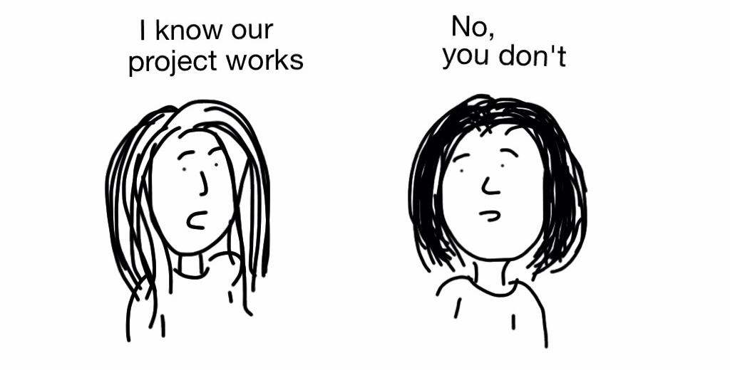
Measurement and Evaluation - Why

Slide 59

Understanding community needs and designing
services for impact
Foto: bit.ly/3Ds082o

Slide 60

Ensuring that stakeholders understand our value and impact
Photo: bit.ly/3oeWjth

Slide 61
QUESTION
What are some of the main challenges for you when it comes to demonstrating value and impact?
Go to www.menti.com and use the code 4101 6690

Slide 62

Measuring and Demonstrating Impact – Challenges and Solutions
Photo: bit.ly/3lygq3F

Slide 63
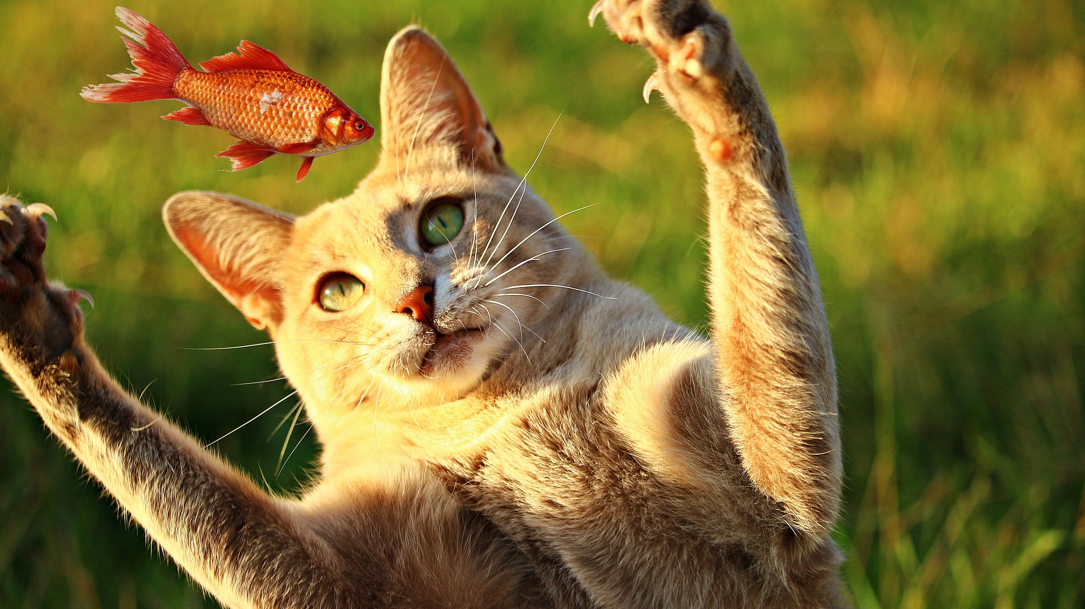
Knowing your target and setting meaningful measures
Photo: bit.ly/2YFFBbp

Slide 64

Understanding stakeholders, their goals, objectives and values
Photo: bit.ly/3FE69Lu

Slide 65

Defining targeted outcomes and impact into the design
Photo: bit.ly/3mLaLGR

Slide 66











Defining targeted outcomes and impact into the design
Photo: bit.ly/3mLaLGR

Slide 67

















Defining targeted outcomes and impact into the design
Photo: bit.ly/3mLaLGR

Slide 68
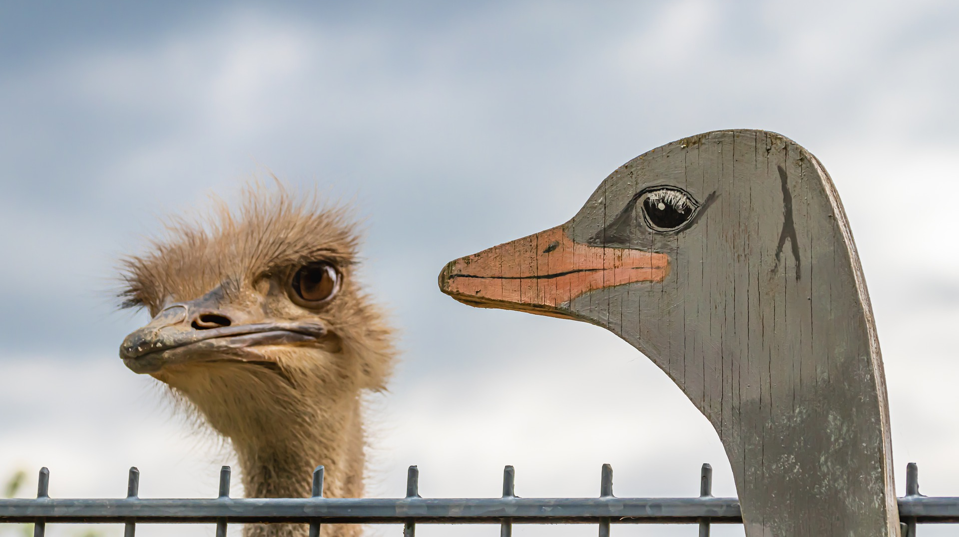
Confusing performance and satisfaction measures with outcome and impact measures
Photo: bit.ly/3v4BJwK

Slide 69
Shortly about measures
Community & Needs data
Outputs & Performance data
Satisfaction data
Outcomes data
Why?
How much?
How effective?
How well?
What’s the benefit?
So what?
Community and target group needs
Library activities, projects, programmes
Satisfaction of users and participants
Outcomes for people and impact on community

Slide 70
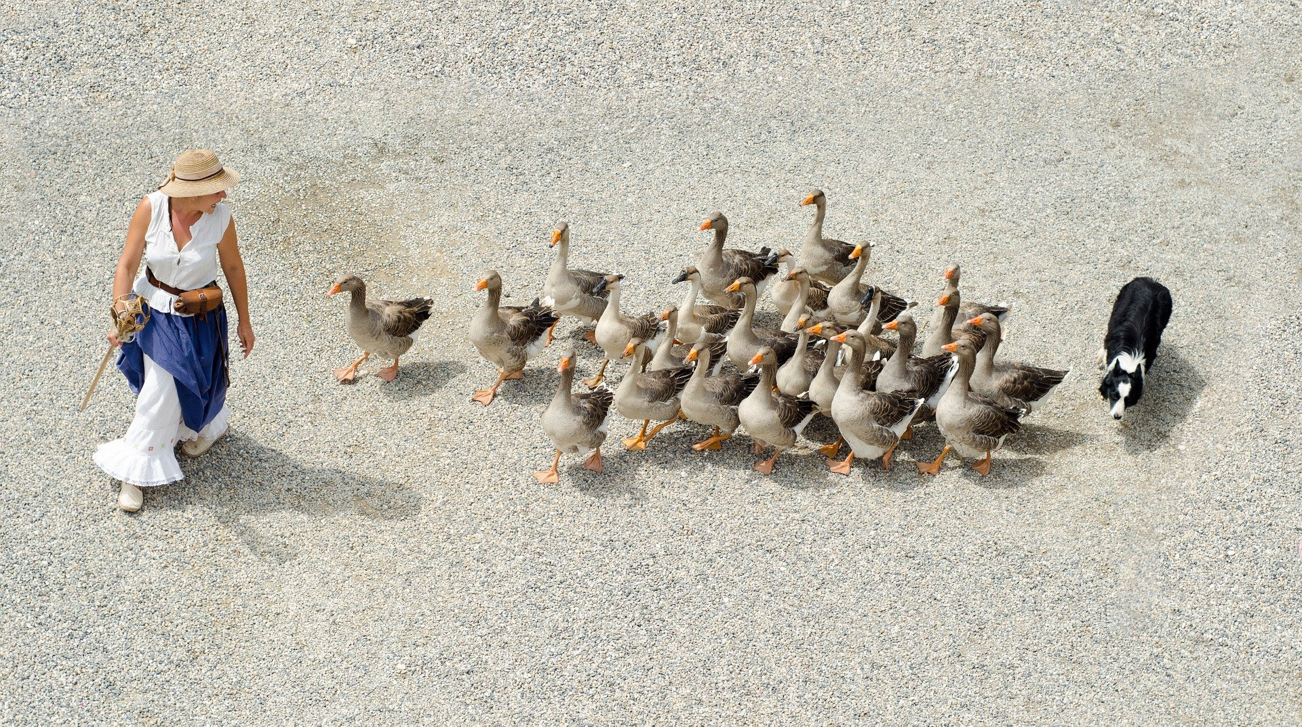
Having a role responsible for managing library’s measures
Photo: bit.ly/3v4Yd0D

Slide 71

Positioning our actions for impact – How?
Photo: bit.ly/3lV3Qu6

Slide 72













Inputs
Outputs
Outcomes
Impact
Photo: bit.ly/3AsNVIU

Slide 73
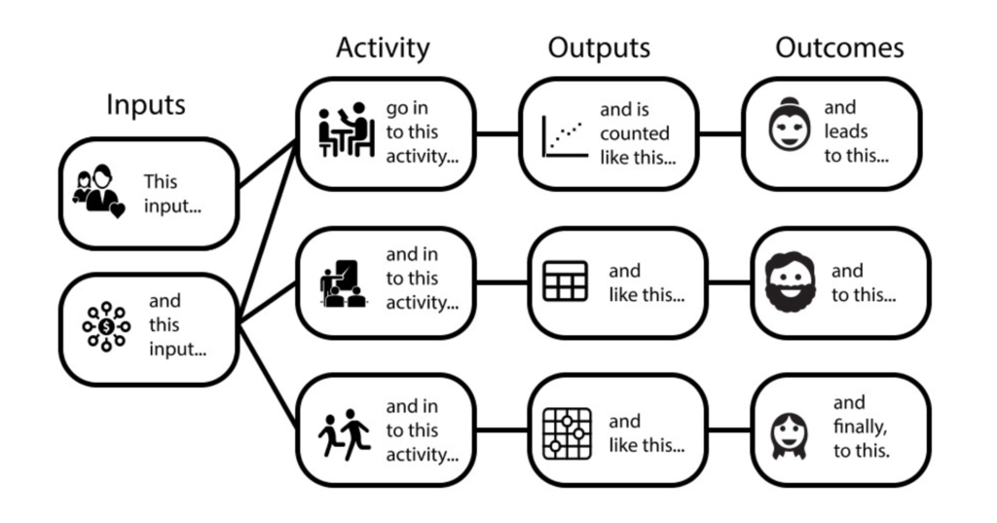
Logic Model
https://freshspectrum.com/charts-and-illustration/

Slide 74
Needs
Inputs
Activities
Outputs
Outcomes
Impact
Photo: bit.ly/3AsNVIU

Slide 75
Impact
Outcomes
Outputs
Activities
Inputs
Conditions/Needs
Community-centred
Logic Model
Aligning activities to meet community needs

Slide 76
Impact (What changes in community do you expect to occur?)
Outcomes (What changes in conditions do you expect to see?)
Outputs (What direct results of your actions do you expect?)
Activities (What activities will you implement to address the needs?)
Inputs (What resources will you use to address the needs?)
Conditions/Needs (What challenge you will contribute to? What are the target group needs?)
Community-centred
Logic Model
Aligning activities to meet community needs

Slide 77
Conditions Needs
Inputs Resources
Activities
Outputs
Outcomes
Impact
There is a challenge or a problem in community, which library can help addressing through a programme that meets the needs
Certain resources are needed to operate your programme
If you have access to them, then you can use them to accomplish your planned activities
If you accomplish your planned activities, then you will hopefully deliver the amount of product and/or service that you intended
If you accomplish your planned activities, to the extent you intended, then your participants will benefit in certain ways
If these benefits to participants are achieved, then certain changes in organisations, communities, or systems might be expected to occur

Slide 78
Needs
Inputs
Activities
Outputs
Outcomes
Impact
Photo: bit.ly/3AsNVIU

Slide 79
























Impact
Needs
Outcomes
Inputs
Outputs
Activities
Photo: bit.ly/3AsNVIU

Slide 80









1 = Stakeholder perspective
2 = People perspective
3 = Library perspective
Impact
Needs
Outcomes
Inputs
Outputs
Activities
Photo: bit.ly/3AsNVIU

Slide 81
1 = Stakeholder perspective
2 = People perspective
3 = Library perspective
Reduced unemployment rates
Employment
People who improved skills, found job
Resources: Staff, equipment, money
Number of trained people
Job skills training
Photo: bit.ly/3AsNVIU

Slide 82
1 = Stakeholder perspective
2 = People perspective
3 = Library perspective
Improved recycling rates
Contamination on the beach
People who see benefit in recycling
Resources: staff, time, money
Number of trained people; kg of trash removed
Training to recycle; Event on the beach
Photo: bit.ly/3AsNVIU

Slide 83
1 = Stakeholder perspective
2 = People perspective
3 = Library perspective
Enabled youth development; Bridging digital gap
Lack of ICT in schools; Failed exams
Improved skills; Enhanced learning; Improved exams
Mobile library van; Equipment; Digital content; Staff
Number of visits; Number of trained
Visits to schools; Hands-on training
Photo: bit.ly/3AsNVIU

Slide 84
Ensuring that stakeholders understand our value and impact
Photo: bit.ly/3oeWjth

Slide 85
Outcomes. Impact. Change.

Slide 86

Impact (What changes in community do you expect to occur?)
Outcomes (What changes in conditions do you expect to see?)
Outputs (What direct results of your actions do you expect?)
Activities (What activities will you implement to address the needs?)
Inputs (What resources will you use to address the needs?)
Conditions/Needs (What challenge you will contribute to? What are the target group needs?)
Community-centred
Logic Model
Aligning activities to meet community needs

Slide 87

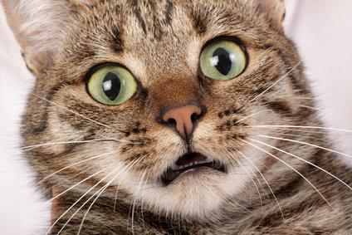
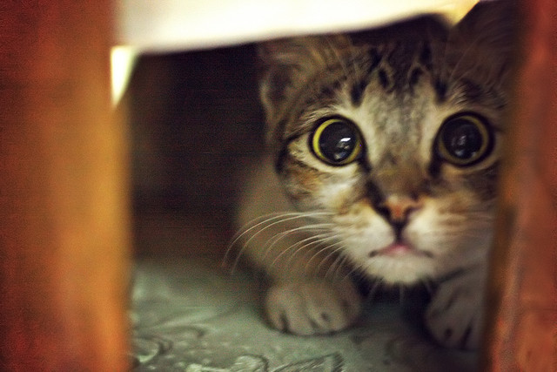
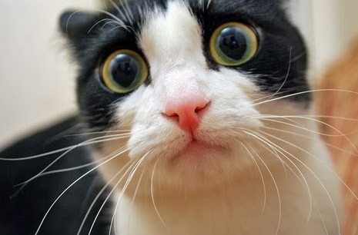
Impact Evaluation
Will I be evaluated?!
What is going to happen now?
Maybe next year…?
Maybe they will forget about me?

Slide 88
Impact is about change and outcomes for people
https://freshspectrum.com/charts-and-illustration/

Slide 89
What is an Outcome?
The way a thing turns out
https://en.oxforddictionaries.com

Slide 90
Outcomes for people
An outcome is a specific benefit that results from a library program or service designed to help patrons change their awareness, knowledge, skills, attitudes, or behavior.
Outcomes are expressed as changes individuals perceive in themselves.
Outcomes can be quantitative or qualitative.
Needs
Inputs
Activities
Outputs
Outcomes
Impact

Slide 91
How does change occur?
Changes in conditions
Impact
Behavior
Attitudes
Skills
Knowledge
Awareness
Time

Slide 92
Example – Training on smartphone use
I feel connected, less isolated
Impact
I use s-phone every day
I think s-phone is useful for me
I know how to use s-phone
I know more about s-phone
I am aware smartphones exist
Time

Slide 93
Impact Planning
Impact objectives
Outcome indicators
Data and evidence

Slide 94
Impact Objectives (Outcomes)
Clear and achievable within a specific time span
Realistic, taking into account your resources
Carefully worded

Slide 95
How to write good outcomes (impact objectives)?
Verb indicating change
What will change
Who will change
Additional specificity
Examples:
To increase
To establish
To reduce
To create
To improve
To produce
To change
Examples:
Access
Availability
Awareness
Knowledge
Skills
Attitudes
Behaviors
Examples:
Children
Young women
Seniors
School dropouts
Illiterate adults
Local farmers
Teachers
Where you expect to see this change? geography)
By when you expect to see the change? (date)
How much change you intend to see? (target)

Slide 96
Outcome Indicators (Measures)
An outcome indicator is a specific, observable, and measurable characteristic that will represent achievement of the outcome.
It is important to think through indicators that can tell you both:
Whether the outcome has occurred
And by how much

Slide 97
Example
Activity: Reading promotion programme
Impact Objective: To improve reading skills and habits among children in [geography] by [year]
Outcome: Improved reading skills and habits among children
Outcome Indicators:
Number of books children read during certain period of time
Percentage of children with good reading skills
Change in children’s attitude towards reading

Slide 98
EXERCISE
Define Outcomes (Impact Objectives) of Your Collaborative Action

Slide 99
EXERCISE: Define Outcomes (Impact Objectives) of Your Collaborative Action
At your table – discuss and identify outcomes (impact objectives) of your collaborative action.
What would be some of the outcomes (impact objectives) of your action?
How would you evaluate the impact of your action?

Slide 100
Share your findings!
Photo: Matt Botsford on Unsplash, unsplash.com/photos/OKLqGsCT8qs

Slide 101
Library Map of the World –
your advocacy tool

Slide 102


Library Map of the World
librarymap.ifla.org
Data
Country Profiles
SDG stories

Slide 103
Library Map of the World
Let’s talk about
Library Map – why and how
Contributors
Library data
Country profiles
SDG stories
Resources

Slide 104
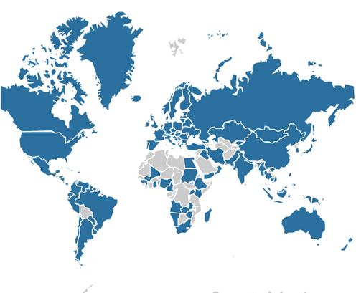
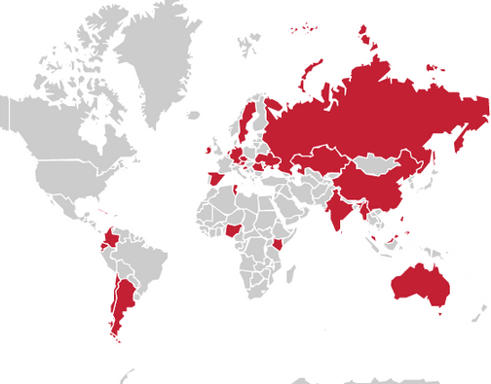
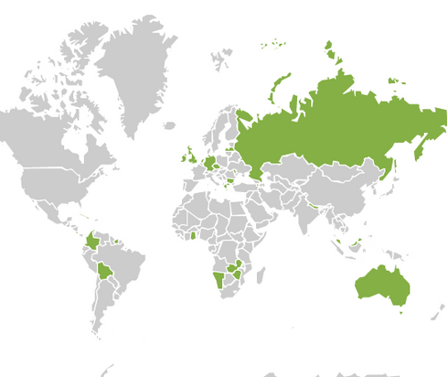
Library Map of the World Contents
Library Statistics
SDG Stories
Country Profiles
141
58
30
countries
stories
countries

Slide 105
Library Map of the World Contents – Europe
Library Statistics
SDG Stories
Country Profiles
45
22
14
countries
stories
countries

Slide 106



Main contributors
Main contributor – an organisation (national library association, national library or other institution) which committed to contributing data and/or country profile.
Take responsibility for collaboration with local partners and stakeholders in their country during data gathering and preparation of content for their country profile,
Act as key contact for the Library Map team during data and content submission and curation.
El Mapa Mundial de Bibliotecas | 2023

Slide 107
Our main contributors

Slide 108
Our main contributors – Europe

Slide 109
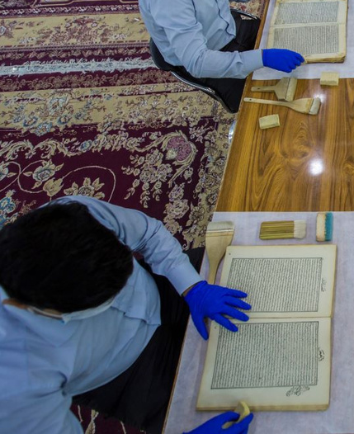




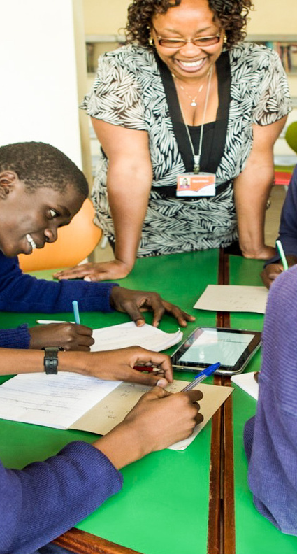


SDG Story contributors –
Each individual library or an organisation which submitted information for an SDG story and worked with the Library Map team during its curation.

Slide 110

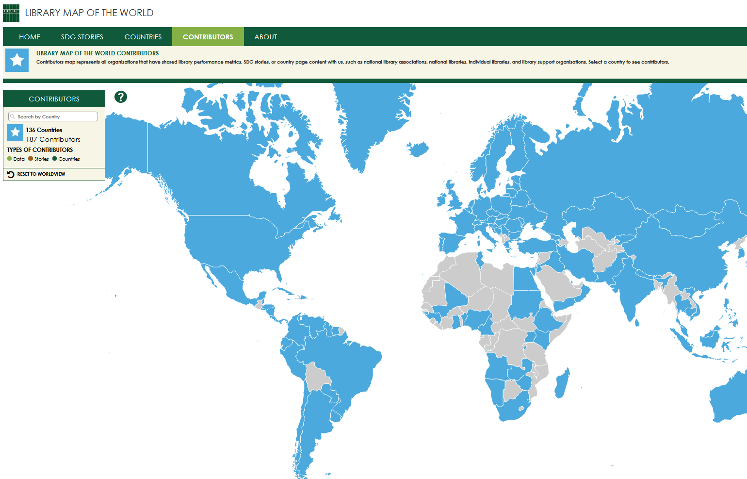


Find contributors on the Map
Contributors with published content (data, country profiles, stories) are listed by country on the Contributors page of the Library Map of the World website.
Search by country or click on the Map to find out who are contributors
from your country!

Slide 111
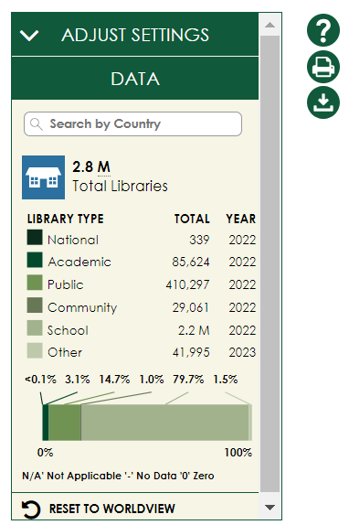
librarymap.ifla.org
A source of country-level library statistics covering all library types

Slide 112
Library data
Country-level library statistics
Updated throughout the year in collaboration with main contributors
Eight basic performance metrics –
Number of libraries
Libraries with Internet access
Staff and volunteers
Registered users and physical visits
Physical and electronic loans
All library types –
National libraries
Academic libraries
Public libraries
Community libraries
School libraries
Other libraries

Slide 113
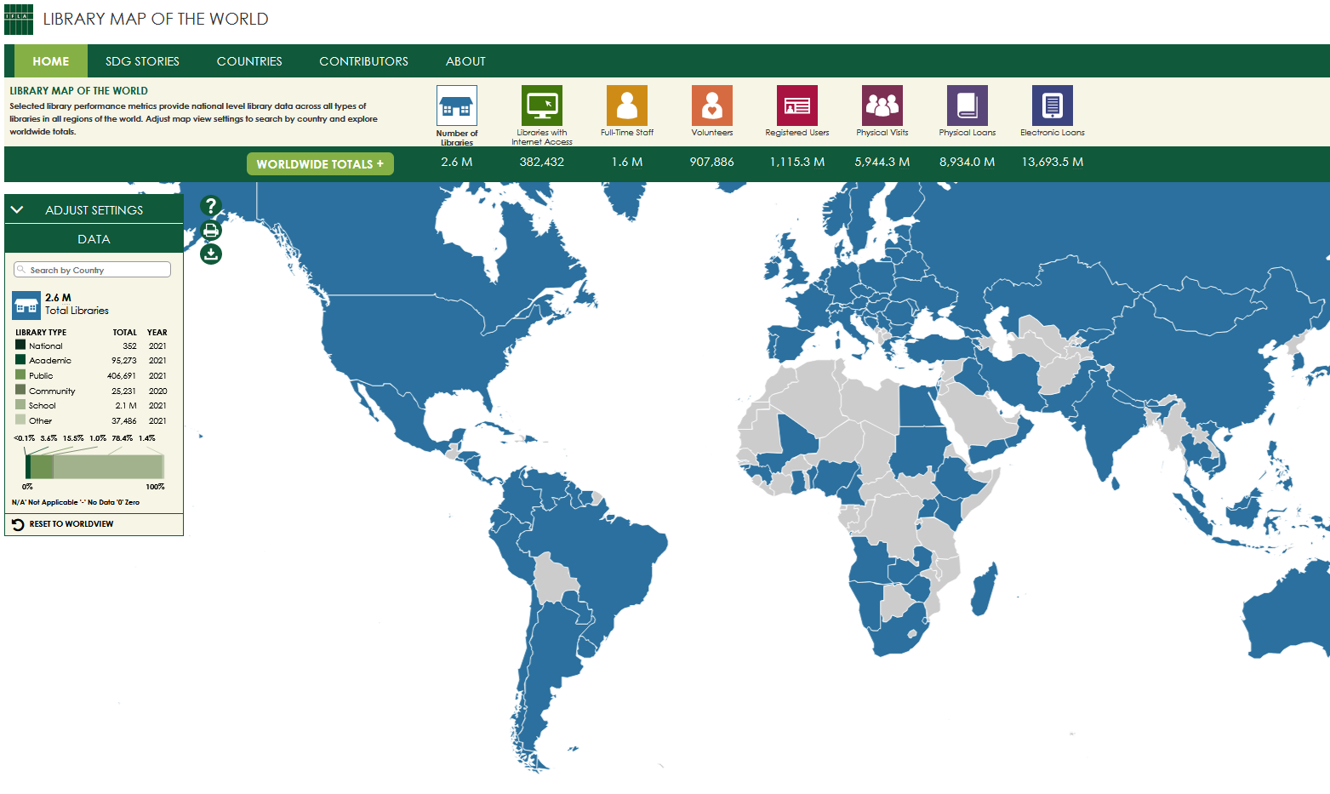

Find data on the
Home page of the Map
Search by country or click on the Map to see your country’s data
Explore worldwide and regional totals
Download the full dataset in csv and make your own data analysis

Slide 114
Countries with published data – Europe (45)

Slide 115
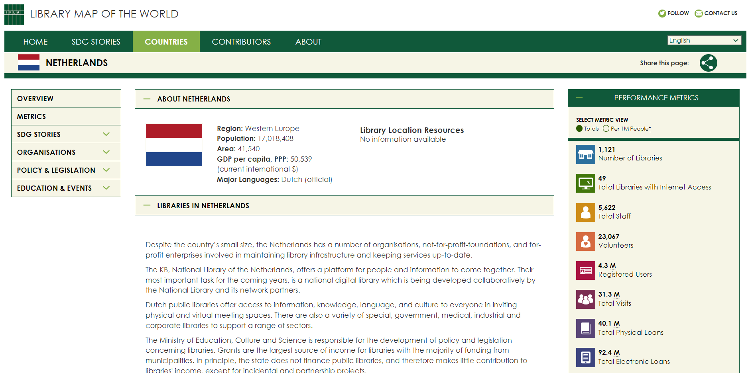
librarymap.ifla.org/countries
A source of information about the library environment, organisations and institutions, policy and legislation, education, and events in each country

Slide 116
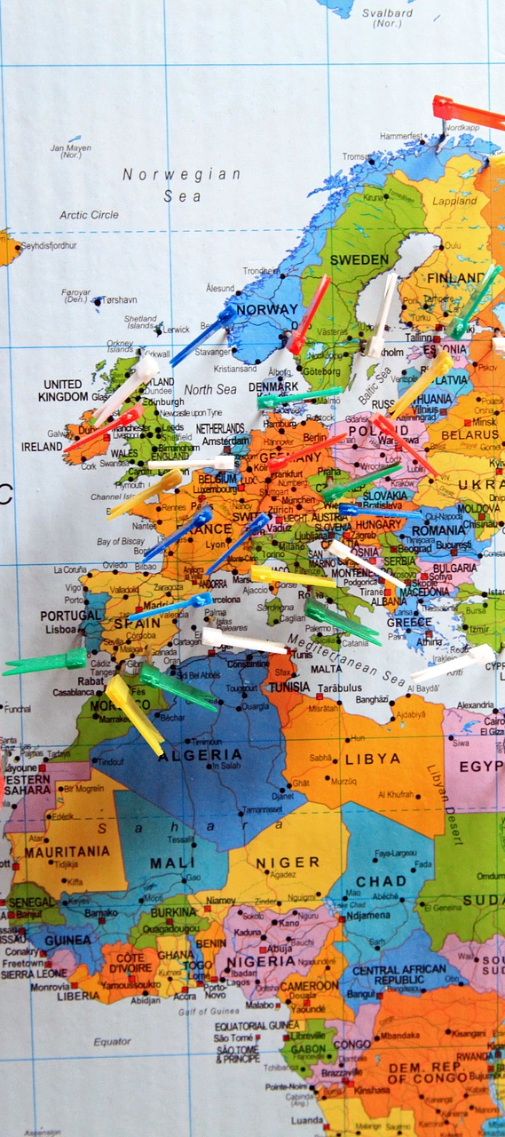

Country profiles (1)
Overview of the library environment – library system, facts and features of different library types, governance and funding models, development and policy priorities, role of library association, recent achievements in the library field.
Links to library location resources – maps maintained by other organisations containing individual library location data
Aggregated view of performance metrics and contextual indicators , including data on population and geography, information and infrastructure, poverty and employment, education and literacy, innovation and skills

Slide 117
Country profiles (2)
Information about organisations – national library associations, national libraries, policy making institutions, library support organisations
Links to national policy documents and legislation such as library law, legal deposit law, copyright and library exceptions
Information about education and events – professional qualification requirements, librarians’ education, links to professional publications and events
Links to country’s SDG stories

Slide 118
Country profiles – Europe
(14 countries)
Armenia
Bulgaria
Cyprus
Czechia
Germany
Greece
Ireland
Israel
Latvia
Luxembourg
Netherlands
Republic of Moldova
Russian Federation
United Kingdom

Slide 119
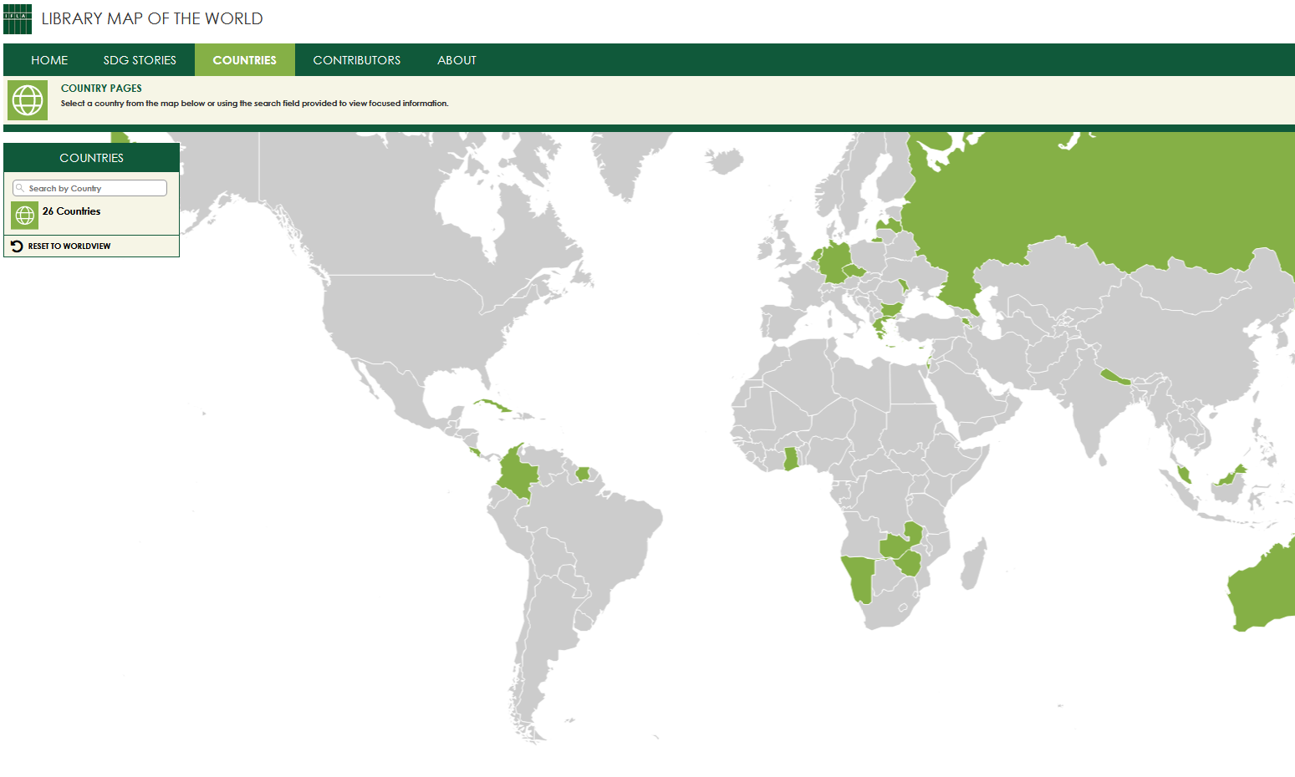
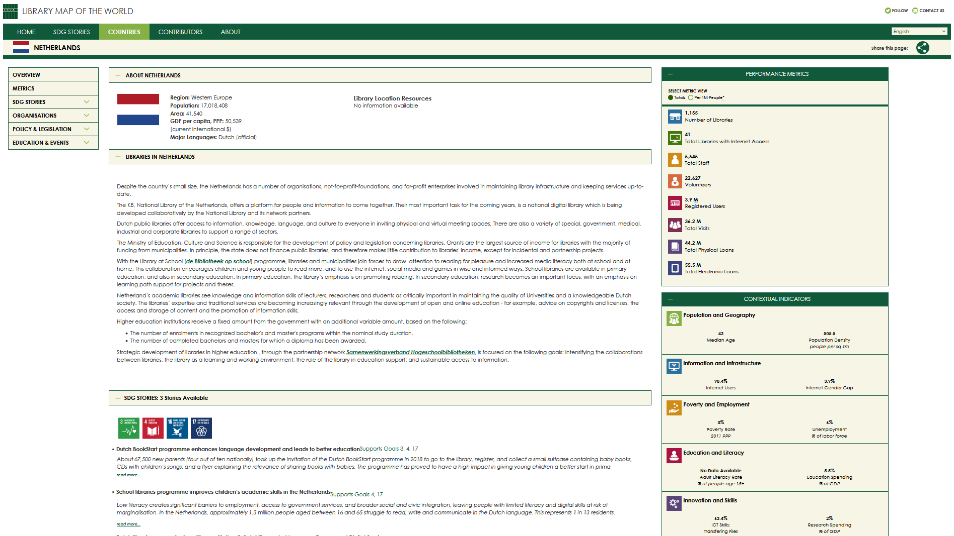
Explore Countries tab
of the Map
Search by country or click on the Map to access country profiles

Slide 120


















librarymap.ifla.org/stories
a collection of inspiring stories about impactful library programmes contributing to achievement of the UN Sustainable Development Goals

Slide 121
Ensuring that stakeholders understand our value and impact
Photo: bit.ly/3oeWjth

Slide 122



Slide 123
SDG Stories – Europe
(22 stories)
Austria
Croatia
Czechia
Germany
Ireland
Netherlands
Republic of Moldova
Romania
Russian Federation
Spain
Sweden
Türkiye
Ukraine

Slide 124
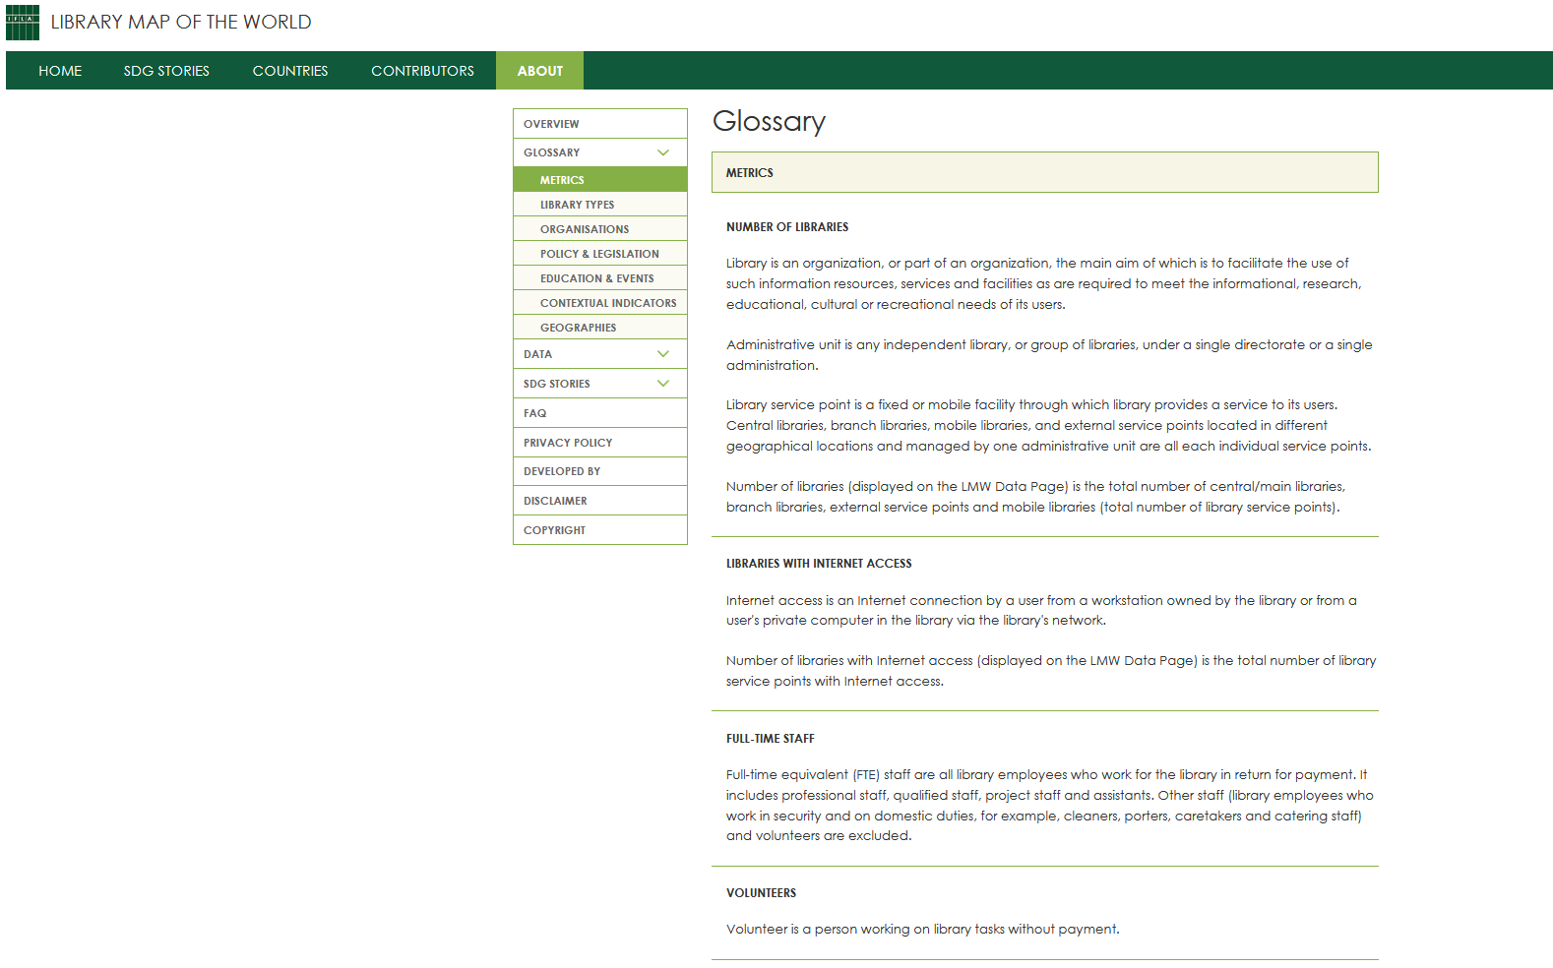
Explore the About page
of the Map
Definitions of data metrics, library types, and items on country profiles
Explainers and guides for data contributors
Instructions for country profile contributors
Resources for SDG storytelling

Slide 125
Power your advocacy with the Library Map!
Library Statistics
SDG Stories
Country Profiles
141
58
30
countries
stories
countries

Slide 126
Library Map data allowing for comparisons
Table 4: Public/Community Library Workers per Institution
 | Low | Average | High
Asia-Oceania | 0.06 | 0.80 | 21.10
Europe | 0.58 | 2.25 | 7.00
LAC | 0.13 | 2.32 | 37.00
MENA | 2.15 | 2.86 | 6.23
North America | 0.59 | 6.88 | 8.13
Sub-Saharan Africa | 1.08 | 1.61 | 8.79
World | 0.06 | 1.77 | 37.00

Slide 127
Library Map data allowing for comparisons
Researchers per Academic Librarian
 | High | Average | Low
Asia-Oceania | 1.235892 | 25.42 | 225.384
Europe | 3.186695 | 26.69 | 354.48
LAC | 0.603956 | 3.70 | 18.58196
MENA | 6.382644 | 19.08 | 21.58446
North America | 18.7384 | 18.98 | 21.5544
Sub-Saharan Africa | 5.695613 | 13.08 | 43.85543
World | 0.603956 | 22.42 | 354.48

Slide 128
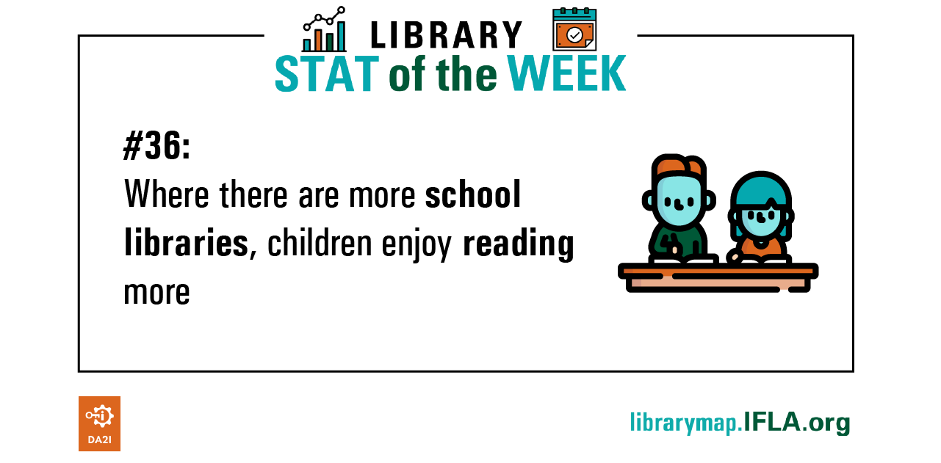
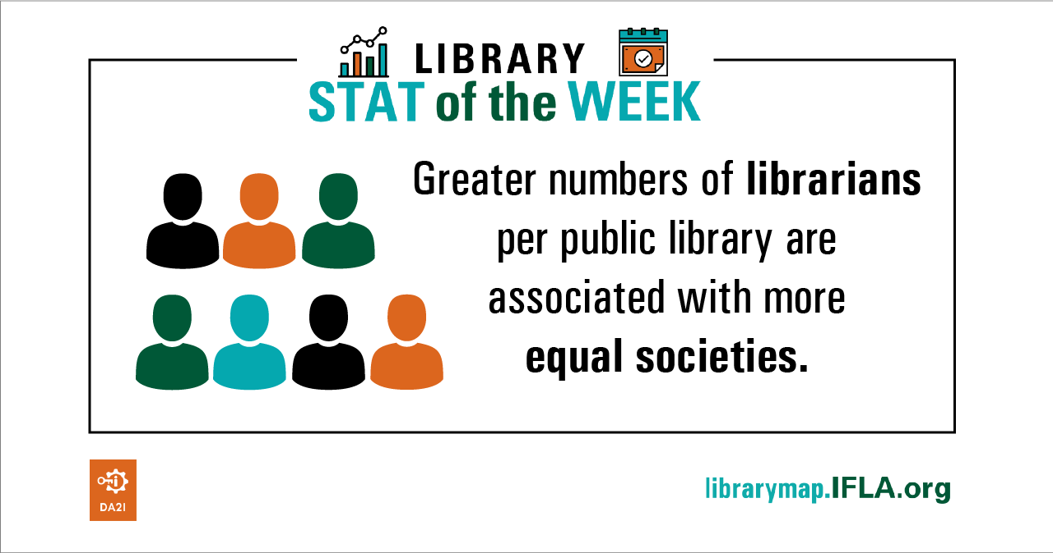

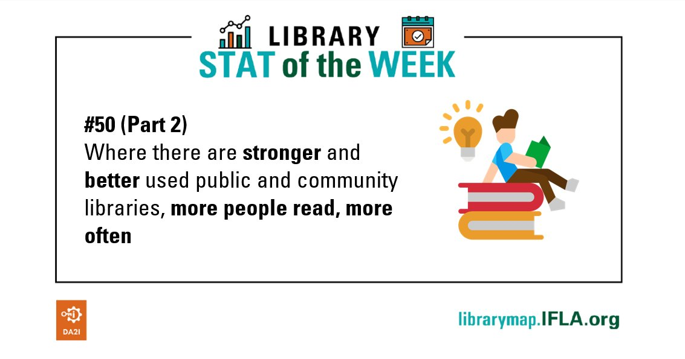
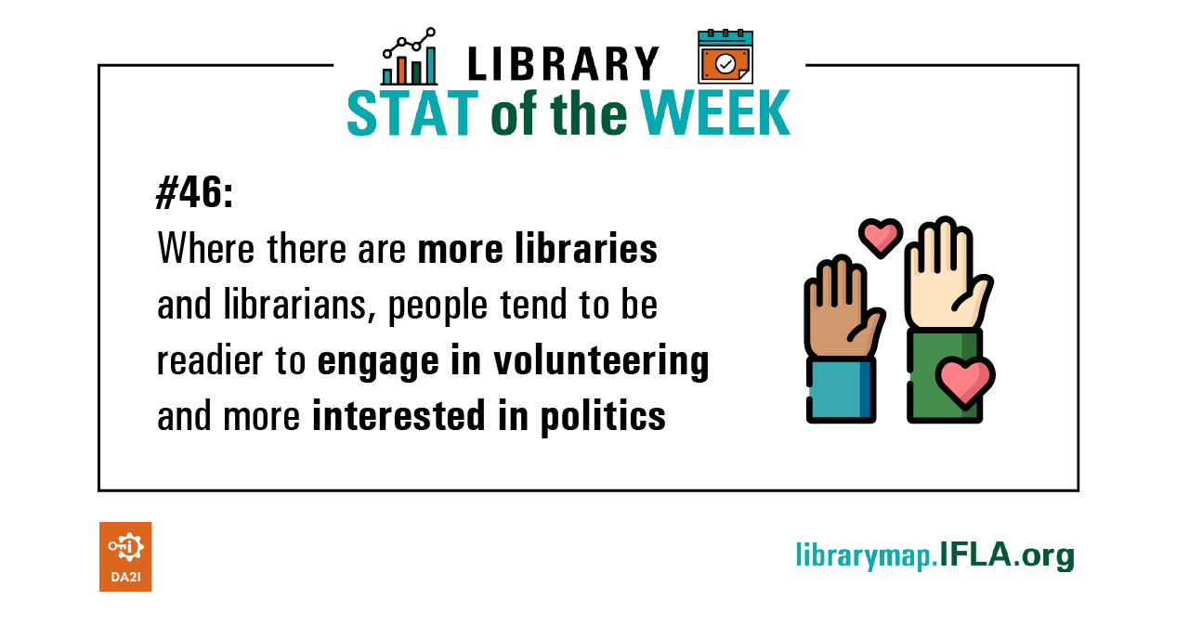
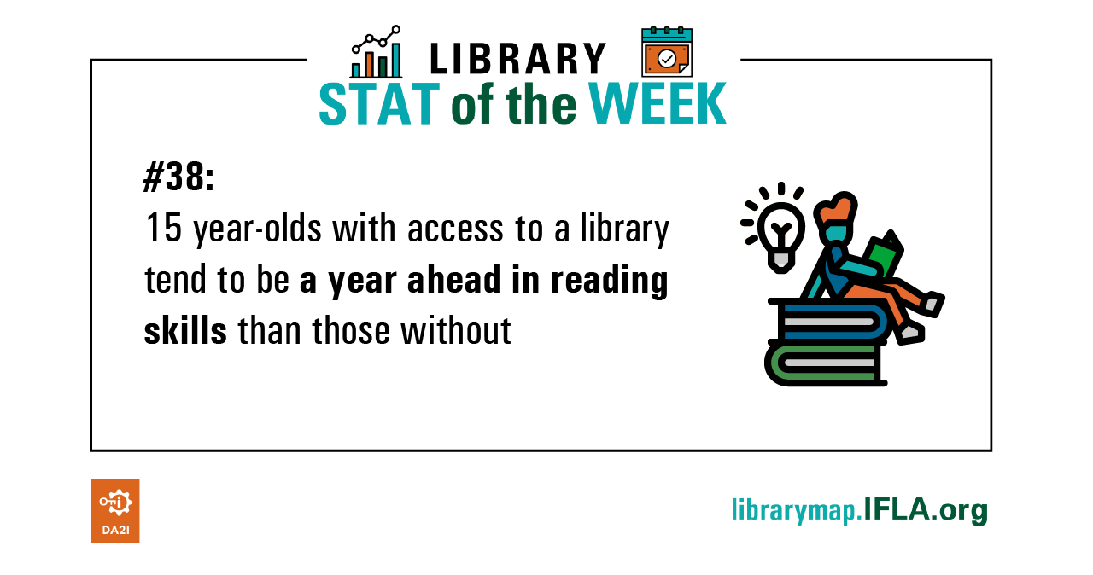
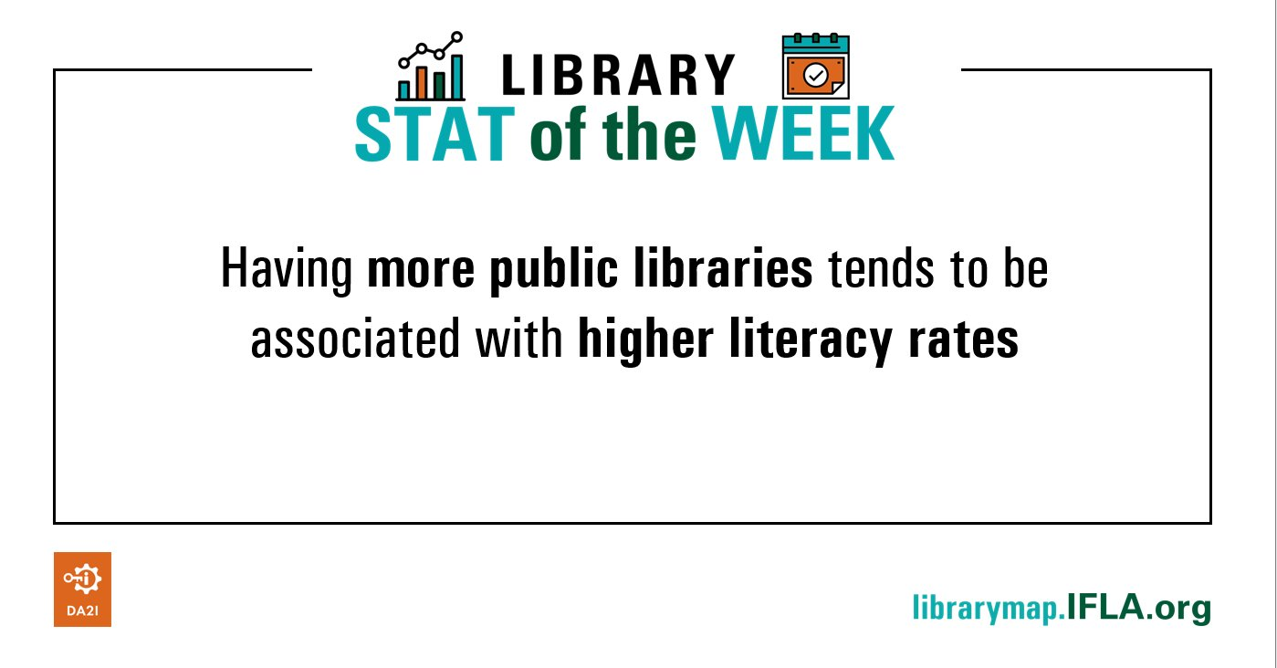
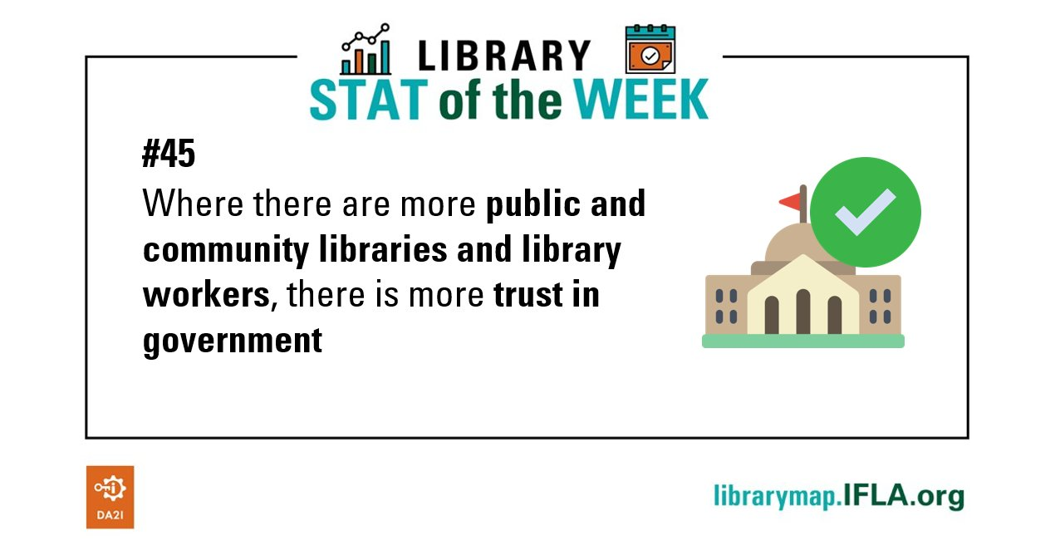
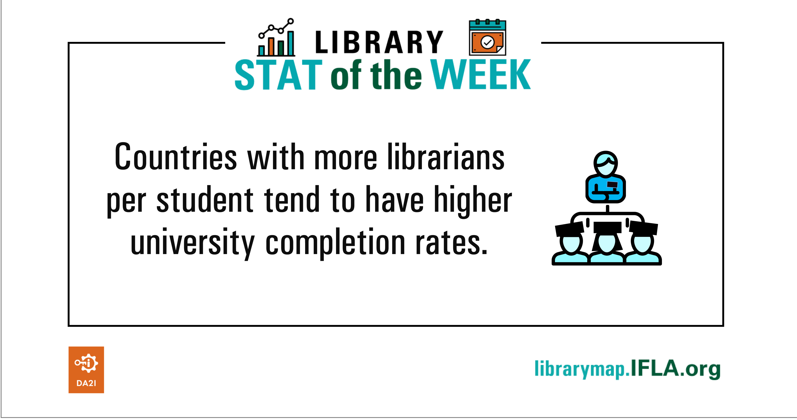
Library Map data as development metric #LibraryStatOfTheWeek

Slide 129

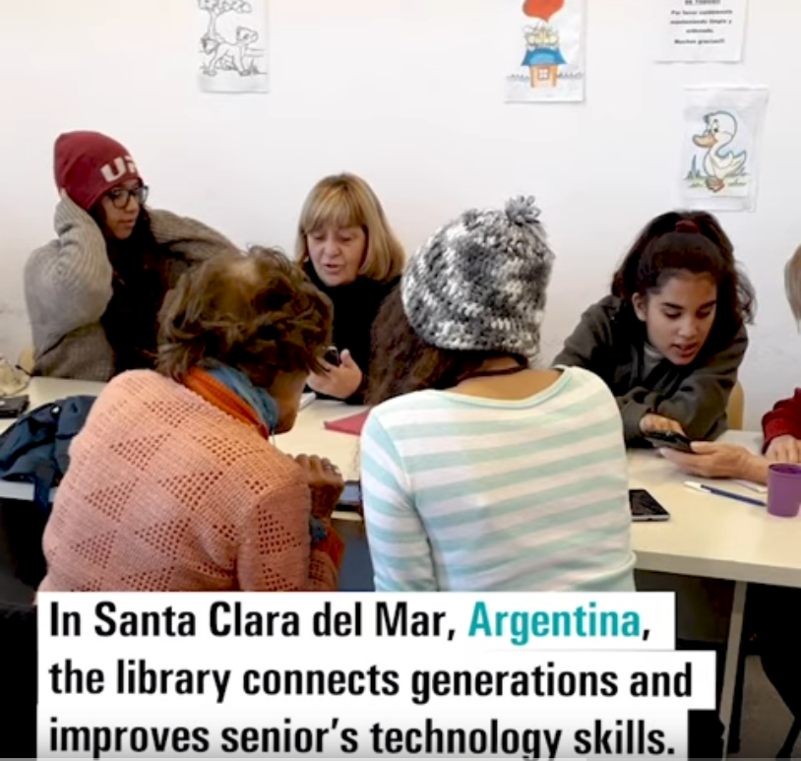
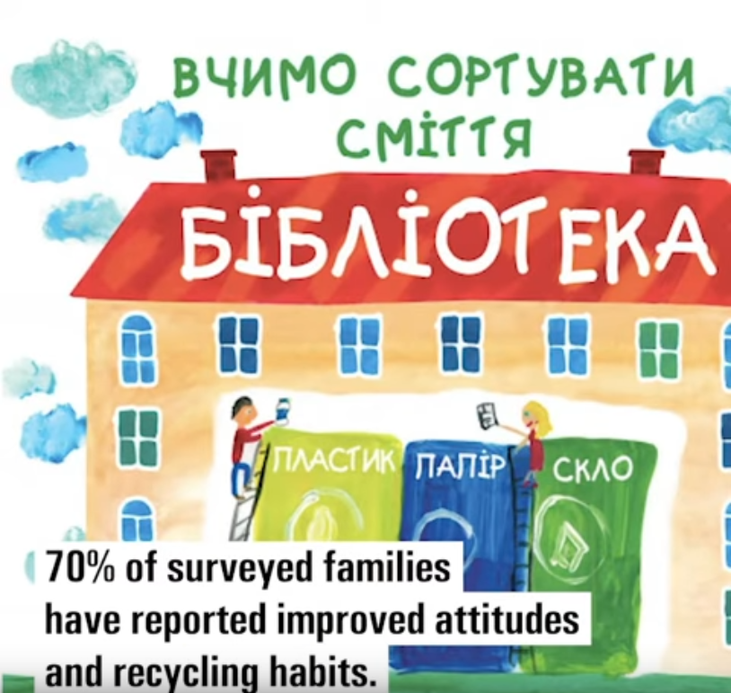

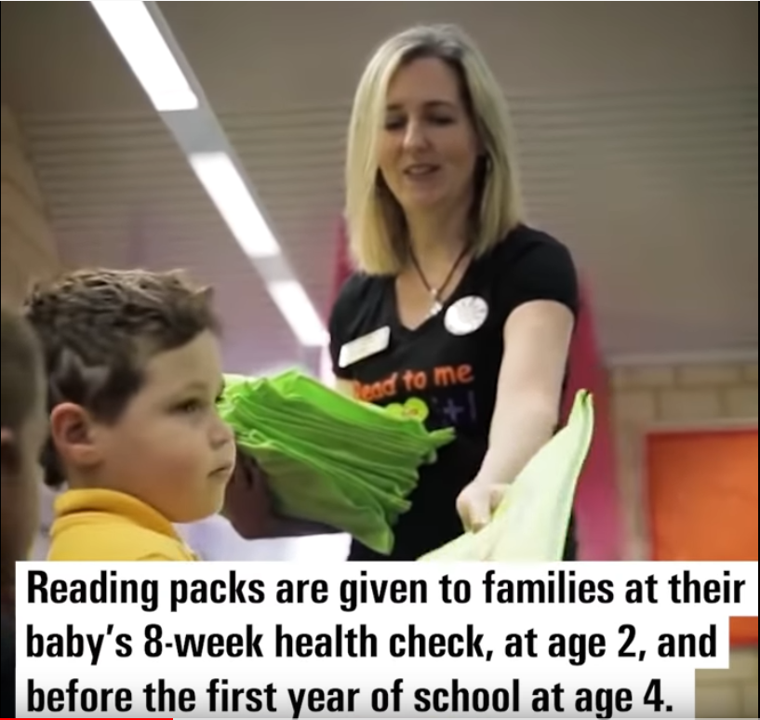
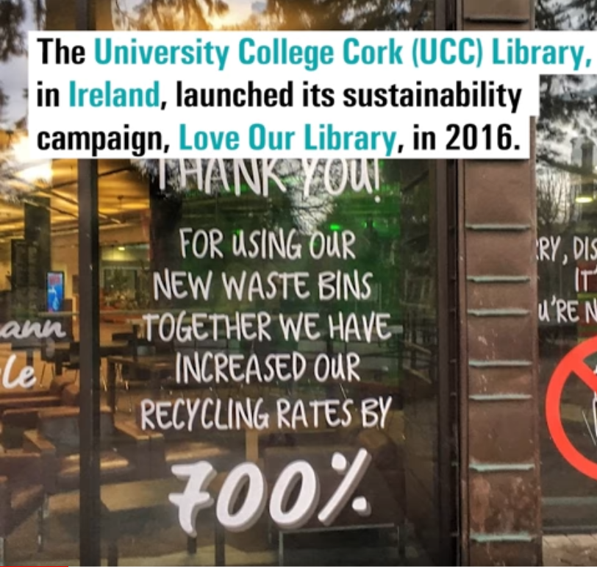
YouTube playlist – IFLA LMW SDG Stories

Slide 130
DISCUSSION
Potential of the Library Map of the World

Slide 131
DISCUSSION: Potential of the Library Map of the World
Let’s discuss:
How can we more effectively use the Library Map of the World to strengthen the voice of libraries and to build a sustainable library field in Europe region and each country within it?
What can you do to help achieving it?

Slide 132
Share your findings!
Photo: Matt Botsford on Unsplash, unsplash.com/photos/OKLqGsCT8qs

Slide 133

Lunch
Photo by Saurav Rastogi on Unsplash, unsplash.com/photos/cooked-waffles-with-ice-cream-rxF0YH7sNTo

Slide 134
Why advocacy matters

Slide 135

EXERCISE
Testing advocacy assumptions

Slide 136
EXERCISE: Testing advocacy assumptions
Decide where you stand (literally) on the following:
In my country, does lobbying have a good or a bad reputation?
Are lobbying and advocacy the same thing?
Is advocacy just a job for senior librarians?

Slide 137
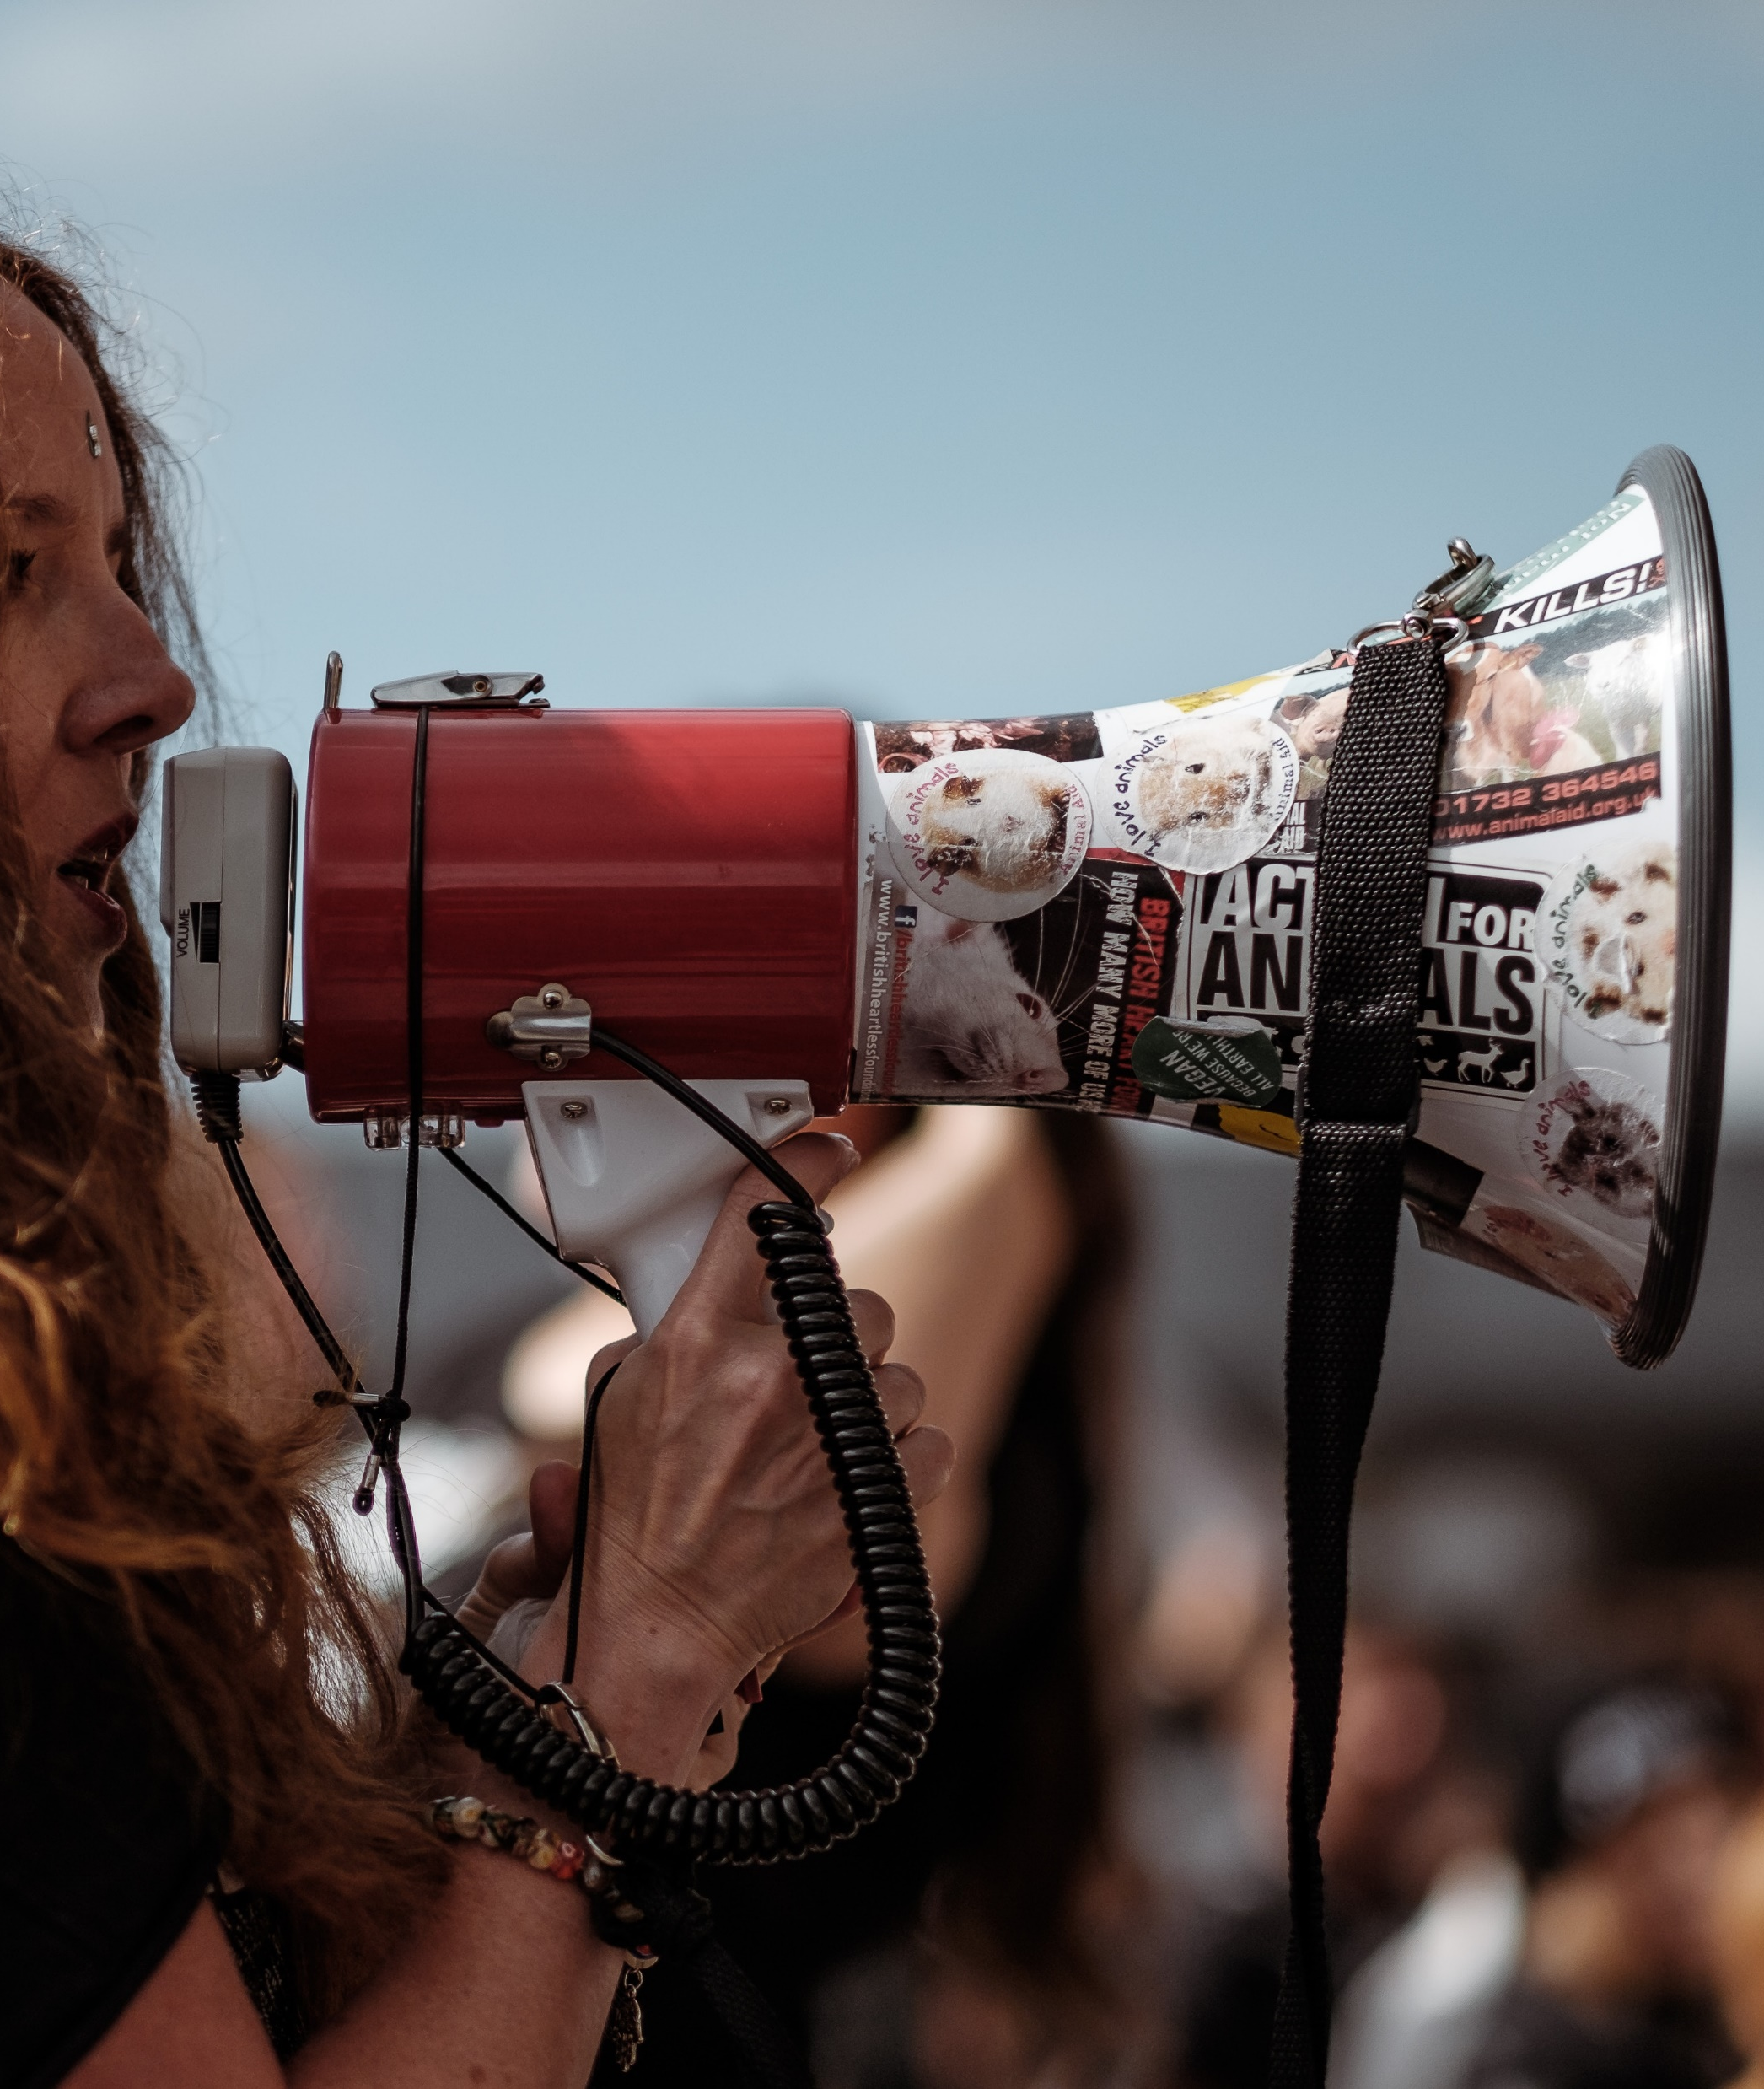
Why we advocate

Slide 138
Why we advocate?
Because we rely on the support of our funders and communities in order, in turn, to be able to give back to them
invest in
Libraries
Communities
invest in

Slide 139
Securing and diversifying sources of support for libraries
As ‘external’ factors, libraries rely on both laws and funding in order to succeed
Decision-makers need to make trade-offs (sympathy isn’t enough)
Our future is safest when we can rely both on champions and broad alliances that support libraries

Slide 140
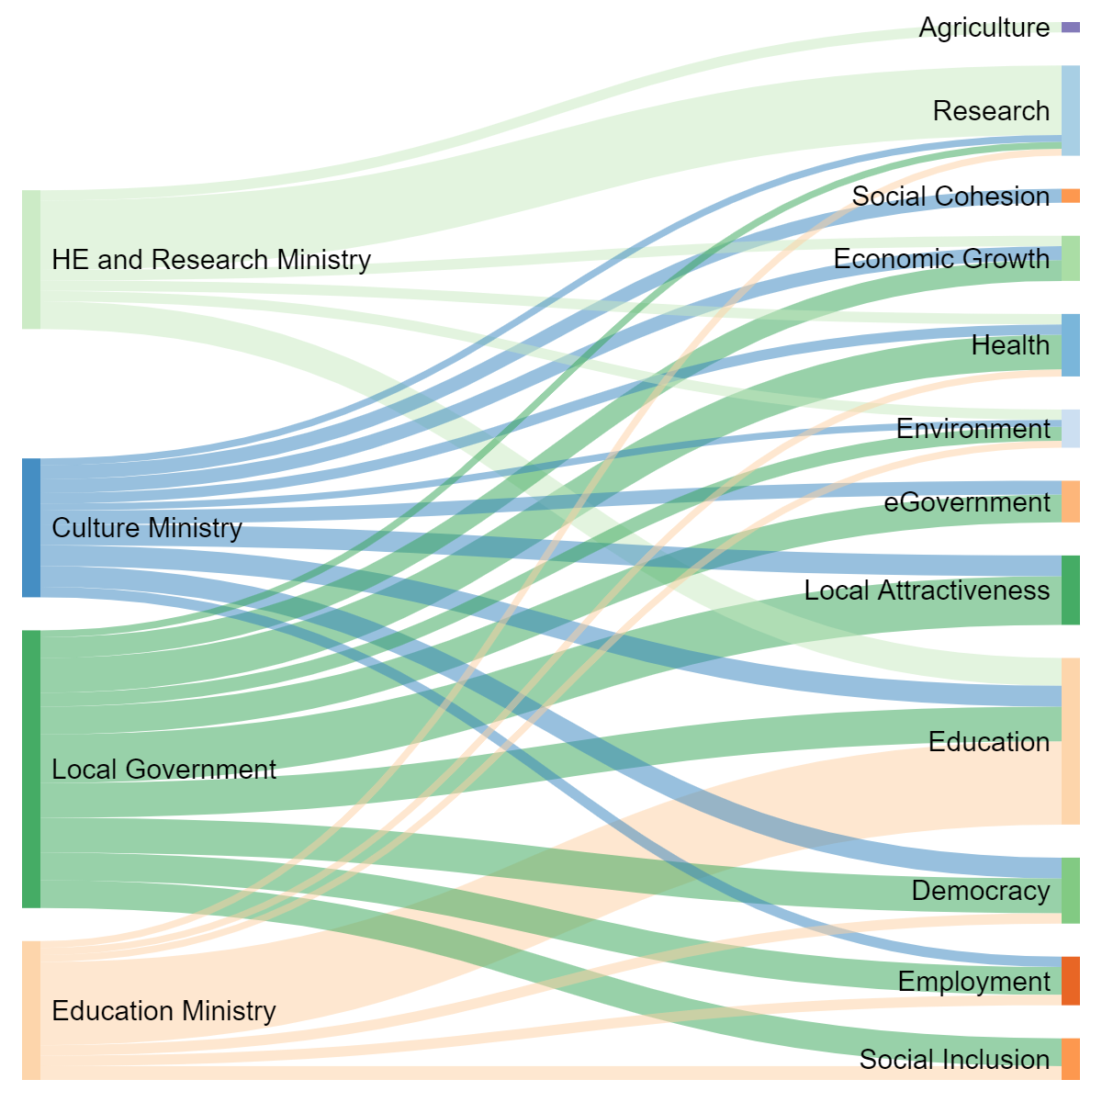
Contribution of different ministries/ agencies
Benefits in policy terms
*Figures are guesswork!

Slide 141
From
Libraries are the answer. What was the question again?
To
How can we show that libraries are the answer to the questions decision-makers (and those who influence them) are asking?

Slide 142
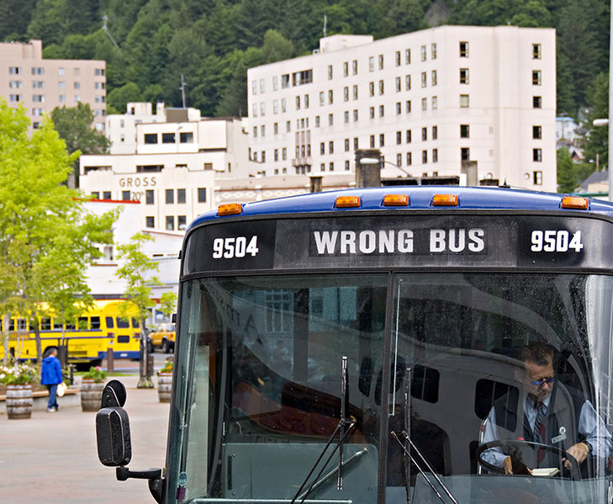
What advocacy isn’t
A solo activity
Just about lobbying
A single skill
Something that you can’t do
Photo: Seth Anderson, CC-BY-SA 2.0, bit.ly/3zb2vGb

Slide 143
HOMEWORK
Do the library advocate personality test

Slide 144
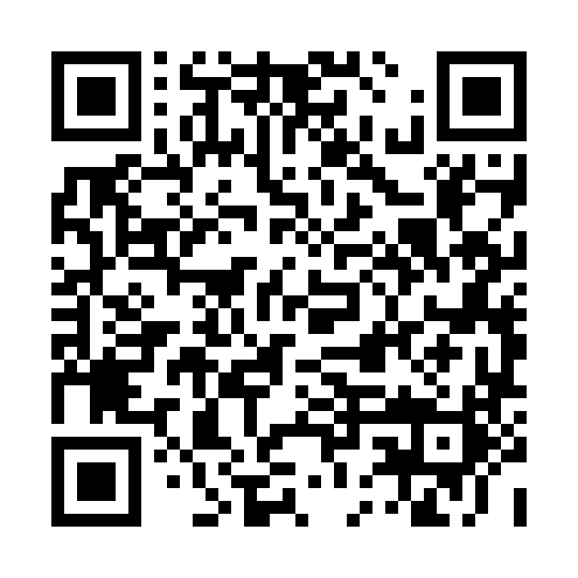
EXERCISE: Do the library advocate personality test
Go to: https://bit.ly/LibraryAdvocateQuiz
Take the test

Slide 145
8 Dimensions of Advocacy
Understanding the landscape
Coordinating your work
Mobilising the field
Gathering evidence
Communication
Building relations with decision-makers
Building advocacy partnerships
Evaluation and goal-setting

Slide 146
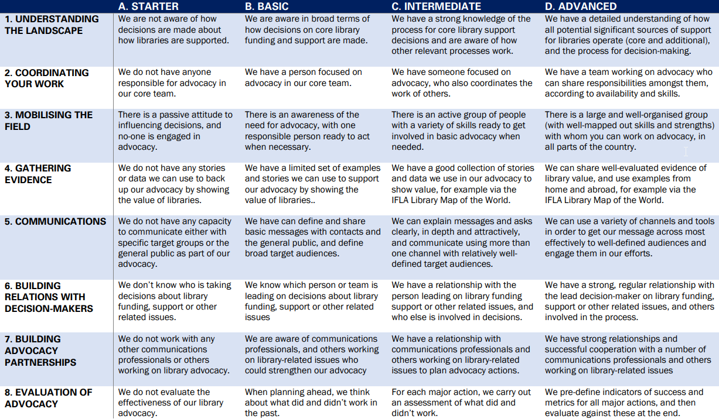

Slide 147
EXERCISE
Library Advocacy Capacities Grid

Slide 148
EXERCISE: Library Advocacy Capacities Grid
Look at the advocacy capacities grid, and do it for your national library field
Share with colleagues on your table
What are your strongest areas? And your weakest?
If time: discuss what partnerships could you form

Slide 150
Share your findings!
Photo: Matt Botsford on Unsplash, unsplash.com/photos/OKLqGsCT8qs

Slide 151
Defining advocacy goals

Slide 152
Why make the international part of your (national) work?
Engage in projects that raise the profile/status of libraries (and sometimes bring funding)
Support reports and recommendations that can influence (and be used to influence) decision-makers
Build networks and gain insights

Slide 153
This evening
Informal reception at Muntpunt
Goal: show ‘external’ partners that we are relevant and dynamic
Invitees: culture, research, education attachés
Format: short opening speeches, a poet, and then chat

Slide 154
The topics we’ll be exploring tomorrow
Libraries as part of wider culture policy
Sustainable urbanization and local government engagement
Digital skills for inclusion and labour market success
Opportunities to engage with UNESCO

Slide 155
How can we
How can we show that libraries are the answer to the questions the EU, Eurocities and UNESCO are asking in Europe?

Slide 156
EXERCISE
Identifying an ask

Slide 157
EXERCISE: Identifying an ask
Tables 1 and 4 visit the DG Education and Culture website
Tables 2 and 6 visit the DG Employment and Social Affairs website
Tables 3 and 7 visit the UNESCO (culture and information) website
Table 5 visits the Eurocities website.
Identify a project you might want to carry out with them

Slide 158
Share your findings!
Photo: Matt Botsford on Unsplash, unsplash.com/photos/OKLqGsCT8qs

Slide 159
Opportunities to engage

Slide 160
Engagement in Media and Information Literacy & Digital Literacy projects
Maria De Brasdefer Policy & Research Officer – Digital Affairs

Slide 161


Both projects:
-Co-funded by the European Union
-Implemented with lead partner organization Tactical Tech + other orgs (e.g. EUN, STC and more)
-Over 10 Library participants
Previous projects:
EU Media Literacy
The Glass Room: Misinformation Edition
Focus: Media and Information Literacy
Approx. 12 months
Structure: Workshops, exhibitions, activities
Focus: Digital Literacy/Misinformation
Approx. 24 months
Structure: Exhibitions, toolkits, workshops, hybrid activities
Notes:
The ultimate goal of these projects was to increase the level of media and digital literacy in Europe by designing activities and resources that are scalable, sustainable and adaptable.
There were several core library interventions across Europe both indoors and outdoors format and physical/online + sub-exhibitions at branch libraries
These interventions consisted either in self-led activities, so for example interactive exhibitions with animations, posters, interactive pieces and other resources; or facilitated workshops and activities on these topics, so for example conversations on how people perceive and interact with social media or how capable do they feel to find trustworthy information online and many other similar topics

Slide 162
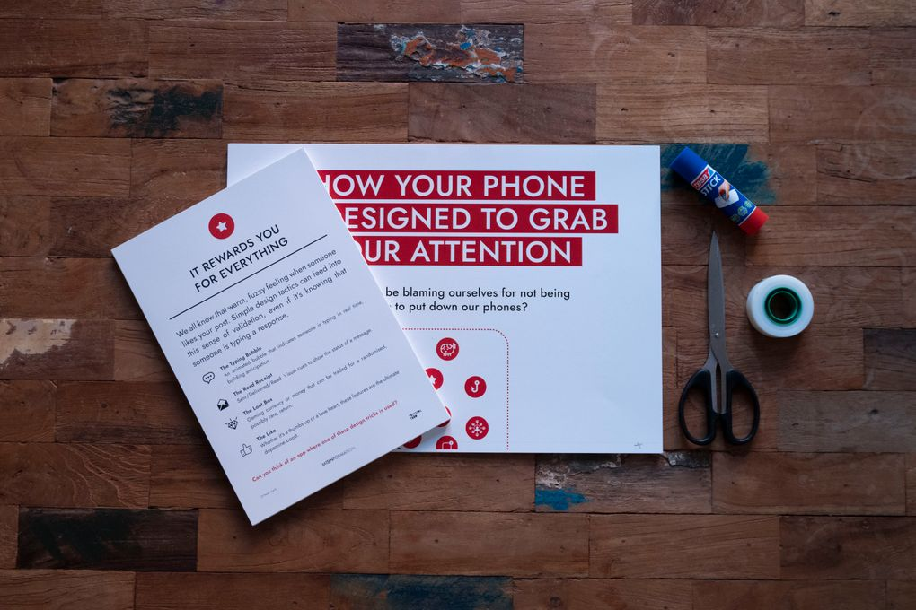
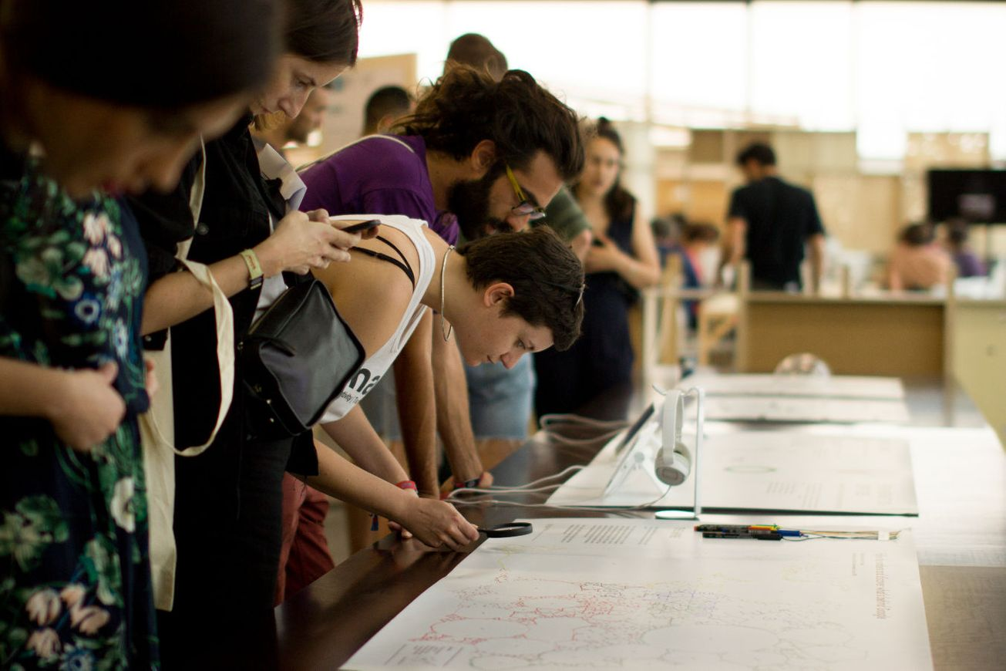
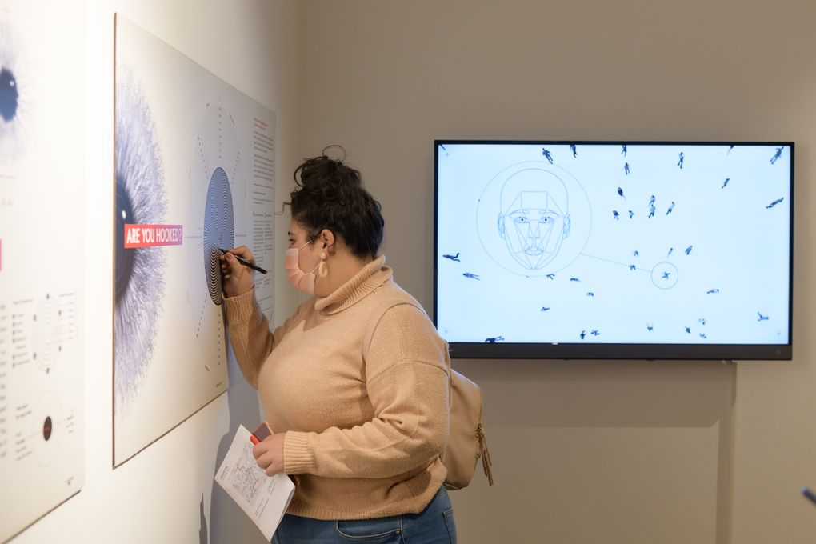
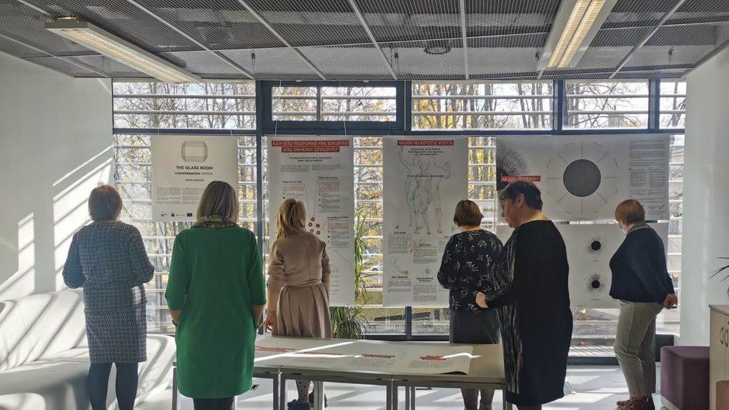
The Glass Room: Misinformation Edition
&
EU Media Literacy
In numbers…
IFLA HEADQUARTERS | 2023
Over 20 exhibitions across Europe
Resources: 11 curriculas, 4 youth activities, 1 digital education platform, 14 posters, 6 short film animations, 2 virtual exhibitions & 10 self-learning resources
Translation to over 10 languages
About 353 MIL champions trained and 200k people reached over 3 years
A total number of 252 on and offline interventions

Slide 163
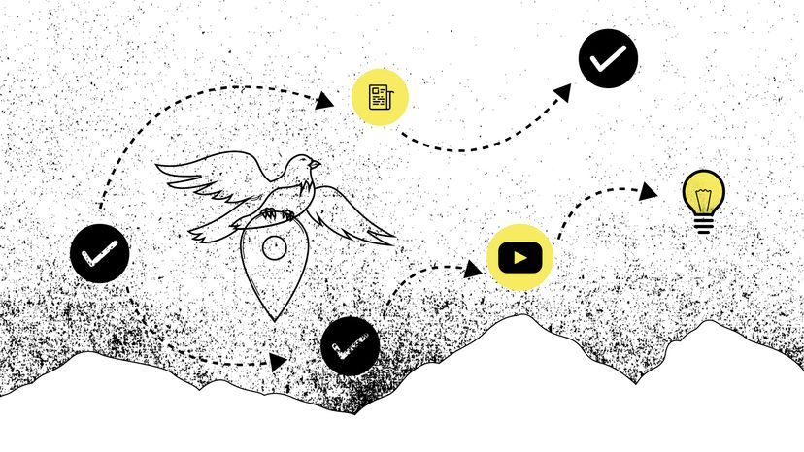
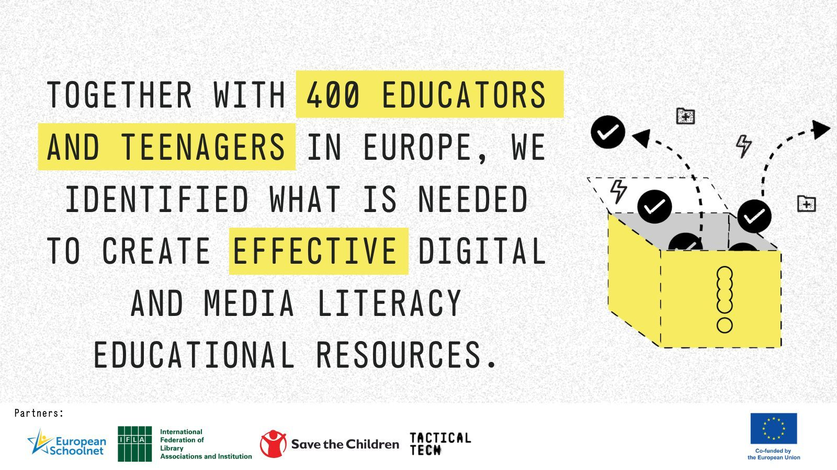
Current projects
Media Literacy Case for Educators – MLCE
Media and Information Literacy
for Societal Resilience – MILSR
3) TwinTransition (Digital and Green
Transitions) - TT
Notes:
Kickstarting early next year between February and March. For the MLCE project, the resource development phase has started but it will be further complemented with input from the participants.
MLCE/MILSR: Increase societal resilience by giving teachers, trainers and librarians (educators) across Europe the skills, tools and resources
they need to be effective, innovative, future-fit advocates and facilitators of media literacy.
TT: Focus TwinTransition
MLCE – (EU) TT – IFLA + EUN + Save The Children
MILSR – (Gulbenkian) – TT - IFLA + Politecnico di Milano
TT – [Fully recruited] (EU) – IFLA + EUN
*Some libraries have already committed for these projects

Slide 164
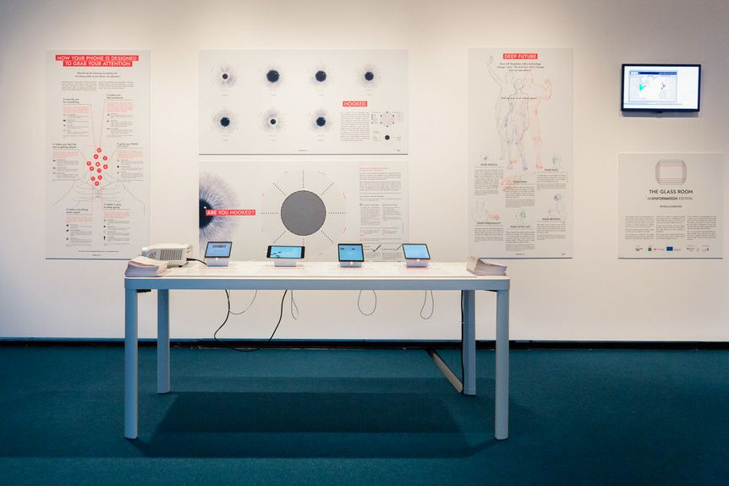
Timeline & Process
1) Resource development 3-6 months [Previous resources + Focus group + Needs assessment]
2) Training of Trainers (ToT) 1-3 months [By TT for IFLA → by IFLA for libraries → by libraries for sub-branches]
3) Implementation 6-12 months
[Led by focal point libraries & sub-branches]
4) Data gathering/Analysis of results 1 month
[Led by Tactical Tech with partner support]
5) Final report and dissemination 1-2 months
[Individual & collective report + dissemination]
Notes:
Duration of ongoing projects 18-24 months
Additional comments:
-Budget -Translation -Certificates

Slide 165

THANK YOU!
IFLA HEADQUARTERS 2023
www.tacticaltech.org (Glassroom & EU Media literacy website)
Maria.debrasdefer@ifla.org

Slide 166
Taking Advocacy from International to National
Policy, Advocacy and Practice

Slide 167


IFLA and UNESCO

Slide 168
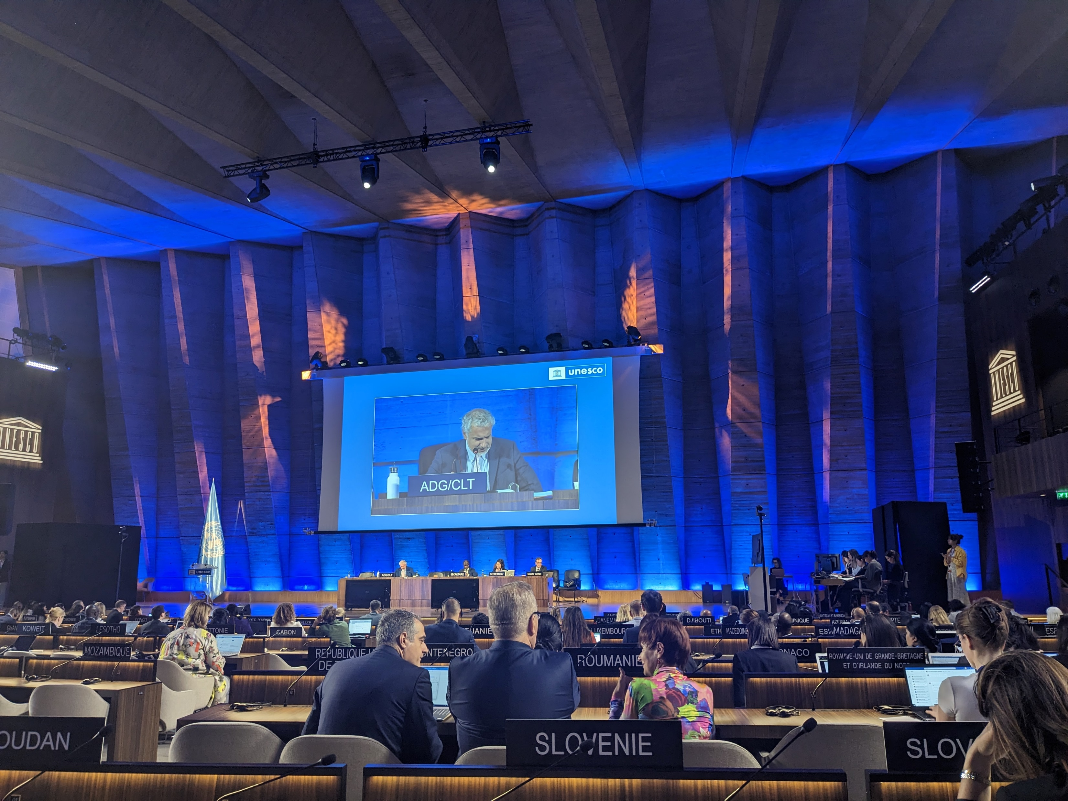
UNESCO
Culture
Communications and Information
Education
Natural Science
Social and Human Sciences

Slide 169
Strategy 2024-2025
Accelerating SDG Progress (4, 11.4, 16.10)
Fair and inclusive education, protecting the environment, social cohesion, technology in service of humankind.
Crisis preparedness & Response
Digital Transformation
Mobilizing partnerships
Notes:
t provides potent levers for progress from the power ofeducation to transform lives to the promise of science to find solutions for the global challenges ofour times; from the dynamism of culture to mobilize and drive change to the fundamental need foropen and free knowledge societies

Slide 170
Major Programme: Culture
Culture and climate change
Culture as a stand-alone goal
Culture and arts education
Supporting cultural rights, leveraging digital technologies, addressing the impact of AI
Emergency preparedness and response
Notes:
t provides potent levers for progress from the power ofeducation to transform lives to the promise of science to find solutions for the global challenges ofour times; from the dynamism of culture to mobilize and drive change to the fundamental need foropen and free knowledge societies

Slide 171
Culture
Identify, protect and manage tangible & living heritage
Fight illicit trafficking, promote restitution
Improve disaster/conflict preparedness and response
Promote, monitor and measure the contribution of culture to the implementation of SDGs at the local, national and regional levels
Notes:
t provides potent levers for progress from the power ofeducation to transform lives to the promise of science to find solutions for the global challenges ofour times; from the dynamism of culture to mobilize and drive change to the fundamental need foropen and free knowledge societies

Slide 172
Culture + Education
Planning and implementation of culture and arts education should overcome siloed approaches by… establishing more sustained cooperation with informal and non-formal learning spaces and actors, such as… libraries… and other relevant stakeholders in order to strengthen learning outcomes and address gaps in education curricula and training.
https://www.unesco.org/en/wccae2024-framework-consultation
Notes:
t provides potent levers for progress from the power ofeducation to transform lives to the promise of science to find solutions for the global challenges ofour times; from the dynamism of culture to mobilize and drive change to the fundamental need foropen and free knowledge societies

Slide 173
Actions
Reach out to Library Associations
Contact UNESCO National Commission
Express support, share evidence ahead of Global Conference
Assist in monitoring and reporting success
Connect to calls for culture in sustainable development
Notes:
t provides potent levers for progress from the power ofeducation to transform lives to the promise of science to find solutions for the global challenges ofour times; from the dynamism of culture to mobilize and drive change to the fundamental need foropen and free knowledge societies

Slide 174
Major Programme: CI
Promote and protect linguistic diversity and multilingualism
Enhance norms and policies on freedom of expression, right to access information
Strengthen media development and media pluralism
Foster universal access to information and knowledge, open solutions, documentary heritage
Strengthen MIL, bridge the digital and knowledge divide
Ethical norms and standards on digital transformation & AI

Slide 175
Actions
IFAP National Committees
Memory of the World National Committees
Develop and communicate MIL and Open Education/Open Science strategies
2022 IFLA/UNESCO Public Library Manifesto

Slide 176
IFAP National Committees
Goal: Help Member States develop and implement national information policies and knowledge strategies
Meeting point for diverse stakeholders
Transfer knowledge & expertise from international to national
Consolidate plans & strategies
Europe: Lithuania, Poland, Russian Federation, Slovakia
www.unesco.org/en/ifap/national-committees

Slide 177

Making Space for Libraries in Climate Action

Slide 178
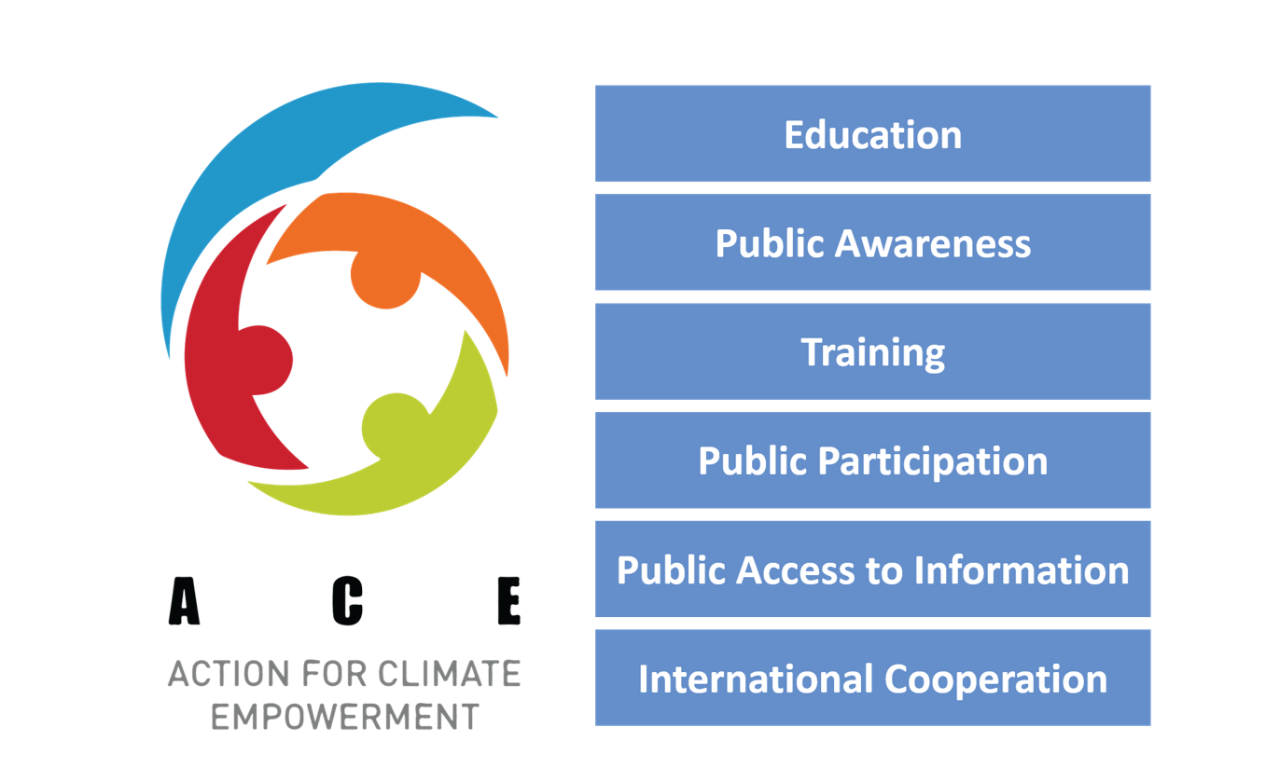
https://unfccc.int/topics/education-and-youth/big-picture/ACE

Slide 179

Everyone must understand and participate in the transition to a low-emission, climate-resilient world.

Slide 180


Policy on ACE

Slide 181
Why does ACE Matter for Libraries?
Lifelong learning – inside and outside formal education
Openness and access to information
Research support and sharing
Awareness-raising, discussion, and action
Information, research, and policy literacy
Platforms for connection

Slide 182
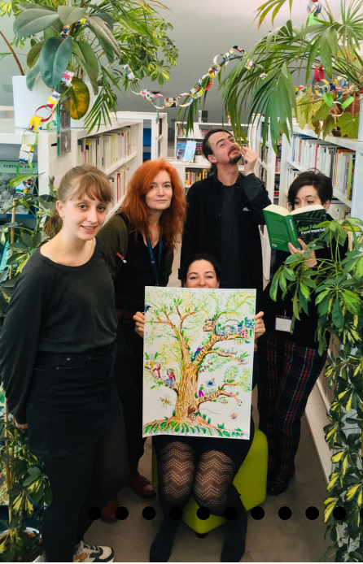
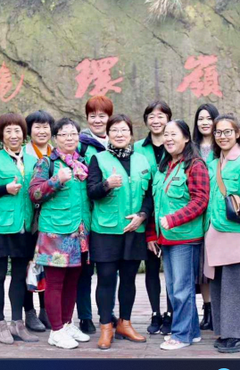
ACE Work Plan Priorities
One
Two
Coordinated Action
Policy Coherence
La Médiathèque de la Canopée, Paris, France
The Hangzhou Public Library’s Environment Branch, China

Slide 183
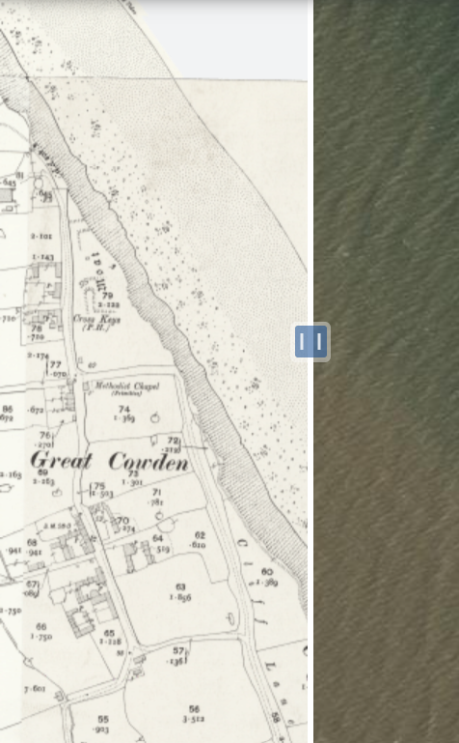

ACE Work Plan Priorities
Three
Four
Monitoring, Evaluating & Reporting
Tools and Support
National Library Scotland Georeferenced Historic Maps
IFLA Green Library Awards

Slide 184

Gaps in ACE
Data management
Reaching all learners/stakeholders
Language diversity in materials
In-country coordination between ministries and civil society

Slide 185
Theory of Change

Slide 186

Source: Innovation for Social Change

Slide 187
Challenge
Libraries are not recognized as hubs of climate empowerment by national and subnational policy makers.
The climate work being done in many libraries is due to the dedication of library professionals and is not being supported sustainably.

Slide 188
Goals
Library professionals can advocate for themselves as climate empowerment hubs.
Climate policymakers proactively include libraries in their climate plans and support accordingly
Libraries can continue and expand their work as climate empowerment hubs.

Slide 189
Resources
Evidence and information
Support to participate
Communications/awareness raising materials
IFLA HQ staff, IFLA volunteer groups, libraries around the world
Relationships with external partners

Slide 190



Process
Awareness-raising
Direct advocacy
Indirect advocacy
Research
Relationship-development

Slide 191
Outcomes – short term
More awareness of ACE
Confident in planning ACE activities and advocacy
Recognition of IFLA & libraries as key partners

Slide 192
Outcomes – medium term
Some countries include libraries in ACE
See libraries in national reports
New opportunities to engage further

Slide 193
Impact
ACE strategies include libraries & report on success
Policymakers allocate support
Libraries can maintain and expand their work
ACE impact is accelerated

Slide 194



Assess Progress
Engagement in ACE
Advocacy Opportunities
Policy change

Slide 195
Why is this important?
Think boldly
Use a framework
You do not have to work alone
Think in terms of impact

Slide 196

Goals: COP28
1
Advocate for a Joint Work Programme on Culture and Climate
Connect with ACE stakeholders
Gain momentum towards library indicators
2
3

Slide 197
What can you do?

Slide 198


Climate Survey
1
Libraries
Associations
2
3
survey.alchemer.com/s3/7245814/IFLA-Libraries-CCE
survey.alchemer.com/s3/7375520/Library-Associations-CCE

Slide 199
Advocacy at all levels
1
Carry out a theory of change exercise for your library/city/community
Determine who is working in this space
Connect with local CCE non-profits, city/municipal government agencies responsible for climate action
Contact your ACE Focal point:
https://unfccc.int/topics/education-youth/national-ace-focal-points
2
3

Slide 200
COP28 Actions
1
Plan a climate/environment themed event in your library
Share information about COP and your country’s climate work
Engage students and learners in climate action
Communicate with others in your community
5. Contact your ACE focal point and let them know libraries are interested in ACE outcomes at COP28
2
3

Slide 201
Practicing advocacy skills

Slide 202
EXERCISE
Advocacy role-play

Slide 203
Break
Photo by Mike Kenneally on Unsplash, unsplash.com/photos/TD4DBagg2wE

Slide 204
Practicing advocacy skills

Slide 205
EXERCISE: Advocacy role-play
Use the project you identified earlier
Choose ONE person to be the director/official, and ONE other to be their advisor/colleague. Everyone else is the library delegation
The role of the library delegation is to convince the director/official to support library involvement in the project
Read the description of the director/official’s role and personality – plan how you will approach the meeting
Hold a 3-4min meeting, and then assess how it went!

Slide 206
Share your findings!
Photo: Matt Botsford on Unsplash, unsplash.com/photos/OKLqGsCT8qs

Slide 207
Preparing for Day 3

Slide 208
Important information
Meet at 6:20pm at reception!
Reception: Muntpunt
Tomorrow: meet at 8:45am at reception

Slide 209
Wrap up

Slide 210
Thank you!

