Slide 1


Slide 2

privacy
This event is being recorded, including chat. ​Recording will be posted on IFLA’s website & YouTube channel​
​
Microphones have been muted for this event. ​Leave your microphone muted when not talking to minimize background noise.
Take a moment to update your name & country so we can acknowledge and call on you. To do this: 1) Click on ‘Participants’; 2) Hold your cursor over your name; 3) Click on ‘More’; 4) Click on ‘Rename’
​Questions or comments? Please type into the chat or Q&A box.
The talk is GDPR-compliant ​
IFLA and ZOOM privacy policies:​
https://www.ifla.org/data-protection-policy ​
https://zoom.us/privacy
Questions regarding privacy
despina.gerasimidou@ifla.org

Slide 4

speaker
Stephen Wyber
IFLA
Director, Policy and Advocacy

Slide 5

speaker
Despina Gerasimidou
IFLA
Strategic Development Officer

Slide 6
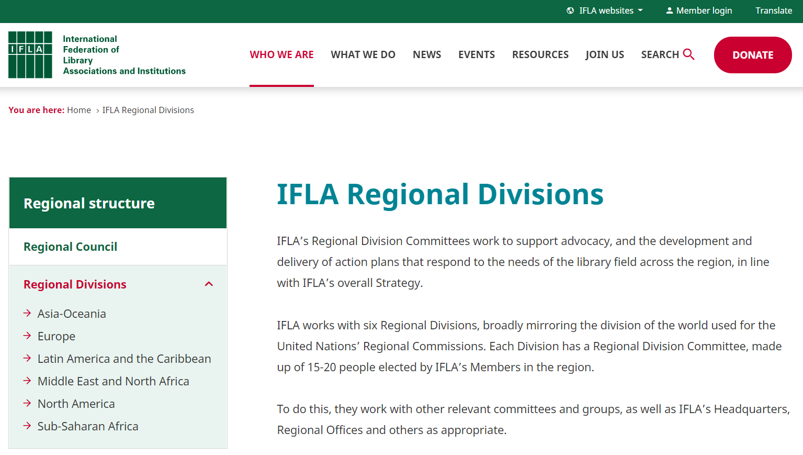
new IFLA REGIONAL DIVISIONS
ifla.org/regional-divisions/

Slide 7
AIM OF the Library Advocacy Priorities study
To see where current advocacy efforts focus globally & regionally
To start conversations
To inspire action that responds to the field’s regional advocacy needs

Slide 8
Library Advocacy Priorities STUDY
USEFUL LINKS
Discover the full results of the study | ifla.org/news/setting-goals-taking-action-ifla-study-explores-library-advocacy-priorities-and-activities-globallly
Initial analysis of responses on policy focus | blogs.ifla.org/lpa/2021/11/05/which-policies-matter-analysing-the-results-of-the-ifla-regional-advocacy-priorities-study/
Initial analysis of responses on advocacy activities | blogs.ifla.org/lpa/2021/11/12/what-are-libraries-doing-to-advocate-analysing-the-results-of-the-ifla-regional-advocacy-priorities-study-part-2/

Slide 9
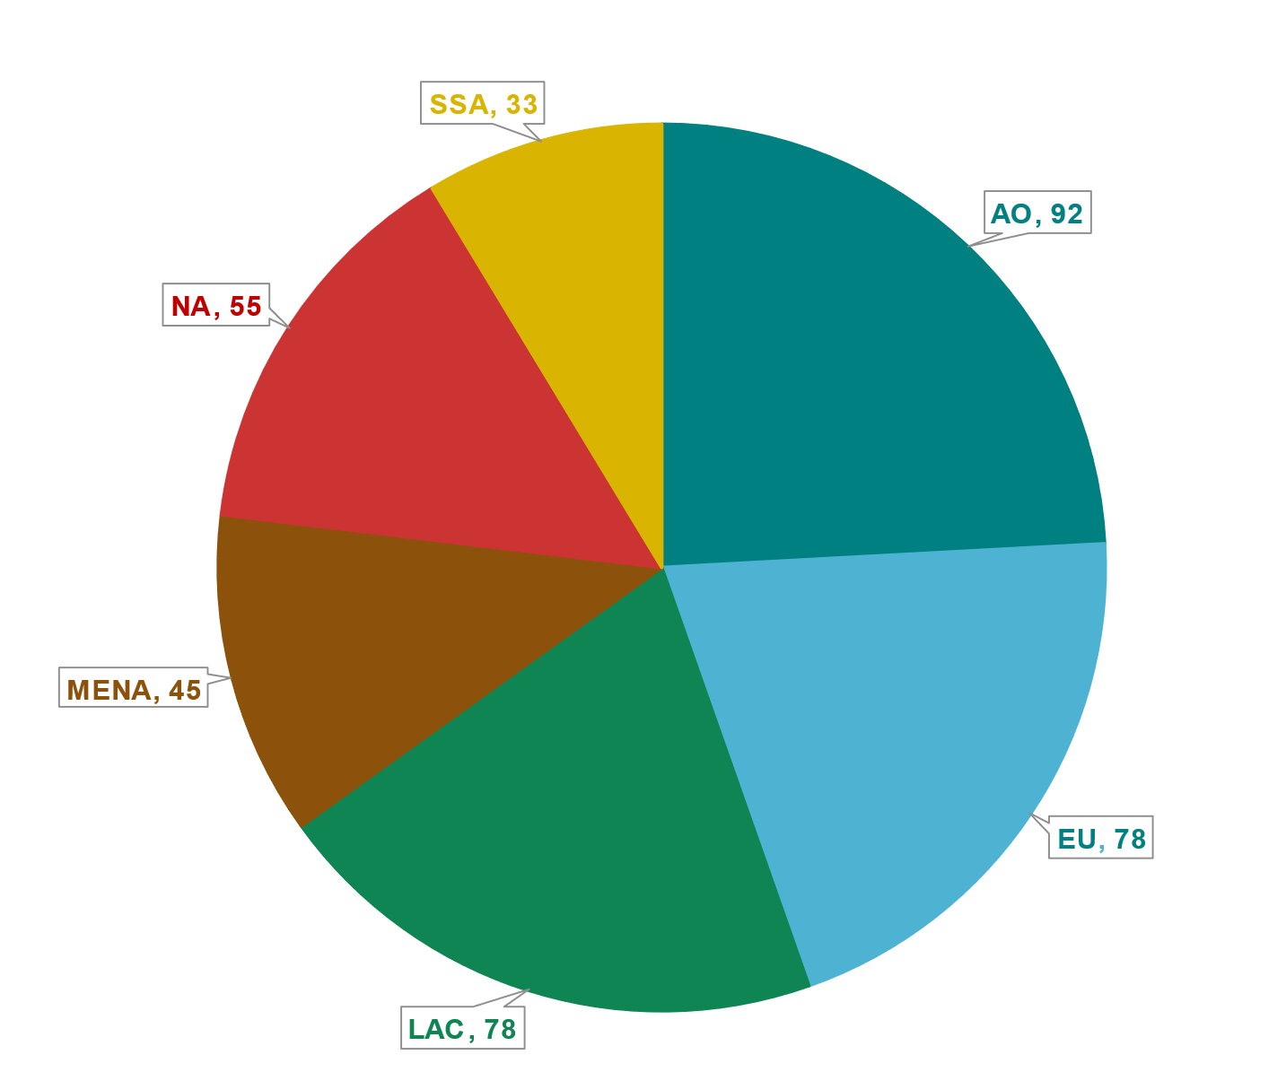

Responses
AO = Asia Oceania
EU = Europe
LAC = Latin America and Caribbean
MENA = Middle East and North Africa
NA = North America
SSA = Sub-Saharan Africa

Slide 10
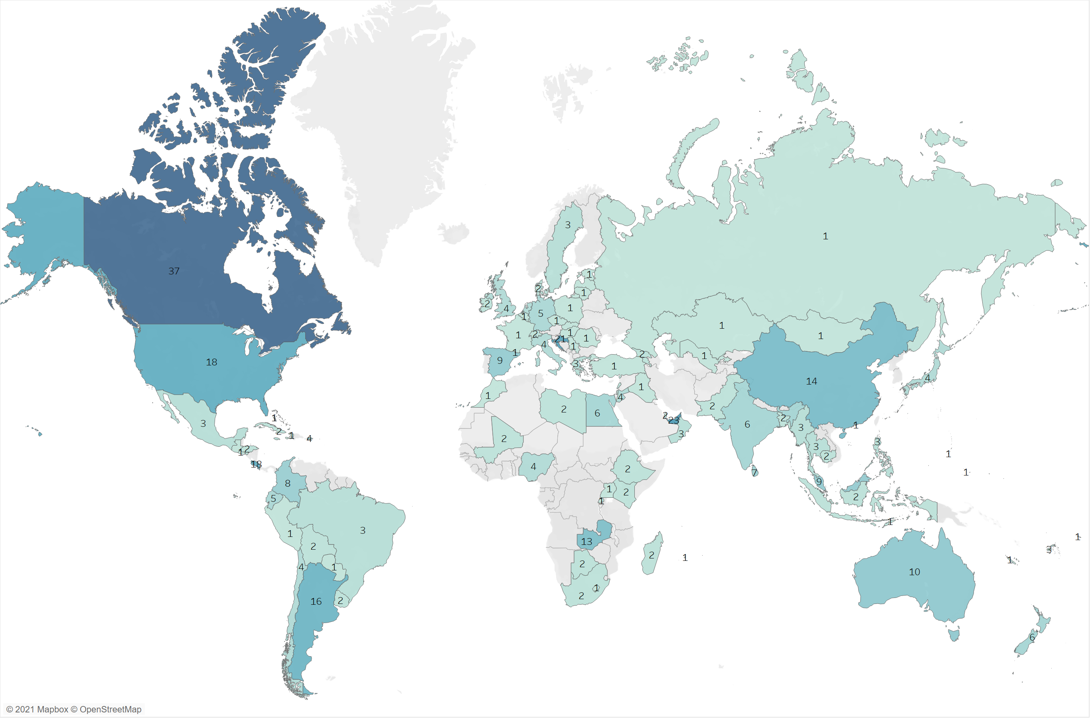
REGIONAL ADVOCACY PRIORITIES SURVEY RESULTS
WORLD RESPONSES

Slide 11
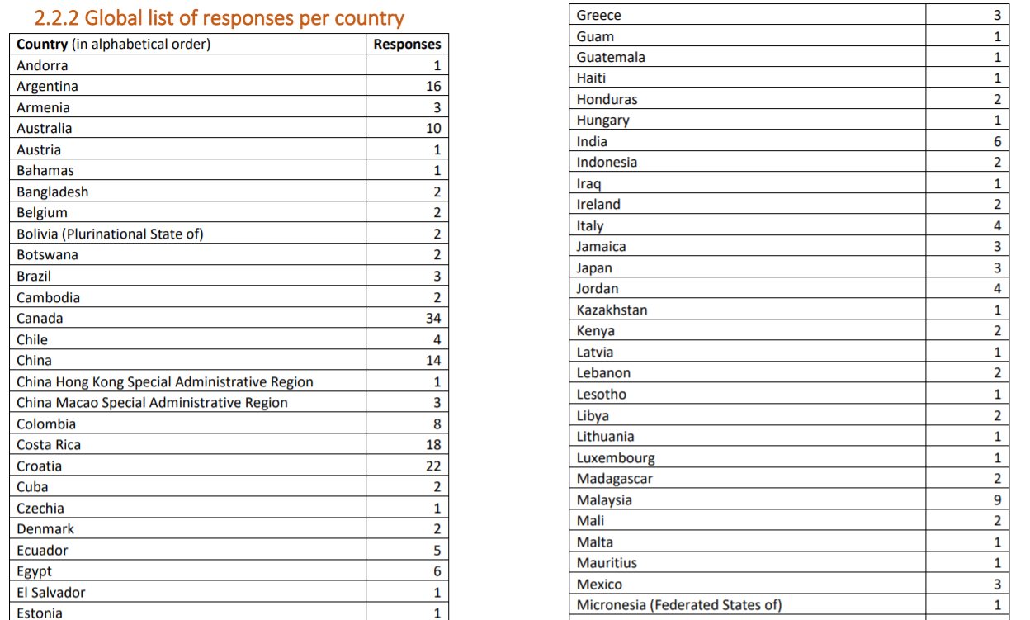
REGIONAL ADVOCACY PRIORITIES STUDY RESULTS
WORLD RESPONSES

Slide 12
Lessons from the Library Advocacy Priorities STUDY
Profile of respondents
-> on behalf of a library association
-> on behalf of a library institution
-> as an individual
small, medium, large

Slide 13
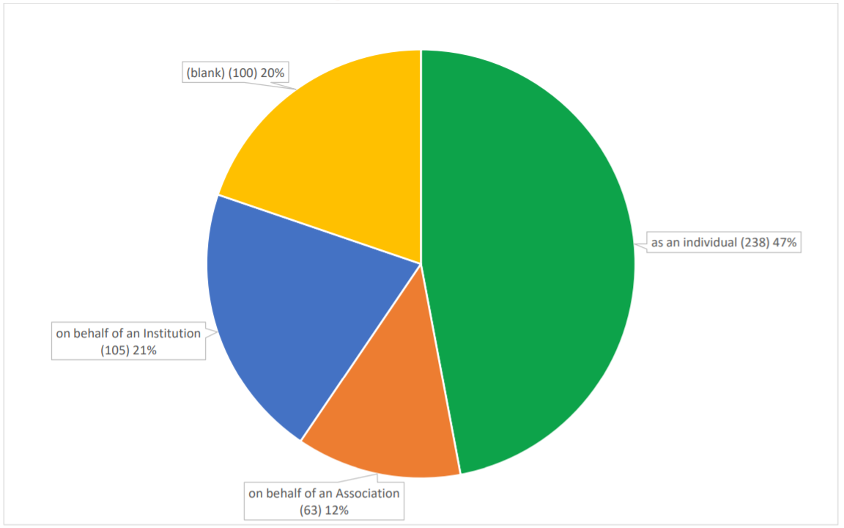
Lessons from the Library Advocacy Priorities STUDY

Slide 14
Lessons from the Library Advocacy Priorities STUDY

Slide 15
Lessons from the Library Advocacy Priorities STUDY
What did we ask
1) levels of focus on financial support for different library types
2) levels of focus on different library policy issues
3) levels of engagement in different library advocacy activities

Slide 16
Lessons from the Library Advocacy Priorities STUDY
Question 1
Which of the following do you see as thematic priorities for advocacy in your country? Ensuring stronger financial support for public, national, school, academic/research or other type of libraries?

Slide 17
1st Question: Ensuring Financial Support: Priorities by Library Type
1 = Not at all a priority
5 = Essential

Slide 18
1st Question: Ensuring Financial Support: Priorities by Library Type
Global view – All regions
Associations’ view
1 = Not at all a priority
5 = Essential

Slide 19
1st Question: Ensuring Financial Support: Priorities by Library Type
AO REGION
Associations’ view
Small, Medium, Big
1 = Not at all a priority
5 = Essential
Notes:
Disclaimer: We had no responses from Medium Associations in the AO region.

Slide 20
1st Question: Ensuring Financial Support: Priorities by Library Type
EU REGION
Associations’ view
Small, Medium, Big
1 = Not at all a priority
5 = Essential
Notes:
Same as the previous one

Slide 21
Lessons from the Library Advocacy Priorities STUDY
Question 2
Which of the following issues do you see as thematic priorities for advocacy in your country (other than financial support)? Improved policies and laws around…?

Slide 22
2nd Question: Policies and Laws: Priorities
1 = Not at all a priority
5 = Essential

Slide 23
2nd Question: Policies and Laws: Priorities
Global view – All regions
Associations’ view
1 = Not at all a priority
5 = Essential

Slide 24
2nd Question: Policies and Laws: Priorities
EU REGION
Associations’ view
Small, Medium, Big
1 = Not at all a priority
5 = Essential

Slide 25
2nd Question: Policies and Laws: Priorities
Global view – All regions
Institutions’ view
1 = Not at all a priority
5 = Essential

Slide 26
2nd Question: Policies and Laws: Priorities
AO REGION
Institutions’ view
Small, Medium, Large
1 = Not at all a priority
5 = Essential

Slide 27
Lessons from the Library Advocacy Priorities STUDY
Question 3
Your current advocacy capacity: What sort of advocacy activities are you carrying out in your association/institution or more broadly in your national library field?

Slide 28
3rd Question: Elements of Advocacy: Current Levels of Activity
1 = Not at all active
5 = Very active

Slide 29
3rd Question: Elements of Advocacy: Current Levels of Activity
Global view – All regions
Associations’ view
1 = Not at all active
5 = Very active

Slide 30
3rd Question: Elements of Advocacy: Current Levels of Activity
AO REGION
Associations’ view
Small, Medium, Big
1 = Not at all active
5 = Very active
Notes:
Disclaimer: We had no responses from Medium Associations in the AO region.

Slide 31
3rd Question: Elements of Advocacy: Current Levels of Activity
EU REGION
Associations’ view
Small, Medium, Big
1 = Not at all active
5 = Very active

Slide 32
new IFLA REGIONAL DIVISIONS
ifla.org/regional-divisions/
IFLA Regional Divisions | Website link
Asia-Oceania | ifla.org/units/asia-oceania-regional-division/
Europe | ifla.org/units/europe-regional-division/
Latin America and the Caribbean | ifla.org/units/latin-america-and-the-caribbean-regional-division/
Middle East and North Africa | ifla.org/units/middle-east-and-north-africa-regional-division/
North America | ifla.org/units/north-america-regional-division/
Sub-Saharan Africa | ifla.org/units/sub-saharan-africa-regional-division/

Slide 33
OPEN MAILING LISTS
GET SUBSCRIBED NOW
IFLA Regional Divisions | Open mailing lists – GET SUBSCRIBED!
Asia-Oceania | mail.iflalists.org/wws/info/rscao-l
Europe | mail.iflalists.org/wws/info/ifla-europe
Latin America and the Caribbean | mail.iflalists.org/wws/info/ifla-lac
Middle East and North Africa | mail.iflalists.org/wws/info/ifla-mena
North America | mail.iflalists.org/wws/info/ifla-na
Sub-Saharan Africa | mail.iflalists.org/wws/info/africa-l

Slide 34
How to use the results
* Assess yourself and your situation
Where would you stand compared to the averages we have presented?
* Look for gaps
Are current advocacy efforts adapted to these priorities?
* Finding the right balance of activities
Are the actions taken suited to the goals you are trying to achieve?
* Prioritise your development
Are there areas you could improve or become more active?
* Learn from others
Are there lessons that others can offer you – and you others?

Slide 35
Thank you
despina.gerasimidou@ifla.org
stephen.wyber@ifla.org

