Slide 1
PRESENTING THE

Slide 2
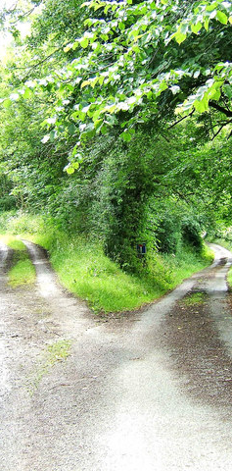


The World We’re In
A time of turmoil and turbulence, in many parts of the world
It is increasingly clear that basing our strategies on a single projection of the future leaves us vulnerable – assumptions can be dangerous!
At the same time, we can build resilience by verifying our assumptions and testing how our plans stand up under different circumstances
A proactive approach to futures planning is empowering, helping us to become actors in shaping the future
But where to start…
Photo by PL Chadwick on Geograph, CC-BY-SA 2.0

Slide 3
Trend Report
The report is a conversation starter.
It aims to be generative rather than predictive.
What is currently happening? What is likely to happen in the near future?
The identified trends occur in the context of the rapid advancement of generative AI and all the questions it raises for information and society in general.
Prepared by Prof. Michael Dezuanni and Dr Kim Osman, Digital Media Research Centre, Queensland University of Technology, Australia
Photo by Pierre Bamin on Unsplash
Notes:
. In many ways we are still grappling with the same issues identified in the 2013 report, privacy and information security, openness, regulation, and inequality. This speaks to the tension between the rapid advancement of information technologies and the sociocultural and material context in which this advancement occurs.
While it’s stating the obvious that the pandemic sparked the rapid advancement and use of mobile and other technologies for healthcare and for information, it also highlighted the persistent lack of access to technologies that provide access to vital information for already marginalised groups.
While we do devote section one to AI & Technology, all the other identified trends occur in the context of the rapid advancement of generative AI and all the questions it raises for the information society and society in general.
More than this though, technology enables creativity and enjoyment, it provides entertainment and connections, and for many, opportunities to learn and be a part of different communities. So,

Slide 4

Developing the 2024 Trend Report
Literature Review
Horizon scan of trends (n=515) across different domains and national contexts including socioeconomic, geopolitical, consumer, business, technology, risk and information.
Coding and synthesizing individual trends to identify their prominence in the literature and their relevance to information futures.
Identification of key trends, sub-trends and their interrelations.
Consultation with expert groups to feedback on identified trends.

Slide 5
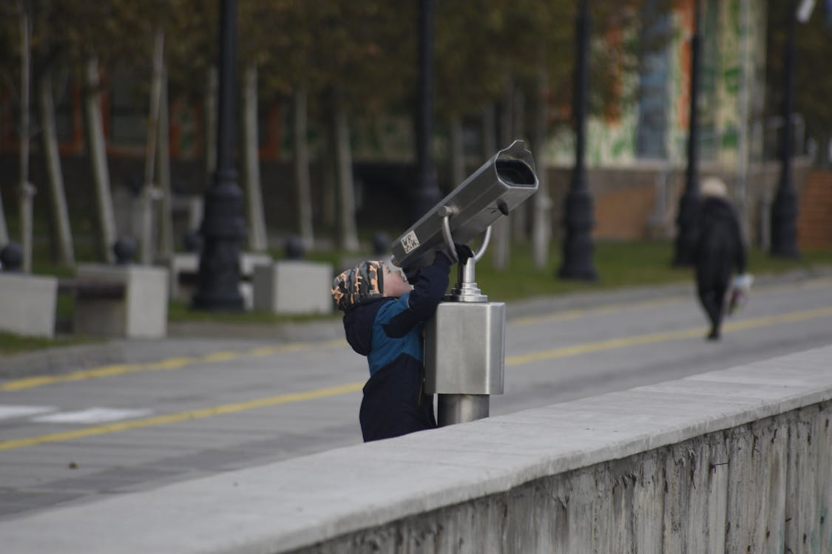
Developing the 2024 Trend Report
Scenarios
Speculative futures over the next 5-10 years.
Combine trends and explore ways they may play out.
A catalyst for thinking through the potential implications for information, knowledge and libraries in a variety of contexts and possible futures.
Photo: Euvgeny PH, Pexels

Slide 6
Trends

Slide 7

Trend 1
Knowledge practices are changing
The future holds both opportunities and challenges for improving equity in knowledge systems
Acceptance of the need to recognize diverse perspectives and voices.
Misinformation continues to impact society
New ways to create, share and use information
How can you build skills in your community to counter misinformation?
How do you use short form video to engage people with library information?
Photo by Nick Moore on Unsplash

Slide 8
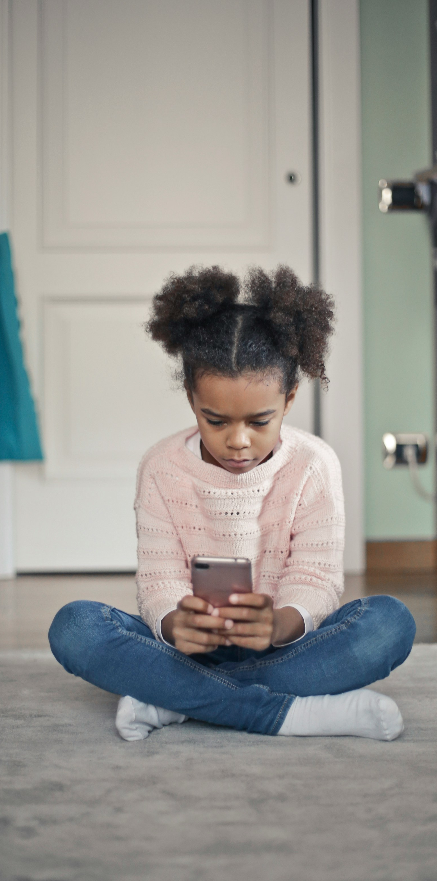
Trend 2
AI and other technologies are transforming society
Generative AI and new technologies are changing how we create, share and use information
Generative AI has great potential, but also potential harms
Digital twins are scaling up
How will AI change things like learning, language translation and creating content and information?
Photo by bruce mars on Unsplash

Slide 9

Trend 3
Trust is being renegotiated
Re-establishing trust in government and media is central for our societies to flourish
The loss of local news production is affecting those communities already disadvantaged in other ways
The open movements face challenges
What role can local libraries play in news deserts?
How can libraries help build trust in public institutions?
Photo by Aniruddha Bhattacharya on Unsplash

Slide 10
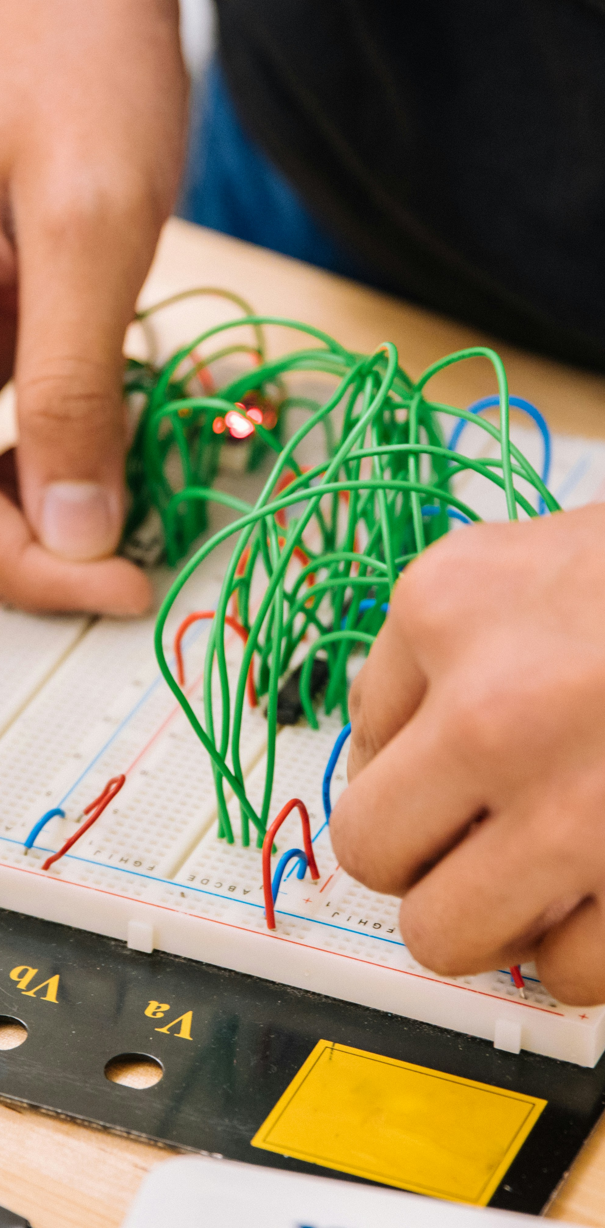
Skills and abilities are becoming more complex
Trend 4
People will need practical, critical and digital skills to thrive
There is a global talent shortage and a growing demand for digital skills and competencies
Media and information literacy benefits individuals and communities
What is the role of libraries in identifying and addressing emerging skills gaps in communities?
Does media and information literacy offer a solution to online harms and threats?
Photo by Jeswin Thomas on Unsplash

Slide 11
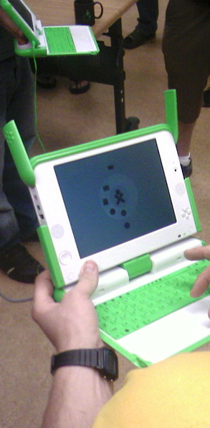
Digital technologies are unevenly distributed
Trend 5
Digital inclusion will increase equity
The digital divide is deepening
Essential services are migrating to digital-first and digital-only service provision that requires a digital identity
Inclusive cultural information frameworks create equitable futures
What data do you currently have? What data do you need? What data should you be collecting (or not)?
What access to devices and connections do people in your community have outside the library?
Photo: Brian Ellin, CC-BY-NC-SA, https://www.flickr.com/photos/brianellin/495063720/

Slide 12
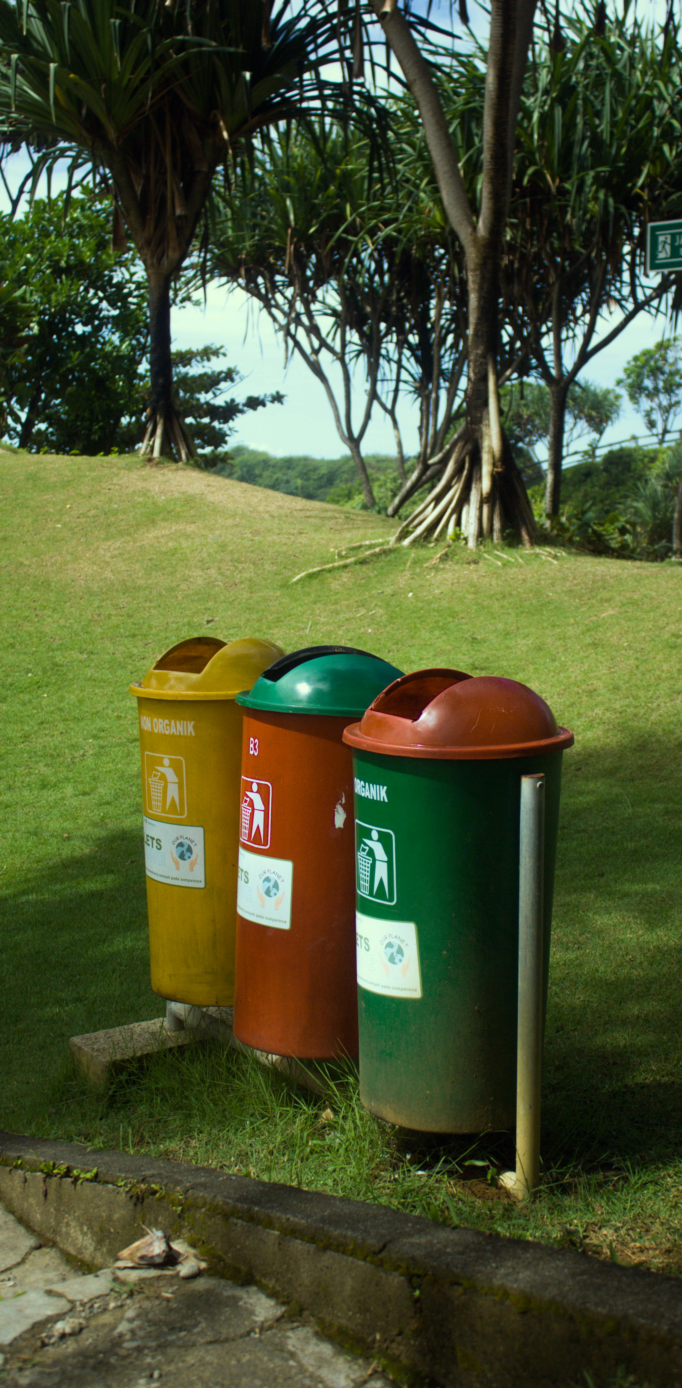
Information systems are using more resources
Trend 6
Our information needs are impacting the planet
Joining the green economy is essential to address climate change
E-waste is a growing problem
Does your organisation have a plan or policy for minimising the generation of e-waste?
How can libraries reduce or offset their environmental impacts?
Photo: Sardwim, https://www.pexels.com/photo/colorful-recycling-bins-on-the-roadside-15737015/

Slide 13
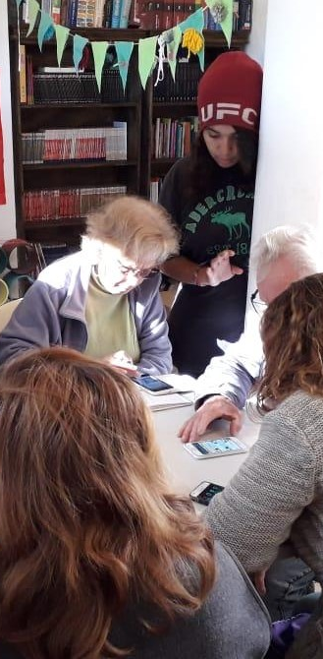
People are seeking community connections
Trend 7
Creating places to share space and resources is key to building an equitable society
Local, place-based events and collaborations builds community resilience and capabilities
Growth in online communities
What is the role of the library in addressing larger social problems like digital exclusion, poverty and education gaps?
What more do libraries need to become catalysts for community life?
Photo: Laura Beatriz Chobadindegui, CC-BY 2.0

Slide 14
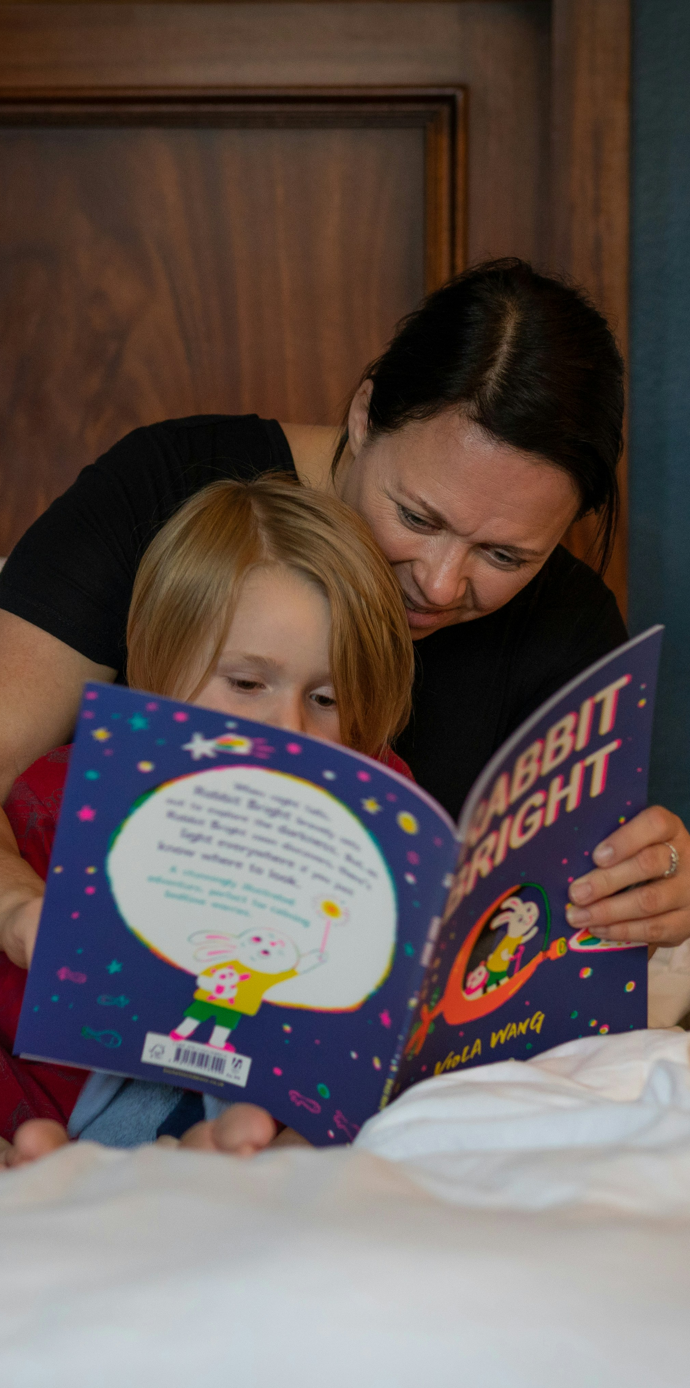
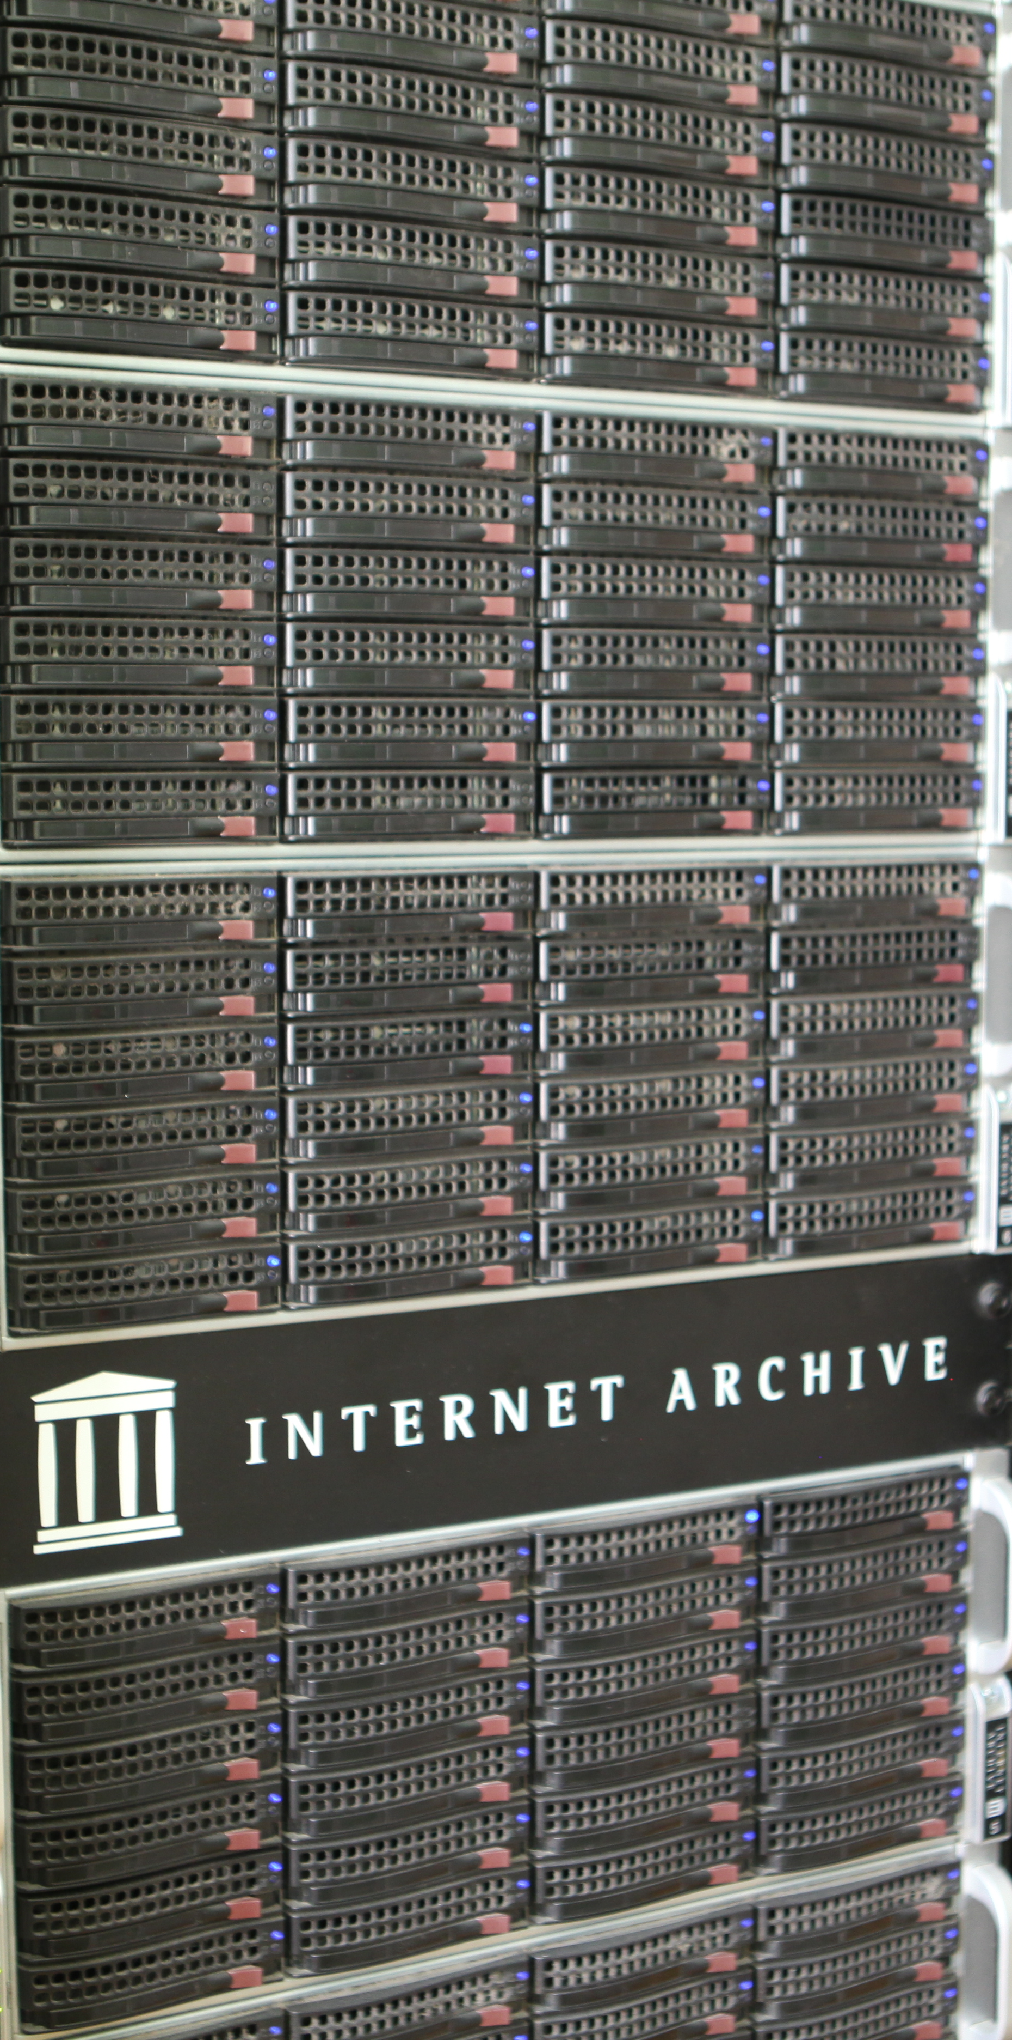
Intersection and interaction of the Trends
Scenarios
Scenarios represent speculative fiction – an imaginative vision of a potential version of the future
Some explore a continuation of current trends, or ways in which they might complement – or conflict – with each other
Others are more radical!
They are there to be used as ‘tests’ for our assumptions, plans and strategies
None will come 100% true. The future may reflect elements of all, some, or none of them
Photo Jason Scott on Wikipedia, CC-BY 2.0

Slide 15
Intersection and interaction of the Trends
Scenarios
AI Scalpers: abuse of AI-led customer service affects access to services
Fuzzy Records: what happens when we can no longer trust the past?
Room 1701: how use of deepfakes can shape and undermine democracy
My voice, my sovereignty: using AI and digital tools to drive local content
Short form: making the most of social media to bring libraries to new audiences
Digital nations: what is life like for people whose country now only exists online
Photo by Ben Griffiths on Unsplash

Slide 16
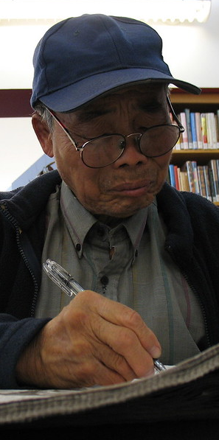
Intersection and interaction of the Trends
Scenarios
Greenformation: how can knowledge sharing help address the climate crisis
Opt-out: what happens when people choose a life without screens
Living memory: making life more livable for older adults in a digital world
Dark libraries: what if library services become more like private education
And also: David Lankes, Supriya Kulkarni, Beth Patin, Michael Oghia, Mei Lin Fung, Daniel Nwaeze, and Elinor Carmi
Photo by Eric Chan on Flickr, CC-BY 2.0

Slide 17

The Trend Report as starting point
What trends do you see? What would you add?
Explore trend intersections? Do they complement, complicate or compete?
What questions would be relevant for your library type or specialisation, or a community you serve?
Develop scenarios based on trend interactions
Imagine a day in the life
Plan for different scenarios (competitively!)
Photo by Markus Spiske on Unsplash
Notes:
. In many ways we are still grappling with the same issues identified in the 2013 report, privacy and information security, openness, regulation, and inequality. This speaks to the tension between the rapid advancement of information technologies and the sociocultural and material context in which this advancement occurs.
While it’s stating the obvious that the pandemic sparked the rapid advancement and use of mobile and other technologies for healthcare and for information, it also highlighted the persistent lack of access to technologies that provide access to vital information for already marginalised groups.
While we do devote section one to AI & Technology, all the other identified trends occur in the context of the rapid advancement of generative AI and all the questions it raises for the information society and society in general.
More than this though, technology enables creativity and enjoyment, it provides entertainment and connections, and for many, opportunities to learn and be a part of different communities. So,

Slide 18
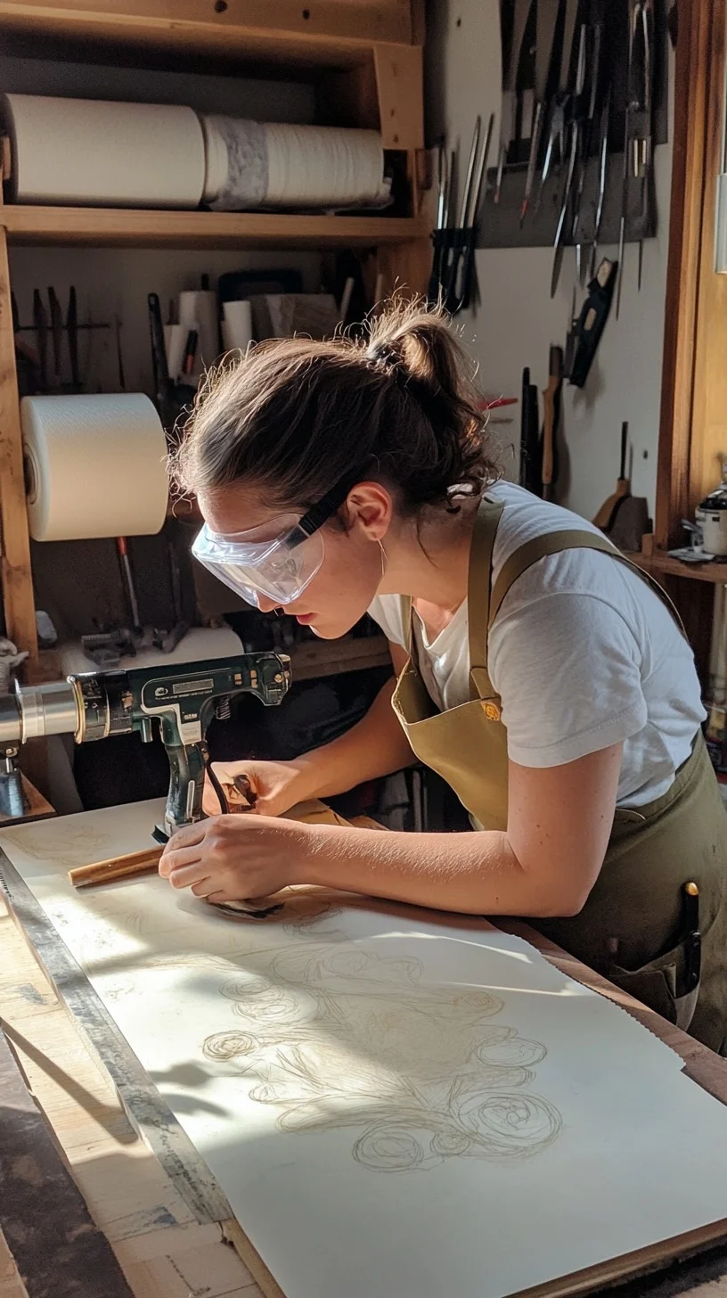
A Skills Agenda for the Trend Report
Based on the inputs of the group of emerging leaders who participated in the IFLA Information Futures Summit
Given the variety of different futures we might face, what are the skills librarians need to survive and thrive?
Practical skills – specific technical competences
Partnership skills – working effectively with others
Personal development skills – learning how to learn
Notes:
. In many ways we are still grappling with the same issues identified in the 2013 report, privacy and information security, openness, regulation, and inequality. This speaks to the tension between the rapid advancement of information technologies and the sociocultural and material context in which this advancement occurs.
While it’s stating the obvious that the pandemic sparked the rapid advancement and use of mobile and other technologies for healthcare and for information, it also highlighted the persistent lack of access to technologies that provide access to vital information for already marginalised groups.
While we do devote section one to AI & Technology, all the other identified trends occur in the context of the rapid advancement of generative AI and all the questions it raises for the information society and society in general.
More than this though, technology enables creativity and enjoyment, it provides entertainment and connections, and for many, opportunities to learn and be a part of different communities. So,

Slide 19
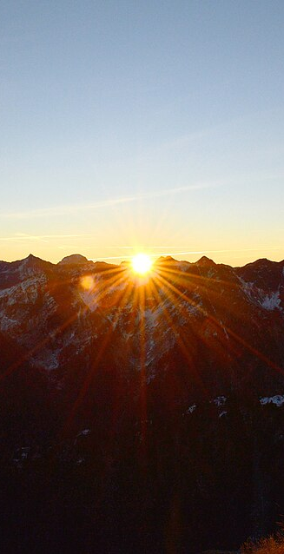
Futures thinking: Part of every librarians’ toolkit?
Moving from a sense of powerlessness or reliance on (unconscious) assumptions to an active, eyes-open approach
Identifying trends, as well as the strong and weak signals that could shape the future
Tools for developing scenarios and pathways that we could follow
Lessons about how to test our plans, as well as identify and challenge asssumptions
Photo by Thomas K on Wikipedia, CC-BY 3.0
Notes:
. In many ways we are still grappling with the same issues identified in the 2013 report, privacy and information security, openness, regulation, and inequality. This speaks to the tension between the rapid advancement of information technologies and the sociocultural and material context in which this advancement occurs.
While it’s stating the obvious that the pandemic sparked the rapid advancement and use of mobile and other technologies for healthcare and for information, it also highlighted the persistent lack of access to technologies that provide access to vital information for already marginalised groups.
While we do devote section one to AI & Technology, all the other identified trends occur in the context of the rapid advancement of generative AI and all the questions it raises for the information society and society in general.
More than this though, technology enables creativity and enjoyment, it provides entertainment and connections, and for many, opportunities to learn and be a part of different communities. So,

Slide 20
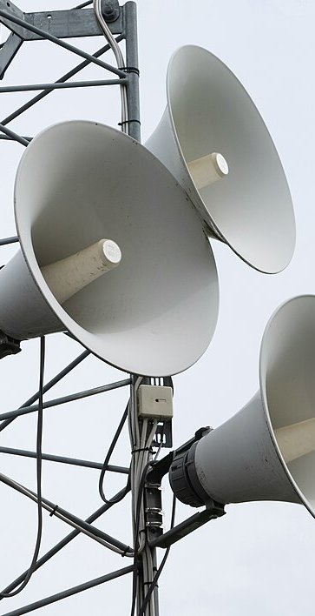
Key messages
Making the future part of our decision-making today helps build resilience, improve planning, challenge assumptions and ensure that we are active – not passive – in our work
The IFLA Trend Report offers a range of tools available to libraries everywhere in order to work with futures
We encourage you to incorporate this into your own regular practice, and of course to share your results!
Photo by W.carter on Wikimedia, CC0
Notes:
. In many ways we are still grappling with the same issues identified in the 2013 report, privacy and information security, openness, regulation, and inequality. This speaks to the tension between the rapid advancement of information technologies and the sociocultural and material context in which this advancement occurs.
While it’s stating the obvious that the pandemic sparked the rapid advancement and use of mobile and other technologies for healthcare and for information, it also highlighted the persistent lack of access to technologies that provide access to vital information for already marginalised groups.
While we do devote section one to AI & Technology, all the other identified trends occur in the context of the rapid advancement of generative AI and all the questions it raises for the information society and society in general.
More than this though, technology enables creativity and enjoyment, it provides entertainment and connections, and for many, opportunities to learn and be a part of different communities. So,

Slide 21


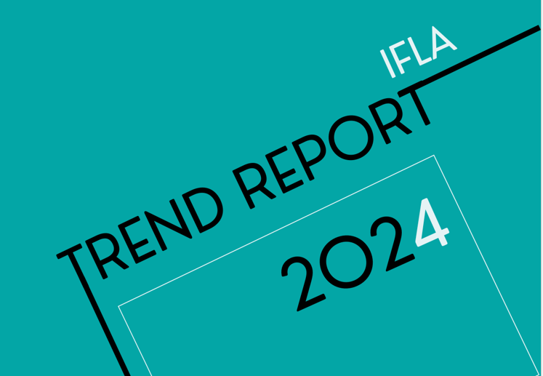
Thanks to…
Our Trend Report Advisory Committee
Our expert author contributions

Slide 22


Thank You ifla.org/trend-report/
Funded by the Gates Foundation via SIGL
Photo by Kelly Sikkema on Unsplash

