Slide 1


A Strong and Sustainable Library Field for LAC
Buenos Aires – 20-21 November 2023

Slide 2


Wi-Fi
Network: BCN-WIFI-IFLA
Password: IFLA2024

Slide 3
Opening and Welcome

Slide 4
Alejandro Santa
Chair, IFLA Regional Council 2023-2025

Slide 5

By the end of this workshop, you should...
Have an understanding of what a sustainable library field means, and how you can apply this in your own work
Have new ideas about how you can engage with the UN, UNESCO and other international initiatives within your country and regionally
Be able to apply (IFLA) tools and references in your own strategic planning, in particular around gathering and applying data, assessing impact, partnerships and emerging leaders
Be ready to work with us in shaping an IFLA ‘offer’ that responds to the needs of the region
Have built your own networks!

Slide 6
Share your experience!
Use #IFLAWorkshop
Tag @iflaglobal (Instagram, LinkedIn)
Tag @ifla.org (Facebook)

Slide 9
Made possible thanks to the financial support of:

Slide 10
Our Agenda (Day 1)
Opening and welcome (almost over!)
Setting the scene and warming up
Trends and Futures
IFLA Strategy and Sustainability
Leadership pathways – bringing forward emerging leaders
Communities – structures and connections to deliver change
Surgeries – Library Map of the World, Advocacy, Impact
Welcome dinner

Slide 11
Our Agenda (Day 2)
Library Map of the World – current priorities and look into the future
Planning for impact – evaluating and demonstrating value and impact
Partnerships – identifying strategic, equitable partnership opportunities
Advocacy – defining advocacy goals and practicing advocacy skills
Reflection and closing – looking forward to impactful regional actions
Surgeries - Library Map of the World, Advocacy, Impact
Dinner

Slide 12
Roles
Kristine and Stephen: Moderators, additional support
Esther: Keeping the show on the road
Cristina: Recording the memories
Arlene and Fernando: consulting on impact
Despina Gerasimidou: here in spirit!
You: essential to the success of our time together!

Slide 13
Meeting rules and norms
Please bring your full attention to this process and to what others are saying
Please ask questions if you don’t understand
Be understanding and help each other out
Assume good intentions, do not immediately make a judgement
Step up if you have something to say. Step back if you’ve talked already.
Use the parking lot to capture topics that are important, but not right now

Slide 14
By the end of this workshop, we should...
Know you and your national library fields better
Have ideas from you about where there are possibilities to work with the UN, UNESCO, and potential funders
Understand better how we can support a sustainable library field in LAC
Have convinced you to extend your engagement in IFLA!

Slide 15
Note
You will sometimes be asked to think about your own experience, sometimes about your national experience, sometimes about your regional experience, and sometimes globally. Be ready to flex!
We’ll be using quite a lot of Mentimeter, so please make sure your device can work. Mentimeter does work well on smartphones!
We’ll be setting out commitments for follow-up work at the national level throughout the workshop, and will summarise these at the end

Slide 16

Setting the scene

Slide 17
Warming up
Have you ever…
Notes:
You might need to upload the bullet point picture, it is on the same folder as this presentation on Sharepoint. To change it, click on the right arrow in bullet list icon from the Home panel, then “Bulletpoints and Numbering”, and finally click “Picture” and upload the png.

Slide 18
Have you ever…
Been an IFLA volunteer?
Notes:
You might need to upload the bullet point picture, it is on the same folder as this presentation on Sharepoint. To change it, click on the right arrow in bullet list icon from the Home panel, then “Bulletpoints and Numbering”, and finally click “Picture” and upload the png.

Slide 19
Have you ever…
Attended an IFLA Congress?
Notes:
You might need to upload the bullet point picture, it is on the same folder as this presentation on Sharepoint. To change it, click on the right arrow in bullet list icon from the Home panel, then “Bulletpoints and Numbering”, and finally click “Picture” and upload the png.

Slide 20
Have you ever…
Nominated someone in an IFLA Election?
Notes:
You might need to upload the bullet point picture, it is on the same folder as this presentation on Sharepoint. To change it, click on the right arrow in bullet list icon from the Home panel, then “Bulletpoints and Numbering”, and finally click “Picture” and upload the png.

Slide 21
Have you ever…
Voted in an IFLA Election?
Notes:
You might need to upload the bullet point picture, it is on the same folder as this presentation on Sharepoint. To change it, click on the right arrow in bullet list icon from the Home panel, then “Bulletpoints and Numbering”, and finally click “Picture” and upload the png.

Slide 22
Have you ever…
Talked to someone else about IFLA?
Notes:
You might need to upload the bullet point picture, it is on the same folder as this presentation on Sharepoint. To change it, click on the right arrow in bullet list icon from the Home panel, then “Bulletpoints and Numbering”, and finally click “Picture” and upload the png.

Slide 23
Have you ever…
Been as wet as yesterday?
Notes:
You might need to upload the bullet point picture, it is on the same folder as this presentation on Sharepoint. To change it, click on the right arrow in bullet list icon from the Home panel, then “Bulletpoints and Numbering”, and finally click “Picture” and upload the png.

Slide 24
What score did you get?

Slide 25
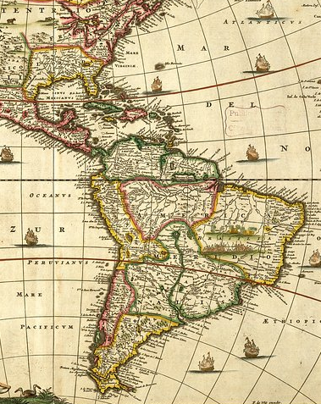
If you had to move to another country in LAC, which one would you choose?
Notes:
You might need to upload the bullet point picture, it is on the same folder as this presentation on Sharepoint. To change it, click on the right arrow in bullet list icon from the Home panel, then “Bulletpoints and Numbering”, and finally click “Picture” and upload the png.

Slide 26
In what other LAC country would you like to live?
Go to www.menti.com and use the code 4916 9923

Slide 27
Introduce yourselves to your table in 1 minute, saying:
Who you are
Your engagement with IFLA
What you want to get from this meeting!

Slide 28
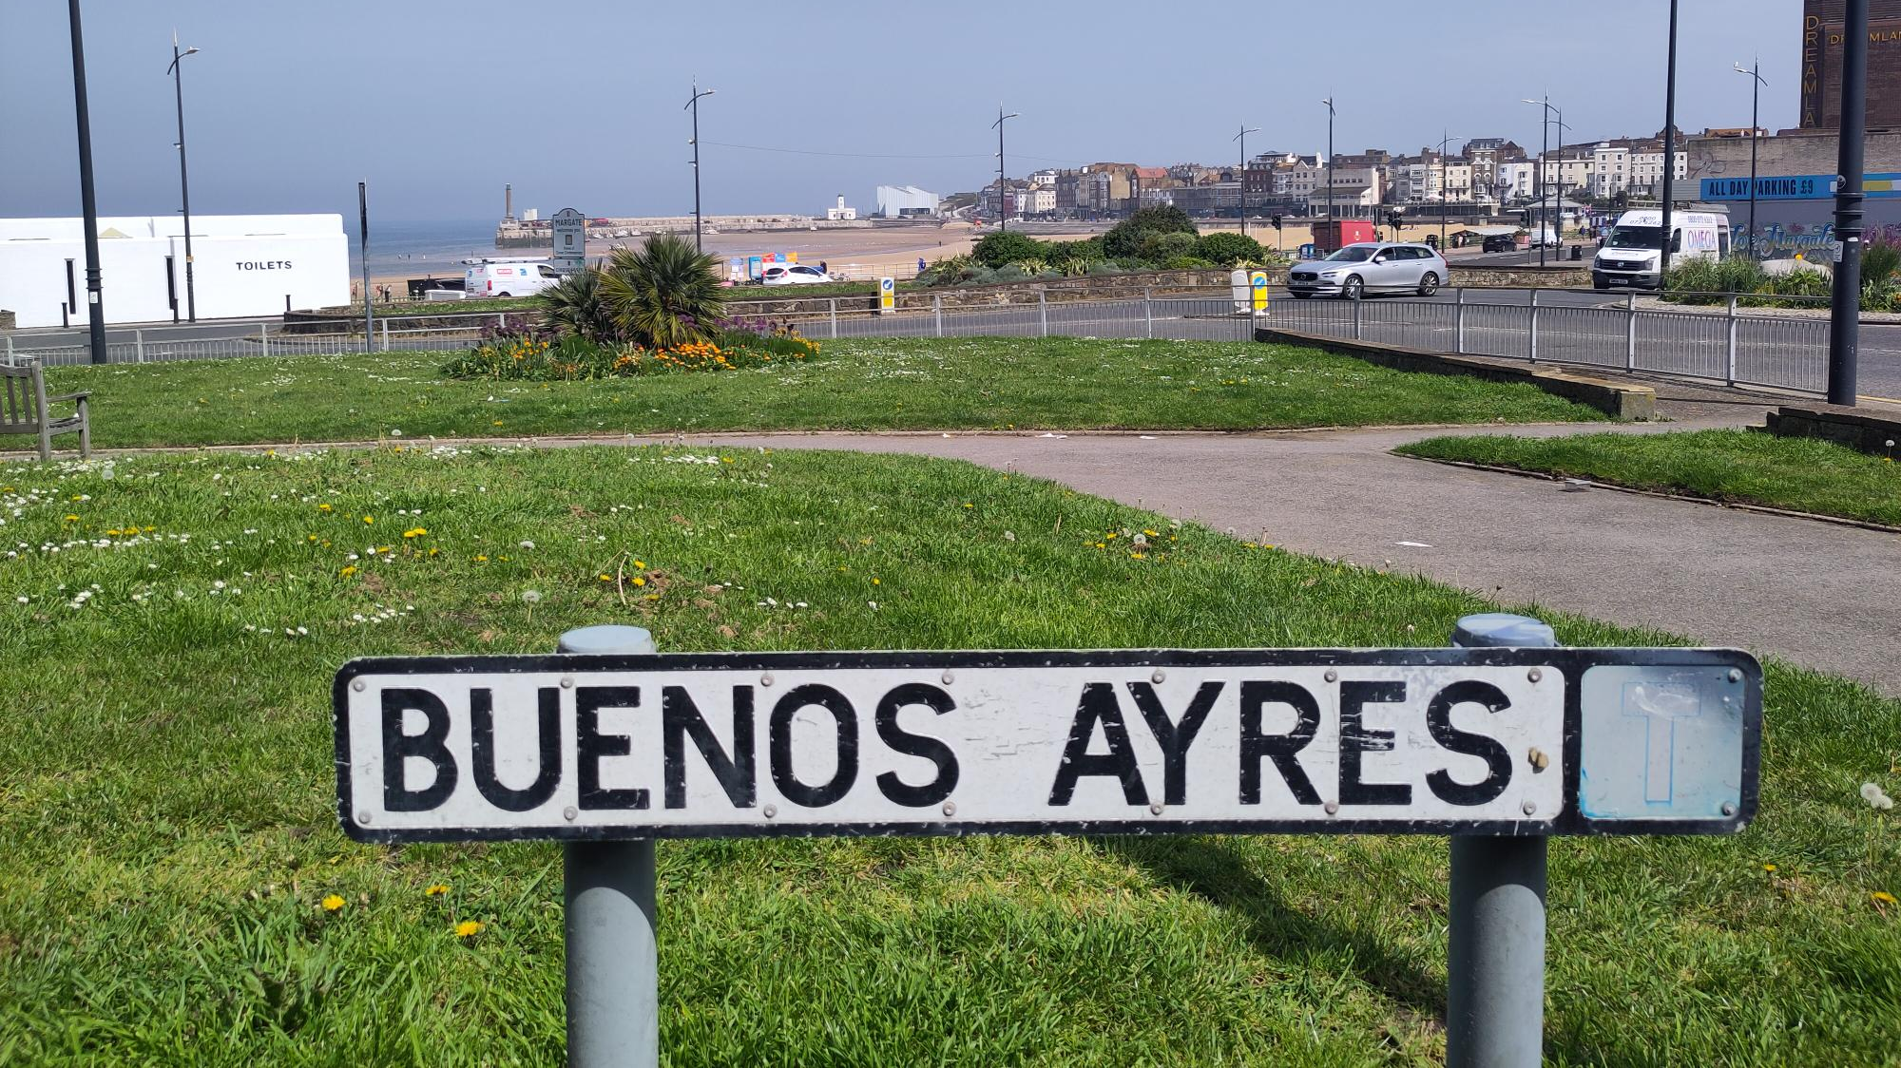
The road to

Slide 29

WELCOME TO
IFLA
the world’s library organisation

Slide 30
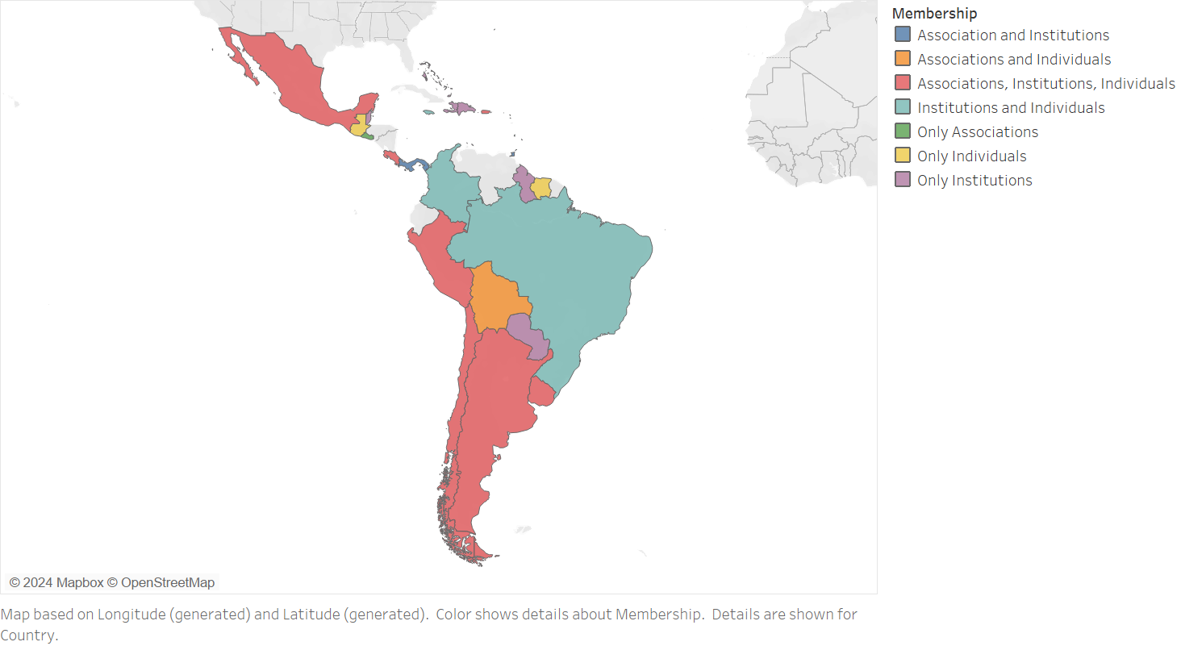

Slide 31
IFLA is…
An essential actor in advancing global librarianship, bringing benefits to libraries, library and information workers, library associations, and the communities that they serve

Slide 32
If IFLA didn’t exist, we would need to invent it because…
We have enough in common to mean we gain from sharing
To collaborate, we need international infrastructures and standards
Decisions are being made internationally that need library input!
Libraries are missing out on partnerships by only working nationally
There is a sense of professional solidarity between colleagues

Slide 33
A virtuous circle is possible…
Stronger delivery on policy/societal goals
Deeper/broader support for libraries

Slide 34

… that can be achieved at all levels of our field…
Photo: Ankush Sabharwal, CC-BY-3.0, https://commons.wikimedia.org/wiki/File:Fractals_in_stone.JPG

Slide 35
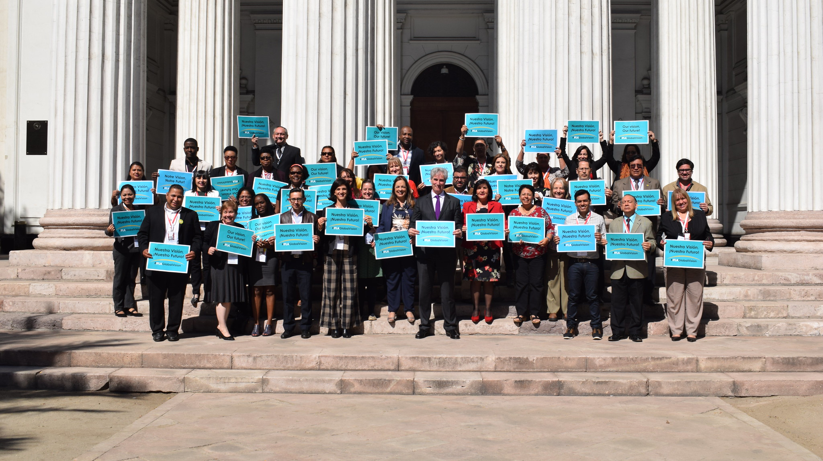

Slide 36
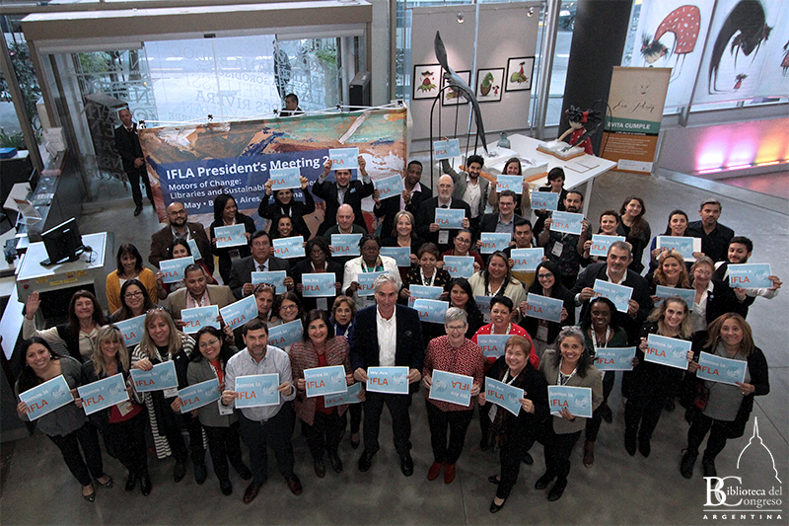

Slide 37
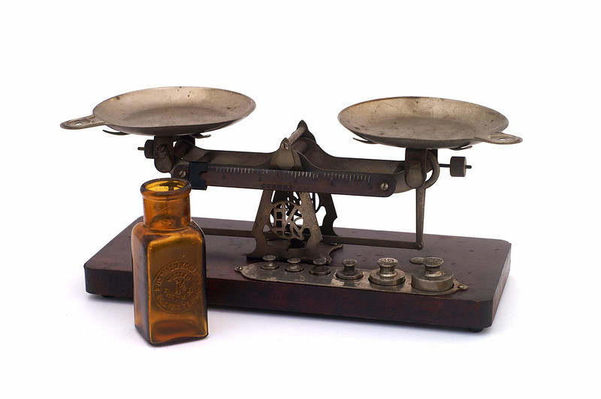
Photo: Steve Harwood, CC-BY-NC 2.0: https://www.flickr.com/photos/captkodak/272746539
… SUSTAINABLY!

Slide 38
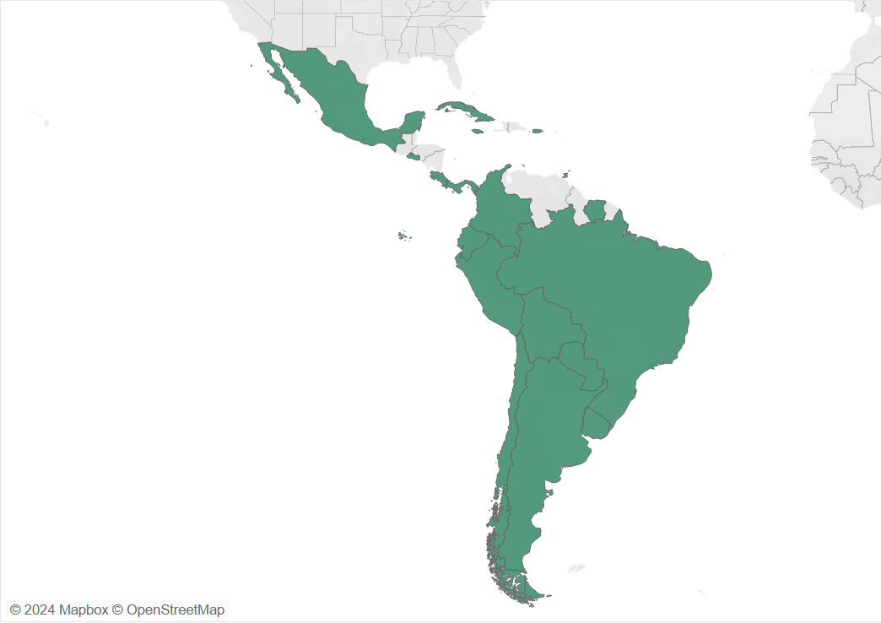
IFLA HEADQUARTERS 2023
Represented here

Slide 39
By the end of this workshop, you should...
Have an understanding of what a sustainable library field means, and how you can apply this in your own work
Have new ideas about how you can engage with the UN, UNESCO and other international initiatives within your country and regionally
Be able to apply (IFLA) tools and references in your own strategic planning, in particular around gathering and applying data, assessing impact, partnerships and emerging leaders
Be ready to work with us in shaping an IFLA ‘offer’ that responds to the needs of the region
Have built your own networks!

Slide 40

Any questions?
Photo: Matt Botsford on Unsplash, unsplash.com/photos/OKLqGsCT8qs

Slide 41
Trends and Futures

Slide 42
PRESENTING THE

Slide 43


Trend Report
The report is generative rather than predictive.
What is currently happening? What is likely to happen in the near future?
The identified trends occur in the context of the rapid advancement of generative AI and all the questions it raises for information and society in general.
Prepared by Prof. Michael Dezuanni and Dr Kim Osman, Digital Media Research Centre, Queensland University of Technology, Australia
Photo by Pierre Bamin on Unsplash
Notes:
. In many ways we are still grappling with the same issues identified in the 2013 report, privacy and information security, openness, regulation, and inequality. This speaks to the tension between the rapid advancement of information technologies and the sociocultural and material context in which this advancement occurs.
While it’s stating the obvious that the pandemic sparked the rapid advancement and use of mobile and other technologies for healthcare and for information, it also highlighted the persistent lack of access to technologies that provide access to vital information for already marginalised groups.
While we do devote section one to AI & Technology, all the other identified trends occur in the context of the rapid advancement of generative AI and all the questions it raises for the information society and society in general.
More than this though, technology enables creativity and enjoyment, it provides entertainment and connections, and for many, opportunities to learn and be a part of different communities. So,

Slide 44

Developing the 2024 Trend Report
Literature Review
Horizon scan of trends (n=515) across different domains and national contexts including socioeconomic, geopolitical, consumer, business, technology, risk and information.
Coding and synthesizing individual trends to identify their prominence in the literature and their relevance to information futures.
Identification of key trends, sub-trends and their interrelations.
Consultation with expert groups to feedback on identified trends.

Slide 45
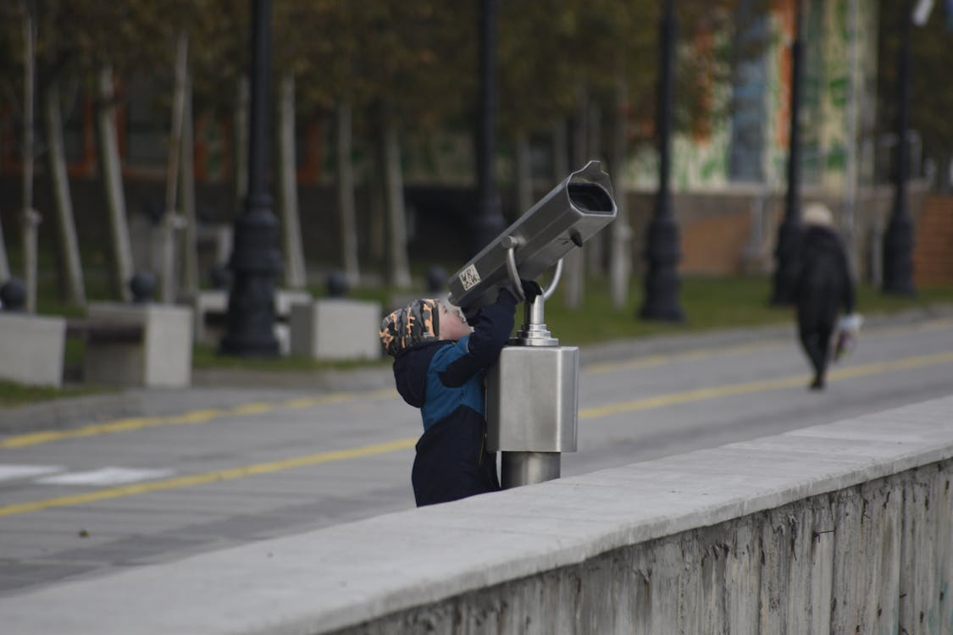
Developing the 2024 Trend Report
Scenarios
Speculative futures over the next 5-10 years.
Combine trends and explore ways they may play out.
A catalyst for thinking through the potential implications for information, knowledge and libraries in a variety of contexts and possible futures.
Photo: Euvgeny PH, Pexels

Slide 46
Trends

Slide 47

Trend 1
Knowledge practices are changing
The future holds both opportunities and challenges for improving equity in knowledge systems
Acceptance of the need to recognize diverse perspectives and voices.
Misinformation continues to impact society
New ways to create, share and use information
How can you build skills in your community to counter misinformation?
How do you use short form video to engage people with library information?
Photo by Nick Moore on Unsplash

Slide 48

AI and other technologies are transforming society
Trend 2
Generative AI and new technologies are changing how we create, share and use information
Generative AI has great potential, but also potential harms
Digital twins are scaling up
How will AI change things like learning, language translation and creating content and information?
Photo by bruce mars on Unsplash

Slide 49
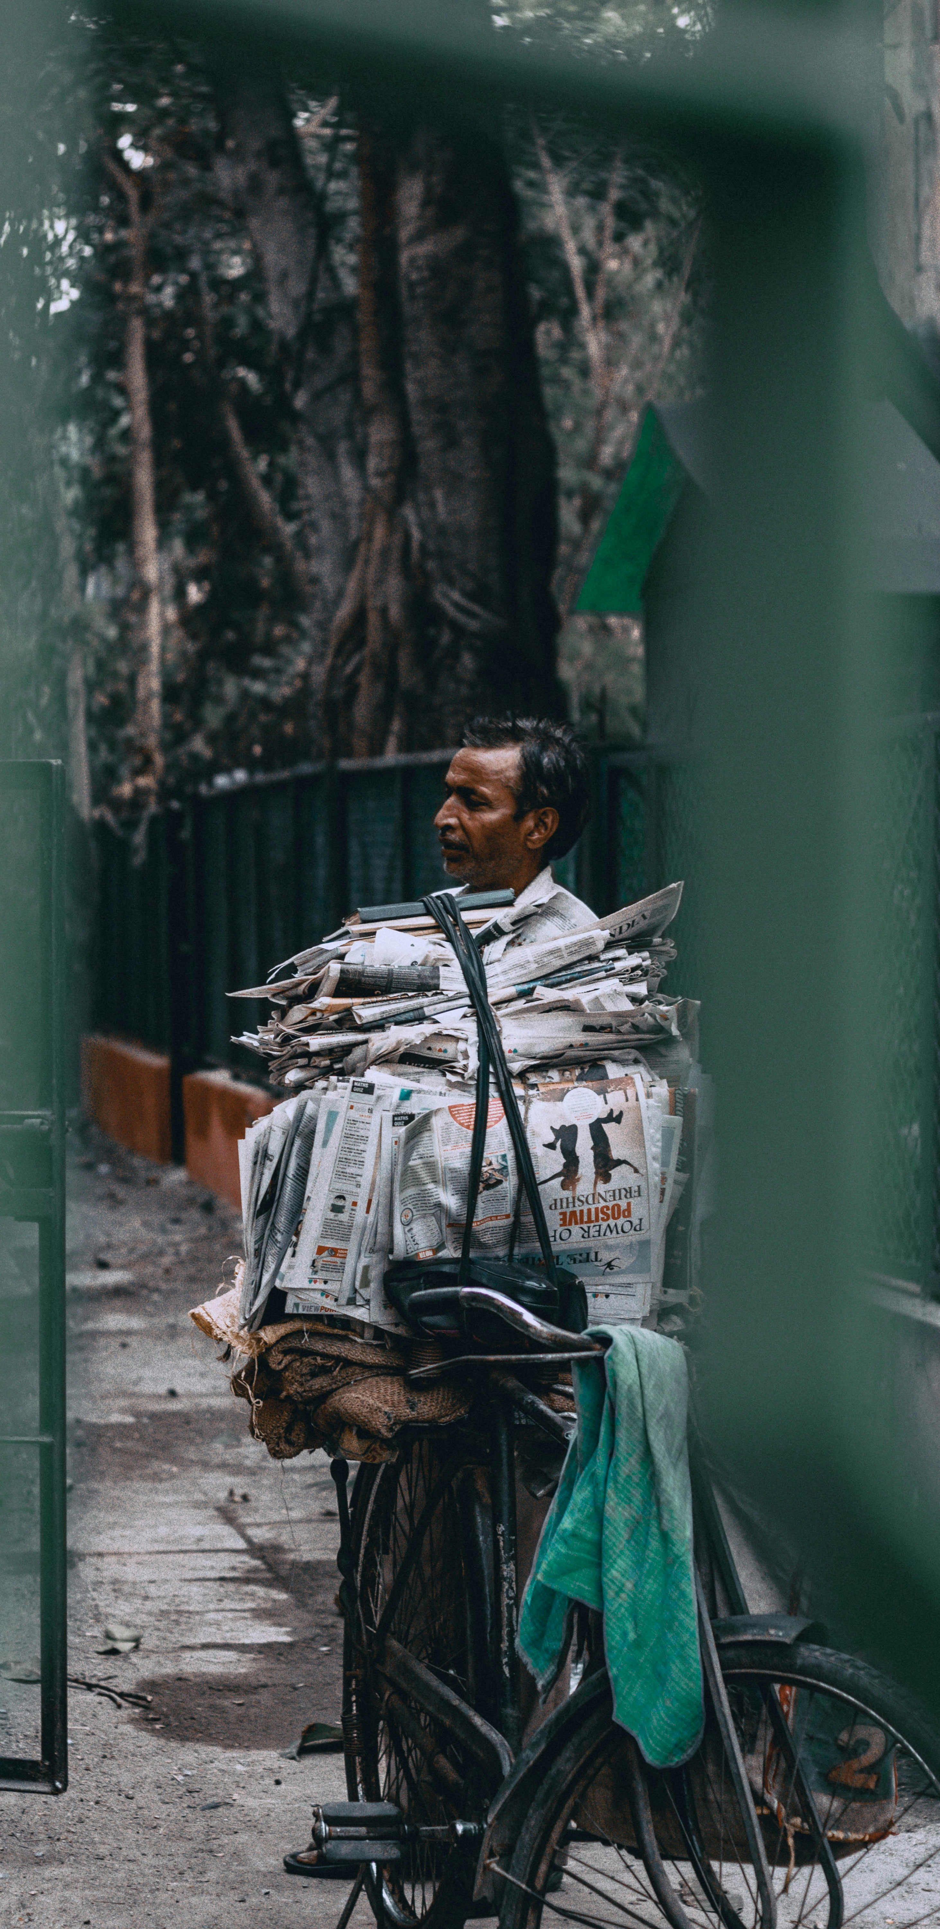
Trend 3
Trust is being renegotiated
Re-establishing trust in government and media is central for our societies to flourish
The loss of local news production is affecting those communities already disadvantaged in other ways
The open movements face challenges
What role can local libraries play in news deserts?
How can libraries help build trust in public institutions?
Photo by Aniruddha Bhattacharya on Unsplash

Slide 50
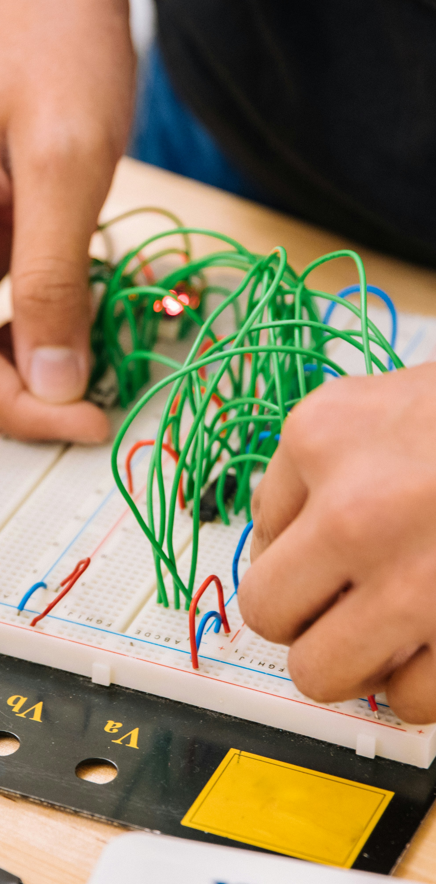
Skills and abilities are becoming more complex
Trend 4
People will need practical, critical and digital skills to thrive
There is a global talent shortage and a growing demand for digital skills and competencies
Media and information literacy benefits individuals and communities
What is the role of libraries in identifying and addressing emerging skills gaps in communities?
Does media and information literacy offer a solution to online harms and threats?
Photo by Jeswin Thomas on Unsplash

Slide 51
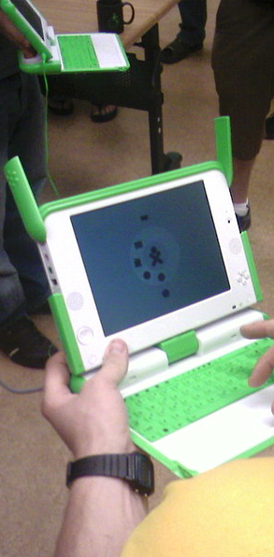
Digital technologies are unevenly distributed
Trend 5
Digital inclusion will increase equity
The digital divide is deepening
Essential services are migrating to digital-first and digital-only service provision that requires a digital identity
Inclusive cultural information frameworks create equitable futures
What data do you currently have? What data do you need? What data should you be collecting (or not)?
What access to devices and connections do people in your community have outside the library?
Photo: Brian Ellin, CC-BY-NC-SA, https://www.flickr.com/photos/brianellin/495063720/

Slide 52
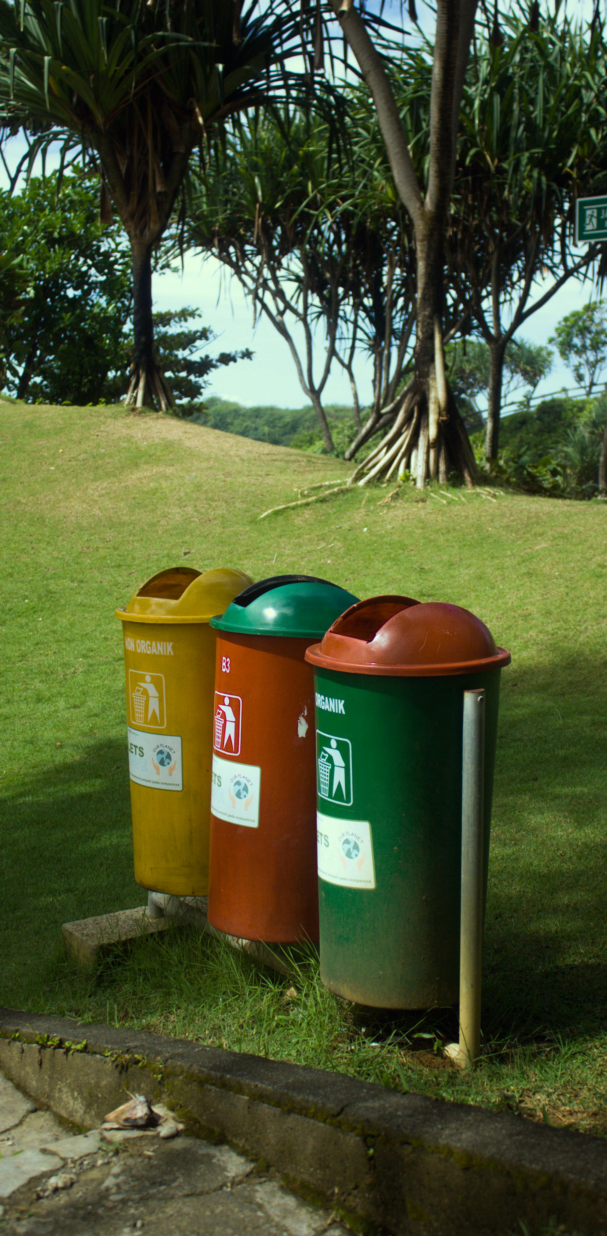
Information systems are using more resources
Trend 6
Our information needs are impacting the planet
Joining the green economy is essential to address climate change
E-waste is a growing problem
Does your organisation have a plan or policy for minimising the generation of e-waste?
How can libraries reduce or offset their environmental impacts?
Photo: Sardwim, https://www.pexels.com/photo/colorful-recycling-bins-on-the-roadside-15737015/

Slide 53
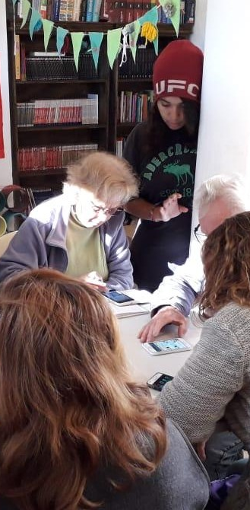
People are seeking community connections
Trend 7
Creating places to share space and resources is key to building an equitable society
Local, place-based events and collaborations builds community resilience and capabilities
Growth in online communities
What is the role of the library in addressing larger social problems like digital exclusion, poverty and education gaps?
What more do libraries need to become catalysts for community life?
Photo: Laura Beatriz Chobadindegui, CC-BY 2.0

Slide 54
How positive/negative are these trends? How important are they for libraries?
Go to www.menti.com and use the code 4916 9923

Slide 55
It is 2034

Slide 56
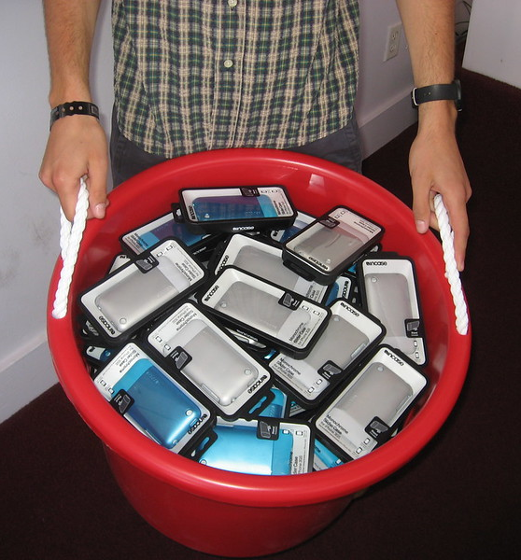
Scenario 1 – Opt Out
1. Expectations of digital citizenship move faster than people’s readiness to embrace it
2. People living informally are not able to benefit, while the digital divide remains an issue for a hard-to-compress share of the population
3. A growing share of the population refuse to adopt new technologies, preferring to live without screens
4. They risk facing exclusion, given that services (public and private) are increasingly available only in digital form. So too is community life
Photo: Incase, CC-BY, https://www.flickr.com/photos/goincase/4664247998/

Slide 57

Scenario 2 – It might be all the chemtrails raining down on you
1. An explosion of misinformation has undermined many people’s belief in what they read or see
2. Instead, many prefer to stick to what makes them comfortable, with attacks on education and research growing
3. Laws follow, with growing moves to censor information that does not match with official viewpoints
4. Yet the consequences of this in terms of falling education results, and scandals linked to misinformation, are making some ask questions
Photo: Steve Tannock, CC-BY-NC-SA, https://bit.ly/40KjMWk

Slide 58
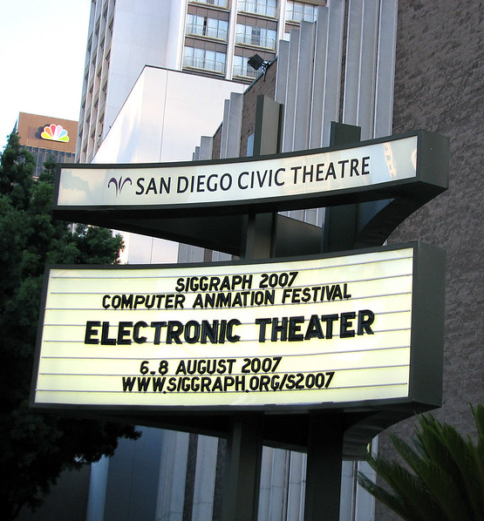
Scenario 3 – All the world’s a stage
1. A growing (and increasingly obvious) divide between macro and micro information environments
2. A constitutional crisis leads to a crisis of confidence in whether the media and information landscape is really working
3. A collective understanding that information needs to work for people, leading to new regulation of platforms and AI to ensure a public interest focus
4. Regulation is backed up by an increasingly aware and activist population
Photo: Better than bacon, CC-BY-NC-ND: https://www.flickr.com/photos/slurm/1119406472/

Slide 59
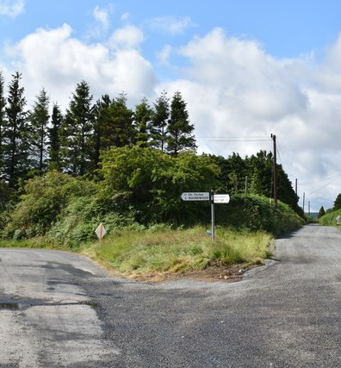
You can’t predict the future, but you can prepare for it
Digital denial (Opt outs)
Conspiracies (Chemtrails)
A new balance (All the world’s a stage)
What choices should we make on:
Our buildings?
Our collections and services?
Our staff training?
Our partnerships?
Photo: Simon Mortimer, CC-BY-SA: https://www.geograph.ie/photo/6220557

Slide 60
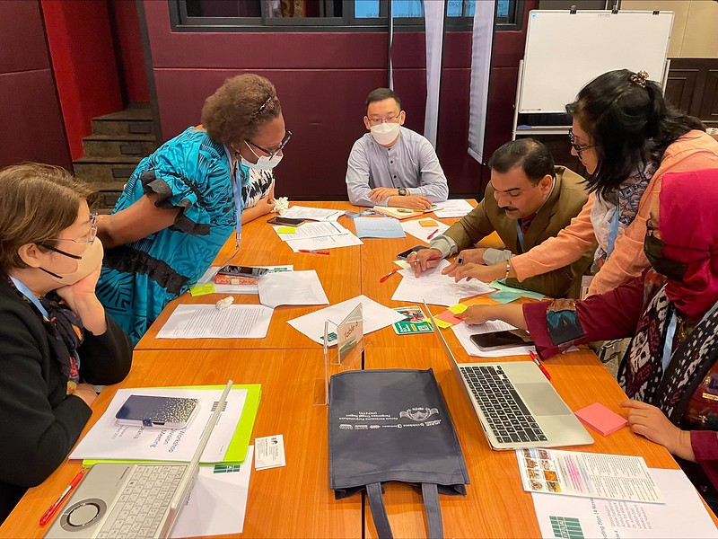
Other options for ‘gaming’ with the Trend Report
What trends do you see? What would you add? Which matter most?
Explore trend intersections? Do they complement, complicate or compete?
Develop scenarios based on trend interactions
Imagine a day in the life
Plan for different scenarios
More to come!
Photo: IFLA, CC-BY, https://www.flickr.com/photos/ifla/52521252859/in/album-72177720303968008

Slide 61

Break
Photo by Mike Kenneally on Unsplash, unsplash.com/photos/TD4DBagg2wE

Slide 62
Library Field Sustainability

Slide 63
What do we mean by a sustainable library field?

Slide 64
The library field is…
Library and information workers, institutions (of all types), associations, and the services and infrastructures that support them

Slide 65
Brundtland Report, 1987
Sustainable development is: “development that meets the needs of the present without compromising the ability of future generations to meet their own needs”

Slide 66
Brundtland Report, 1987
Sustainable development is: “development that meets the needs of the present without compromising the ability of future generations to meet their own needs”

Slide 67
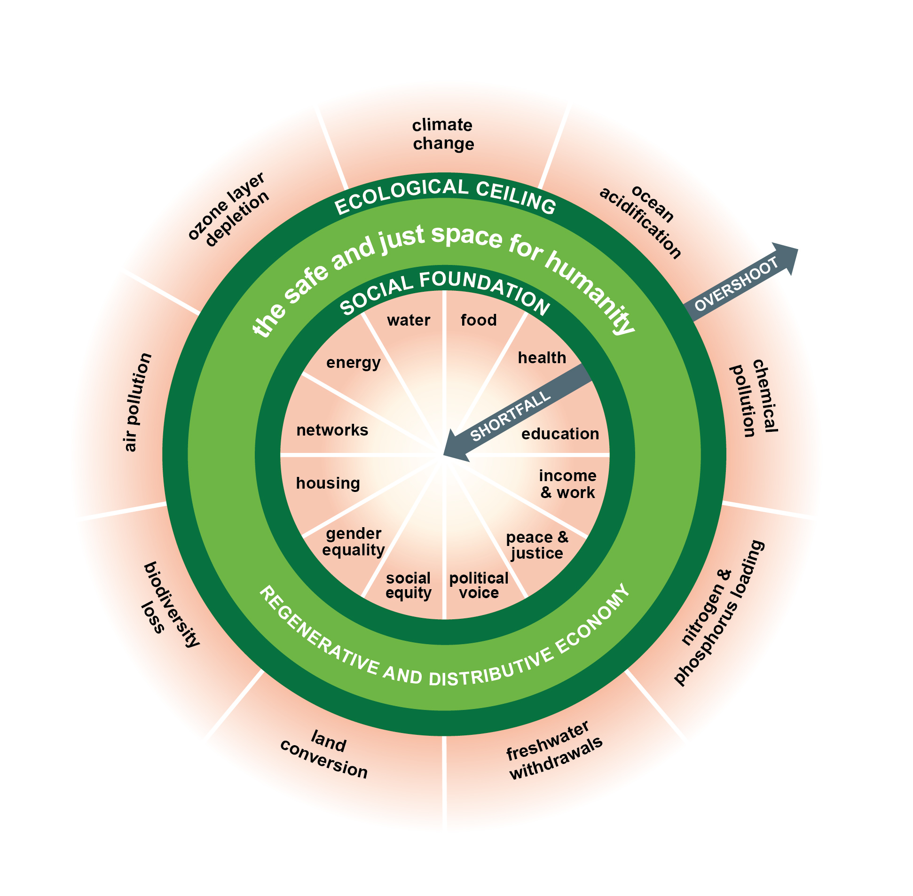
Doughnut economics and the limits to growth

Slide 68

The UN Sustainable Development Goals
Transforming Our World: the 2030 Agenda for Sustainable Development, agreed in 2015
Includes:
Sustainable Development Goals
Resource mobilisation
Follow-up mechanisms

Slide 69
We can talk about sustainability…
As an internal issue for our field
As a practical issue in our relationships with others (users, suppliers, supporters, partners)
As a policy issue

Slide 70

EXERCISE
What does library sustainability mean for you?

Slide 71
EXERCISE: What does library sustainability mean for you?
Go to menti.com (4101 6690), and add in the words you think are most relevant in defining what sustainability means for libraries in your country
Write down your own ideas as a tweet
Compare on your table, and write a shared definition on your flipchart (240 characters)
Swap with a neighbouring table, and note – on post-its – what you like, and what you’d add

Slide 72

EXERCISE
Define and apply a library field sustainability index

Slide 73
EXERCISE: Define and apply a library field sustainability index
Brainstorm the factors of sustainability
Combine your ideas to get to 4-8 factors in total
Assign weightings of 1-5 to these factors
Score your national field, and the region on each factor (1-5), and multiply by the weightings
Discuss your findings and what they mean

Slide 74
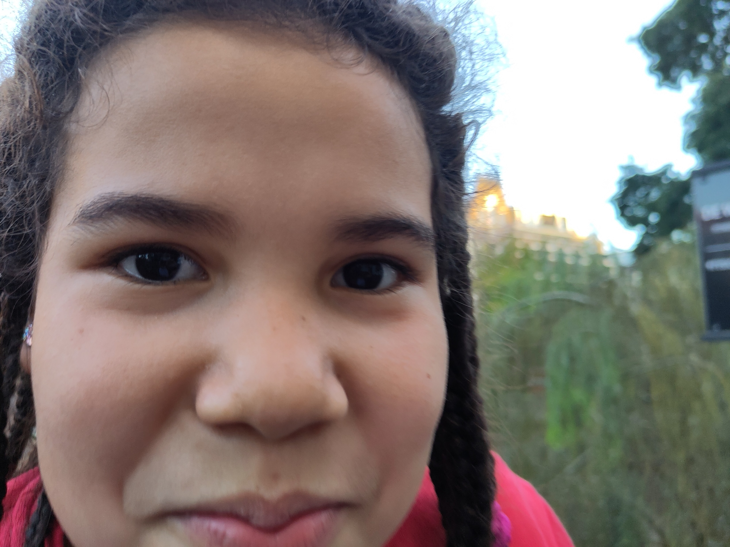

Slide 75
Example
(but for deciding where to take Camila to dinner)
1) What matters (define my factors):
Taste
Quantity
Atmosphere
Price
Plays La Macarena
Garlic sauce

Slide 76
Example
(but for deciding where to take Camila)
2) Assign weightings, i.e., how much they matter for me (1 = not important, 5 = essential)
Taste (3)
Quantity (4)
Atmosphere (2)
Price (3)
Plays la Macarena (3)
Garlic sauce (5)

Slide 77
Example
3) Rate restaurants A and B on the factors
Factor | Restaurant A | Restaurant B
Taste | 4 | 2
Quantity | 3 | 5
Atmosphere | 3 | 3
Price | 3 | 5
Plays La Macarena | 4 | 2
Garlic sauce | 1 | 5

Slide 78
Example
4) Apply your index: score x weighting, and add these up
Factor | Restaurant A (score x weighting) | Restaurant B (score x weighting)
Taste | 4 x 3 = 12 | 2 x 3 = 6
Quantity | 3 x 4 = 12 | 5 x 4 = 20
Atmosphere | 3 x 3 = 9 | 3 x 2 = 6
Price | 3 x 3 = 9 | 5 x 3 = 15
Plays La Macarena | 4 x 3 = 12 | 2 x 3 = 6
Garlic sauce | 1 x 5 = 5 | 5 x 5 = 25
TOTAL | 59 | 78

Slide 79
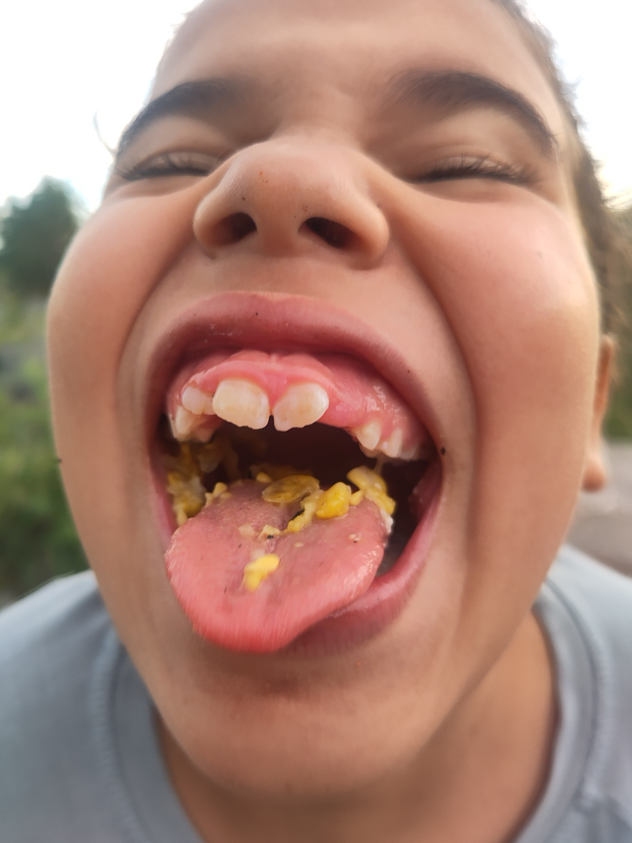

Slide 80
EXERCISE: Define and apply a library sustainability index
Brainstorm the ingredients of sustainability
Combine your ideas to get to 4-8 in total
Assign weightings of 1-5 to these factors
Score your national field, and the region on each factor (1-5), and multiply by the weightings
Discuss your findings and what they mean
Use the sheets handed out to you!

Slide 81
Template
Sustainability Factor | Weighting | Country Score (1-5) | Country Totals | Region Score (1-5) | Region Totals
A
B
C
D
 |  | TOTAL = |  | TOTAL =

Slide 82
Share your findings!
Photo: Matt Botsford on Unsplash, unsplash.com/photos/OKLqGsCT8qs

Slide 83

COMMITMENT
Carry out this exercise in your own national field – what results do you get?

Slide 84


IFLA Strategy 2024-2029

Slide 85
A New Vision
Sustainable futures for all through knolwedge and information

Slide 86


Impact Area 1
Libraries are connected and energised through vibrant, global professional communities
IFLA Strategy 2024-2029

Slide 87


Impact Area 2
Libraries are recognised, represented and valued as
partners
IFLA Strategy 2024-2029

Slide 88


Impact Area 3
Libraries are enabled to deliver meaningful change at all levels
IFLA Strategy 2024-2029

Slide 89

ENABLER: Future-Proofing IFLA
Ensuring IFLA's governance, projects, and partnerships are effective, transparent, and innovative.
IFLA Strategy 2024-2029

Slide 90

OUR VISION
Sustainable Futures for All Through Knowledge and Information
Impact Area 2
Libraries are recognised, represented and valued as partners
Impact Area 1
Libraries are connected and energised through vibrant, global professional communities
ENABLER
Future-Proofing IFLA
Ensuring IFLA's governance, projects, and partnerships are effective, transparent, and innovative.
Impact Area 3
Libraries are enabled to deliver meaningful change at all levels

Slide 91
How many of these areas appear in your own strategies?
Go to www.menti.com and use the code 4916 9923

Slide 92
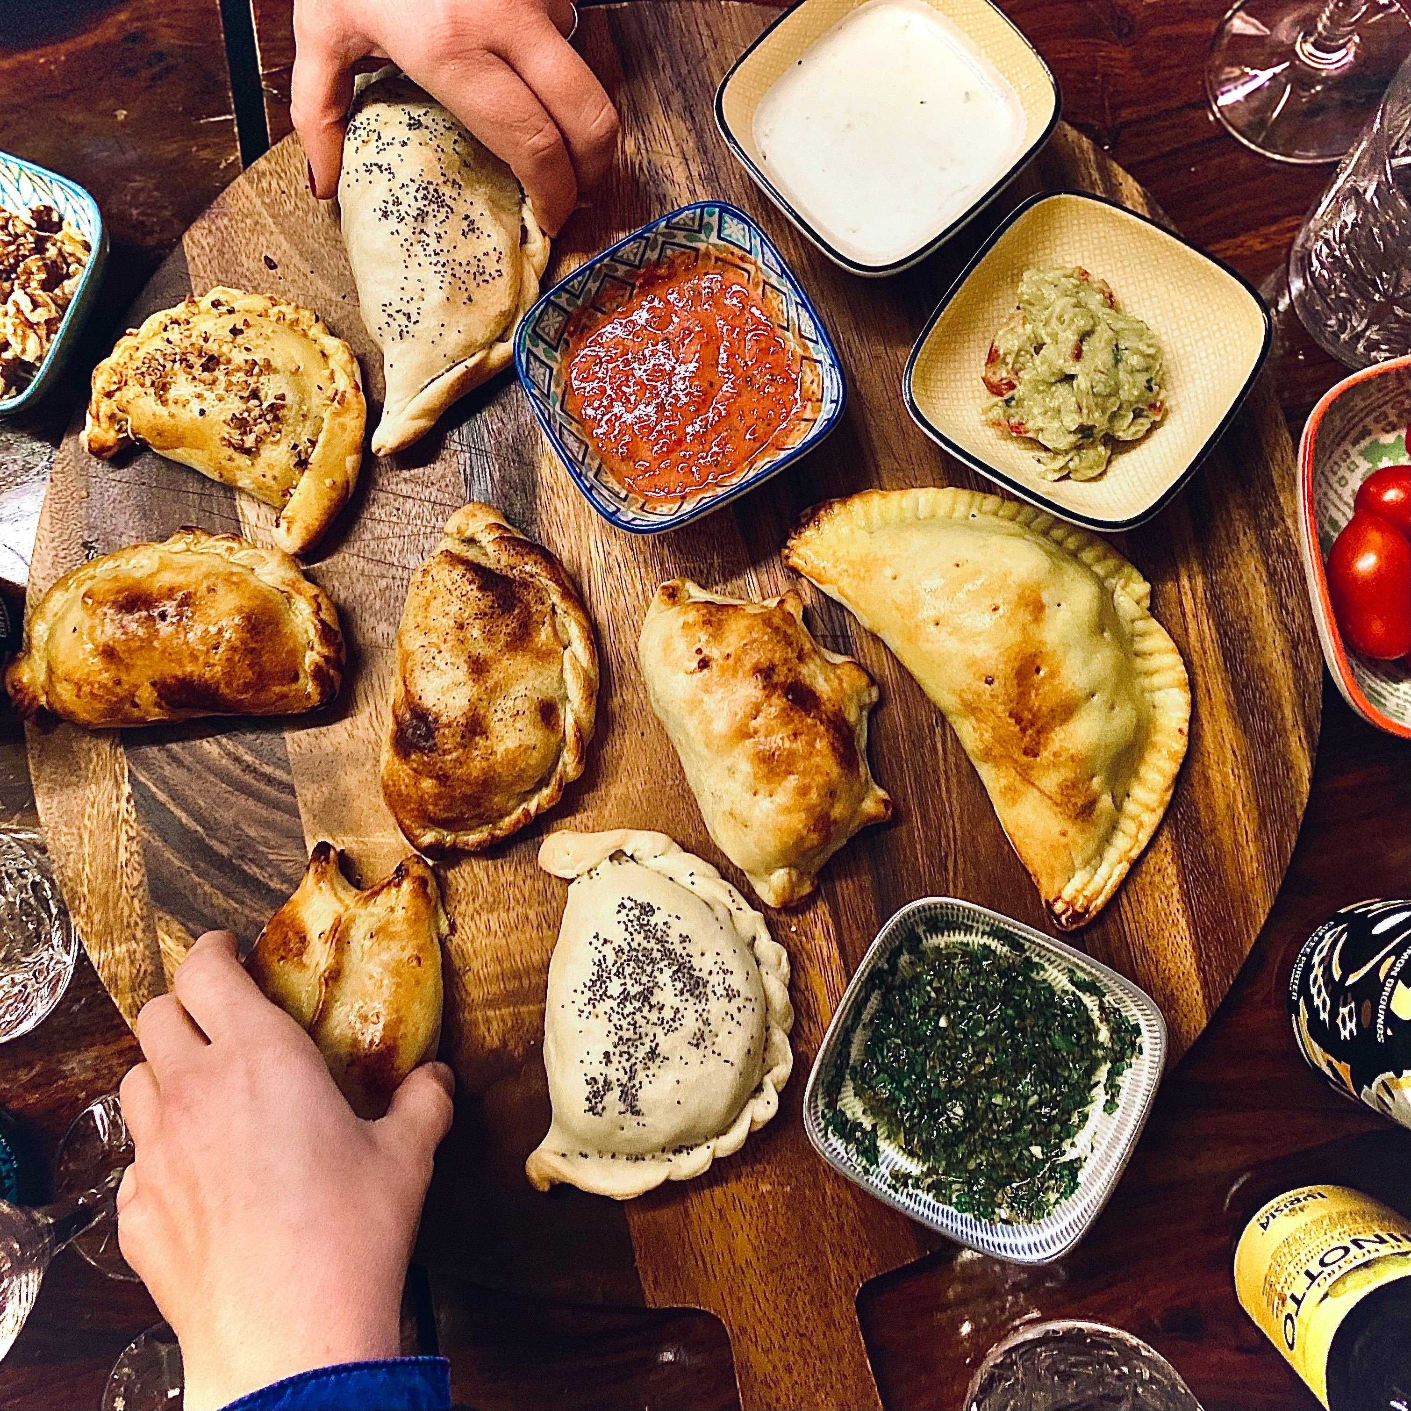
Lunch

Slide 93
Planning for the future – Bringing Forward Emerging Leaders

Slide 94
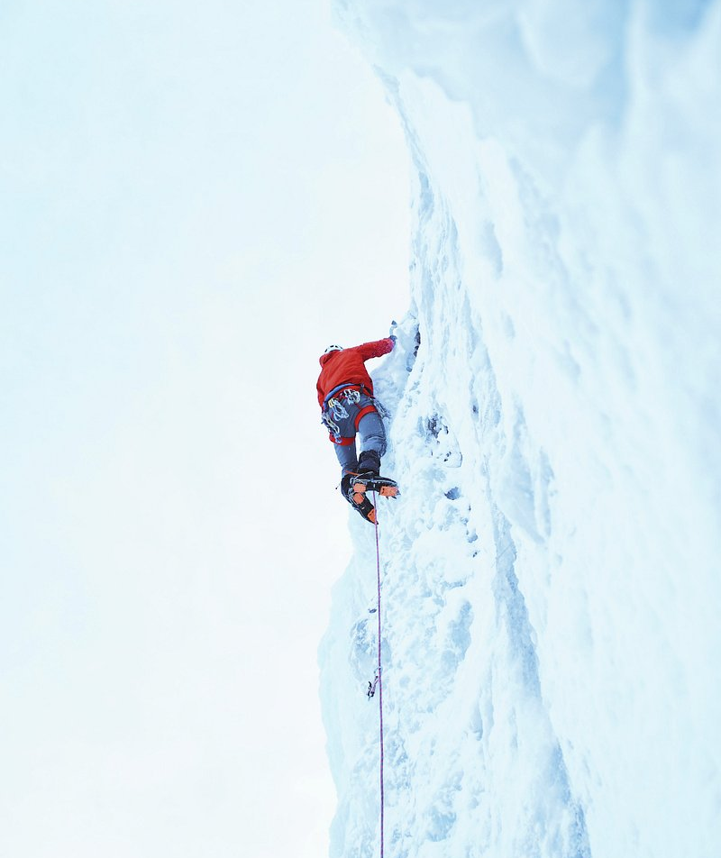
Support for emerging leaders as a pillar of sustainability
Photo: Ian Capper, CC-BY-SA 3.0, www.geograph.org.uk/photo/3804467
Photo by Ulvi Safari on Unsplash, unsplash.com/photos/tCj8uuABLBA

Slide 95
EXERCISE
Knowledge and assumptions about emerging leaders

Slide 96
EXERCISE: knowledge and assumptions about emerging leaders
Go to menti.com (4101 6690), and answer the following questions:
How many years of experience do you have in the field?
At what age did you get into librarianship?
Can we give space to emerging leaders to develop without more established librarians making sacrifices?
Do emerging leaders already enter the field with the skills they need to succeed?
Do associations (nationally, regionally and internationally) have a role in supporting emerging leaders’ development?
What one thing does an emerging leader need to succeed?

Slide 97

What one experience really helped you advance in your career?
What was your main frustration?
Have you experienced a successful leaders’ programme? What made it so good?
DISCUSSION

Slide 98
EXERCISE
From emerging to emerged – what CV?

Slide 99

EXERCISE: from emerging to emerged
Imagine a librarian who, within 15 years of joining the profession has just joined the board of their library association
On your table, think about what training, experience and other opportnities they have had in order to achieve this
Prepare a CV for them on a flipchart
Share it with the room!

Slide 100
DISCUSSION
What experiences are similar across groups?
Where can we help to find solutions regionally?

Slide 101
COMMITMENT
Identify at least one initiative you can take to support emerging leaders

Slide 102
Communities

Slide 103
The library field is…
Library and information workers, institutions (of all types), associations, and the services and infrastructures that support them

Slide 104
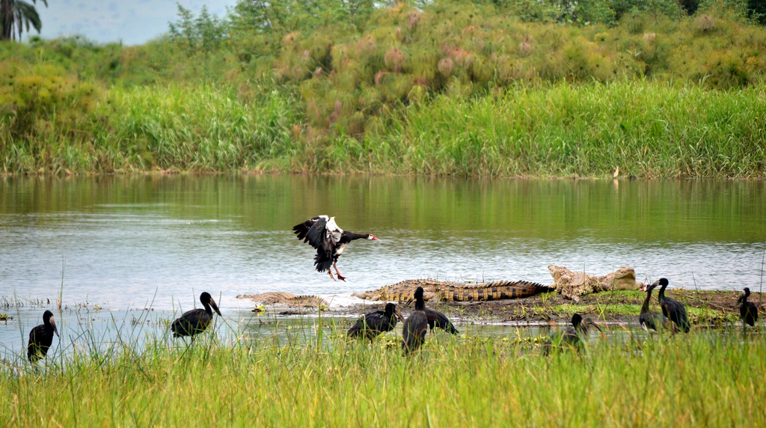
The library field is an ecosystem
Photo: Abhishedk Singh, CC-BY-SA 2.0: https://upload.wikimedia.org/wikipedia/commons/6/6e/The_lake_ecosystem_-_Flickr_-_askmeaks.jpg

Slide 105
How well connected/integrated is the library field in your country?
Go to www.menti.com and use the code 4916 9923

Slide 106
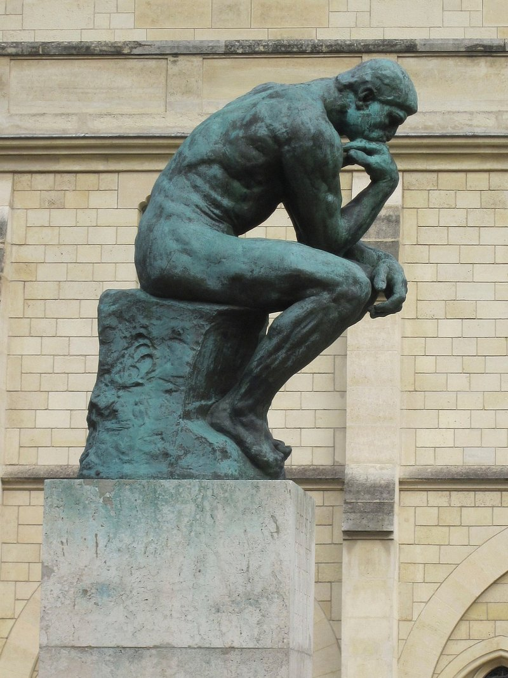
A hypothesis
Libraries – through both their geographical reach and the range of different library types and activities – are uniquely placed to support the systematic delivery of societal goals, if we can coordinate

Slide 107
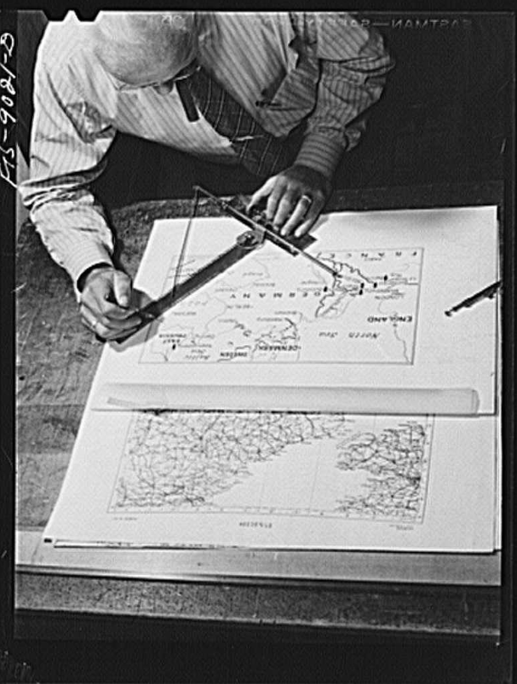
Mapping the library field for outsiders
How to help non-library people navigate their way through our sector?

Slide 108
The scenario (1/2)
A UN agency wants to fund a project to raise public awareness of and interest in open government activities
The agency wants to work at the national level, delivering activities and results in every region of the country

Slide 109
The scenario (2/2)
This will involve training public and school librarians in using government publications, who in turn will train people, in particular youth
There is an expectation that the project will contain an academic/research component, not least in evaluation

Slide 110
The task
Draw a map of your library field in order to help the agency understand how you might deliver on such a project. This should include:
How you engage with the agency
How you ensure oversight/coordination
How you ensure reach to all regions
How you ensure training of librarians
How you ensure research support

Slide 111
The task
Individual reflection
On your tables, pick one country, and share ideas on how to visualize
Design your map on the flipchart
Present!

Slide 112
Discussion questions
How far do you have structures to perform the different roles?
How well connected are these structures?
How strong is the sense of community?
Photo: Matt Botsford on Unsplash, unsplash.com/photos/OKLqGsCT8qs

Slide 113
What one action could help build collaboration in order to deliver at a national or regional level?
Go to www.menti.com and use the code 4916 9923

Slide 114
Share your experiences of working as a field!
Photo: Matt Botsford on Unsplash, unsplash.com/photos/OKLqGsCT8qs

Slide 115

Our members
Becoming a member of IFLA demonstrates your commitment to delivering exceptional library services and promoting the core values of library and information work.
You are our greatest strength – you make what we do possible.

Slide 116
Asia-Oceania
Europe
Latin America and the Caribbean
29 Associations
163 Institutions
138 Individuals
66 Associations
404 Institutions
107 Individuals
13 Associations
49 Institutions
27 Individuals
Middle East and North Africa
North America
Sub-Saharan Africa
19 Associations
108 Institutions
272 Individuals
15 Associations
65 Institutions
14 Individuals
6 Associations
42 Institutions
20 Individuals
Membership statistics as of October 2024
At the end of October, we have 1,557 Members and Affiliates in 149 countries.

Slide 117
Numbers as of October 2024.
At the end of October, we have organisation members in 149 countries.

Slide 118
IFLA membership

Slide 120

BEING A LIBRARIAN IS A MISSION.
BUT BEING WITH LIBRARIANS IS ALSO AT THE HEART OF OUR PROFESSION.
IFLA PROVIDES US WITH ENCOUNTER, DIALOGUE, AND KNOWLEDGE.
What does
IFLA Membership mean to you?
IFLA Personal Affiliate

Slide 121

What is the main highlight from your IFLA Membership?
AS A MEMBER OF THE MULTICULTURAL POPULATIONS COMMITTEE,
I RECEIVED A CALL FOR A BOOK CHAPTER AND IT WILL BE MY FIRST TIME BEING PUBLISHED!
IFLA Personal Affiliate

Slide 122

What would you say to others about IFLA?
IT IS A GLOBAL COMMUNITY OF LIBRARY AND INFORMATION PROFESSIONALS WITH A COMMON GOAL OF MAKING A DIFFERENCE!
IFLA Member

Slide 123
Who else could benefit from IFLA membership?
Let us know who the key universities and other institutions are!

Slide 124
Reflection

Slide 125
Final questions!
What was the most interesting discussion you had on your table?
Can you see how we can advance in these areas at the national/regional/global levels?
Are you tired?

Slide 126
This evening
Consultation sessions for those who want on advocacy, impact and Library Map of the World (17:30-18:30)
Otherwise back to the hotel!
Meet at hotel reception at 19:40
Tomorrow morning, meet at 8:35

