Slide 1


Mobilising Libraries to Deliver on UN Goals in Africa
Nairobi – 18 October 2023

Slide 2
Introduction
Edlam Abera Yemuru
Chief, Knowledge and Innovation Branch, UN HABITAT
Vicki McDonald
IFLA President, 2023-2025

Slide 3
Delivering sustainable urbanisation in Africa
The work of UN Habitat
Edlam Abera Yemuru, Chief, Knowledge and Innovation Branch, UN HABITAT
Introduction: Alejandro Santa, IFLA Regional Council Chair

Slide 4
Supporting science and climate empowerment in Africa
The work of the UN Environment Programme in Africa
Rula Qalyoubi, Senior Programme Management Officer and UNEP Science-Policy Sub-programme Coordinator
Introduction: Stephen Wyber, IFLA

Slide 5

Break
Photo by Mike Kenneally on Unsplash, unsplash.com/photos/TD4DBagg2wE

Slide 6
Enabling preservation of and access to information
The work of UNESCO
Sharmaine Koh, Communications and Information Sector, UNESCO Nairobi
Xianhong Hu, Programme Specialist, UNESCO Paris
Introduction: Sharon Memis, Secretary-General, IFLA

Slide 7
UN Libraries in Africa
Opportunities for engagement
Angeline Djampou, Head, Knowledge and Publications Management Unit, UNEP
Irene Onyancha, Chief of Knowledge Management Services, UN ECA
Hellen Nyabera, Head, Knowledge Management Unit, UN Habitat
Introduction: Nthabiseng Kotsokoane, IFLA Governing Board

Slide 8
Mobilising Libraries to Deliver on UN Goals in Africa
Thank you!

Slide 9

Lunch
Photo: Keesha's Kitchen on Unsplash, https://unsplash.com/photos/_y325luZNUs

Slide 10
A Strong and Sustainable Library Field for Africa
IFLA HEADQUARTERS 2023
Nairobi – 16-18 October 2023

Slide 11


Welcome back!

Slide 12

Your takeaways from the event at the UN?

Slide 13
Highlights and reflections

Slide 14
What has been the highlight of the workshop for you?

Slide 15
What is the main thing you will take back to your national library field?

Slide 16
What do you want to find out more about?

Slide 17
What action item do you think the Sub-Saharan Africa RDC should adopt as a flagship action item?

Slide 18
What skillsets would you volunteer to the Sub-Saharan Africa RDC in implementing flagship action items?

Slide 19
Certificates

Slide 20
What’s next

Slide 21

Key contacts
Our Regional Division Committee
Our Regional Office
Our Preservation and Conservation Centres
Our Headquarters Team
You!

Slide 22
Commitments
Establish/strengthen links with local UN/UNESCO office
Share the results of national library field sustainability indexes
Identify a priority partnership to build
Identify a step to help emerging leaders develop
Provide further input to the Library Map of the World
Take part in our Nairobi workshop community
Become a member/share details of other potential members

Slide 23
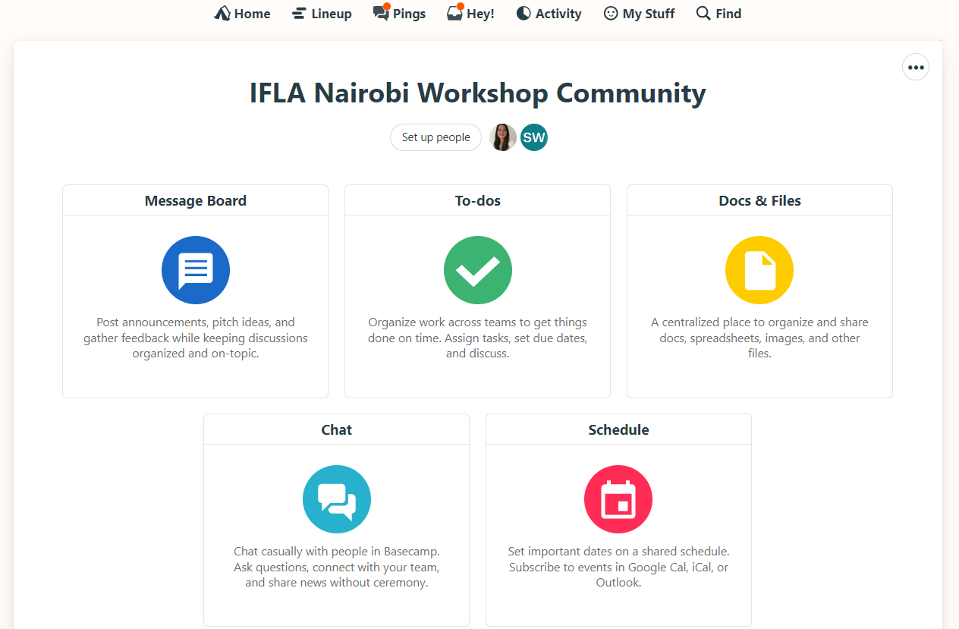

Slide 24
Forward look
By the weekend: fill in the evaluation survey
Next week: accept invitations to join the Community
Next month: share a plan for follow-up
By January: join a 1st check-in call
By April: join a 2nd check-in call, fill in a progress survey
By October: join a 3rd check-in call, fill in a progress survey
Ongoing: share updates on the community!

Slide 25
Evaluation

Slide 26
Evaluation
We’ll e-mail the form to you
Please answer by the weekend!

Slide 27
By the end of this workshop, you should...
Have an understanding of what a sustainable library field means, and how you can apply this in your own work
Have new ideas about how you can engage with the United Nations and other international initiatives within your country and regionally
Be able to apply (IFLA) tools and references in your own strategic planning, in particular around gathering and applying data, assessing impact, partnerships and emerging
Be ready to work with us in shaping an IFLA ‘offer’ that responds to the needs of the region
Have built your own networks!

Slide 28
By the end of this workshop, we should...
Know you and your national library fields better
Have ideas from you about where there are possibilities to work with the United Nations and other potential funders
Understand better how we can support a sustainable library field in Sub-Saharan Africa
Have convinced you to extend your engagement in IFLA!

Slide 29
Thank you!

Slide 30
A Strong and Sustainable Library Field for Africa
IFLA HEADQUARTERS 2023
Nairobi – 16-18 October 2023

