Slide 1

Towards a stronger and more sustainable library field in Asia-Oceania
IFLA Workshop, Bangkok, Thailand
14-16 November 2022

Slide 2

Welcome back!

Slide 3

Reminder: Our Agenda (Day 3)
Evaluating and demonstrating value and impact
Library Map of the World – your advocacy tool
Highlights and reflections
Certificates and closing

Slide 4
A Challenge for Today…
If you haven’t spoken to the room yet, today is your chance!

Slide 5
Evaluating and Demonstrating Value and Impact

Slide 6
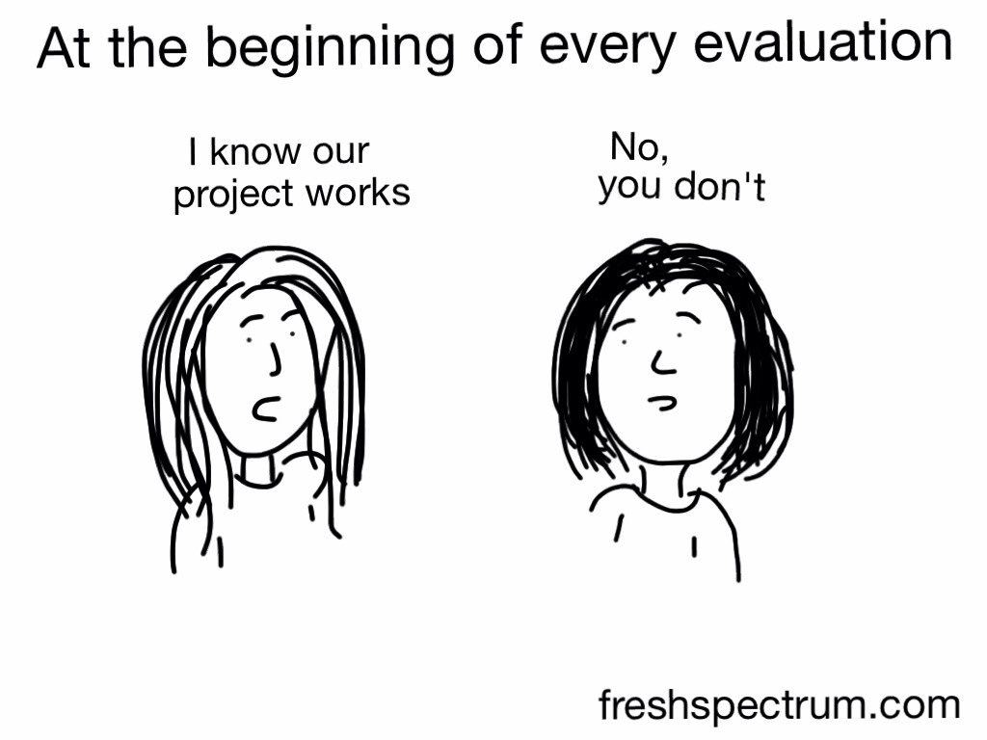
Measurement and Evaluation – Why?

Slide 7

Understanding community needs and designing
services for impact
Foto: bit.ly/3Ds082o

Slide 8

Ensuring that stakeholders understand our value and impact
Photo: bit.ly/3oeWjth

Slide 9
What are some of the main challenges for you when it comes to demonstrating value and impact (of libraries; of work you do)?

Slide 10

Evaluating and Demonstrating Impact – Challenges and Solutions
Photo: bit.ly/3lygq3F

Slide 11
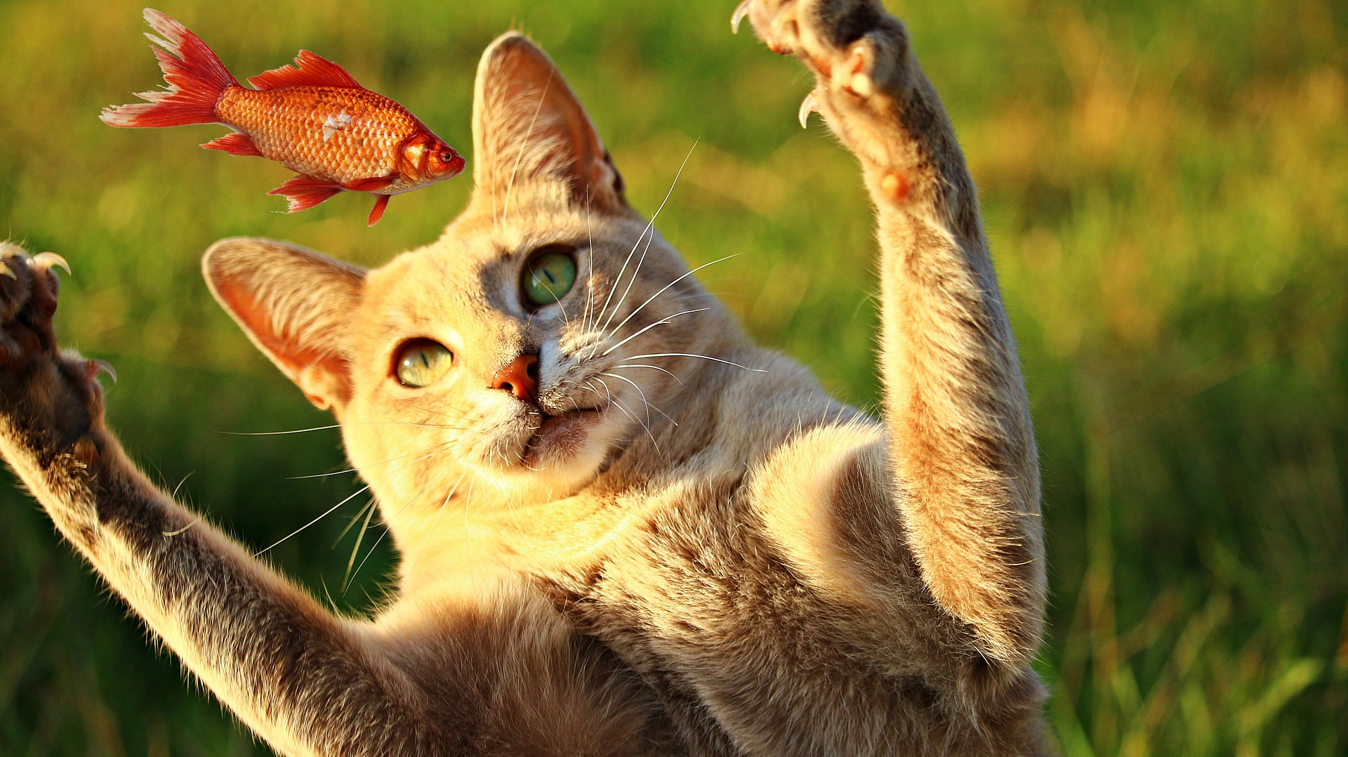
Knowing your target and setting meaningful measures
Photo: bit.ly/2YFFBbp

Slide 12

Understanding stakeholders, their goals, objectives and values
Photo: bit.ly/3FE69Lu

Slide 13

Defining targeted outcomes and impact into the design
Photo: bit.ly/3mLaLGR

Slide 14













Defining targeted outcomes and impact into the design
Photo: bit.ly/3mLaLGR

Slide 15


















Defining targeted outcomes and impact into the design
Photo: bit.ly/3mLaLGR

Slide 16

Confusing performance and satisfaction measures with outcome and impact measures
Photo: bit.ly/3v4BJwK

Slide 17
..shortly about measures..
Community & needs data
Performance data
Satisfaction data
Outcomes data
Why?
How much?
How well?
So what?
Community and target group needs
Library activities, projects, programmes
Satisfaction of users and participants
Outcomes for people and impact on community

Slide 18
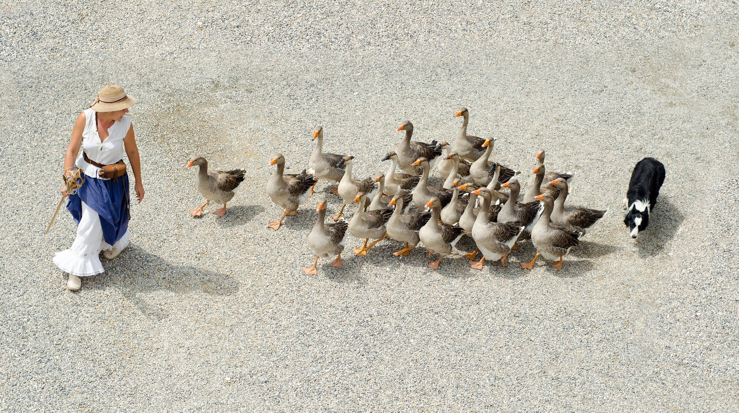
Having a role responsible for managing library’s measures
Photo: bit.ly/3v4Yd0D

Slide 19

Positioning our actions for impact – How?
Photo: bit.ly/3lV3Qu6

Slide 20
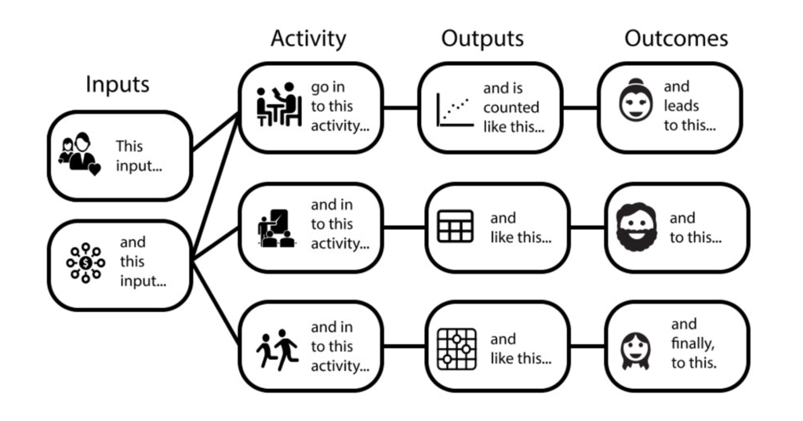
Logic Model
https://freshspectrum.com/charts-and-illustration/

Slide 21














Inputs
Outputs
Outcomes
Impact
Photo: bit.ly/3AsNVIU

Slide 22
Impact
Outcomes
Outputs
Actions
Inputs
Conditions/Needs
Community-centred
Logic Model
Aligning library services to meet community needs

Slide 23
Impact (What is the overall impact or result you are looking for?)
Outcomes (What changes in conditions do you expect to see?)
Outputs (What direct results of your actions do you expect?)
Actions (What activities will you implement to address it?)
Inputs (What resources will you use to address the issue/need?)
Conditions/Needs (What challenge/problem do you want to change?
Community-centred
Logic Model

Slide 24
Impact (What is the overall impact or result you are looking for?)
Outcomes (What changes in conditions do you expect to see?)
Outputs (What are the direct results of your actions?)
Actions (What activities is your library doing?
Inputs (What resources will you use to address the issue/need?)
Conditions/Needs (What community challenge/problem are you about to change?)
MEASUREMENT AND EVALUATION
Performance / Outcomes / Impact
Outcomes Data
Performance Data
ACTION PLANNING AND DELIVERY
Statistics
COMMUNITY NEEDS ASSESSMENT
Community Data

Slide 25
Needs
Inputs
Activities
Outputs
Outcomes
Impact
Photo: bit.ly/3AsNVIU

Slide 26






























Impact
Needs
Outcomes
Inputs
Outputs
Activities
Photo: bit.ly/3AsNVIU

Slide 27












1 = Stakeholder perspective
2 = People perspective
3 = Library perspective
Impact
Needs
Outcomes
Inputs
Outputs
Activities
Photo: bit.ly/3AsNVIU

Slide 28
1 = Stakeholder perspective
2 = People perspective
3 = Library perspective
Reduced unemployment rates
Employment
People who improved skills, found job
Resources: Staff, equipment, money
Number of trained people
Job skills training
Photo: bit.ly/3AsNVIU

Slide 29
1 = Stakeholder perspective
2 = People perspective
3 = Library perspective
Improved recycling rates
Contamination on the beach
People who see benefit in recycling
Resources: staff, time, money
Number of trained people; kg of trash removed
Training to recycle; Event on the beach
Photo: bit.ly/3AsNVIU

Slide 30
1 = Stakeholder perspective
2 = People perspective
3 = Library perspective
Enabled youth development; Bridging digital gap
Lack of ICT in schools; Failed exams
Improved skills; Enhanced learning; Improved exams
Mobile library van; Equipment; Digital content; Staff
Number of visits; Number of trained
Visits to schools; Hands-on training
Photo: bit.ly/3AsNVIU

Slide 31
Ensuring that stakeholders understand our value and impact
Photo: bit.ly/3oeWjth

Slide 32
Outcomes. Impact. Change

Slide 33

Impact (What is the overall impact or result you are looking for?)
Outcomes (What changes in conditions do you expect to see?)
Outputs (What direct results of your actions do you expect?)
Actions (What activities will you implement to address it?)
Inputs (What resources will you use to address the issue/need?)
Conditions/Needs (What challenge/problem do you want to change?
Community-centred
Logic Model

Slide 34

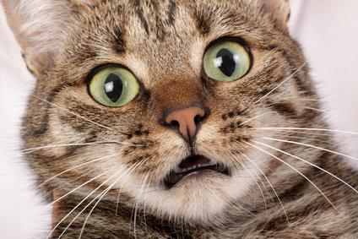

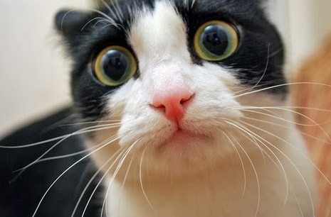
Impact Evaluation
Will I be evaluated?!
What is going to happen now?
Maybe next year…?
Maybe they will forget about me?

Slide 35
Impact is about change and outcomes for people
https://freshspectrum.com/charts-and-illustration/

Slide 36
What is Outcome?
The way a thing turns out
https://en.oxforddictionaries.com

Slide 37
Demystifying Outcomes
An outcome is a specific benefit that results from our actions designed to help our target group to change their awareness, knowledge, skills, attitudes, or behavior.
Outcomes are generally expressed as changes individuals perceive in themselves.
Outcomes can be quantitative or qualitative.

Slide 38
How does change occur?
Quality of life
Impact
Behaviour
Attitude
Skills
Knowledge
Time

Slide 39
Example – Training on smartphone use
I feel more empowered, I fell less lonely, more connected to outside world
Impact
I use smartphone every day
I think smartphone is useful to me
I know how to use smartphone
I know more about smartphone
Time

Slide 40
Impact Planning
Impact objectives
Outcome indicators
Data and evidence

Slide 41

Impact Objectives (Outcomes)
Clear and achievable within a specific time span
Realistic, taking into account your resources
Carefully worded

Slide 42
How to write good impact objectives (outcomes)?
Verb indicating change
What will change
Who will change
Additional specificity
Examples:
To increase
To establish
To reduce
To create
To produce
To change
Examples:
Access
Availability
Attitude
Behaviour
Knowledge
Skills
Examples:
Children
Young women
Seniors
School dropouts
Illiterate adults
Local farmers
Where you expect to see this change? geography)
By when you expect to see the change? (date)
How much change you intend to see? (target)

Slide 43

Outcome Indicators (Measures)
An outcome indicator is a specific, observable, and measurable characteristic that will represent achievement of the outcome.
It is important to think through indicators that can tell you both:
    Whether the outcome has occurred
    And by how much

Slide 44
EXERCISE: Define Milestones and Impact of Your National Action
Individually – reflect and identify milestones and impact of your national action:
What would be the target group and some milestones (outputs) of your action?
What would be the impact objective (outcomes) of your action?
How would you evaluate the impact of your action?

Slide 45

EXERCISE: Define Milestones and Impact of Your Collaborative Action
At your table – discuss and identify milestones and impact of your collaborative action:
What would be the target group and some milestones (outputs) of your action?
What would be the impact objective (outcomes) of your action?
How would you evaluate the impact of your action?

Slide 46

Share your findings!
Photo: Matt Botsford on Unsplash, unsplash.com/photos/OKLqGsCT8qs

Slide 47

Coffee Break
Photo by Mike Kenneally on Unsplash, unsplash.com/photos/TD4DBagg2wE

Slide 48


Library Map
of the World
Bookmark the Library Map of the World as your essential advocacy tool!

Slide 49
PART 1
Library Map of the World –
contents and contributors
PART 2
Presentation
Outline
Library data
PART 3
Country profiles
PART 4
SDG stories
PART 5
Resources for advocacy

Slide 50


librarymap.ifla.org
Library Map of the World –
Data – a source of country-level library statistics covering all library types,
Country profiles – a source of information about the library environment, organisations and institutions, policy and legislation, education, and events in each country,
SDG stories – a collection of inspiring stories about impactful library programmes contributing to achievement of the UN Sustainable Development Goals.

Slide 51




Library Map of the World contents
LIBRARY DATA
136
countries
SDG STORIES
56
stories
COUNTRY PROFILES
29
countries
Numbers as of November 2022

Slide 52



Main contributors
Main contributor – an organisation (national library association, national library or other institution) which committed to contributing data and/or country profile.
Each engaged country has one or two main contributors which:
Take responsibility for collaboration with local partners and stakeholders in their country during data gathering and preparation of content for their country profile,
Act as key contact for the Library Map team during data and content submission and curation.
We now have over 190 established main contributors from around 170 engaged countries and territories worldwide.

Slide 53
Our main contributors
Numbers as of January 2022

Slide 54
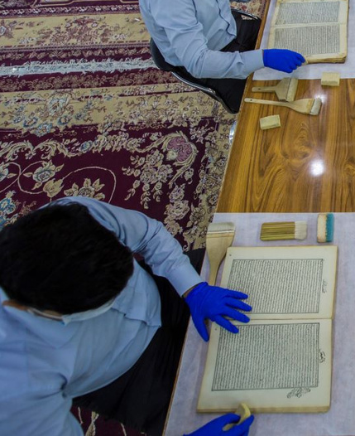




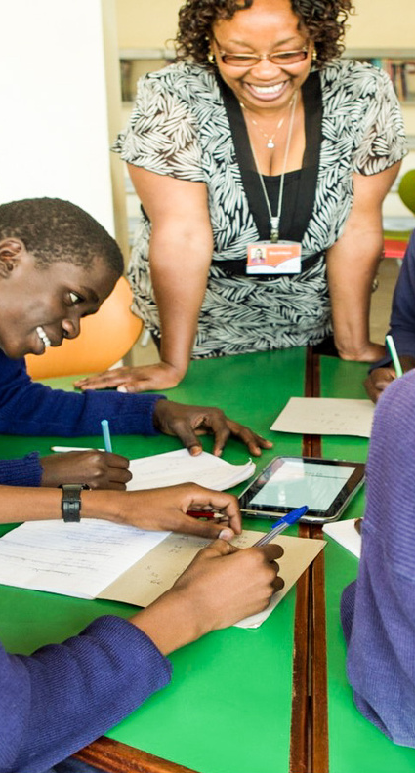
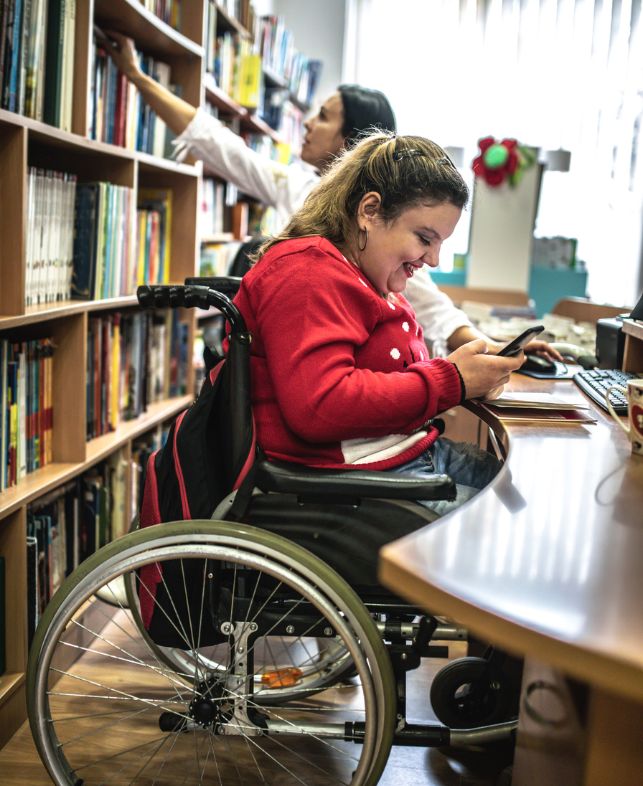

SDG Story contributors
SDG Story contributor – each individual library or an organisation which submitted information for an SDG story and worked with the Library Map team during its curation.
We now have around 50 such contributors from over 30 countries with their SDG stories published on the Map.

Slide 55

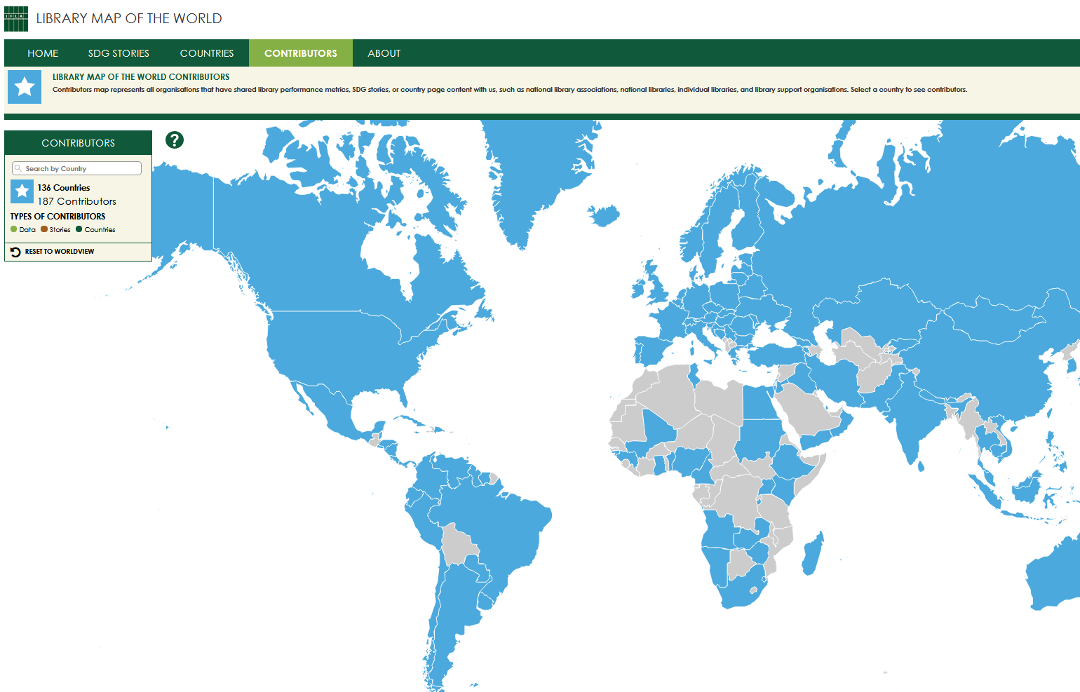

Find contributors
on the Library Map website
Contributors with published content (data, country profiles, stories) are listed by country on the Contributors page of the Library Map of the World website.
Search by country or click on the Map
to find out who are contributors
from your country!

Slide 56
Library data
Country-level library statistics
Updated throughout the year in collaboration with main contributors
Eight basic performance metrics –
Number of libraries
Libraries with Internet access
Staff and volunteers
Registered users and physical visits
Physical and electronic loans
All library types –
National libraries
Academic libraries
Public libraries
Community libraries
School libraries
Other libraries

Slide 57
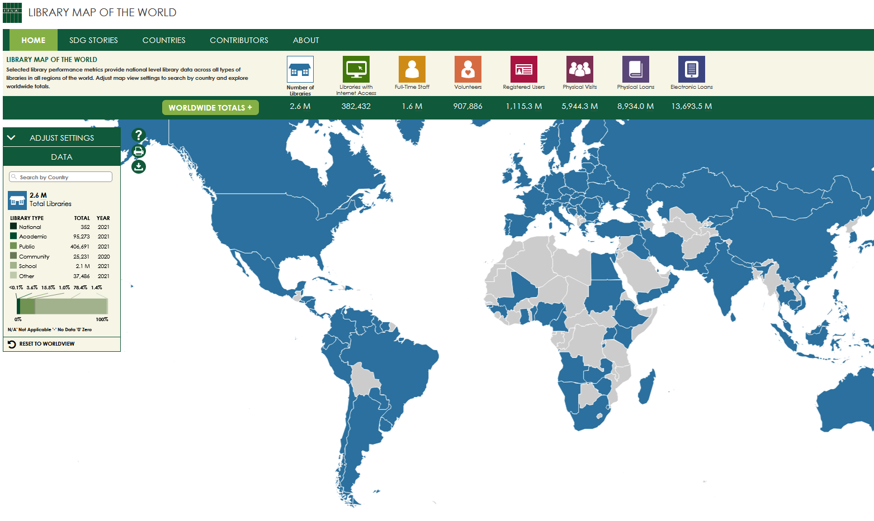
Find data on the Home page
of the Library Map website
Search by country or click on the Map to see your country’s data
Explore worldwide and regional totals
Download the full dataset in csv and make your own data analysis

Slide 58
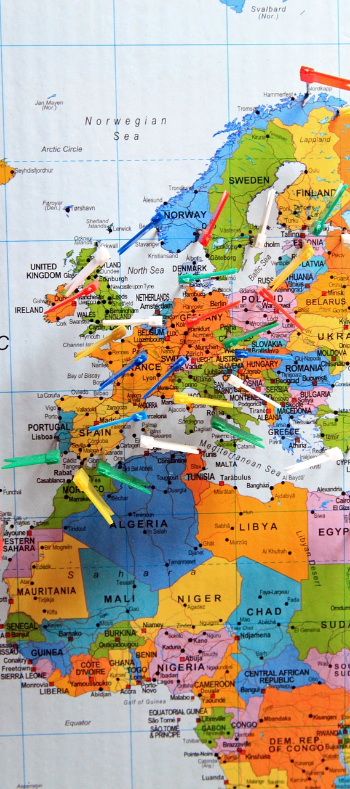
Country profiles
Overview of the library environment – library system, facts and features of different library types, governance and funding models, development and policy priorities, role of library association, recent achievements in the library field.
Links to library location resources – maps maintained by other organisations containing individual library location data
Aggregated view of performance metrics and contextual indicators , including data on population and geography, information and infrastructure, poverty and employment, education and literacy, innovation and skills

Slide 59
Country profiles - continued
Information about organisations – national library associations, national libraries, policy making institutions, library support organisations
Links to national policy documents and legislation such as library law, legal deposit law, copyright and library exceptions
Information about education and events – professional qualification requirements, librarians’ education, links to professional publications and events
Links to country’s SDG stories

Slide 60
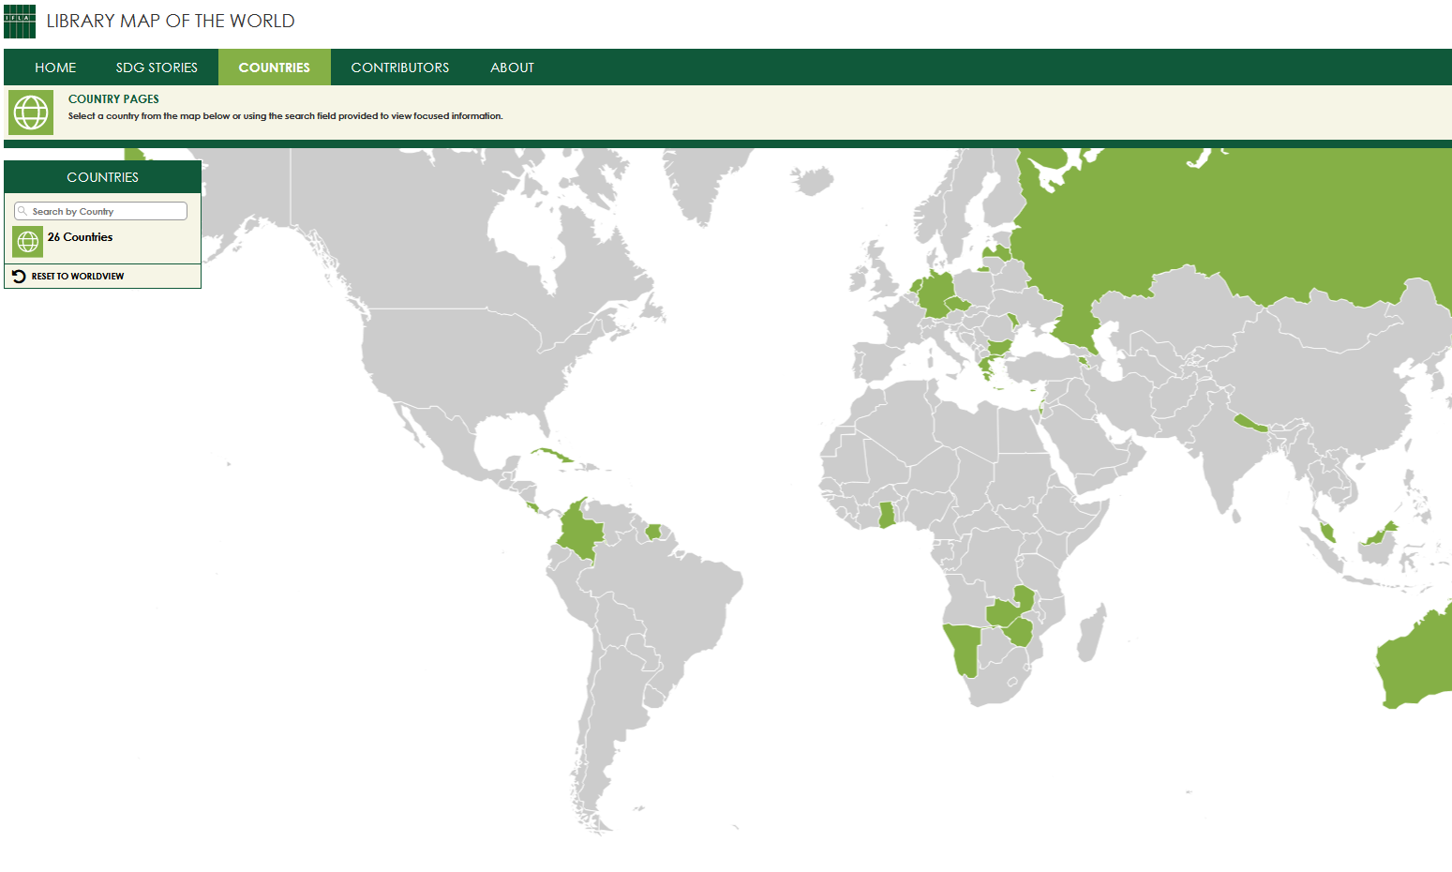
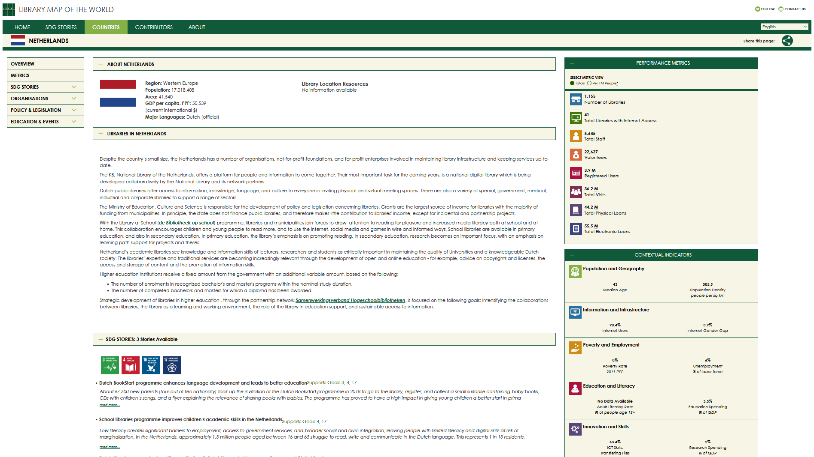
Explore Countries tab
of the Library Map website
Search by country or click on the Map to see country profile

Slide 61
SDG stories
SDG stories – stories about library activities, projects and programmes and their impact on people’s lives and communities that contribute to achievement of the United Nations Sustainable Development Goals (SDGs).
Check out requirements for stories in our:
SDG Storytelling Manual
SDG Storytelling Flowchart
Submit information for your own story:
bit.ly/submit-for-sdg-story

Slide 62
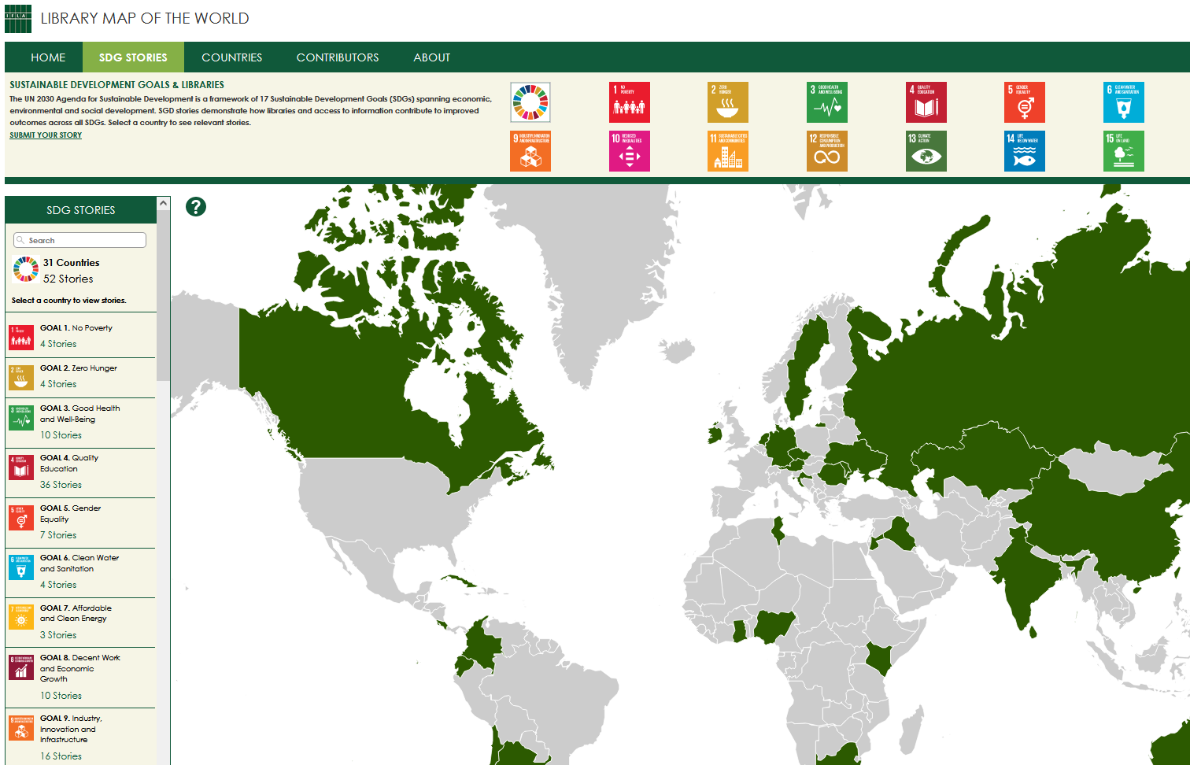
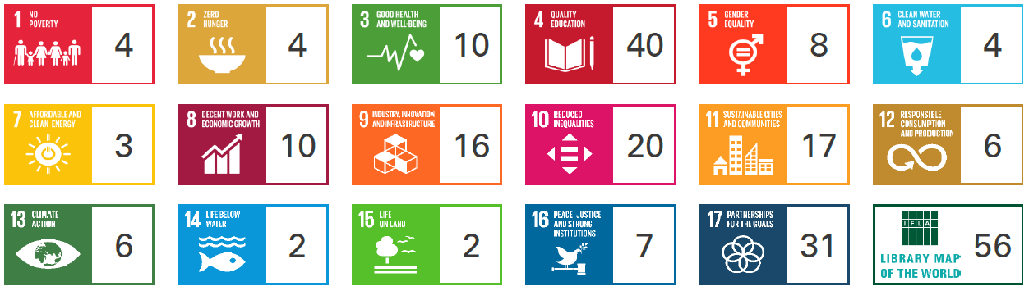
Explore SDG stories
on the Library Map website
Search by country or click on the Map to find stories from your country. Choose the SDG to see relevant stories.
We have stories for all 17 SDGs.
Numbers as of July 2022

Slide 63
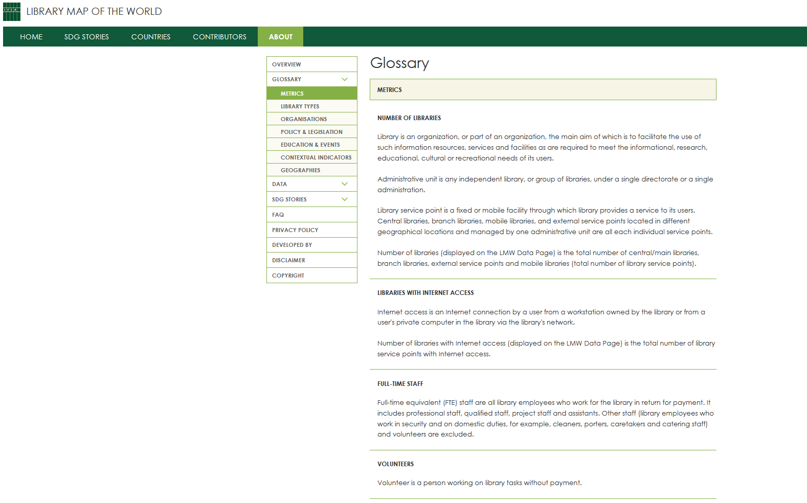
Explore About page
of the Library Map website
Definitions of data metrics, library types, and items on country profiles
Explainers and guides for data contributors
Instructions for country profile contributors
Resources for SDG storytelling

Slide 64
Power your advocacy!
LIBRARY DATA
136
countries
SDG STORIES
56
stories
COUNTRY PROFILES
29
countries
Use data in briefs, presentations and messages
Use stories to motivate, persuade, and inspire to act
Use country profiles to highlight priorities, issues, and achievements

Slide 65
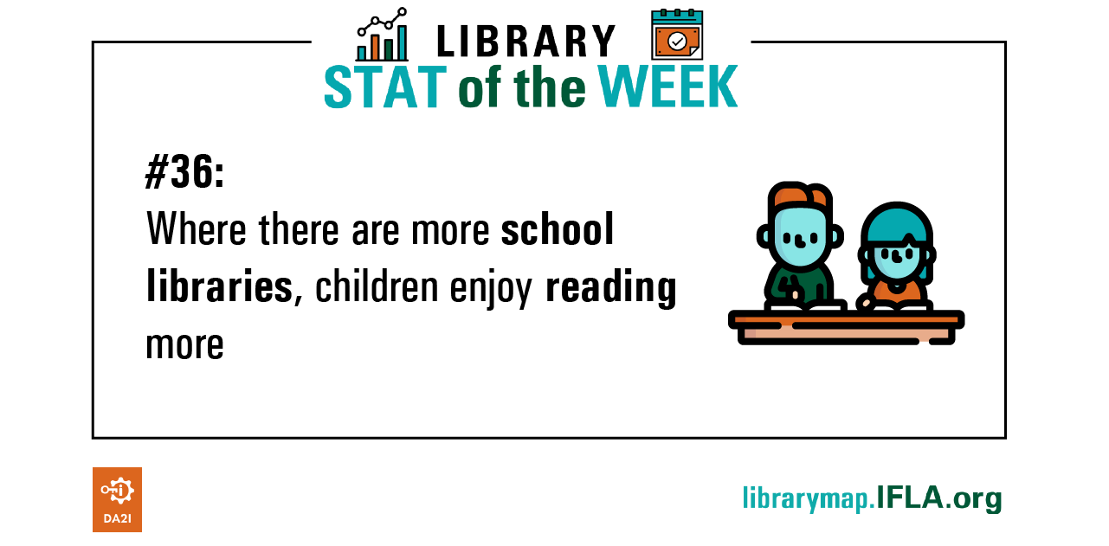
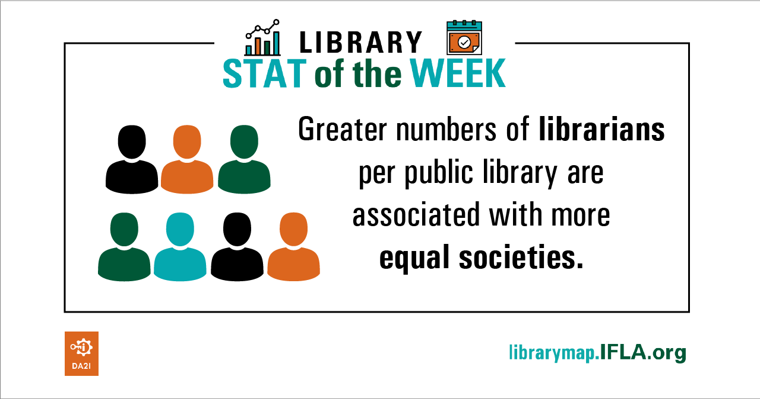
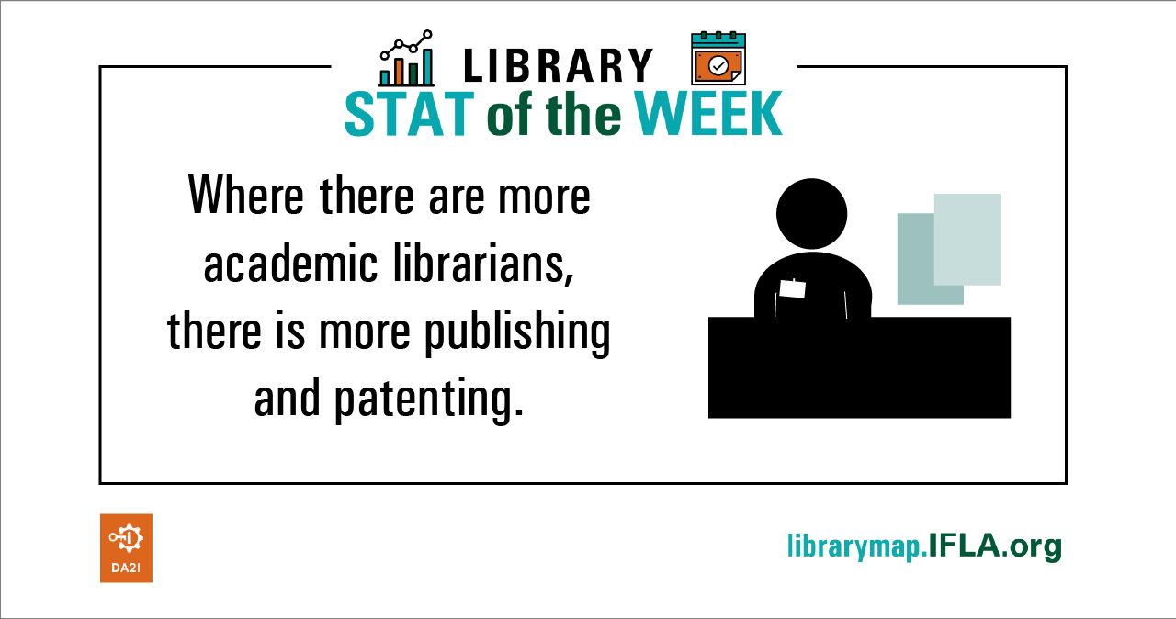
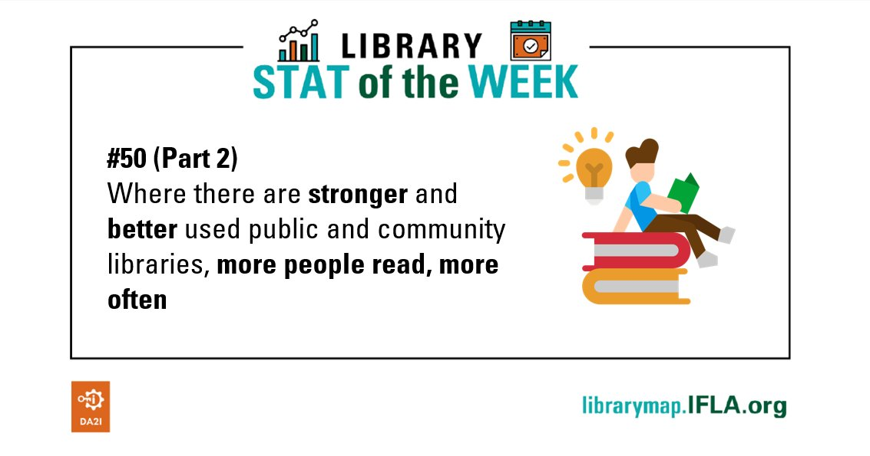
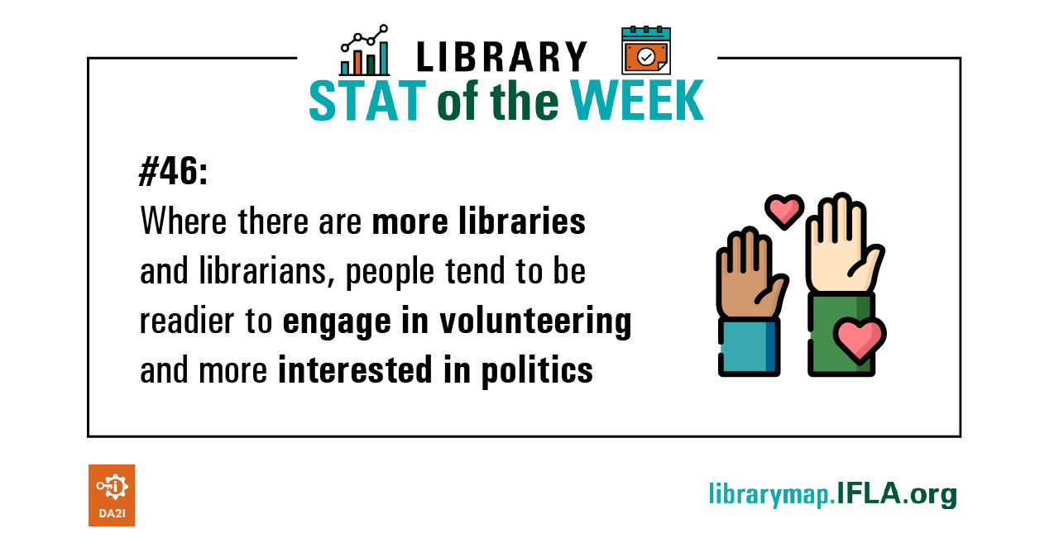
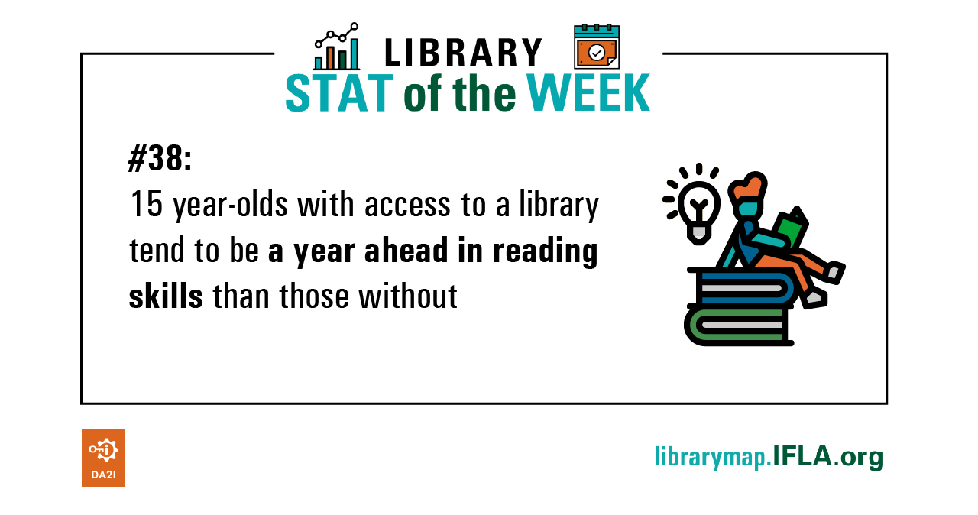
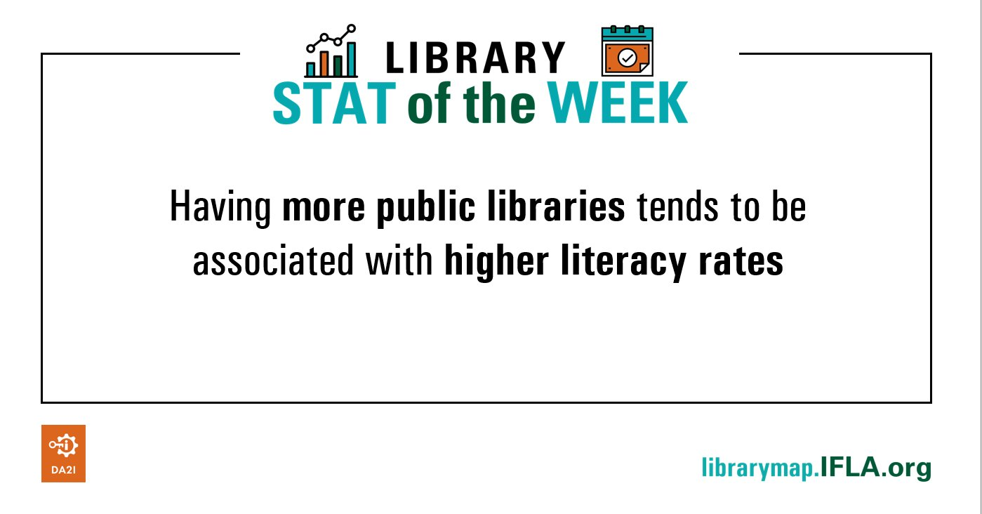
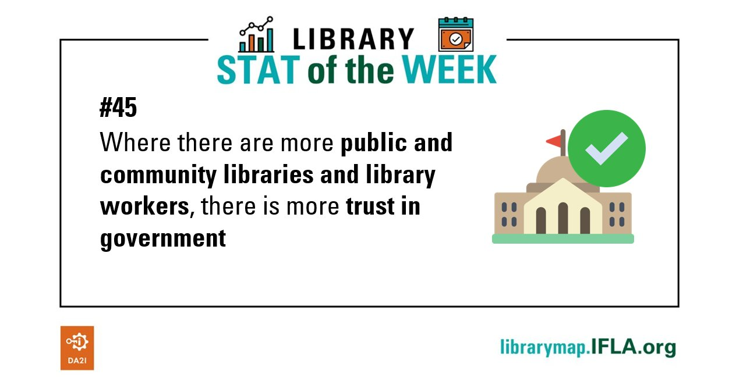
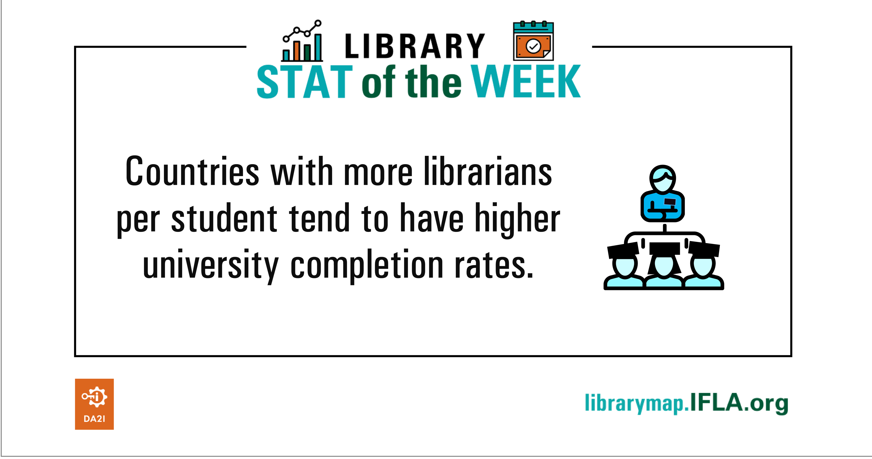
Library Map data as development metric #LibraryStatOfTheWeek

Slide 66

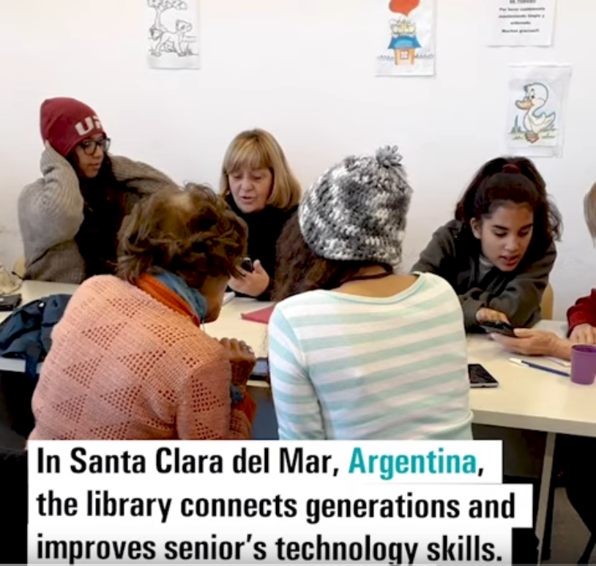
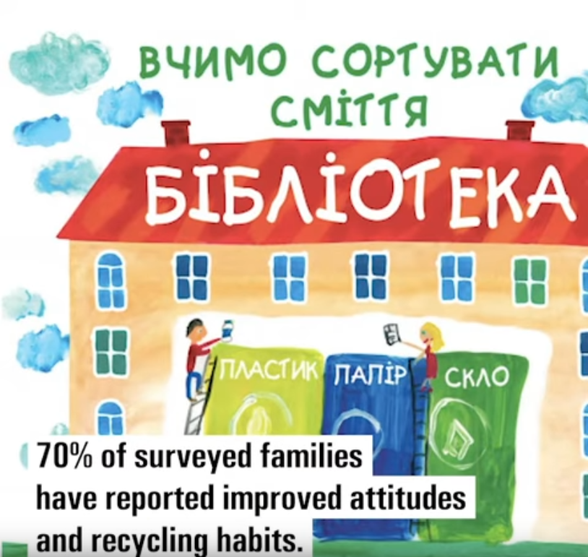

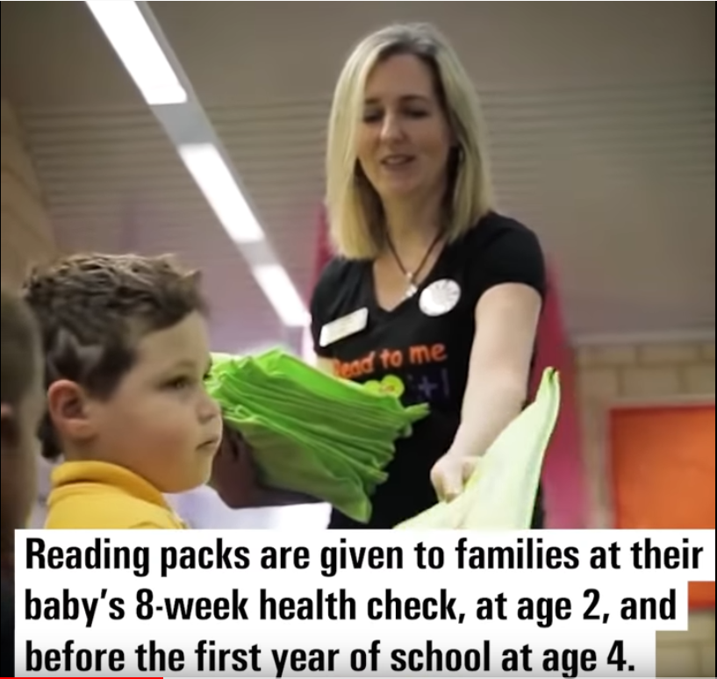
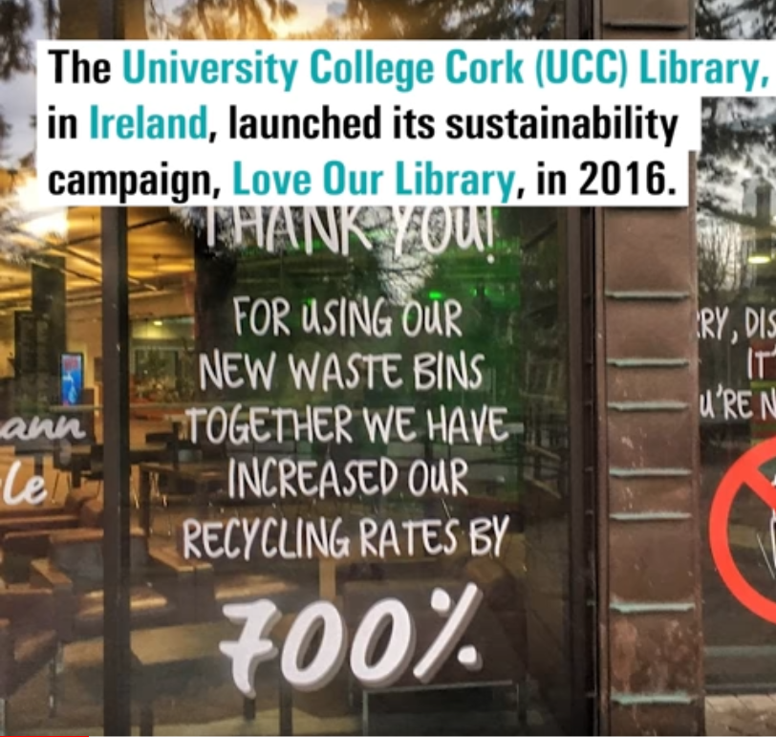
YouTube playlist – IFLA LMW SDG Stories

Slide 67
Country profile

Slide 68
DISCUSSION: Use of the Library Map
At your table – discuss:
How can we more effectively use the Library Map of the World to strengthen the voice of libraries and to build a sustainable library field in Asia and Oceania region and each country within it?
What can you do to help achieving it?

Slide 69
Share your findings!
Photo: Matt Botsford on Unsplash, unsplash.com/photos/OKLqGsCT8qs

Slide 70

Lunch break
Photo: Max Griss on Unsplash, https://unsplash.com/photos/3ni86XCruis

Slide 71
Highlights and Reflections

Slide 72
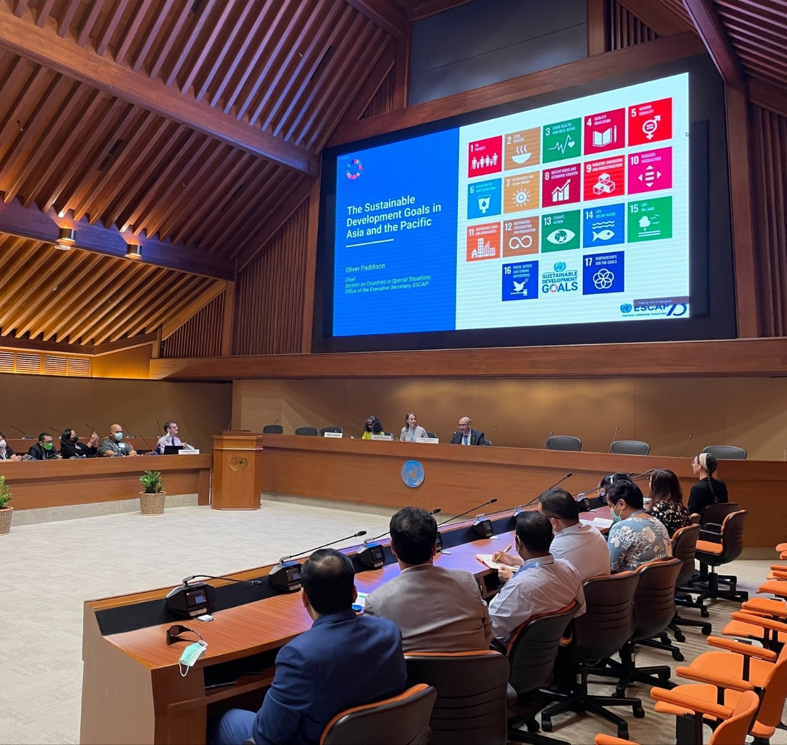
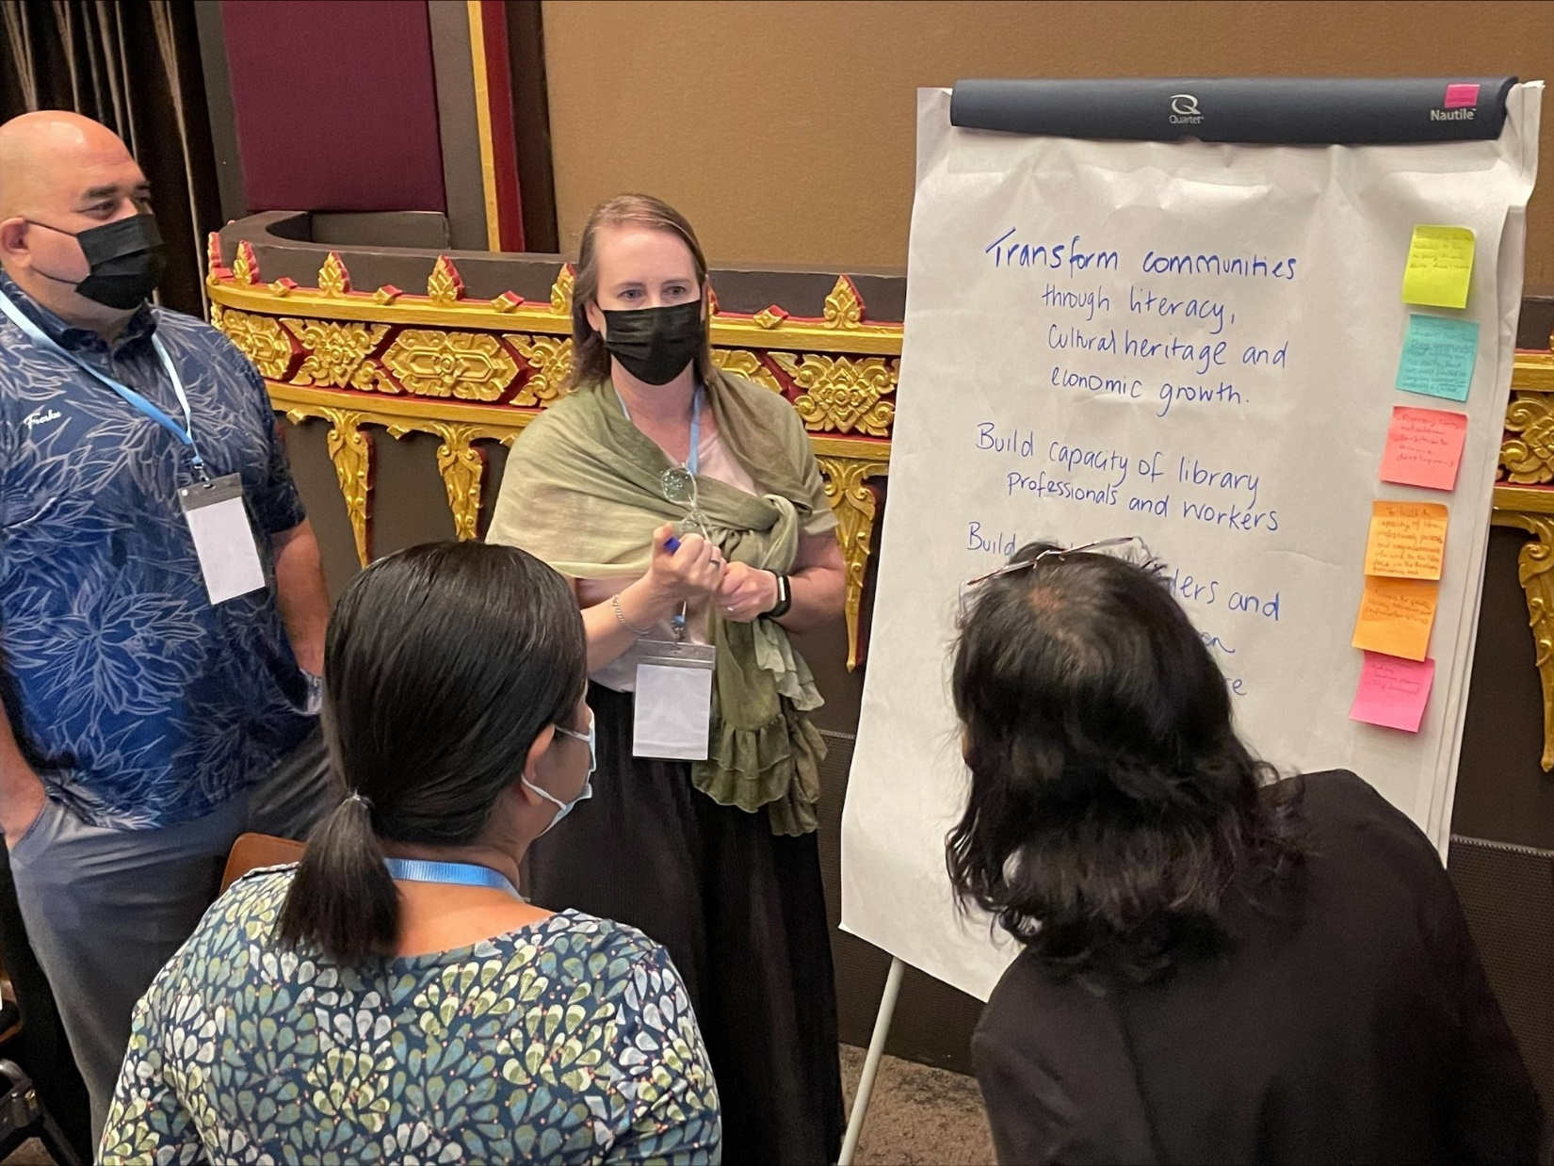
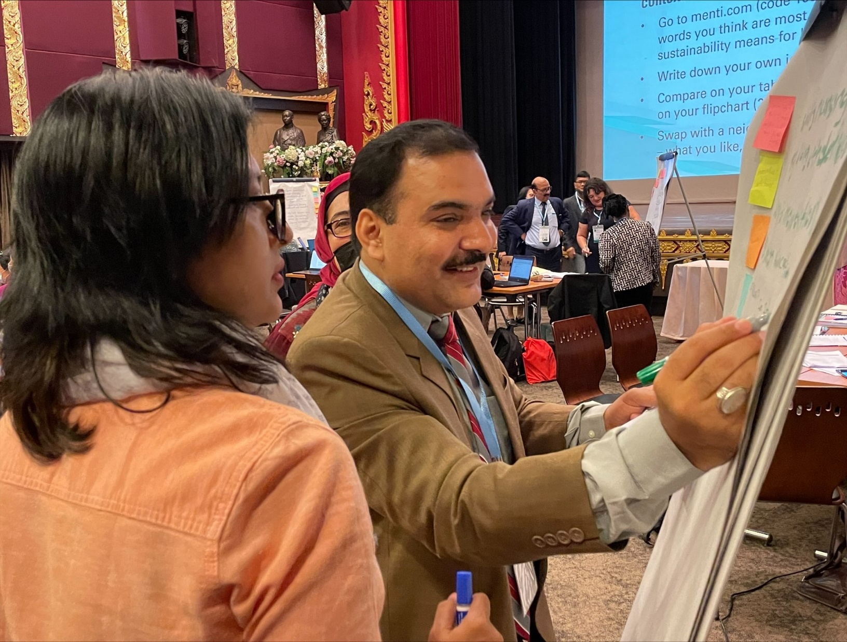
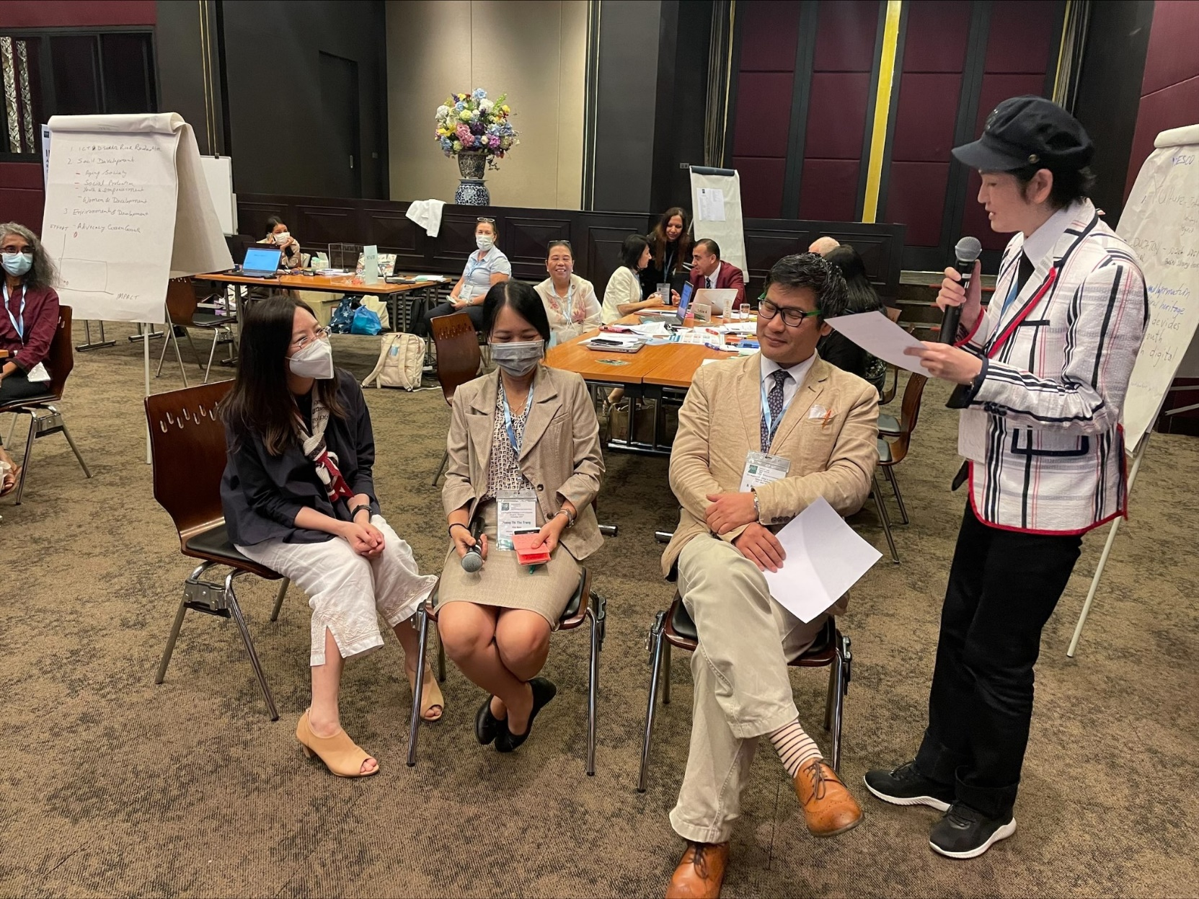
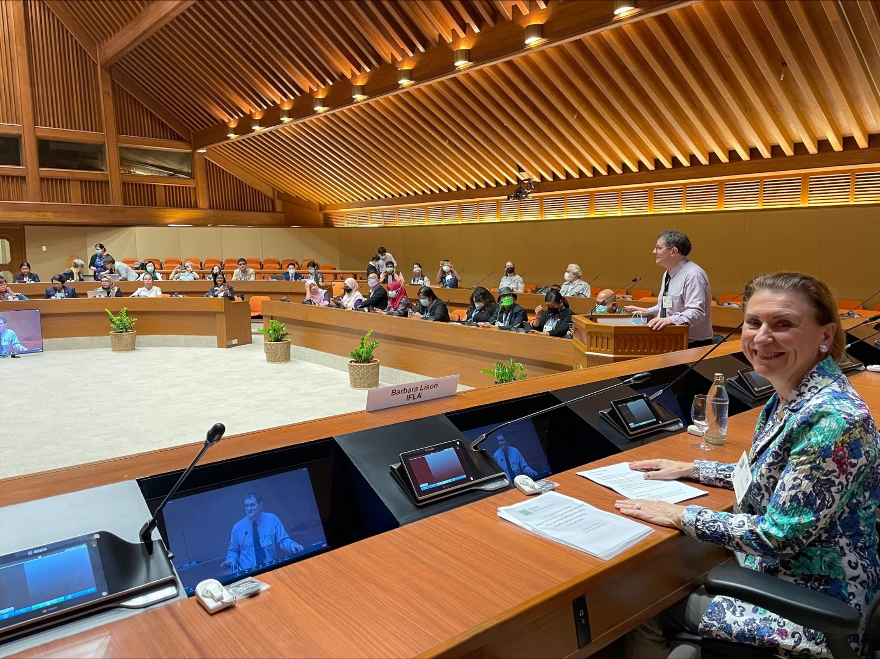
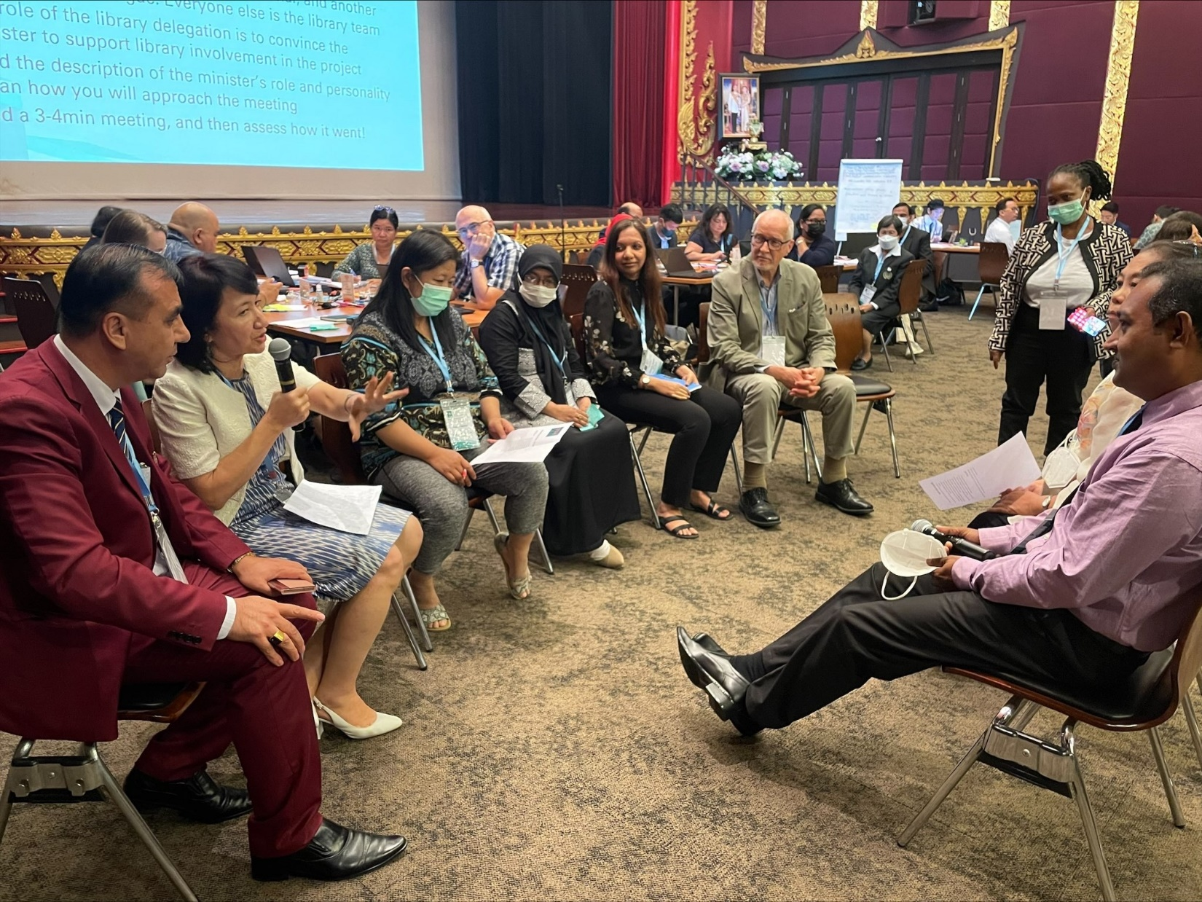

Slide 73
What has been the highlight of the workshop for you?

Slide 74
What is the main thing you will take back to your national library field?

Slide 75
What do you want to find out more about?

Slide 76
What next?

Slide 77
Key contacts

Slide 78
Key contacts
Our Regional Division Committee
Our Regional Office
Our Preservation and Conservation Centres
Our Headquarters Team
You!

Slide 79
Follow-up

Slide 80
Follow-up
Find out what the UN and UNESCO are doing in your country, and see how you might get involved – individually and collectively
Report back on how you are using the tools and insights provided, what we could do better – we’ll provide a template!
Keep an eye on your e-mails – we’ll be looking to find opportunities to bring you together to go further on specific issues… and also contact us proactively!
Think about engaging in our elections next year!
Make sure you have an (up-to-date) presence on the Library Map of the World!

Slide 81
Evaluation

Slide 82
By the end of this workshop, you should...
Have an understanding of what a sustainable library field means, and how you can apply this in your own work
Have new ideas about how you can engage with the United Nations and other international initiatives within your country and regionally
Be able to apply (IFLA) tools and references in your own strategic planning, in particular around gathering and applying data
Be ready to work with us in shaping an IFLA ‘offer’ that responds to the needs of the region
Have built your own networks!

Slide 83
By the end of this workshop, we should...
Know you and your national library fields better
Have ideas from you about where there are possibilities to work with the United Nations and other potential funders
Understand better how we can support a sustainable library field in Asia-Oceania
Have convinced you to extend your engagement in IFLA!

Slide 84
Certificates

Slide 85
Thank you!

Slide 86
Towards a stronger and more sustainable library field in Asia-Oceania
IFLA Workshop, Bangkok, Thailand
14-16 November 2022

