Slide 1
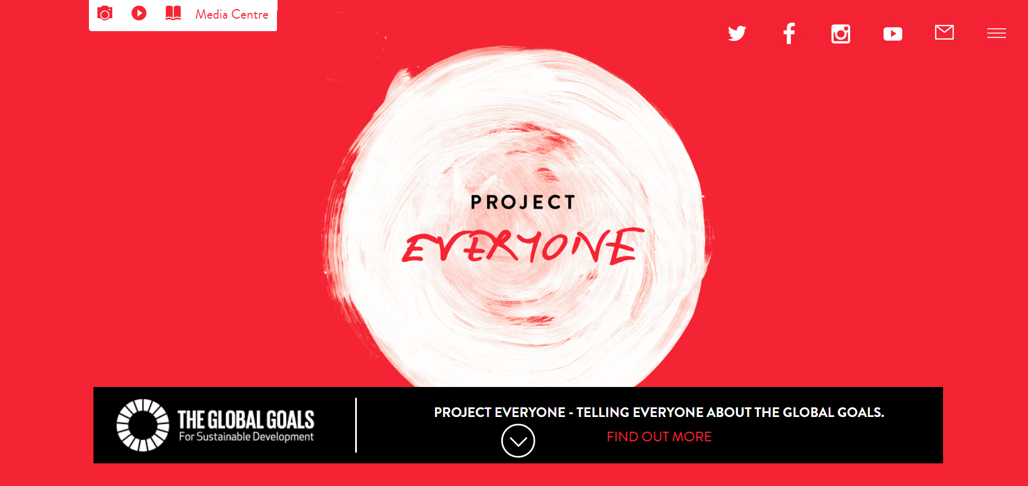
Project Everyone https://www.project-everyone.org/

Slide 2
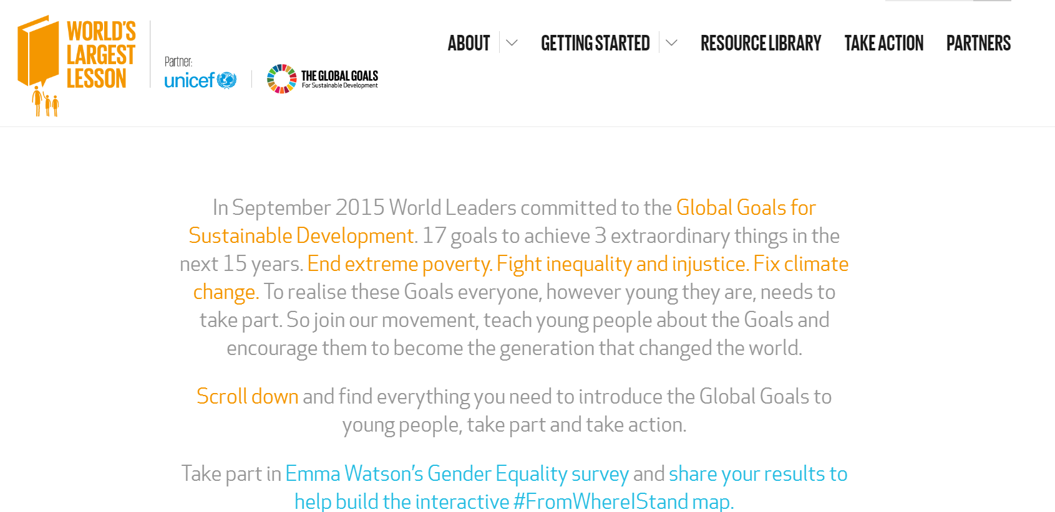
The world’s largest lesson http://worldslargestlesson.globalgoals.org/

Slide 3
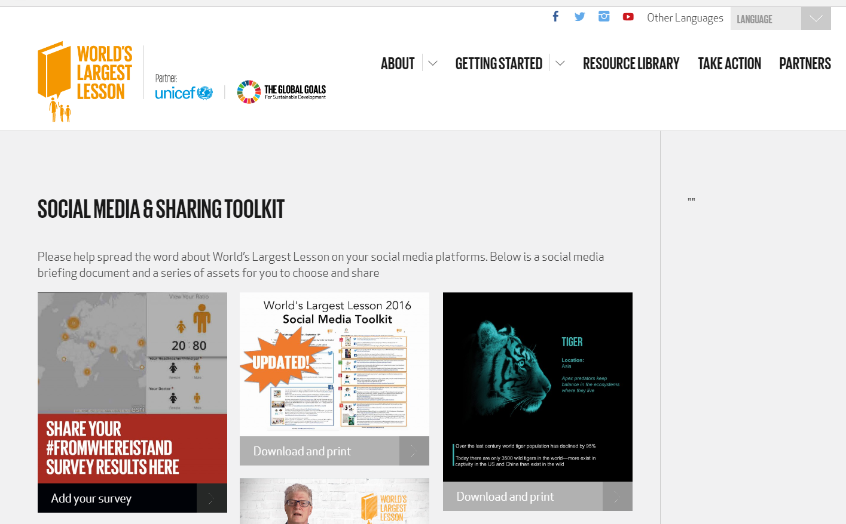
The world’s largest lesson: social media toolkit http://worldslargestlesson.globalgoals.org/social-media/

Slide 4
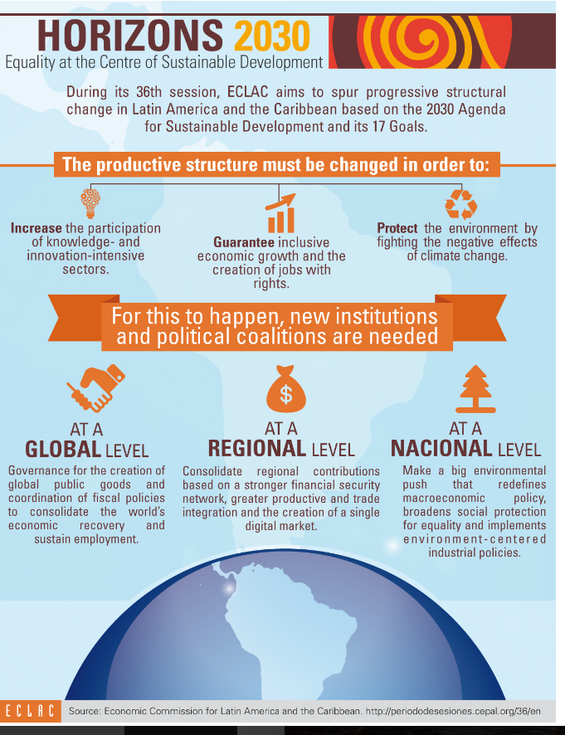
Infographics: Latin America & Caribbean http://www.cepal.org/en/infografias eg http://www.cepal.org/en/infographics/horizons-2030

Slide 5
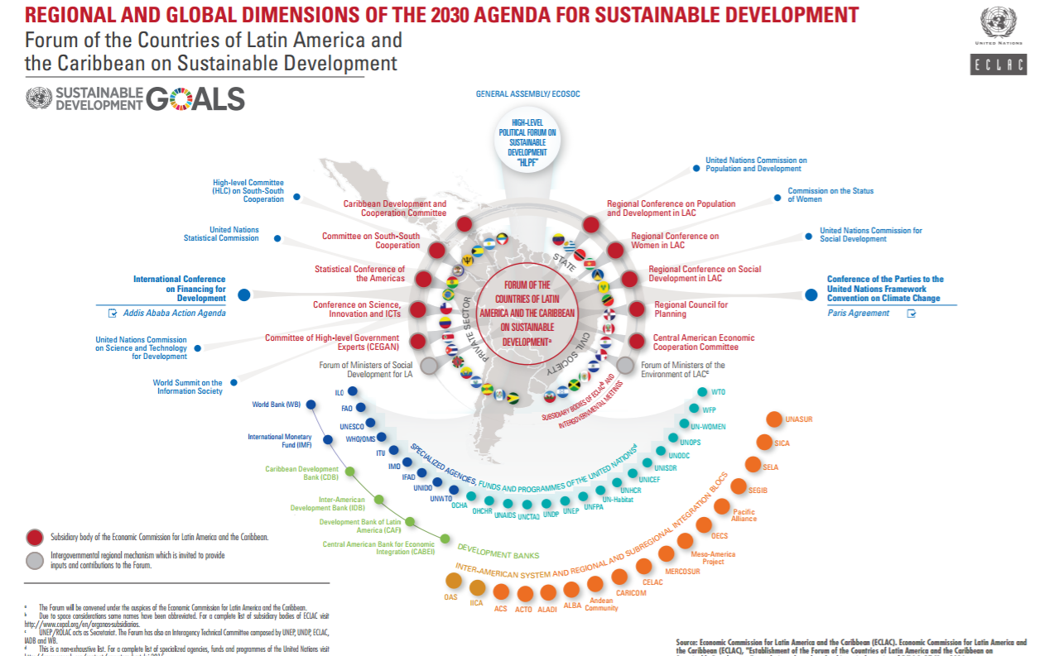
Forum http://www.cepal.org/sites/default/files/infographic/files/infographic_alc_forum_.pdf

Slide 6
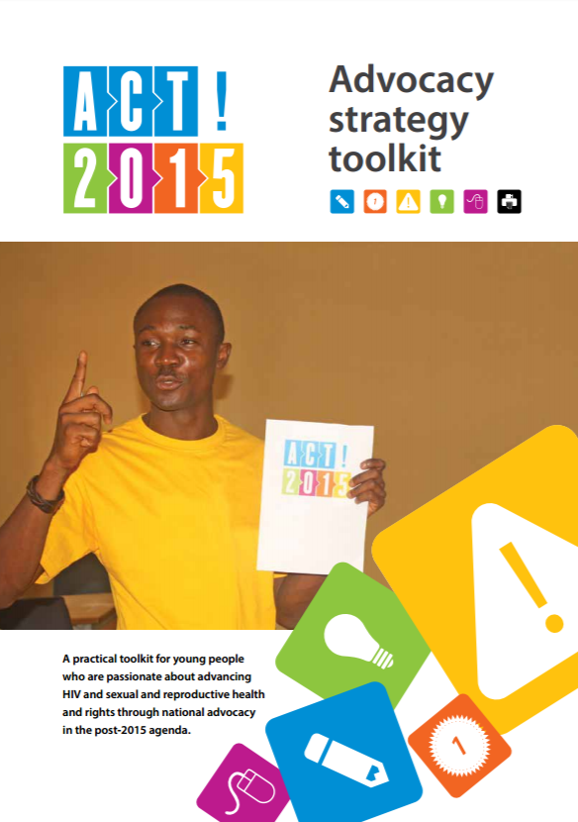
Advocacy strategy http://eecayouthvoice.org/wp-content/uploads/2014/10/UNAIDS_PACT_ACT2015_final_ENG.pdf

Slide 7
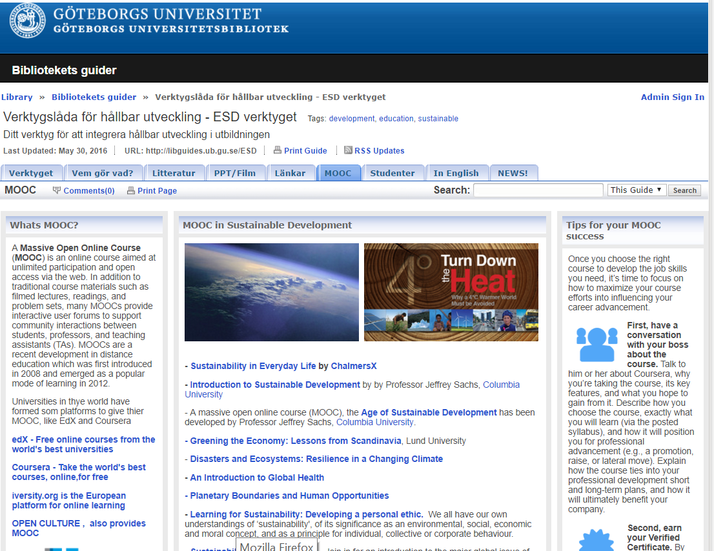
Gothenburg University Library: Libguide http://libguides.ub.gu.se/content.php?pid=577916&sid=5374177

Slide 8
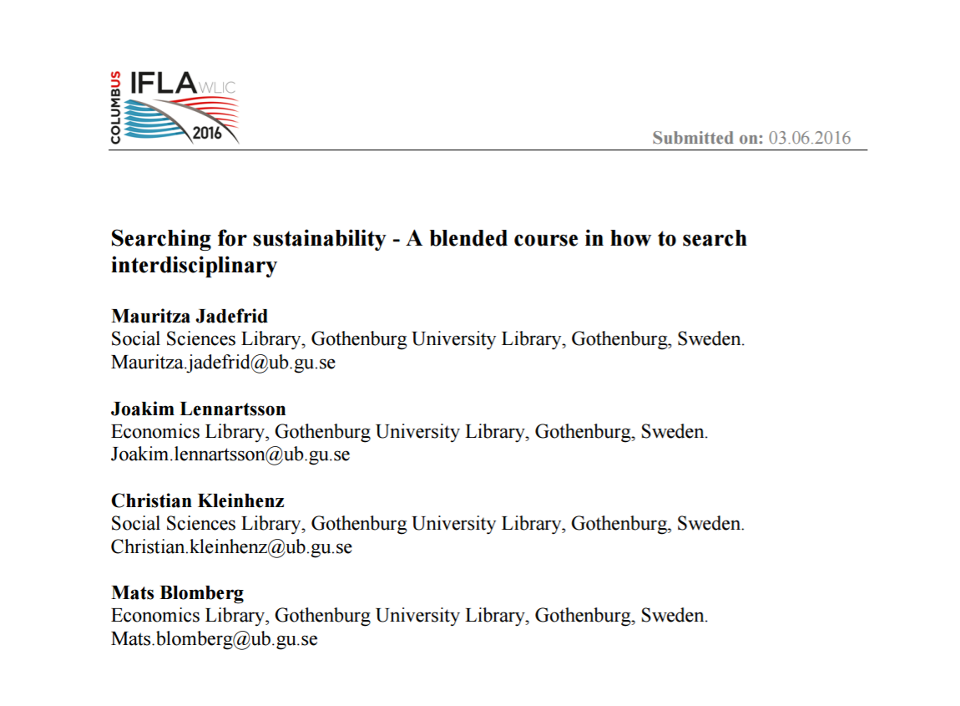
Gothenburg University Library: IFLA WLIC 2016 http://library.ifla.org/1340/1/215-jadefrid-en.pdf

Slide 9
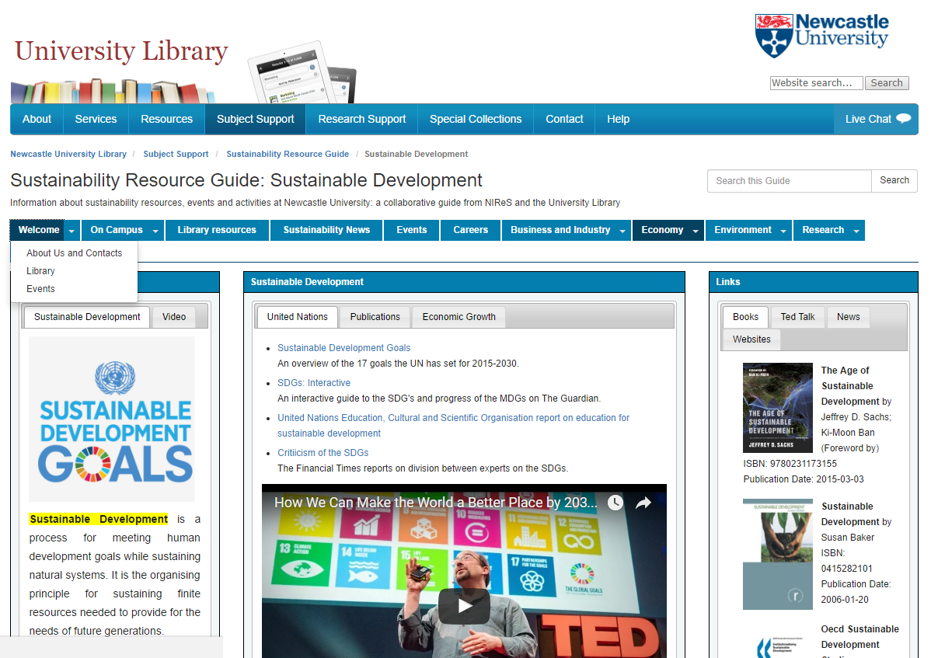
University of Newcastle Library: sustainable development LibGuide http://libguides.ncl.ac.uk/c.php?g=130216&p=3933900

Slide 10
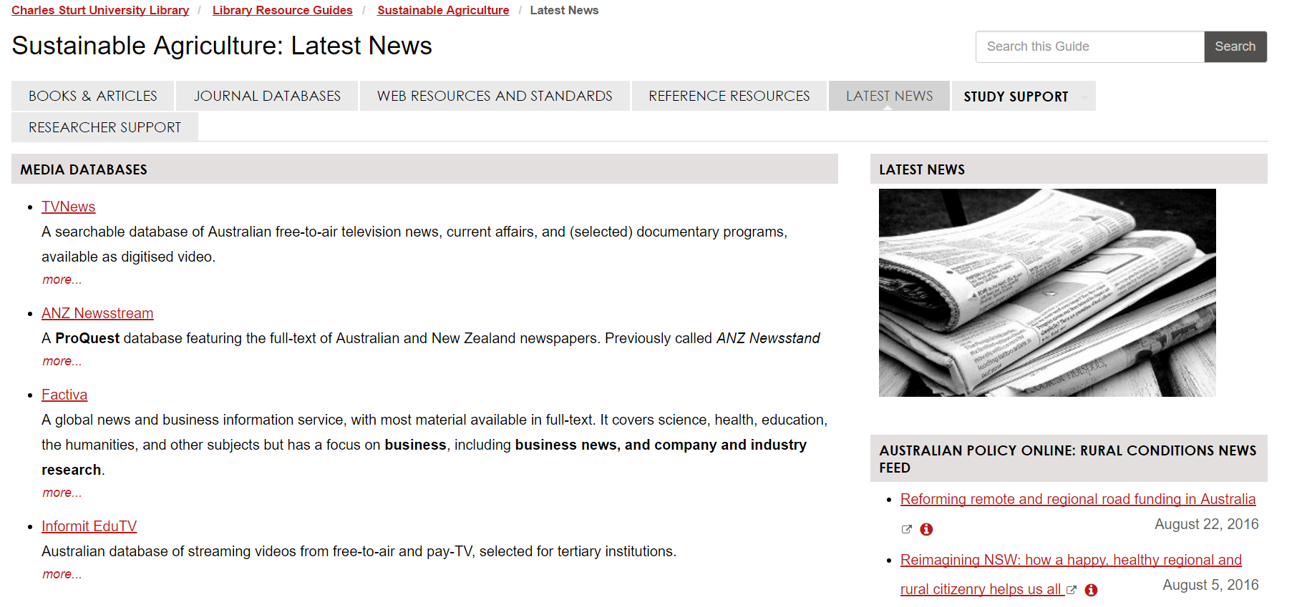
Charles Sturt University, Australia: sustainable agriculture LibGuide http://libguides.csu.edu.au/c.php?g=467946&p=3199663

Slide 11
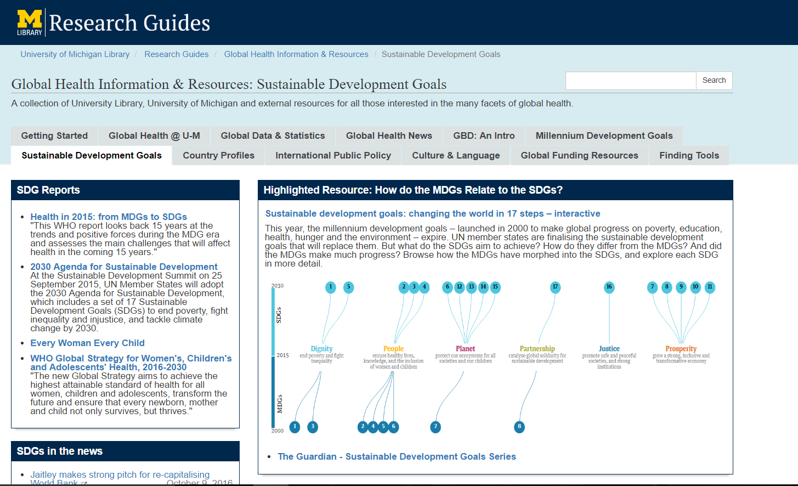
University of Michigan Library: SDGs and global health LibGuide http://guides.lib.umich.edu/c.php?g=282776&p=2641859

Slide 12
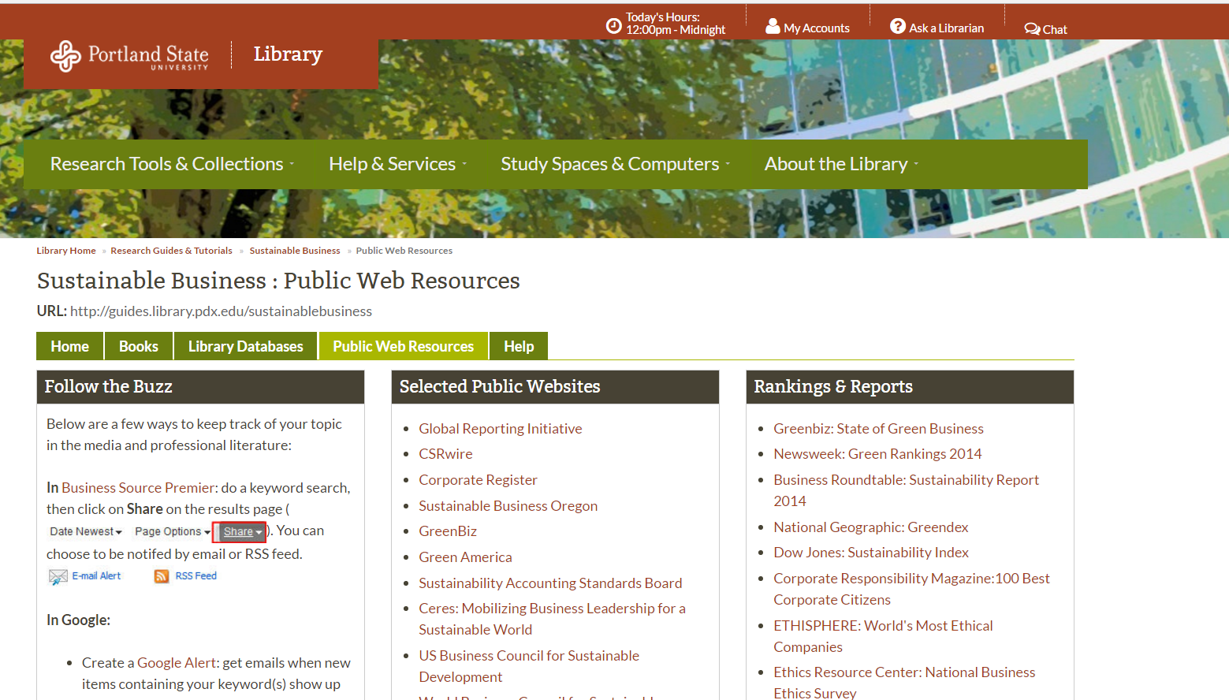
Portland State University: sustainable business LibGuide http://guides.library.pdx.edu/c.php?g=271281&p=1811087

Slide 13
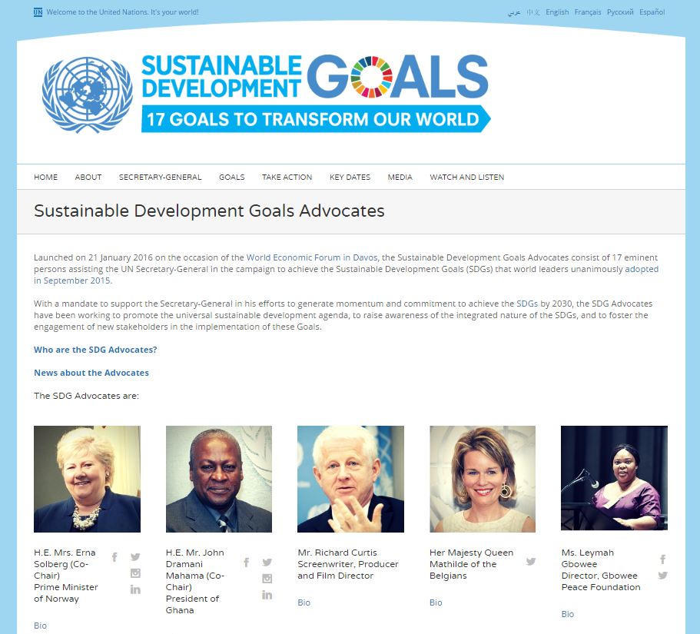
Sustainable Development Goals Advocates http://www.un.org/sustainabledevelopment/sdgadvocates/

Slide 14
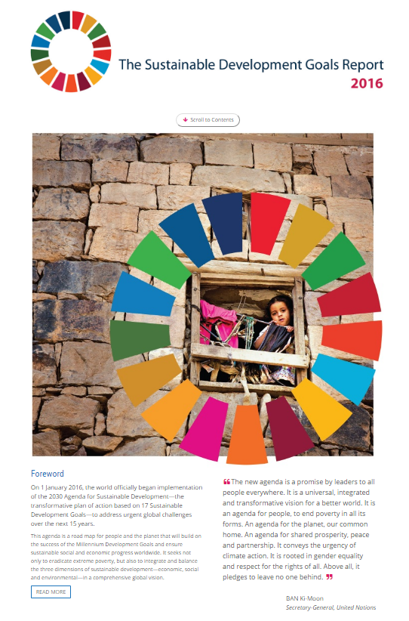
The Sustainable Development Goals Report 2016 http://unstats.un.org/sdgs/report/2016/

Slide 15

Your activity: your time: your interests…
Image: https://explore.univ-psl.fr/fr

