Slide 1


A Strong and Sustainable Library Field for Africa
IFLA HEADQUARTERS 2023
Nairobi – 16-18 October 2023

Slide 2


Welcome back!

Slide 3

Reminder: Our Agenda (Day 2) - KNLS
From priorities to plans
IFLA Strategy reminder
Evaluating and demonstrating value and impact
Library Map of the World – your advocacy tool
Introduction – why advocacy matters
Defining advocacy goals
Practicing advocacy skills
Dinner

Slide 4
A Challenge for Today…
If you haven’t spoken to the room yet, today is your chance!
… and a question
We would be keen to share e-mails – let us know if this is NOT OK with you!

Slide 5
From priorities to plans – defining impactful actions

Slide 6

DISCUSSION
Talk about your strategies

Slide 7
DISCUSSION: Talk about your strategies
What was the process for preparing it?
What did you think about when preparing it?
Does it define goals?

Slide 8
Defining impactful actions
Through your library sustainability indexes, you have an idea of where you may need to act in order to maximise library sustainability... now to define actions

Slide 9

How to define an effective action

Slide 10
Develop
Coordinate
Manage
Support
Upgrade
Create
Implement
Produce
Provide
Maintain
Oversee
Plan
Evaluate
Engage
…
S = Specific
What action will you take?
What are you trying to accomplish? Why?
Who needs to be involved?
Where and when does it need to happen?

Slide 11

M = Measurable
What does success of the action will look like?
What data and evidence will measure the goal?
How much? How well?

Slide 12

A = Achievable
Is it doable?
Do you have the necessary skills, resources and tools?
If not, how can you obtain them?
Do you have the motivation to achieve the goal?
Is the amount of effort required feasible with what the action will achieve?

Slide 13

R = Relevant
Who do you need to take this action now?
How does your action align with other things you do?
Why is result important for your community, library field?

Slide 14

T = Time-bound
What is the timeframe for accomplishing the goal of the action?
What are the deadlines and milestones?
Is it realistic?

Slide 15
SMART action – Example 1
Initial statement:
To produce a country profile for the Library Map of the World

Slide 16
SMART action – Example 1 – Specific
There is no information on the Library Map website about the library environment in my country. I will work together with partners and volunteers to prepare and submit the content by July 2024.

Slide 17
SMART action – Example 1 – Measurable
Creating content is time consuming, so I want to make sure the content is used. It’d like to have at least 500 visitors to our country profile within 12 months after its launch, to make sure that people are more aware about libraries in my country.

Slide 18
SMART action – Example 1 – Achievable
Compiling content requires human resources, time and English language skills. I will set up a team of volunteers and students and will manage them to achieve milestones; and I will keep everyone motivated.

Slide 19
SMART action – Example 1 – Relevant
The Library map is a hub of information about the library landscape in each country. It is important that my country is represented with up-to-date information, so that our achievements can be seen by stakeholders and inspire other librarians. This aligns with other actions we take to increase visibility of contribution of libraries to the sustainable development.

Slide 20
SMART action – Example 1 – Time-bound
In order to be able to submit the content by July 2024, I need to set up a team as soon as possible and hold regular meetings to track progress. In addition, to achieve at least 500 user sessions in one year after launch, we need to think about a communications plan over the year following the launch of the country profile.

Slide 21
Example 1 – SMART action
To make people more aware about our library field, we will produce the country profile containing comprehensive information. We will prepare content and make sure it is published by the end of 2024, and through communications, achieves 500 visits within a year.
What does success look like?
Country Profile published by the end of 2024
500 visits to our country profile by the end of 2025
People are more aware about the library field in my country

Slide 22
SMART action – Example 2
Initial statement:
To engage with government in preparation of my country’s Voluntary National Review

Slide 23













SMART action – Example 2
Initial statement:
To engage with government in preparation of my country’s Voluntary National Review

Slide 24
SMART action – Example 2 – Specific
The SDGs represent a commitment by governments to promote and report on policies which will favor stronger, fairer, more sustainable growth. We want to engage with government in the preparation of the Voluntary National Review; we want libraries to be mentioned in this report.
This should lead to better recognition of libraries as key partners in delivering development.

Slide 25
SMART action – Example 2 – Measurable
I want to get libraries mentioned in the VNR at least once in relation to the SDGs. I want my association/library to be invited to at least one meeting, and follow-up online, leading to both opportunities to input into the creation of the official report and improve relationships with policy makers.

Slide 26
SMART action – Example 2 – Achievable
Governments have engaged to work with all stakeholders, including civil society, to deliver on the SDGs, and libraries are usually seen as friendly. We can use submissions to VNRs, meetings with officials, and cooperation with local UN offices to go further.

Slide 27
SMART action – Example 2 – Relevant
The SDGs as a whole are important because governments have committed to taking steps to deliver them, and to report on progress to their peers at the UN. Better recognition of libraries within this context could lead to libraries benefiting from new policies and laws in my country.

Slide 28
SMART action – Example 2 – Time-bound
We will need to act quickly to identify key contacts and opportunities by the end of the year, especially if we will undertake a VNR. We will respect the deadlines set by governments for contributions and consultation meetings in Q1 2024. We will be able to assess success once the report is published in July 2024.

Slide 29
Example 2 – SMART action
We will look to get libraries recognized as key partners in delivering the SDGs, in order to help secure the laws and funding our institutions need to serve our communities better. We will identify key opportunities and contacts for engagement, as part of the VNR process, using the opportunities this offers to highlight what libraries can contribute within the time frame set by the process. We will aim to get libraries’ role recognized in the official report and be invited to continue to deepen our relationship.
What does success look like?
At least one meeting held with officials
Formal contributions made to consultations
At least one significant reference to libraries in the official report
Greater recognition and support for libraries

Slide 30
SMART action – Example 3
Initial statement:
To provide advocacy training for librarians

Slide 31
SMART action – Example 3 – Specific
We need more and better library advocates in our country, but not every librarian has the skills or confidence to do this. Therefore, within the next 6 months, we will translate and adapt IFLA’s “10-Minute Library Advocate” series, will compile them into a training pack, and will pilot it through training of 30 members of our association. This should increase advocacy skills of librarians.

Slide 32
SMART action – Example 3 – Measurable
Translation and adaptation of IFLA’s materials will be time consuming, so we want to make sure that more librarians are aware that it is published and available to be downloaded and used for self-learning. We will make the 30 trainees into ambassadors for the material in order to promote it to a total of 300 other librarians and library workers, who will each download a copy for their own use during the first year after the training. This should lead to an overall increase in advocacy skills in the library community.

Slide 33
SMART action – Example 3 – Achievable
We would need about 3 months for translation and adaptation, and we can conduct the pilot training of selected librarians in another 3 months. We will engage with the library schools, both in order to accelerate translation (by students as an assignment of their English class), and teachers can be engaged in piloting the material with librarians.

Slide 34
SMART action – Example 3 – Relevant
Every librarian an advocate! It’s what we need to aim for. More and better advocates at all levels will help us to better demonstrate the value and contribution of libraries to our stakeholders.

Slide 35
SMART action – Example 3 – Time-bound
The timeframe of 6 months may sound ambitious, but we will be using “10-Minute Library Advocate” materials provided by IFLA. All we need to do is to translate and adapt it to the local context, e.g., adding local examples and resources. We will use time before the academic year to engage with the LIS school. After setting up a team, we will spend 3 months to translate/adapt the material and other 3 months to prepare for and deliver the pilot training.

Slide 36
Example 3 – SMART action
We need more and better library advocates in our country, but not every librarian has sufficient advocacy skills. Therefore, within 6 months, we will translate and adapt IFLA’s “10-Minute Library Advocate” series and pilot it by training of 30 members of our association. These trainees will act as ambassadors and spread the word about this training material for self-learning to other 300 librarians in our country, which should ultimately lead to increased advocacy skills.
What does success look like?
Translated and adapted advocacy training materials uploaded to our website by [month] 2024
300 downloads within the next year after publication on website
Increased advocacy skills among members of our association and other librarians

Slide 37

EXERCISE
Define an Impactful Collaborative Action

Slide 38
EXERCISE: Define an Impactful Collaborative Action
Individually – within a topic of advocacy or sustainability, reflect and identify one national action
At your table – within a topic of advocacy or sustainability, discuss and identify one collaborative strategic action.
What would be the action with the biggest impact and the least amount of effort?
What would success look like?
Can you make it SMARTer?

Slide 39

Share your findings!
Photo: Matt Botsford on Unsplash, unsplash.com/photos/OKLqGsCT8qs

Slide 40
IFLA Strategy Reminder

Slide 41
Photo: Matt Botsford on Unsplash, unsplash.com/photos/OKLqGsCT8qs

Slide 42
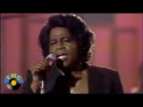

Slide 43




IFLA Strategy 2019-2024

Slide 44
Vision
A strong and united library field powering literate, informed and participatory societies
Mission
To inspire, engage, enable and connect the global library field
IFLA Strategy 2019-2024

Slide 45
Strategic Directions 2019-2024
ONE
Strengthen the Global Voice of Libraries
TWO
Inspire and Enhance Professional Practice
THREE
Connect and Empower the Field
FOUR
Optimise our Organisation

Slide 46
The IFLA Strategy is designed to be…
A means of responding to the opportunities highlighted in the Global Vision
A reference point for all parts of IFLA in their work
A tool for our Members and beyond in their own strategy-building
A framework for building cooperation and realising synergies within the library field

Slide 47

The road to the IFLA Strategy 2024-2029

Slide 48

EXERCISE
Your experience of the IFLA Strategy 2019-2024

Slide 49
EXERCISE: Your experience of the 2019-24 Strategy
Say how far you agree with the following questions:
How far do you agree that IFLA’s Vision and Mission inspire/guide/inform you?
How far do you agree that IFLA’s Strategic Directions inspire/guide/inform you?
What changes would you suggest?

Slide 50
IFLA Strategy 2019-2024
Vision
A strong and united library field powering literate, informed and participatory societies
Mission
To inspire, engage, enable and connect the global library field
Strategic Directions
Strengthen the global voices of libraries
Inspire and enhance professional practice
Connect and enable the field
Optimise our organisation

Slide 51
IFLA Strategy 2024-2029
Look out for opportunities to engage!

Slide 52

Break
Photo by Mike Kenneally on Unsplash, unsplash.com/photos/TD4DBagg2wE

Slide 53
Evaluating and demonstrating value and impact

Slide 54
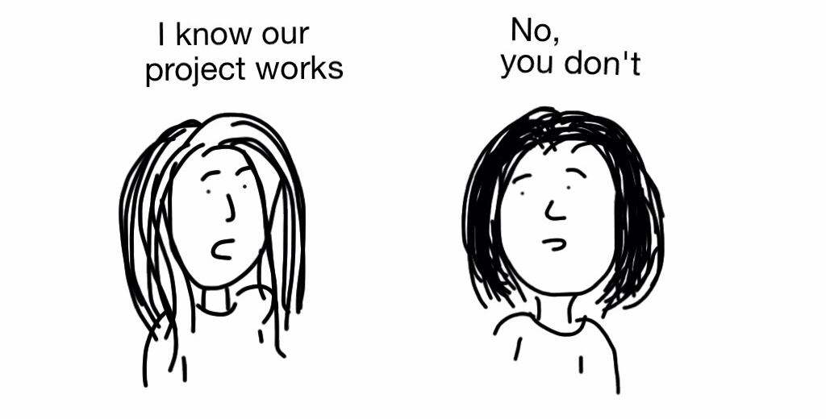
Measurement and Evaluation - Why

Slide 55

Understanding community needs and designing
services for impact
Foto: bit.ly/3Ds082o

Slide 56

Ensuring that stakeholders understand our value and impact
Photo: bit.ly/3oeWjth

Slide 57
QUESTION
What are some of the main challenges for you when it comes to demonstrating value and impact?
Go to www.menti.com and use the code 2422 8925

Slide 58

Measuring and Demonstrating Impact – Challenges and Solutions
Photo: bit.ly/3lygq3F

Slide 59
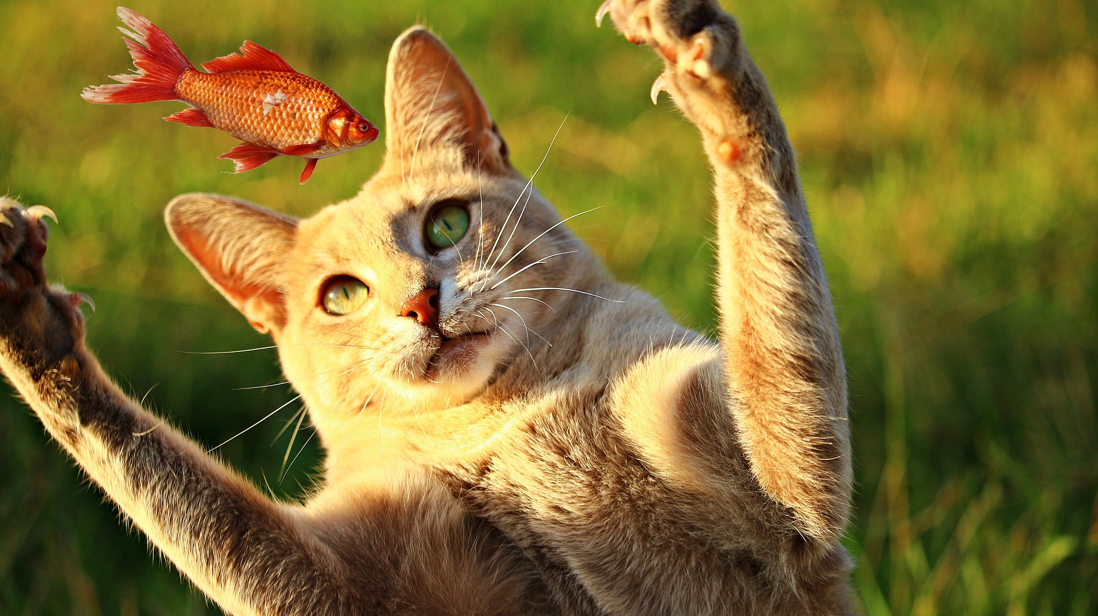
Knowing your target and setting meaningful measures
Photo: bit.ly/2YFFBbp

Slide 60

Understanding stakeholders, their goals, objectives and values
Photo: bit.ly/3FE69Lu

Slide 61

Defining targeted outcomes and impact into the design
Photo: bit.ly/3mLaLGR

Slide 62











Defining targeted outcomes and impact into the design
Photo: bit.ly/3mLaLGR

Slide 63

















Defining targeted outcomes and impact into the design
Photo: bit.ly/3mLaLGR

Slide 64
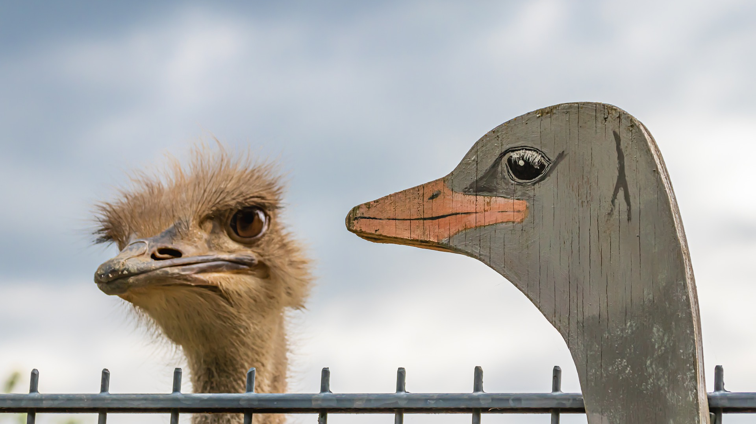
Confusing performance and satisfaction measures with outcome and impact measures
Photo: bit.ly/3v4BJwK

Slide 65
Shortly about measures
Community & needs data
Performance data
Satisfaction data
Outcomes data
Why?
How much?
How well?
So what?
Community and target group needs
Library activities, projects, programmes
Satisfaction of users and participants
Outcomes for people and impact on community

Slide 66
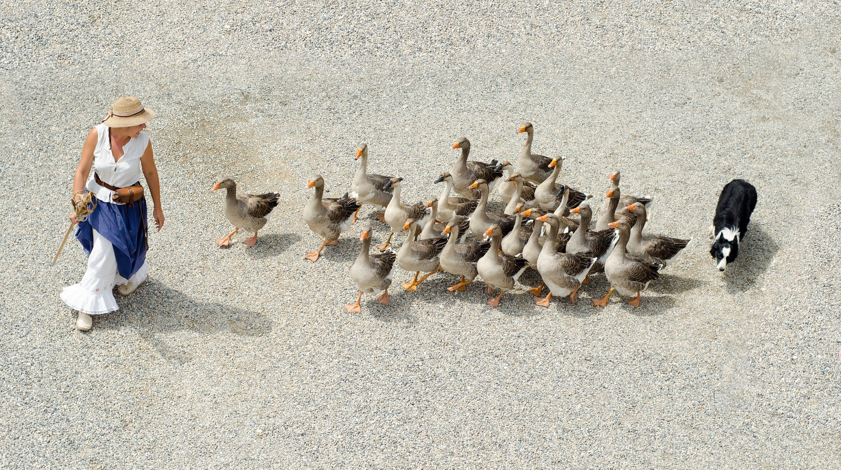
Having a role responsible for managing library’s measures
Photo: bit.ly/3v4Yd0D

Slide 67

Positioning our actions for impact – How?
Photo: bit.ly/3lV3Qu6

Slide 68













Inputs
Outputs
Outcomes
Impact
Photo: bit.ly/3AsNVIU

Slide 69
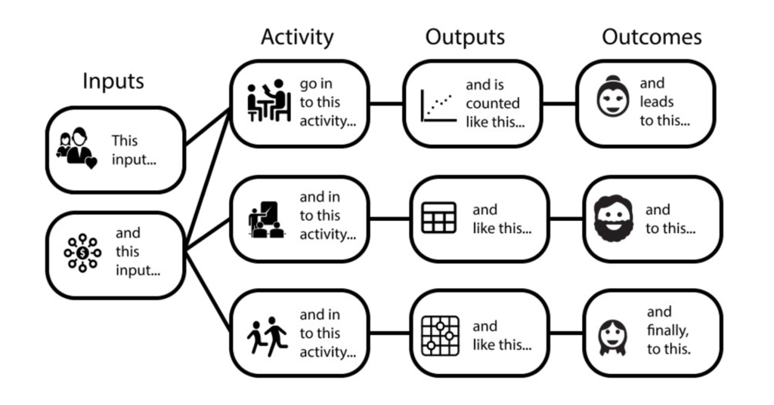
Logic Model
https://freshspectrum.com/charts-and-illustration/

Slide 70
Needs
Inputs
Activities
Outputs
Outcomes
Impact
Photo: bit.ly/3AsNVIU

Slide 71
Impact
Outcomes
Outputs
Activities
Inputs
Conditions/Needs
Community-centred
Logic Model
Aligning activities to meet community needs

Slide 72
Impact (What is the overall impact or result you are looking for?)
Outcomes (What changes in conditions do you expect to see?)
Outputs (What direct results of your actions do you expect?)
Activities (What activities will you implement to address it?)
Inputs (What resources will you use to address the issue/need?)
Conditions/Needs (What challenge/problem do you want to change?
Community-centred
Logic Model
Aligning activities to meet community needs

Slide 73
Resources /
Inputs
Activities
Outputs
Outcomes
Impact
Certain resources are needed to operate your programme
If you have access to them, then you can use them to accomplish your planned activities
If you accomplish your planned activities, then you will hopefully deliver the amount of product and/or service that you intended
If you accomplish your planned activities, to the extent you intended, then your participants will benefit in certain ways
If these benefits to participants are achieved, then certain changes in organisations, communities, or systems might be expected to occur

Slide 74
Needs
Inputs
Activities
Outputs
Outcomes
Impact
Photo: bit.ly/3AsNVIU

Slide 75
























Impact
Needs
Outcomes
Inputs
Outputs
Activities
Photo: bit.ly/3AsNVIU

Slide 76









1 = Stakeholder perspective
2 = People perspective
3 = Library perspective
Impact
Needs
Outcomes
Inputs
Outputs
Activities
Photo: bit.ly/3AsNVIU

Slide 77
1 = Stakeholder perspective
2 = People perspective
3 = Library perspective
Reduced unemployment rates
Employment
People who improved skills, found job
Resources: Staff, equipment, money
Number of trained people
Job skills training
Photo: bit.ly/3AsNVIU

Slide 78
1 = Stakeholder perspective
2 = People perspective
3 = Library perspective
Improved recycling rates
Contamination on the beach
People who see benefit in recycling
Resources: staff, time, money
Number of trained people; kg of trash removed
Training to recycle; Event on the beach
Photo: bit.ly/3AsNVIU

Slide 79
1 = Stakeholder perspective
2 = People perspective
3 = Library perspective
Enabled youth development; Bridging digital gap
Lack of ICT in schools; Failed exams
Improved skills; Enhanced learning; Improved exams
Mobile library van; Equipment; Digital content; Staff
Number of visits; Number of trained
Visits to schools; Hands-on training
Photo: bit.ly/3AsNVIU

Slide 80
Ensuring that stakeholders understand our value and impact
Photo: bit.ly/3oeWjth

Slide 81
Outcomes. Impact. Change.

Slide 82

Impact (What is the overall impact or result you are looking for?)
Outcomes (What changes in conditions do you expect to see?)
Outputs (What direct results of your actions do you expect?)
Activities (What activities will you implement to address it?)
Inputs (What resources will you use to address the issue/need?)
Conditions/Needs (What challenge/problem do you want to change?
Community-centred
Logic Model
Aligning activities to meet community needs

Slide 83

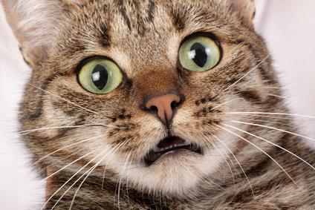
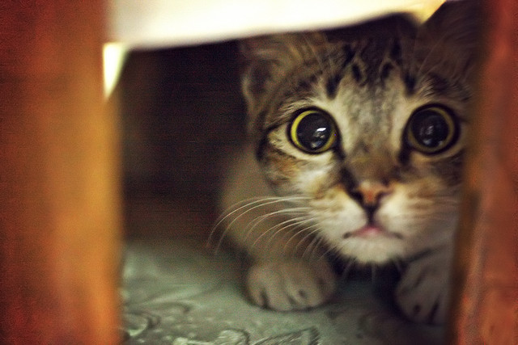
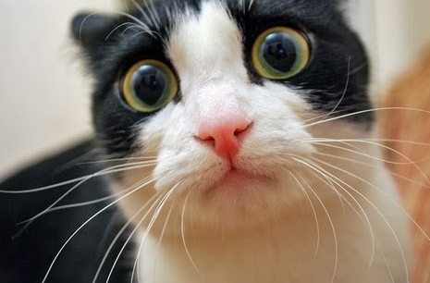
Impact Evaluation
Will I be evaluated?!
What is going to happen now?
Maybe next year…?
Maybe they will forget about me?

Slide 84
Impact is about change and outcomes for people
https://freshspectrum.com/charts-and-illustration/

Slide 85
What is Outcome?
The way a thing turns out
https://en.oxforddictionaries.com

Slide 86
Demystifying Outcomes
An outcome is a specific benefit that results from our actions designed to help our target group to change their awareness, knowledge, skills, attitudes, or behavior.
Outcomes are generally expressed as changes individuals perceive in themselves.
Outcomes can be quantitative or qualitative.

Slide 87
How does change occur?
Quality of life
Behaviour
Impact
Attitudes
Skills
Knowledge
Awareness
Time

Slide 88
Example – Training on smartphone use
I feel more empowered, I feel less lonely, more connected to outside world
Impact
I use smartphone every day
I think smartphone is useful to me
I know how to use smartphone
I know more about smartphone
Time

Slide 89
Impact Planning
Impact objectives
Outcome indicators
Data and evidence

Slide 90
Impact Objectives (Outcomes)
Clear and achievable within a specific time span
Realistic, taking into account your resources
Carefully worded

Slide 91
How to write good impact objectives (outcomes)?
Verb indicating change
What will change
Who will change
Additional specificity
Examples:
To increase
To establish
To reduce
To create
To produce
To change
Examples:
Access
Availability
Attitude
Behaviour
Knowledge
Skills
Examples:
Children
Young women
Seniors
School dropouts
Illiterate adults
Local farmers
Where you expect to see this change? geography)
By when you expect to see the change? (date)
How much change you intend to see? (target)

Slide 92
Outcome Indicators (Measures)
An outcome indicator is a specific, observable, and measurable characteristic that will represent achievement of the outcome.
It is important to think through indicators that can tell you both:
Whether the outcome has occurred
And by how much

Slide 93
EXERCISE
Define Outcomes (Impact Objectives) of Your Collaborative Action

Slide 94
EXERCISE: Define Outcomes (Impact Objectives) of Your Collaborative Action
At your table – discuss and identify outcomes (impact objectives) of your collaborative action.
What would be the target group and some milestones (outputs) of your action?
What would be the outcomes (impact objectives) of your action?
How would you evaluate the impact of your action?

Slide 95
Share your findings!
Photo: Matt Botsford on Unsplash, unsplash.com/photos/OKLqGsCT8qs

Slide 96
Library Map of the World –
your advocacy tool

Slide 97


Library Map of the World
librarymap.ifla.org
Data
Country Profiles
SDG stories

Slide 98
Library Map of the World
Let’s talk about
Library Map – why and how
Contributors
Library data
Country profiles
SDG stories
Resources

Slide 99
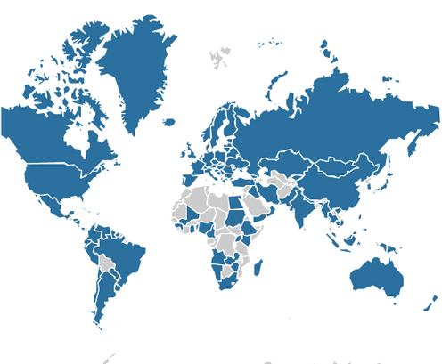
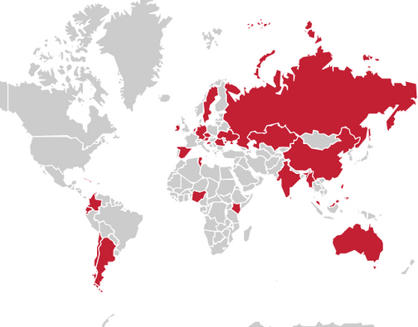
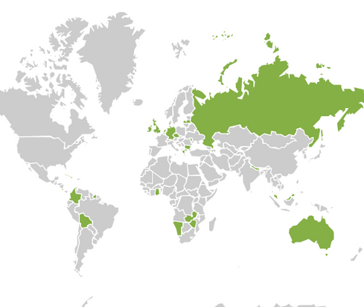
Library Map of the World Contents
Library Statistics
SDG Stories
Country Profiles
140
57
30
countries
stories
countries

Slide 100



Main contributors
Main contributor – an organisation (national library association, national library or other institution) which committed to contributing data and/or country profile.
Take responsibility for collaboration with local partners and stakeholders in their country during data gathering and preparation of content for their country profile,
Act as key contact for the Library Map team during data and content submission and curation.
El Mapa Mundial de Bibliotecas | 2023

Slide 101
Our main contributors

Slide 102
Our main contributors – Sub-Saharan Africa

Slide 103
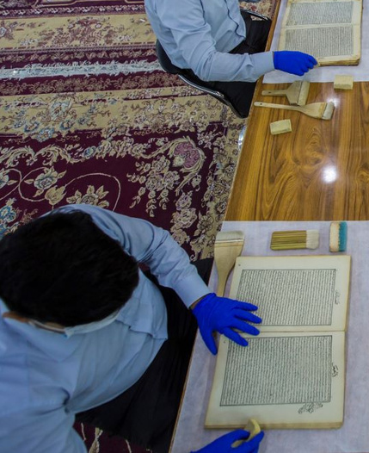




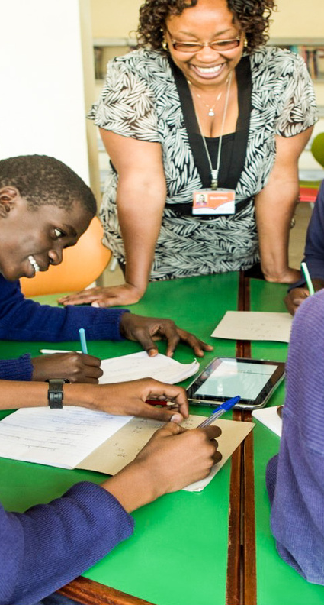


SDG Story contributors –
Each individual library or an organisation which submitted information for an SDG story and worked with the Library Map team during its curation.

Slide 104

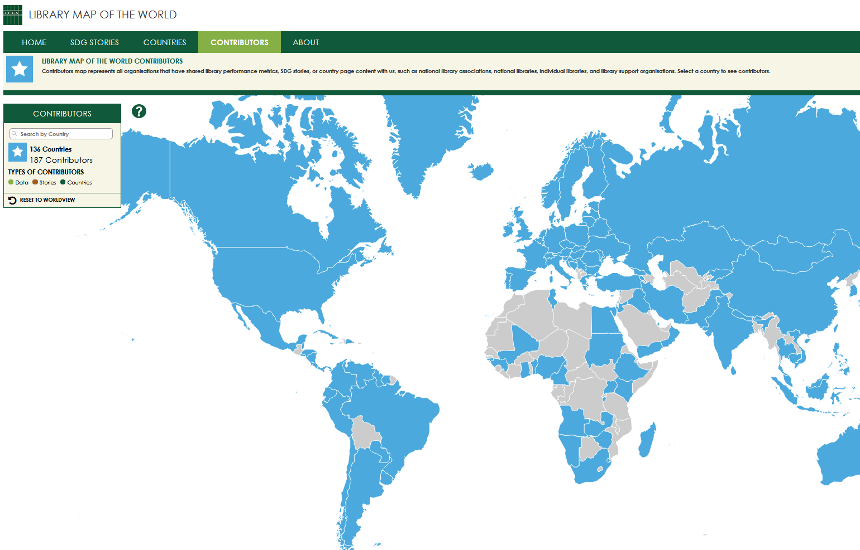


Find contributors on the Map
Contributors with published content (data, country profiles, stories) are listed by country on the Contributors page of the Library Map of the World website.
Search by country or click on the Map to find out who are contributors
from your country!

Slide 105
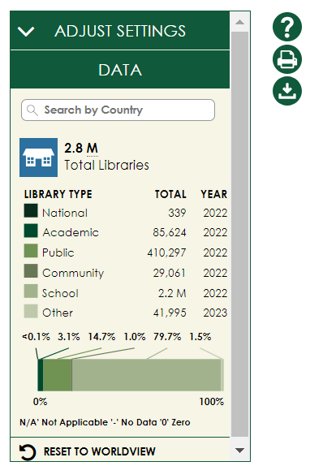
librarymap.ifla.org
A source of country-level library statistics covering all library types

Slide 106
Library data
Country-level library statistics
Updated throughout the year in collaboration with main contributors
Eight basic performance metrics –
Number of libraries
Libraries with Internet access
Staff and volunteers
Registered users and physical visits
Physical and electronic loans
All library types –
National libraries
Academic libraries
Public libraries
Community libraries
School libraries
Other libraries

Slide 107
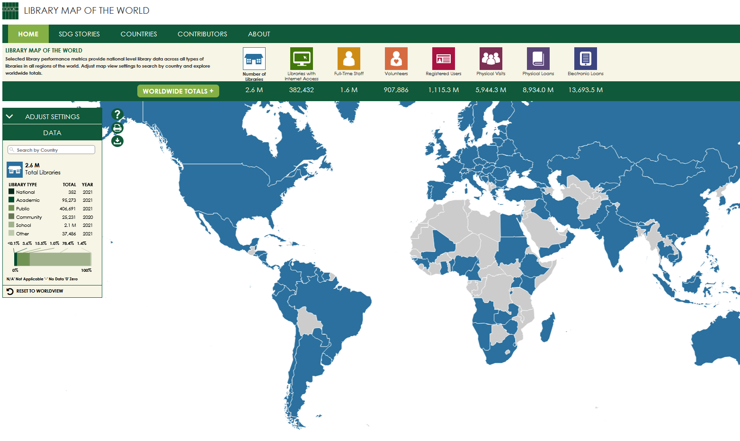

Find data on the
Home page of the Map
Search by country or click on the Map to see your country’s data
Explore worldwide and regional totals
Download the full dataset in csv and make your own data analysis

Slide 108
Countries with published data – Sub-Saharan Africa (22)

Slide 109
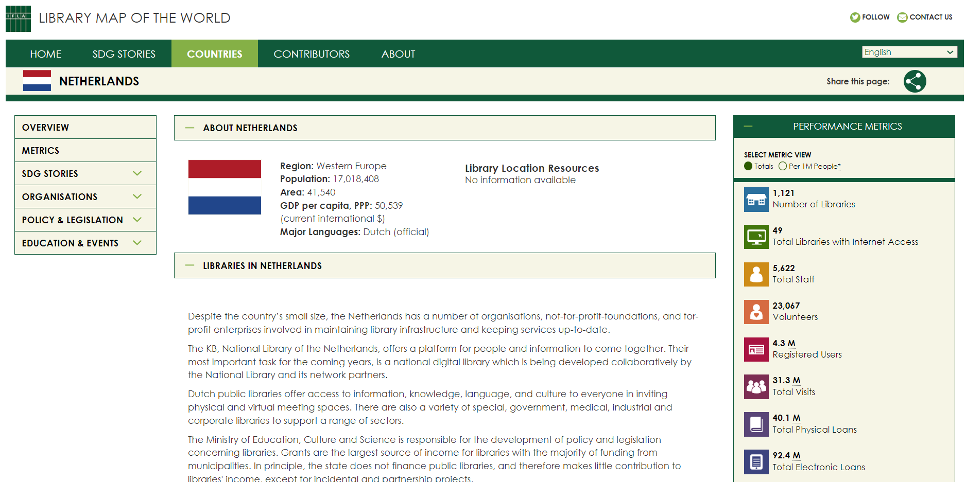
librarymap.ifla.org/countries
A source of information about the library environment, organisations and institutions, policy and legislation, education, and events in each country

Slide 110


Country profiles (1)
Overview of the library environment – library system, facts and features of different library types, governance and funding models, development and policy priorities, role of library association, recent achievements in the library field.
Links to library location resources – maps maintained by other organisations containing individual library location data
Aggregated view of performance metrics and contextual indicators , including data on population and geography, information and infrastructure, poverty and employment, education and literacy, innovation and skills

Slide 111
Country profiles (2)
Information about organisations – national library associations, national libraries, policy making institutions, library support organisations
Links to national policy documents and legislation such as library law, legal deposit law, copyright and library exceptions
Information about education and events – professional qualification requirements, librarians’ education, links to professional publications and events
Links to country’s SDG stories

Slide 112
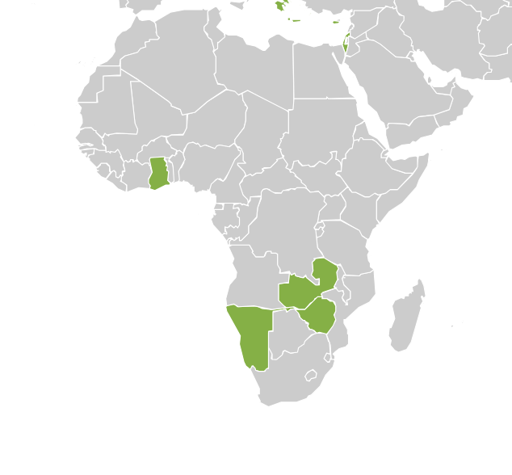
Country profiles –
Sub-Saharan Africa (4 countries)
Ghana
Namibia
Zambia
Zimbabwe

Slide 113
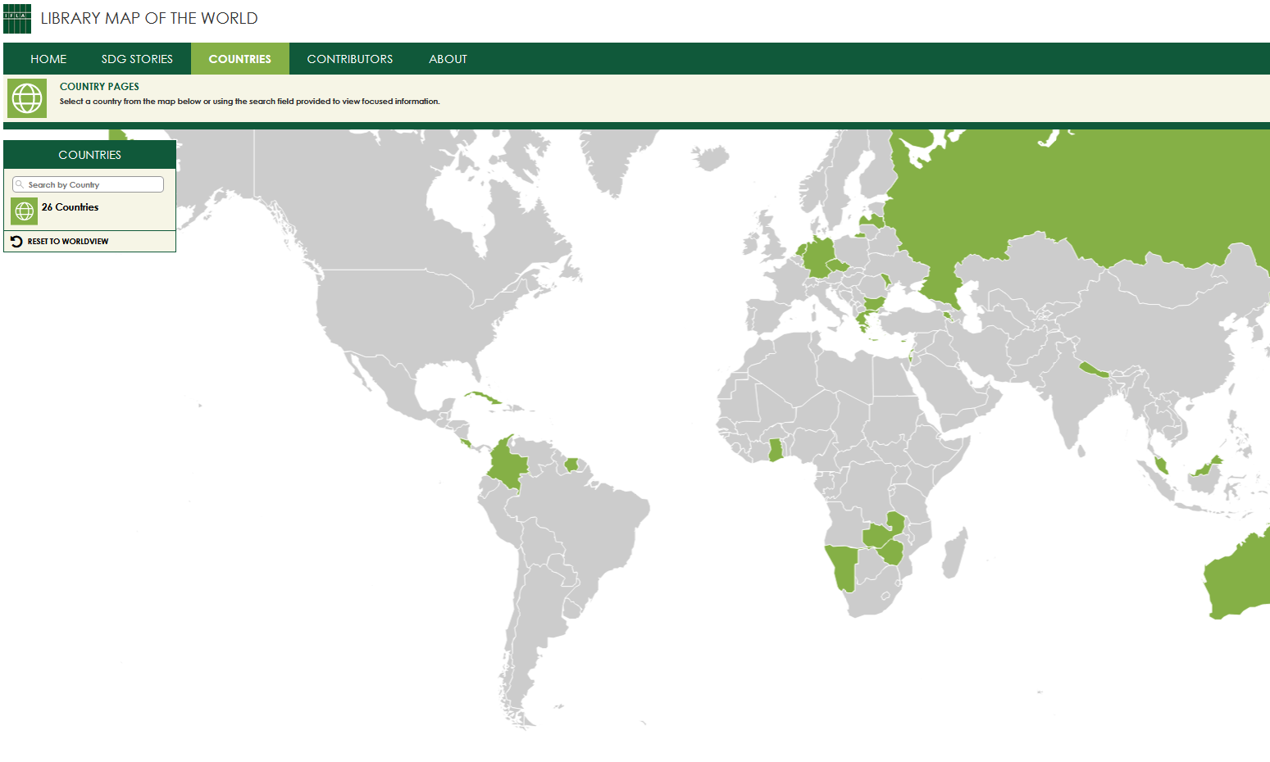
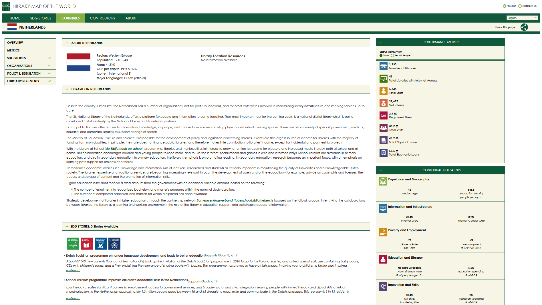
Explore Countries tab
of the Map
Search by country or click on the Map to access country profiles

Slide 114


















librarymap.ifla.org/stories
a collection of inspiring stories about impactful library programmes contributing to achievement of the UN Sustainable Development Goals

Slide 115
Ensuring that stakeholders understand our value and impact
Photo: bit.ly/3oeWjth

Slide 116



Slide 117
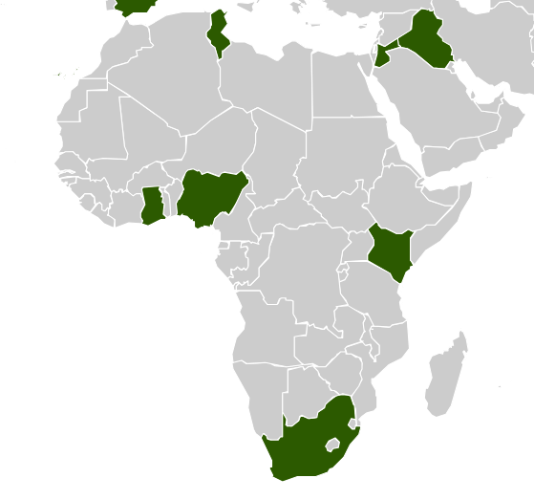
SDG Stories –
Sub-Saharan Africa (6 stories)
Ghana
Kenya
Nigeria
South Africa

Slide 118
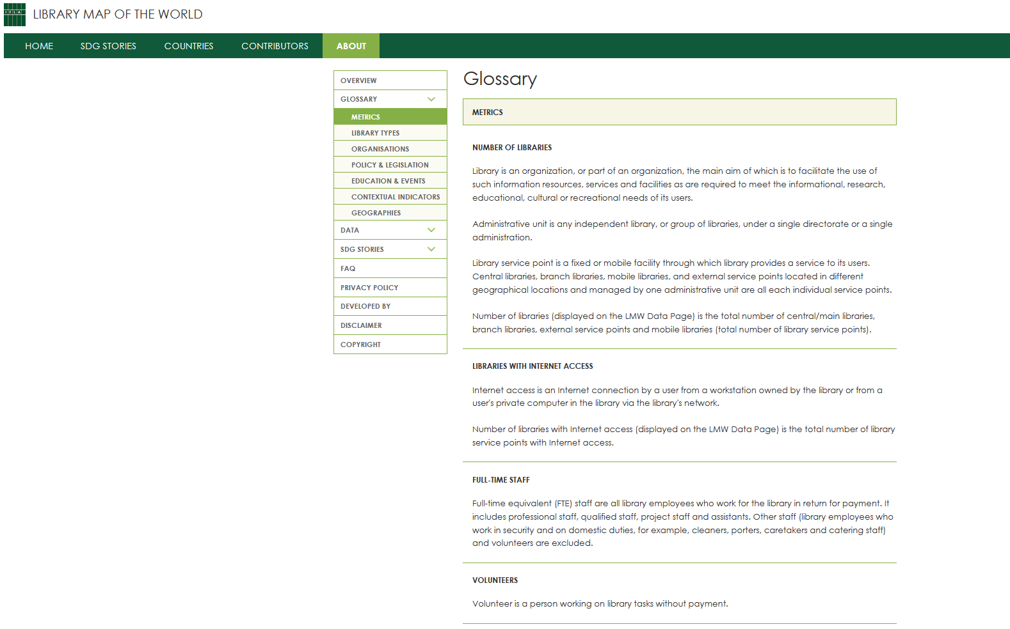
Explore the About page
of the Map
Definitions of data metrics, library types, and items on country profiles
Explainers and guides for data contributors
Instructions for country profile contributors
Resources for SDG storytelling

Slide 119
Power your advocacy with the Library Map!
Library Statistics
SDG Stories
Country Profiles
140
57
30
countries
stories
countries

Slide 120
Library Map data allowing for comparisons
Share of Public Libraries Offering Internet Access
 | High | Average | Low
Asia-Oceania | 100% | 77.62% | 50.22%
Europe | 100% | 67.69% | 12.23%
LAC | 100% | 55.44% | 8.33%
MENA | 100% | 20.05% | 6.25%
North America | 100% | 96.18% | 96.17%
Sub-Saharan Africa | 100% | 69.14% | 7.24%

Slide 121
Library Map data allowing for comparisons
Researchers per Academic Librarian
 | High | Average | Low
Asia-Oceania | 1.235892 | 25.42 | 225.384
Europe | 3.186695 | 26.69 | 354.48
LAC | 0.603956 | 3.70 | 18.58196
MENA | 6.382644 | 19.08 | 21.58446
North America | 18.7384 | 18.98 | 21.5544
Sub-Saharan Africa | 5.695613 | 13.08 | 43.85543
World | 0.603956 | 22.42 | 354.48

Slide 122
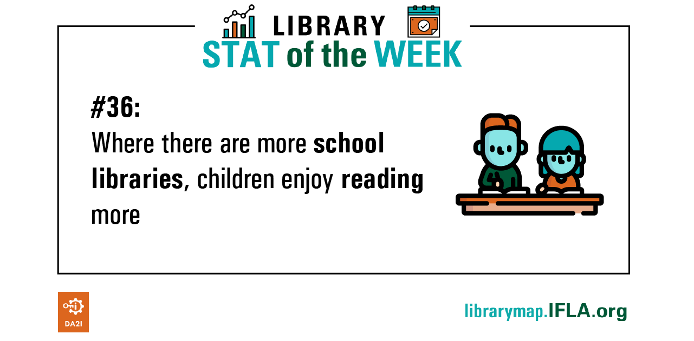
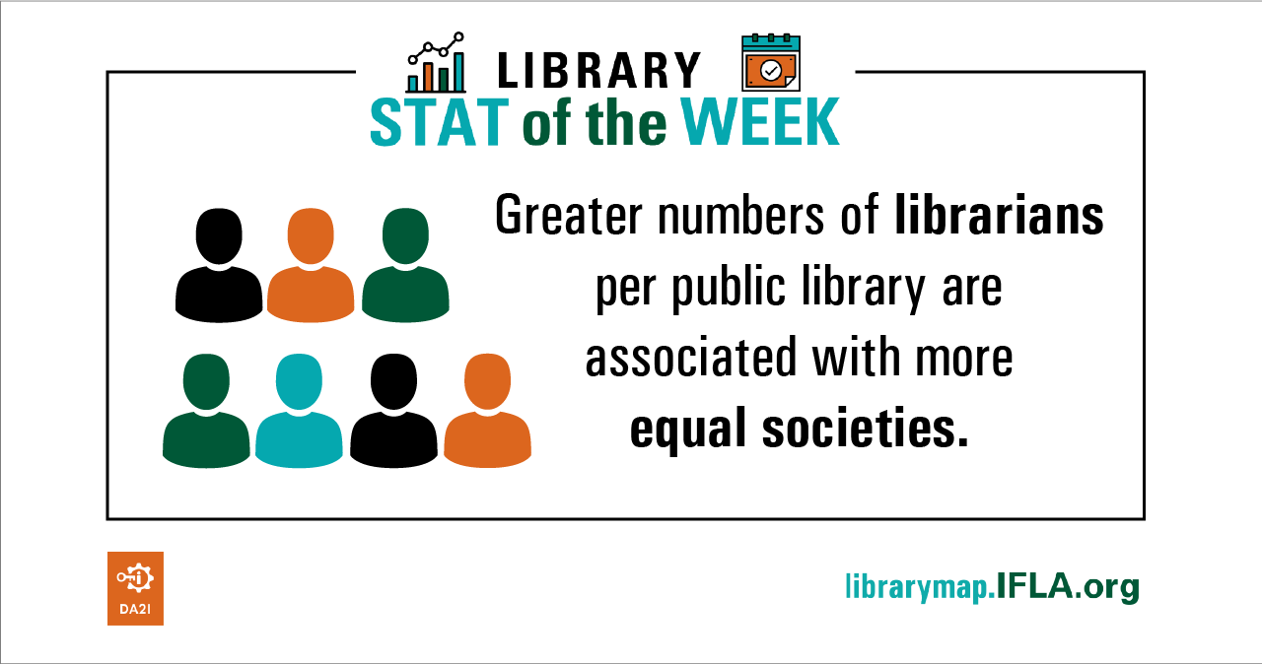

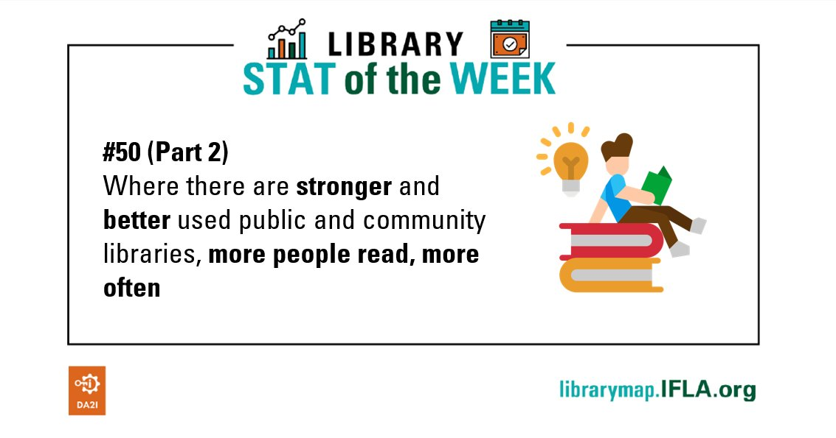
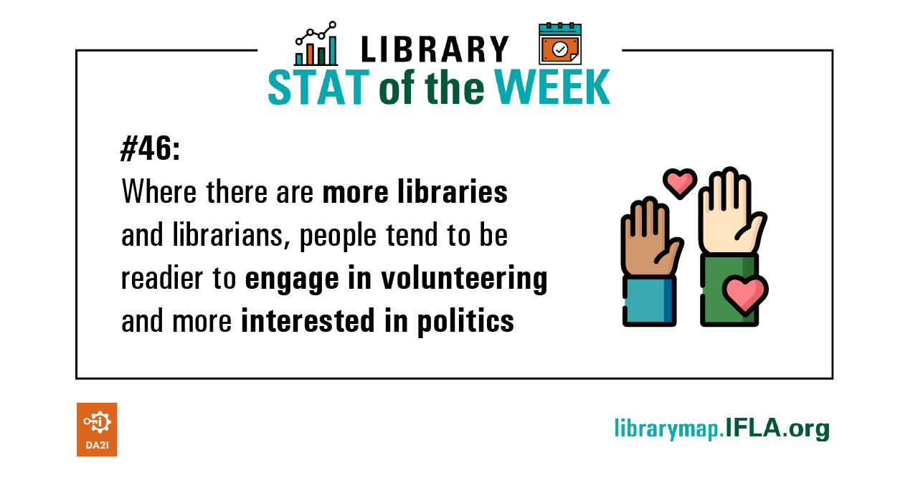
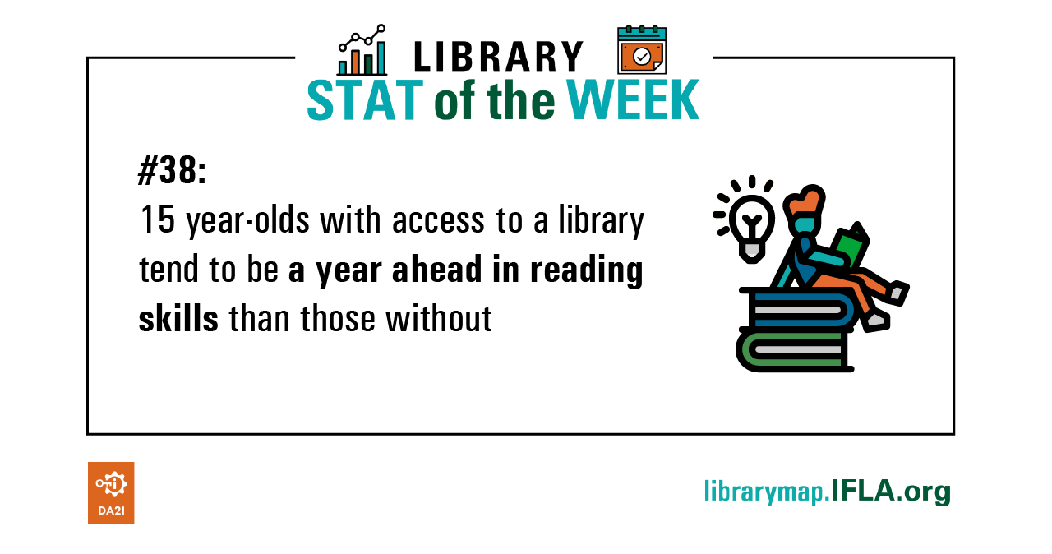
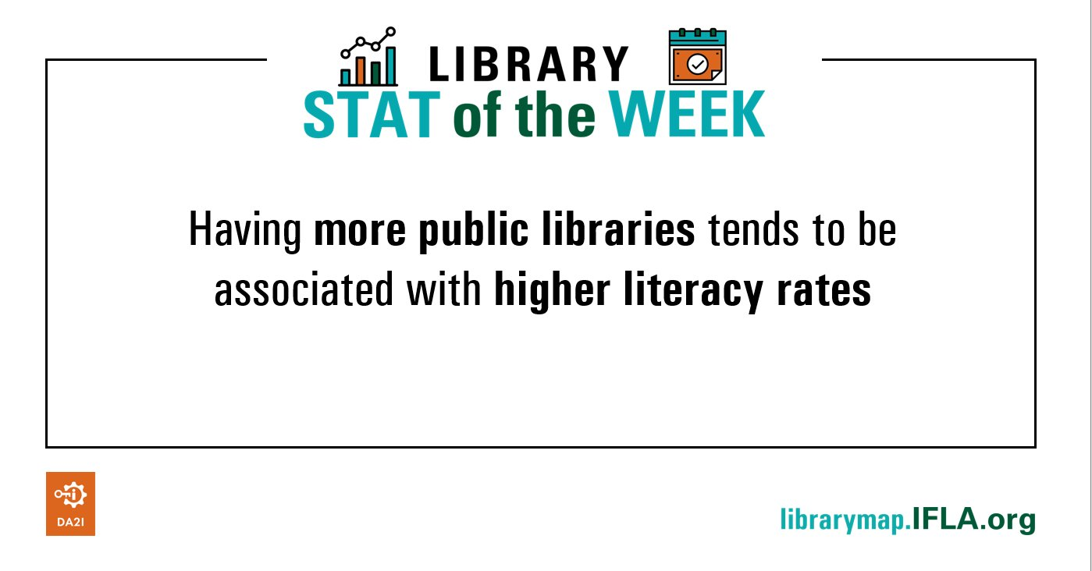
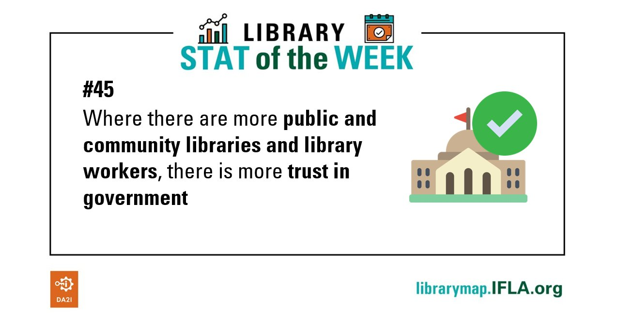
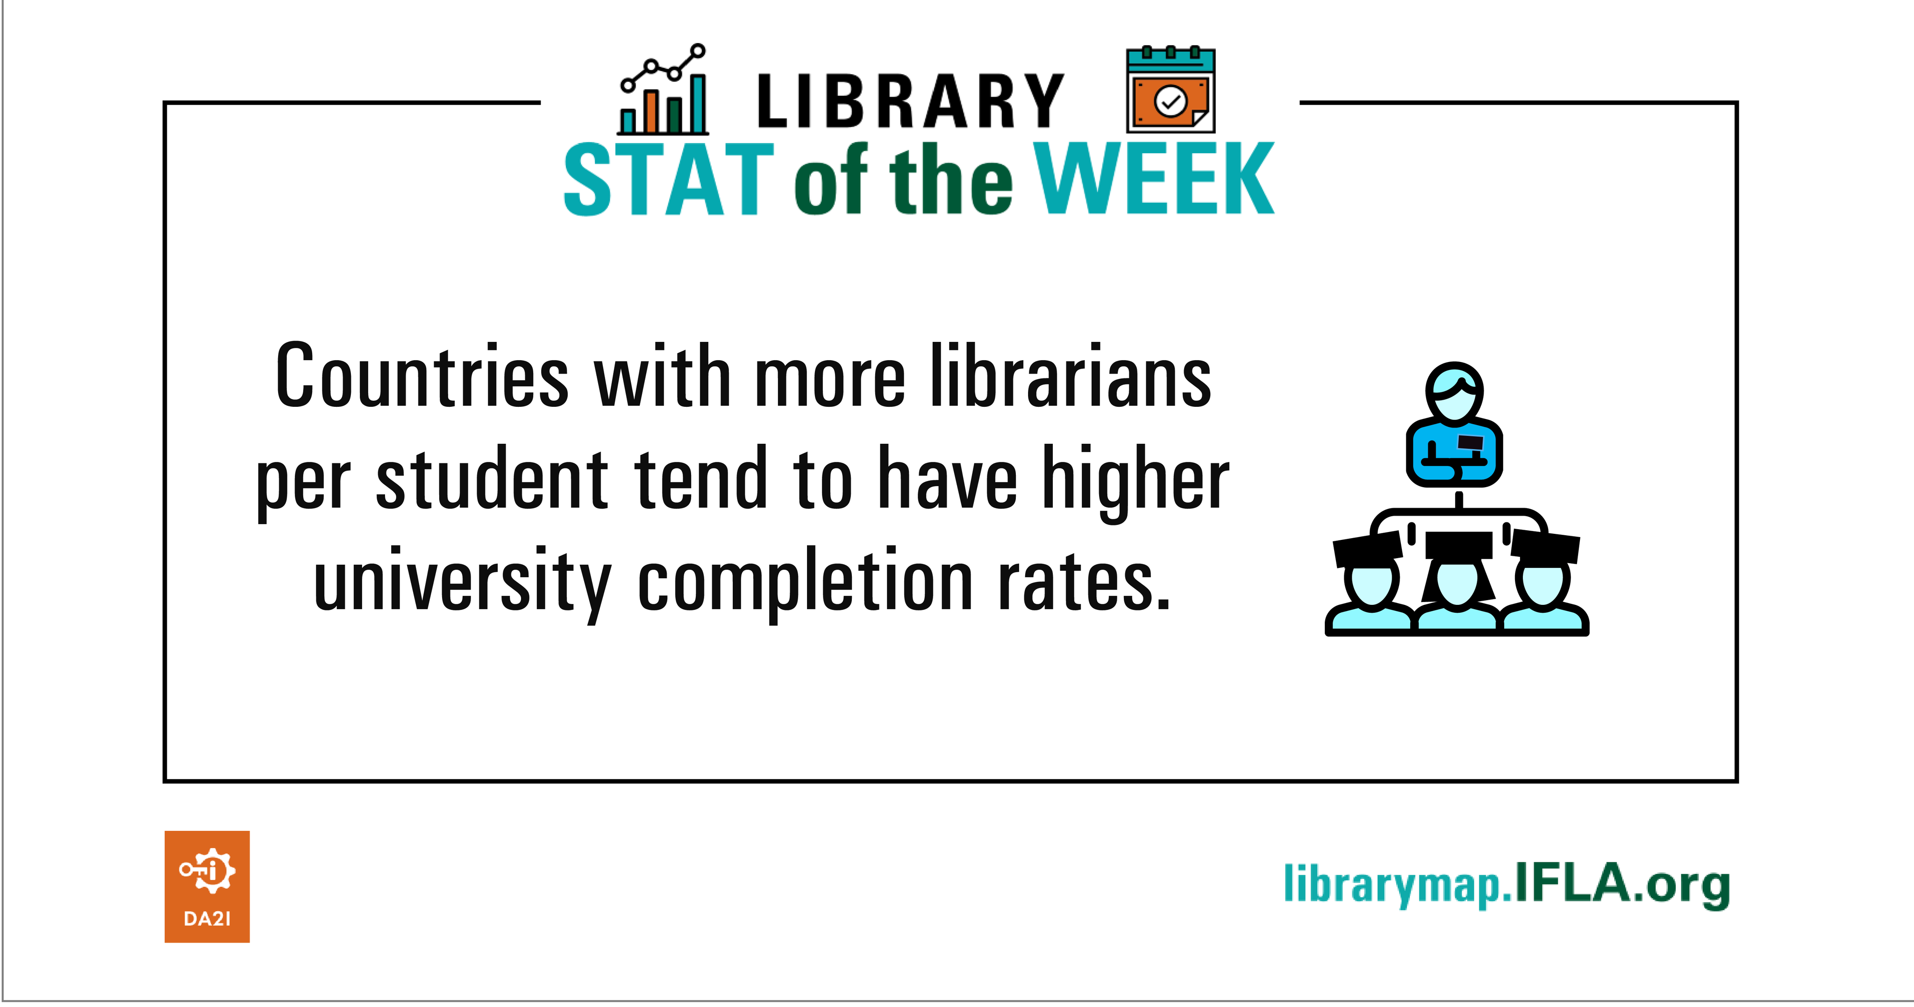
Library Map data as development metric #LibraryStatOfTheWeek

Slide 123

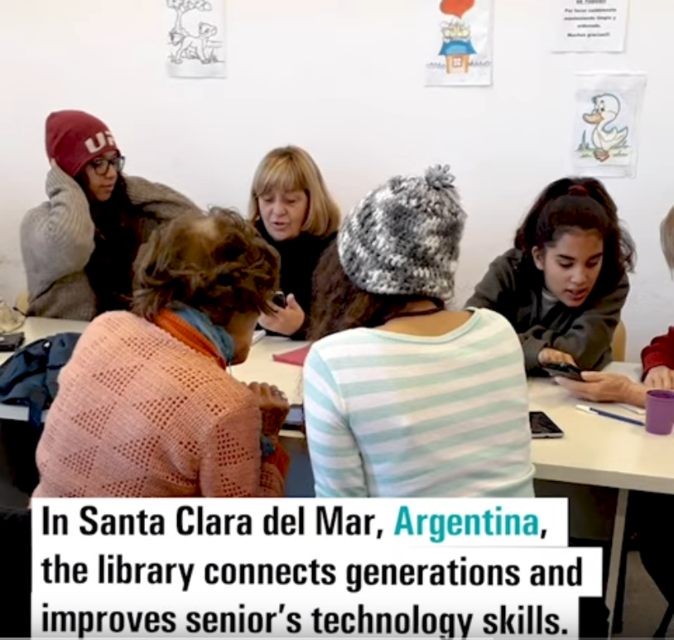


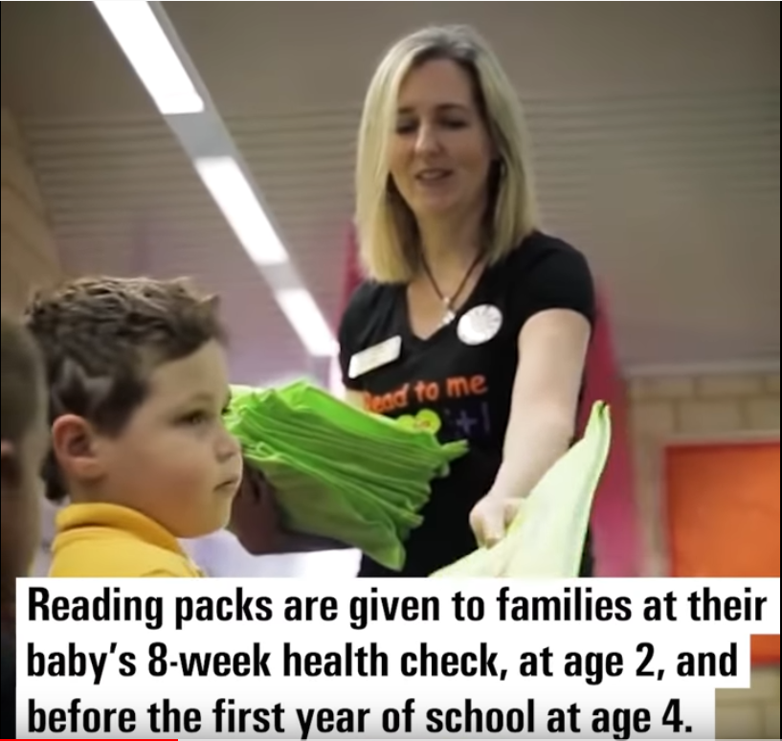
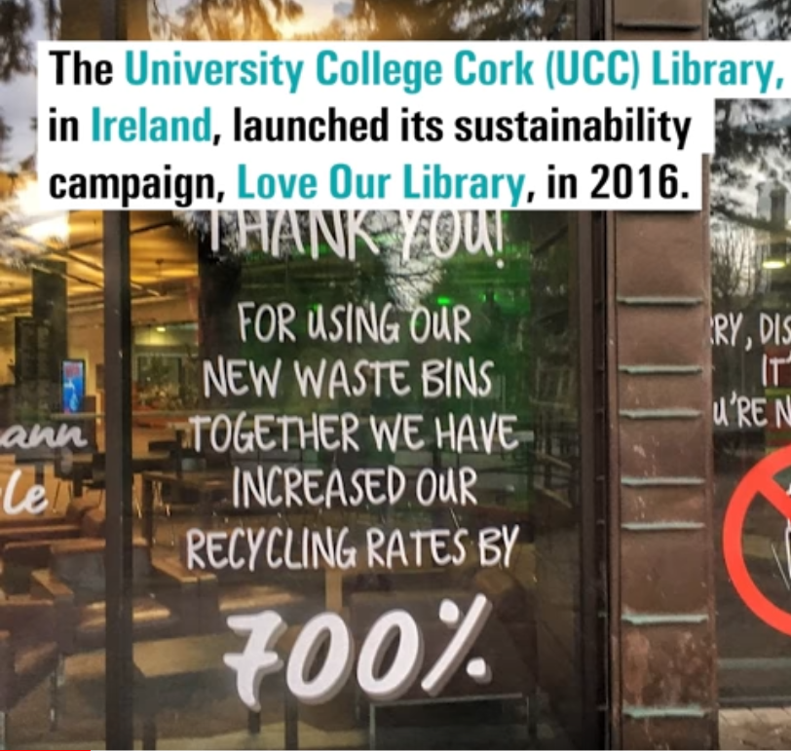
YouTube playlist – IFLA LMW SDG Stories

Slide 124
DISCUSSION
Potential of the Library Map of the World

Slide 125
DISCUSSION: Potential of the Library Map of the World
At your table – discuss:
How can we more effectively use the Library Map of the World to strengthen the voice of libraries and to build a sustainable library field in Sub-Saharan Africa region and each country within it?
What can you do to help achieving it?

Slide 126
Share your findings!
Photo: Matt Botsford on Unsplash, unsplash.com/photos/OKLqGsCT8qs

Slide 127

Lunch
Photo: Keesha's Kitchen on Unsplash, https://unsplash.com/photos/_y325luZNUs

Slide 128
Why advocacy matters

Slide 129

EXERCISE
Testing advocacy assumptions

Slide 130
EXERCISE: Testing advocacy assumptions
Decide where you stand (literally) on the following:
In my country, does lobbying have a good or a bad reputation?
Are lobbying and advocacy the same thing?
Is advocacy just a job for senior librarians?

Slide 131

Why we advocate

Slide 132
Why we advocate?
Because we rely on the support of our funders and communities in order, in turn, to be able to give back to them
invest in
Libraries
Communities
invest in

Slide 133
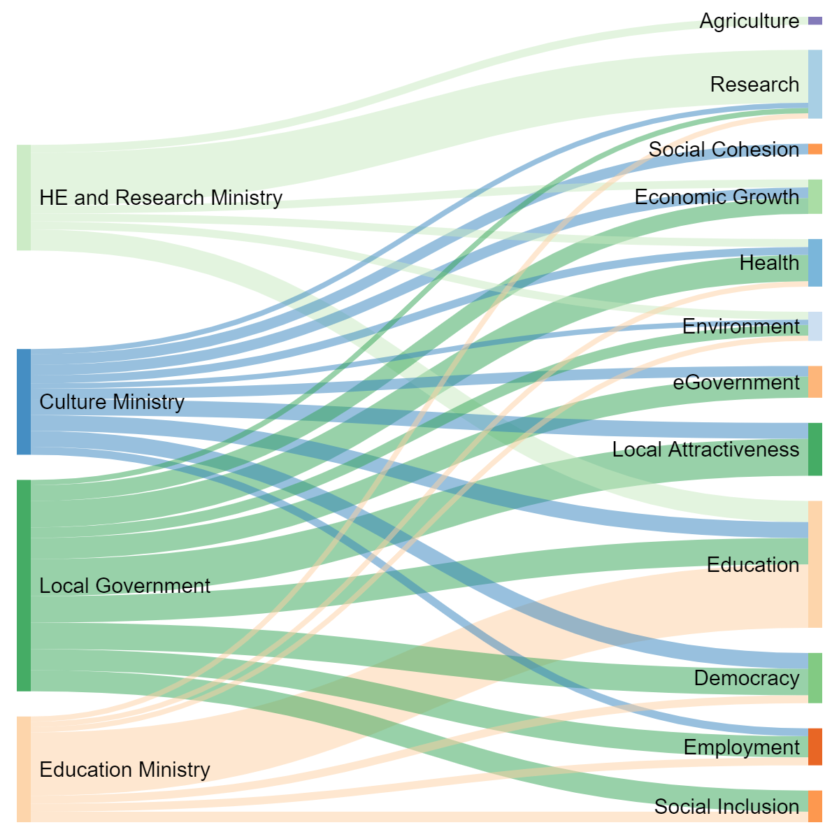
Contribution of different ministries/ agencies
Benefits in policy terms
*Figures are guesswork!

Slide 134
Securing and diversifying sources of support for libraries
As ‘external’ factors, libraries rely on both laws and funding in order to succeed
Decision-makers need to make trade-offs (sympathy isn’t enough)
Our future is safest when we can rely both on champions and broad alliances that support libraries

Slide 135
From
Libraries are the answer. What was the question again?
To
How can we show that libraries are the answer to the questions decision-makers (and those who influence them) are asking?

Slide 136
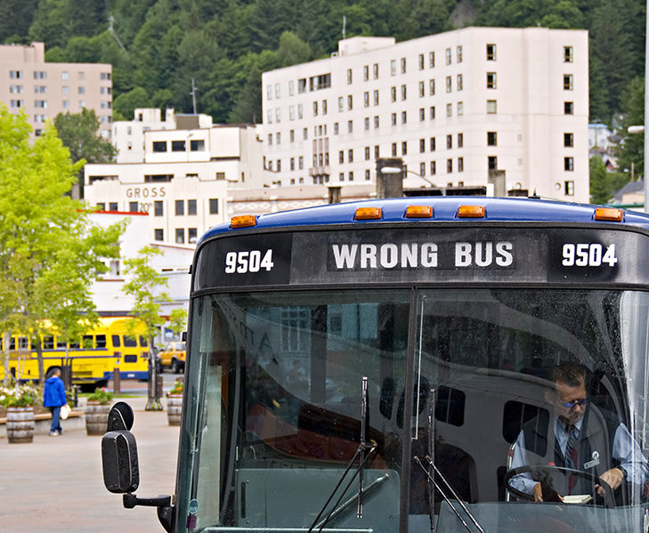
What advocacy isn’t
A solo activity
Just about lobbying
A single skill
Something that you can’t do
Photo: Seth Anderson, CC-BY-SA 2.0, bit.ly/3zb2vGb

Slide 137
EXERCISE
Do the library advocate personality test

Slide 138
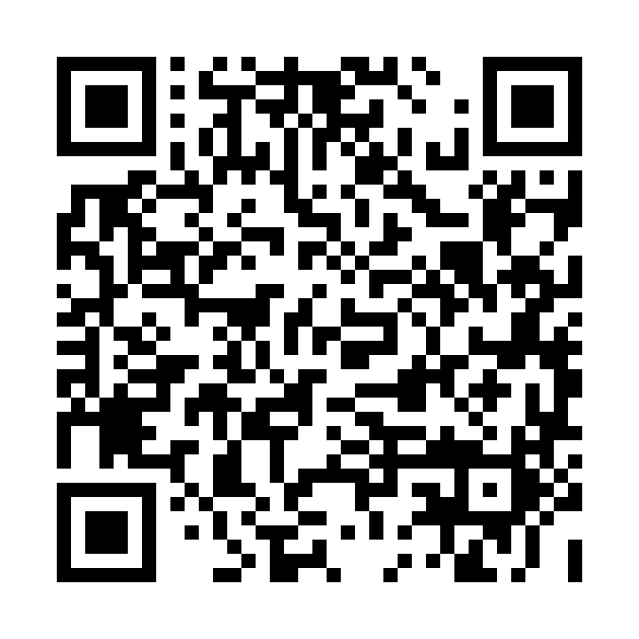
EXERCISE: Do the library advocate personality test
Go to: https://bit.ly/LibraryAdvocateQuiz
Take the test
Share your results!

Slide 139
8 Dimensions of Advocacy
Understanding the landscape
Coordinating your work
Mobilising the field
Gathering evidence
Communication
Building relations with decision-makers
Building advocacy partnerships
Evaluation and goal-setting

Slide 140
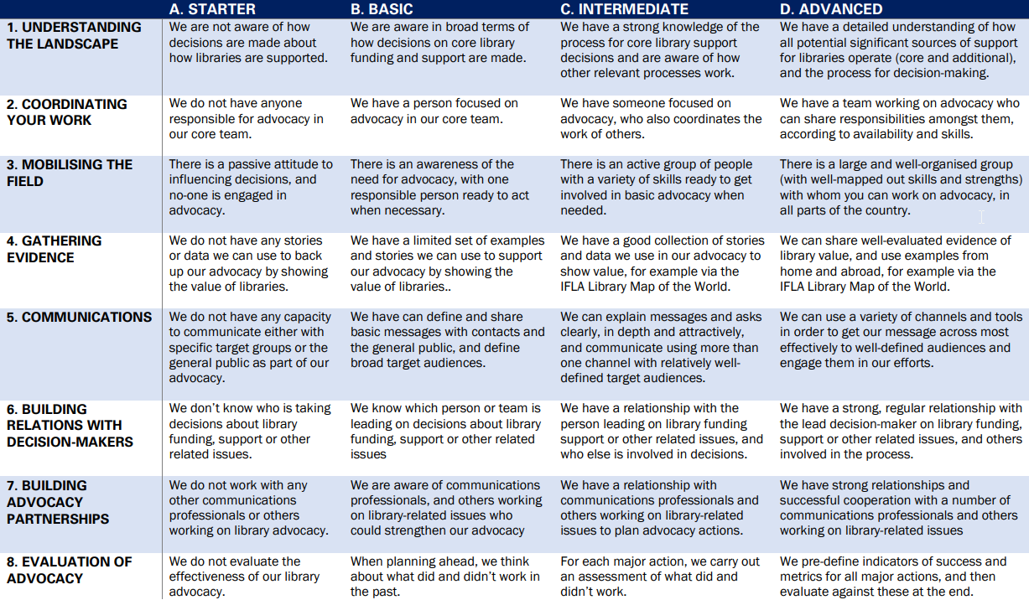

Slide 141
EXERCISE
Library Advocacy Capacities Grid

Slide 142
EXERCISE: Library Advocacy Capacities Grid
Look at the advocacy capacities grid, and do it for your national library field
Share with colleagues on your table
What are your strongest areas? And your weakest?
If time: discuss what partnerships could you form

Slide 144
Share your findings!
Photo: Matt Botsford on Unsplash, unsplash.com/photos/OKLqGsCT8qs

Slide 145
Defining advocacy goals

Slide 146
Celebrating advocacy successes
Share examples you know about where libraries have convinced decision-makers/funders of the need to support libraries, especially outside of our ‘traditional’ partners, and (ideally!) built partnerships!

Slide 147

The UN Sustainable Development Goals
Transforming Our World: the 2030 Agenda for Sustainable Development, agreed in 2015
Includes:
Sustainable Development Goals
Resource mobilisation
Follow-up mechanisms

Slide 148


Slide 149
The SDGs are good for libraries because
They provide a framework for thinking about our impact
They provide a language for talking about our work
They provide a structure for engaging with new contacts, nationally and internationally

Slide 150
EXERCISE
On which SDGs do you – or should you – engage?

Slide 151
EXERCISE: On which SDGs do you – or should you – engage?
Look at the SDGs online (sdgs.un.org)
On which 5 SDGs are you working most now?
On which 5 SDGs should you be working most in future?

Slide 152
Why engage with the UN system in Sub-Saharan Africa (or anywhere else)?
Engage in projects that raise the profile/status of libraries (and sometimes bring funding)
Support reports and recommendations that can influence (and be used to influence) decision-makers
Build networks and gain insights

Slide 153
The topics we’ll be exploring tomorrow
Information for all
Sustainable urbanisation
Science and research for the environment
Opportunities to engage with UN libraries

Slide 154
How can we
How can we show that libraries are the answer to the questions UN Habitat, UNEP, UNESCO and UNECA are asking in Sub-Saharan Africa?

Slide 155
EXERCISE
Identifying an ask

Slide 156
EXERCISE: Identifying an ask
Tables 1 and 5 visit the UNESCO Kenya website
Tables 2 and 6 visit the UNEP website
Tables 3 and 7 visit the UNECA website
Tables 4 and 8 visit the UN Habitat website
Identify areas where they are working which are relevant to libraries
Identify a project (real or invented) where you could work with them

Slide 157
Share your findings!
Photo: Matt Botsford on Unsplash, unsplash.com/photos/OKLqGsCT8qs

Slide 158
Break
Photo by Mike Kenneally on Unsplash, unsplash.com/photos/TD4DBagg2wE

Slide 159
Practicing advocacy skills

Slide 160
EXERCISE
Advocacy role-play

Slide 161
EXERCISE: Advocacy role-play
On your table, choose one of the projects you identified earlier
Choose ONE person to be the director/official, and ONE other to be their advisor/colleague. Everyone else is the library delegation
The role of the library delegation is to convince the director/official to support library involvement in the project
Read the description of the director/official’s role and personality – plan how you will approach the meeting
Hold a 3-4min meeting, and then assess how it went!

Slide 162
Share your findings!
Photo: Matt Botsford on Unsplash, unsplash.com/photos/OKLqGsCT8qs

Slide 163
Preparing for Day 3

Slide 164
Important information
Meet at 7pm at reception! We won’t be waiting ☺
Dinner: Mama Ashanti Restaurant
Tomorrow – meet at 8am at reception

Slide 165
Wrap up

Slide 166
Thank you!

