Slide 1

THE IRAQI MANUSCRIPTS,THEIR REALITY, INSTITUTIONS ,THEIR CHALLENGES
DR. FAIZA ALBAYATI
President of the Iraqi Information, Libraries and Documentation Specialists Association
IRAQ

Slide 2

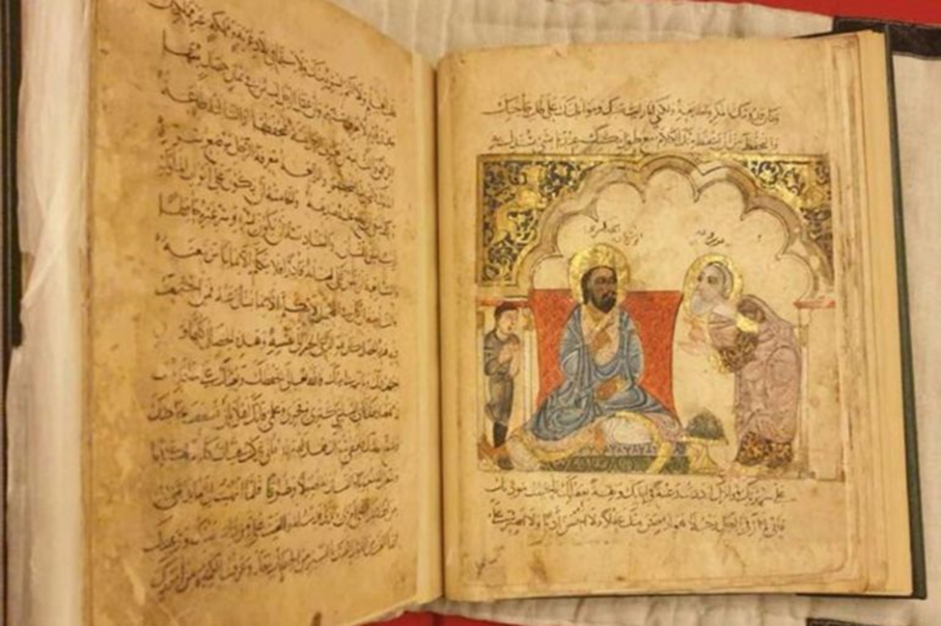

Slide 3

Introduction
Since the invasion and occupation of Iraq in 2003, ignorance of the situation of the Iraqi manuscripts heritage is still widespread ,
During the past twenty years workers in the field of manuscripts in Iraq have become more isolated from the international professional community.

Slide 4
(Looting and destroying the Iraqi Intellectual Heritage of Manuscripts.)
Background
Historical blogs indicate that the Mongols destroyed and burned the manuscripts that were in the Abbasids House of Wisdom in Baghdad, which included a huge manuscript intellectual heritage written by Arab Muslim scholars who came to Baghdad and settled there,
More than (400 ,000) manuscripts were stolen and smuggled at that time
Another more than (1200) manuscripts were stolen by a British traveler transferred them to the British Museum Library during the British occupation of Iraq (1914-1958).

Slide 5
What remained of this heritage was scattered among mosques and private libraries, until God gave some safe hands to protect and preserve it by indexing some manuscripts, and investigating and publishing others during the period from (1918-2003).
large number of precious and rare manuscripts that were looted and smuggled during the years lawlessness Iraq witnessed through (1991-2003),

Slide 6
Preserving Manuscripts before 2003
After the issuance of the Antiquities Law No. (59) of (1936) in (1940), Iraq began collecting manuscripts
The House of manuscripts was established in (1961) , the number of the collected manuscripts at that time reached (2250) manuscripts.
In (1974) the Antiquities Law No. (120) was issued, (as amended Law) provided greater protection for manuscripts as a national wealth.

Slide 7
Since (1974) until the beginning of the eighties, the number of manuscripts reached (36,500) manuscripts.
In (1988) the manuscripts were transferred to the Iraqi Manuscripts House that occupy one of the most beautiful heritage houses in Baghdad, the house affiliated to the General Authority for Antiquities and Heritage.
After (1988) and because their number increased to (47,000) volumes, the manuscripts occupied three heritage houses in the heart of the capital Baghdad.

Slide 8
The house preserves the precious of historical and literary manuscripts (some of which date back to the first century AH) belong to major authors, historians, scientists and writers, also included wide scientific fields approaching (33) fields.
The number of manuscripts of the public and private libraries after registered in the house , reached to a total of (35,000) volumes.
Perhaps one of the most famous stolen manuscripts before 2003 are:
the Qur'an delivered to the British museum, this manuscript written by the most famous calligrapher in history, Ali bin Hilal (Ibn Al-Bawab), who died in (413 AH )

Slide 9
2. Israeli documents archived in ministries such as foreign affairs, and Iraq's official accusation of Israel of stealing the Babylonian Torah manuscript is perhaps the most famous indication of the looting of its manuscripts.
3. The Islamic State's invasion of Mosul in (2014) also burned and looted many manuscripts ,especially manuscripts at the University of Mosul and places designated for preserving manuscripts and churches, the number of the looted manuscripts exceeded to (4,000) manuscripts.
4. During an uprising in the provinces in (1991),(20,000) manuscripts were endangered, (346) were confirmed missing .
5. (1,000) manuscripts from the Baraki, and Kashani, also other special collections of Najaf and Karbala were transferred to Iran during that uprising.

Slide 10
Another protections procedures before 2003
All MSS were taken to the shelter, microfilms to a second (undisclosed) location, and CD-ROM's to a third (undisclosed) location.
All MSS were taken to the shelter, microfilms to a second (undisclosed) location, and CD-ROM's to a third (undisclosed) location.
The shelter contains nearly (800) steel trunks of MSS, including (500) trunks of the manuscripts house as follows:
- (200) trunks from other collections,
- (83) trunks of rare published books.

Slide 11
These trunks contain (50,000 ) MSS, including (47,000) from the collection and 3,000 MSS from other collections of:
The Iraqi Academy of Sciences: (667) MSS
Mosul Central Library, (301) MSS
University of Mosul Library: (122) MSS
University of Tikrit: (40) MSS
Kirkuk Central Library, (40) MSS

Slide 12
Numbers of manuscripts lost during the U.S. invasion in 2003
“ Libraries, archives and manuscripts must be preserved as essential parts of the rich heritage of Iraq. Libraries are the essence of knowledge societies. nearly twenty centuries of written history of mankind are in danger”
The Director-General of UNESCO, Koïchiro Matsuura speaking in mid-April 2003, after the war.

Slide 13
After interviewing with a number of officials whom working with manuscript collections , it became immediately clear to history researcher that:
There are significant losses , and a great deal of work lies ahead to reconstitute such facilities in the coming months and years.
The libraries of Iraqi manuscript collections had many needs that should be addressed as soon as possible.
According to the appendix included to his major report ,the number of looted and lost manuscripts were as follows:

Slide 14
(Appendix) IRAQ MSS COLLECTIONS lost through 2003 American Inventions
 | Collection | Holdings | Comments
 | BAGHDAD COLLECTIONS
1 | Dar al-Makhtutat al-‘Iraqiyya / Iraqi House of Manuscripts [formerly Dar Saddam lil-Makhtutat / Saddam House of Manuscripts] | 47,000 own MSS, 3,000 other MSS from the Academy, Mosul, Tikrit, Kirkuk, Basra | Collection transferred to Shelter #12, Hayy Dakhiliyya; preservation facilities looted.
2 | Maktabat al-Awqaf al-Markaziyya / Ministry of Endowments & Religious Affairs Central Library | 7000 MSS. | 5250 MSS transferred to undisclosed location, 600-700 MSS burned, 1000-1100 MSS looted Facility burned.
3 | National Library & Archive / Dar al-Kutub wa al-Watha’iq | 12 million documents, published books. | Facility looted & burned. Rumors of some docs saved.
4 | Bayt al-Hikma / House of Wisdom | 100 MSS, US, French, Ottoman, UK document copies | Facility looted & burned. Some MSS may re-surface.
5 | Iraqi Academy of Sciences / Al-Majma’ al-‘Ilmi al-Iraqi | 2000 MSS, 58,000 published books. | Facility looted, but not burned. 80% books looted, Some MSS returned.

Slide 15
6 | Qadiriyya Mosque Collection | 1883 MSS | OK
7 | Deir al-Aba al-Krimliyin | 120 MSS | Christian MSS, OK?
8 | Maktabat al-Hidaya, Baghdad? | 500 MSS | Condition unknown
9 | Univ. of Baghdad Central Library / Al-Maktaba al-Markaziyya | research collection of published works | OK.
10 | Mustansiriyya University Medical School Library | medical textbooks, research publications | OK
11 | Mustansiriyya University Main Library | research collection of published works | Looted.
12 | Baghdad Medical College Library | medical textbooks, research publications | Looted.

Slide 16
13 | Deir Mar Behnam, Mosul | unknown number of Christian MSS | Reportedly moved to al-Dura neighborhood of Baghdad
14 | Maktabat Karakosh, Mosul | unknown MSS number | Condition unknown
15 | Deir Mar Matti, Mosul | unknown number of Christian MSS | Reportedly moved to al-Dura neighborhood of Baghdad
16 | Madrasat al-Jalili, Mosul | 400 MSS | OK?
17 | Maktabat Mahmud al-Jalili, Mosul | 60 MSS | OK?
18 | Maktabat al-Mufti, Arbil | 120 MSS | OK?
19 | Salah al-Din University, Arbil | 402 MSS | OK?, published catalogue
20 | Maktabat al-Awqaf, Sulaymaniya | 6000 MSS | OK?
21 | Al-Shaykh Muhammad al-Khal, Sulaymaniya | 350 MSS | Includes rare MSS, OK?
22 | Dar al-Makhtutat in Mosque of Hussein, Karbala | 1200 MSS | OK?

Slide 17
23 | Maktabat Amir al-Mu’iminin, Najaf | 3000 MSS | OK?
24 | Maktabat al-Hakim, Najaf | 1600 MSS | OK?
25 | Maktabat Kashif al-Ghita, Najaf | 3000 MSS | OK?
26 | Maktabat Al-Jamal al-Din, Suq al-Shuyukh, Nasiriyya | 180 MSS | Condition unknown
27 | Cleric’s Private Collection, Diwaniyya | 300 MSS | Condition unknown.
28 | Bash A’yan al-‘Abbasiyya, Basra (source) http://oi.uchicago.edu/OI/IRAQ/docs/nat.html | 1200 MSS | OK?

Slide 18
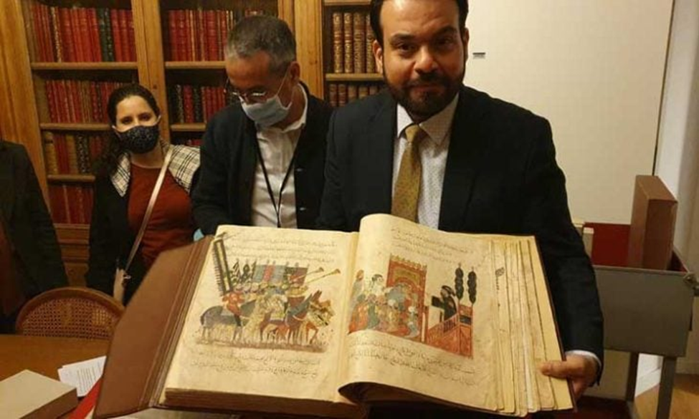
The New Agenda for the Manuscripts Center

Slide 19
Holding monthly meetings by the Board of Directors in the Center.
Reorganizing the administrative structure of the center.
Replacing the card catalog with an automated authentication system.
Make the employees multi-skilled by involving them in various training courses inside and outside Iraq.
Appointing new employees with appropriate competencies to work in manuscripts.
6. Fighting the financial and administrative corruption.

Slide 20
7. Establishing a large cultural building in the heart of Baghdad, to embrace the great heritage wealth of manuscripts .
8. Facilitating the use of the contents of various manuscripts by providing best services to those whom interested in the Arabic and Islamic manuscripts inside and outside Iraq.
9. Establishing cultural exchange relations with manuscript centers in the world, based on the principle of mutual benefit through the exchange of manuscript images.

Slide 21
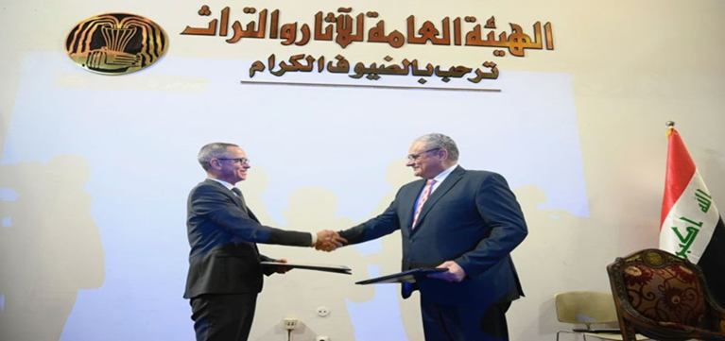
Great Initiative to Revive Its Unique Manuscripts
Signing a memorandum of cooperation between the President of the Iraqi Antiquities Authority and the Counselor of the French Embassy in Baghdad to advance the work of the House of Manuscripts

Slide 22
In order to save what remains and to recover some of the lost the Iraqi Manuscripts House launched a major multilateral initiative in (2022) This initiative aims to:
“Build the capacity of the House's technical teams in the field of preserving valuable manuscripts and rare books”.
This program is launched in partnership with the:
1. Bibliothèque nationale de France.
2. The Geneva-based International Alliance for the Protection of Heritage in Conflict Areas (Alef Foundation),
3. The Iraqi Organization for the Preservation of Heritage/ (Liwan) for Culture and Development acting as the program's implementing partner.

Slide 23
The most prominent needs of the house revealed from the review
1- The first objective of the initiative is the digitization and timelessness of manuscripts, since the conditions for the protection of the originals are not guaranteed.
2. Lack of digital photocopying equipment to provide a digital copy of manuscripts.
3. Iraqi manuscripts need a color digital photocopy characterized by accuracy and the possibility of preservation in special digital archiving.

Slide 24
4. Decrease in specialized staff and expertise required for maintenance and restoration, also in indexing.
5- Cooperating with Iraqi and international bodies to implement this initiative and benefiting from the experiences of other countries in this field.
6- The plan aspires to expand the initiative to include the diagnosis of stolen manuscripts, through cooperation and coordination with the Iraqi provinces in order to preserve the manuscripts they have.

Slide 25
The joint effort with France and Italy includes:
“Exchange experiences on written heritage”
1-Starting with an invitation was made to a three of the house employees to the training course held by the French National Library in Lebanon in June 2022.
2- A four-week workshop of intensive training in Baghdad during October and December 2022, with the support of the Italian and French embassies).

Slide 26
Project outline
(BnF) and (Liwan), as the implementing partner, have been funded by an (Aliph grant) to implement the following activities with the objectives of reinforcing the capacities of the House of Manuscripts in its digitization initiative, its digital infrastructure and cataloguing programs, as well as the physical conservation of manuscripts. The planned activities are as follows:
Implementation of a new Integrated Library System (ILS), based on KOHA, a free open-source and widely used software, suitable for manuscripts, currently shared by many libraries in Iraq including the Iraqi National Library and Archives;

Slide 27
Implementation of a new Integrated Library System (ILS), based on KOHA, a free open-source and widely used software, suitable for manuscripts, currently shared by Setting up of a new digital and data infrastructure, autonomous and dedicated for the House of Manuscripts, with its own server and improved storage capacities for digital images of manuscripts;
Supplying new digitization equipment, notably the purchase of Book Eye scanners compatible with existing IT equipment used by the House of Manuscripts;

Slide 28
Purchase of equipment and supplies for conservation and restoration.
Continuous technical support from Iraqi and BnF (Bank National Funds) experts, on-site and online, to assist with the implementation and enhancement of the procedures, activities and capacities at the House of Manuscripts.

Slide 29
Thank you for lessening

