Slide 1

IFLA
Townhall
April 2024

Slide 2
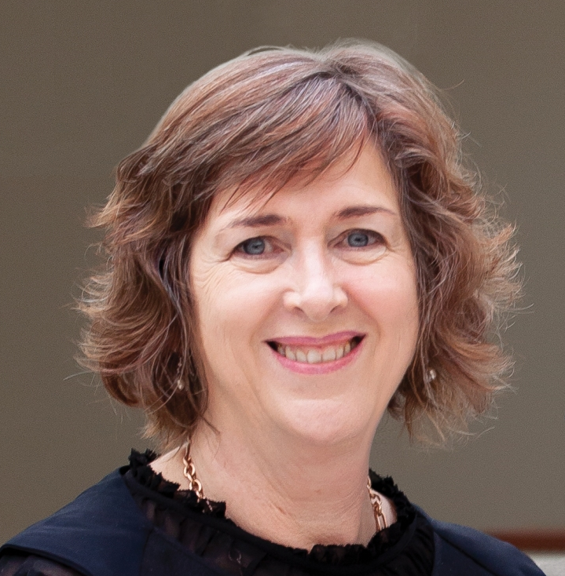
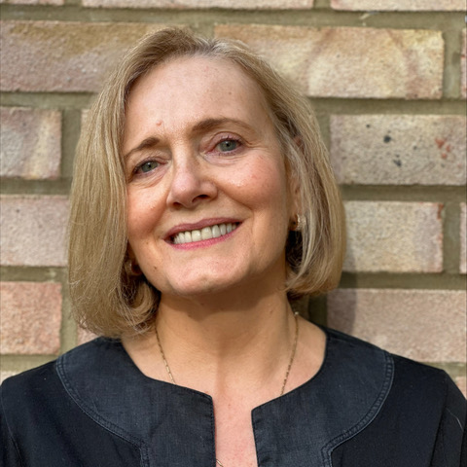
SPEAKERS
Vicki McDonald
IFLA President
Sharon Memis
IFLA Secretary-General

Slide 3
How we’ll work
We’ll maximise the time available to answer questions. We’re starting with questions asked in advance, but you can also use the Q&A function to ask questions
If your question has already been asked, we may need to prioritise those whose questions haven’t been asked yet
Please ask for clarifications – if it doesn’t make sense to you, it may not to other people also!
We are here because of a shared commitment to international librarianship – let’s focus on how best to support this!

Slide 4


On the agenda today
What’s a townhall?
Looking forward to the Information Futures Summit
Towards charity status for IFLA
General updates and discussion
Notes:
You might need to upload the bullet point picture, it is on the same folder as this presentation on Sharepoint. To change it, click on the right arrow in bullet list icon from the Home panel, then “Bulletpoints and Numbering”, and finally click “Picture” and upload the png.

Slide 5

WHAT’S A TOWNHALL?

Slide 6
As part of our commitment to communicating better with our Members and volunteers, a chance to keep you up to date, hear your questions and reactions, and talk about the issues that matter to you!

Slide 7
LOOKING FORWARD TO THE INFORMATION FUTURES SUMMIT

Slide 8
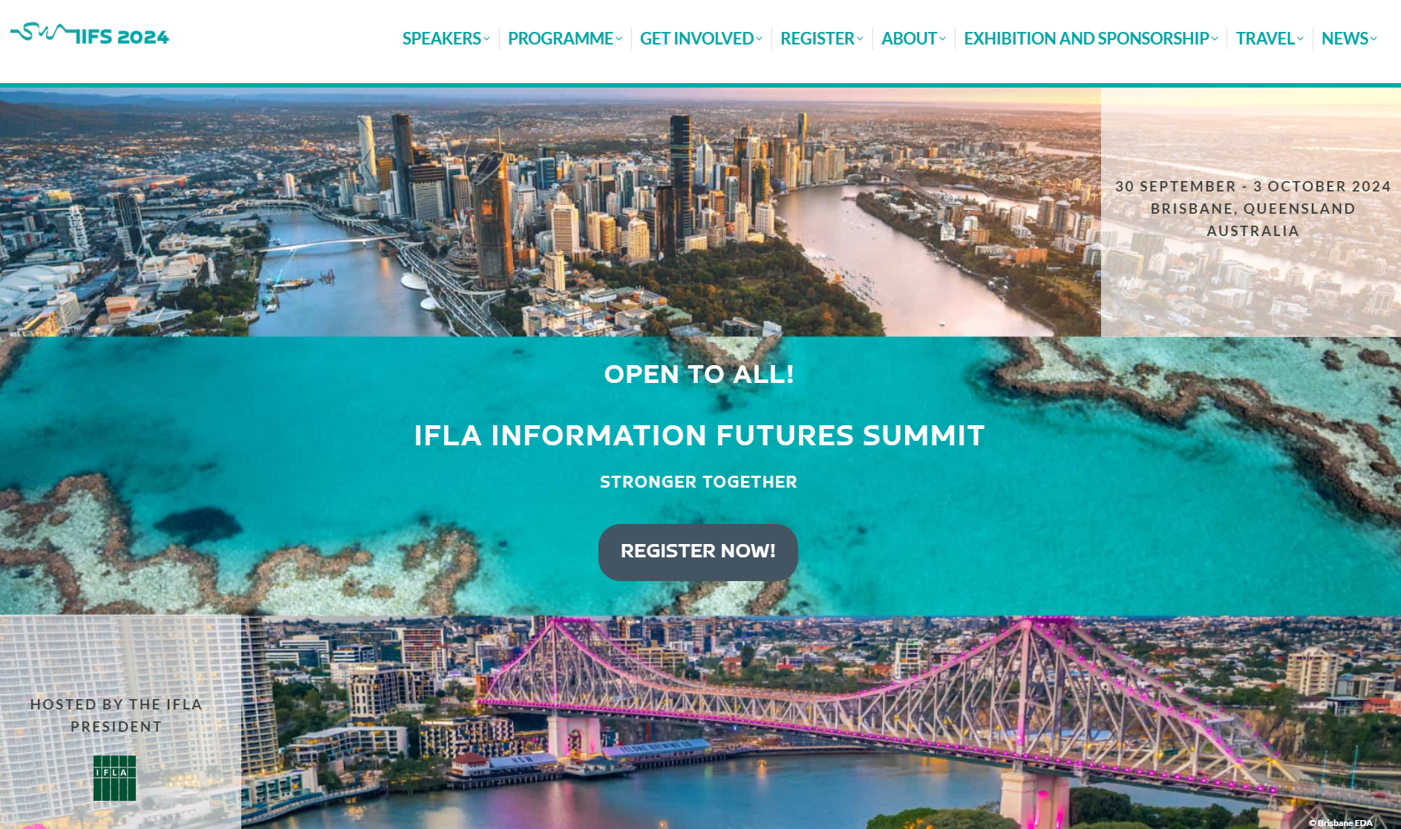

Slide 9
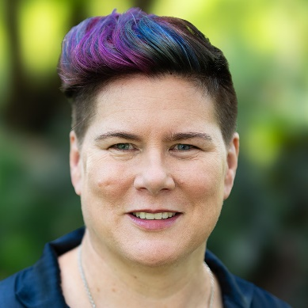
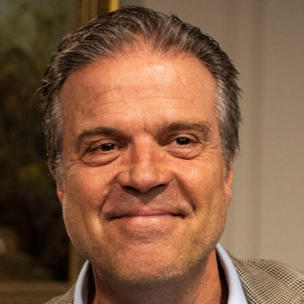
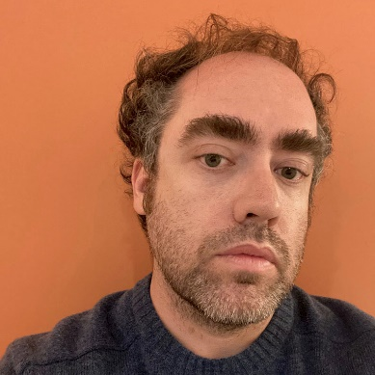
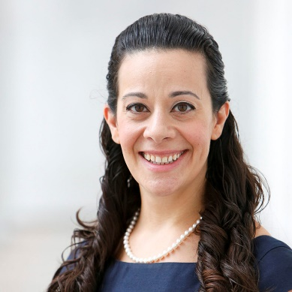
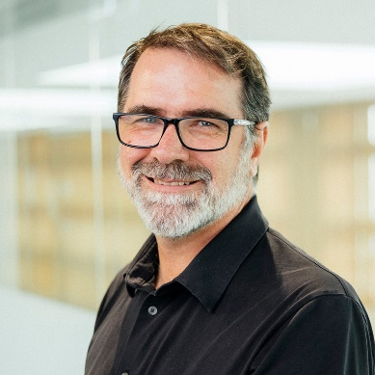
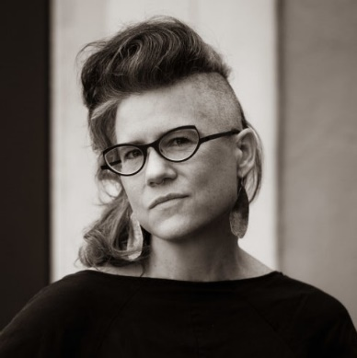
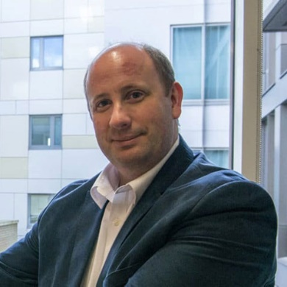
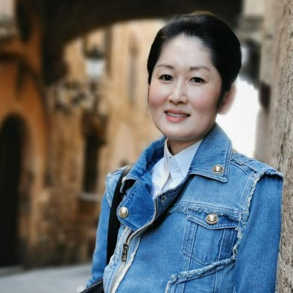
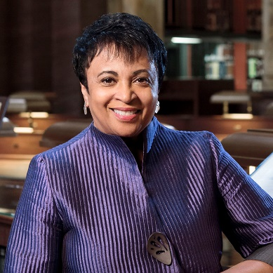
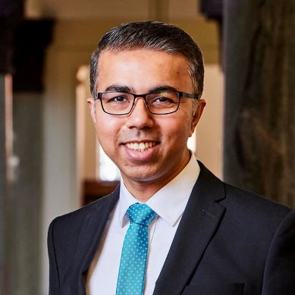
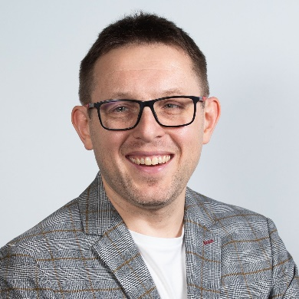
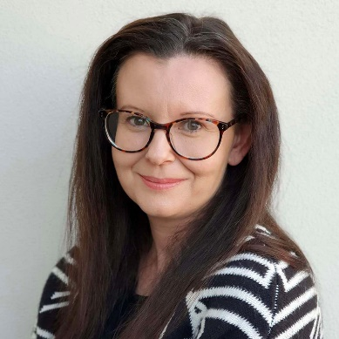
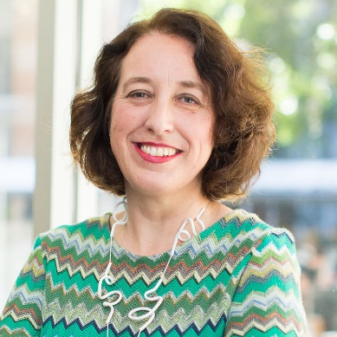
Our inspiring speakers
From the library field
Carla Hayden | Masud Khokhar | Ng Cher Pong | Gene Tan |
Kate Zwaard
From outside the library field
Jean Burgess | Damian Cardona | Paul Crosby |
Michael Dezuanni | Rebecca Giblin | Daniel Hook |
Marek Kowalkiewicz | Kim Osman | Ana Filipa Vrdoljak

Slide 10
Opportunities to engage!
Open
Hear
Discuss
Think
Connect
Build
Develop
Inspire
Experience
A curated programme, built around opportunities to think together about the future
A strong focus on making the connection between key trends and ideas, and what this means for libraries
New formats for an IFLA event, as well as over 20 Ignite talks

Slide 11



IFLA Trend Report 2024
Michael Dezuanni & Kim Osman

Slide 12
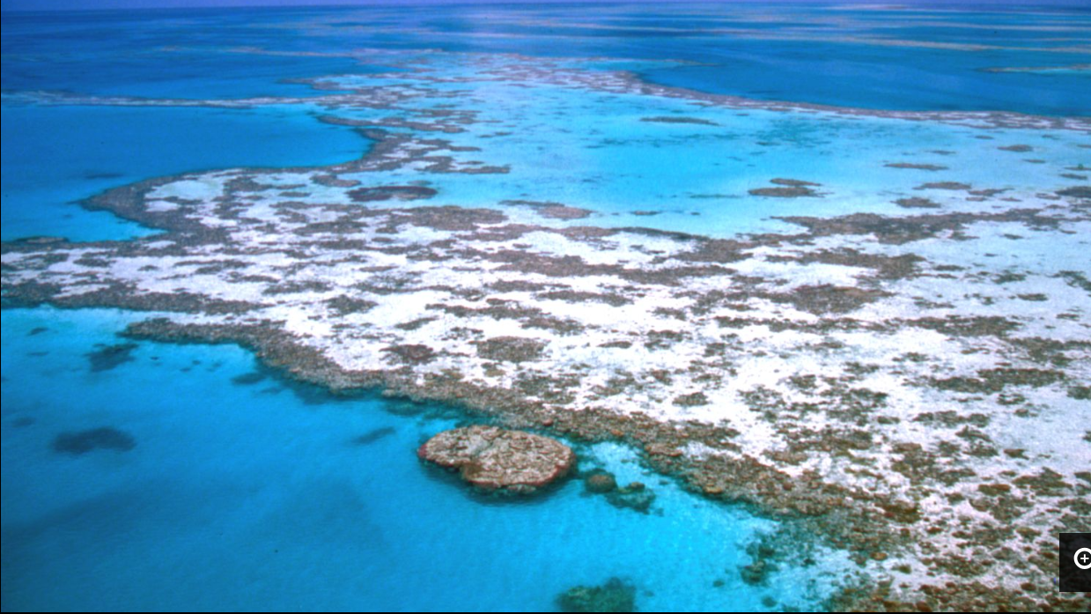
Release of the new IFLA Strategy
2024-2029
Aerial view of Hardy Reef on the Whitsundays, part of the Great Barrier Reef, 1989.
7435 Ron and Ngaire Gale collection. State Library of Queensland

Slide 13
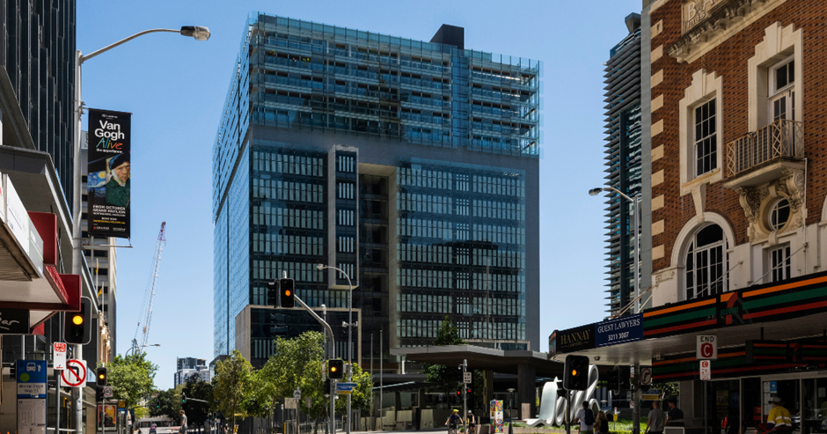
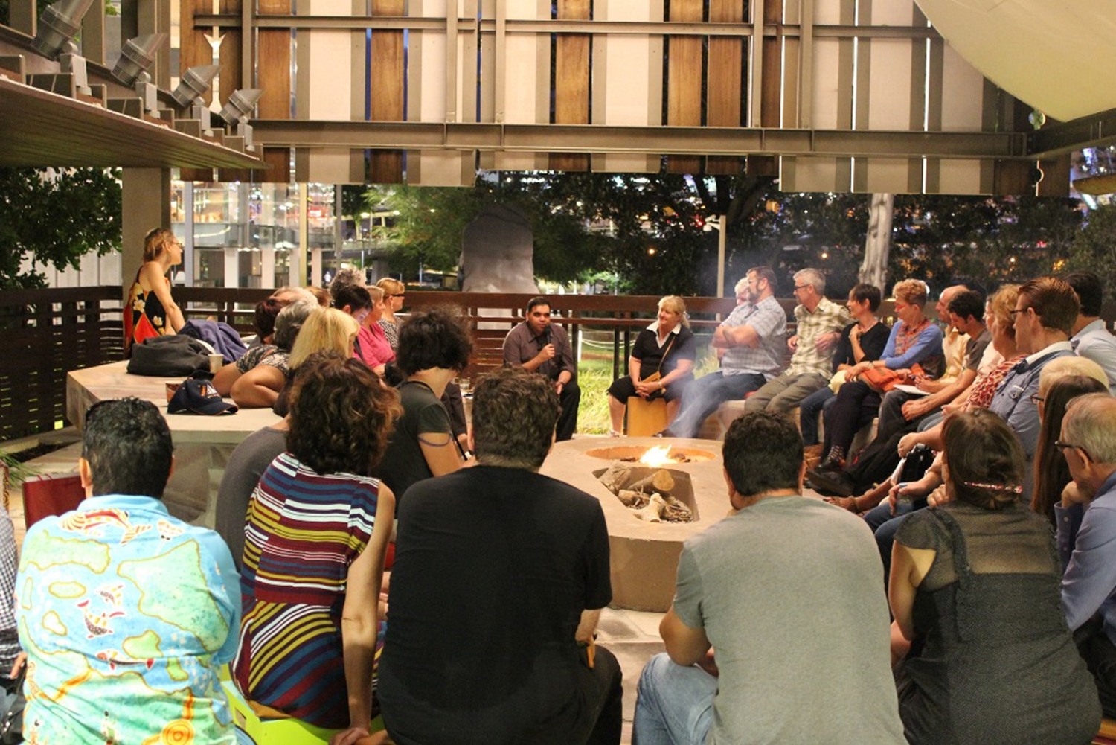
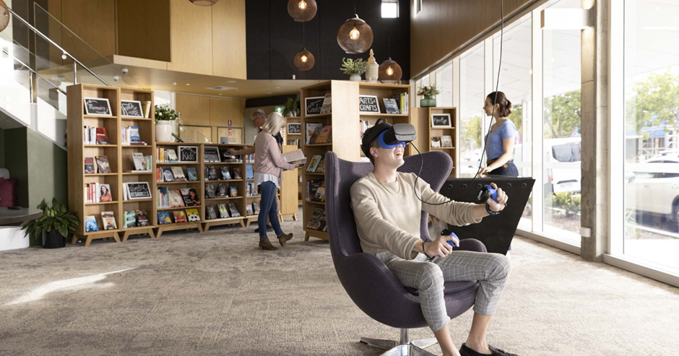
Library explorer tours in Brisbane
Explore our libraries on 3 October
Experience the activities and environment of the local library field
SCLQ image library collection
Image State Library Queensland
Image Ipswich Library

Slide 14
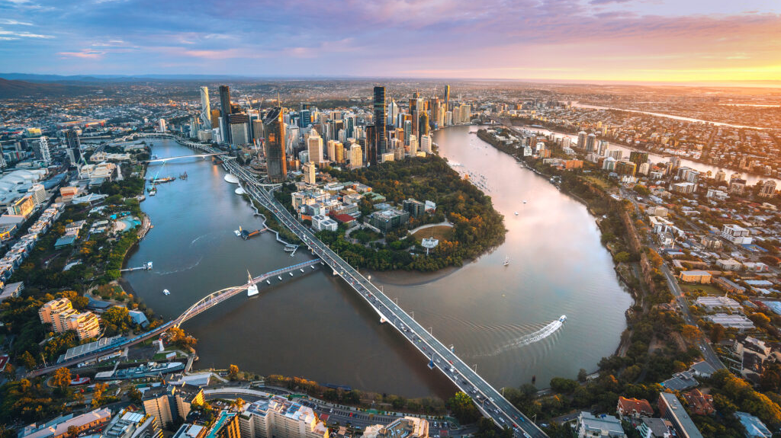

Slide 15
What participants will bring home
New insights about the future of information and the place of libraries in it that you can share
Practical ideas that you can apply in your institutions and associations
Connections with colleagues from Australia, Asia-Oceania and the world
Refreshed energy and enthusiasm to build the future our communities need!

Slide 16
Stay tuned for more to come!
Bookmark the website: 2024.ifla.org
Follow the IFLA newsletter
Look out for e-mails
Share news with colleagues!

Slide 17
TOWARDS CHARITY STATUS FOR IFLA

Slide 18
A vibrant, inclusive international library field, long into the future

Slide 19
To do this, we need to...
Provide great opportunities for committed volunteers to network, share and grow
Provide a clear value-add, as the essential, trusted global membership body for libraries
Be a recognised stakeholder internationally and an effective delivery partner on relevant projects

Slide 20
Algemeen Nut Beogende Instelling
= Public Benefit Institution

Slide 21
What this means...
Simpler to build partnerships which can bring new support for the benefit of IFLA members, volunteers, and the comunities they serve
An amendment to the Statutes to confirm that if IFLA were to close, remaining funding would need to pass to a charity with a similar purpose
A clarification that our role is to represent the interests of the library field as a whole

Slide 22
... and what this does not mean
No changes to our decision-making process (i.e. Members’ voting rights)
No additional reporting requirements for committees

Slide 23
ROADMAP
15-17 April
w/c 22 April
May/June
20 June
Governing Board discusses, approves proposed amendment
Briefing about proposed changes shared
Special sessions for Members in order to explain changes, answer questions
General Assembly, followed by formal revision (if accepted)

Slide 24
GENERAL UPDATES AND DISCUSSION

Slide 25

Celebrating successes!
Recognition of the role of libraries in UNESCO Framework for Culture and Arts Education
Trend Report 2023 released, bringing together the inputs of emerging leaders
Standards Procedure Manual updated and published
The World Through Picture Books (3rd edition) released
Marrakesh Treaty Monitoring Report 2024 Update published
Newsletters focused on Milestones (January), Culture and Education (February), Diversity, Equity and Inclusion (March)

Slide 26
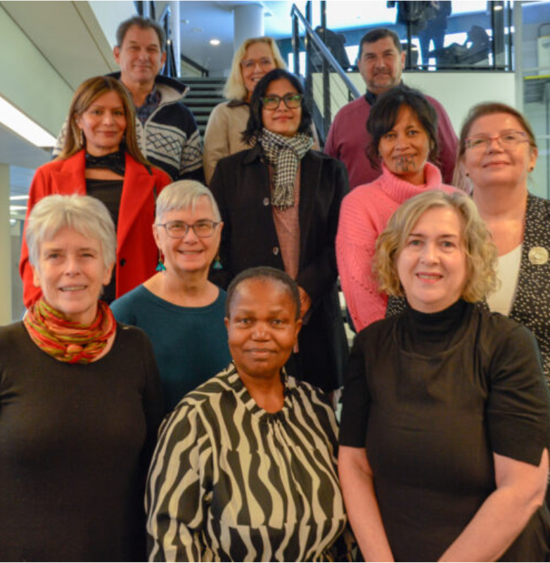
Finalising the financial report from 2023 for the General Assembly
IFLA’s future sustainability
Governance and transparency
Agree a draft IFLA Strategy for Member and volunteer input
WLIC 2025 and IFLA100
Updates from the Professional and Regional Councils, Management of Library Associations Section, and a dialogue with the chair of CLM
On the agenda at the Governing Board

Slide 27
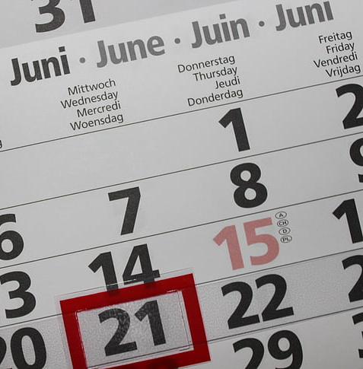
Upcoming opportunities
April
  Opening of IFLA Strategy survey
  WLIC Review pulse survey
  Climate action survey (associations)
May
  IFLA Strategy consultations
  Pre-GA briefing and discussion sessions
  Trend Report pulse survey
June
  General Assembly (Annual Report, Statutes Amendment, Honours and Awards)
  WLIC Review consultation
  Further Trend Report engagement

Slide 28
YOUR QUESTIONS

Slide 29

IFLA HEADQUARTERS 2023
THANK YOU

