Slide 1


Reshaping the ISBD
Rehab Ouf
IFLA webinar “From ISBD to ISBDM”, 26 January 2023

Slide 2
Entity-Relationship Model Impact on ISBD Structure

Slide 3
LRM Vs. FRBR
A New Paradigm
From Records to Data
Manifestation Statement
Representative Expression
Better understanding and modeling of aggregates
New entities (Nomen, Agent, Collective agent, Place, Time-span)
Attributes to relationships (more relational, optimized to linked data environment)
Bibliographic Transition
3R Project (RDA Toolkit Restructure and Redesign Project) to align with LRM
Cope with technological development (super class – subclass) – inheritance
Learns from experience and research and responds to user demands
More modular

Slide 4
Pre 2018 Aligning ISBD to LRM Outcomes
Started in the purpose of Alignment, ended to “ISBD to LRM Mapping” (2018)
    “semantic mapping between the ISBD element set and the IFLA LRM elements, that could not be considered a formal alignment, or viewed as an alignment”
Not everything could be mapped to LRM-Manifestation
Relationships not mapped unless explicit (Manifestation to Manifestation)
ISBD Resource: WEMI

Slide 5

New Paradigm - New/Explicit Components
Entities | Attributes |Relationships
Vocabulary Encoding Schemes
Manifestation Statements
Elements Types |Recording Methods
Actionable Links

Slide 6

ISBD-LRM Aligning Revision (2019- )
Complete an alignment of the ISBD to the LRM at the Manifestation entity level, working out an element set for the alignment & stipulations
Provisions for transforming the ISBD for Manifestation into a full Implementation of LRM
New structure for the ISBD
New publication form accommodating and optimizing the new structure

Slide 7

Why the Manifestation?
Focus of the current ISBD
Longest list of elements
Practical cataloguing level
Applicable (works for a standalone solution until a full LRM implementation is developed)

Slide 8
ISBD to ISBDM: Baseline Decisions
Develop the ISBD into a modular standard
Structure shifting away from traditional bib standards
Reconstruction of stipulations
Data utility and usage

Slide 9
ISBDM (ISBD for Manifestation) Specs.
Components
Baseline Decisions
Entities | Attributes |Relationships
Vocabulary Encoding Schemes
Manifestation Statements
Elements Types |Recording Methods
Actionable Links
Develop the ISBD into a modular standard
Structure shifting away from traditional bib standards
Reconstruction of stipulations
Data utility and usage

Slide 10
ISBD: Where Do We Are

Slide 11
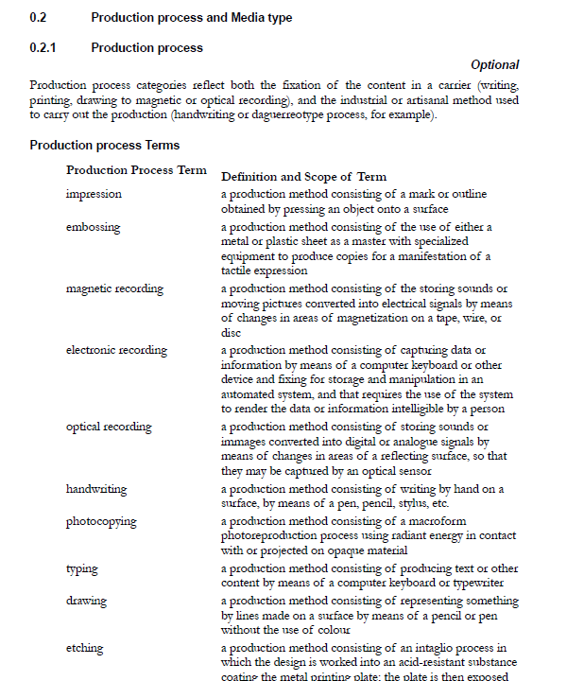
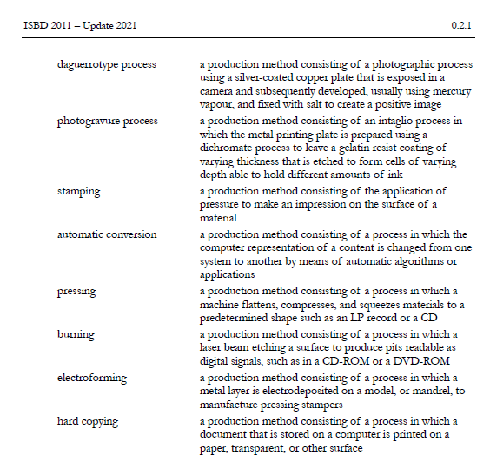
Current Arrangement of ISBD
General Chapter
  (sources of info, language and script of the description, abbr., Capitalization,…)
Areas 0 (vocabularies)
  (Content Form |Content Qualifications |Media Type)
Areas 1 – 8
  (Specification of Elements)

Slide 12

Closer Look
ISBD Resource maps to WEMI entities
Within Areas
  Prescribed punctuation
  Elements + stipulations in a print-based traditional bib standard layout
Stipulations
  thorough & prescriptive
  but lacking categorization (scope, definition, conditional, data provenance, notes,…)

Slide 13
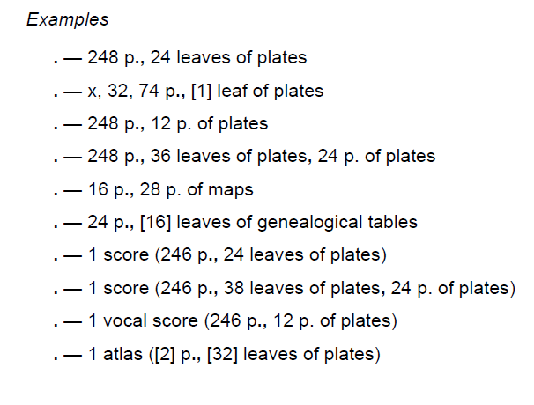
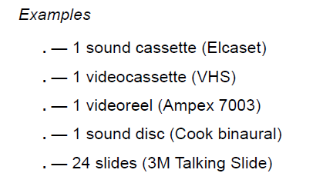
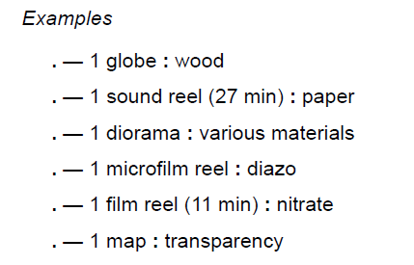
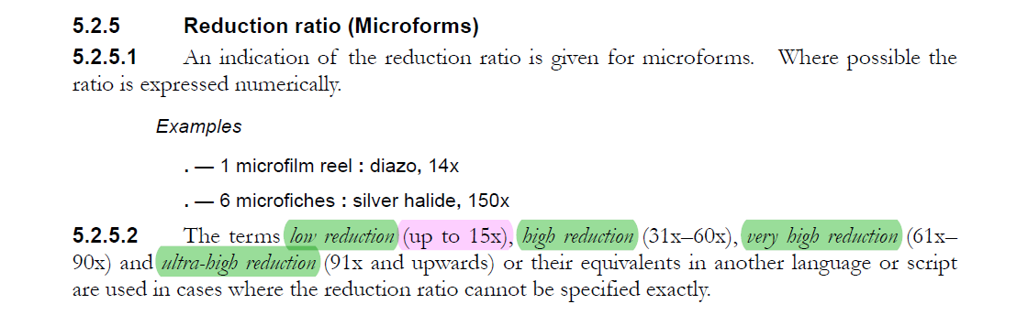
Relationships & Vocabularies
Relationships to LRM entities not explicit
Hidden vocabulary sets
  carrier type attributes in glossary
Even more Hidden/Incomplete
  other VESs in glossary/element set/examples/stipulations

Slide 14
ISBDM: What We Want to Achieve

Slide 15
Modularity / More Clarity / More Usability
Entity-relationship model
  make the elements of linked data and vocabularies obvious and at forefront
  base the structure on this
Interoperability with counterparts
Metadata utility and data portability in systems
  emphasis on entity-based cataloguing and its processing in online information systems
  IFLA Namespaces | MARC formats (UNIMARC, MARC 21,…)

Slide 16
ISBDM Components & Arrangement
Element Reference Card
Each element is self-contained for clarity and better understanding (type, definition, scope, broader/narrower, domain/range, transcription rules, notes)
Relationships made explicit
Manifestation to Manifestation and Manifestation to other LRM entities
Attributes
Vocabularies
Workflows
support cataloguer’s precoding decision
guide through appropriate paths for the description
Elements value

Slide 17
ISBDM Elements
Transcription vs. Recording Elements
Manifestation statement elements for coarse granularity
  How the Manifestation presents itself to the users
  Sub-types map to ISBD Areas (title and responsibility, ppmd,…)
  For display and keyword indexing
Recording elements for finer granularity
  Attributes elements
  Controlled vocabularies, Authority files and other sources
  No prescription in ISBDM

Slide 18
Delivery of ISBDM
Components
Readiness for Use and Transition
LRM Entities
Manifestation Statements
Vocabulary Encoding Schemes
Syntax Encoding Schemes
Metadata utility
Element values
Workflow
Attributes
Relationships
Standalone and self-contained
  Longest lists of elements
  Practical cataloguing level
  Immediately applicable
Extensible to ISBD-LRM
  Use of some Devices to manage the transition from Manifestation to full LRM implementation (shortcuts)
    Category of Manifestation => Expression Content Type

Slide 19
Achievements
Alignment to LRM
New components
Modularity
Data utility
Extensibility
More Clarity
More value to cataloguers and cataloguing agencies

Slide 20
Thank you

