Slide 1



INTERNATIONAL ADVOCACY PROGRAMME
LIBRARIES, DEVELOPMENT,
AND THE UN 2030 AGENDA
TOPIC 2: THE ROLE OF LIBRARIES IN THE UN 2030 AGENDA

Slide 2
For trainers
If you edit this file, please change the file name to show the region and the new date
  Delete the word [Master] from the file name
  Insert the region, eg Asia, Africa, Europe, LAC
  Change the date, using format YYYYMMDD
  Use underscore [ _ ] to link the elements of the file name
IFLA_IAP_Topic2_RoleOfLibraries_[Region]_YYYYMMDD

Slide 3
Topic 2: The role of libraries in the UN 2030 Agenda
Learning objectives
To introduce you to some successful library initiatives which demonstrate the role libraries can play to support specific SDGs
To help you understand that these initiatives may indirectly support other SDGs
To enable you to identify ways in which some of your current library activities are already contributing to the SDGs
To consider the ways in which your library association’s advocacy activities can be aligned with the SDGs
To prepare you to develop a campaign to raise awareness of the UN 2030 Agenda in your own country

Slide 4
Overview of this topic
We look at what libraries are already doing to support the SDGs, as presented in:
  IFLA Toolkit: Libraries and National Development Plans
  IFLA Booklet: Access and opportunities for all: How libraries contribute to the United Nations 2030 Agenda
We examine some examples of library programs and services which are directly contributing to the UN 2030 Agenda, specifically:
  Goal 4: Quality education
  Goal 2: Sustainable agriculture
We will map some of activities of your library and your library association to the SDGs
We will stress the critical importance of libraries raising awareness about the SDGs

Slide 5
The journey so far
IFLA worked with the UN to ensure that the concept of ‘access to information’ was included in Goal 16.10
It is argued that access to information is fundamental to better decision making, and beyond that, to ensure people have a better life
A number of IFLA documents develop the idea further
  IFLA Statement on Libraries and Development (2013)
  The Lyon Declaration on Access to Information and Development (2014)
  Libraries, The Lyon Declaration and the Road to 2030
  (webinar, 2015) [see Topic 1B: IFLA’s work at the UN]

Slide 6
IFLA Statement on Libraries and Development (2013)
Libraries provide opportunity for all
  All locations, all people, marginalised groups,
Libraries empower people for their own self-development
  People can learn, create and innovate
  Culture of literacy and inquiry
  Upskilling in ICT to improve lives and communities
Libraries offer access to the world’s knowledge
  Access to information in all its forms
  Traditional knowledge, national cultural and scientific heritage
  Partnering to ensure equitable access to knowledge resources
http://www.ifla.org/publications/ifla-statement-on-libraries-and-development

Slide 7
IFLA Statement on Libraries and Development cont.
Librarians provide expert guidance
  Library staff are trained and trusted intermediaries
  Provide learning support for information and media literacies
Libraries are part of a multi-stakeholder society
  Working effectively with many groups
  Government, education, civil society, business
  Experienced partners to deliver policy outcomes
Libraries must be recognised in development policy frameworks
  Policy makers should encourage the strengthening and positioning of libraries to solve development problems at community levels
  “Libraries have a natural role in providing access to information content and networked services that underpin sustainable development.”
http://www.ifla.org/publications/ifla-statement-on-libraries-and-development

Slide 8
The Lyon Declaration on Access to Information and Development (2014)
Aimed at UN member states, in order to influence decisions in the 2030 Agenda
Positions libraries as:
  Enablers of development
  Partners with governments and development agencies
“It’s crucial that the voice of libraries is heard in these negotiations”
The declaration will get the message about the importance of libraries “where it needs to be heard”
For an “active and engaged civil society,” the involvement of libraries is essential
Opportunities to show how libraries can do more than just provide access to information
Libraries also support a culture of critical thinking and inquiry
www.lyondeclaration.org

Slide 9
The Lyon Declaration argues that access to information supports development
Empowering people to:
Exercise their civil, political, economic, social and cultural rights
Learn and apply new skills
Make decisions and participate in an active and engaged civil society
Create community-based solutions to development challenges
Ensure accountability, transparency, good governance, and empowerment
Measure progress on public and private commitments on sustainable development

Slide 10
The impact of the Lyon Declaration
Over 600 signatories
Supported by IFLA membership, drawn from 150 countries around the world
Facilitated engagement with government policy makers, to underscore the role of libraries in national development
Served as a tool – a document to wave – at the UN
Underscores the fact that universal literacy is a key element of access to information

Slide 11
The reach of the Lyon Declaration
Visibility
  The importance of access to information
  The intrinsic value of libraries
Brings together a large group of organisations, reaching beyond the library sector
Signatories:
  Library associations
  Libraries
  Universities
  Agencies relating to peace, human rights, press freedom, open access, health services…

Slide 12
Responsibility for SDGs has been passed to the
UN member states
UN 2030 Agenda is handed over to the UN member states
All member states must prepare their national development plans, and report on their progress
Libraries can play a role in the national development plans
  To highlight where current and future library services and
  programmes fit
  To change the way libraries are seen; the roles they can play
Librarians must take up the momentum achieved so far

Slide 13

Activity 2.1. SDGs in your local context
What do you already know about
SDGs in your local context?
Do you know if there a
National Development Plan?
If you are not very sure,
how could you find out more?

Slide 14

Case study:
Jamaica – Vision 2030
Video [1’56”]
https://www.youtube.com/watch?v=_07e7Ge3lUY
Full video [10’16”]
https://www.youtube.com/watch?v=hD7F-L7m5N0
National Development Plan
http://www.vision2030.gov.jm/National-Development-Plan

Slide 15
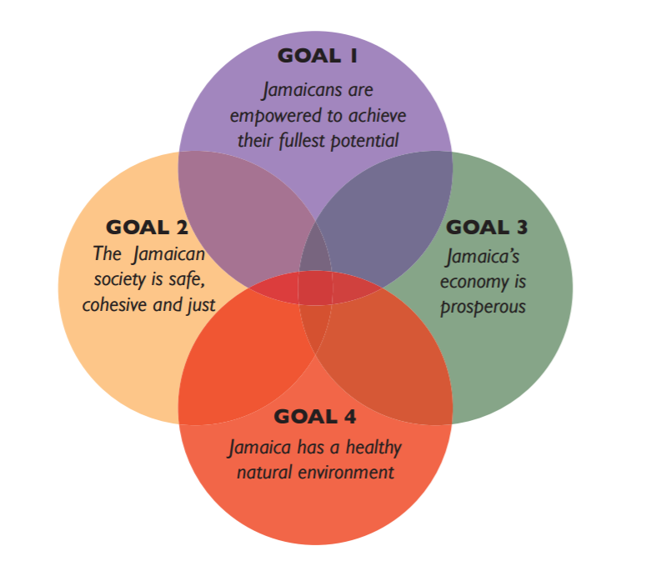
Vision 2030 Jamaica: four goals
http://www.vision2030.gov.jm/Portals/0/NDP/Executive%20Summary.pdf

Slide 16
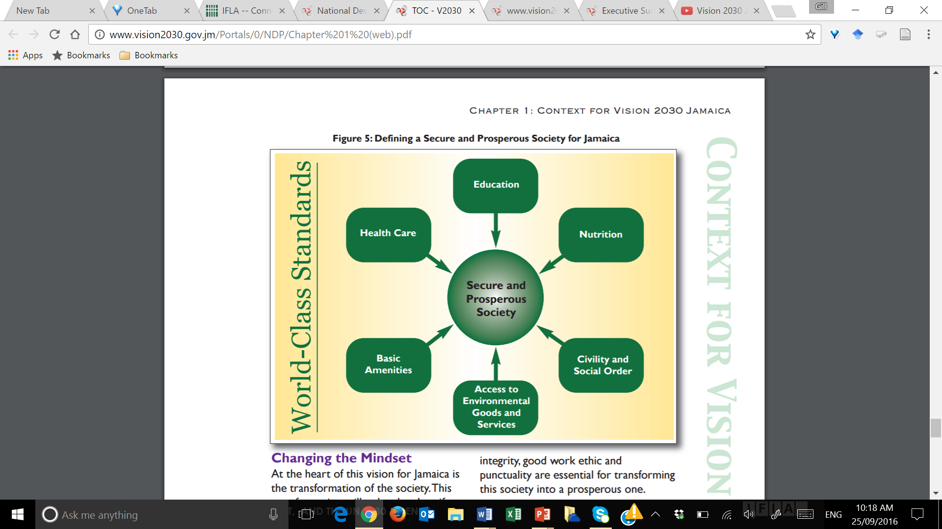
Defining a secure and prosperous society
http://www.vision2030.gov.jm/Portals/0/NDP/Chapter%201%20(web).pdf

Slide 17
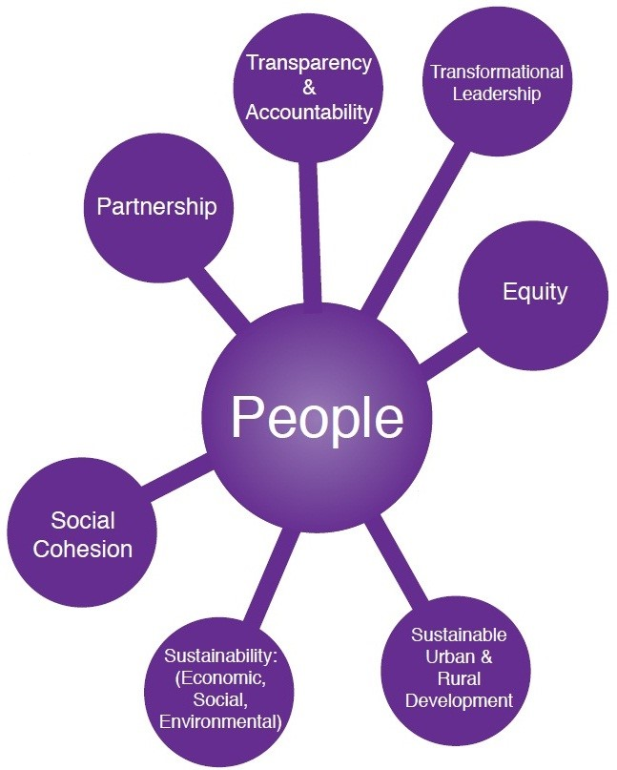
Guiding principles
http://www.vision2030.gov.jm/Portals/0/NDP/Executive%20Summary.pdf

Slide 18
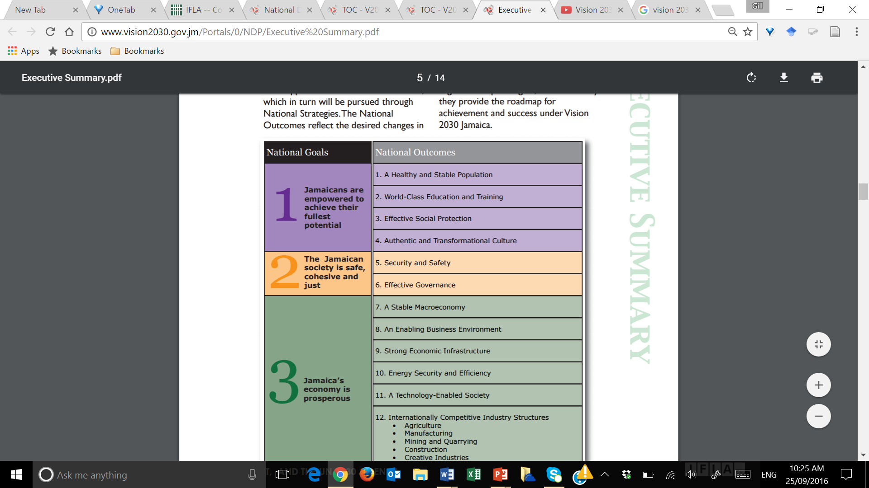
National goals and national outcomes

Slide 19
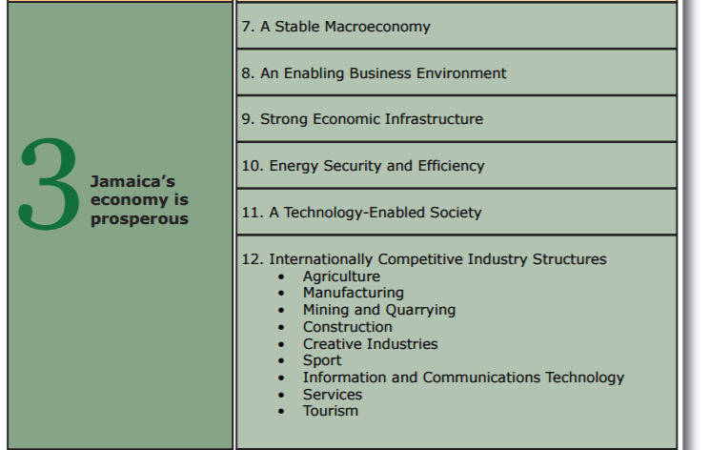

Slide 20

http://www.vision2030.gov.jm/Portals/0/NDP/Executive%20Summary.pdf

Slide 21
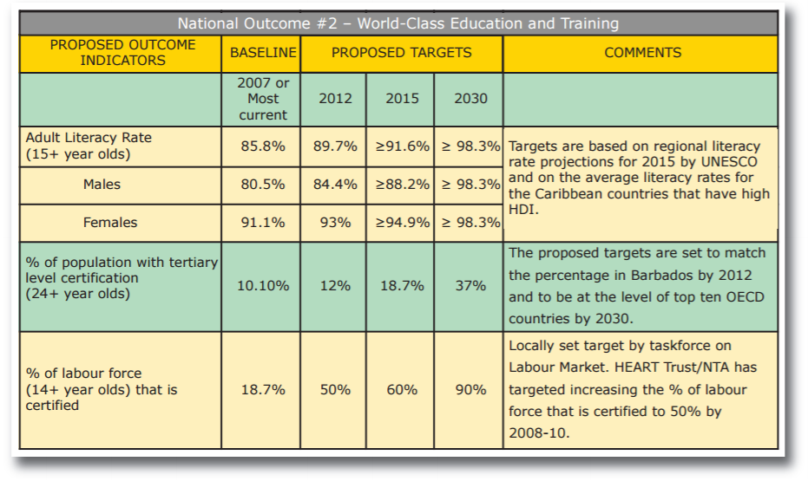
National outcomes and targets (example)
http://www.vision2030.gov.jm/Portals/0/NDP/Vision%202030%20Jamaica%20NDP%20Full%20No%20Cover%20(web).pdf

Slide 22
Monitoring and evaluation
Dashboard
http://devinfolive.info/dashboard/Jamaica_vision2030/index.php
See also:
http://blogs.iadb.org/caribbean-dev-trends/2015/05/06/interactive-dashboard-monitor-jamaicas-vision-2030-national-plan/
Facebook site:
https://www.facebook.com/Vision2030Ja?fref=ts

Slide 23
Different visions for different countries
Vision 2030 Jamaica:
“Jamaica is the place of choice to live, work, raise families and do business.”
Vision 2030 Kingdom of Saudi Arabia:
“Our vision is built around three themes: a vibrant society, a thriving economy and an ambitious nation”
[or select another relevant country in the region]

Slide 24
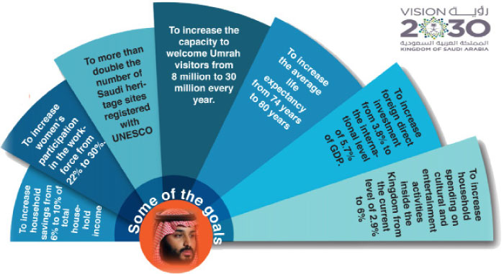
Saudi Arabia: some targets

Slide 25
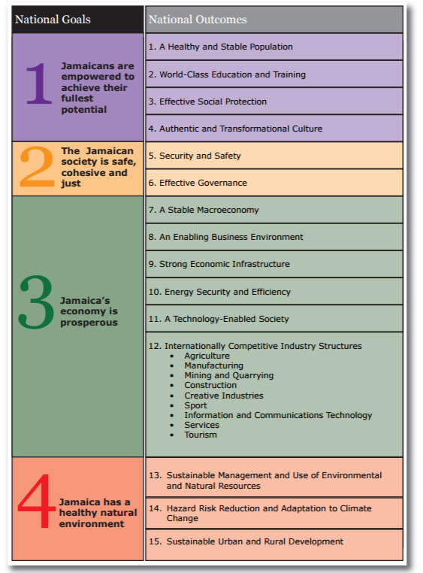
Activity 2.2. The role of libraries
Taking Vision 2030 Jamaica as an example
Please refer to the handout of Jamaica’s
National Goals and National Outcomes
Just in very general terms, where do you see that
libraries might be able to make a contribution?
Write your ideas on sticky notes – one idea on one sticky note
Handout: Vision 2030 Jamaica, Executive Summary, p.5
http://www.vision2030.gov.jm/Portals/0/NDP/Executive%20Summary.pdf

Slide 27

Libraries facilitate access to information
Access to information supports:
  Eradication of poverty
  Agriculture
  Quality education
  Health and wellness
  Public access to ICT
  Culture
  Economic growth
  Civil society
  …
Access to information underpins the achievement of all SDGs

Slide 28
The role of library staff in the context of SDGs
Library staff promote the information rights of citizens
Library staff develop relevant collections and facilitate access to resources
Library staff support access to government information, in all media
Library staff support the development of freedom of access legislation
Library staff model high standards of information ethics
Library staff work with NGOs seeking to ensure transparency in society
….

Slide 29
Libraries and implementation of the UN 2030 Agenda
Libraries make an important contribution to development
Advocacy is needed to ensure that national and regional policy makers understand that libraries and access to information must be included as part of national and regional development plans
Libraries must now show that they can drive progress across the entire 2030 Agenda.
While the SDGs are universal goals, each country will be responsible for developing and implementing national strategies to achieve them, and will be expected to track and report its own progress toward each target
(IFLA Toolkit, p.1)

Slide 30
Libraries have a huge contribution to make
National development plans will shape many government spending and programme priorities
  Social development plans
  Education plans
  Health and wellness plans
  ICT infrastructure plans
  …
The priorities will be different in different countries and regions, as we saw with:
  Vision 2030 Jamaica
  Vision 2030 Kingdom of Saudi Arabia [or alternative]

Slide 31
Libraries need to be in the mix
When governments are discussing funding priorities, it is imperative that libraries are recognised
By promoting the leading role that they play in national and regional development, there should be changes in the way in which libraries, especially public libraries, are funded
The UN 2030 Agenda offers the library sector opportunities to change the assumptions made about libraries – and therefore also the funding provided

Slide 32
Library associations and the library sector need to:
Increase awareness – at all levels of society – about the critical contribution libraries can make
We need very clear statements of the role(s) libraries can play in the development arena
We need to have clear examples of good practice to illustrate and provide evidence of the impact libraries make

Slide 33
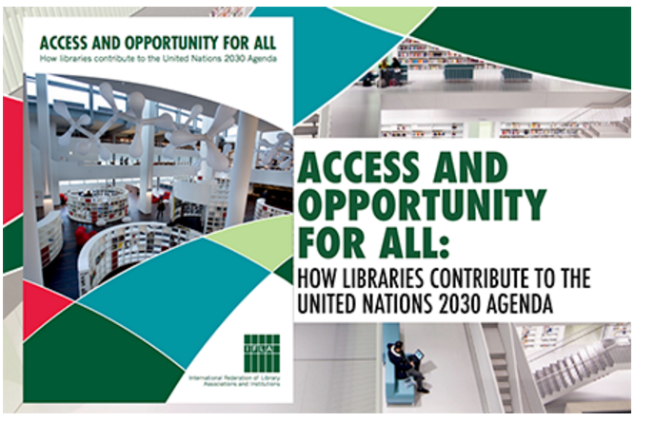
Let’s look at IFLA’s booklet
http://www.ifla.org/publications/node/10546

