Slide 1
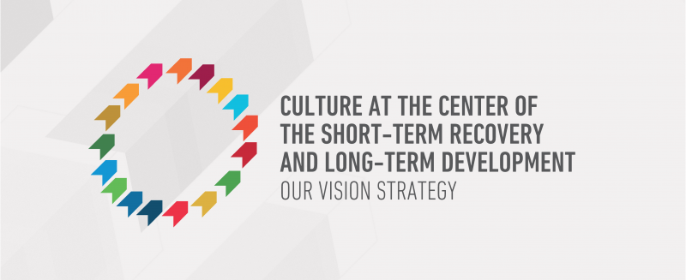
A Sustainable Development Goal for Culture
An introduction to the Culture2030Goal campaign

Slide 2
Our time together today
Why culture and development?
Why was 2015 a failure, and what impact has this had?
What is the Culture2030Goal campaign doing?
What can you do?

Slide 3
Definitions
Culture: the cultural sector, cultural institutions, but also the underlying culture that shapes behaviours
Development: sustainable development, that enables the fulfilment of rights by everyone, now and into the future – see the UN 2030 Agenda

Slide 4

Culture is a goal in itself
Culture is an enabler of other goals
Source: DNB, https://www.dnb.de/EN/Benutzung/benutzung_node.html

Slide 5
Bringing culture and development together within IFLA
Uphold cultural rights as a force for individual fulfilment and social cohesion
Unique role of libraries in delivering development
Public Library Manifesto

Slide 6
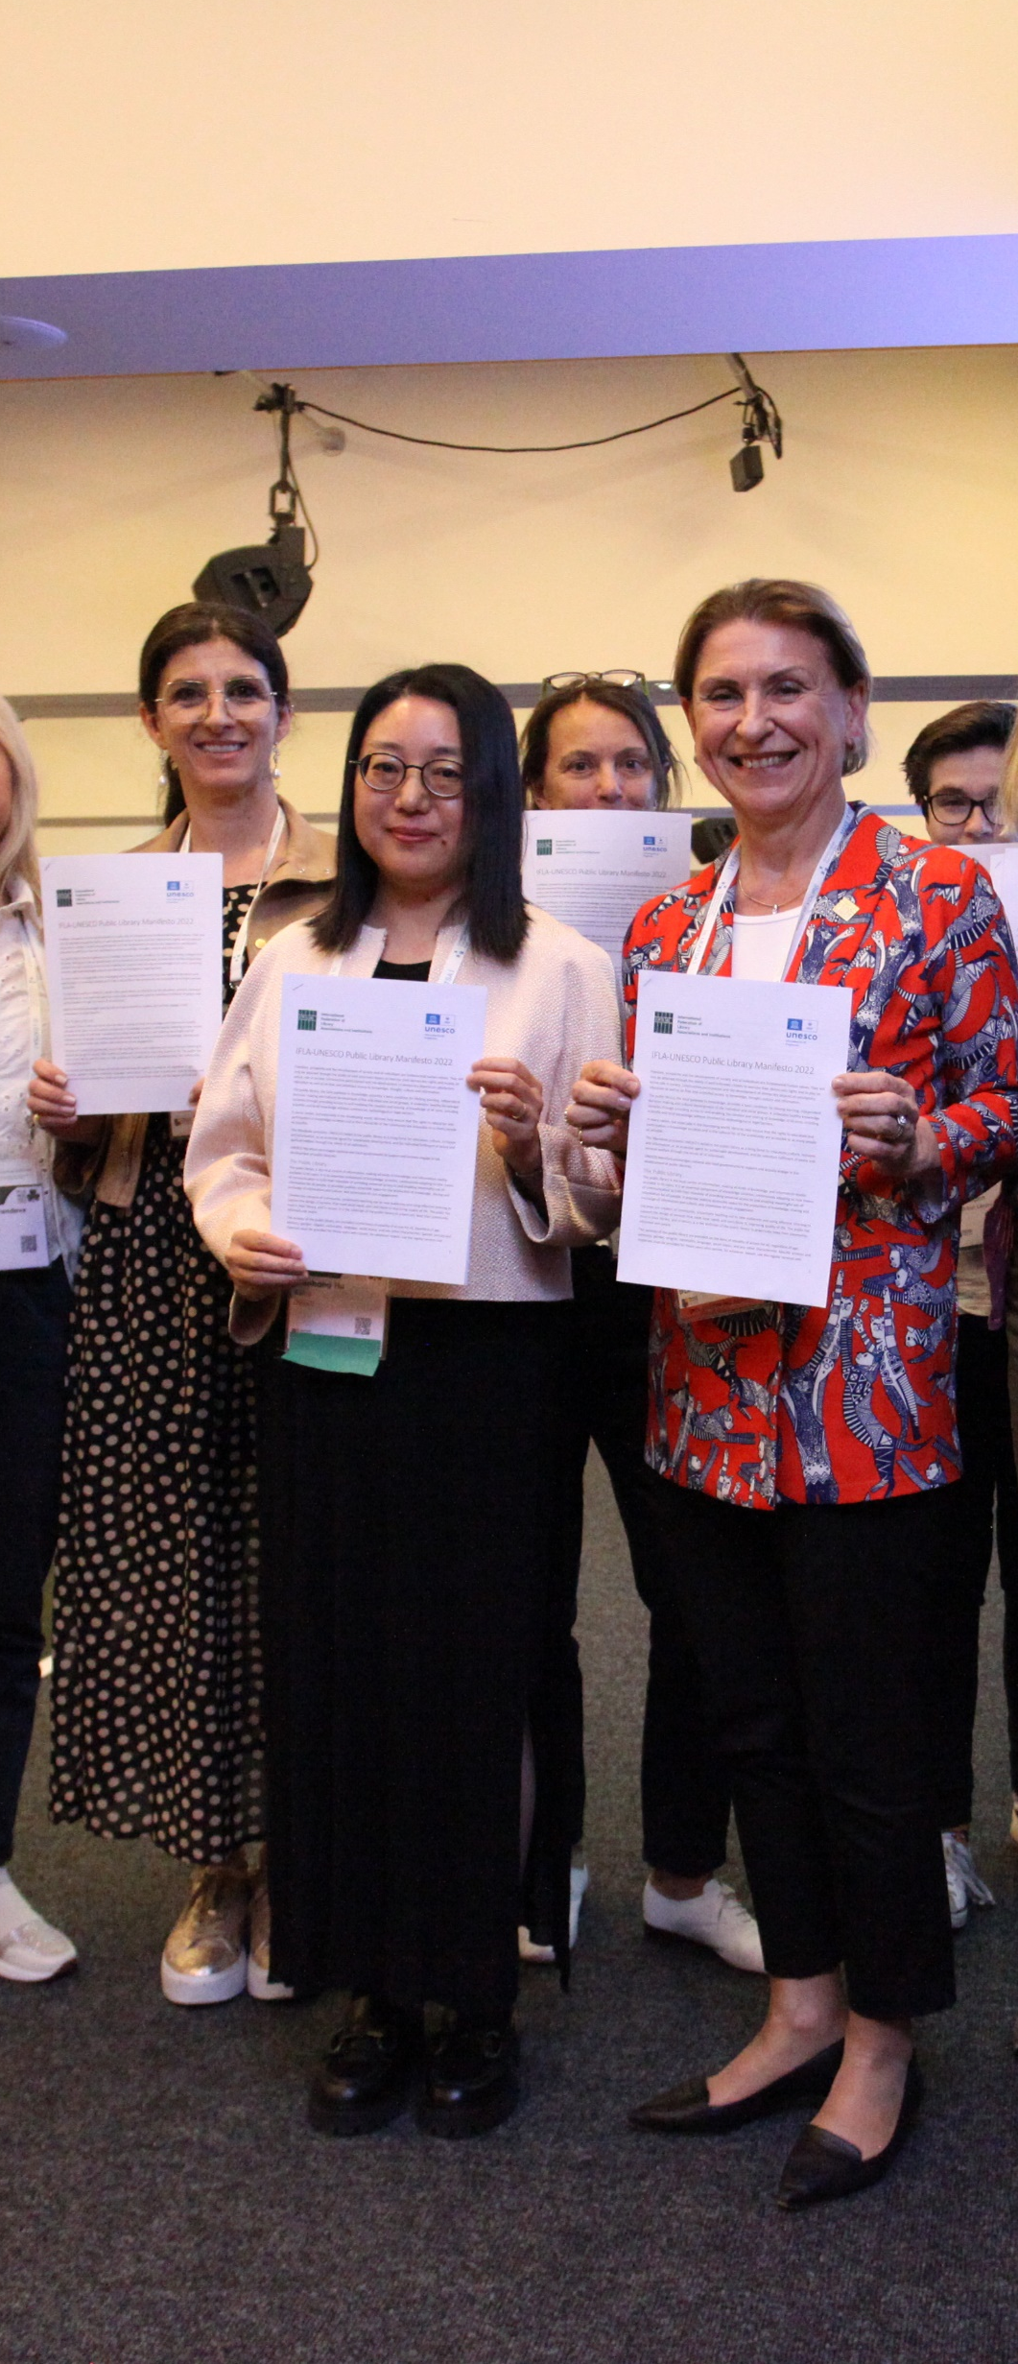
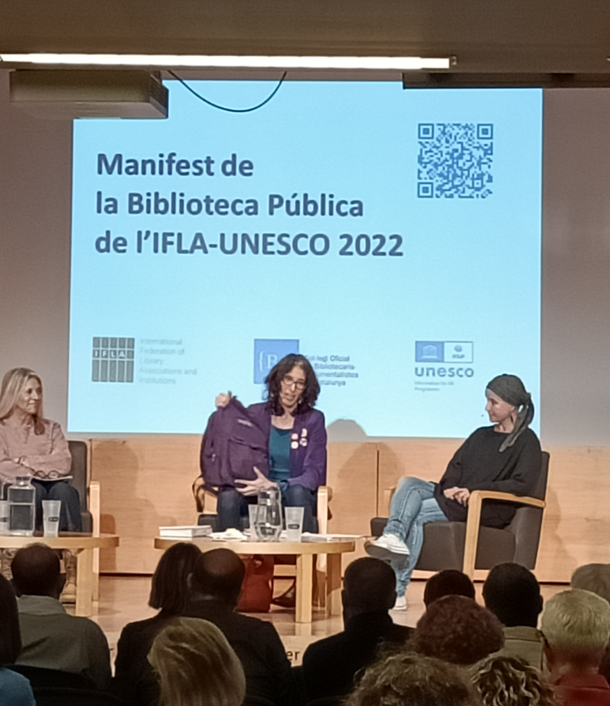
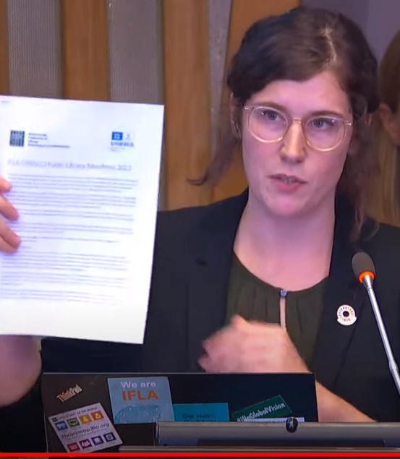
2022 IFLA-UNESCO Public Library Manifesto
IFLA and IFAP Collaboration
IFLA works at international level
IFLA members work at national level
Engagement with UNESCO and member states
Notes:
To illustrate how IFLA and UNESCO can work together, take the 2022 launch of a new update to the IFLA-UNESCO Public Library Manifesto
IFLA has fostered a strong relationship with the UNESCO Information for All Programme around the drafting and implementation of this manifesto
Culture features strongly - it proclaims UNESCO’s belief in the public library as a living force for education, culture and information, and as an essential agent for the fostering of peace and welfare through the minds of all people.
It declares that public libraries contribute to the Sustainable Development Goals and the construction of more equitable, humane, and sustainable societies.
Implementing the manifesto is taking multilevel action – with UNESCO cooperating with IFLA at the international level, IFLA engaging in other UN processes, like the Transforming Education Summit, and national and subnational action led by IFLA’s members and volunteers
This could be a model for further engagements with UNESCO on advocating for culture’s role in sustainable development

Slide 7
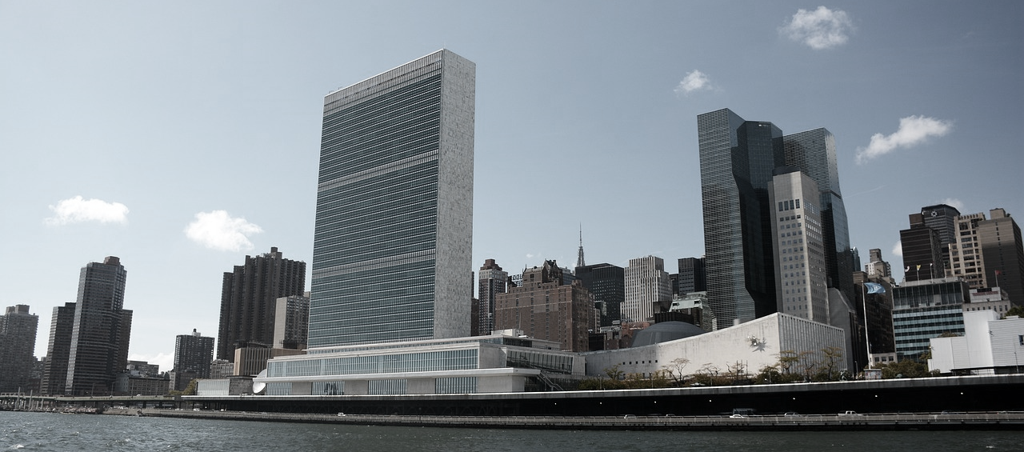
Was 2015 a failure?

Slide 8
What went wrong?
Fear of ending up in a silo
Focus on sector-specific asks
Lack of a loud enough voice
Failure to integrate across the UN system

Slide 9
What is in the 2030 Agenda?
References to the importance of cultural diversity
Role of culture referenced in SDG4.7
Role of cultural tourism highlighted
Safeguarding of cultural and natural heritage

Slide 10
What impacts?
Culture not seen as an equal pillar of sustainable development
Culture ministries/agencies not engaged in implementation
Culture unevenly featured in Voluntary National Reviews
Missed opportunities and unrealised potential

Slide 11
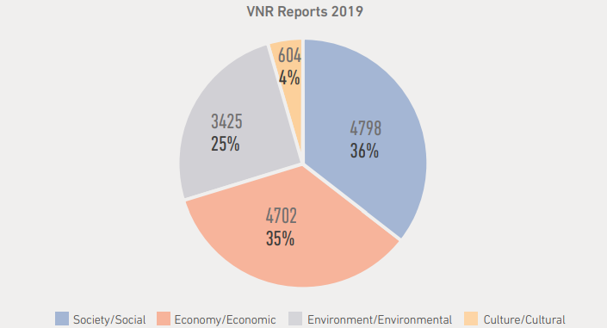

Slide 12
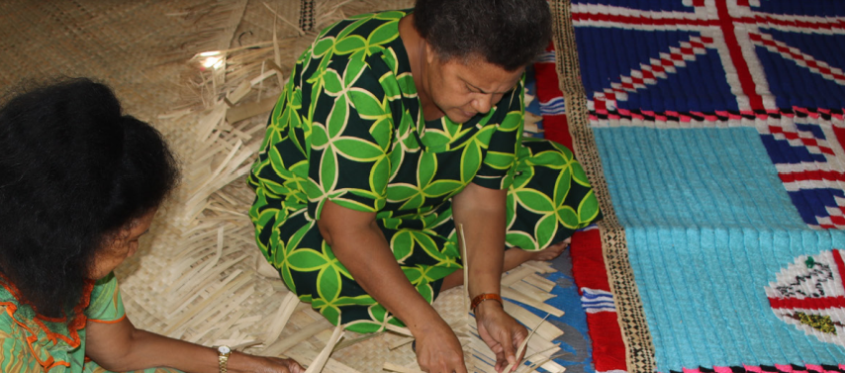
The Culture2030Goal Campaign

Slide 13



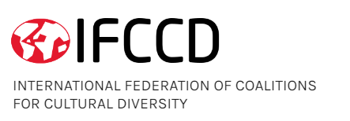



Campaign members

Slide 14
The Goals of the Campaign
Ensure that culture is seen as a pillar of sustainable development
To encourage governments to act today as if culture was a goal
To promote a culture goal in the post-2030 framework

Slide 15
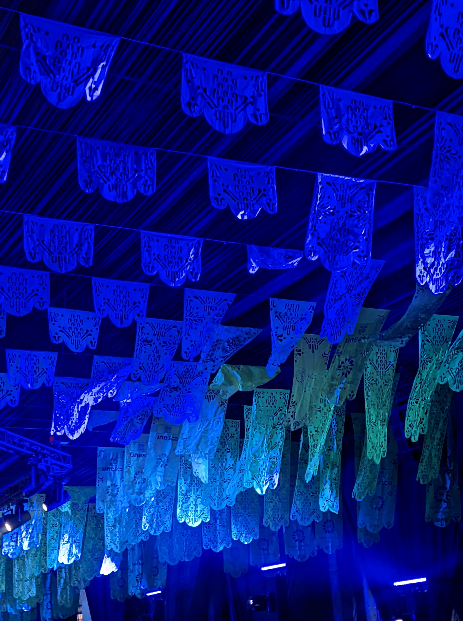
Time to Deliver
“World leaders must not again miss the opportunity to explicitly recognise the
role of culture as an accelerator of development”
Statement by the Culture 2030 Goal Campaign
February 2023
Notes:
For the Culture 2030 Campaign, this is a significant stepping-up of commitment by national policymakers and intergovernmental bodies towards calling for a culture-specific goal.
The campaign launched the Zero Draft on the occasion of Mondiacult, and has been engaging in the follow-up from the conference, to hold member states to their word in calling for culture’s role in sustainable development to be more strongly recognized and invested in
In February 2023, a statement was launched and circulated to UNESCO member states
The campaign declared their readiness to work with states to keep culture at the heart – not the fringes – of sustainable development policy making

Slide 16
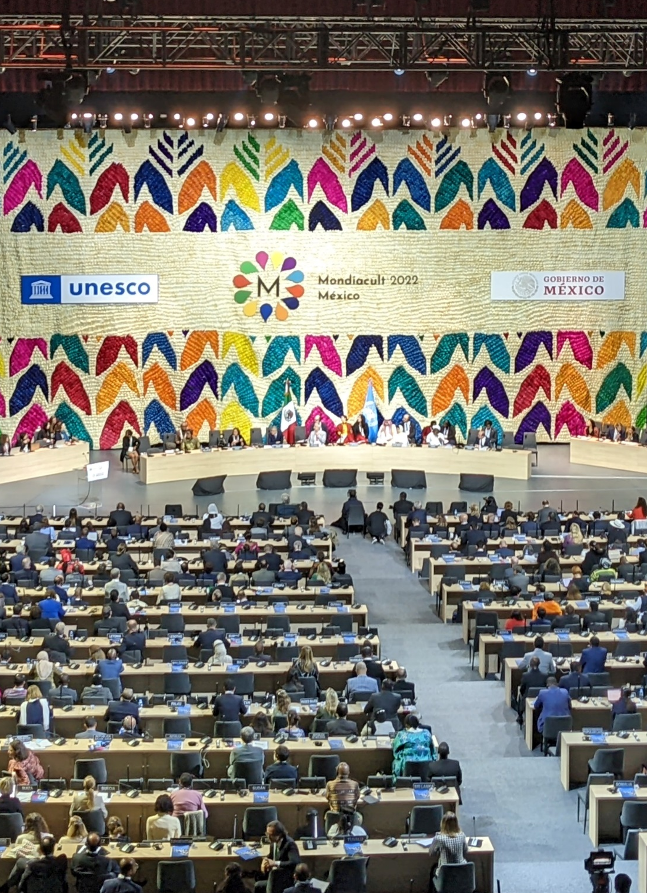
UNESCO Mondiacult 2022
UNESCO World Conference on Cultural Policies and Sustainable Development
September 2022, Mexico
150 Member States
How can cultural policy can help tackle global challenges?
Notes:
The UNESCO World Conference on Cultural Policies and Sustainable Development was held in September 2022 in Mexico City, and was the largest cultural policy meeting in 40 years
It brought 150 countries together to discuss how can cultural policy can help tackle global challenges.
The discussion was based around four themes, one of which was explicitly culture for sustainable development
IFLA was on the programme, leading a side event focusing on linking culture and education

Slide 17
The Mondiacult
Declaration
Culture as a global public good
Culture can and should benefit all – governments must strive to ensure this.
Culture as a stand-alone goal
Culture should be a specific objective in the sustainable development framework
Policy that upholds cultural rights
The rights of artists, indigenous communities, freedom, the protection of heritage, culture in the digital environment, and more
Linking culture and education
Promoting cultural diversity, multilingualism, arts education and digital literacy in school and lifelong
Notes:
At the end of Mondiacult, 150 States unanimously adopted an ambitious Declaration for Culture – the Mondiacult Declaration
This has focussed countries around the world on a common roadmap to strengthen public policies.
Notably, the Declaration recognizes culture as a global public good with an intrinsic value to enable and drive sustainable development.
In fact, it explicitly calls for culture to be included “as a specific objective in its own right” among the next United Nations Sustainable Development Goals.
This is strengthened with a series of specific areas which need public policy development in order to uphold the cultural rights of all – notably including access to culture and cultural diversity in the digital environment
It further covers areas like promoting synergies between culture and education, including culture in discussions on climate change, and stepping up the fight against illicit trafficking

Slide 18
Working through UNESCO
Mondiacult 2022 demonstrated the international will to improve cultural policy’s ability to fuel sustainable development
The Mondiacult Declaration accelerated calls for a stand-alone culture goal
Culture and libraries have an impact across UNESCO’s areas of competency
IFLA works with UNESCO to amplify this, but members and volunteers can help!

Slide 19
Working through the UN
Ongoing implementation of the 2030 Agenda
Summit of the Future (2024)
SDG Summit (2023)

Slide 20
Tools available
Analyses of culture in Voluntary National Reviews
Statements
Zero-draft of a culture goal

Slide 21
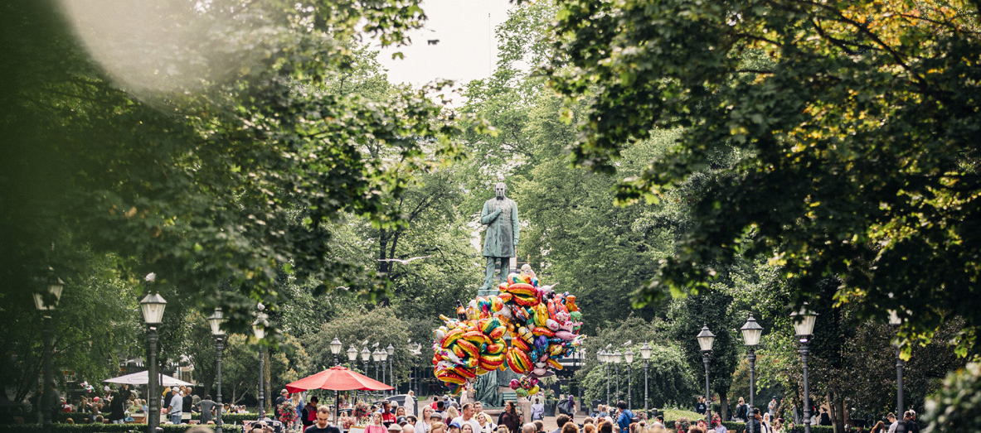
How to Get Involved

Slide 22
What you can do...
Contact UN missions to urge inclusion of culture in the SDG Summit Declaration
Consider organising workshops around the culture goal zero-draft
Follow the Culture2030Goal campaign!

Slide 23
Thank you!

