Slide 1

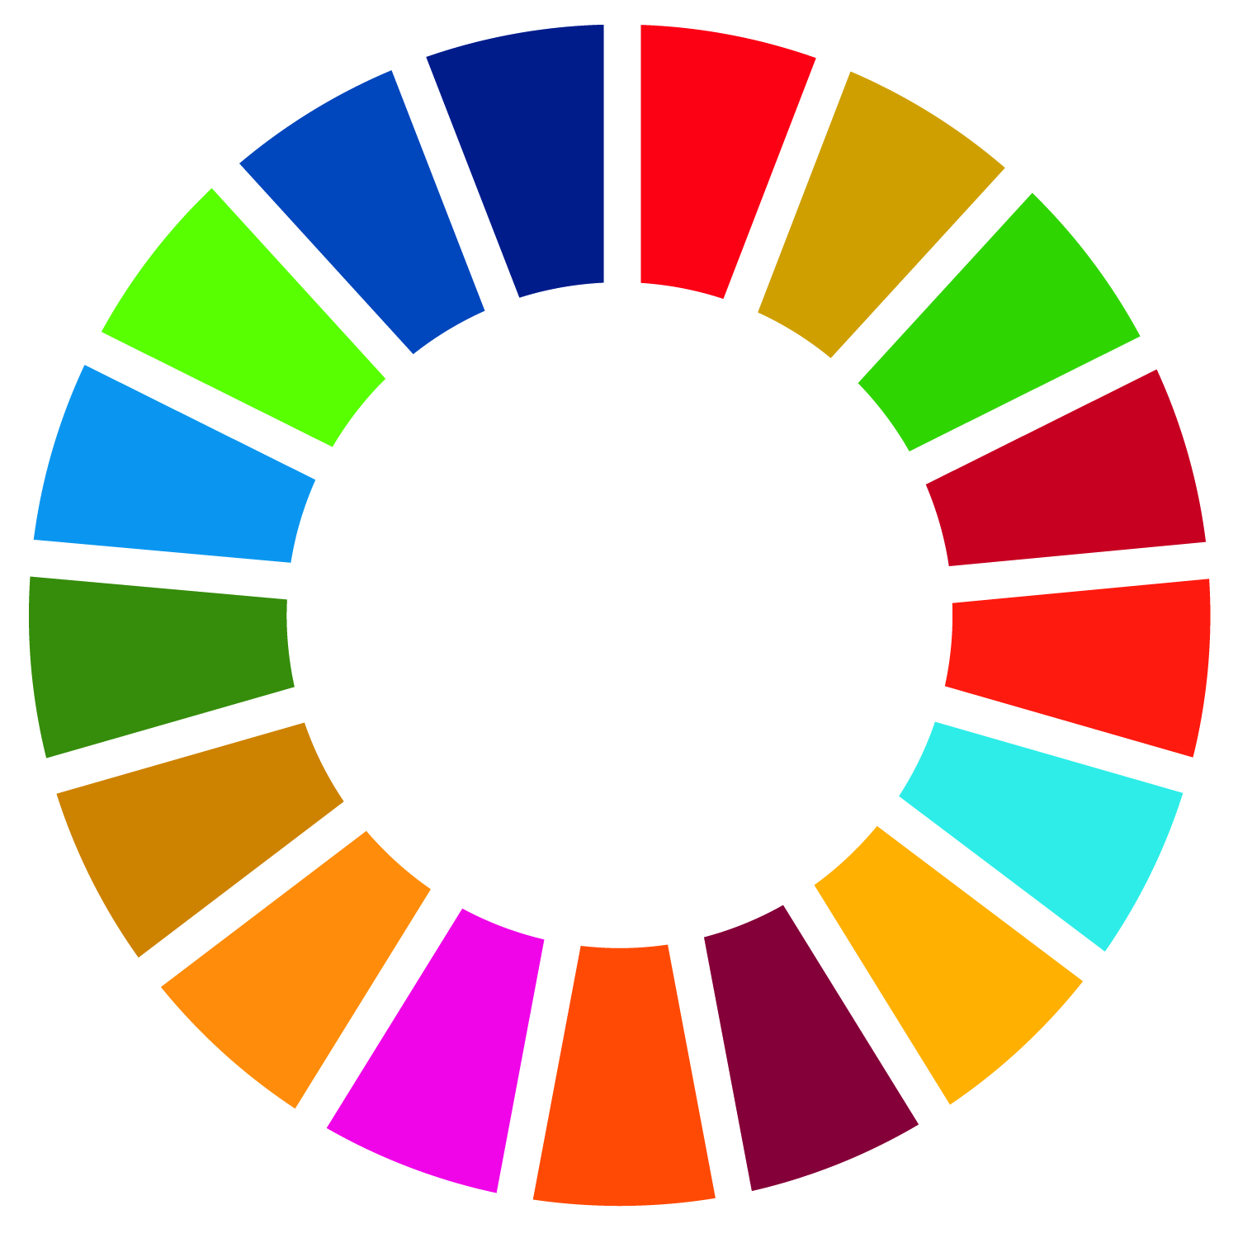
SDG
Storytelling Flowchart
How to know if you are ready to submit your story to the Library Map of the World
An SDG Story is a narrative about an activity, project or programme, implemented by a library or in partnership with a library, to the benefit of library users and communities. It addresses a problem or challenge, and contributes to local, regional or national development needs.
Does your story fit the criteria? Answer Yes or No to the questions below:
‘WHY’ is about your community and target group, and their needs. Explain the situation and include demographic and socio-economic characteristics.*
‘WHAT’ is about your library activity, project or programme. Describe what you did, when and how it was done, and who was involved. Remember to include statistics.*
‘IMPACT’ is about change and outcomes for people. Include proven results, data and testimonials that illustrate a positive change in the community and people’s lives.*
I have a story
to tell
Is it about a specific activity, project or programme?
Has it been done by a library or in partnership with a library?
Does it improve the lives of library users and/or communities?
Can you explain clearly WHY you did this?
Can you provide details about WHAT you did, and how and when you did it?
Have you evaluated the IMPACT on users' lives and communities?
Prepare to submit your SDG Story!
Y
Y
Y
Y
Y
Y
N
N
N
N
N
N
This is not an SDG Story
suitable for the Library Map of the World
Find out more information, data or evidence
before submitting your story
Is it about the IFLA International Advocacy Programme or library advocacy?
Y
Get in touch with DA2I@ifla.org
N
Share your story with a relevant audience through other channels
*Learn more about storytelling in Libraries and the Sustainable Development Goals: a Storytelling Manual pages 11 - 12
librarymap@ifla.org | librarymap.ifla.org/stories
#WorldLibraryMap #SDGs #StoriesThatMatter #Lib4Dev

