Slide 1



INTERNATIONAL ADVOCACY PROGRAMME
LIBRARIES, DEVELOPMENT,
AND THE UN 2030 AGENDA
TOPIC 4: DEVELOPING AN ADVOCACY PLAN
TO SUPPORT THE UN 2030 AGENDA

Slide 2
For trainers
If you edit this file, please change the file name to show the region and the new date
  Delete the word [Master] from the file name
  Insert the region, eg Asia, Africa, Europe, LAC
  Change the date, using format YYYYMMDD
  Use underscore [ _ ] to link the elements of the file name
IFLA_IAP_Topic4_DevelopingAnAdvocacyPlan_[Region]_YYYYMMDD

Slide 3
Topic 4: Developing an advocacy plan to support the UN 2030 Agenda
Learning objectives
To help you work through the seven steps of the advocacy planning cycle discussed in Topic 3, to draft your own plan
To enable you to shape your own ideas into a strong and cohesive document to guide your advocacy activities to take back to your association

Slide 4
The real importance of planning
“Effective planning is at the heart of successful advocacy”
(Open Society Foundations)
“Writing is an iterative process and planning is an essential part of the process…”
  Constructing a plan is a way to provide yourself with an outline or 'road map' to help work out which direction to take
  A plan can focus and define your ideas, provide a starting point and help break the task into manageable parts
  (University of New South Wales)

Slide 5
The advocacy cycle
Step 1
Identify and analyse the issue
Step 2
Set the goals and the objectives
Step 3
Identify the decision makers
Step 4
Define the message and the ‘ask’
Step 5
Set your timeline
Step 6
Assess resources, choose tactics & implement
Step 7
Monitor, evaluate, and share
Adapted from Open Society Foundations
https://www.opensocietyfoundations.org

Slide 6
Overview: the overarching framework for your advocacy plan
1
2
3
4
5
6
7
  Step 1: Identify and analyse the issue
    What problem do you want to address?
  Step 2: Set the goal and the objectives
    What do you want to achieve?
  Step 3: Identify the decision makers
    Who do you need to influence?
  Step 4: Define the message and your proposal
    What is the focus of your campaign?
  Step 5: Set your timeline
    When should you do it?
  Step 6: Assess resources, choose tactics & implement
    How will you do it?
  Step 7: Monitor, evaluate, and share
    How will you measure success?

Slide 7
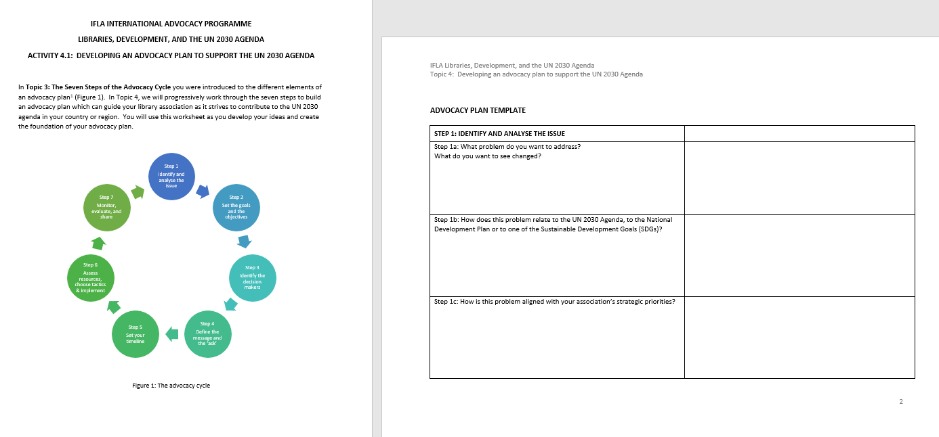
Activity 4.1 Developing an advocacy plan to support the UN 2030 Agenda: Worksheet

Slide 8
Activity 4.1 Developing an advocacy plan to support the UN 2030 Agenda
In your country or regional groups, you can work on turning your ideas into reality
Please make sure you have:
  The slides from Topic 3: The advocacy planning cycle
  Please refer to the notes to each step in the planning cycle
  Your own notes
  The Activity 4.1 worksheet
We will work progressively through the seven planning steps to enable to shape your ideas

Slide 9
Step 1: Identify and analyse the issue
Step 1a: What problem do you want to address?
What do you want to see changed?
Some library associations may want to be directly included as a partner on the committee working on the national development plan
Some library associations may need to take a different approach, and consider a problem relating to a specific issue, such as early childhood literacy
The problem area is likely to be quite different in different countries across the world, but it is likely to be of a socio-political nature

Slide 10
Step 1: Identify and analyse the issue, cont.
Step 1b: How does this problem relate to:
  The UN 2030 Agenda?
  The National Development Plan?
  One of the Sustainable Development Goals?
What is the context for the problem or issue?
At a high level, you may be seeking to ensure that libraries are visible in your country’s planning and reporting processes to the UN
At a lower level, you may be seeking to ensure that libraries contribute to the progress made towards one specific SDG, eg Goal 4 Quality education

Slide 11
Step 1: Identify and analyse the issue, cont.
Step 1c: How is this problem aligned with your association’s strategic priorities?
Does your association have:
  A vision and mission?
  A strategic plan?
  Specific goals or objectives?
  Particular values?
Your advocacy plan will have much more merit in the eyes of all stakeholders – members and decision makers – if you can clearly demonstrate that:
  It is aligned with the ‘core business’ of the association
  That is it is really obvious that the association should be actively working in this space

Slide 12
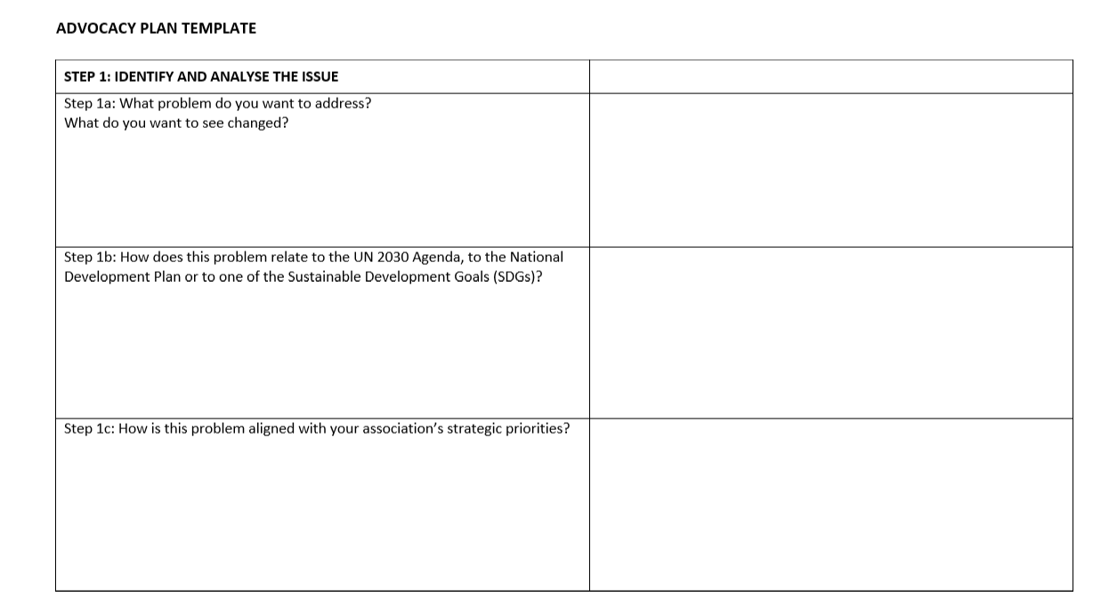
Take some time to shape your ideas and add them to the worksheet

Slide 13


Slide 14
Step 2: Set the goals and objectives
Step 2a: What is your ultimate goal?
Here you need to be more specific: what can you imagine actually happening?
Can you see yourselves sitting in regular meetings with the decision makers, discussing your country’s national development plan?
Are you really hoping to see a significant increase early childhood literacy rates?

Slide 15
Step 2: Set the goals and objectives, cont.
Step 2b: How does your actual goal contribute to the achievement of:
  The National Development Plan?
  The Sustainable Development Goals?
You began to think about this in Step 1…
Now you can be a bit more specific about how the library association and the library sector might fit into the mix
The association needs a seat at the table because of the work libraries do to ensure freedom of access to information
The library sector is already a key player in early literacy development, through the resources and programs it provides

Slide 16
Step 2: Set the goals and objectives, cont.
Step 2c: What specific objectives do you hope to achieve?
Can you break your main goal down into a few smaller objectives?
“To achieve our goal, we need to…”
You must make sure that these objectives contribute to your goal
Look back at what we discussed when we looked at Step 2 in Topic 3
Remember that your objectives must be SMART!
Can you think about milestones that map your progress?

Slide 17
Step 2: Set the goals and objectives, cont.
Step 2d: Who will have overarching responsibility for each objective?
Nothing will get done unless someone knows that it is their job to get it done!
For each objective, please think about who might be the best person to coordinate the activities relating to the different objectives
It may be an opportunity to ask some new people to get involved – they might be pleased to be asked!

Slide 18
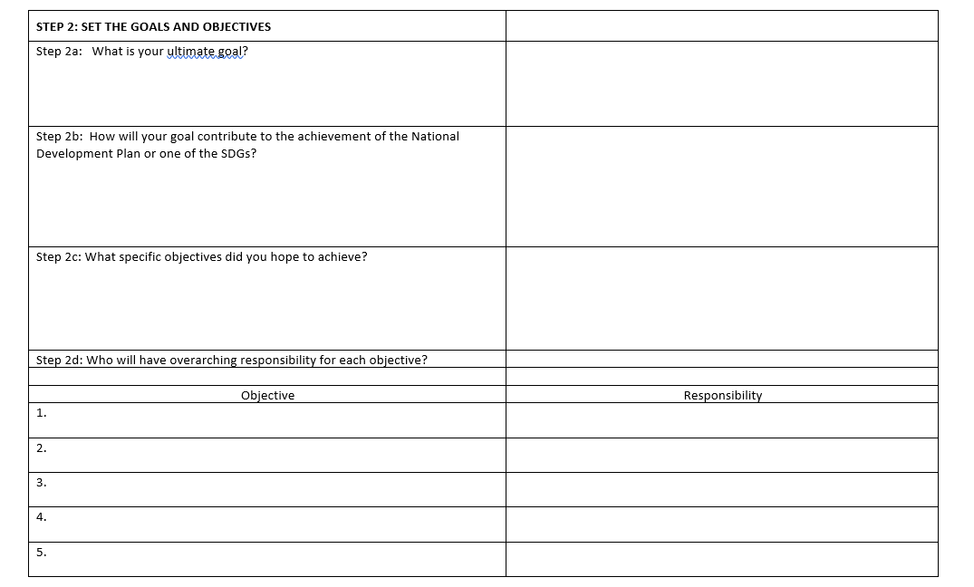
Work together on Step 2…

Slide 20
Step 3: Identify the decision makers
Step 3a: Who are the key stakeholders you will need to influence in order to see the change you wish to see, eg:
  In the national government?
  In local government?
  In NGOs?
  In community organisations?
This will probably require some research:
  You need to think first of all about which organisations will be the most relevant one
  Then you have to work out how to find about the people who work there, and the roles they play (or the other way round – find out about the key positions in the organisation and who hold that position

Slide 21
An example from Australia
[Trainers – can you introduce a local example?]
In Australia, responsibility for the UN 2030 Agenda activities sits within the Department of Foreign Affairs and Trade (DFAT)
The ministerial portfolios cover:
  Foreign affairs
  Trade
  Tourism
  International investment
  International development
  The Pacific region
The following screen shots show the complexity of identifying the relevant decision makers
And it will be different in every government!

Slide 22
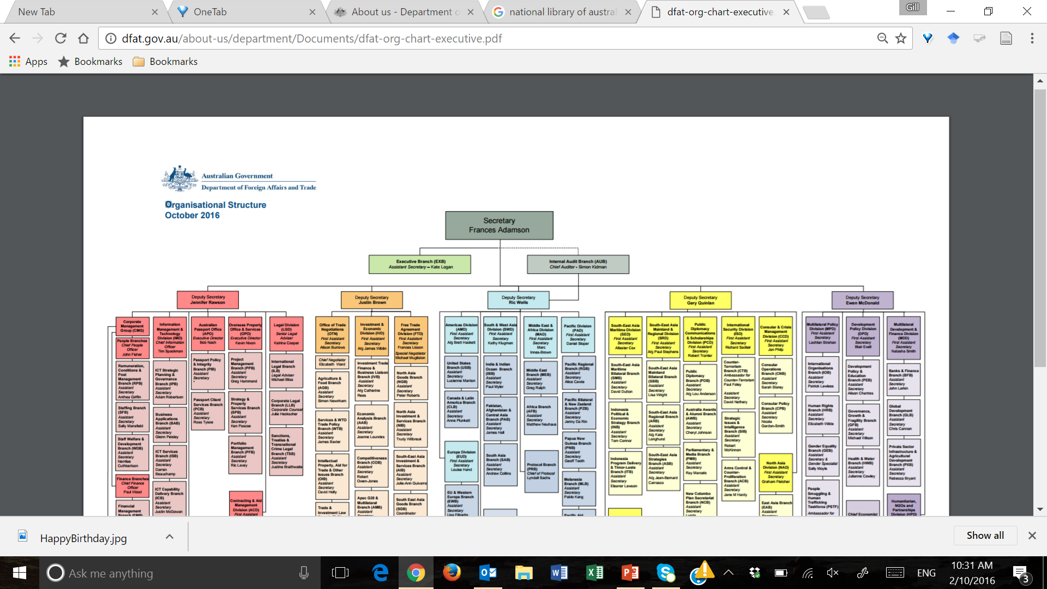
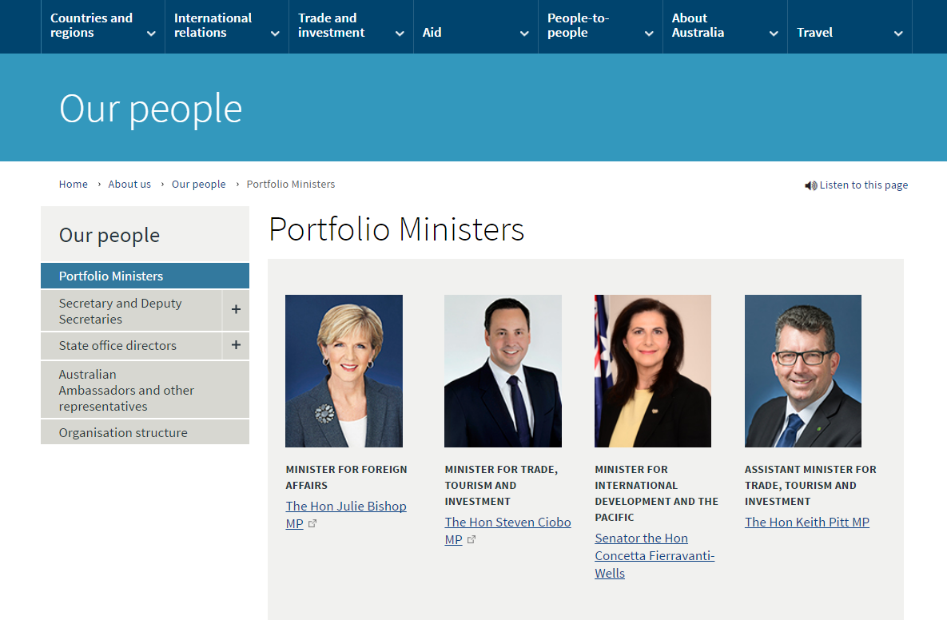

Slide 23
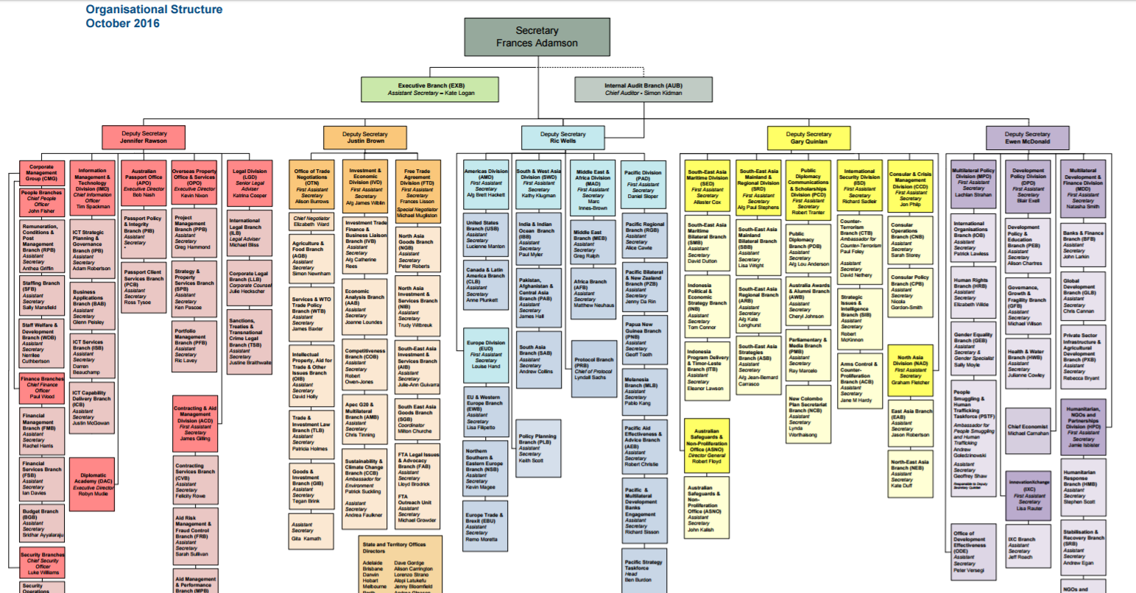

Slide 24
Development Policy

Slide 25
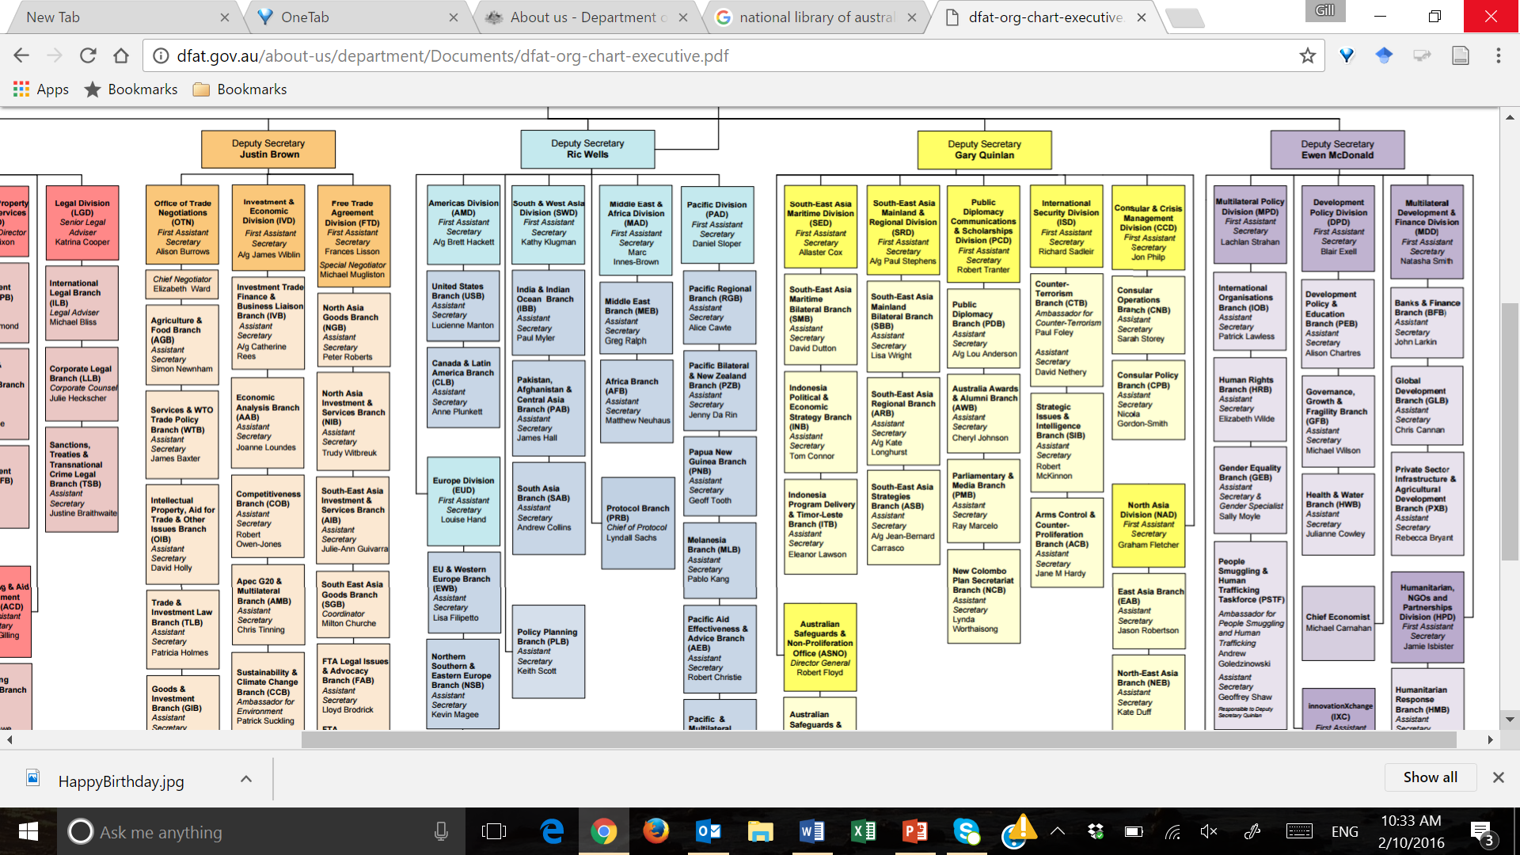
Development
Policy

Slide 26
Step 3: Identify the decision makers, cont.
Step 3b: How will your program help these stakeholders achieve their own goals in the context to the NDP or one of the SDGs?
One of your critical strategies will be that you want to make a proposal to the decision makers: how can you make life easier for them and help them achieve their own goals for their work relating to the UN 2030 Agenda?

Slide 27

Now – a bit of a change of pace
Image: http://blog.thefluffy.me/wp-content/uploads/2014/10/put-yourself-in-their-shoes.jpg

Slide 28
Activity 4.2 Meeting with policy makers
This is a role play activity
Full details of the activity are presented in the handout for Activity 4.2
The roleplay involves meetings with the Ministers:
  Minister for Culture
  Minister for Education
  Minister for National Development Planning
Your advocacy topic will need to be aligned with the Minister’s portfolio

Slide 30
Step 3: Identify the decision makers, cont.
Step 3c: Who else can you reach out to, collaborate or partner with, in order to achieve your objectives, eg:
  Board members
  Other library associations
  Consortia
  The national library
  Libraries across the sector
Your work will be much stronger if you can collaborate with other organisations who share similar goals
Think about potential partners, and where your interests overlap

Slide 31
Step 3: Identify the decision makers, cont.
Step 3d: How will you engage your local community and the public?
Your best allies may be close to home!
In Topic 2 you were thinking about how to raise awareness about the UN 2030 Agenda and the SDGs
Your advocacy plan will help you do this in a more focused way
Consider ways you could encourage certain sections of the community to get involved

Slide 32
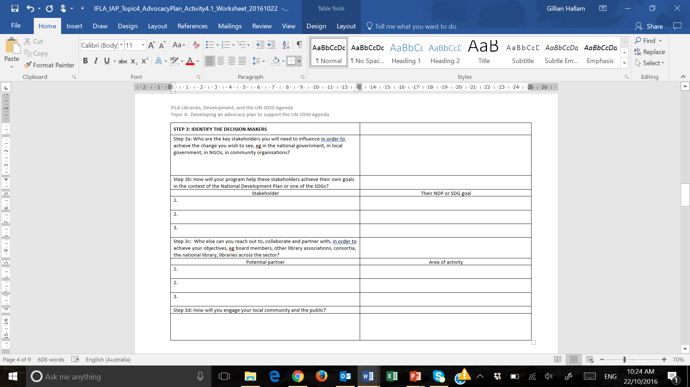
Over to the worksheet….

Slide 34
Step 4: Define your message and the proposal
Step 4a: What are the messages you will take to the stakeholders? What will your proposal be?
You will need to craft your messages carefully
Your proposal needs to be convincing: to state clearly what needs to happen and the change you wish to see
Is your message concise, and tailored to the specific decision maker and the target audience you want to reach?
Think carefully about the language you use – translate your ideas into the idiom of your audience
  Government officials don’t use ‘library language’ ☺
How will your message:
  Resonate with the decision maker’s own values?
  Help overcome obstacles to change?
  Motivate the decision maker into action?

Slide 35
Step 4: Define your message and the proposal, cont.
Step 4b: What evidence do you have to support your proposal?
You don’t want to use motherhood statements – you need powerful evidence about the issue and how change is achievable

Slide 36
Drafting a letter to the decision maker
It is important that you are able to write a letter which will be noticed by the decision maker – and most likely his or her staff who manage the correspondence received
For guidance on writing letters to people of influence, please see:
  IFLA Toolkit: Libraries and implementation of the UN 2030 Agenda
  Programme Manual for the IAP workshop

Slide 37
Preparing a brief for policy makers
Present evidence of the problem, preferably from a variety of credible sources
Briefly summarise the existing situation or policy environment, and explain why it is insufficient or inadequate
Provide a clear outline of your proposal to change policy and explain what it would achieve
Focus on the social costs, as well as the monetary costs, of your proposal

Slide 38
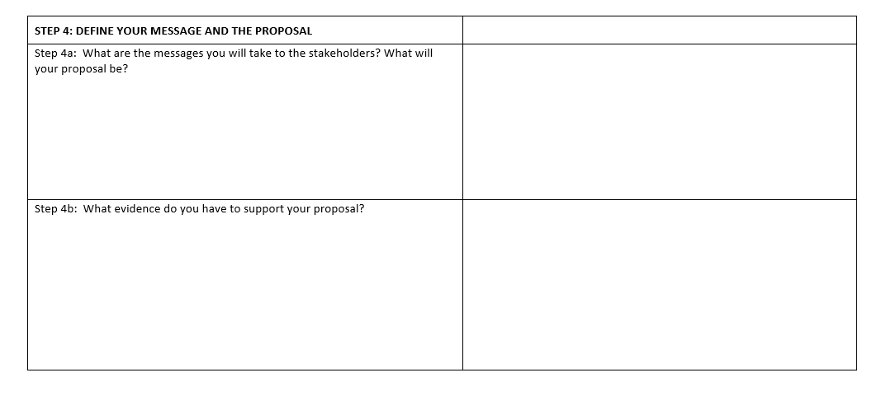
Spend some time thinking about your messages

Slide 40
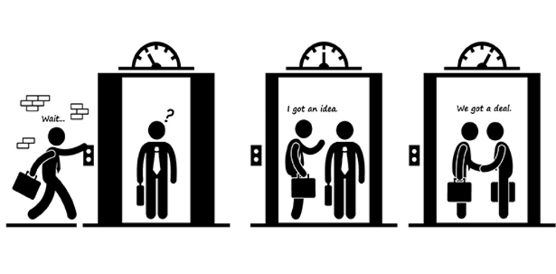
The elevator pitch
Image: http://www.monkfeet.com/cdn/20150129/c_112_1422544729_l.jpg

Slide 41
Activity 4.3 Making an elevator pitch
An elevator pitch is a short, snappy presentation to a person of influence, who may be in the lift with you or at a function you are attending
You only have the small window of opportunity to have your message heard – so it must be quick and to the point
The handout for Activity 4.3 provides all the details for this exercise

Slide 43
Step 5: Set your timelines
Step 5a: What do you have to consider in terms of the timelines for your advocacy activities?
When will be the ‘right’ time?
What is the overall timeframe for your activities?
Can you identify different stages for your activities?
Are these directly aligned with the milestones towards the achievement of your objectives?

Slide 44
Step 5: Set your timelines, cont.
Step 5b: What challenges might you face when you are working with these timelines?
Risk management is important! Your suggested timelines may be overly ambitious – or there may be some stumbling blocks along the way
It’s a good idea to think creatively about what could happen, and about some workarounds to get back on track

Slide 45
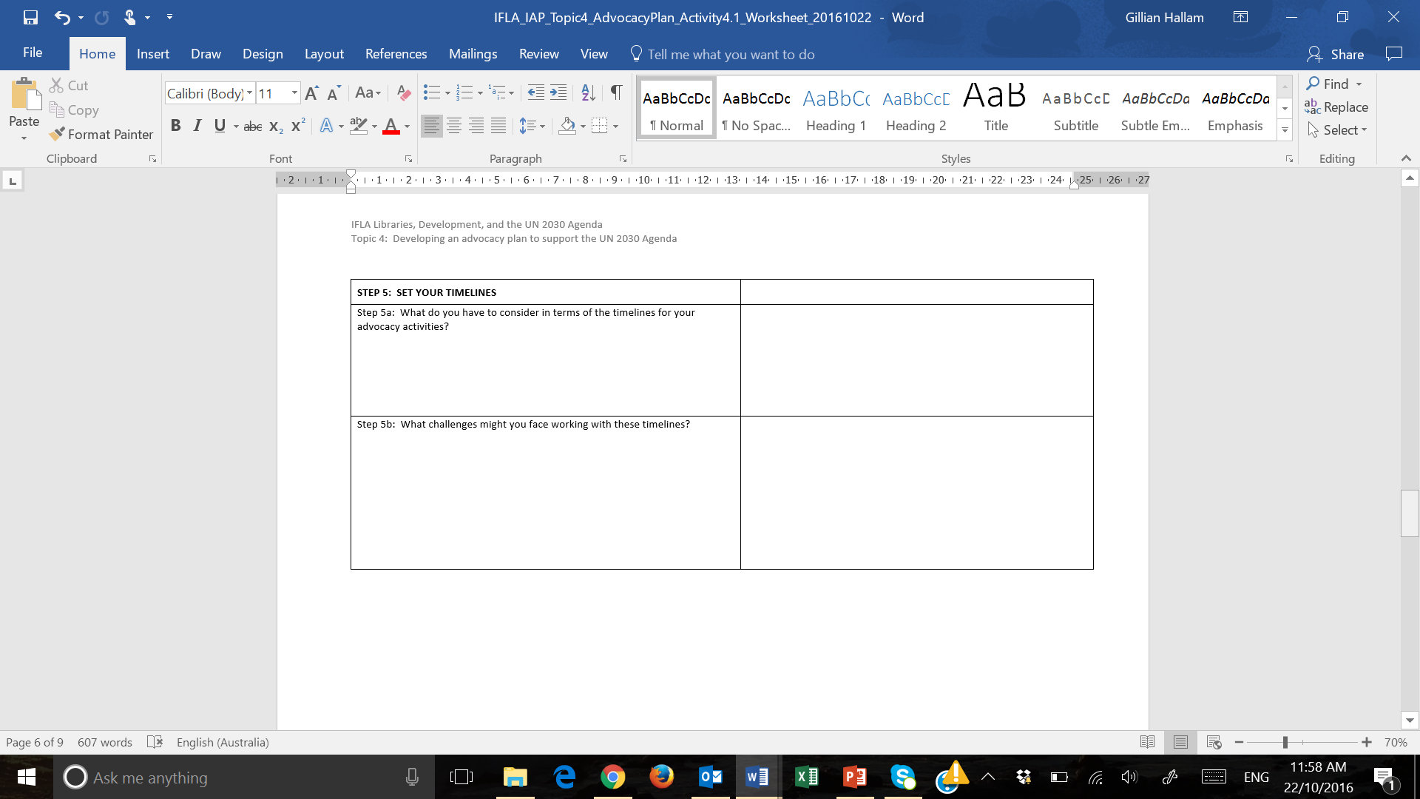
Add some of your ideas to the worksheet

Slide 46
Step 6: Assess resources, choose tactics and implement
Step 6a: What resources will you need for your advocacy activities?
  Human resources: who will be in your team?
  Financial resources: what sort of funding will you need?
  Material resources: What additional resources will you need? Is there any in-kind support you can draw on?
  Information resources: What research will you need to undertake?
Careful planning at this point will really contribute to ensuring that your activities are realistic, meaningful and achievable

Slide 47
Step 6: Assess resources, choose tactics and implement, cont.
Step 6b: What will be your strategies?
  What tactics will you use to achieve your objectives?
  Who will be responsible?
  What are your timelines?
This is the real action plan – you need to work out, for each of your objectives, what you are actually going to do
This step goes hand in hand with Step 6a – what resources you need to accomplish the tasks, so you can work through Step 6a and Step 6b in tandem

Slide 48
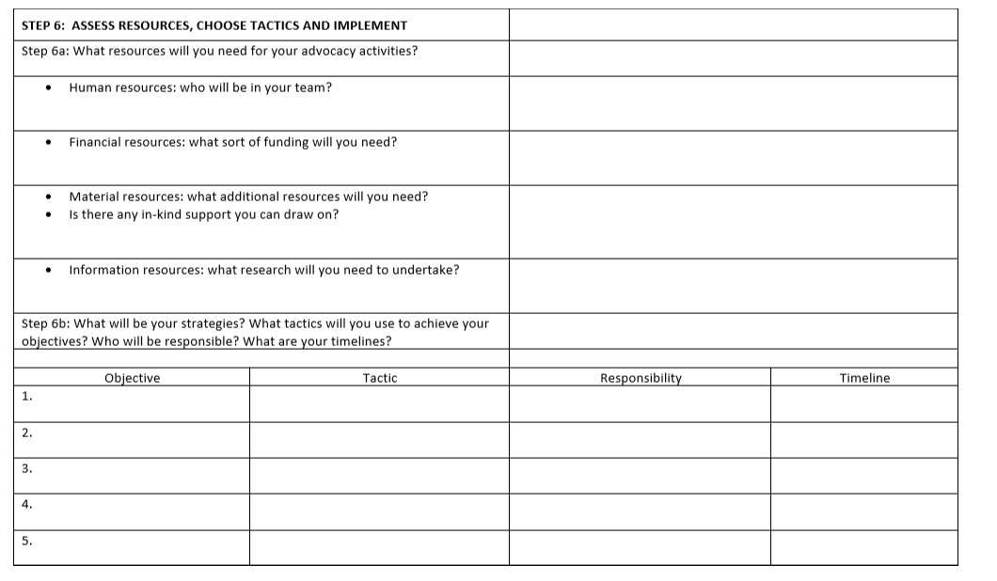
Begin to capture some of your ideas

Slide 50
Step 6: Assess resources, choose tactics and implement, cont.
Step 6c: What is your communications plan?
How will you communicate your activities to the diverse stakeholders?
People will want to know about what you are doing
  Your planning
  The actual activities and events
Think about ways to communicate with your different audiences
  What are the expected – or their preferred – channels of communication?
  How often do you need to communicate with them?
  Who will be responsible for doing it all?

Slide 51
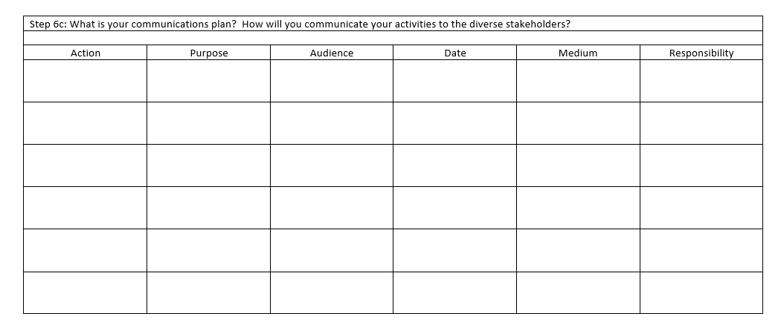
Back to the worksheet!

Slide 53
Step 7: Monitor, evaluate and share
Step 7a: How will you know whether you have been successful?
This closes the loop…
What were your goals and objectives?
To what extent did you achieve them?
Did you get part of the way there?

Slide 54
Step 7: Monitor, evaluate and share, cont.
Step 7b: What data will you collect about your advocacy activities?
  Quantitative data: facts and figures
  Qualitative data: the compelling stories
You need to plan ahead about what sort of data you will need, and how you will collect this
You need to know you are heading in the right direction and using your resources appropriately, or whether you need to adjust your strategies because the changing environment

Slide 55
Step 7: Monitor, evaluate and share, cont.
Step 7c: How will you disseminate information about your achievements?
This is linked back to your communications plan in Step 6c
Will you need to draft a final report for your stakeholders?
How will you work with the media?

Slide 56

Step 7: Monitor, evaluate and share, cont.
Step 7d: How will you celebrate the successful outcomes?
Can your successful outcomes
be a spring board for further
funding and support?

Slide 57
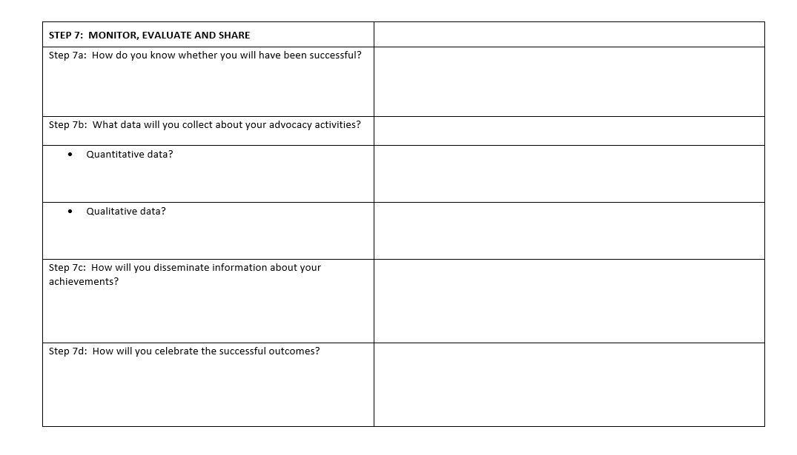
Make a note of all your ideas

Slide 59
Well – what does your plan look like?
1
2
3
4
5
6
7
  Step 1: Identify and analyse the issue
    What problem do you want to address?
  Step 2: Set the goal and the objectives
    What do you want to achieve?
  Step 3: Identify the decision makers
    Who do you need to influence?
  Step 4: Define the message and your proposal
    What is the focus of your campaign?
  Step 5: Set your timeline
    When should you do it?
  Step 6: Assess resources, choose tactics & implement
    How will you do it?
  Step 7: Monitor, evaluate, and share
    How will you measure success?

Slide 60
Activity 4.4 The summary of your advocacy plan
You have all been working progressively through the seven steps of the advocacy planning cycle, discussing various aspects along the way.
Now is the time to spend some time working with your partner to summarise what you have in your plan
  To tell the other participants what you want to see happen, and how you aim to achieve this goal
  To report back to your association and your professional colleagues when you return home
Spend a few minutes collating your information, to prepare and present a 5 minute summary

Slide 62
Summary
Well done! You have all worked so hard!
You have progressively developed your draft advocacy plan which you can share with people when you get home
Remember it is a draft… you should reflect on it, discuss it, and consider ways to improve it further
You have thought analytically and creatively about the issues you would like to see addressed and the change you would like to see happen
You can hopefully see a way forward to ensure that libraries are indeed contributing actively to the UN 2030 Agenda

Slide 63
Topic 5: IFLA IAP funding proposal
[Information to be added]

Slide 64

Topic 6: Understanding the resources available to support advocacy
Resources to help you:
IFLA resources…
UN resources…
NGO resources…
Corporate resources…
Image: https://letztalkbiz.ca

