Slide 1
Starting Point
Report on baseline data from membership survey for evaluating success of IFLA’s 2024-2029 Strategy

Slide 2
Introduction

Slide 3
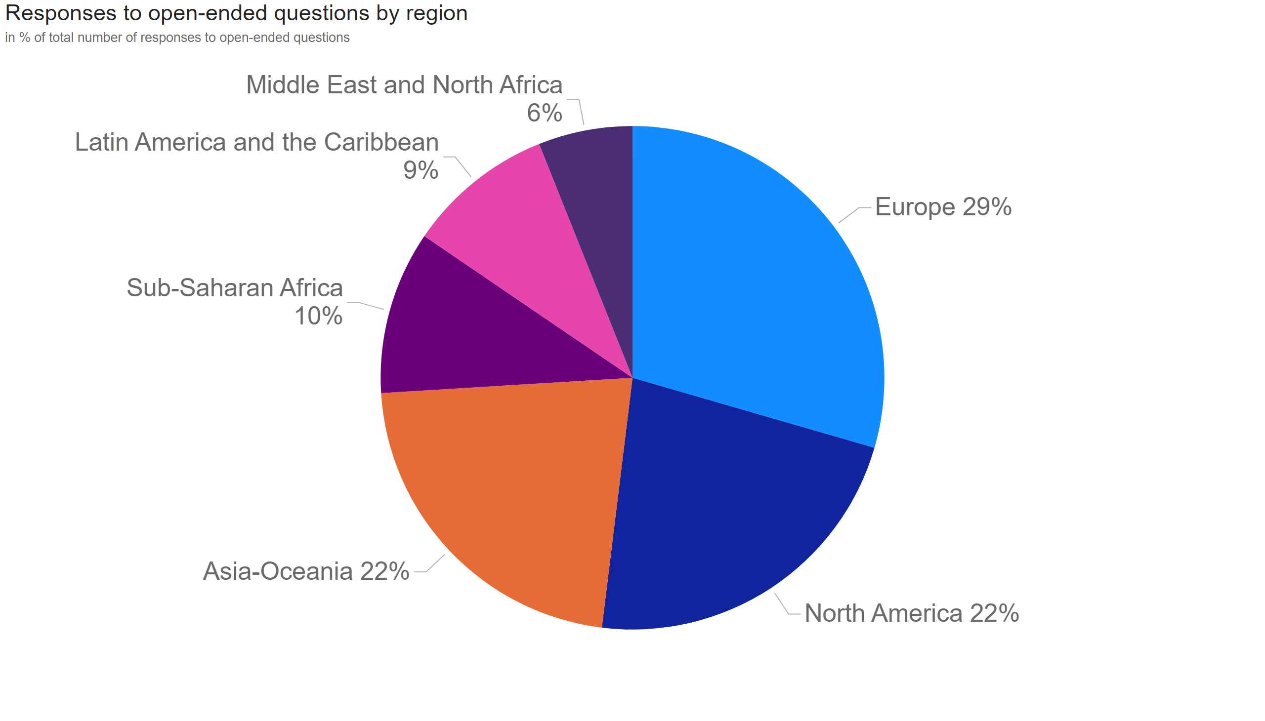
Totals
Notes:
Responses to open-ended questions by region

Slide 4
Membership value, benefits, satisfaction and loyalty

Slide 5
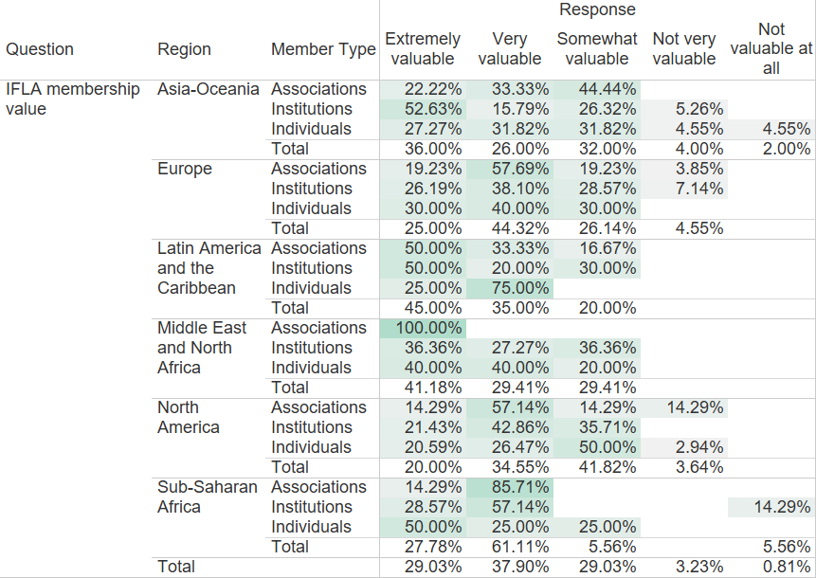
Notes:
How valuable do you find your IFLA membership?

Slide 6
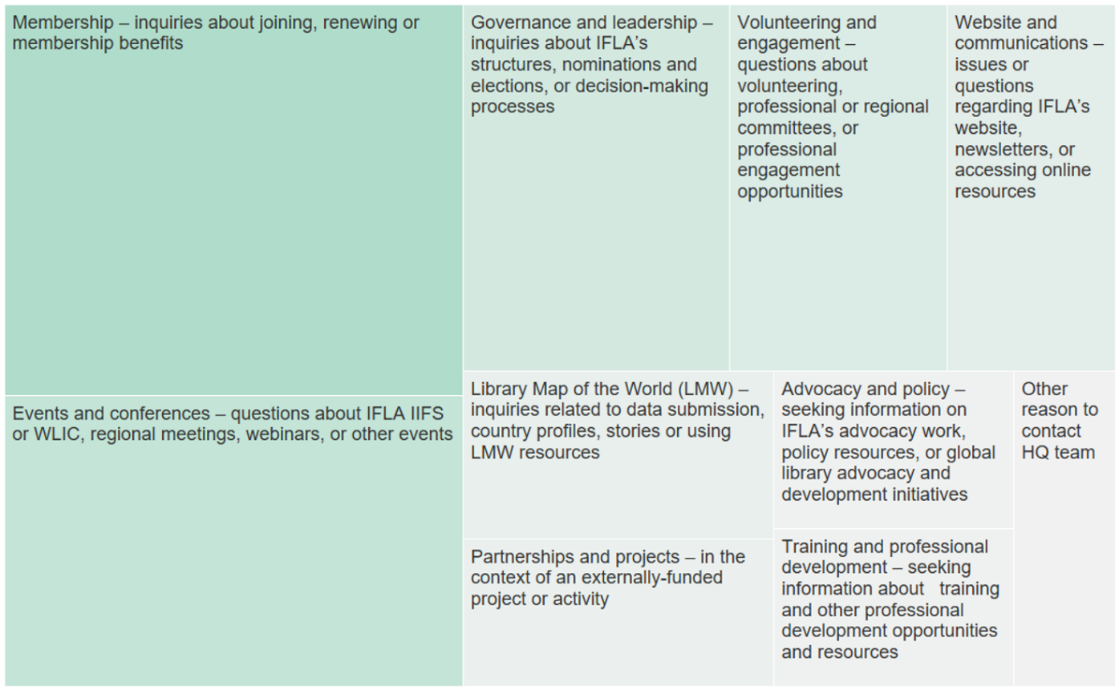
Notes:
Which of the following benefits have you found most valuable as a member?

Slide 7
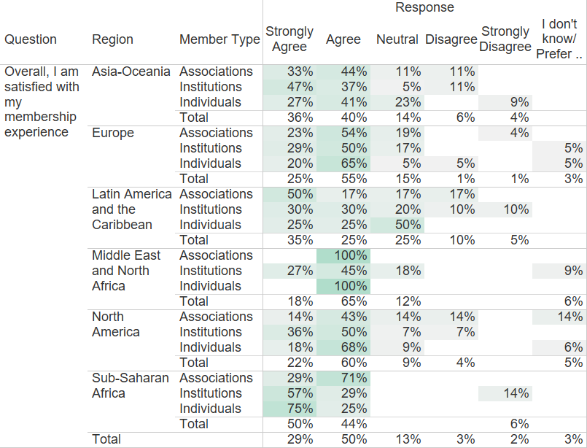
Notes:
To what extent do you agree with these statements? Overall, I am satisfied with my membership experience.

Slide 8
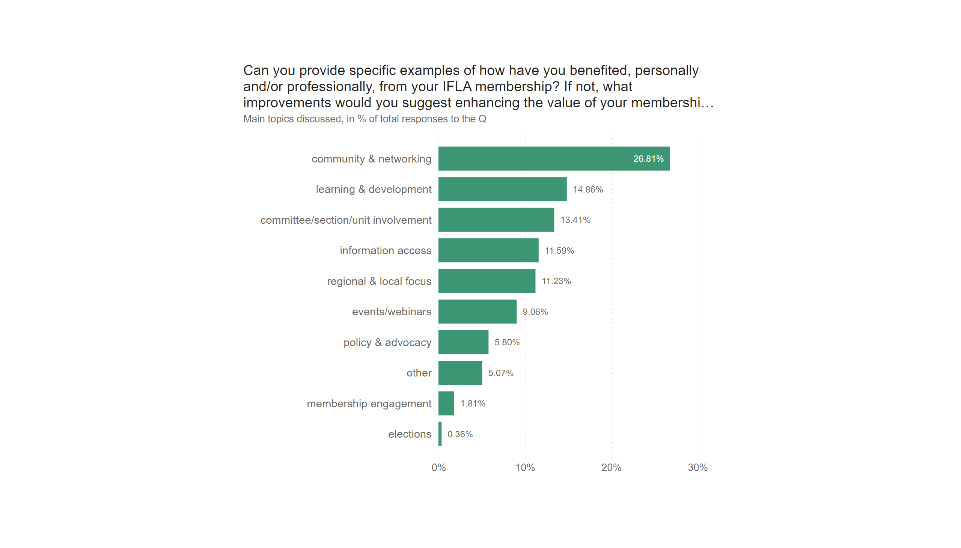
Page 4
Notes:
Can you provide specific examples of how have you benefited, personally and/or professionally, from your IFLA membership? If not, what improvements would you suggest enhancing the value of your membership?

Slide 9
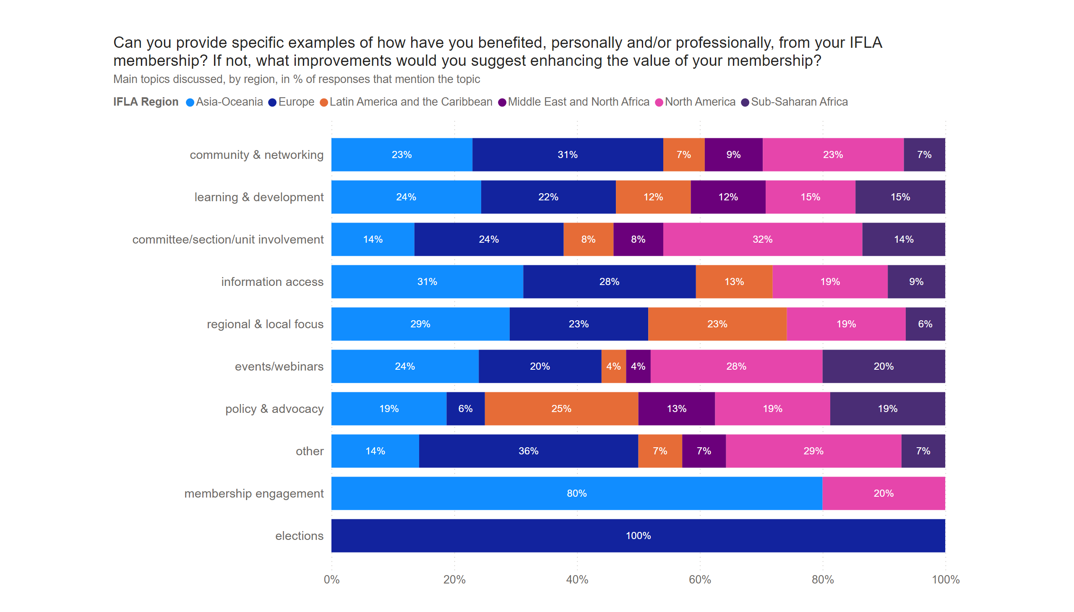
Page 8
Notes:
Can you provide specific examples of how have you benefited, personally and/or professionally, from your IFLA membership? If not, what improvements would you suggest enhancing the value of your membership?

Slide 10
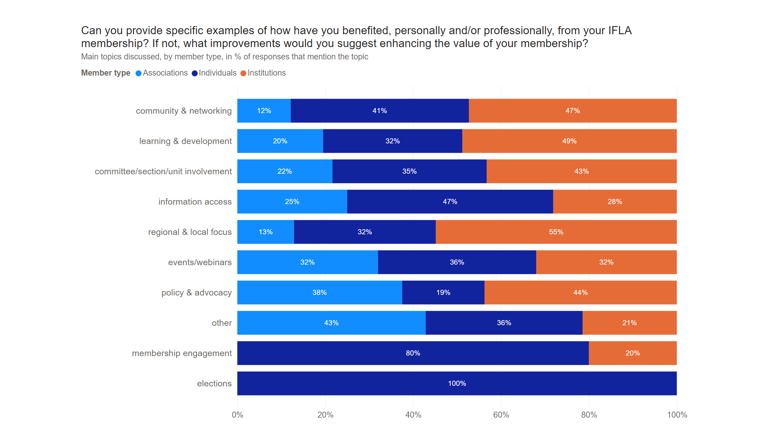
Page 9
Notes:
Can you provide specific examples of how have you benefited, personally and/or professionally, from your IFLA membership? If not, what improvements would you suggest enhancing the value of your membership?

Slide 11
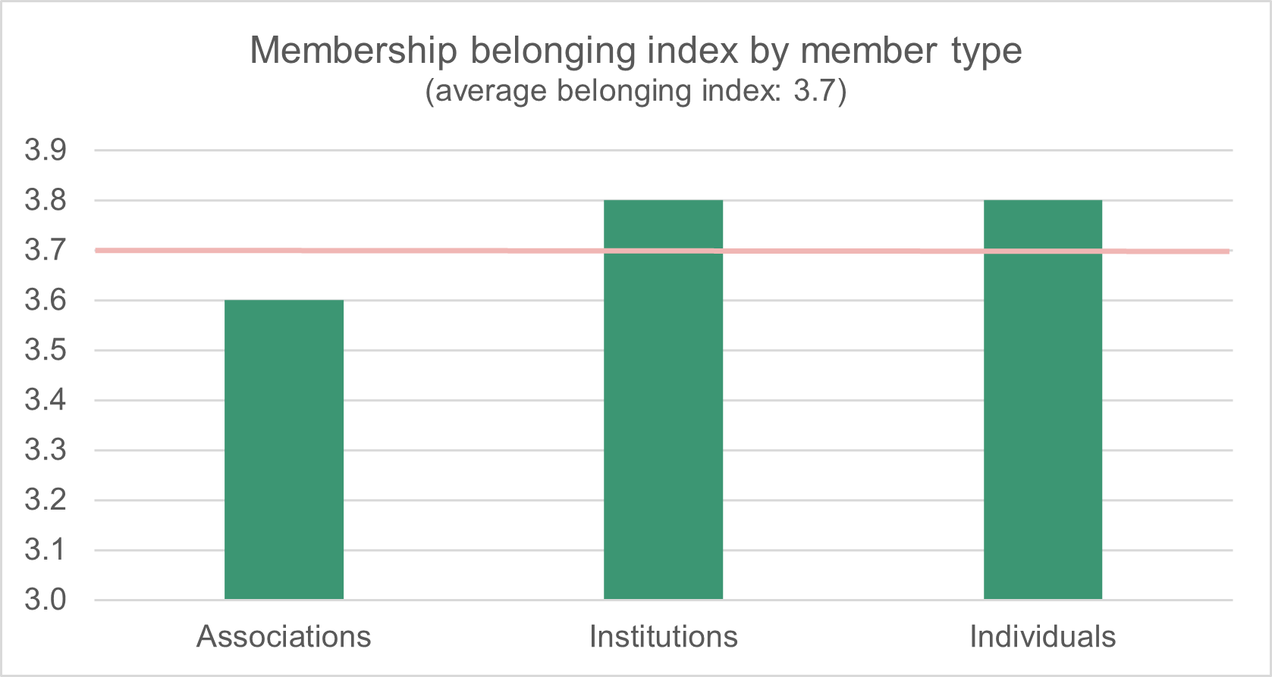
Notes:
To what extent do you agree with these statements? I feel a strong sense of belonging to IFLA

Slide 12
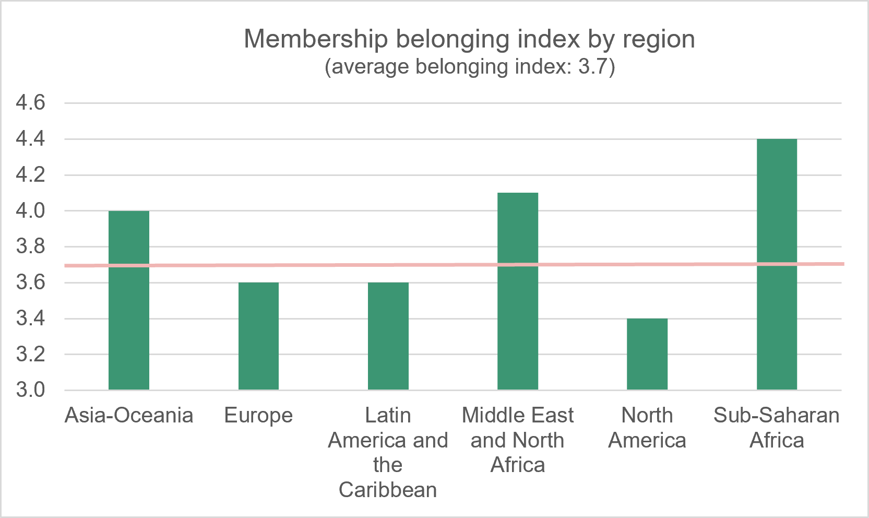
Notes:
To what extent do you agree with these statements? I feel a strong sense of belonging to IFLA

Slide 13
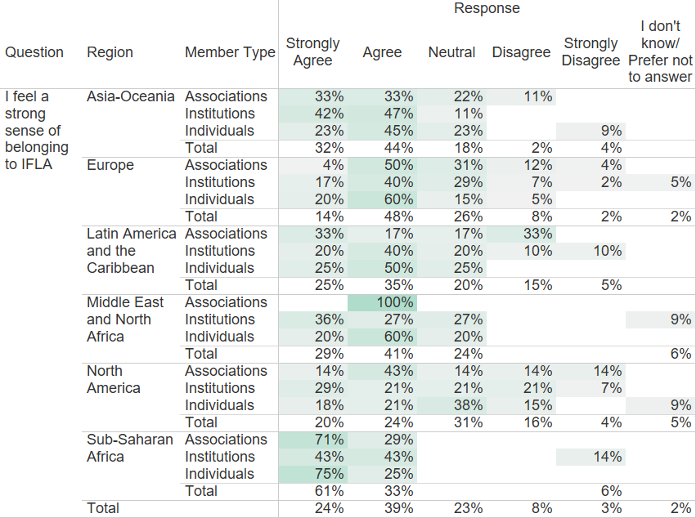
Notes:
To what extent do you agree with these statements? I feel a strong sense of belonging to IFLA

Slide 14
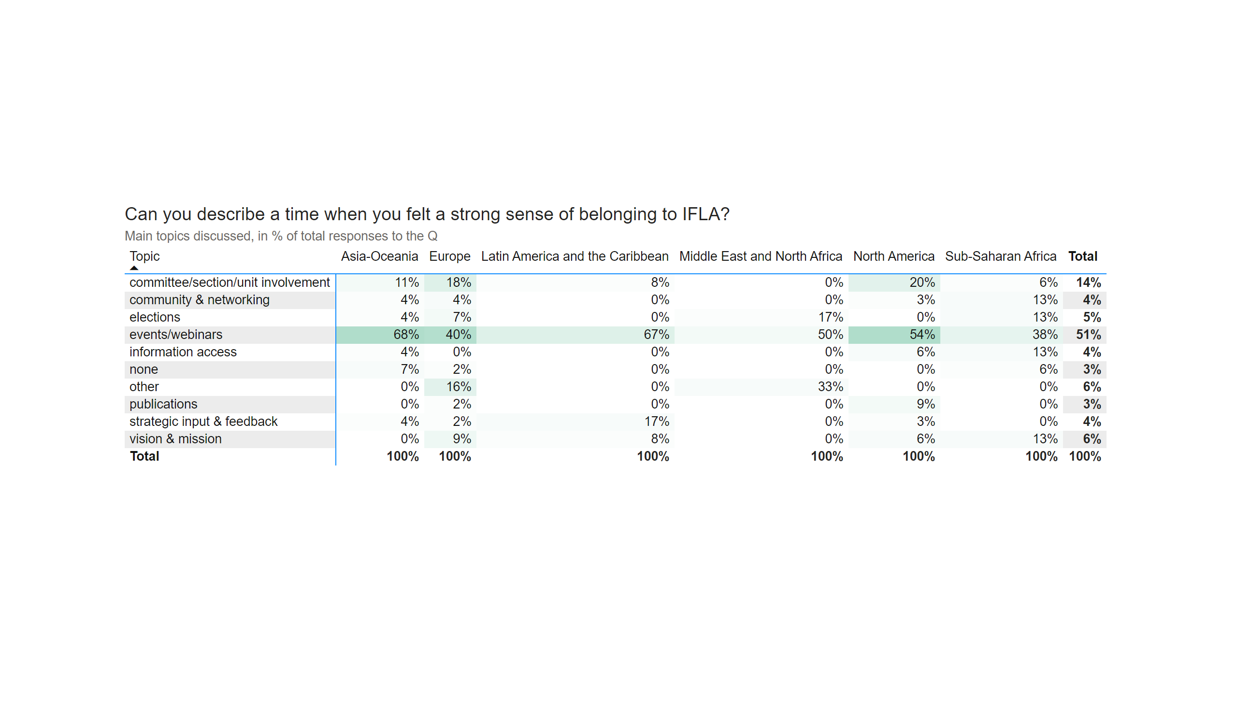
Page 5
Notes:
Can you describe a time when you felt a strong sense of belonging to IFLA?

Slide 15
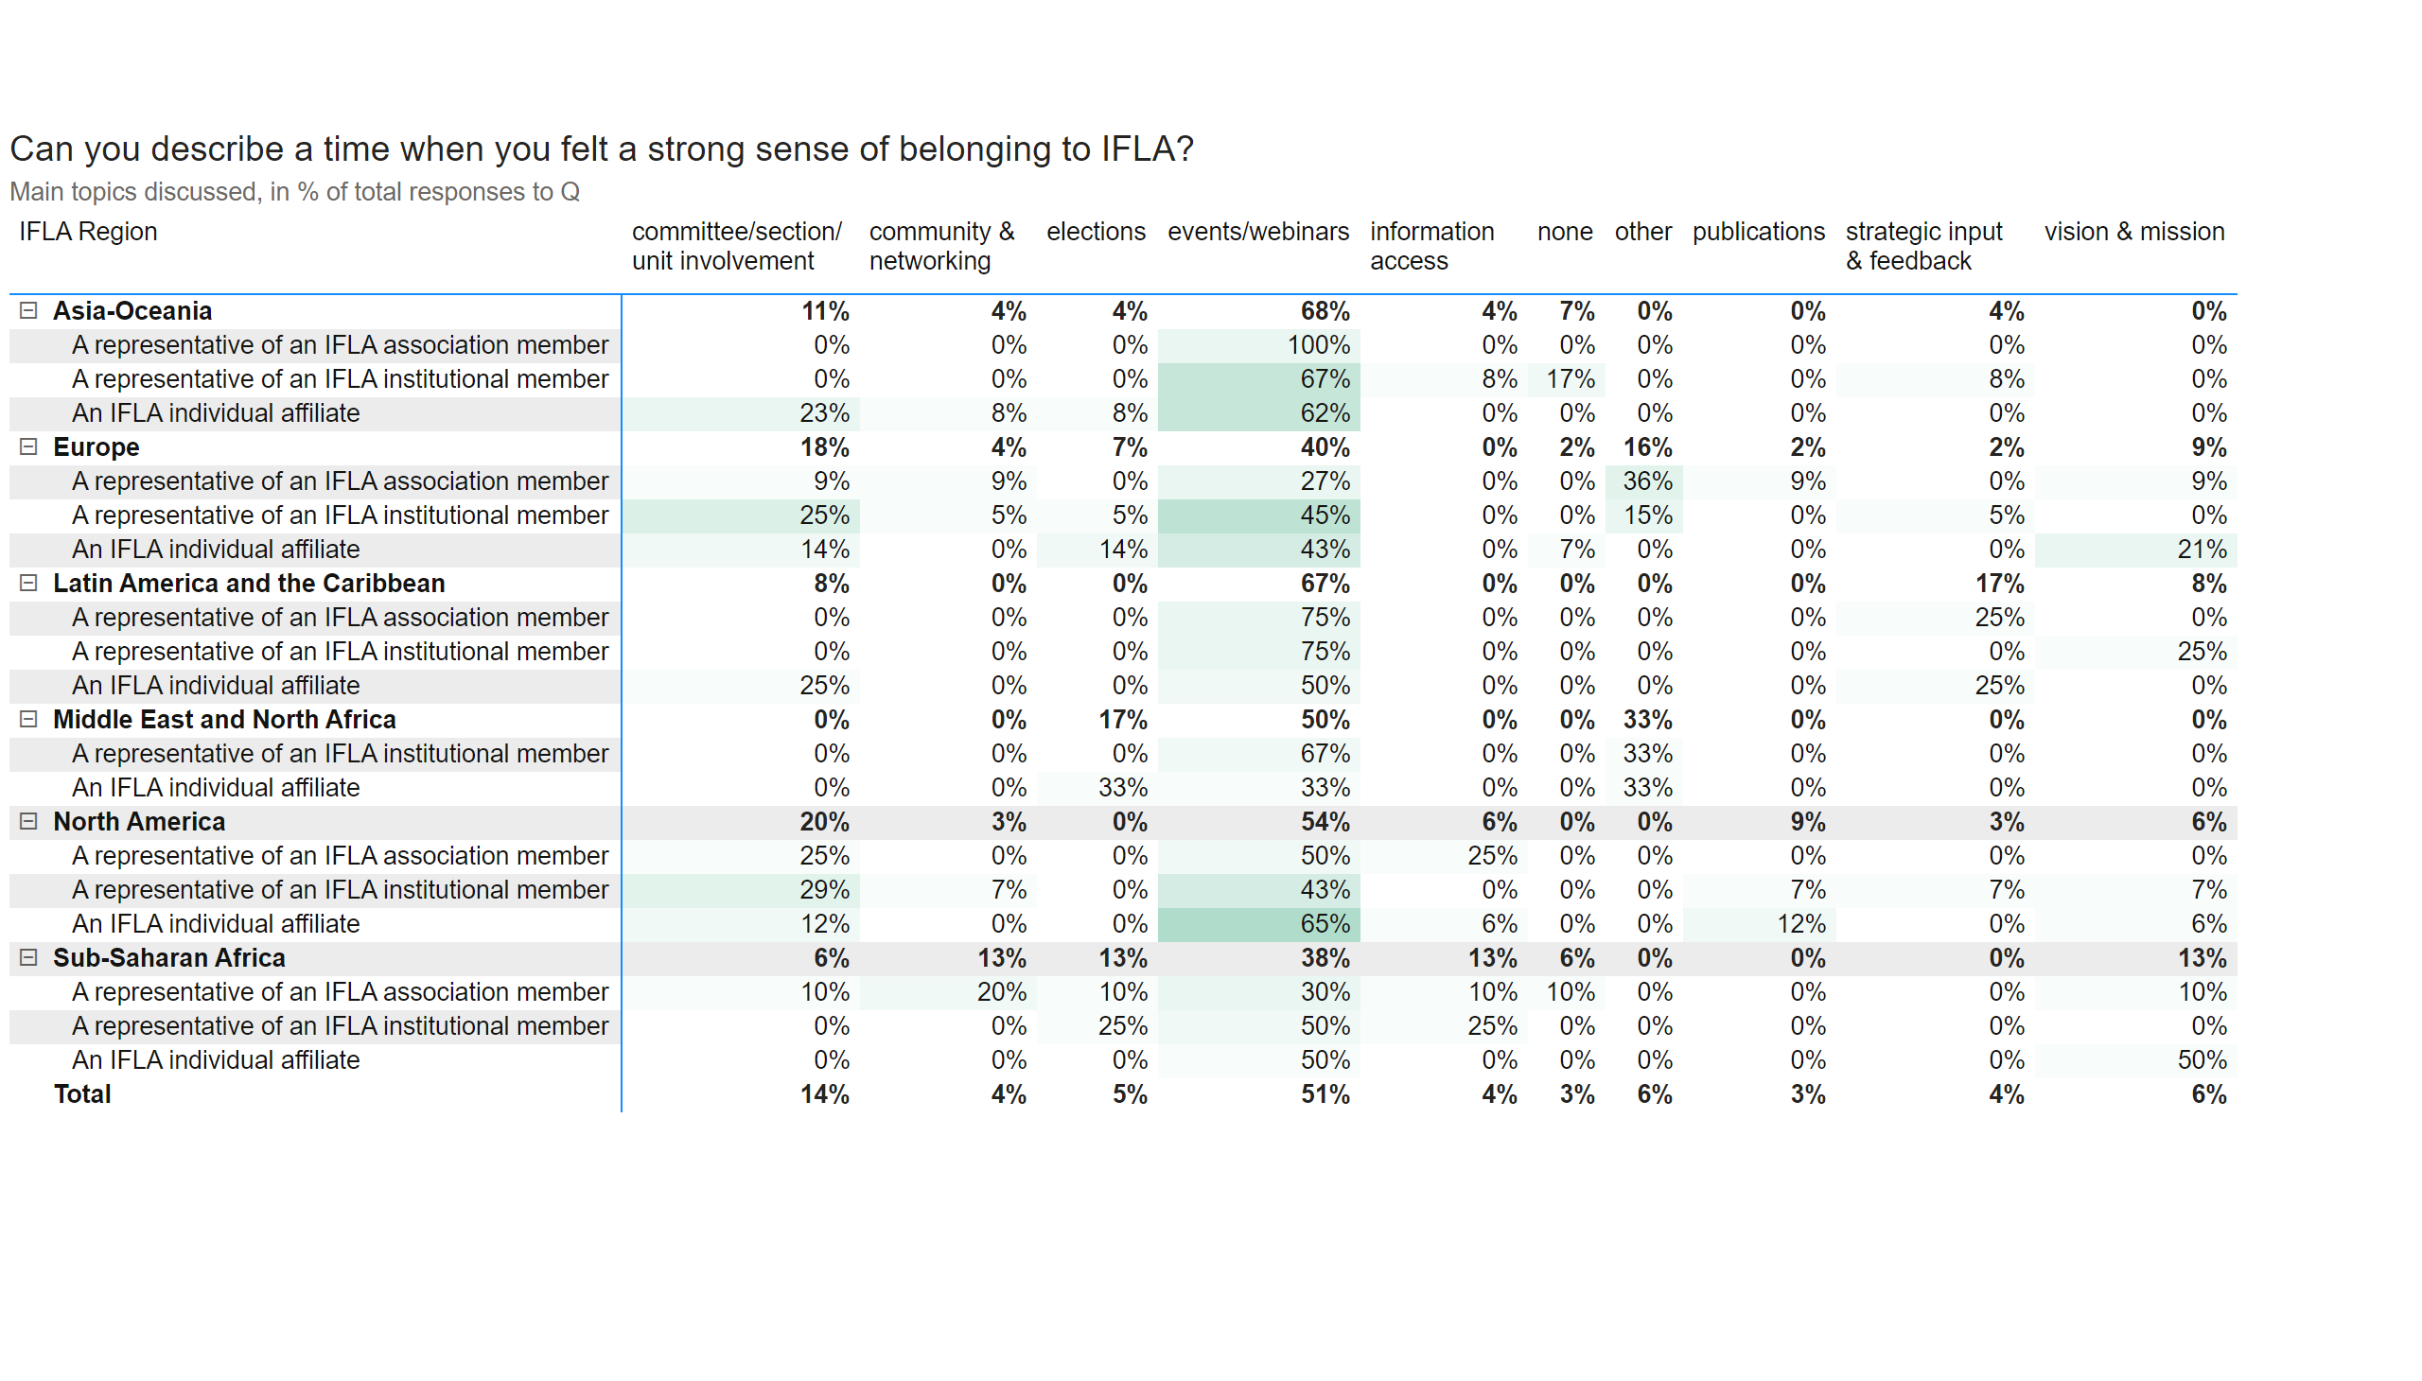
Q6 extended for export
Notes:
Can you describe a time when you felt a strong sense of belonging to IFLA?

Slide 16
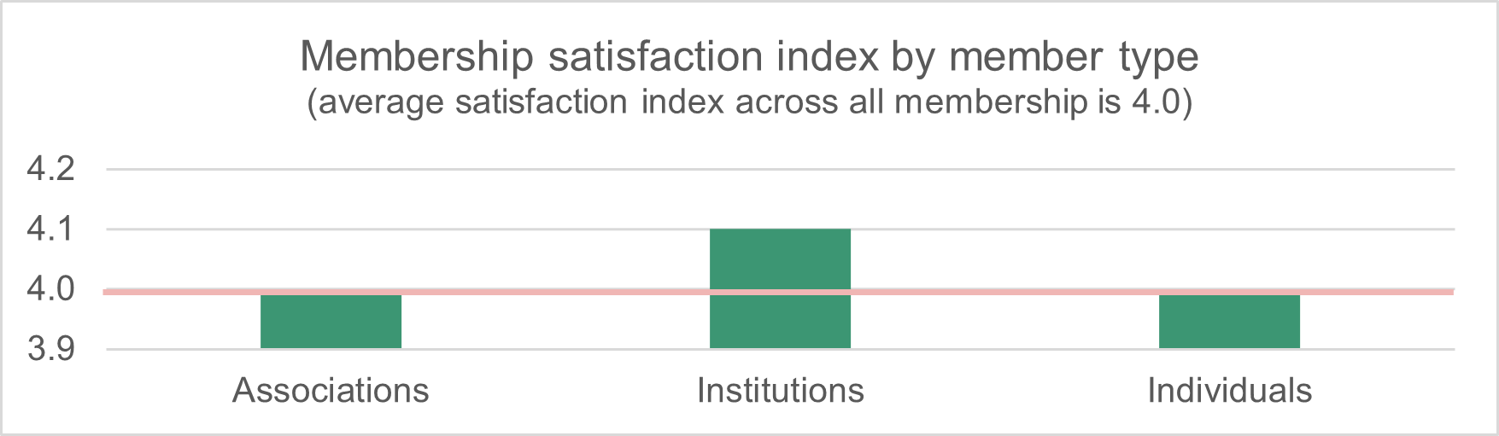
Notes:
Overall, I am satisfied with my membership experience.
The membership satisfaction index is calculated as a weighted average based on Likert-scale values, where responses are assigned scores from 5 (Strongly Agree) to 1 (Strongly Disagree). Responses marked as 'I don’t know/Prefer not to answer' are excluded from the calculation.

Slide 17
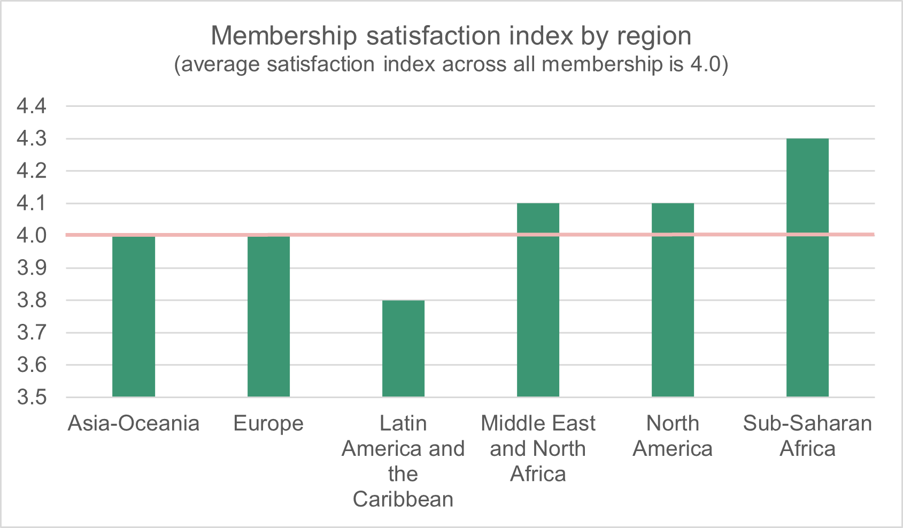
Notes:
Overall, I am satisfied with my membership experience.
The membership satisfaction rate is calculated as a weighted average based on Likert-scale values, where responses are assigned scores from 5 (Strongly Agree) to 1 (Strongly Disagree). Responses marked as 'I don’t know/Prefer not to answer' are excluded from the calculation.

Slide 18
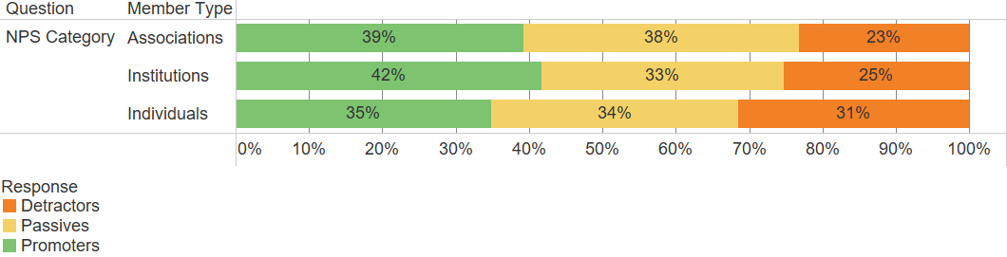
Notes:
On a scale of 0 to 10, how likely are you to recommend IFLA membership to a friend or colleague? NPS distribution (Promoters, Passives, Detractors) among member types

Slide 19
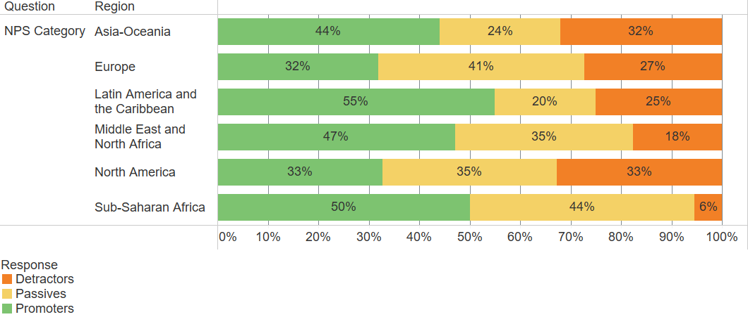
Notes:
On a scale of 0 to 10, how likely are you to recommend IFLA membership to a friend or colleague? NPS distribution (Promoters, Passives, Detractors) among regions

Slide 20
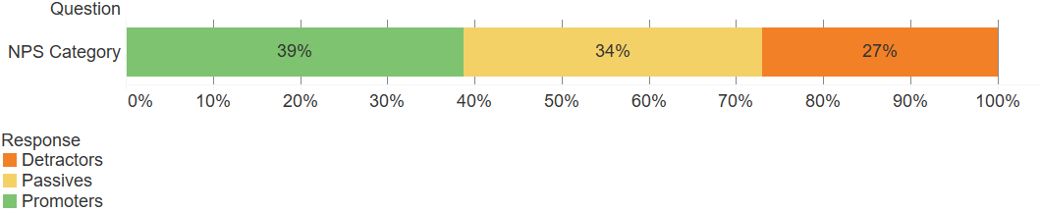
Notes:
On a scale of 0 to 10, how likely are you to recommend IFLA membership to a friend or colleague? NPS distribution (Promoters, Passives, Detractors) in total

Slide 21
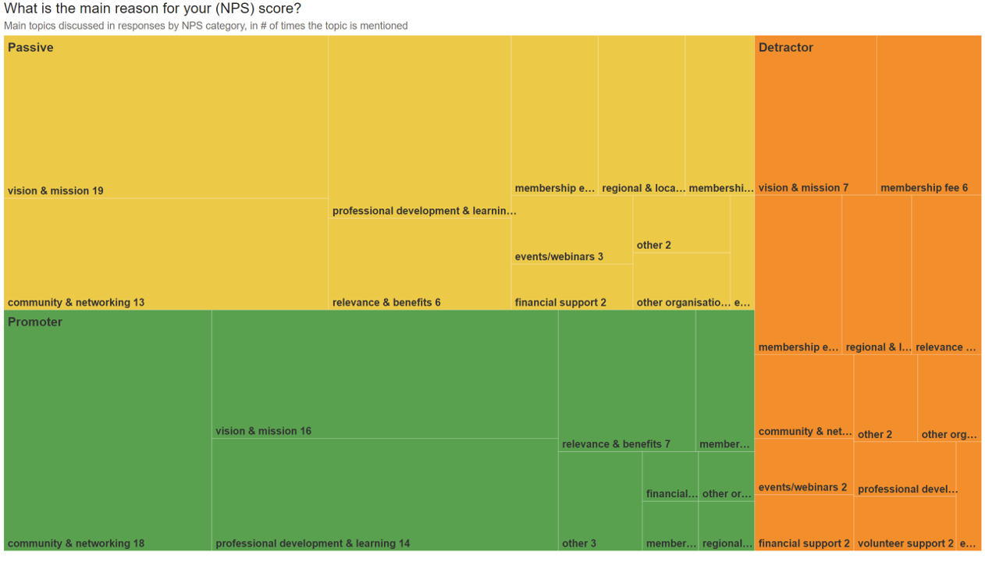
Notes:
What is the main reason for your (NPS) score?

Slide 22
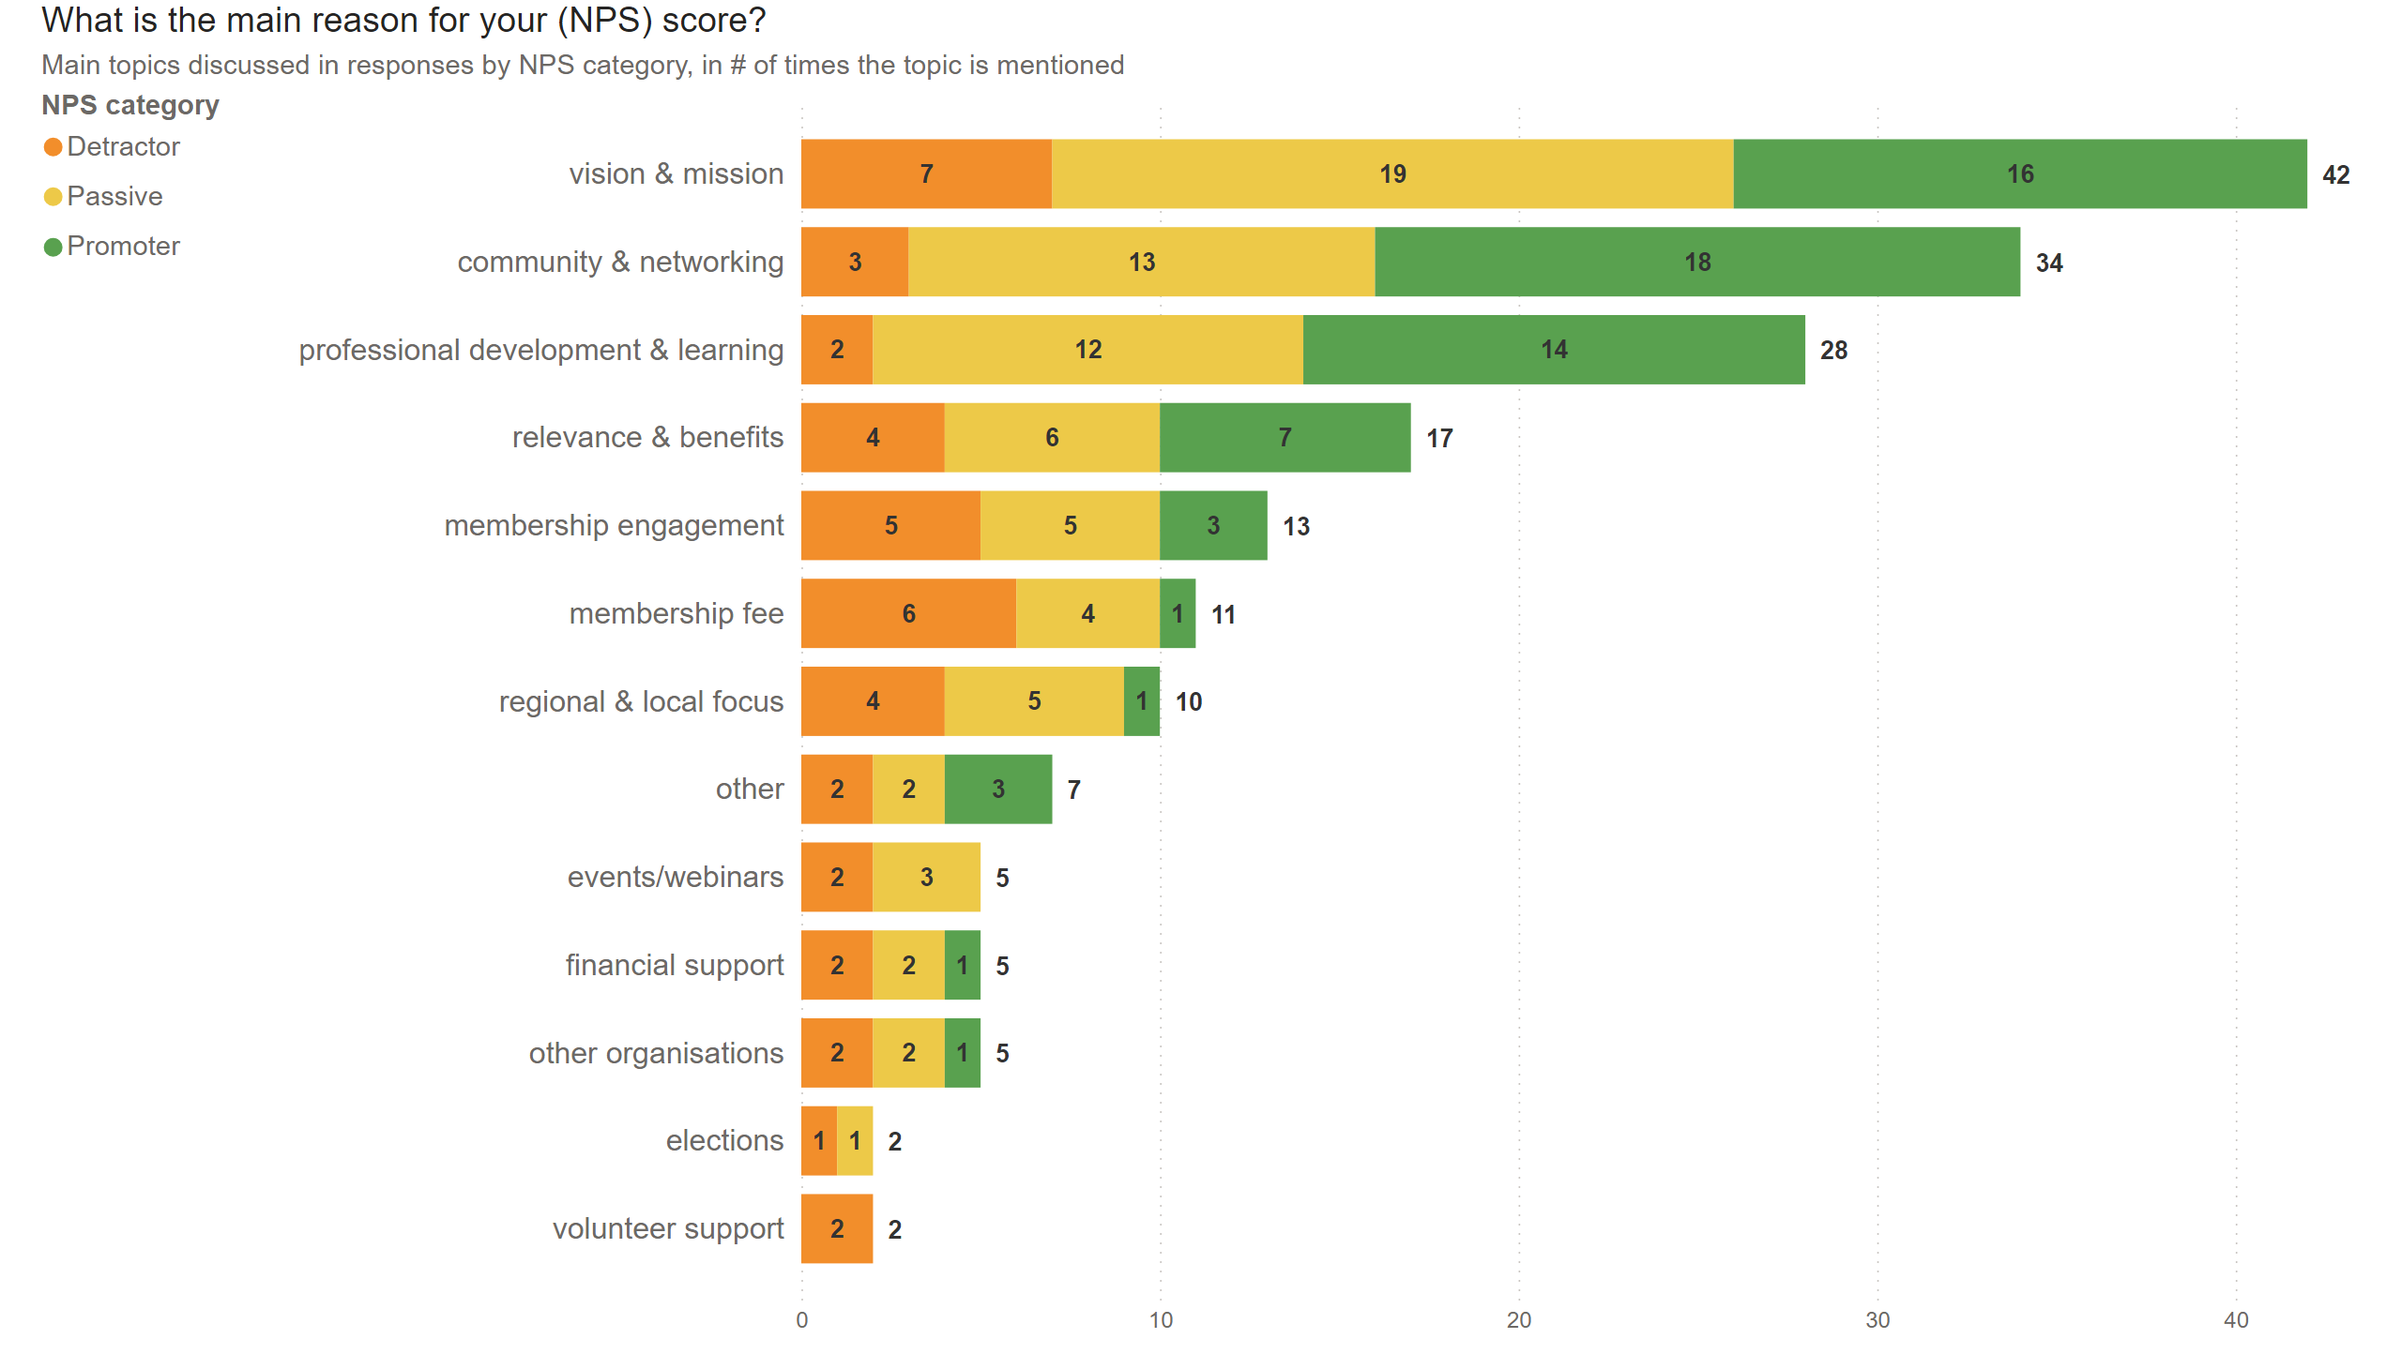
Duplicate of Q7 (3)
Notes:
What is the main reason for your (NPS) score?

Slide 23
Awareness and use of resources

Slide 24
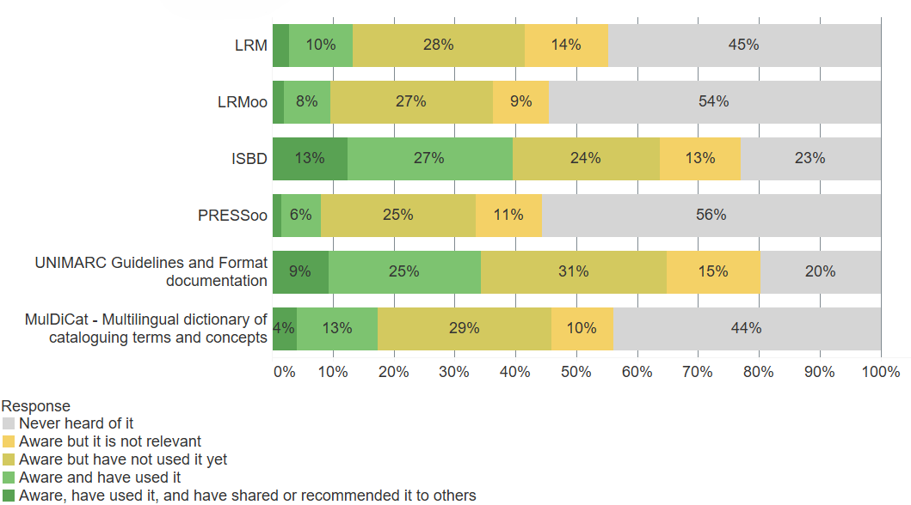
Notes:
How familiar are you with these IFLA technical/metadata standards?

Slide 25
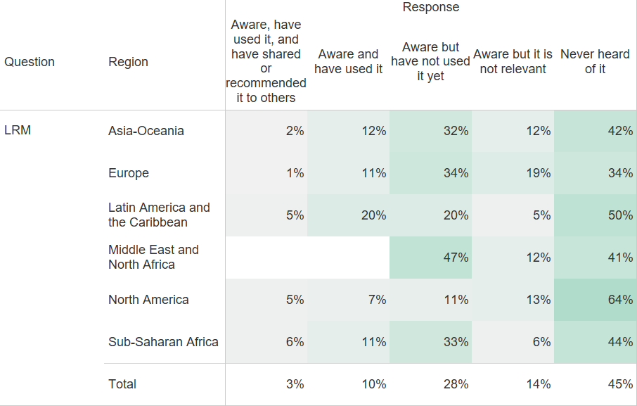
Notes:
How familiar are you with these IFLA technical/metadata standards?
LRM

Slide 26
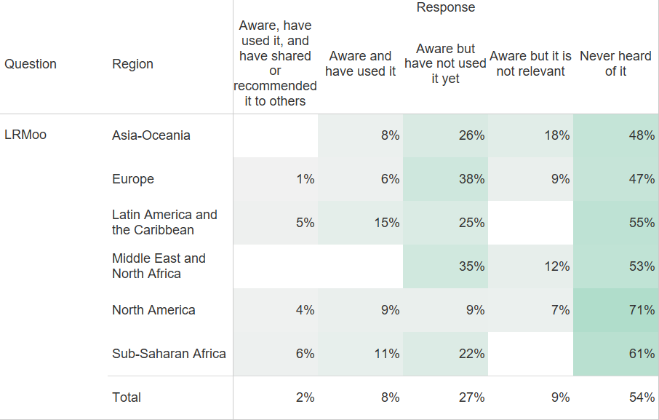
Notes:
How familiar are you with these IFLA technical/metadata standards?
LRMoo

Slide 27
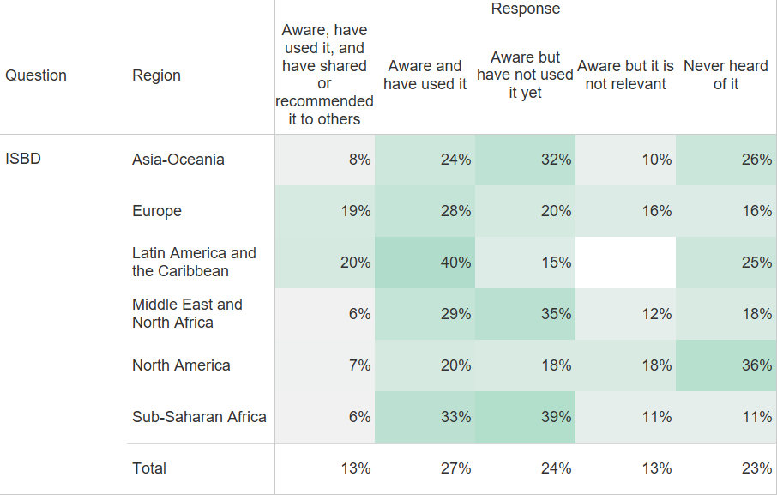
Notes:
How familiar are you with these IFLA technical/metadata standards?
ISBD

Slide 28
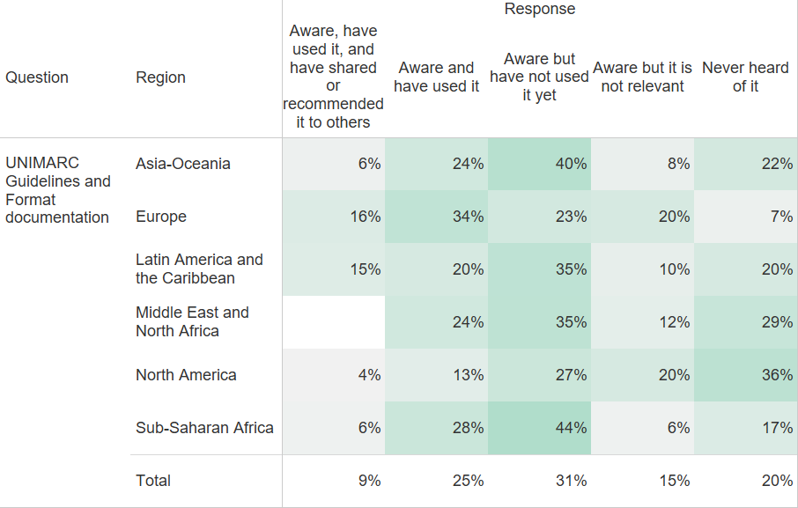
Notes:
How familiar are you with these IFLA technical/metadata standards?
UNIMARC Guidelines and Format documentation

Slide 29
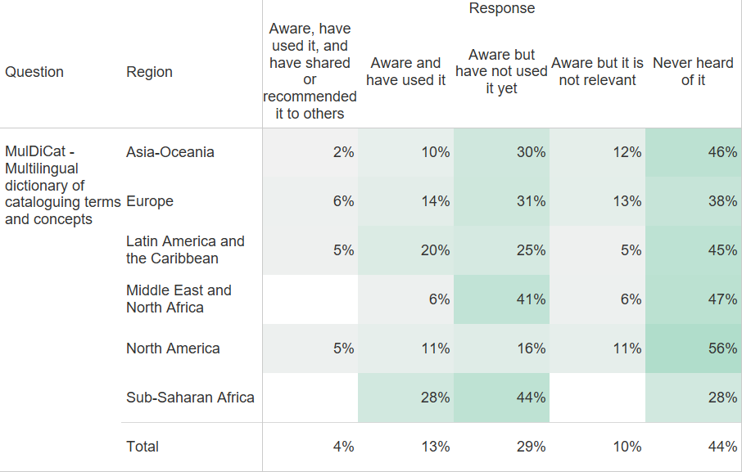
Notes:
How familiar are you with these IFLA technical/metadata standards?
MulDiCat - Multilingual dictionary of cataloguing terms and concepts

Slide 30
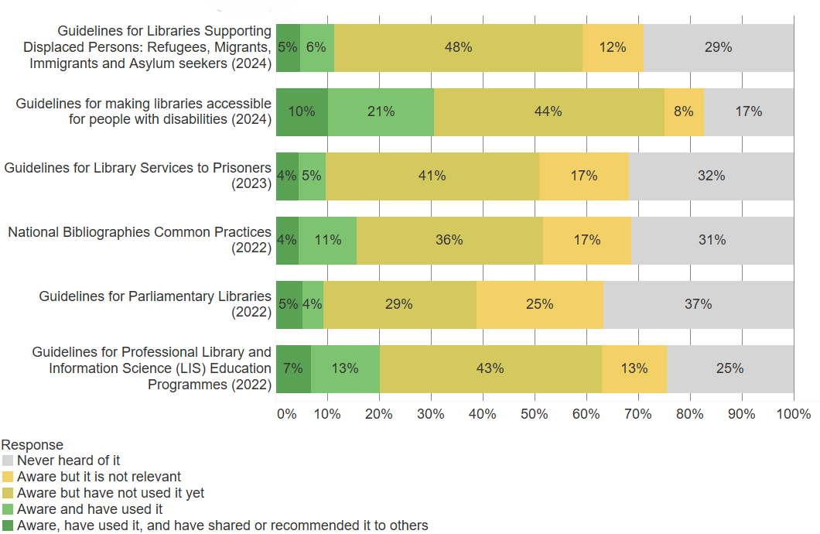
Notes:
How familiar are you with these recently published IFLA guidelines?

Slide 31
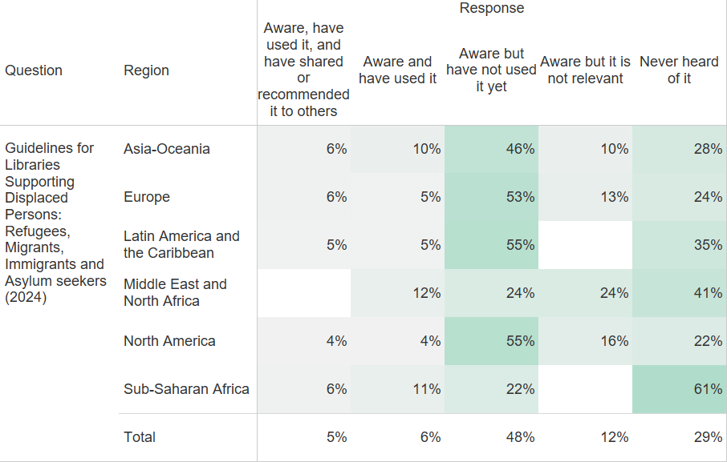
Notes:
How familiar are you with these recently published IFLA guidelines?
Guidelines for Libraries Supporting Displaced Persons: Refugees, Migrants, Immigrants and Asylum seekers (2024)

Slide 32
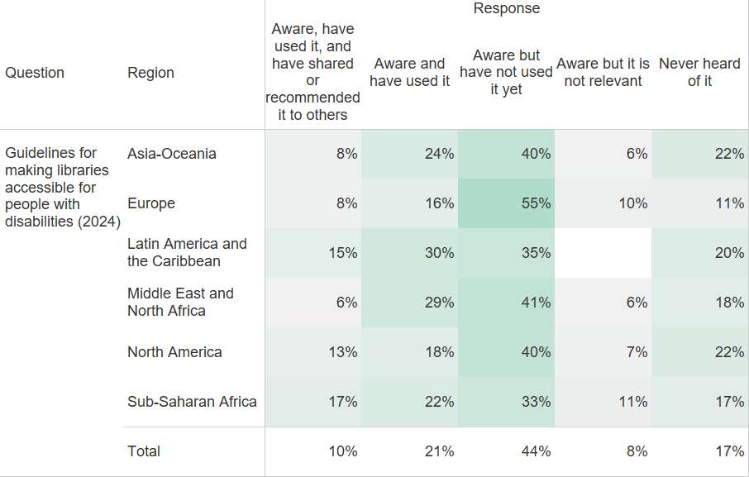
Notes:
How familiar are you with these recently published IFLA guidelines?
Guidelines for making libraries accessible for people with disabilities (2024)

Slide 33
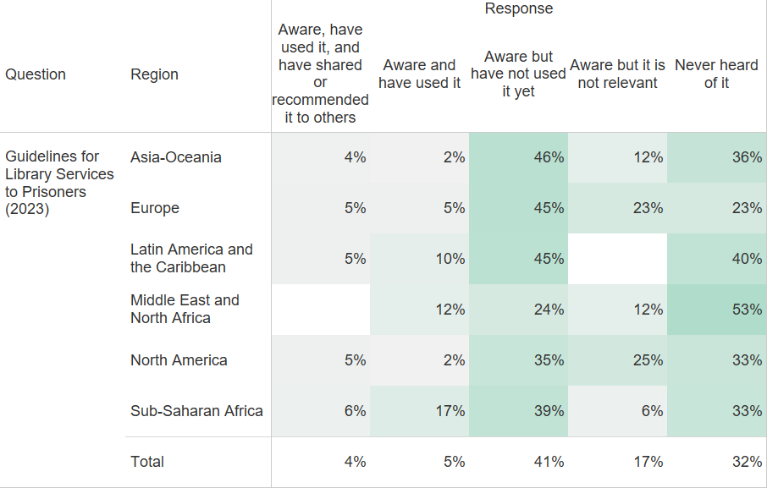
Notes:
How familiar are you with these recently published IFLA guidelines?
Guidelines for Library Services to Prisoners (2023)

Slide 34
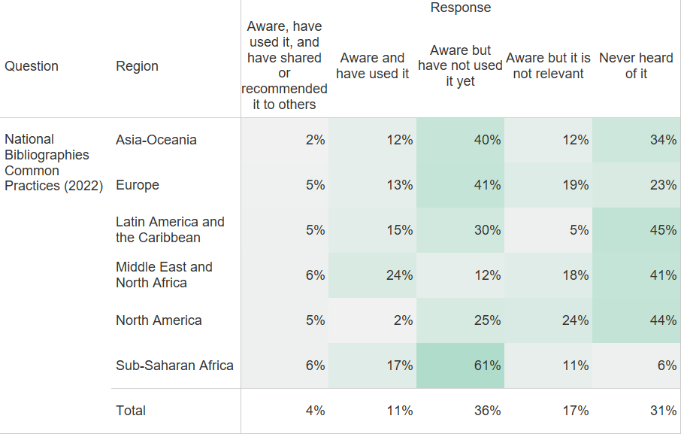
Notes:
How familiar are you with these recently published IFLA guidelines?
National Bibliographies Common Practices (2022)

Slide 35
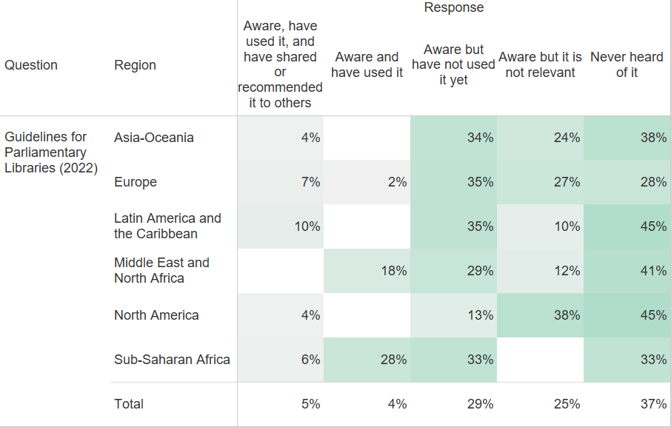
Notes:
How familiar are you with these recently published IFLA guidelines?
Guidelines for Parliamentary Libraries (2022)

Slide 36
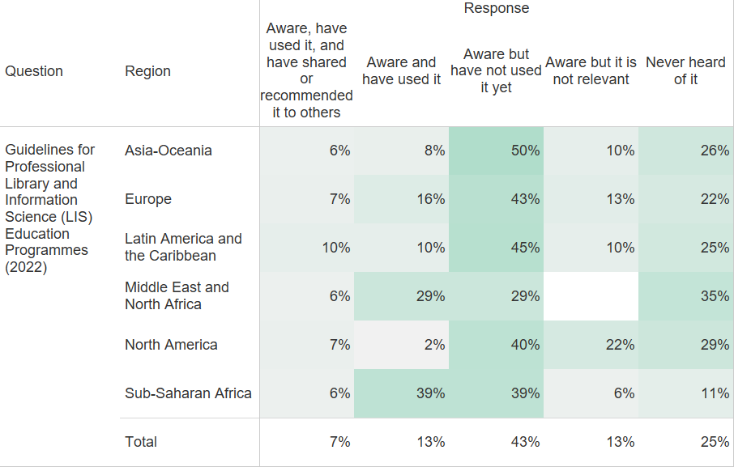
Notes:
How familiar are you with these recently published IFLA guidelines?
Guidelines for Professional Library and Information Science (LIS) Education Programmes (2022)

Slide 37
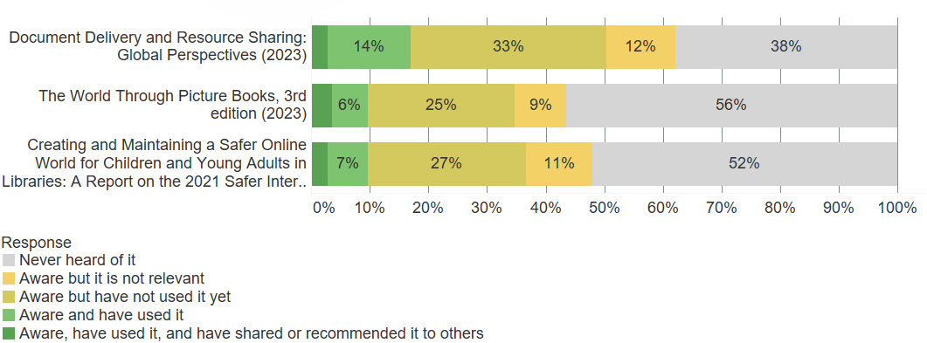
Notes:
How familiar are you with these recently published IFLA Professional Reports?

Slide 38
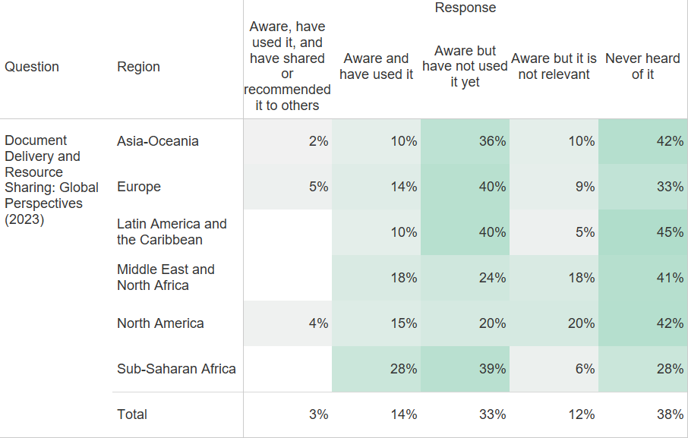
Notes:
How familiar are you with these recently published IFLA Professional Reports?
Document Delivery and Resource Sharing: Global Perspectives (2023)

Slide 39
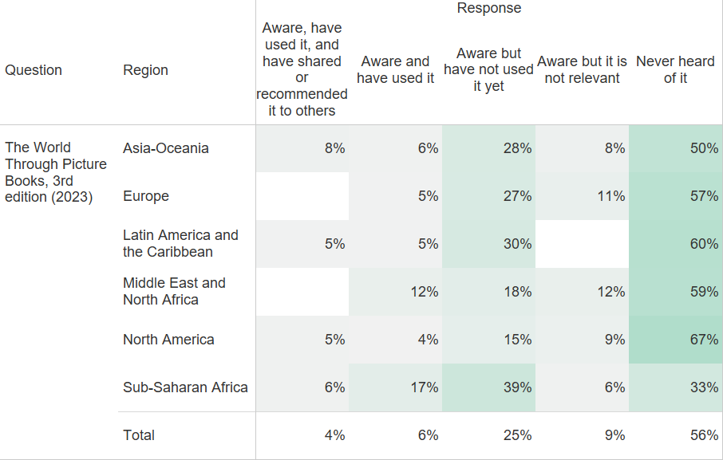
Notes:
How familiar are you with these recently published IFLA Professional Reports?
The World Through Picture Books, 3rd edition (2023)

Slide 40
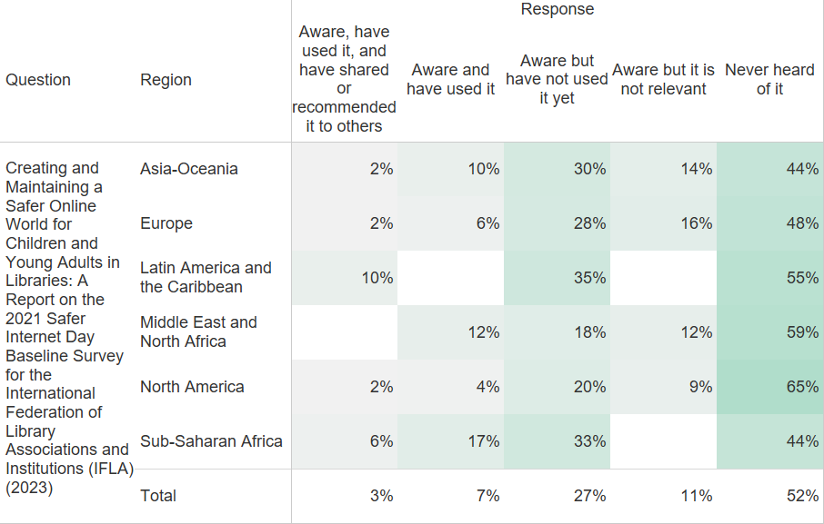
Notes:
How familiar are you with these recently published IFLA Professional Reports?
Creating and Maintaining a Safer Online World for Children and Young Adults in Libraries: A Report on the 2021 Safer Internet Day Baseline Survey for the International Federation of Library Associations and Institutions (IFLA) (2023)

Slide 41
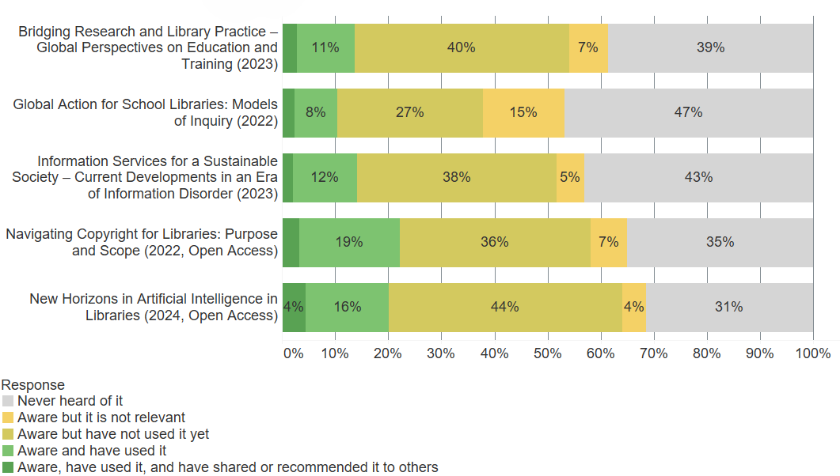
Notes:
How familiar are you with these recently published resources in the IFLA/De Gruyter Publications Series?

Slide 42
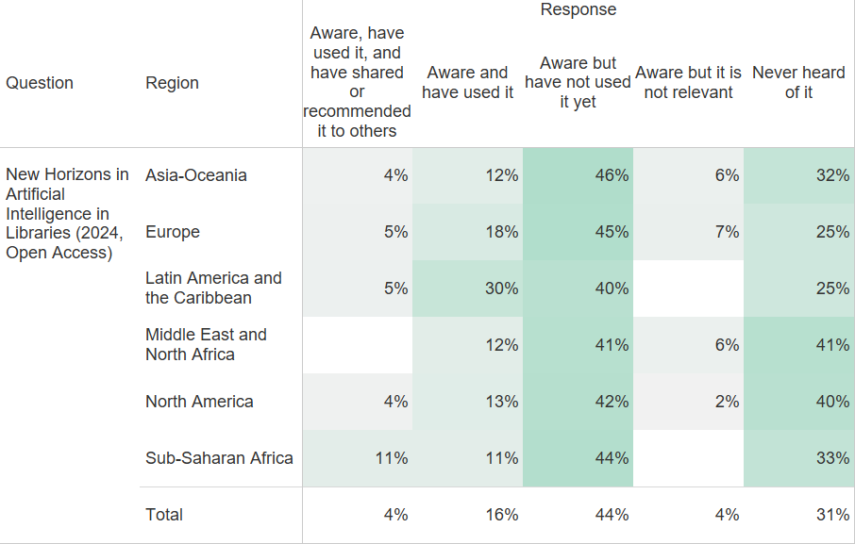
Notes:
How familiar are you with these recently published resources in the IFLA/De Gruyter Publications Series?
New Horizons in Artificial Intelligence in Libraries (2024, Open Access)

Slide 43
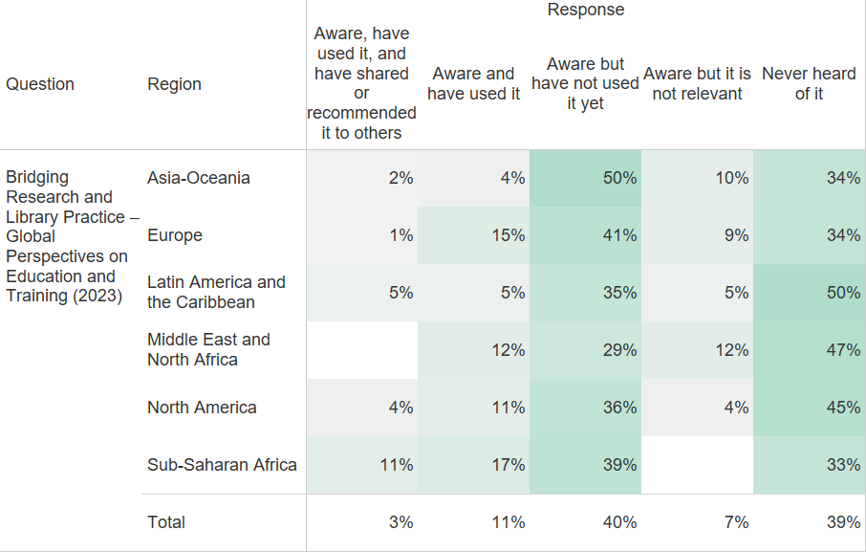
Notes:
How familiar are you with these recently published resources in the IFLA/De Gruyter Publications Series?
Bridging Research and Library Practice – Global Perspectives on Education and Training (2023)

Slide 44
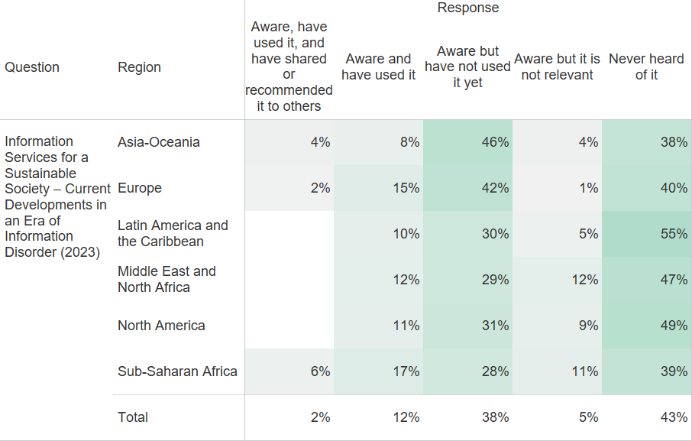
Notes:
How familiar are you with these recently published resources in the IFLA/De Gruyter Publications Series?
Information Services for a Sustainable Society – Current Developments in an Era of Information Disorder (2023)

Slide 45
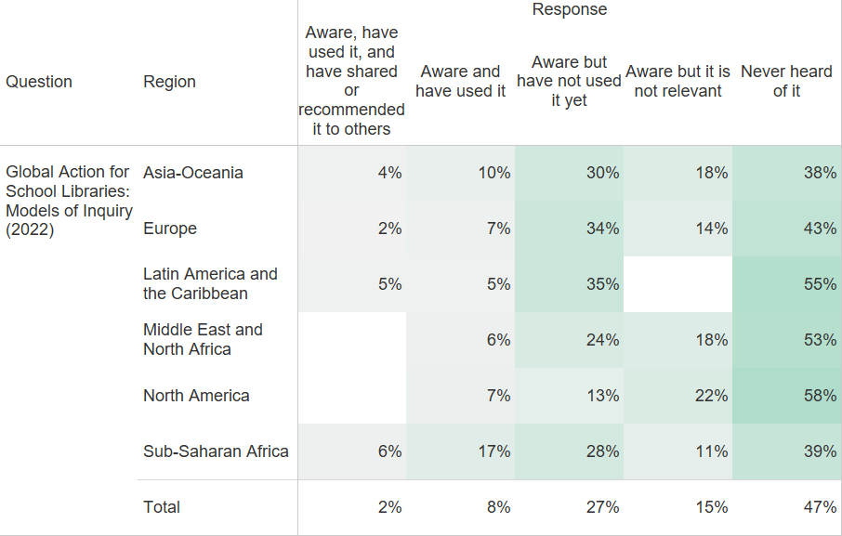
Notes:
How familiar are you with these recently published resources in the IFLA/De Gruyter Publications Series?
Global Action for School Libraries: Models of Inquiry (2022)

Slide 46
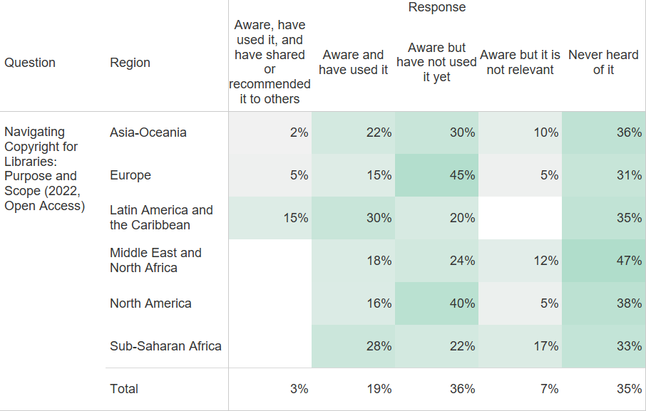
Notes:
How familiar are you with these recently published resources in the IFLA/De Gruyter Publications Series?
Navigating Copyright for Libraries: Purpose and Scope (2022, Open Access)

Slide 47
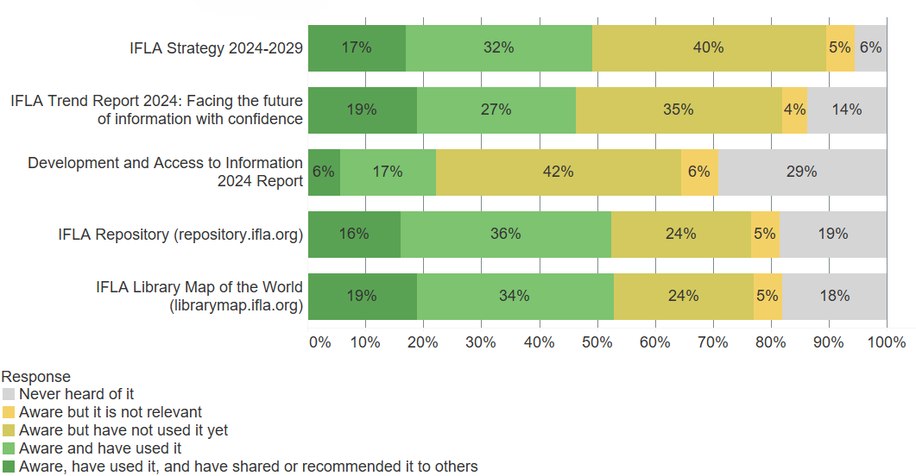
Notes:
How familiar are you with these IFLA resources?

Slide 48
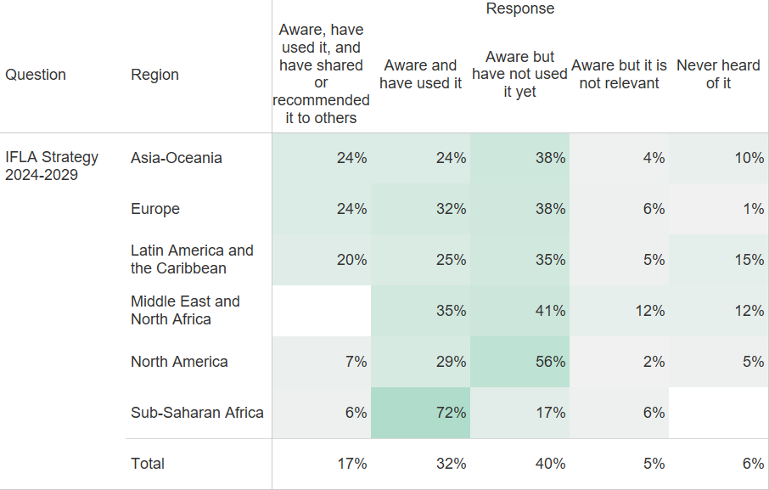
Notes:
How familiar are you with these IFLA resources?
IFLA Strategy 2024-2029

Slide 49
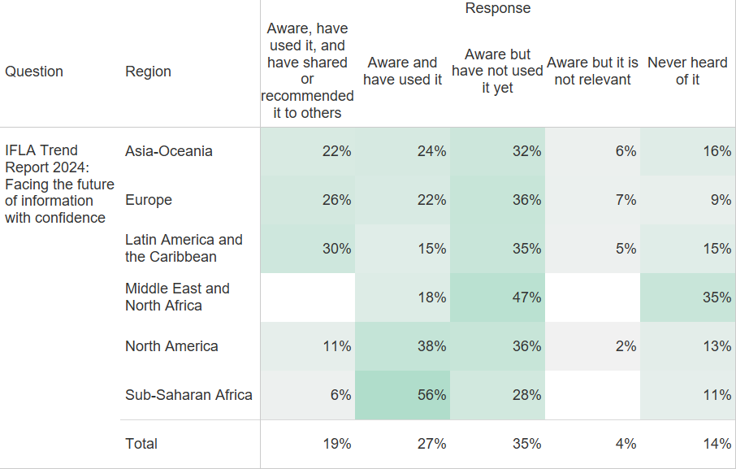
Notes:
How familiar are you with these IFLA resources?
IFLA Trend Report 2024: Facing the future of information with confidence

Slide 50
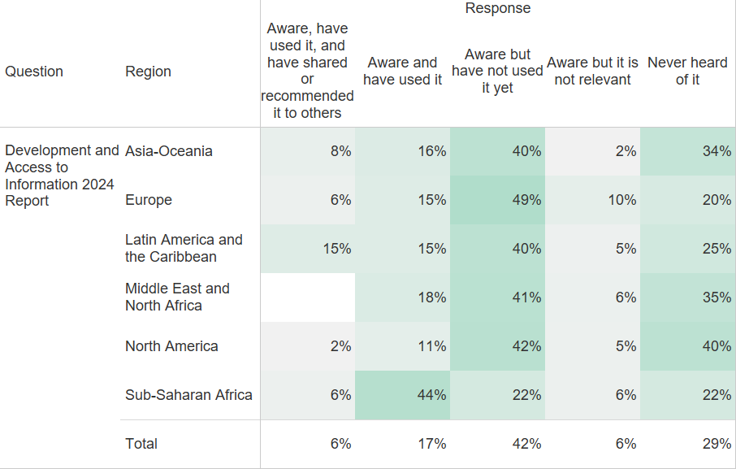
Notes:
How familiar are you with these IFLA resources?
Development and Access to Information 2024 Report

Slide 51
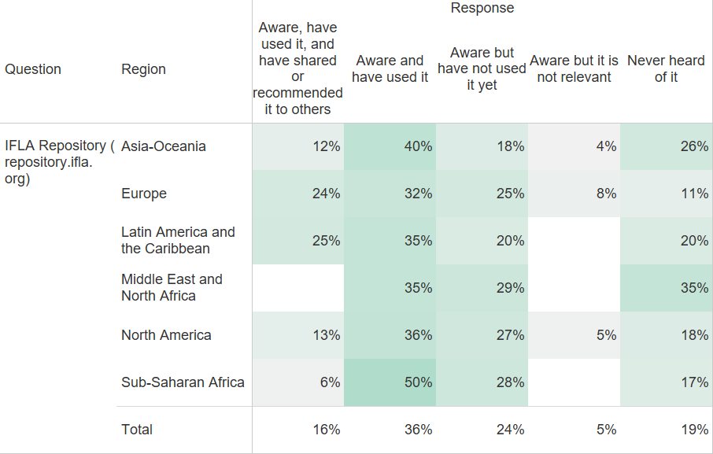
Notes:
How familiar are you with these IFLA resources?
IFLA Repository (repository.ifla.org)

Slide 52
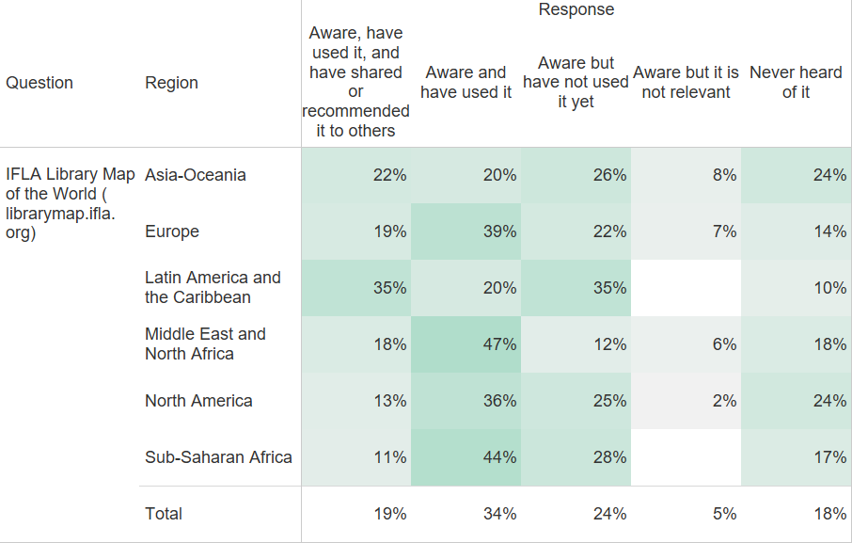
Notes:
How familiar are you with these IFLA resources?
IFLA Library Map of the World (librarymap.ifla.org)

Slide 53
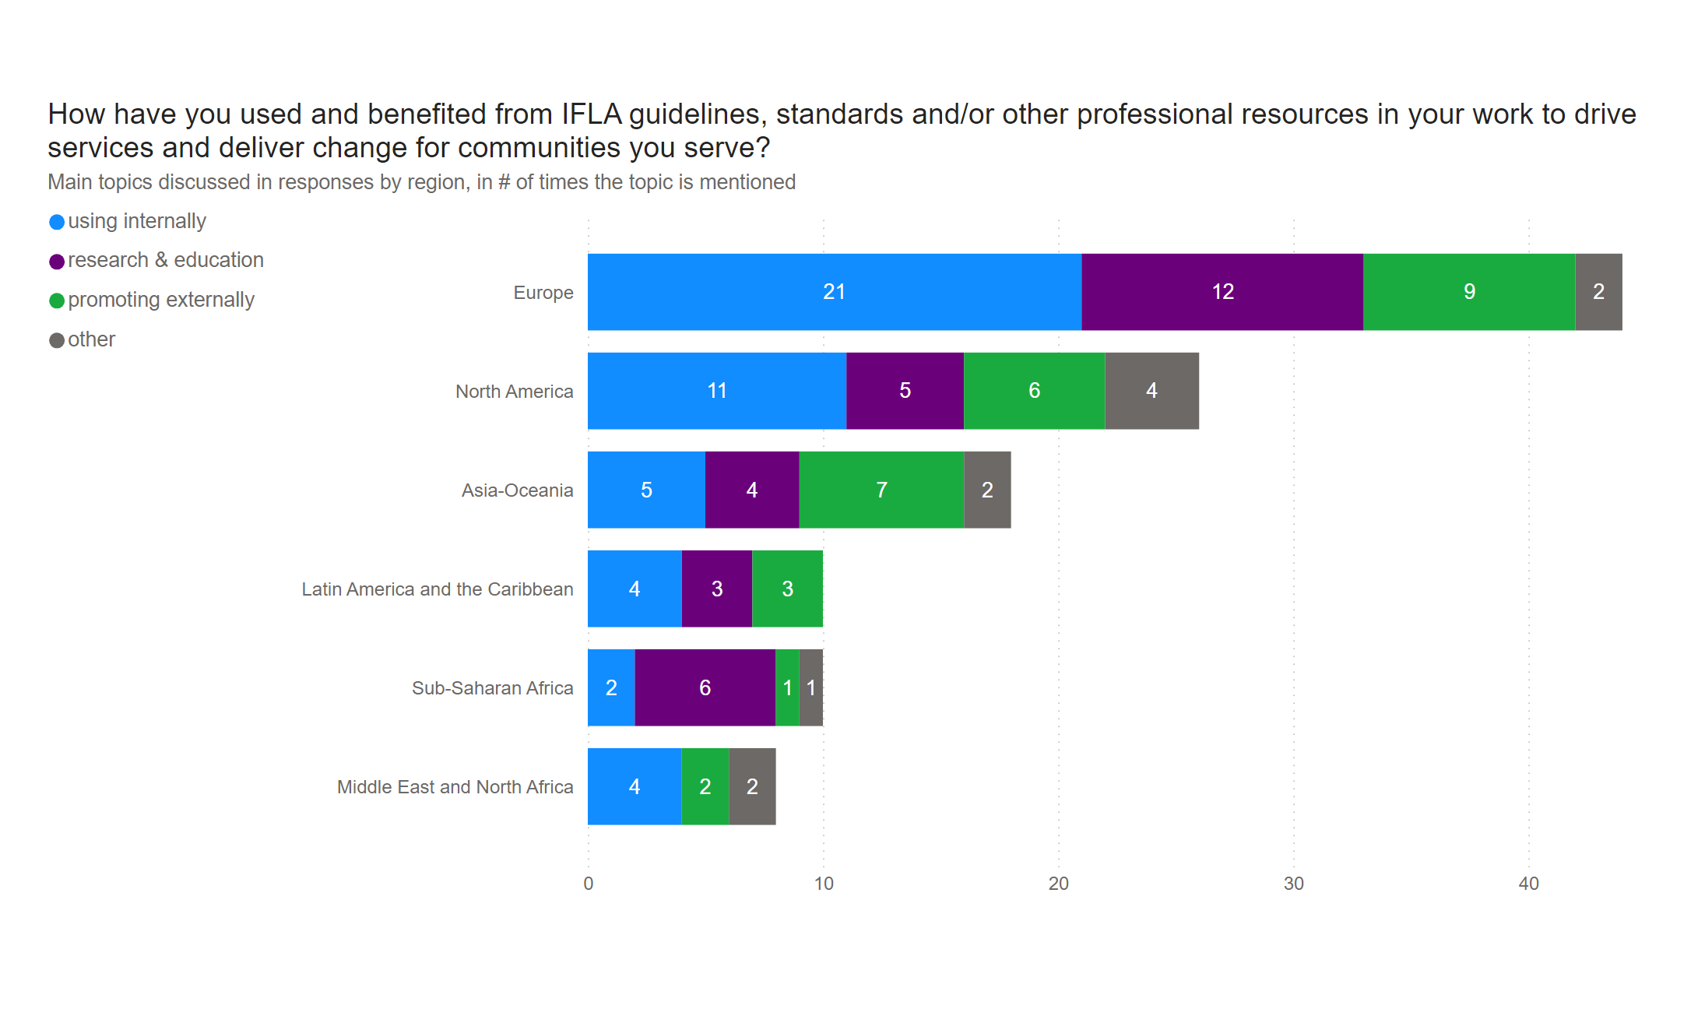
Q8 (3)
Notes:
How have you used and benefited from IFLA guidelines, standards and/or other professional resources in your work to drive services and deliver change for communities you serve?

Slide 54
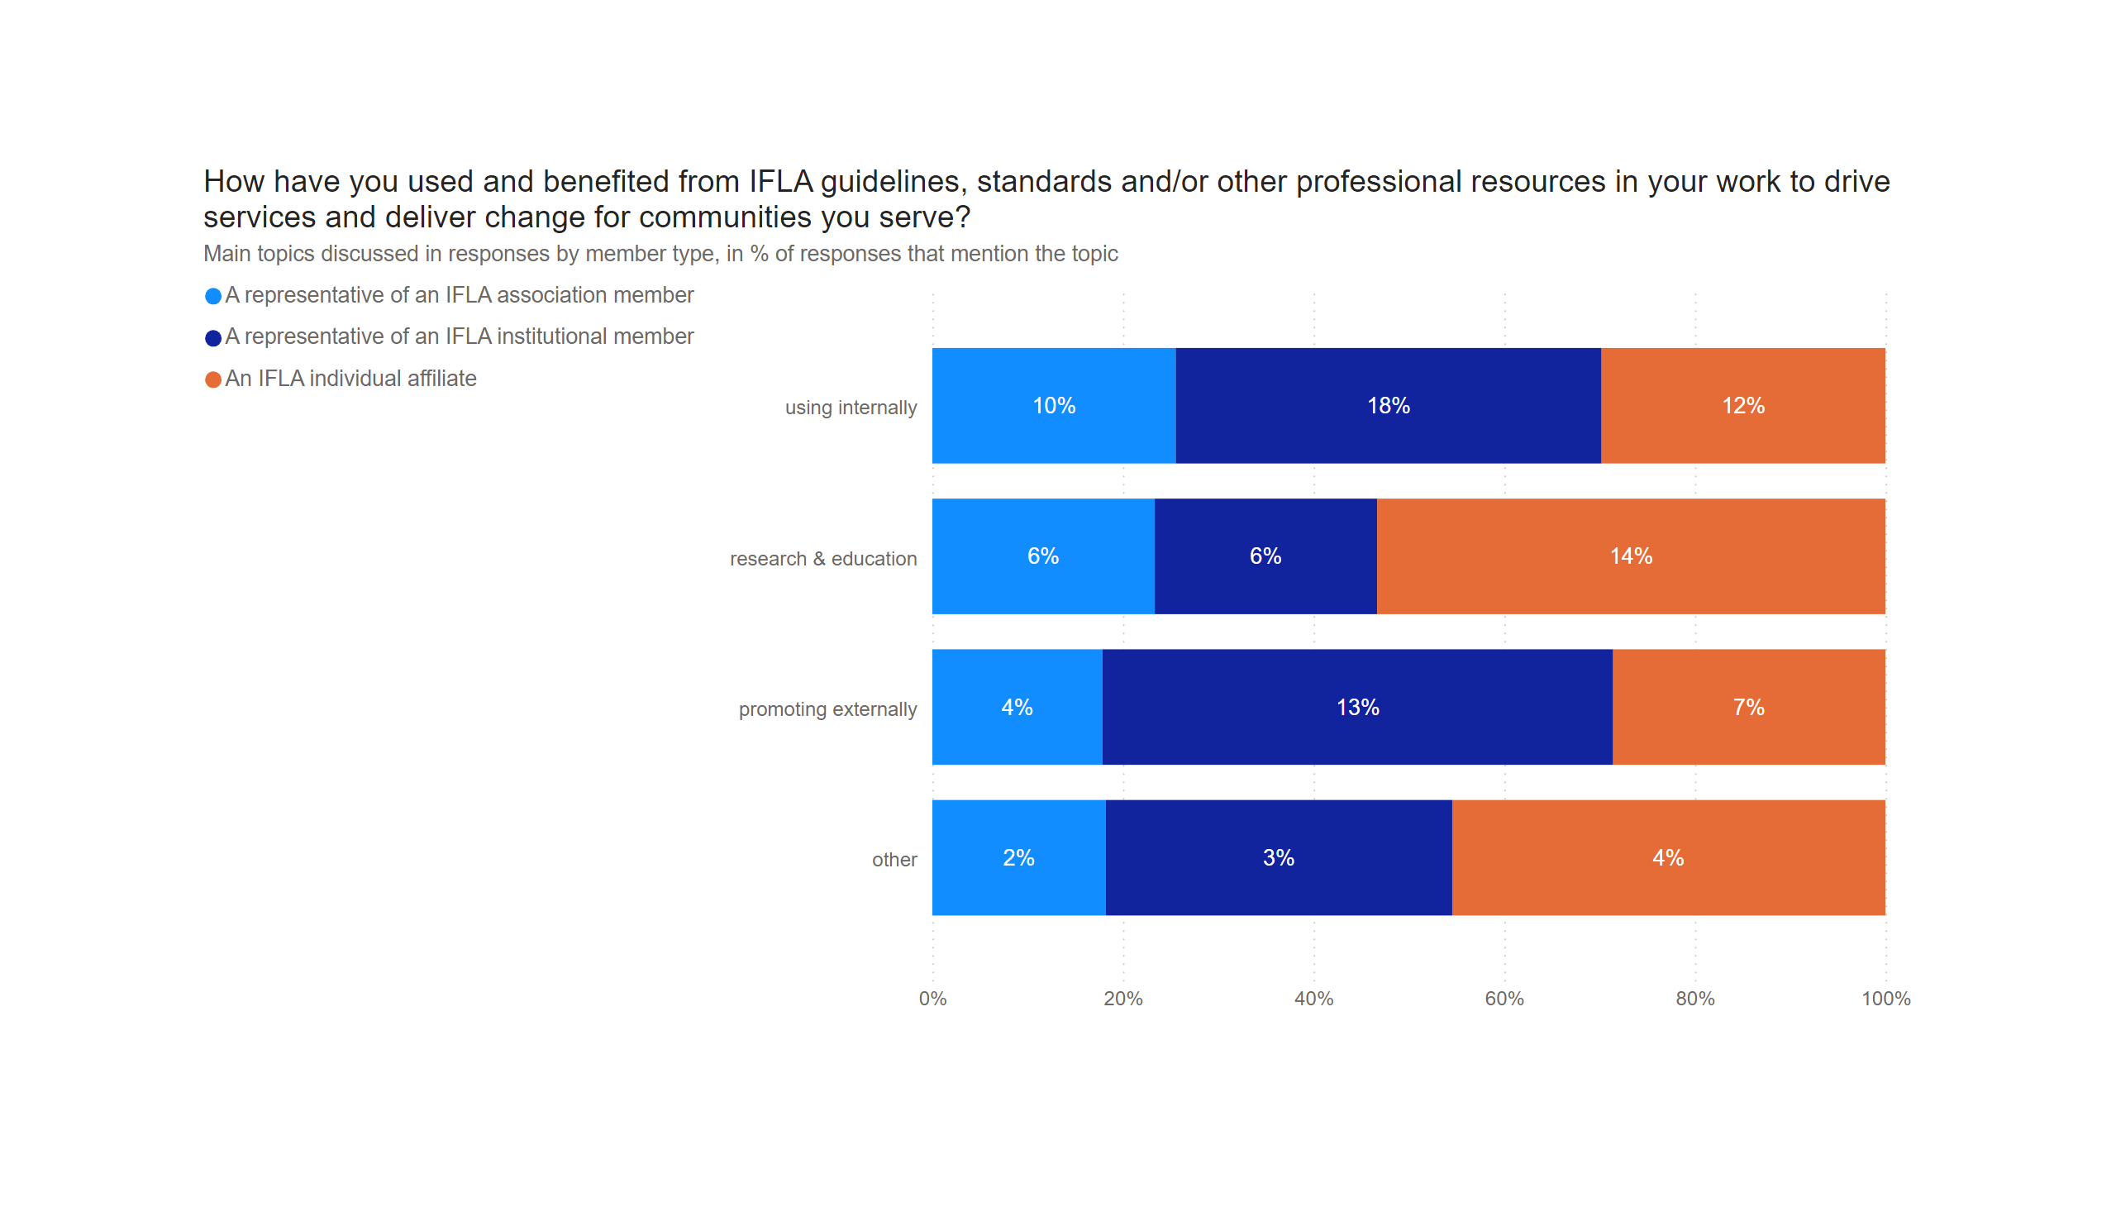
Duplicate of Q8 (3)
Notes:
How have you used and benefited from IFLA guidelines, standards and/or other professional resources in your work to drive services and deliver change for communities you serve?

Slide 55

Duplicate of Duplicate of Q8 (3)
Notes:
How have you used and benefited from IFLA guidelines, standards and/or other professional resources in your work to drive services and deliver change for communities you serve?

Slide 56
Professional development

Slide 57

Notes:
How relevant do you find the training and professional development opportunities offered by IFLA to your work and career growth?

Slide 58

Notes:
Overall, how would you rate this event?

Slide 59

Notes:
To what extent did you learn something at this event that could help you in your work?

Slide 60
Engagement with IFLA’s volunteer units and Headquarters

Slide 61

Notes:
In the past year, in what ways did you engage with your registered Professional Section(-s)?

Slide 62

Notes:
In the past year, in what ways did you engage with your registered Professional Section(-s)?
Participated in Section professional development and/or other events

Slide 63

Notes:
In the past year, in what ways did you engage with your registered Professional Section(-s)?
Attended Section Standing Committee's meeting as an observer

Slide 64

Notes:
In the past year, in what ways did you engage with your registered Professional Section(-s)?
Provided feedback or suggestions

Slide 65

Notes:
In the past year, in what ways did you engage with your registered Professional Section(-s)?
Engaged in Section projects or initiatives

Slide 66

Notes:
In the past year, in what ways did you engage with your registered Professional Section(-s)?
Explored Section Action Plan and/or brought forward ideas for their Action Plan

Slide 67

Notes:
In the past year, in what ways did you engage with your registered Professional Section(-s)?
Contacted Section Chair, Secretary or Information Coordinator

Slide 68

Notes:
In the past year, in what ways did you engage with your registered Professional Section(-s)?
Received direct communication including news and updates from Section Standing Committee

Slide 69

Notes:
In the past year, in what ways did you engage with your registered Professional Section(-s)?
Followed and participated in discussions through the Section mailing list

Slide 70

Notes:
To what extent do you agree with these statements? Engagement with my registered Professional Section(-s) helped me and/or my organisation
Extent of agreement is calculated as a weighted average based on Likert-scale values, where responses are assigned scores from 5 (Strongly Agree) to 1 (Strongly Disagree). Responses marked as 'I don’t know/Prefer not to answer' are excluded from the calculation.

Slide 71

Notes:
To what extent do you agree with these statements? Engagement with my registered Professional Section(-s) helped me and/or my organisation
Make connections and expand professional networks

Slide 72

Notes:
To what extent do you agree with these statements? Engagement with my registered Professional Section(-s) helped me and/or my organisation
Update professional practice

Slide 73

Notes:
To what extent do you agree with these statements? Engagement with my registered Professional Section(-s) helped me and/or my organisation
Develop professional knowledge and skills

Slide 74

Notes:
To what extent do you agree with these statements? Engagement with my registered Professional Section(-s) helped me and/or my organisation
Share my/our own experience more broadly

Slide 75

Notes:
To what extent do you agree with these statements? Engagement with my registered Professional Section(-s) helped me and/or my organisation
Develop close links with experts in my field of interest

Slide 76

Notes:
How would you rate your understanding of the role of IFLA's Regional Divisions in supporting the library field across regions?

Slide 77

Notes:
How would you rate your understanding of the role of IFLA's Regional Offices?

Slide 78

Notes:
How valuable do you think the work of IFLA’s regional structures (e.g., Regional Divisions, Regional Offices) is in driving positive change at the national and regional levels?

Slide 79

Notes:
In the past year, in what ways did you engage with your Regional Division?

Slide 80

Notes:
In the past year, in what ways did you engage with your Regional Division?
Participated in Regional Division professional development and/or other events

Slide 81

Notes:
In the past year, in what ways did you engage with your Regional Division?
Attended Regional Division Committee's meeting as an observer

Slide 82

Notes:
In the past year, in what ways did you engage with your Regional Division?
Provided feedback or suggestions

Slide 83

Notes:
In the past year, in what ways did you engage with your Regional Division?
Engaged in Regional Division projects or initiatives

Slide 84

Notes:
In the past year, in what ways did you engage with your Regional Division?
Explored Regional Division Action Plan and/or brought forward ideas for their Action Plan

Slide 85

Notes:
In the past year, in what ways did you engage with your Regional Division?
Contacted Regional Division Chair, Secretary or Information Coordinator

Slide 86

Notes:
In the past year, in what ways did you engage with your Regional Division?
Received direct communication including news and updates from Regional Division Committee

Slide 87

Notes:
In the past year, in what ways did you engage with your Regional Division?
Followed and participated in discussions through the Regional Division mailing list

Slide 88

Notes:
To what extent do you agree with these statements? Engagement with my Regional Division helped me and/or my organisation:
Extent of agreement is calculated as a weighted average based on Likert-scale values, where responses are assigned scores from 5 (Strongly Agree) to 1 (Strongly Disagree). Responses marked as 'I don’t know/Prefer not to answer' are excluded from the calculation.

Slide 89

Notes:
To what extent do you agree with these statements? Engagement with my Regional Division helped me and/or my organisation:
Make connections and expand professional networks in my region

Slide 90

Notes:
To what extent do you agree with these statements? Engagement with my Regional Division helped me and/or my organisation:
Expand my international professional network, through taking part in cross-regional collaborations of my Regional Division

Slide 91

Notes:
To what extent do you agree with these statements? Engagement with my Regional Division helped me and/or my organisation:
Develop professional knowledge and skills

Slide 92

Notes:
To what extent do you agree with these statements? Engagement with my Regional Division helped me and/or my organisation:
Update professional practice

Slide 93

Notes:
To what extent do you agree with these statements? Engagement with my Regional Division helped me and/or my organisation:
Share my/our own experience more broadly

Slide 94

Notes:
What was the main reason for your contact with HQ team?

Slide 95

Notes:
To what extent do you agree with these statements about IFLA Headquarters team? HQ team is highly responsive in addressing my concerns and needs as an IFLA member.
Matrix: Perceptions about responsiveness of HQ team among members by region

Slide 96

Notes:
To what extent do you agree with these statements about IFLA Headquarters team? HQ team is highly responsive in addressing my concerns and needs as an IFLA member.
Bar chart: Perceptions about responsiveness of HQ team among members by region

Slide 97

Notes:
To what extent do you agree with these statements about IFLA Headquarters team? HQ team actively seek out creative and innovative solutions to challenges faced by members and communities we serve.

Slide 98

Notes:
To what extent do you agree with these statements about IFLA Headquarters team? HQ team actively seek out creative and innovative solutions to challenges faced by members and communities we serve.
Extent of agreement is calculated as a weighted average based on Likert-scale values, where responses are assigned scores from 5 (Strongly Agree) to 1 (Strongly Disagree). Responses marked as 'I don’t know/Prefer not to answer' are excluded from the calculation.

Slide 99

Notes:
To what extent do you agree with these statements about IFLA Headquarters team? Interaction with HQ team has helped me accomplish my own and/or my organisation's goals.

Slide 100

Notes:
To what extent do you agree with these statements about IFLA Headquarters team? Interaction with HQ team has helped me accomplish my own and/or my organisation's goals.
Extent of agreement is calculated as a weighted average based on Likert-scale values, where responses are assigned scores from 5 (Strongly Agree) to 1 (Strongly Disagree). Responses marked as 'I don’t know/Prefer not to answer' are excluded from the calculation.

Slide 101
Perceptions of IFLA: awareness, confidence and sustainability

Slide 102

Notes:
How well do you understand what IFLA is and what it offers to its members and the library field?

Slide 103

Notes:
How confident are you in IFLA's vision and its ability to adapt to the evolving needs of the library field?

Slide 104

Notes:
How do you perceive IFLA’s sustainability?

Slide 105

Q15 (2)
Notes:
What do you think IFLA should focus on to strengthen its long-term sustainability?

Slide 106

Duplicate of Duplicate of Q15 (2)
Notes:
What do you think IFLA should focus on to strengthen its long-term sustainability?

Slide 107

Notes:
How effective do you think IFLA's leadership is in ensuring the long-term success and sustainability of the organisation?

