Slide 1

IFLA GB REPORT
IFLA HEADQUARTERS 2024
Highlights December 2023 - April 2024

Slide 2

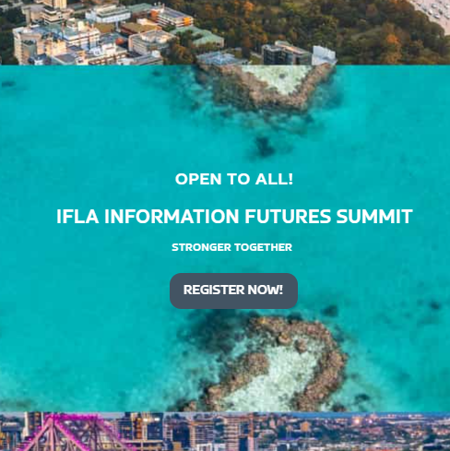

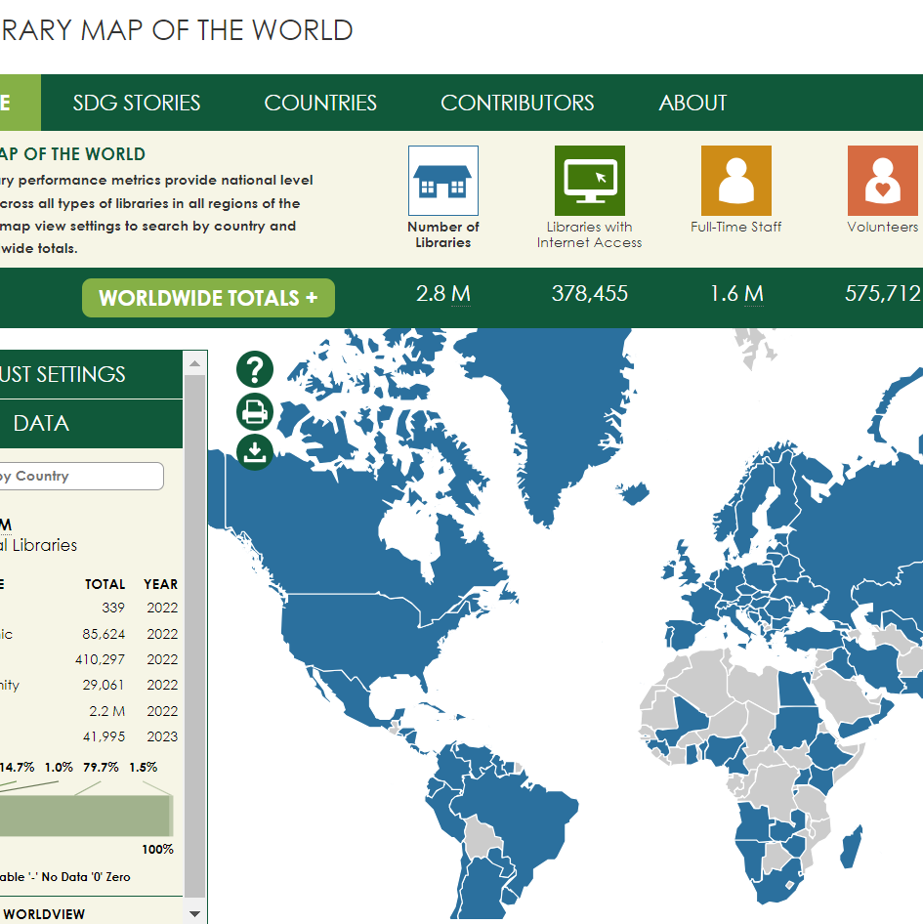
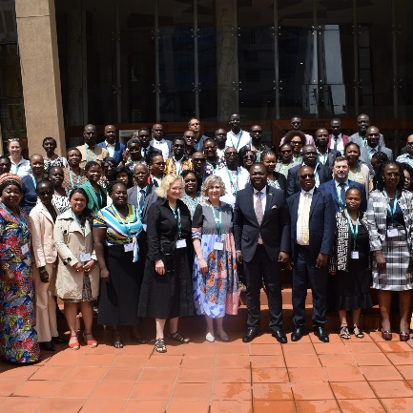
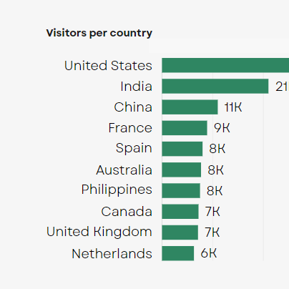
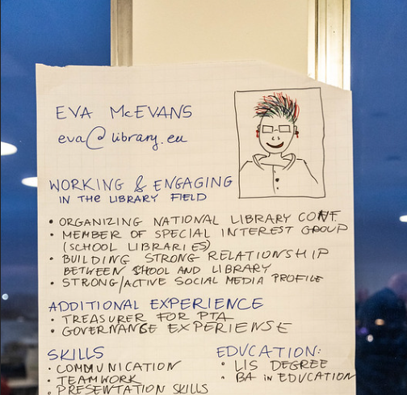
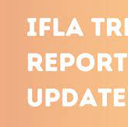

Highlight all that we’ve achieved since December
Make the connection with the IFLA Strategy
Celebrate good work!
IFLA HEADQUARTERS | 2023

Slide 3
1. Strengthen the
Global Voice of Libraries
Our work to support
effective and relevant advocacy at all levels
2. Inspire and enhance professional practice
Our work to provide
key information resources and
spaces for professional discussion
3. Connect and empower
the field
Our events – in particular WLIC – and
work to build the capacity of the field,
especially at regional level
4. Optimise our organisation
Our work to make IFLA more sustainable,
both through outreach and
better resource mobilization

Slide 4

1. Strengthen the Global Voice of Libraries
Libraries recognized in UNESCO Framework for Culture and Arts Education
134 countries covered in our latest Marrakesh Monitoring Report

Slide 5
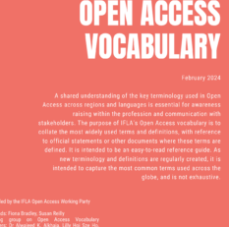
1. Strengthen the Global Voice of Libraries
Libraries in 44 countries contacted to prepare for 2024 Voluntary National Reviews
Open Access Vocabularies released

Slide 6

1. Strengthen the Global Voice of Libraries
“We have used the IFLA-UNESCO manifesto in many of our advocacy efforts and librarianship workshops, in particular to talk about the urgency of having a free, excellent & inclusive public library system in India.”
Purnima Rao, Free Libraries Network – FLN
“[In my organisation, we are] using the IFLA toolkits and guidelines to improve our library services and for advocacy purposes. I love it when I am able to localise library best practice to suit us. I also find that when I make a request to upper management for resources. I am successful because I can justify it.”
A representative of an IFLA institutional member

Slide 7
2: Inspire and Enhance Professional Practice
145 countries and territories with data on the Library Map
31 country profiles and
58 SDG stories from 36 countries

Slide 8
2: Inspire and Enhance Professional Practice
2023 Trend Report Update published
7 Emerging Leaders from 4 different regions

Slide 9
2: Inspire and Enhance Professional Practice
3rd edition of The World Through Picture Books
5 Standards under revision, 15 others in development

Slide 10
2: Inspire and Enhance Professional Practice
“The World Through Picture Books programme [was our IFLA membership highlight in 2023]. Iran succeeded in using the opinions of librarians in public libraries and registering ten selected books in this programme. Of course, we are still following up on the final and modified version of this program, which is published on the IFLA website.”
Mohammad Mahdi Zarafshan, Iran Public libraries Foundation
“I benefited from connecting with trends and challenges on the global front and relating global trends to my local situation.
A representative of an IFLA institutional member

Slide 11
3: CONNECT AND ENABLE THE FIELD
IIFS concept and programme developed and released
New Events Hub

Slide 12
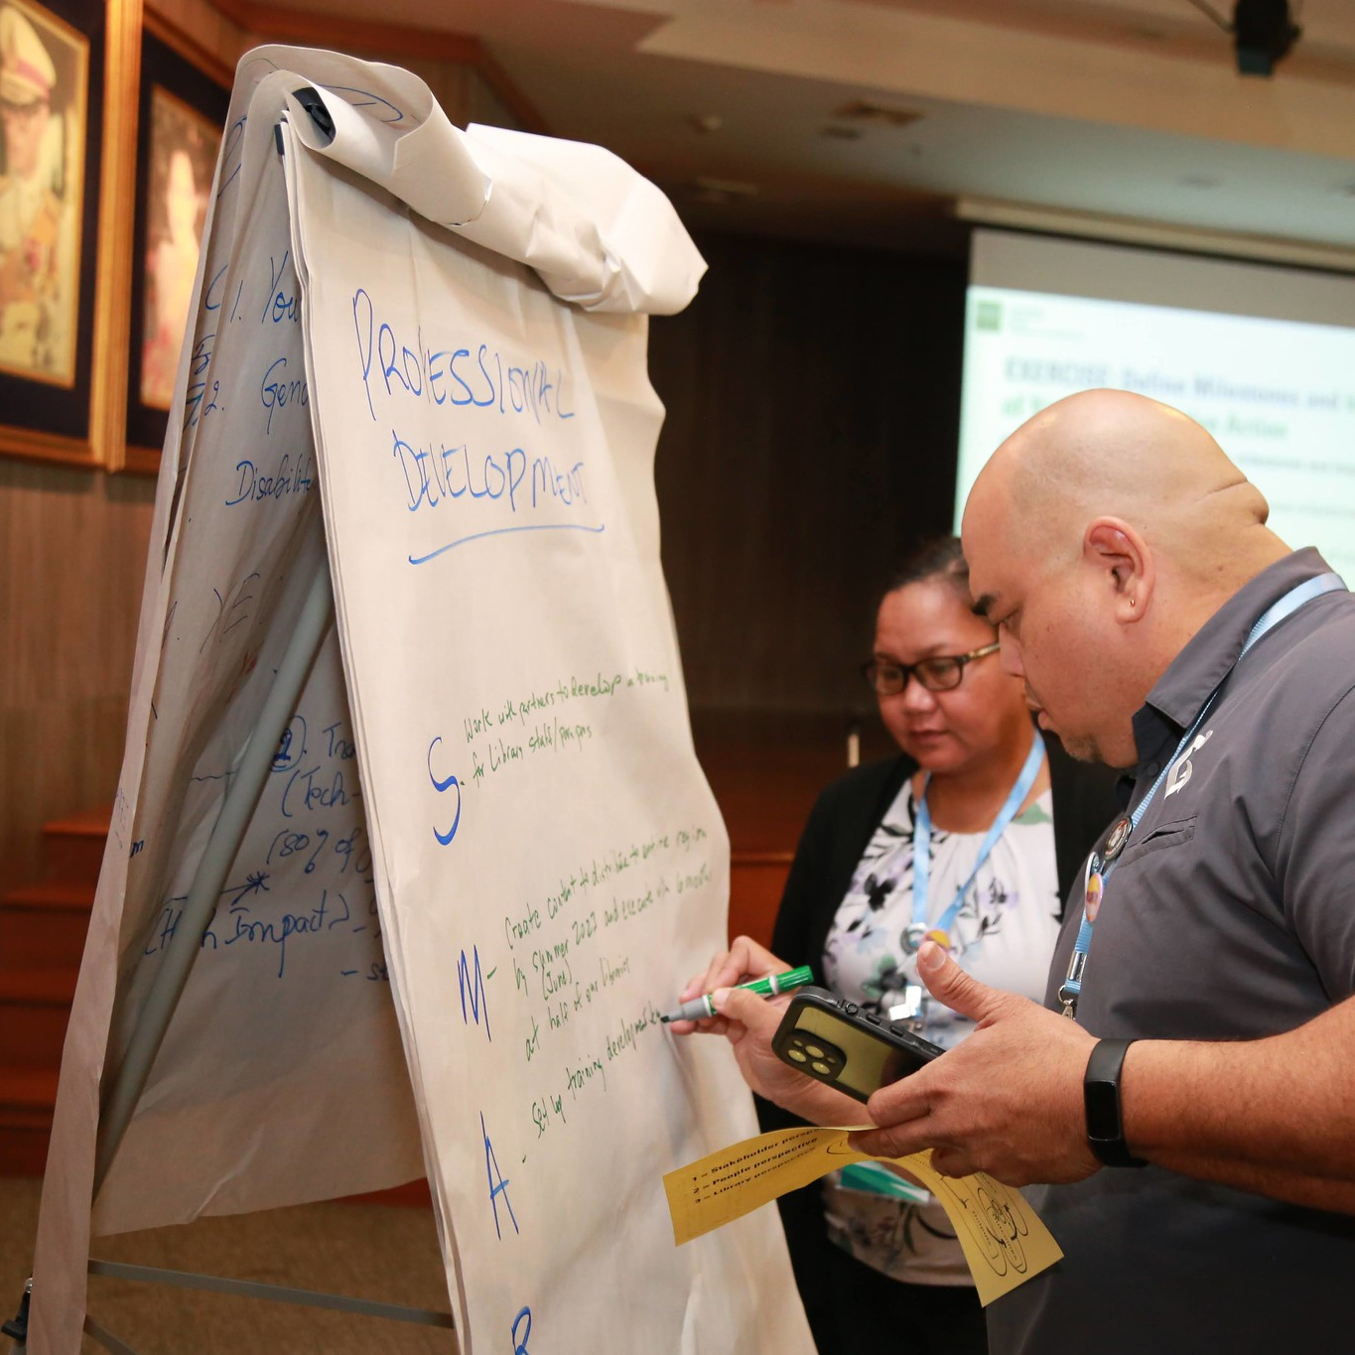
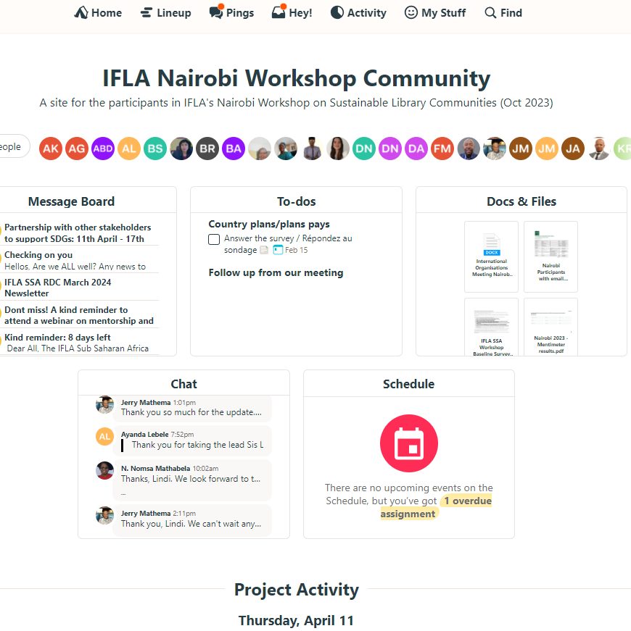
3: CONNECT AND ENABLE THE FIELD
>2/3 of regional workshop participants
very active in following up
Dynamic community pages for workshop participants

Slide 13

3: CONNECT AND ENABLE THE FIELD
“[..] IFLA Workshop on building a Strong and Sustainable Library field in Sub-Saharan Africa [..] was an eye opening for me living in a country like Somalia which has been in a destruction of all sorts of public services for long though is currently recovering from there. I share the knowledge gained from IFLA with my team, and they utilize the information. This has also helped our institution to be easily identifiable on the IFLA list as the only representing institution from Somalia. This could also be seen as a form of corporate promotion.”
Mohamud Mohamed Siad, SIMAD University
“I got a great opportunity to learn new ideas and experiences, study current topics and trends in library development. Participating in conferences allows me to travel and change the world around me for the better.”
Kabiba Akzhigitova, The Association of Librarians of the East Kazakhstan Region of the Republic of Kazakhstan

Slide 14
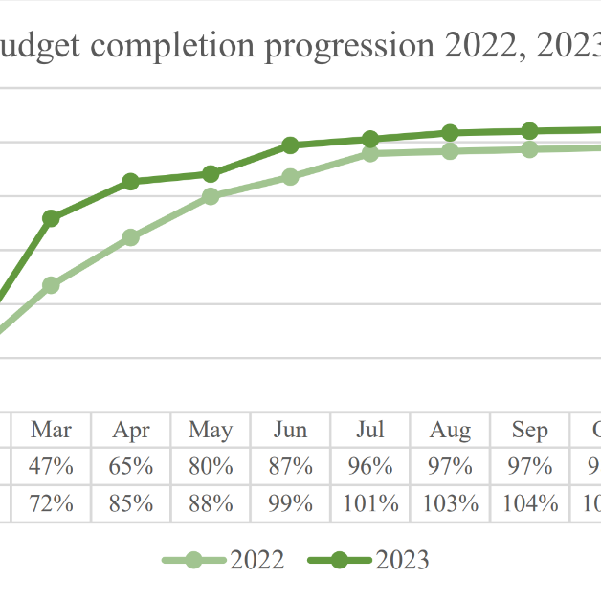
4: optimise our organisation
106.3% of expected membership revenue collected at end of 2023
Survey of membership sentiments identifies baseline net promoter score
Notes:
Statistics – end of July

Slide 15
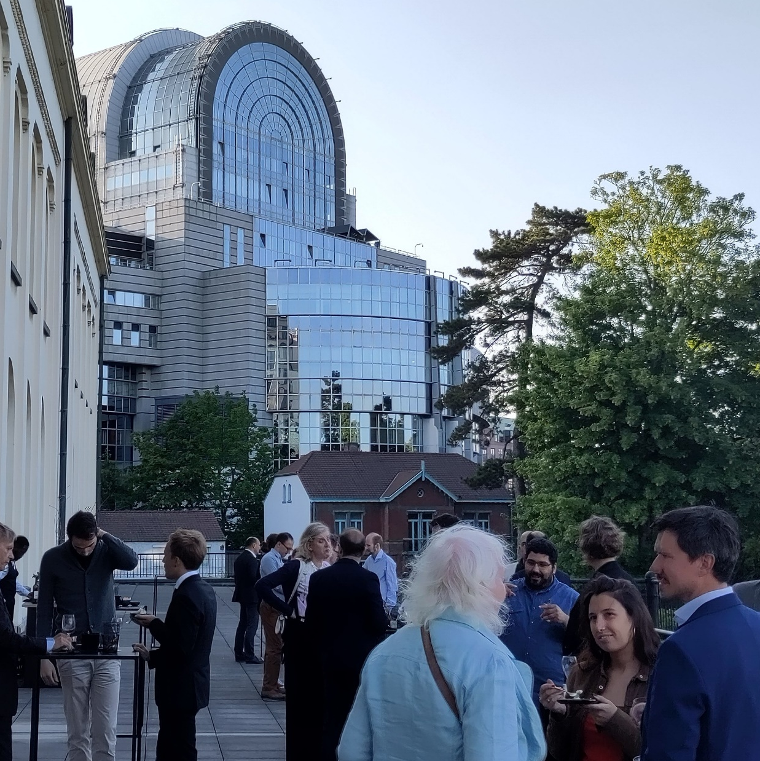
4: optimise our organisation
Launch of EU-funded train the trainers programme on media literacy
Knowledge Rights 21 Programme
Provisionally extended 5 years
Notes:
Statistics – end of July

Slide 16
4: optimise our organisation
First IFLA Townhall meetings held, positive feedback on comms
5th survey on IFLA Strategy 2024-29, focused on change pathways
Notes:
Statistics – end of July

Slide 17

4: optimise our organisation
GDPR training provided, structure for compliance in place
New Organisational Design for IFLA HQ, and coach-facilitator now operating
Notes:
Statistics – end of July

Slide 18
4: optimise our organisation
Followers:
57,894 Facebook 40,298 LinkedIn 8,817 Instagram 33,693 Twitter
5,882 newsletter subscribers
In 2023 we had 2,147,737
post impressions on our social media channels & 46,000 website visitors per month
Notes:
Statistics – end of July

Slide 19
4: optimise our organisation
“IFLA membership has enabled us to build a network with global professionals, enriching our institutional knowledge and perspectives. This networking has facilitated collaborations and the sharing of best practices, which have been instrumental in improving our services and operations. Additionally, the access to a wealth of resources and learning opportunities has kept us informed about the latest trends and developments in our field, further enhancing our ability to serve our community effectively. Overall, the IFLA membership has been a key factor in our institution's growth and success.”
A representative of an IFLA institutional member
Notes:
Statistics – end of July

Slide 20



With thanks to our funders
IFLA's Members, Affiliates and donors
Stichting IFLA Global Libraries
Arcadia Fund
European Commission
… and all those who give their time and energy to make IFLA what it is!

Slide 21
… and particular thanks to the team at IFLA Headquarters

Slide 22

THANK YOU
IFLA HEADQUARTERS 2023

