Slide 1


A Strong and Sustainable Library Field for LAC
IFLA HEADQUARTERS 2023
Buenos Aires – 20-21 November 2024

Slide 2


Welcome back!

Slide 3

Share your experience!
Use #IFLAWorkshop
Tag @iflaglobal (Instagram, LinkedIn)
Tag @ifla.org (Facebook)

Slide 4
Our Agenda (Day 2)
Library Map of the World – current priorities and look into the future
Planning for impact – evaluating and demonstrating value and impact
Partnerships – identifying strategic, equitable partnership opportunities
Advocacy – defining advocacy goals and practicing advocacy skills
Reflection and closing – looking forward to impactful regional actions
Surgeries - Library Map of the World, Advocacy, Impact
Dinner

Slide 5
A Challenge for Today…
If you haven’t spoken to the room yet, today is your chance!
… and two questions
We would be keen to share e-mails – let us know if this is NOT OK with you!
You have received an e-mail asking permission to share your number with the Chilean bus company – please reply!

Slide 6
IFLA membership

Slide 7

Our members
Becoming a member of IFLA demonstrates your commitment to delivering exceptional library services and promoting the core values of library and information work.
You are our greatest strength – you make what we do possible.

Slide 8
Asia-Oceania
Europe
Latin America and the Caribbean
29 Associations
163 Institutions
138 Individuals
66 Associations
404 Institutions
107 Individuals
13 Associations
49 Institutions
27 Individuals
Middle East and North Africa
North America
Sub-Saharan Africa
19 Associations
108 Institutions
272 Individuals
15 Associations
65 Institutions
14 Individuals
6 Associations
42 Institutions
20 Individuals
Membership statistics as of October 2024
At the end of October, we have 1,557 Members and Affiliates in 149 countries.

Slide 9
Numbers as of October 2024.
At the end of October, we have organisation members in 149 countries.

Slide 10
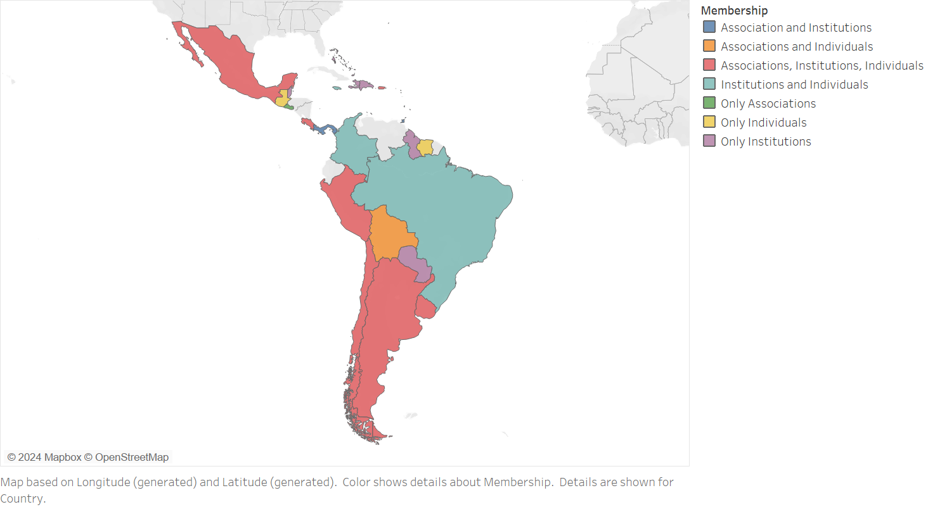

Slide 11

BEING A LIBRARIAN IS A MISSION.
BUT BEING WITH LIBRARIANS IS ALSO AT THE HEART OF OUR PROFESSION.
IFLA PROVIDES US WITH ENCOUNTER, DIALOGUE, AND KNOWLEDGE.
What does
IFLA Membership mean to you?
IFLA Personal Affiliate

Slide 12

What is the main highlight from your IFLA Membership?
AS A MEMBER OF THE MULTICULTURAL POPULATIONS COMMITTEE,
I RECEIVED A CALL FOR A BOOK CHAPTER AND IT WILL BE MY FIRST TIME BEING PUBLISHED!
IFLA Personal Affiliate

Slide 13

What would you say to others about IFLA?
IT IS A GLOBAL COMMUNITY OF LIBRARY AND INFORMATION PROFESSIONALS WITH A COMMON GOAL OF MAKING A DIFFERENCE!
IFLA Member

Slide 14


Slide 15
Who else could benefit from IFLA membership?
Let us know who the key universities and other institutions are!

Slide 16
Library Map of the World

Slide 17


Library Map of the World
librarymap.ifla.org
Data
Country Profiles
SDG stories

Slide 18
Library Map of the World
Library Map – today
Contributors
Library data
Country profiles
SDG stories
Resources
Library Map – future

Slide 19
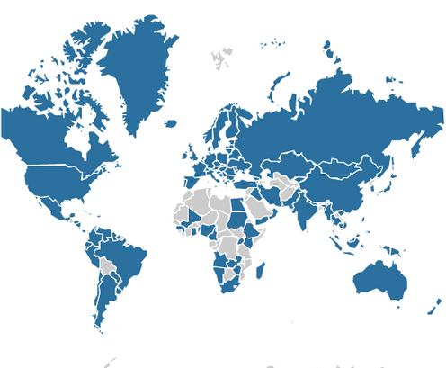
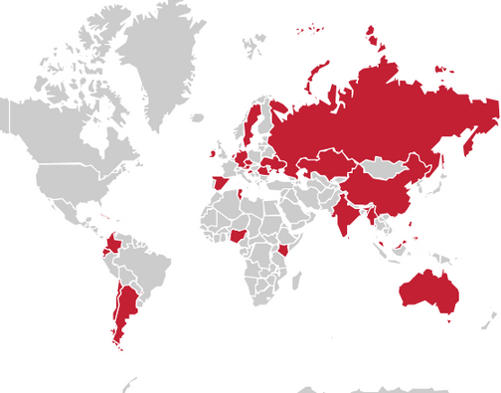
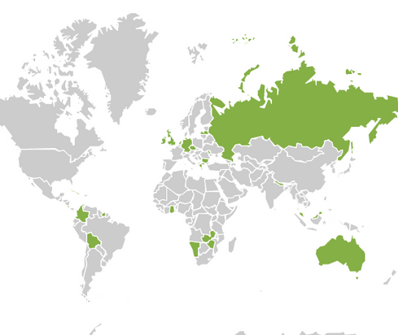
Library Map of the World Contents
Library Statistics
SDG Stories
Country Profiles
147
58
31
countries
stories
countries

Slide 20
Library Map of the World Contents – LAC
Library Statistics
SDG Stories
Country Profiles
33
11
7
countries
stories
countries

Slide 21



Main contributors
Main contributor – an organisation (national library association, national library or other institution) which committed to contributing data and/or country profile.
Take responsibility for collaboration with local partners and stakeholders in their country during data gathering and preparation of content for their country profile,
Act as key contact for the Library Map team during data and content submission and curation.
El Mapa Mundial de Bibliotecas | 2023

Slide 22
Our main contributors

Slide 23
Our main contributors – LAC

Slide 24
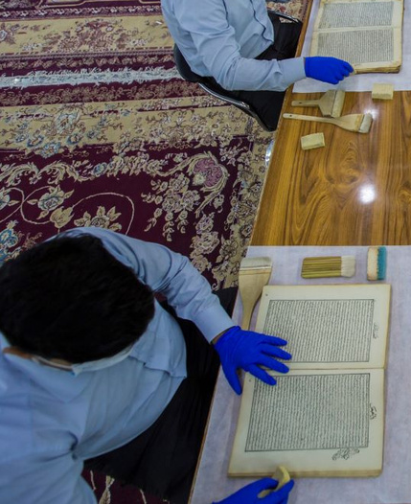




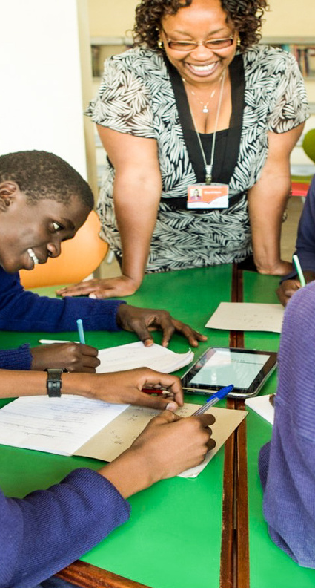


SDG Story contributors –
Each individual library or an organisation which submitted information for an SDG story and worked with the Library Map team during its curation.

Slide 25

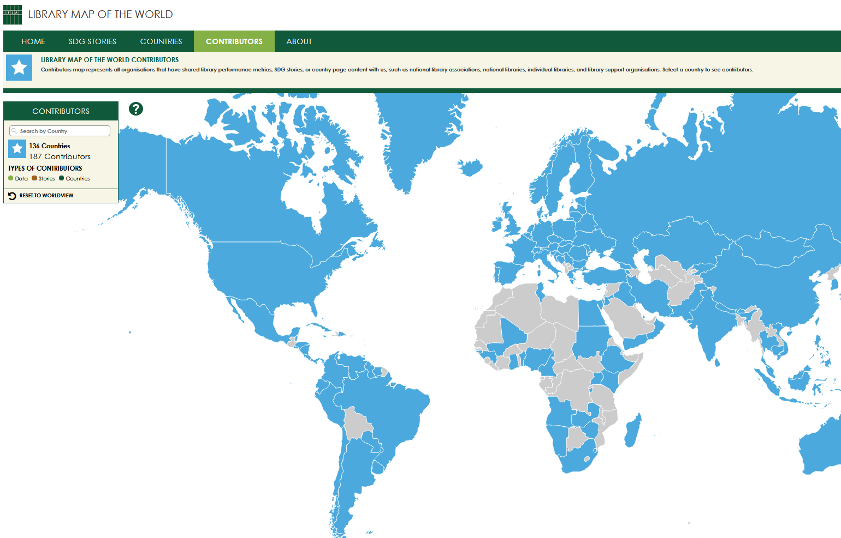


Find contributors on the Map
Contributors with published content (data, country profiles, stories) are listed by country on the Contributors page of the Library Map of the World website.
Search by country or click on the Map to find out who are contributors
from your country!

Slide 26
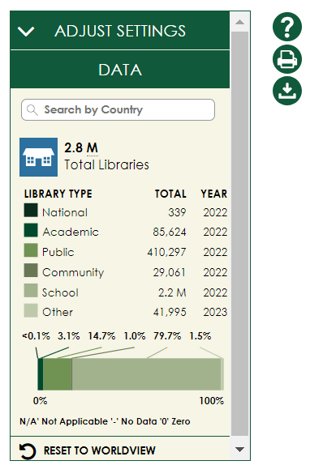
librarymap.ifla.org
A source of country-level library statistics covering all library types

Slide 27
Library data
Country-level library statistics
Updated throughout the year in collaboration with main contributors
Eight basic performance metrics –
Number of libraries
Libraries with Internet access
Staff and volunteers
Registered users and physical visits
Physical and electronic loans
All library types –
National libraries
Academic libraries
Public libraries
Community libraries
School libraries
Other libraries

Slide 28
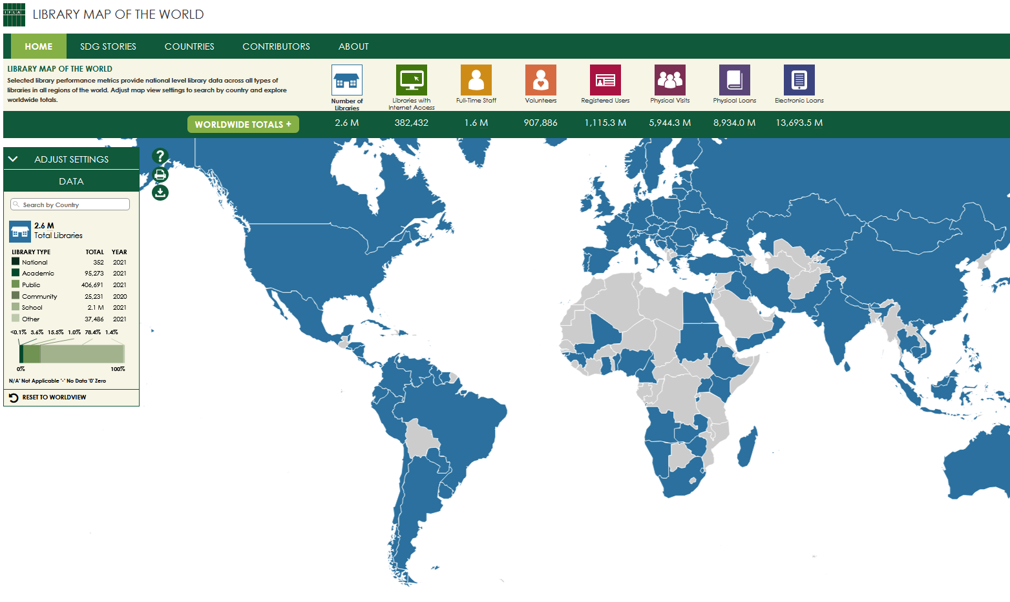

Find data on the
Home page of the Map
Search by country or click on the Map to see your country’s data
Explore worldwide and regional totals
Download the full dataset in csv and make your own data analysis

Slide 29
Countries with published data – LAC (33)

Slide 30
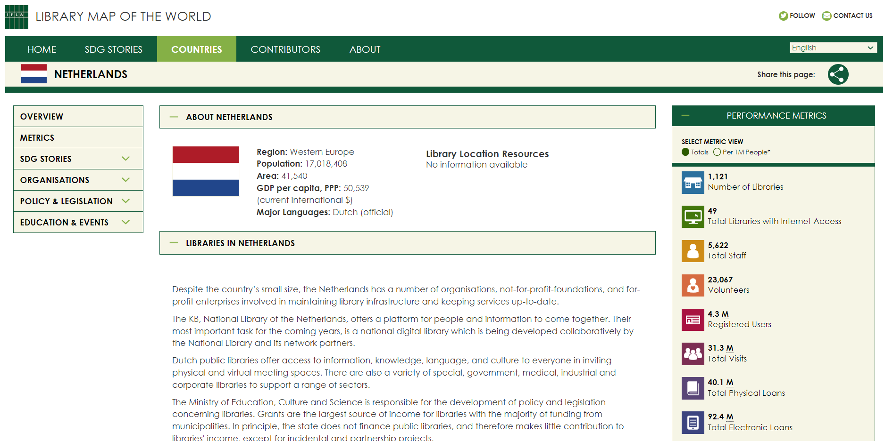
librarymap.ifla.org/countries
A source of information about the library environment, organisations and institutions, policy and legislation, education, and events in each country

Slide 31
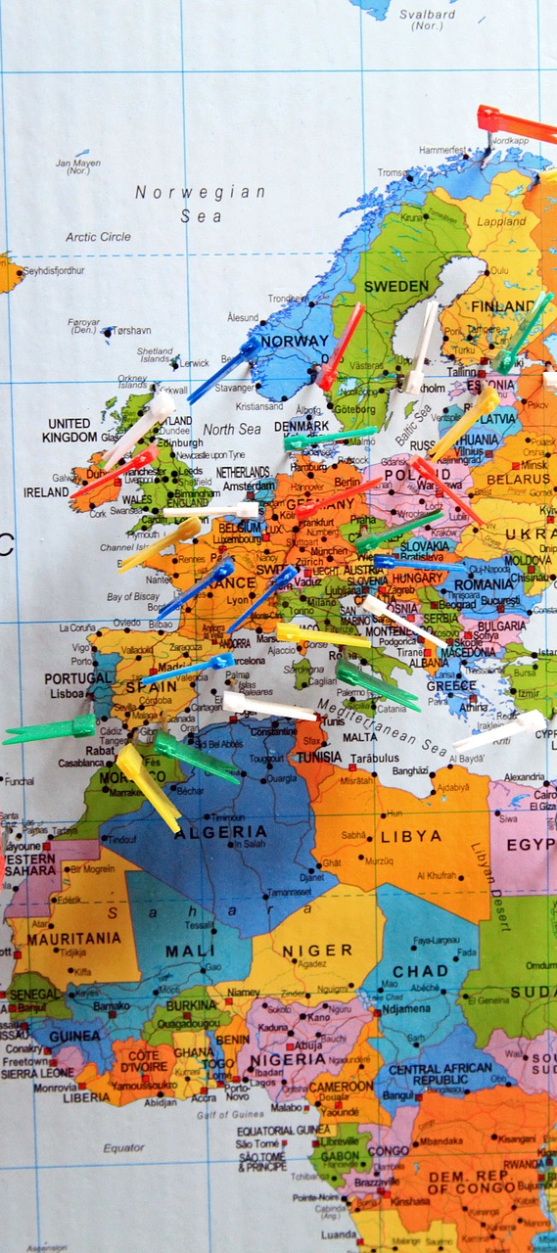

Country profiles (1)
Overview of the library environment – library system, facts and features of different library types, governance and funding models, development and policy priorities, role of library association, recent achievements in the library field.
Links to library location resources – maps maintained by other organisations containing individual library location data
Aggregated view of performance metrics and contextual indicators , including data on population and geography, information and infrastructure, poverty and employment, education and literacy, innovation and skills

Slide 32
Country profiles (2)
Information about organisations – national library associations, national libraries, policy making institutions, library support organisations
Links to national policy documents and legislation such as library law, legal deposit law, copyright and library exceptions
Information about education and events – professional qualification requirements, librarians’ education, links to professional publications and events
Links to country’s SDG stories

Slide 33
Country profiles – LAC
(7 countries)
Bolivia
Colombia
Costa Rica
Cuba
Saint Kitts and Nevis
Saint Lucia
Suriname

Slide 34
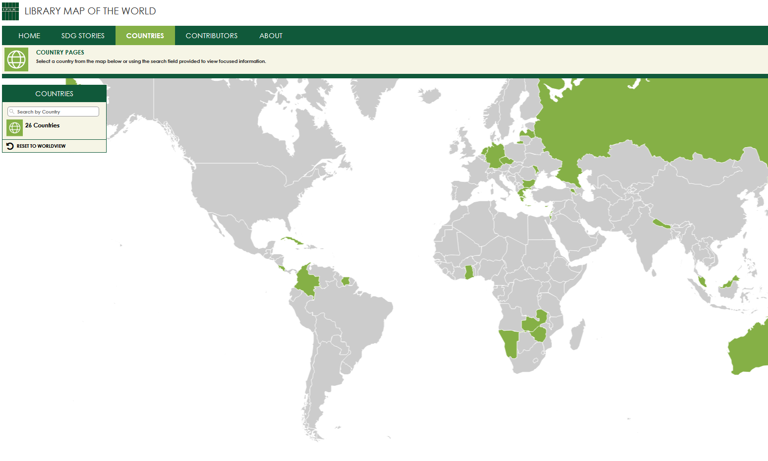
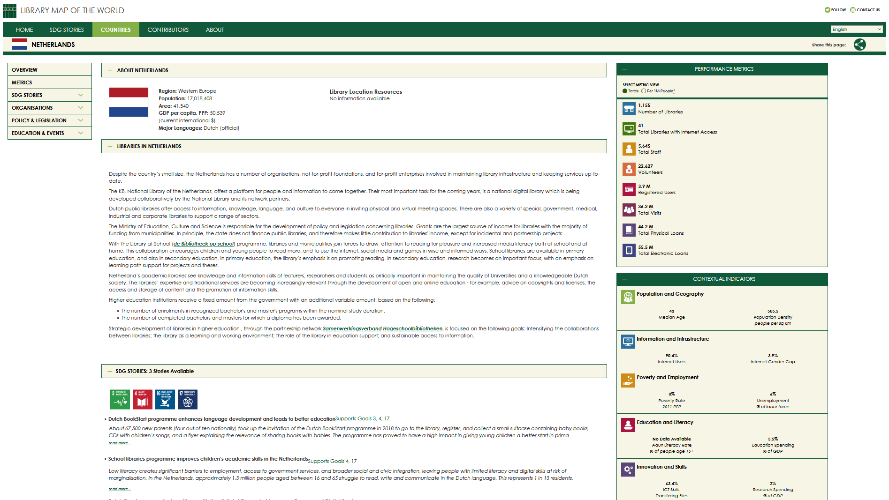
Explore Countries tab
of the Map
Search by country or click on the Map to access country profiles

Slide 35


















librarymap.ifla.org/stories
a collection of inspiring stories about impactful library programmes contributing to achievement of the UN Sustainable Development Goals

Slide 36

Ensuring that stakeholders understand our value and impact
Photo: bit.ly/3oeWjth

Slide 37
SDG Stories – LAC
(11 stories)
Argentina (5)
Chile (1)
Colombia (2)
Costa Rica (1)
Cuba (1)
Ecuador (1)

Slide 38
Power your advocacy with the Library Map!
Library Statistics
SDG Stories
Country Profiles
147
58
31
countries
stories
countries

Slide 39
Library Map data allowing for comparisons
Table 4: Public/Community Library Workers per Institution
 | Low | Average | High
Asia-Oceania | 0.06 | 0.80 | 21.10
Europe | 0.58 | 2.25 | 7.00
LAC | 0.13 | 2.32 | 37.00
MENA | 2.15 | 2.86 | 6.23
North America | 0.59 | 6.88 | 8.13
Sub-Saharan Africa | 1.08 | 1.61 | 8.79
World | 0.06 | 1.77 | 37.00

Slide 40
Library Map data allowing for comparisons
Researchers per Academic Librarian
 | High | Average | Low
Asia-Oceania | 1.235892 | 25.42 | 225.384
Europe | 3.186695 | 26.69 | 354.48
LAC | 0.603956 | 3.70 | 18.58196
MENA | 6.382644 | 19.08 | 21.58446
North America | 18.7384 | 18.98 | 21.5544
Sub-Saharan Africa | 5.695613 | 13.08 | 43.85543
World | 0.603956 | 22.42 | 354.48

Slide 41
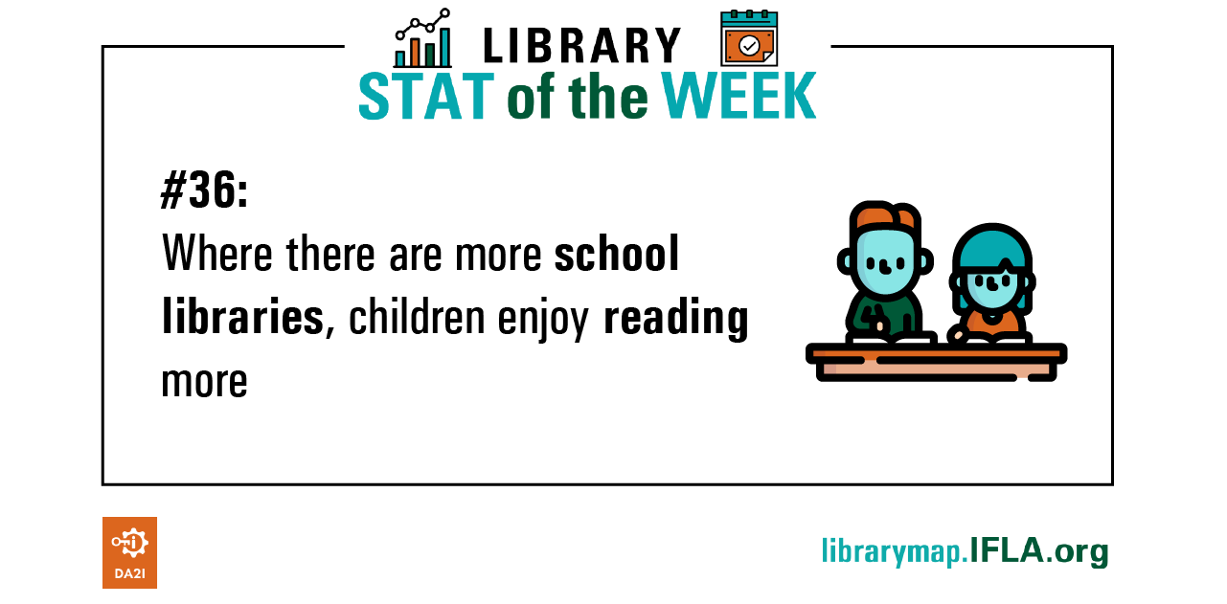
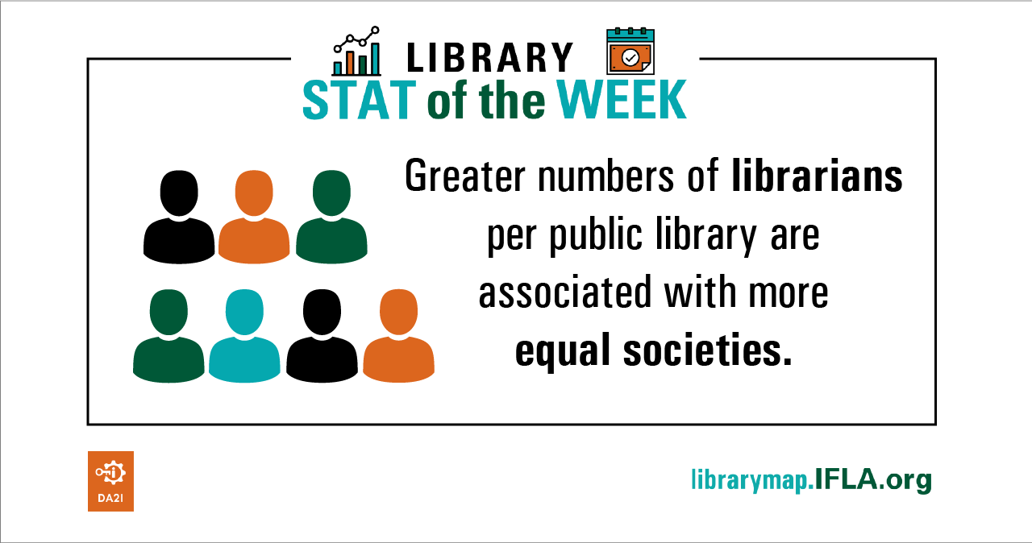
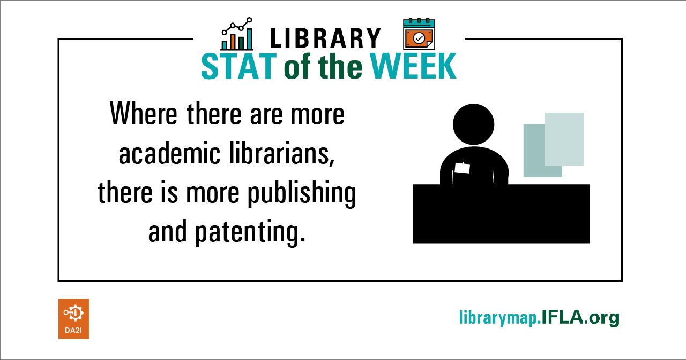
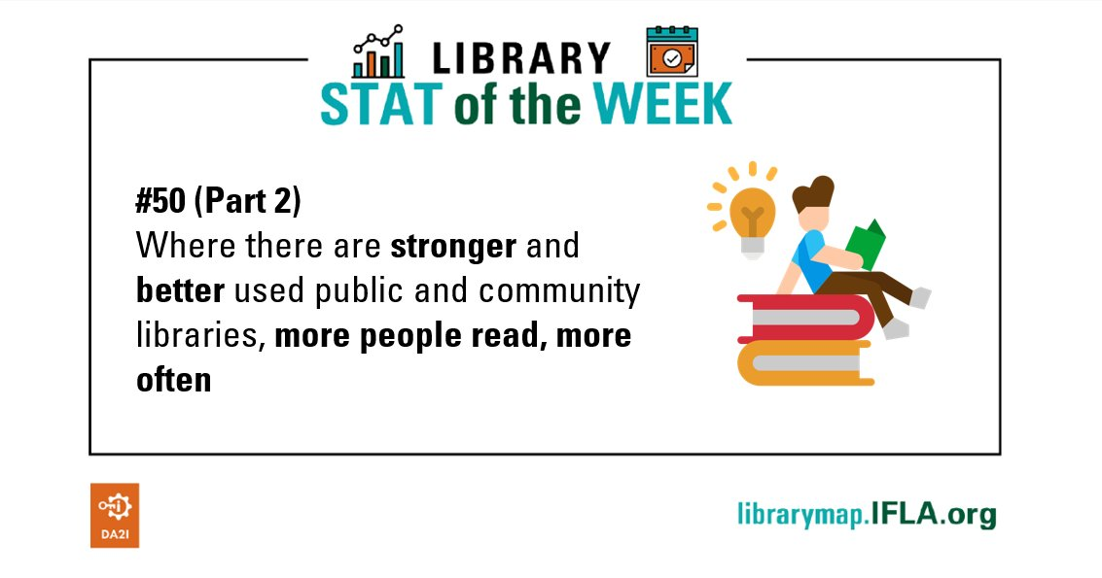
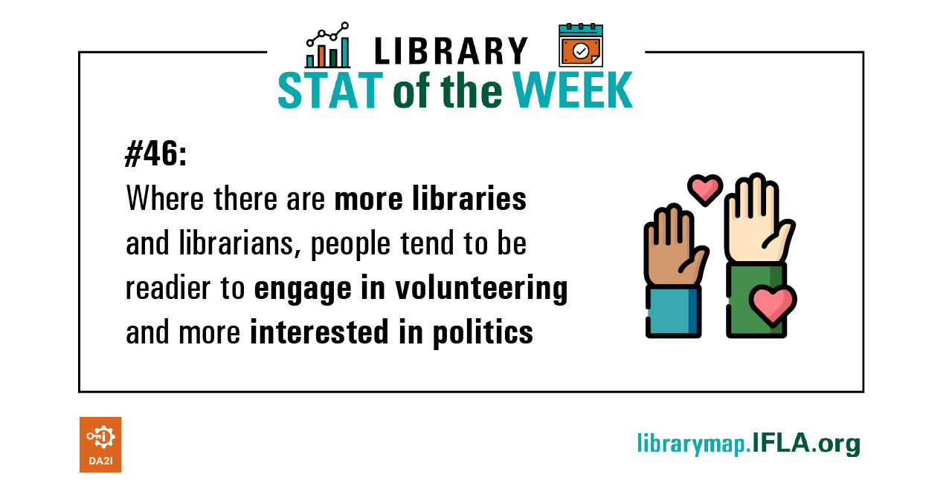
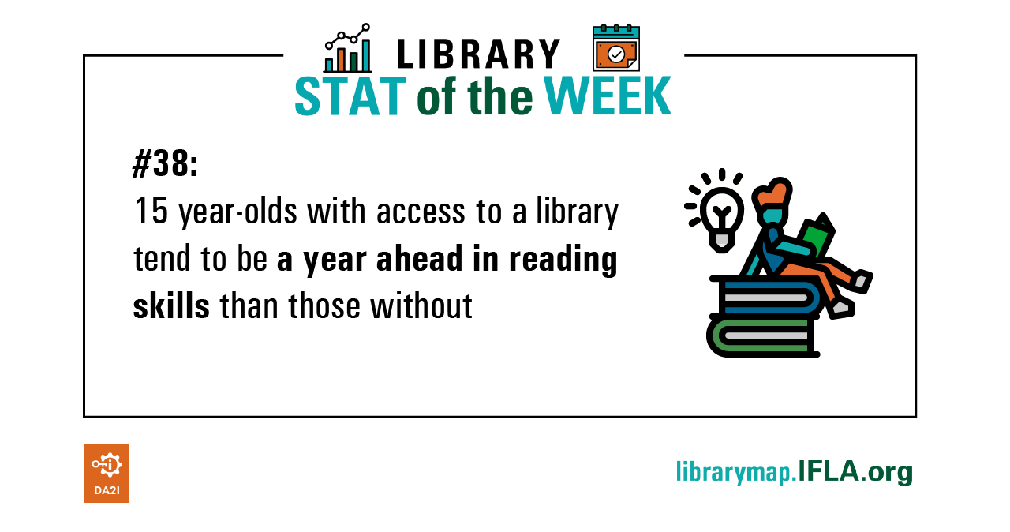
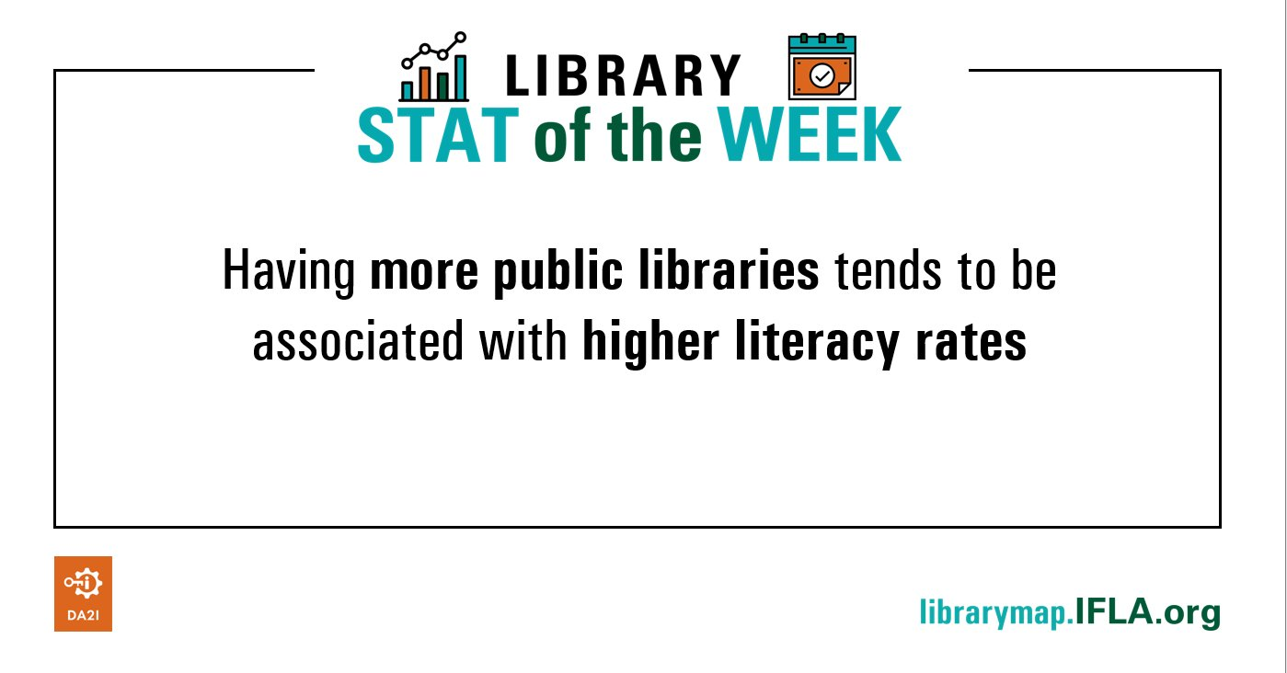
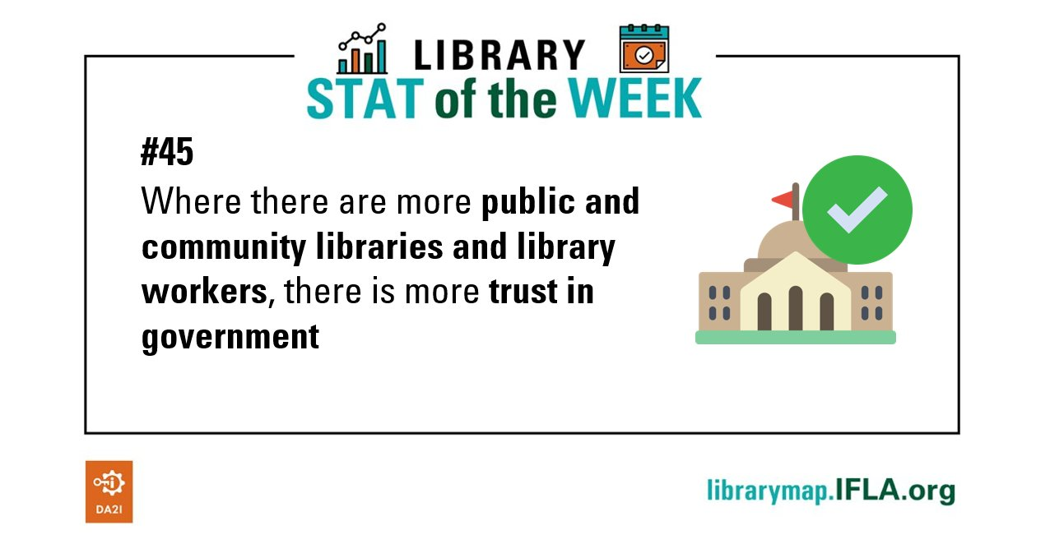
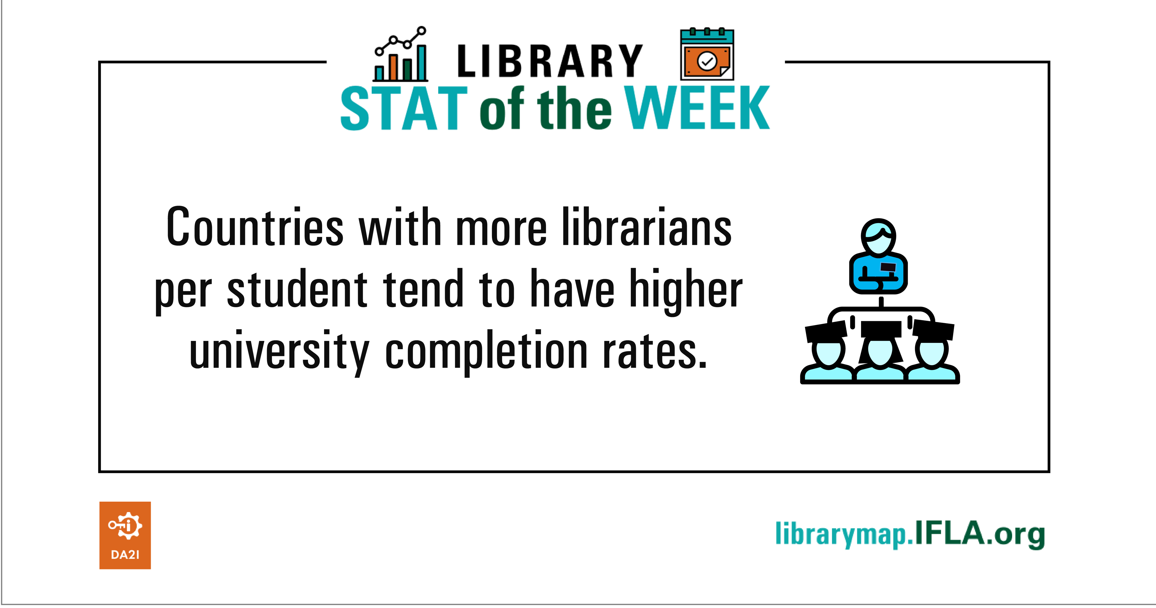
Library Map data as development metric #LibraryStatOfTheWeek

Slide 42

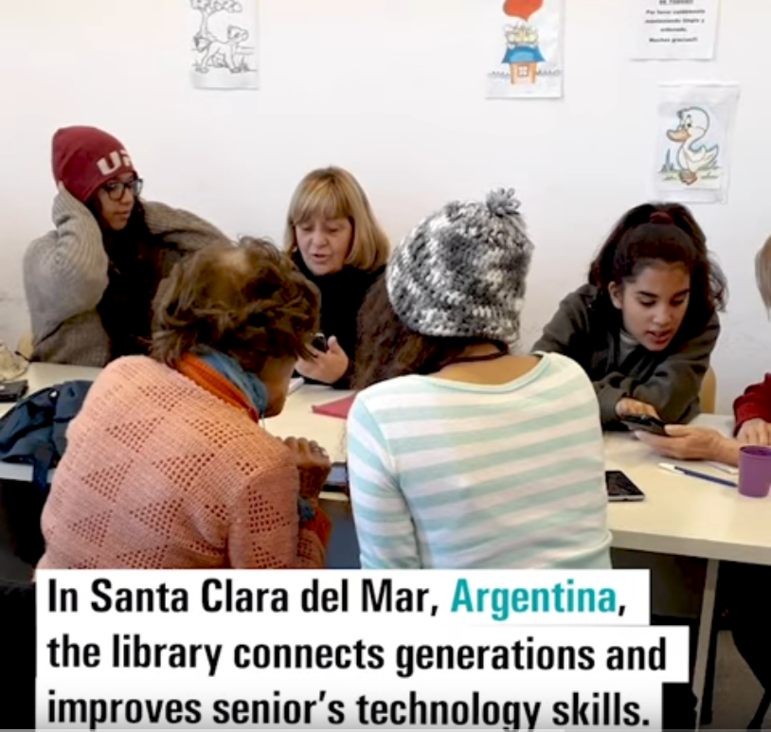
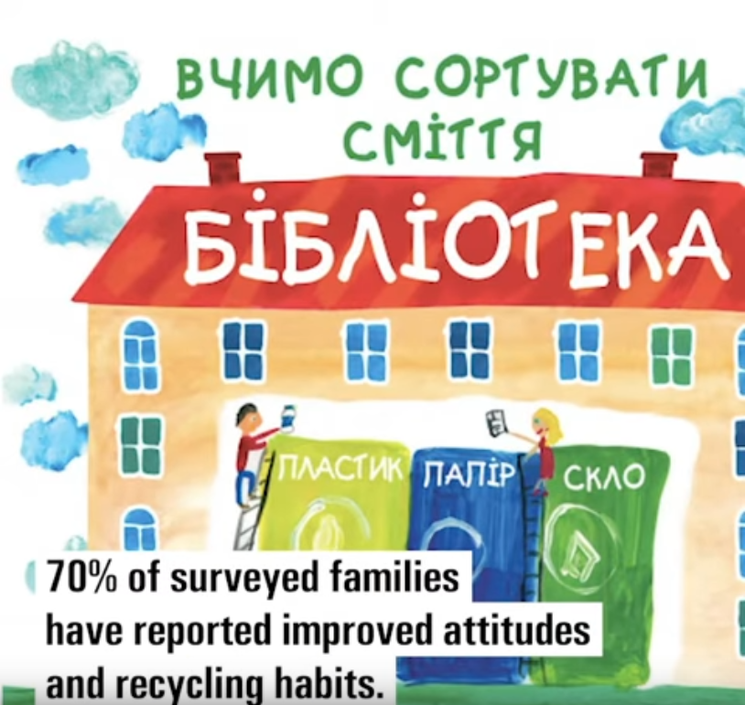

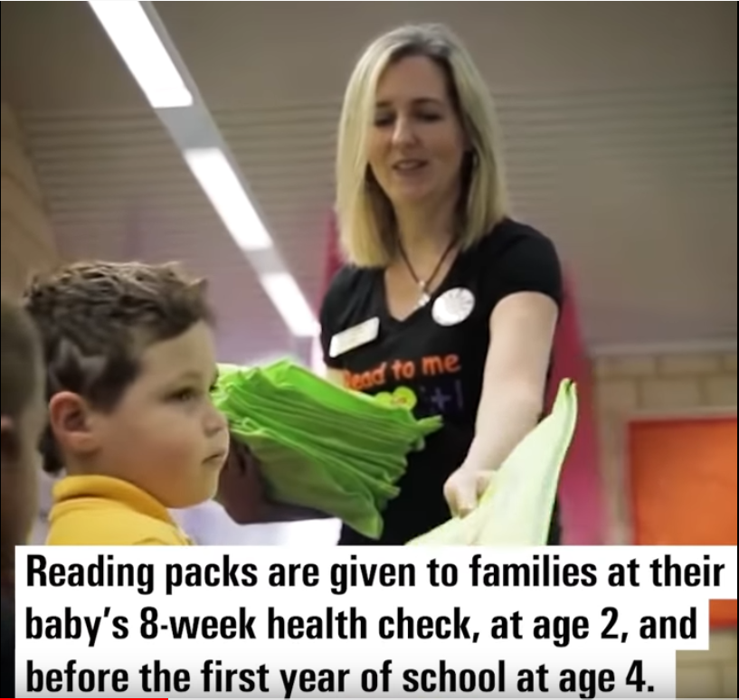
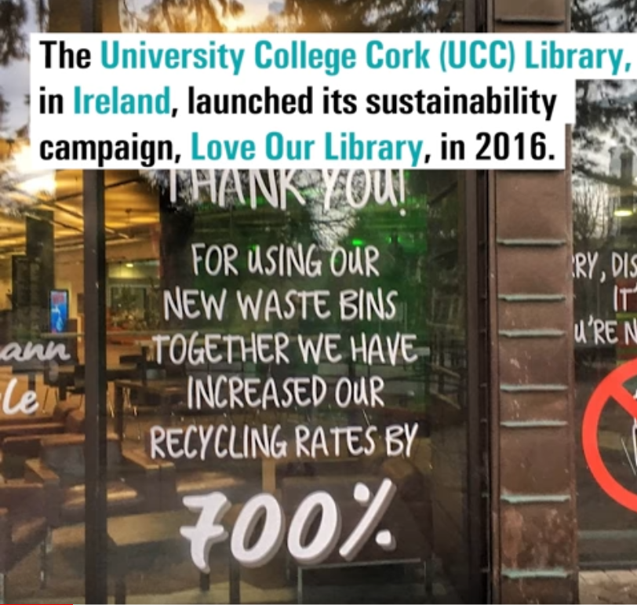
YouTube playlist – IFLA LMW SDG Stories

Slide 43
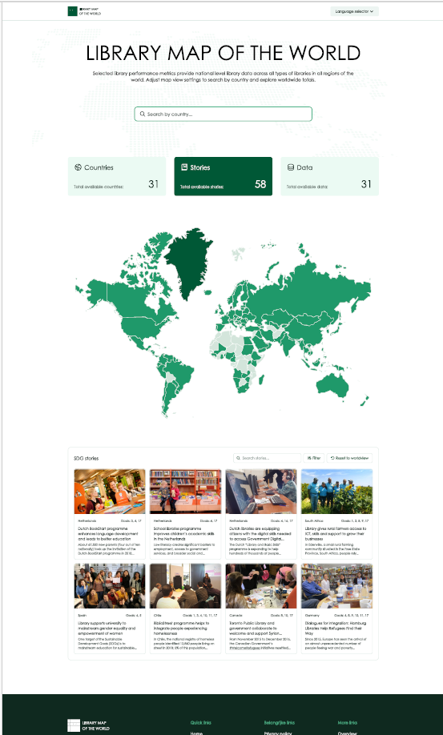
Library Map Redesign
Improved information architecture
Modern and responsive visual design, including mobile design
Meaningful content visualisation and display
Efficient content management system

Slide 44

DISCUSSION
Potential of the Library Map of the World

Slide 45
DISCUSSION: Potential of the Library Map of the World
Let’s discuss:
How can we more effectively use the Library Map of the World to strengthen the voice of libraries and to build a sustainable library field in the LAC region and each country within it?
What can you do to help achieving it?

Slide 46

Break
Photo by Mike Kenneally on Unsplash, unsplash.com/photos/TD4DBagg2wE

Slide 47
Planning for impact

Slide 48
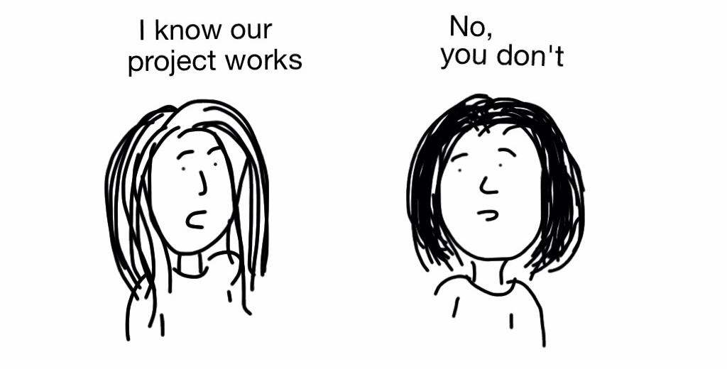
Measurement and Evaluation - Why

Slide 49

Understanding community needs and designing
services for impact
Foto: bit.ly/3Ds082o

Slide 50
Ensuring that stakeholders understand our value and impact
Photo: bit.ly/3oeWjth

Slide 51
QUESTION
What are some of the main challenges for you when it comes to demonstrating value and impact?
Go to www.menti.com and use the code 4916 9923

Slide 52

Measuring and Demonstrating Impact – Challenges and Solutions
Photo: bit.ly/3lygq3F

Slide 53
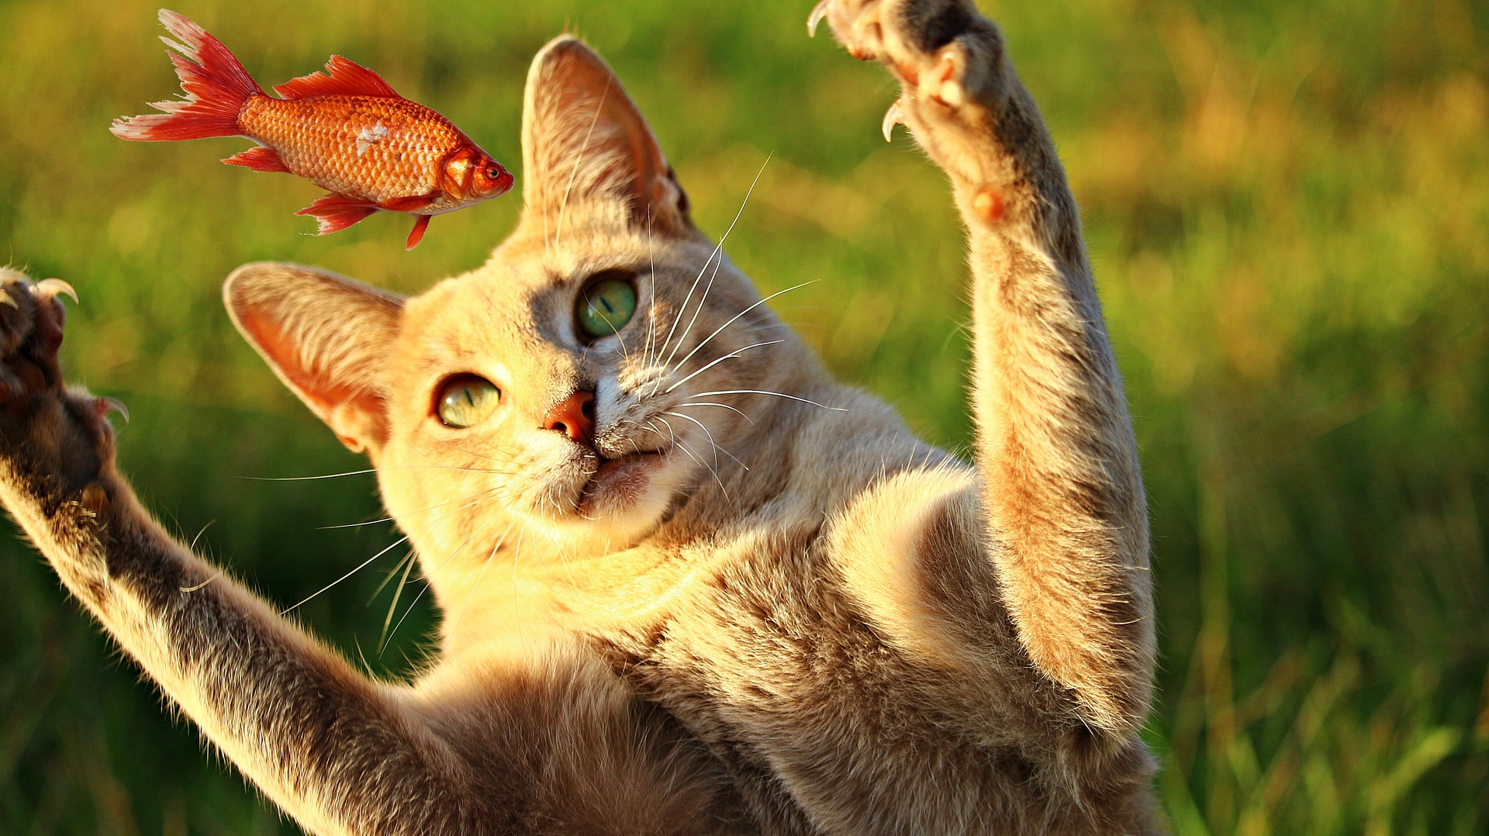
Knowing your target and setting meaningful measures
Photo: bit.ly/2YFFBbp

Slide 54

Understanding stakeholders, their goals, objectives and values
Photo: bit.ly/3FE69Lu

Slide 55

Defining targeted outcomes and impact into the design
Photo: bit.ly/3mLaLGR

Slide 56











Defining targeted outcomes and impact into the design
Photo: bit.ly/3mLaLGR

Slide 57

















Defining targeted outcomes and impact into the design
Photo: bit.ly/3mLaLGR

Slide 58
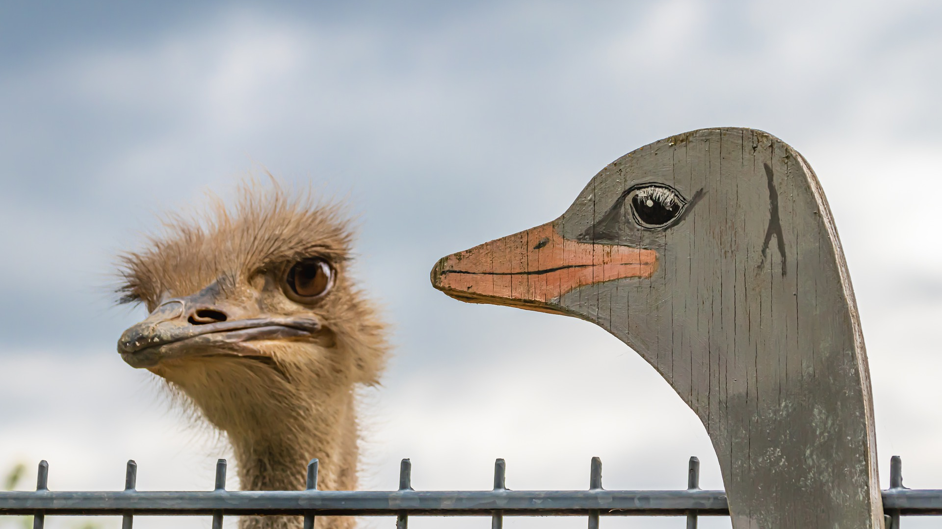
Confusing performance and satisfaction measures with outcome and impact measures
Photo: bit.ly/3v4BJwK

Slide 59
Shortly about measures
Community & Needs data
Outputs & Performance data
Satisfaction data
Outcomes data
Why?
How much?
How effective?
How well?
What’s the benefit?
So what?
Community and target group needs
Library activities, projects, programmes
Satisfaction of users and participants
Outcomes for people and impact on community

Slide 60
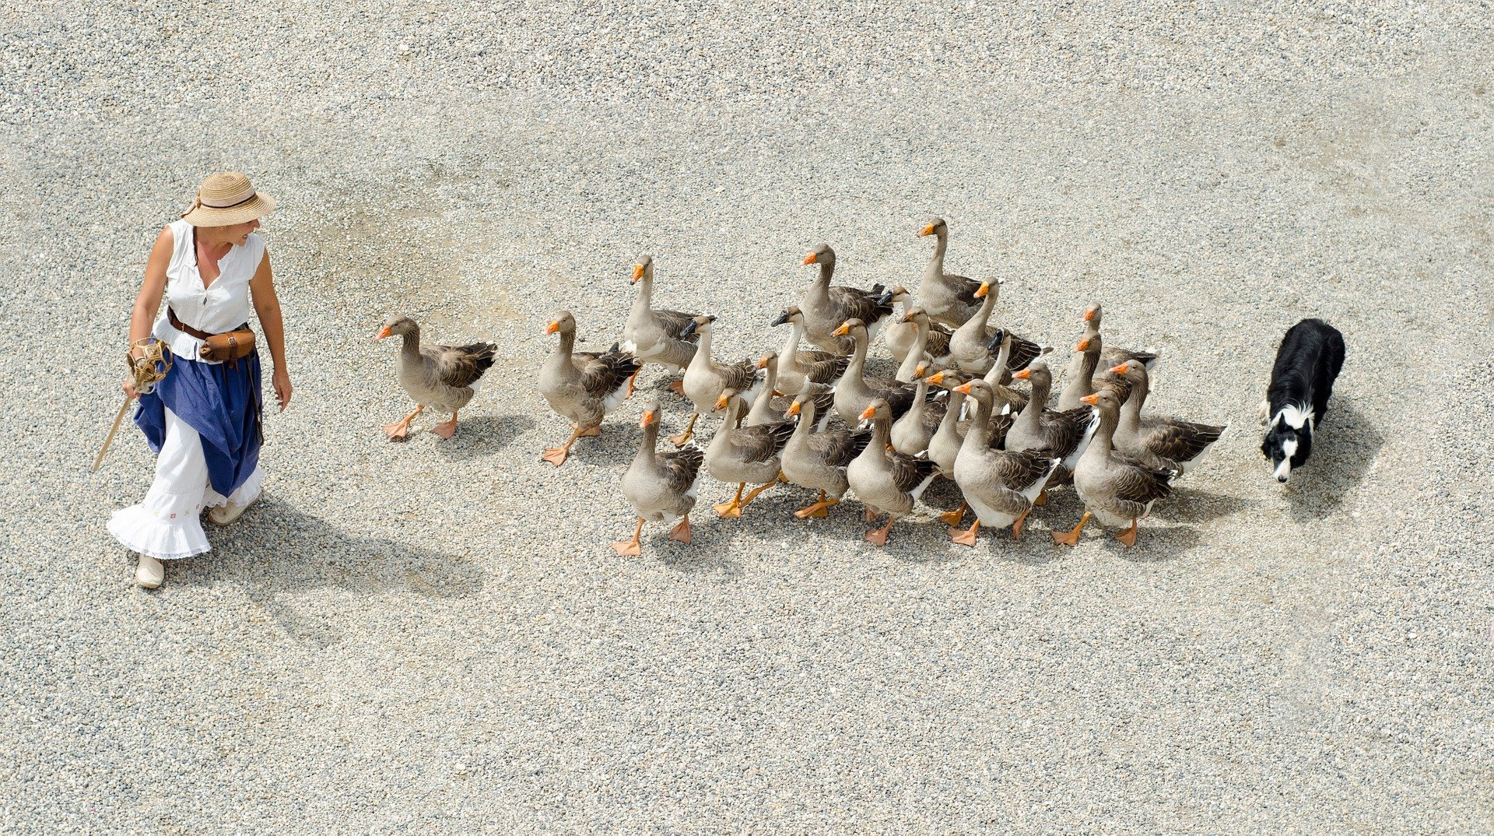
Having a role responsible for managing library’s measures
Photo: bit.ly/3v4Yd0D

Slide 61

Positioning our actions for impact – How?
Photo: bit.ly/3lV3Qu6

Slide 62
Conditions Needs
Inputs Resources
Activities
Outputs
Outcomes
Impact
There is a challenge or a problem in community, which library can help addressing through a programme that meets the needs
Certain resources are needed to operate your programme
If you have access to them, then you can use them to accomplish your planned activities
If you accomplish your planned activities, then you will hopefully deliver the amount of product and/or service that you intended
If you accomplish your planned activities, to the extent you intended, then your participants will benefit in certain ways
If these benefits to participants are achieved, then certain changes in organisations, communities, or systems might be expected to occur

Slide 63













Needs
Inputs
Activities
Outputs
Outcomes
Impact
Photo: bit.ly/3AsNVIU

Slide 64
Impact
Outcomes
Outputs
Activities
Inputs
Conditions/Needs
Community-centred
Logic Model
Aligning activities to meet community needs

Slide 65
Impact (What changes in community do you expect to occur?)
Outcomes (What changes in conditions do you expect to see?)
Outputs (What direct results of your actions do you expect?)
Activities (What activities will you implement to address the needs?)
Inputs (What resources will you use to address the needs?)
Conditions/Needs (What challenge you will contribute to? What are the target group needs?)
Community-centred
Logic Model
Aligning activities to meet community needs

Slide 66
Conditions Needs
Inputs Resources
Activities
Outputs
Outcomes
Impact
There is a challenge or a problem in community, which library can help addressing through a programme that meets the needs
Certain resources are needed to operate your programme
If you have access to them, then you can use them to accomplish your planned activities
If you accomplish your planned activities, then you will hopefully deliver the amount of product and/or service that you intended
If you accomplish your planned activities, to the extent you intended, then your participants will benefit in certain ways
If these benefits to participants are achieved, then certain changes in organisations, communities, or systems might be expected to occur

Slide 67
Needs
Inputs
Activities
Outputs
Outcomes
Impact
Photo: bit.ly/3AsNVIU

Slide 68
























Impact
Needs
Outcomes
Inputs
Outputs
Activities
Photo: bit.ly/3AsNVIU

Slide 69









1 = Stakeholder perspective
2 = People perspective
3 = Library perspective
Impact
Needs
Outcomes
Inputs
Outputs
Activities
Photo: bit.ly/3AsNVIU

Slide 70
1 = Stakeholder perspective
2 = People perspective
3 = Library perspective
Reduced unemployment rates
Employment
People who improved skills, found job
Resources: Staff, equipment, money
Number of trained people
Job skills training
Photo: bit.ly/3AsNVIU

Slide 71
1 = Stakeholder perspective
2 = People perspective
3 = Library perspective
Improved recycling rates
Contamination on the beach
People who see benefit in recycling
Resources: staff, time, money
Number of trained people; kg of trash removed
Training to recycle; Event on the beach
Photo: bit.ly/3AsNVIU

Slide 72
1 = Stakeholder perspective
2 = People perspective
3 = Library perspective
Enabled youth development; Bridging digital gap
Lack of ICT in schools; Failed exams
Improved skills; Enhanced learning; Improved exams
Mobile library van; Equipment; Digital content; Staff
Number of visits; Number of trained
Visits to schools; Hands-on training
Photo: bit.ly/3AsNVIU

Slide 73
Ensuring that stakeholders understand our value and impact
Photo: bit.ly/3oeWjth

Slide 74
Outcomes. Impact. Change.

Slide 75

Impact (What changes in community do you expect to occur?)
Outcomes (What changes in conditions do you expect to see?)
Outputs (What direct results of your actions do you expect?)
Activities (What activities will you implement to address the needs?)
Inputs (What resources will you use to address the needs?)
Conditions/Needs (What challenge you will contribute to? What are the target group needs?)
Community-centred
Logic Model
Aligning activities to meet community needs

Slide 76
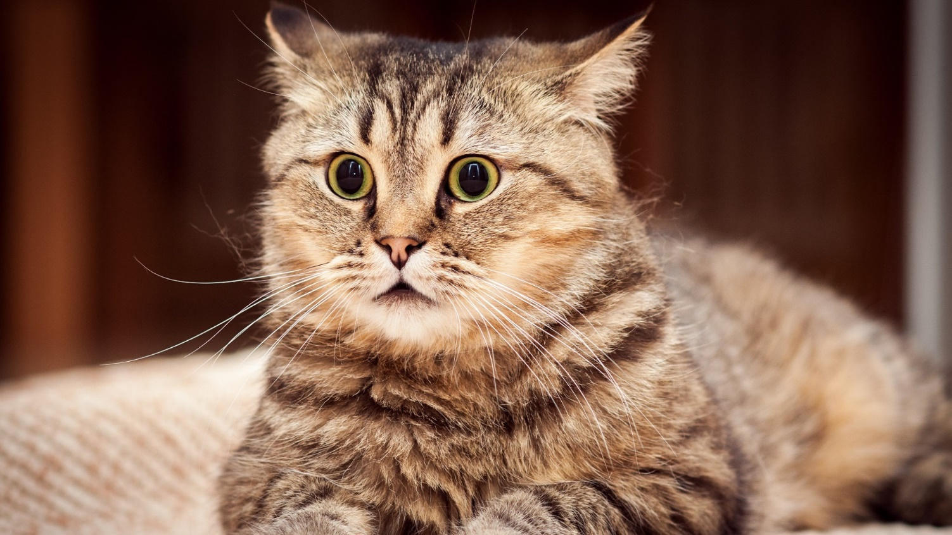
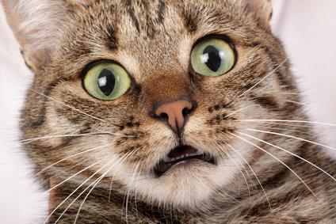
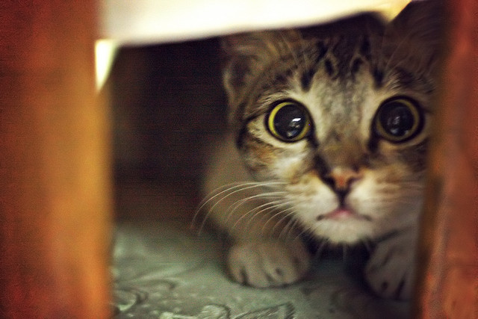
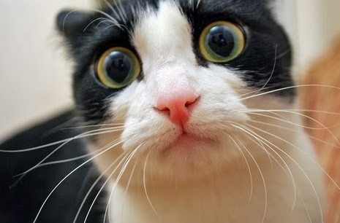
Impact Evaluation
Will I be evaluated?!
What is going to happen now?
Maybe next year…?
Maybe they will forget about me?

Slide 77
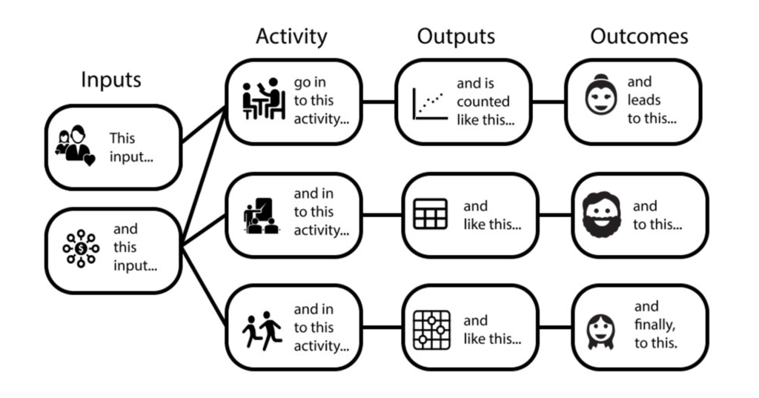
Impact is about change and outcomes for people
https://freshspectrum.com/charts-and-illustration/

Slide 78
What is an Outcome?
The way a thing turns out
https://en.oxforddictionaries.com

Slide 79
Outcomes for people
An outcome is a specific benefit that results from a library program or service designed to help patrons change their awareness, knowledge, skills, attitudes, or behavior.
Outcomes are expressed as changes individuals perceive in themselves.
Outcomes can be quantitative or qualitative.
Needs
Inputs
Activities
Outputs
Outcomes
Impact

Slide 80
How does change occur?
Changes in conditions
Impact
Behavior
Attitudes
Skills
Knowledge
Awareness
Time

Slide 81
Example – Training on smartphone use
I feel connected, less isolated
Impact
I use s-phone every day
I think s-phone is useful for me
I know how to use s-phone
I know more about s-phone
I am aware smartphones exist
Time

Slide 82
Impact Planning
Impact objectives
Outcome indicators
Data and evidence

Slide 83
Impact Objectives (Outcomes)
Clear and achievable within a specific time span
Realistic, taking into account your resources
Carefully worded

Slide 84
How to write good outcomes (impact objectives)?
Verb indicating change
What will change
Who will change
Additional specificity
Examples:
To increase
To establish
To reduce
To create
To improve
To produce
To change
Examples:
Access
Availability
Awareness
Knowledge
Skills
Attitudes
Behaviors
Examples:
Children
Young women
Seniors
School dropouts
Illiterate adults
Local farmers
Teachers
Where you expect to see this change? geography)
By when you expect to see the change? (date)
How much change you intend to see? (target)

Slide 85
Outcome Indicators (Measures)
An outcome indicator is a specific, observable, and measurable characteristic that will represent achievement of the outcome.
It is important to think through indicators that can tell you both:
Whether the outcome has occurred
And by how much

Slide 86
Example
Activity: Reading promotion programme
Impact Objective: To improve reading skills and habits among children in [geography] by [year]
Outcome: Improved reading skills and habits among children
Outcome Indicators:
Number of books children read during certain period of time
Percentage of children with good reading skills
Change in children’s attitude towards reading

Slide 87
EXERCISE
Define a SMART Impactful Collaborative Action

Slide 88
Defining impactful actions
Through your library sustainability indexes, you have an idea of where you may need to act in order to maximise library sustainability... now to define actions

Slide 89
Yesterday’s ideas (summarised)
Preservation and conservation
Strong infrastructures, incl. technology
Accessibility and access, equality and inclusivity
Skilled workforce, leadership development
Training and empowerment of users
Climate, environmental resilience
Collaboration, forming alliances, partnerships
Community engagement, needs assessment
Ongoing evaluation
Promotion and evidence-based advocacy at all levels
Solid strategies
Financial sustainability
Healthy and open information environment, literacies

Slide 90
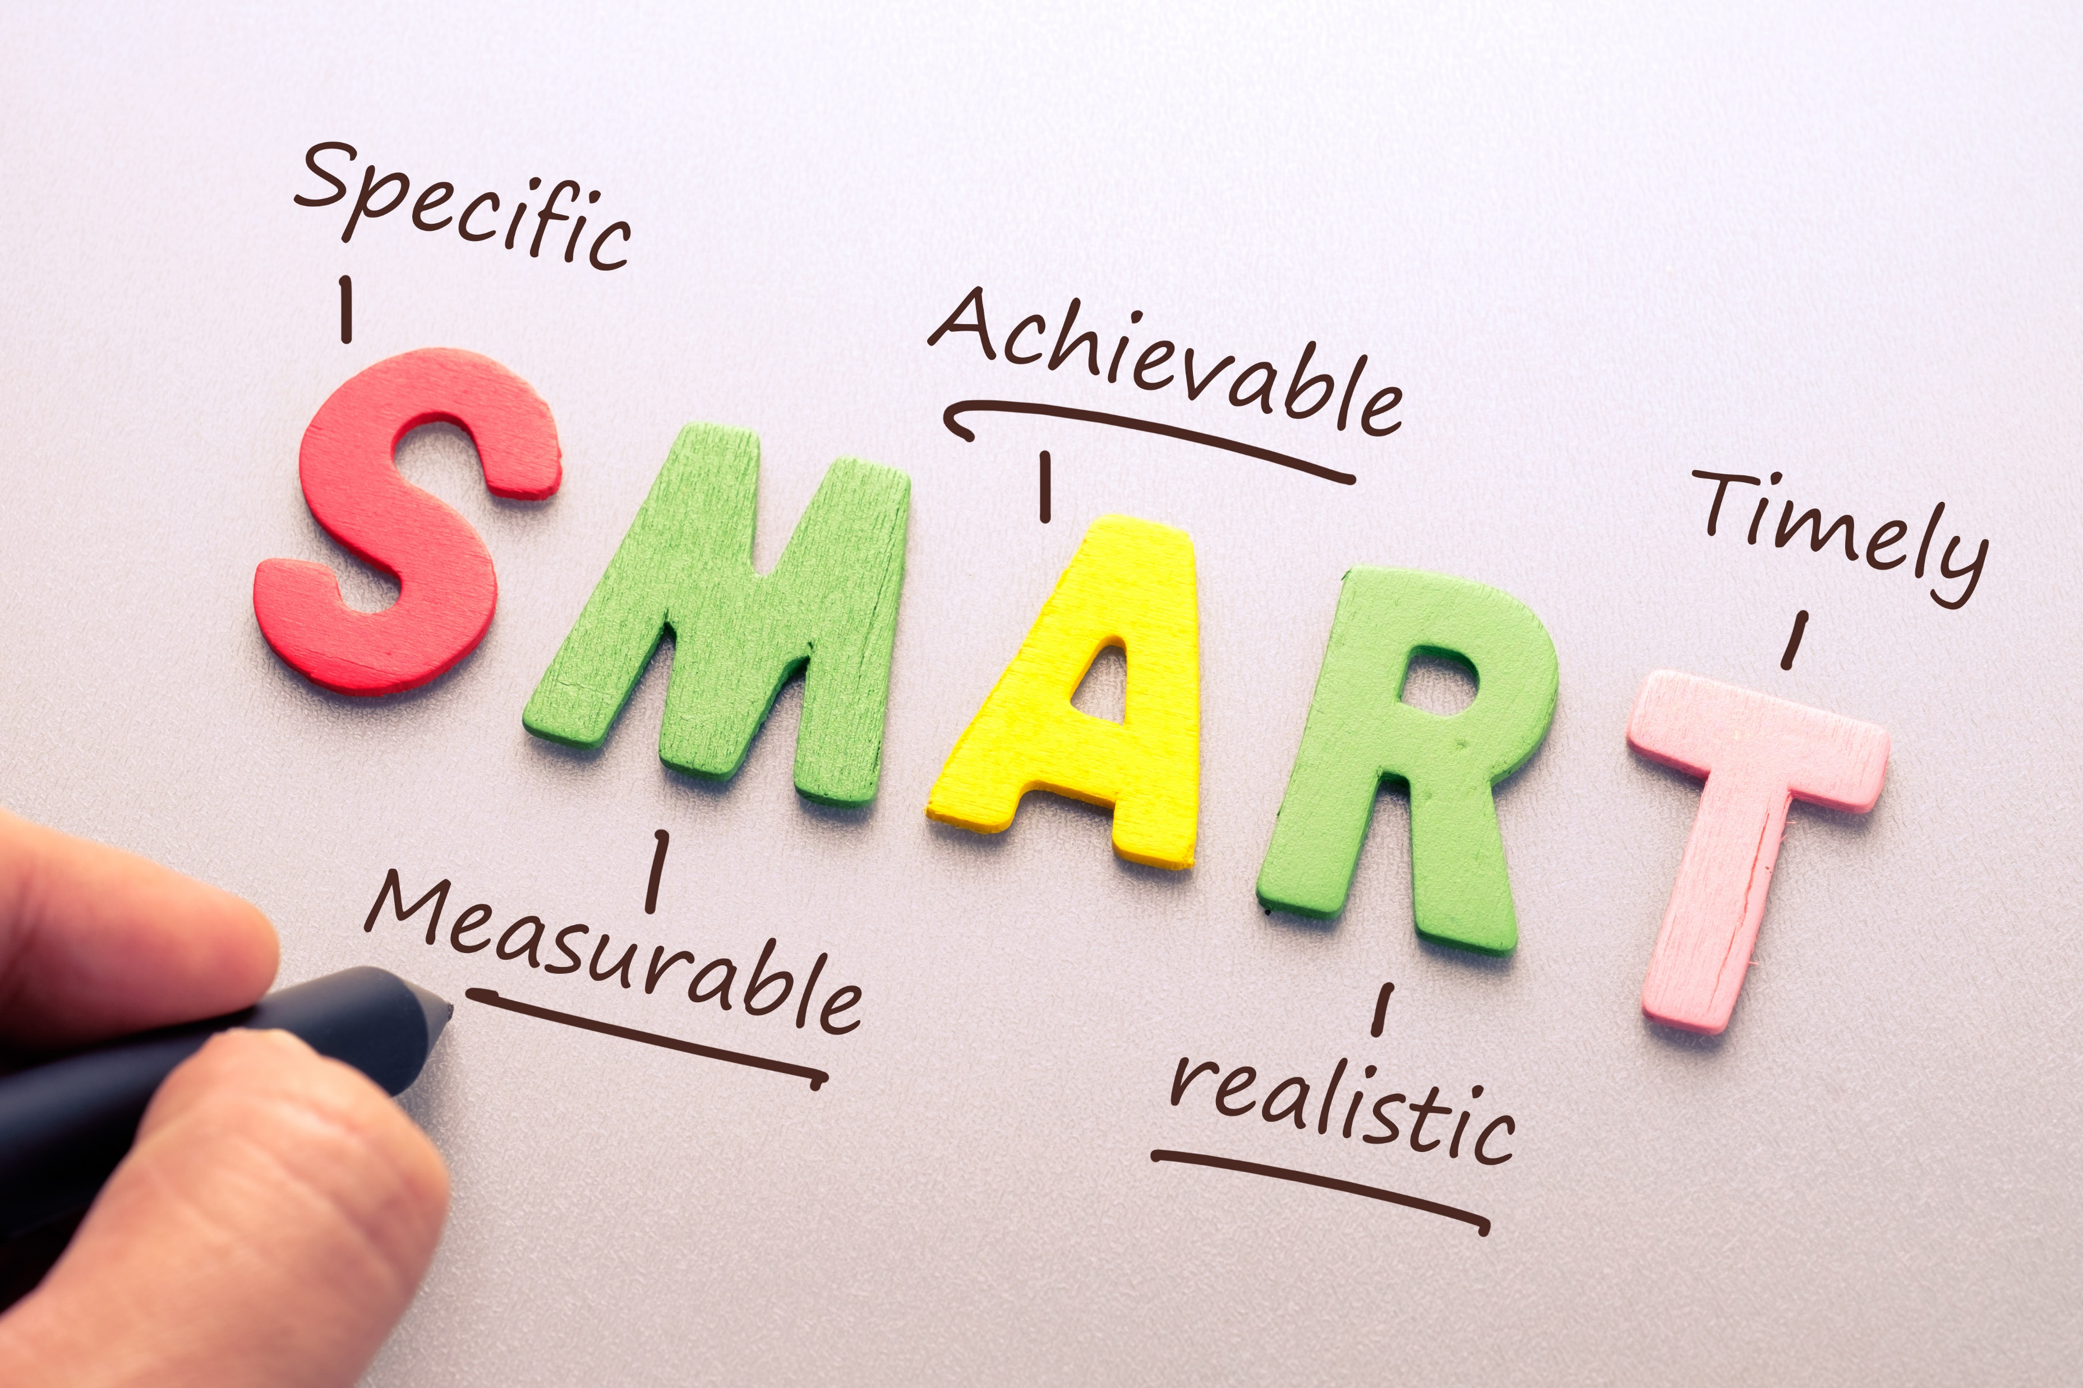
How to define an effective action

Slide 91
Develop
Coordinate
Manage
Support
Upgrade
Create
Implement
Produce
Provide
Maintain
Oversee
Plan
Evaluate
Engage
…
S = Specific
What action will you take?
What are you trying to accomplish? Why?
Who needs to be involved?
Where and when does it need to happen?

Slide 92

M = Measurable
What does success of the action will look like?
What data and evidence will measure the goal?
How much? How well?

Slide 93

A = Achievable
Is it doable?
Do you have the necessary skills, resources and tools?
If not, how can you obtain them?
Do you have the motivation to achieve the goal?
Is the amount of effort required feasible with what the action will achieve?

Slide 94

R = Relevant
Who do you need to take this action now?
How does your action align with other things you do?
Why is result important for your community, library field?

Slide 95

T = Time-bound
What is the timeframe for accomplishing the goal of the action?
What are the deadlines and milestones?
Is it realistic?

Slide 96
EXERCISE: Define an Impactful Collaborative Action
At your table – within a topic of advocacy or sustainability, discuss and identify one collaborative strategic action.
What would be the action with the biggest impact and the least amount of effort?
What would be the target group and some milestones of your action?
Can you make it SMARTer?

Slide 97
EXERCISE
Define Outcomes (Impact Objectives) of Your Collaborative Action

Slide 98
EXERCISE: Define Outcomes (Impact Objectives) of Your Collaborative Action
At your table – discuss and identify outcomes (impact objectives) of your collaborative action.
What would be some of the outcomes (impact objectives) of your action?
How would you evaluate the impact of your action?

Slide 99

Share your findings!
Photo: Matt Botsford on Unsplash, unsplash.com/photos/OKLqGsCT8qs

Slide 100
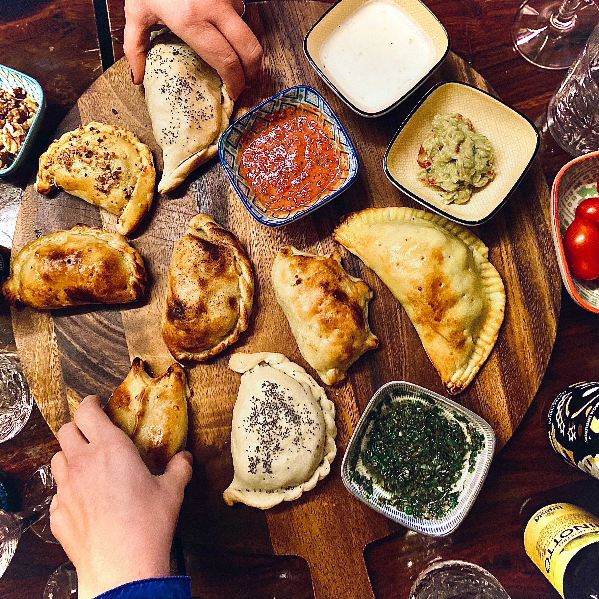
Lunch

Slide 101
Identifying, building and maintaining partnerships

Slide 102

Libraries are not all-powerful…

Slide 103

But we can make excellent partners!

Slide 104

What pieces do we have?
What pieces do we need?
Photo: CrazyPhunk, CC-BY-SA, https://commons.wikimedia.org/wiki/File:Puzzle-piece.jpg

Slide 105

Tables 1, 3, 5, 7: identify 5 unique strengths of libraries that you can contribute to a partnership
EXERCISE
Tables 2, 4, 6: identify 5 things that libraries are less good at, where partners can help

Slide 106
Share your findings!
Photo: Matt Botsford on Unsplash, unsplash.com/photos/OKLqGsCT8qs

Slide 107




The 4 ‘I’s of Strategic Partnerships
INFLUENCE
INNOVATION
INVESTMENT
IMPACT
Notes:
Now let’s look at a simple framework the four Is - to help you identify partnerships needs and also what your offer is.
Think in terms of ‘gap analysis’ – what do YOU need and what do your partners need.
What are your organizational needs/project requirements to achieve impact.

Slide 108
The 4 ‘I’s of Strategic Partnerships
INFLUENCE Partners with access to networks, decision-makers, media, business and others that can help us achieve our goals and create opportunities for new strategic partnerships Partners that help raise our profile and increase recognition of our contribution | INNOVATION Partners with the skills, knowledge, technology or platforms we don’t have and may be too costly or take too long for us to acquire Partners who strengthen our internal capacity - teach us new skills, accelerate learning, provide job shadowing and secondment opportunities etc.
INCOME Partners who provide funding (cash and/or in-kind) or who have access to funders Partners who build our capacity to write funding proposals or diversify and grow income | IMPACT Partners who have experience of delivering change with our target beneficiaries – e.g., hard-to-reach communities Partners and consortia who bring the other 3 ‘I’s (Influence, Innovation & Income) to amplify our work and achieve greater impact than we can alone.
Notes:
Now let’s look at a simple framework the four Is - to help you identify partnerships needs and also what your offer is.
Think in terms of ‘gap analysis’ – what do YOU need and what do your partners need.
What are your organizational needs/project requirements to achieve impact.
This works for advocacy – influence essentially that. And for any kind of project – SDGs a useful framework

Slide 109
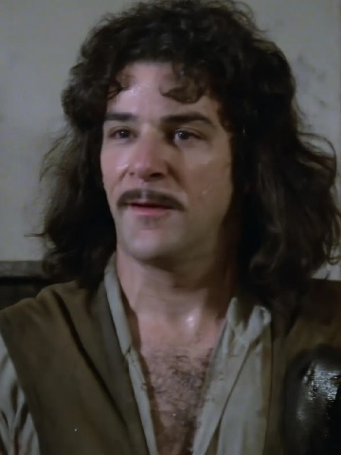
You keep using that word ‘strategic’…

Slide 110
Effective & Sustainable Strategic Partnerships
Are not…
Are…
Vague, open-ended MOUs
Driven just by finances
One-sided
Just friendly agreements
Mutually beneficial – ‘win-win’
Flexible and innovative
Based on a commitment to learning
Built on trust
Organised, accountable and reviewed
Notes:
Focus on strategic
You will not have many of them…
Neither is superior
You need to analyse and understand your offer and listen to the priorities of partners. Listen (and do your research) first.
Always ask yourself: How can I help THEM? How can I be the partner of choice? And why should they partner with us?

Slide 111
EXERCISE: how strategic are your partnerships?
Think of a partnership you are involved in
What makes it work?
What more would you like to do with it?
What do you need to do more?

Slide 112

Go to menti.com
Code: 4916 9923
In which areas would you like to partner more
With which partners would you like to work more?
EXERCISE

Slide 113
Why advocacy matters

Slide 114

EXERCISE
Testing advocacy assumptions

Slide 115
EXERCISE: Testing advocacy assumptions
Decide where you stand (literally) on the following:
In my country, does lobbying have a good or a bad reputation?
Are lobbying and advocacy the same thing?
Is advocacy just a job for senior librarians?

Slide 116
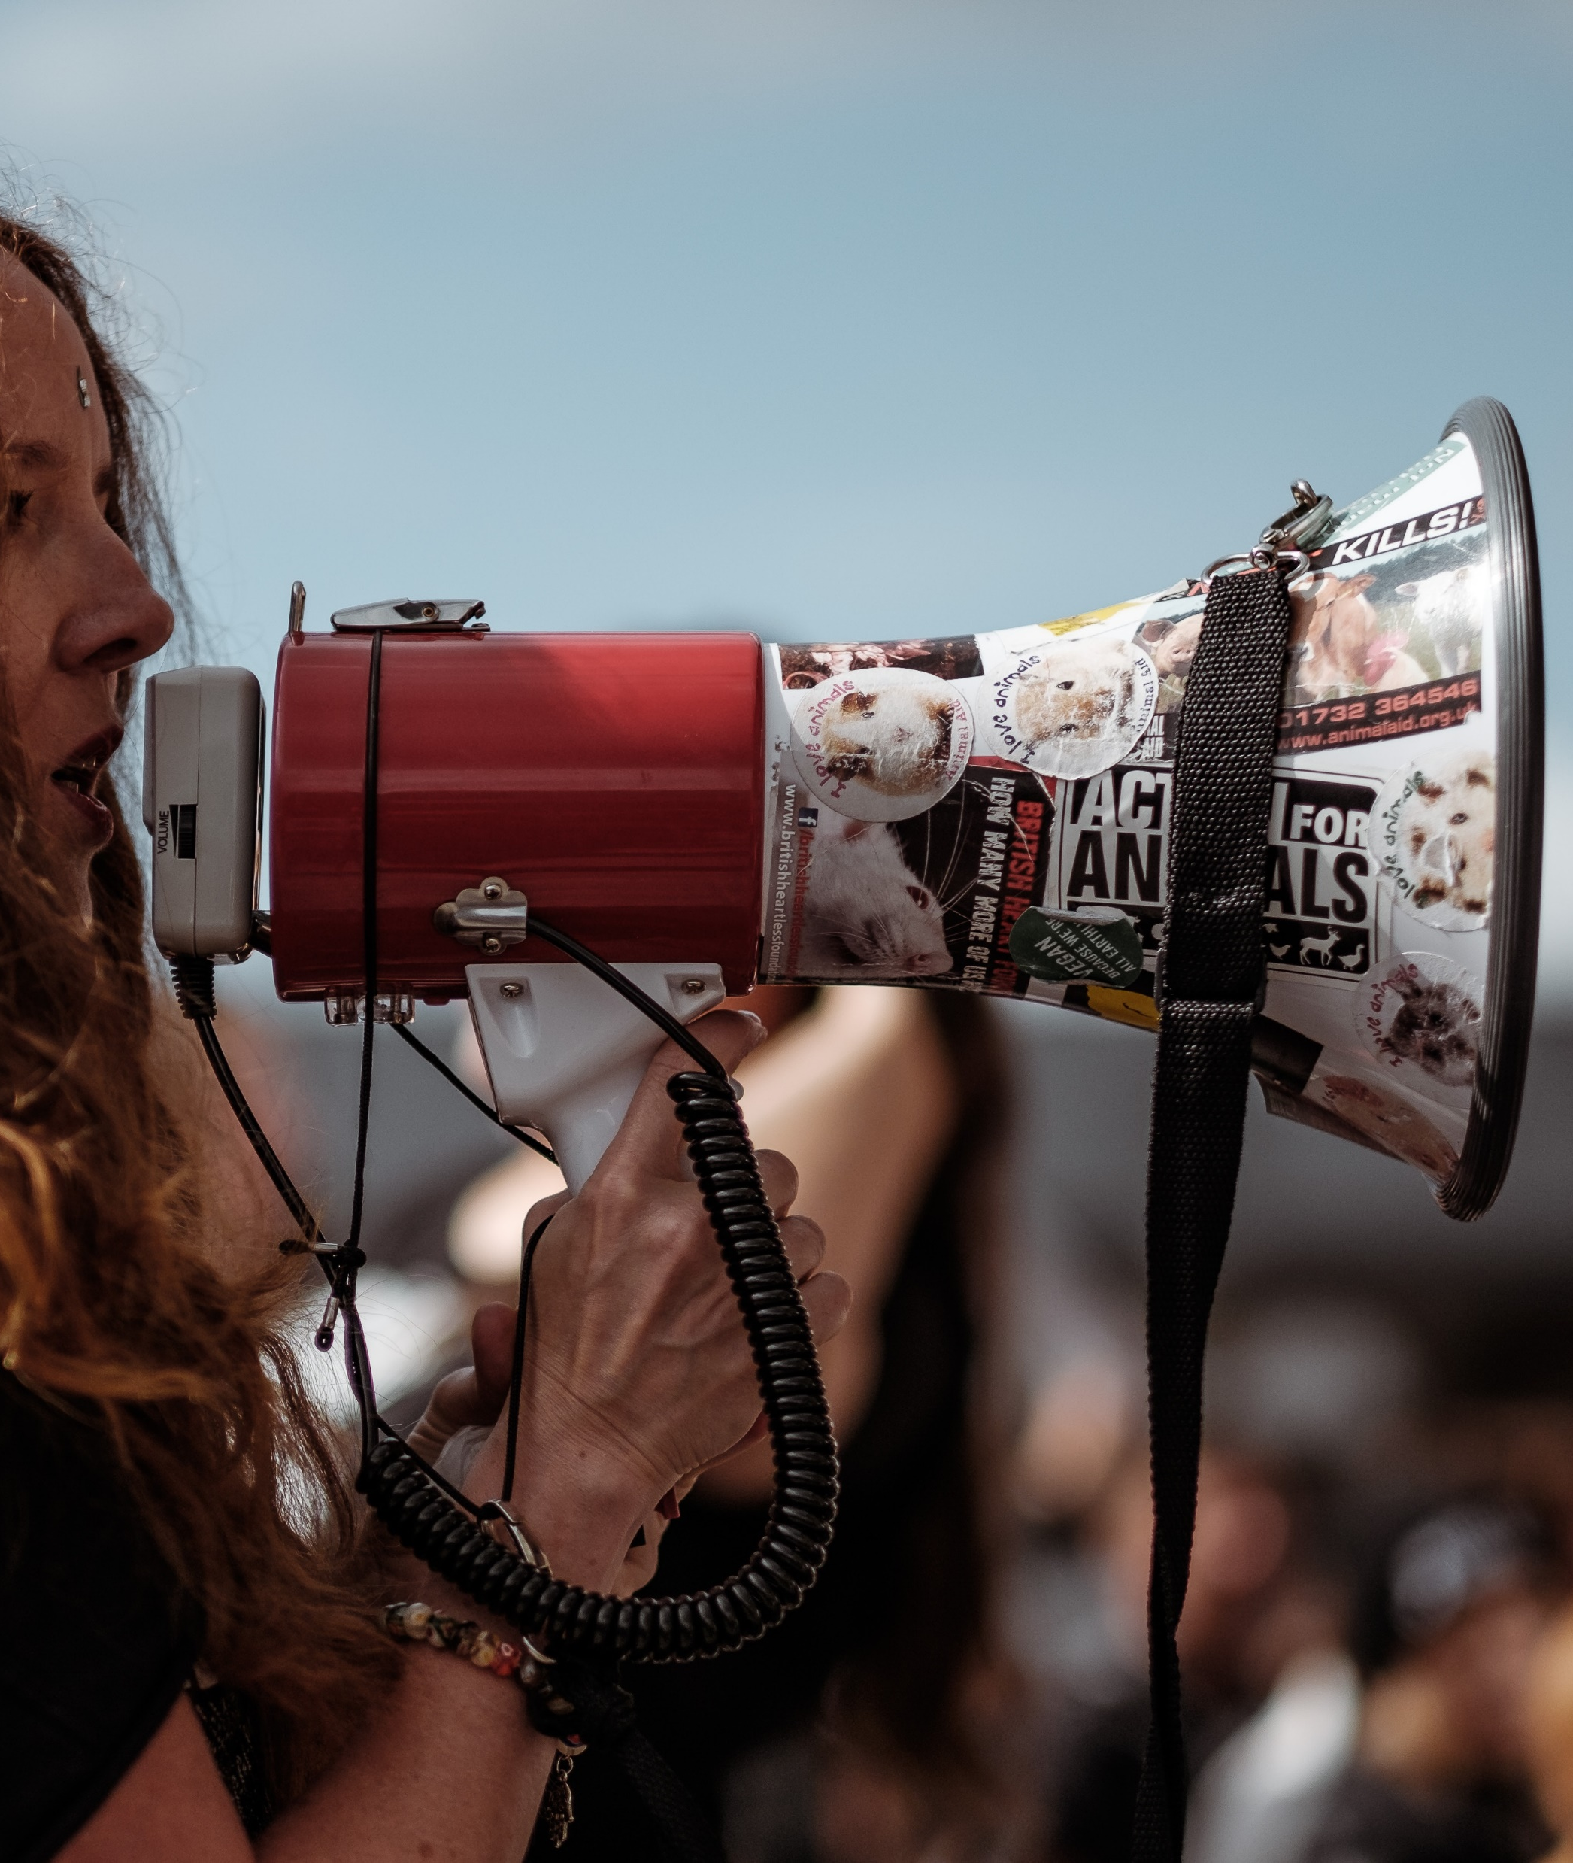
Why we advocate

Slide 117
Why we advocate?
Because we rely on the support of our funders and communities in order, in turn, to be able to give back to them
invest in
Libraries
Communities
invest in

Slide 118
Securing and diversifying sources of support for libraries
As ‘external’ factors, libraries rely on both laws and funding in order to succeed
Decision-makers need to make trade-offs (sympathy isn’t enough)
Our future is safest when we can rely both on champions and broad alliances that support libraries

Slide 119
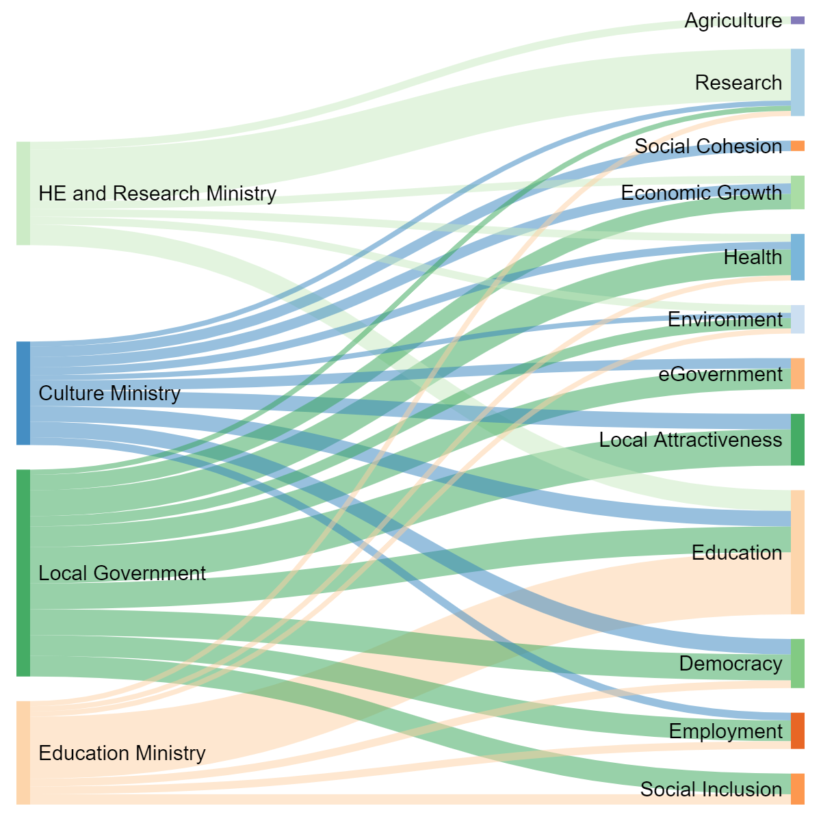
Contribution of different ministries/ agencies
Benefits in policy terms
*Figures are guesswork!

Slide 120
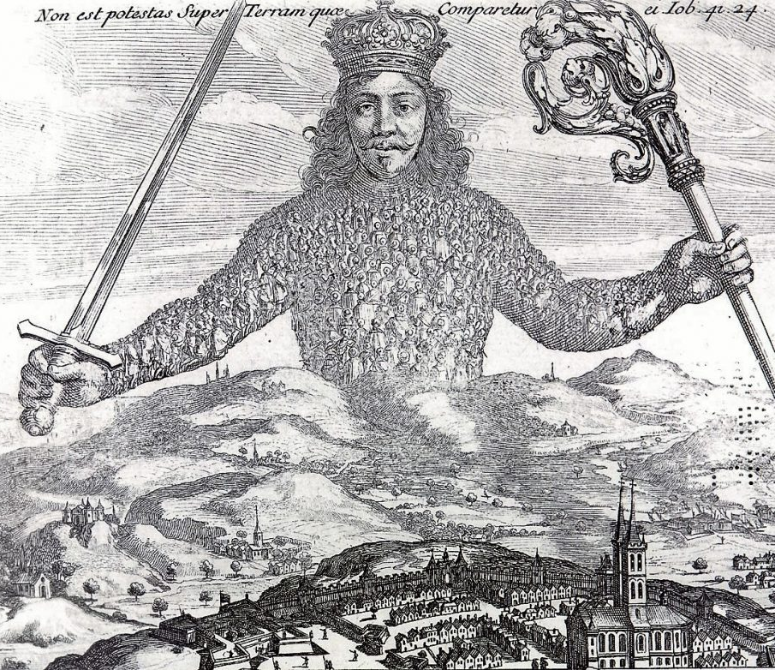
There is no divine right of libraries

Slide 121
From
Libraries are the answer. What was the question again?
To
How can we show that libraries are the answer to the questions decision-makers (and those who influence them) are asking?

Slide 122

Every librarian can be an advocate!

Slide 123
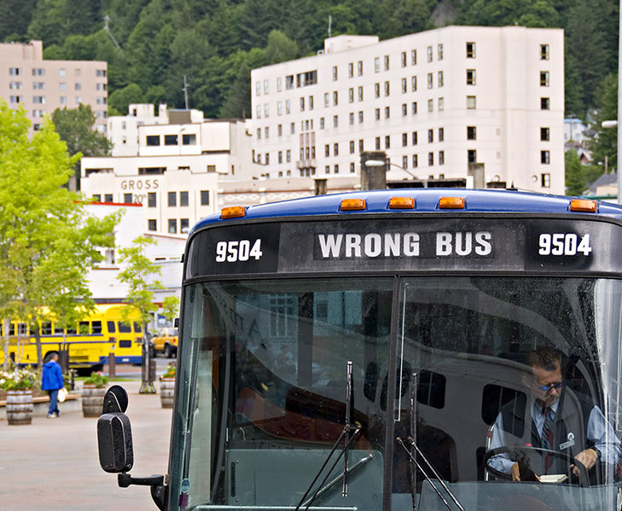
What advocacy isn’t
A solo activity
Just about lobbying
A single skill
Something that you can’t do
Photo: Seth Anderson, CC-BY-SA 2.0, bit.ly/3zb2vGb

Slide 124

HOMEWORK
Do the library advocate personality test

Slide 125
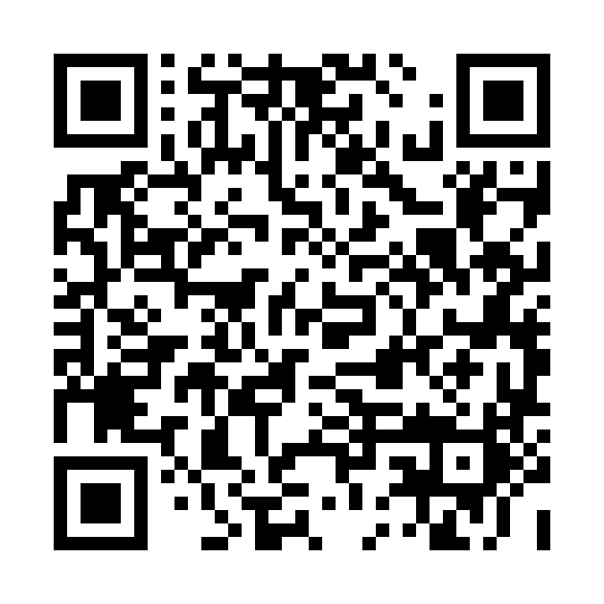
EXERCISE: Do the library advocate personality test
Go to: https://bit.ly/LibraryAdvocateQuiz
Take the test

Slide 126
8 Dimensions of Advocacy
Understanding the landscape
Coordinating your work
Mobilising the field
Gathering evidence
Communication
Building relations with decision-makers
Building advocacy partnerships
Evaluation and goal-setting

Slide 127
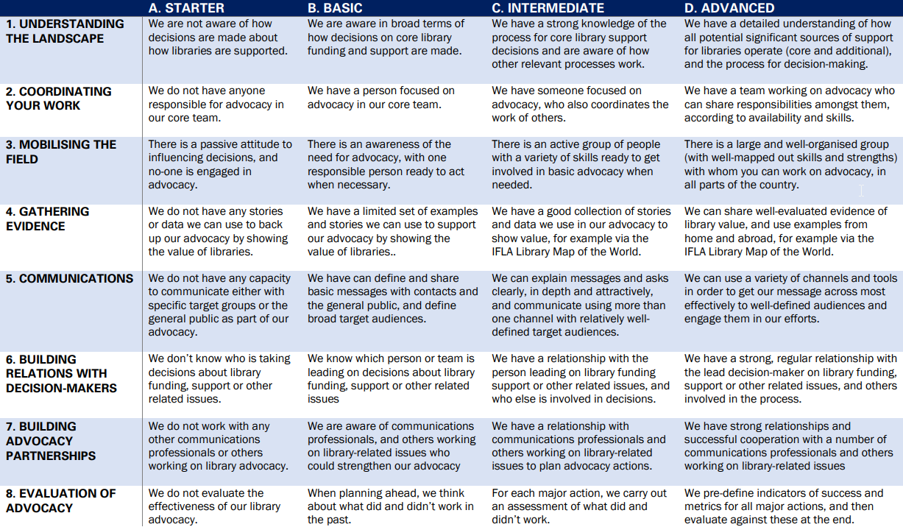

Slide 128
Share your findings!
Photo: Matt Botsford on Unsplash, unsplash.com/photos/OKLqGsCT8qs

Slide 129
Defining advocacy goals

Slide 130
Why make the international part of your (national) work?
Engage in projects that raise the profile/status of libraries (and sometimes bring funding)
Support reports and recommendations that can influence (and be used to influence) decision-makers
Build networks and gain insights

Slide 131
Monday
Event at CEPAL, with speakers from CEPAL, UNESCO, the FAO and World Bank
Goal: show ‘external’ partners that we are relevant and dynamic
Format: short presentations by UN staff, then library responses, and then open Q&A

Slide 132
How can we show that libraries are the answer to the questions that CEPAL, UNESCO, the FAO and others are asking in Latin America and the Caribbean, and form partnerships?

Slide 133
EXERCISE
Identifying an ask

Slide 134
EXERCISE: Identifying an ask
Tables 1, 4 and 7 visit the UNESCO Field Office website: www.unesco.org/en/fieldoffice/santiago
Think: culture and education
Tables 2 and 5 visit the CEPAL website: www.cepal.org
Think: inclusive development, digital
Tables 3 and 7 visit the FAO website: https://www.fao.org/chile/fao-en-chile/es/
Think: rural development and information

Slide 135
EXERCISE: Identifying an ask
For your organisation, identify an area where you think you can develop a partnership, and develop a proposal for something you could do together!
Think about what both of you can contribute (why is it interesting for them!), and how to make it strategic!

Slide 136
Practicing advocacy skills

Slide 137
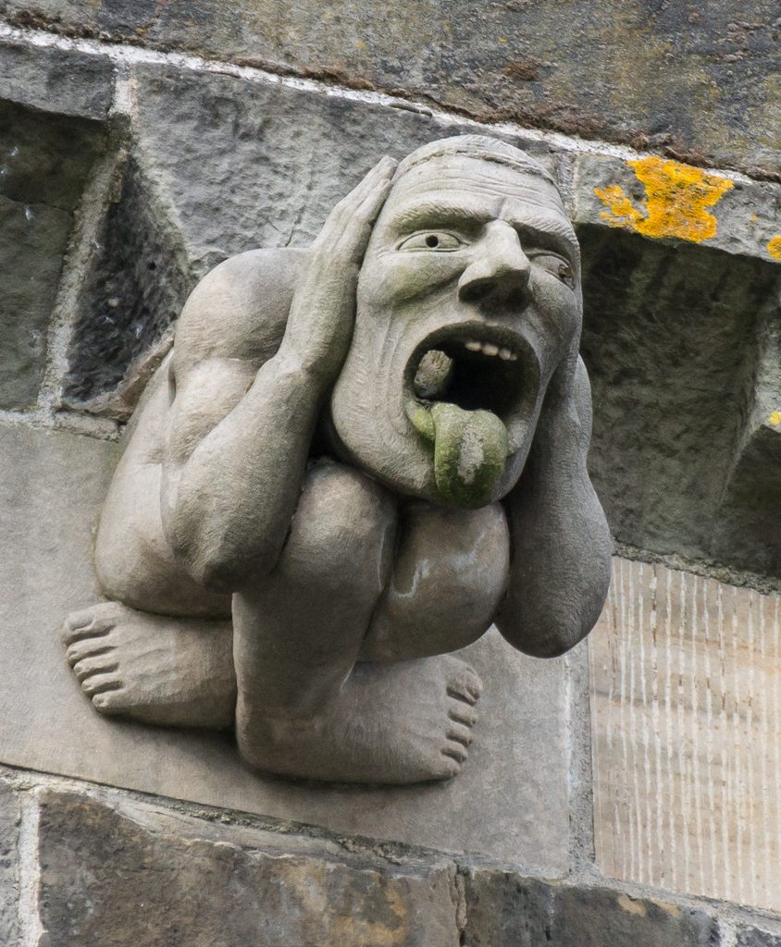
Things to remember
What is the interest of the partner (professional/ personal)?
What language and arguments will make most sense for your interlocutor?
Be briefed, be quick, be nice
Photo Colin, CC-BY-SA, https://commons.wikimedia.org/wiki/File:See_speak_hear_no_evil_Paisley_Abbey.jpg

Slide 138
EXERCISE: Advocacy role-play
Use the project you have identified earlier
Choose ONE person to be the offical, and ONE other to be their advisor/colleague. Everyone else is the library delegation
Read the description of the official’s role and personality – plan how you will approach the meeting
The role of the library delegation is to convince the official to support a partnership between the agency and libraries
The role of the official is to decide if they are going to support this
Hold a 3-4min meeting, and then assess how it went!

Slide 139
Share your findings!
Photo: Matt Botsford on Unsplash, unsplash.com/photos/OKLqGsCT8qs

Slide 140
Highlights and reflections

Slide 141
What has been the main takeaway of the workshop for you?
Go to www.menti.com and use the code 4916 9923

Slide 142
Certificates

Slide 143
What’s next

Slide 144
Key contacts
Our Regional Division Committee
Our Regional Office
Our Headquarters Team
You!

Slide 145
Commitments
Establish/strengthen links with local UN/UNESCO offices
Share the results of national library field sustainability indexes
Identify a priority partnership to build and needs
Identify a step to help emerging leaders develop
Provide further input to the Library Map of the World
Take part in our LAC workshop community (on Basecamp)
Spread learning about impact evaluation in your country
Become a member/share details of other potential members
Let us know if you want to take part in any of our projects

Slide 146
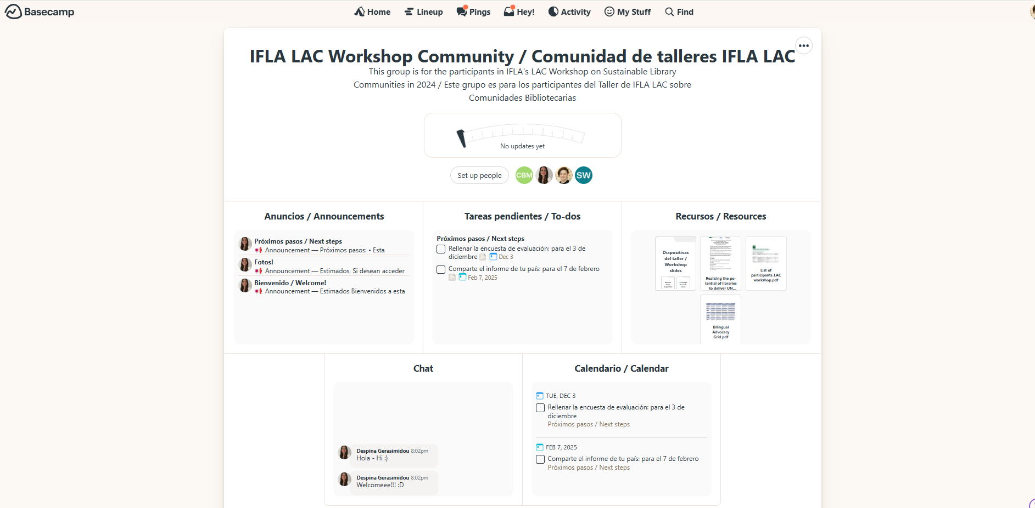

Slide 147
Forward look
By the weekend: fill in the evaluation survey
Next week: accept invitations to join the Community
Next month: share a plan for follow-up (we’ll share a template!)
By January: join a 1st check-in call
By April: join a 2nd check-in call, fill in a progress survey
By October: join a 3rd check-in call, fill in a progress survey
Ongoing: share updates on the community!

Slide 148
The coming days
Tonight: meet at the hotel at 19:40
Tomorrow: meet at reception at 08:35
How to build copyright education!
50th anniversary celebration
Gala dinner

Slide 149
Evaluation

Slide 150
Evaluation
https://survey.alchemer.com/s3/8084807/LAC-Workshop-2024-Evaluation
Please answer by 3 December 2024!

Slide 151
By the end of this workshop, you should...
Have an understanding of what a sustainable library field means, and how you can apply this in your own work
Have new ideas about how you can engage with the UN, UNESCO and other international initiatives within your country and regionally
Be able to apply (IFLA) tools and references in your own strategic planning, in particular around gathering and applying data, assessing impact, partnerships and emerging leaders
Be ready to work with us in shaping an IFLA ‘offer’ that responds to the needs of the region
Have built your own networks!

Slide 152
Thank you!

