Slide 1



INTERNATIONAL ADVOCACY PROGRAMME
LIBRARIES, DEVELOPMENT,
AND THE UN 2030 AGENDA
TOPIC 3: THE SEVEN STEPS OF THE ADVOCACY PLANNING CYCLE

Slide 2
For trainers
If you edit this file, please change the file name to show the region and the new date
  Delete the word [Master] from the file name
  Insert the region, eg Asia, Africa, Europe, LAC
  Change the date, using format YYYYMMDD
  Use underscore [ _ ] to link the elements of the file name
IFLA_IAP_Topic3_AdvocacyPlanningCycle_[Region]_YYYYMMDD

Slide 3
Topic 3: The seven steps of the advocacy planning cycle
Learning objectives
To understand a structured framework which presents the seven steps involved in developing an effective advocacy campaign
To provide you with the foundation knowledge to enable you to progressively draft an advocacy plan for your library association in Topic 4

Slide 4
Overview of Topic 3
We underscore the importance of good planning to underpin any advocacy initiative
We introduce you to the steps which can guide you to draft an advocacy plan for your library association
We highlight the critical importance of performance indicators to demonstrate how your activities can help drive:
  A change in policy
  A change in practice
  A change in attitudes and behaviour

Slide 5
A definition of ‘advocacy’
The term ‘advocacy’ is interpreted differently in different languages and cultures
One helpful way to look at the concept is that ‘advocacy’ refers to “the actions individuals or organizations undertake to influence decision making at the local, regional, state, national, and international levels that help create a desired policy or funding change in support of [public] libraries”
Global Libraries Advocacy Guide (2011), p.2

Slide 6
We will start with a bit of theory…
4.7.4 Action Plans and Timelines
  Later today we will look at how library associations can partner with diverse stakeholders, including government officials and policy makers, and representatives of other agencies
  We will argue that you should develop a specific plan for each individual partnership; one size does not fit all
  Nevertheless, there are some common principles and approaches which underpin all of the planning processes

Slide 7
The value of effective planning
“Effective planning is at the heart of successful advocacy.”
(Open Societies Foundation, 2010)
It is worth spending time at the outset:
  To decide what you want to achieve
  How you will do it
  Who will be responsible for the different activities
  How you know whether or not you have been successful

Slide 8
The advocacy cycle
Step 1
Identify and analyse the issue
Step 2
Set the goals and the objectives
Step 3
Identify the decision makers
Step 4
Define the message and the ‘ask’
Step 5
Set your timeline
Step 6
Assess resources, choose tactics & implement
Step 7
Monitor, evaluate, and share
Adapted from Open Society Foundations
https://www.opensocietyfoundations.org

Slide 9
The overarching framework for an advocacy plan
1
2
3
4
5
6
7
  Step 1: Identify and analyse the issue
    What problem do you want to address?
  Step 2: Set the goal and the objectives
    What do you want to achieve?
  Step 3: Identify the decision makers
    Who do you need to influence?
  Step 4: Define the message and your proposal
    What is the focus of your campaign?
  Step 5: Set your timeline
    When should you do it?
  Step 6: Assess resources, choose tactics & implement
    How will you do it?
  Step 7: Monitor, evaluate, and share
    How will you measure success?

Slide 10
Step 1: Identify and analyse the issue
1
2
3
4
5
6
7
Do you have a vision for the future?
What do you want to see changed?
Is it something you are passionate about?
Can you express your vision clearly and simply?
  In one or two sentences?
  Is it understandable to others?
Your vision should inspire…
  Libraries are key partners in the development agenda
Your mission will be to work towards achieving this vision

Slide 11
What problem do you want to address?
Libraries are not yet fully acknowledged as integral partners in the UN 2030 Agenda
You need to think about this issue and how it plays out on different levels
  At the local level
  At the regional
  At the national level
  At the international level
What evidence do you have of this issue in your own country?
Are any other agencies or groups concerned about this issue?
It may be helpful to think critically and prepare a summary discussion document which focuses on your concerns

Slide 12
If you are going to conduct advocacy, especially at the national level, you will need strong, relevant evidence to show that this is an important issue and that existing policies are not working
You will also need strong evidence to reinforce your proposed solution(s)
In preparing your advocacy plan, you will need to develop a suitably persuasive argument which details the causes, effects, and proposed solution, presenting authoritative evidence from a range of sources
(Open Society Foundations, 2010, p.6)

Slide 13
Step 2: Set your goal and objectives
5.3.2 Goals and Objectives
1
2
3
4
5
6
7
What do you actually want to achieve?
The overarching goal
  This is your mission: to ensure that your vision for the future can become real
The objectives
  More specific changes which you can assess over time
Objectives have ‘milestones’ along the way, to help you measure progress towards your goal

Slide 14
An example of goals and objectives
Goal: The library sector is acknowledged to be an integral development partner in your country
Objective 1
  To demonstrate that libraries are already making a significant contribution to quality education outcomes (Goal 4)
Objective 2
  To demonstrate that libraries are already making a significant contribution to sustainable agricultural practices (Goal 2)

Slide 15
To achieve your goals and objectives, your work must be SMART!
Specific
  Clear statement about what you seek to achieve
Measurable
  How you will measure your progress towards the goals
Achievable
  Ensure that it is realistic
Relevant
  Know that it is worthwhile, at the right time, with the right people
Time-bound
  Grounded within a given time

Slide 16
A worked example
Goal: The library sector is acknowledged to be an integral partner in your country’s development goals
Objective 1:
  To demonstrate that libraries are already making a significant contribution to quality education outcomes
  Example: public libraries coordinate the Boekstart program to ensure young children are literate
The aims of the Boekstart activities are SMART:
  Specific
  Measurable
  Achievable
  Relevant
  Time-bound

Slide 17
The aims of the Boekstart programme are SMART
Specific:
  To increase the level of literacy in the country
Measurable:
  The level of children’s literacy at age 7 increases by 10%
Achievable:
  The desired change is realistic, it is not overly ambitious
  Note: you could look back at some of the reported
  achievements of the Millennium Development Goals
Relevant:
  Government, education agencies and the community are all committed to a literate society
Time-bound:
  This is a five year program

Slide 18
Step 3: Identify the decision makers
1
2
3
4
5
6
7
“Advocacy involves influencing people with the power to effect change: these decision makers
are your primary targets.”
Local influencers
National influencers
Regional influencers
Global influencers
Local
Regional
Global
National

Slide 19
Who are the key decision makers?
The particular issue you seek to address will determine the people with whom you need to engage
The next few slides provide a general overview of the range of stakeholders you may need to think about
You won’t need to try to work with all of them!

Slide 20
Local influencers
Local
Local government decision makers
Mayors and councillors
Key bridge between the community and the national government
Often more accessible and more willing to be engaged than decision makers at other levels

Slide 21
National influencers
National
National UN delegation
Often with the national Ministry of Foreign Affairs
  Head of Delegation: often the Minister, or?
  Delegates: parliamentarians, civil society representatives, experts on key issues…
  Any delegate with responsibility for specific issues that are relevant to your interests: education, health, youth etc
Permanent mission
  Your country’s embassy to the UN, based in New York
  Closely linked to the National Delegation in your country
Community leaders at the grass roots
  Opinion leaders in your country, who have influence over public debate: business leaders, religious leaders…
UN Resident Coordinator and civil society
  UN Development Group (UNDG) https://undg.org/home/resident-coordinators/
  UN at country level https://undg.org/home/country-teams/unct-home/
  Coordination of development activities within a country
  Non-Government Organisations (NGOs)
  NGO Forum
    Public health – water and sanitation - http://www.ngof.org/
    Uganda National NGO Forum http://ngoforum.or.ug/

Slide 22
Regional influencers
Regional
Requires an understanding of regional politics
Not all countries have equal bargaining power in international negotiations
Regional or thematic alliances to advance common interests
Within the region, some countries may be more powerful than others, which influences the regional perspective

Slide 23
Global influencers
Global
UN agencies
  United Nations Social Policy and Development (DESA/DSPD)
  United Nations Educational, Scientific and Cultural Organization (UNESCO)
  United Nations Population Fund (UNFPA)
  United Nations Children’s Fund (UNICEF)
  International Labour Organization (ILO)
  WIPO
  IFLA
These institutions work actively at a variety of levels, from local to global

Slide 24
Other potential targets
Others
The private sector
  In the context of the SDGs, there is an interest in exploring ways in which the private sector can engage in development practice
  UN Global Compact
    To translate the SDGs into innovative business practices around the world
    National initiatives: eg UN Global Compact Australia
And… who else might be relevant in your own context?

Slide 25
Step 4: Define your message and the proposal
1
2
3
4
5
6
7
“Your message describes the problem, offers compelling or new evidence, and presents why you think people and policy makers should care.”
“Good messages are short, clear and persuasive.”
Your proposal should be a clear, tailored request or recommendation:
  To state what needs to happen to address the issue
  To indicate the change you wish to see
Your proposal must be tailored to suit different decision makers:
  To specifically target the policies and practices that
  they have influence over

Slide 26
Step 5: Set your timelines
1
2
3
4
5
6
7
“Timing is everything in advocacy.”
The government official or politician will pay more attention if your message is delivered within the context of a significant event, eg:
  A policy decision
  A major summit
  An election
You should develop clear timelines for carrying out your action plans: create an ‘advocacy calendar’
Plan to deliver the right message to the right person at the right time
Set priorities – it is better to improve even one critical strategic partnership and achieve one stated objective in a given time than to be overloaded with too many
Be realistic about what you an accomplish – and stick to your plan
(but take advantage of any new opportunities that may arise through
the developing relationship!)

Slide 27
Step 6: Assess resources, choose tactics, and implement
1
2
3
4
5
6
7
“Every advocacy initiative requires expertise, funding and compelling evidence.”
What resources do you need?
  Information
  Human
  Financial
  Materials
What are your tactics?
  You need to develop effective strategies to translate your ideas into reality
How will you communicate with your stakeholders?

Slide 28
The ‘right strategy’
To work to change policy
  Preparing briefing packs
  Meeting with decision makers
  Providing evidence to argue the case for change
To build capacity
  Developing the skills and building the structures
  required for effective advocacy
To run a campaign
  Mobilising public support: petitions, demonstrations, letters to politicians, media
To leverage the media
  Print, TV, radio, online
  This will be part of your communications strategy

Slide 29
Your strategies
Your strategies are specific methods or actions designed to achieve your goals and objectives
An example:
  Goal: The library sector is acknowledged to be an integral partner in your country’s development goals
  Objective 1: To demonstrate that libraries are already making a significant contribution to quality education outcomes
The strategy:
  Public libraries coordinate the Boekstart program to ensure young children are literate
So, what do you need to actually do to make this happen?

Slide 30
Your tactics
The strategy
  Public libraries coordinate the Boekstart program to ensure young children are literate
  Parents of new born babies are given a book and library card
Your tactics
  The potential partners are identified:
    Maternity hospitals, children’s health centres, kindergartens, primary schools, early literacy groups, publishers
  There are arrangements for the distribution of books to new babies
  There are arrangements for the delivery of early literacy training
  …

Slide 32
Step 7: Monitor, evaluate and share
1
2
3
4
5
6
7
“You will want to know if you have been successful, and if your advocacy has achieved the objectives you set at the beginning.”
Challenges:
  Advocacy is difficult to monitor
  Advocacy is extremely difficult to evaluate
  Advocacy focuses on long term change… and often unpredictable change
  Advocacy processes are complex, with no specific causal effects

Slide 33
The need for performance indicators
Align your measurements with the government’s own indices to note your contribution towards the overall national or local goals
Ensure the selected indicators are simple and easy to monitor
Validity: ensure the indicators measure what you want to measure
Reliability: ensure different people would get the same results

Slide 34
Some performance indicators
Goal
  The library sector is acknowledged to be an integral partner in your country’s development goals: education is one of these goals
Objective 1
  To demonstrate that libraries are already making a significant contribution to quality education outcomes
The strategy
  Public libraries coordinate the Boekstart program to ensure young children are literate
  Parents of new born babies are given a book and library card
Performance indicators:
  Number of babies receiving a book and library card
  Number of books distributed
  Number of maternity units in hospitals involved in the program
  Number of public libraries participating in the program

Slide 35
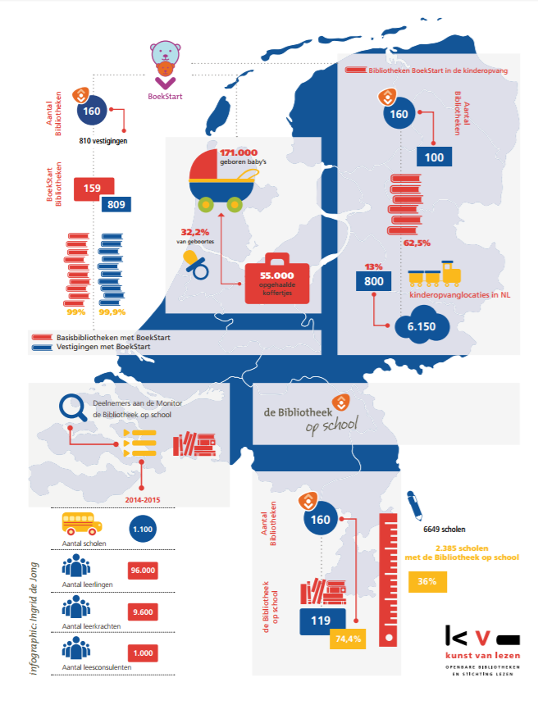
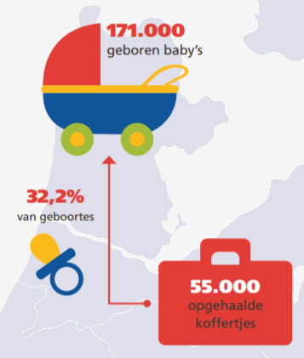
http://www.debibliotheken.nl/fileadmin/documenten/belangenbehartiging/2015_toolkit-bibliotheek-maatschappelijk-hart_inspiratiesheet-educatie_kb-vob.pdf

Slide 36
Monitoring
Relates to the continuous assessment of progress over time
Monitoring is important:
To ensure accountability
  Are you doing the things you said you would in your strategy
To follow progress towards your stated objectives
To make sure that the achievements against the plan are reported regularly to all stakeholders
To recognise when you may need to adjust your initial strategy for better results

Slide 37
Evaluation
Relates to the periodic assessment of the work with respect to its stated objectives
  The relevance
  Performance
  Efficiency
  Impact
Evaluation:
  Takes place at a specific point in time (eg midway or final)
  Helps you think what you might do differently next time

Slide 38
Questions to ask in an evaluation
To what extent did you achieve the objectives?
What factors contributed to your successes and failures?
Which specific initiatives worked, which did not, and why?
Did your ways of working help or hinder your progress?
Were there any unintended outcomes?
What needs to be changed as a result of the evaluation?

Slide 39
Indicators for progress for policy change
Increase in numbers of people/agencies calling for change
Increased dialogue about the issue and the policies
Increased media coverage
Shift in the rhetoric
Changed opinions

Slide 40
Indicators for impact of policy change
New policies have been introduced
Changes in legislation – and enacted to become law

Slide 41
Indicators of progress for change in practice
Increased dialogue about the practice that needs to be changed, amongst practitioners as well as policy makers and the general public
Changed opinion of leading practitioners in the field
Pilot practice change model introduced, training and exchange visits
Senior level discussion about practice change
Evidence that external advice is being sought

Slide 42
Indicators of impact of practice change
Policy change implemented
New legislation enacted
High quality personnel in charge of implementing policy
Evidence of monitoring and enforcing practice change
  Guidelines, standards, orders etc
Evidence of penalties handed out for breach of policy
Long term: positive change in people’s lives as a result of the changes to policy and/or legislation

Slide 43
Indicators for progress for change in attitude and/or behaviour
Greater awareness of individual rights and the power systems that withhold rights
Changed rhetoric
Citizens’ knowledge, skills and capacity to mobilise and advocate on their own
Evidence of nurturing new leaders
Evidence of new groups mobilising, self-organised groups

Slide 44
Indicators of impact of changes in attitude and/or behaviour
Public recognition of people’s rights by decision makers
Spokesmen from the affected groups feel able to engage in public discourse without fear or prejudice
Leaders of affected groups are accountable to their constituencies
Participation of leaders in policy making processes
Positive change in people’s lives as a result

Slide 45
Sharing with others: dissemination is critical!
The lessons you learn through monitoring and evaluation should be shared widely within your organisation and with similar agencies
Collect data and stories to use as evidence
What worked well, and why?
What was less effective, and why?
What would you do differently next time?

Slide 46

Celebrate successes
When the initiative concludes (remember the timelines!) be sure to acknowledge completion and celebrate success in achieving your objectives and goals!

Slide 47
The process to work through
5.3.6 Situational Analysis
As you work on your advocacy plan, you will need to think about many things, which will need to be linked across the different elements of your plan
  Stakeholders – who are they?
  Who are the decision makers?
  What are your objectives, strategies, activities?
  How might your strategies vary across stakeholders?
  Risks - what are they and how they might be managed?
  Budget – what will it cost?
  Who will be responsible for the actions?
  What are the timelines?
  How will we communicate with stakeholders?
  How will we evaluate the outcomes?

Slide 48
Summary
We continued to focus on the important role libraries can
play in advocacy initiatives to support SDGs in your
country or region
We underscored the importance of good planning to underpin an advocacy initiative
We introduced the steps involved in creating an advocacy plan, including effective communications strategies
We highlighted the critical importance of performance indicators
  Change in policy
  Change in practice
  Change in attitudes and behaviour

Slide 49
References
Bill & Melinda Gates Foundation (2011). Global Libraries advocacy guide.
https://onedrive.live.com/?authkey=%21AE7zcm5eCCcPauk&cid=69D9A1EBADFCA884&id=69D9A1EBADFCA884%21321&parId=69D9A1EBADFCA884%21118&o=OneUp
Open Societies Foundation (2010). An introductory guide to successful advocacy.
https://www.opensocietyfoundations.org/sites/default/files/guide-to-successful-advocacy-20100101.pdf

Slide 50
References
Bill & Melinda Gates Foundation (2011). Global Libraries advocacy guide.
https://onedrive.live.com/?authkey=%21AE7zcm5eCCcPauk&cid=69D9A1EBADFCA884&id=69D9A1EBADFCA884%21321&parId=69D9A1EBADFCA884%21118&o=OneUp
Open Societies Foundation (2010). An introductory guide to successful advocacy.
https://www.opensocietyfoundations.org/sites/default/files/guide-to-successful-advocacy-20100101.pdf

