Slide 1
Goal 4: Quality education
Statement:
“Libraries are at the heart of schools, universities and colleges in every country around the world. Libraries support literacy programmes, provide a safe place for learning, and support researchers to reuse research and data to create new knowledge.”
Examples:
  Netherlands
  Sweden
  Singapore

Slide 2
Trainers: please use regionally relevant examples
Select the relevant SDGs
Select the appropriate examples to illustrate the alignment of library programmes with the given SDG

Slide 3
Example: The Netherlands
Boekstart works with day care and healthcare centres, public libraries and the first two years of primary school to provide books and literacy training to 75,000 children aged 0-4 per year.
The programme is supported by national and local government, and aims to establish long-term collaboration between organisations that support children’s literacy.
This programme is clearly aligned with Goal 4: Quality education
http://www.boekstart.nl/

Slide 4
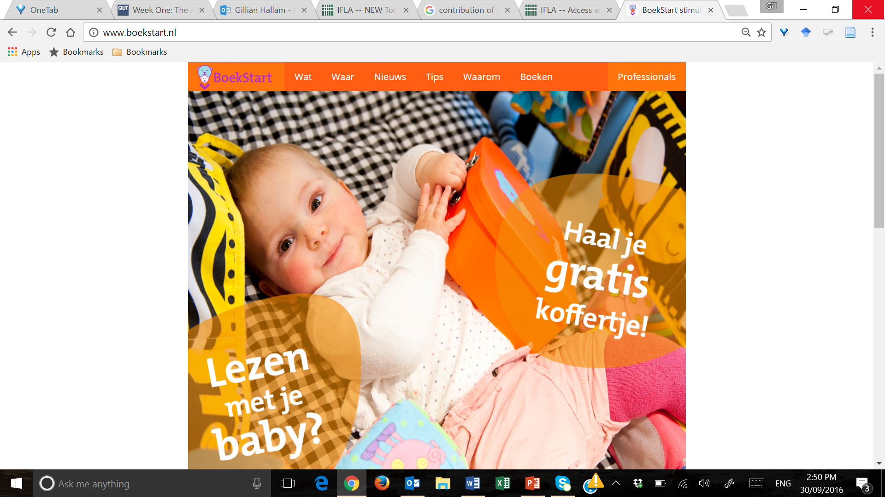
http://www.boekstart.nl/

Slide 5
Elements of the Boekstart programme
Partnering with other stakeholders:
  Day care
  Healthcare centres
  Public libraries
  Primary schools
Deliverables from the programme:
  Books
  Literacy training
The programme’s reach:
  75,000 children aged 0-4 per year
  Thousands of families
Government involvement
  National government
  Local government
An integrated approach across the community
  To establish long-term collaboration between organisations that support children’s literacy.

Slide 6
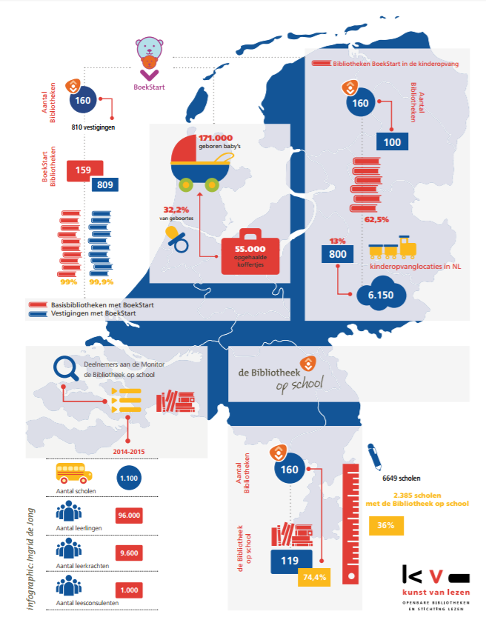
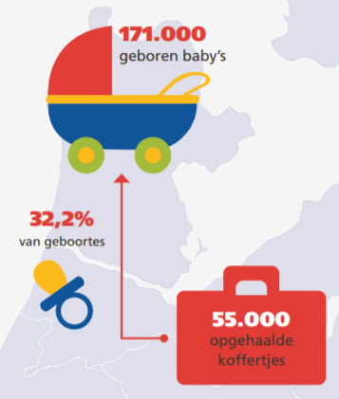
http://www.debibliotheken.nl/fileadmin/documenten/belangenbehartiging/2015_toolkit-bibliotheek-maatschappelijk-hart_inspiratiesheet-educatie_kb-vob.pdf

Slide 7
Activity 2.3. Beyond quality education, how might this programme indirectly support other SDGs?
Boekstart works with:
  Day care
  Healthcare centres
  Public libraries
  Primary schools
Boekstart provides:
  Books
  Literacy training
Boekstart reaches:
  75,000 children aged 0-4 per year
Boekstart is supported by:
  National government
  Local government
Boekstart aims:
  To establish long-term collaboration between organisations that support children’s literacy.
Please work in your country or local regional groups
Record your ideas on sticky notes

Slide 8


Slide 9
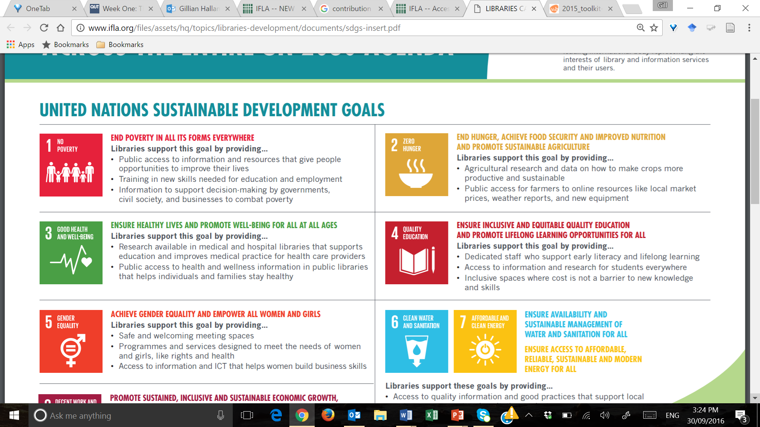
Other statements relating to Goal 4
Note the focus of the messages that are expressed here
http://www.ifla.org/files/assets/hq/topics/libraries-development/documents/sdgs-insert.pdf

Slide 10
Goal 2: End hunger, achieve food security and improved nutrition and promote sustainable agriculture
Statement:
“Libraries, including specialist agricultural libraries and extension services, provide access to research and data on crops, market information and farming methods that supports resilient, productive agriculture.”
An example
  Libraries supporting farmers in Romania

Slide 11
Example: Libraries supporting farmers in Romania
Librarians trained by Biblionet (IREX) helped over 90,000 farmers receive
US $155 million in subsidies via new Internet and computer services between 2011 and 2013
1,000 library staff who had participated in training decided to rollout the service in libraries
They had the support of local mayors who understood the benefits that this service brought to farmers – and city hall staff were also involved
Partnership with the Payment and Intervention Agency in Agriculture (APIA)
Special attention was paid to local needs in order to guarantee take-up
The programme helped farmers learn how to use the technology available in libraries to access financial forms and submit them to the government, saving time and money
Prior to online submission, farmers would have to travel to the capital city to submit their paperwork
The programme saw many people become new members of the library

Slide 12
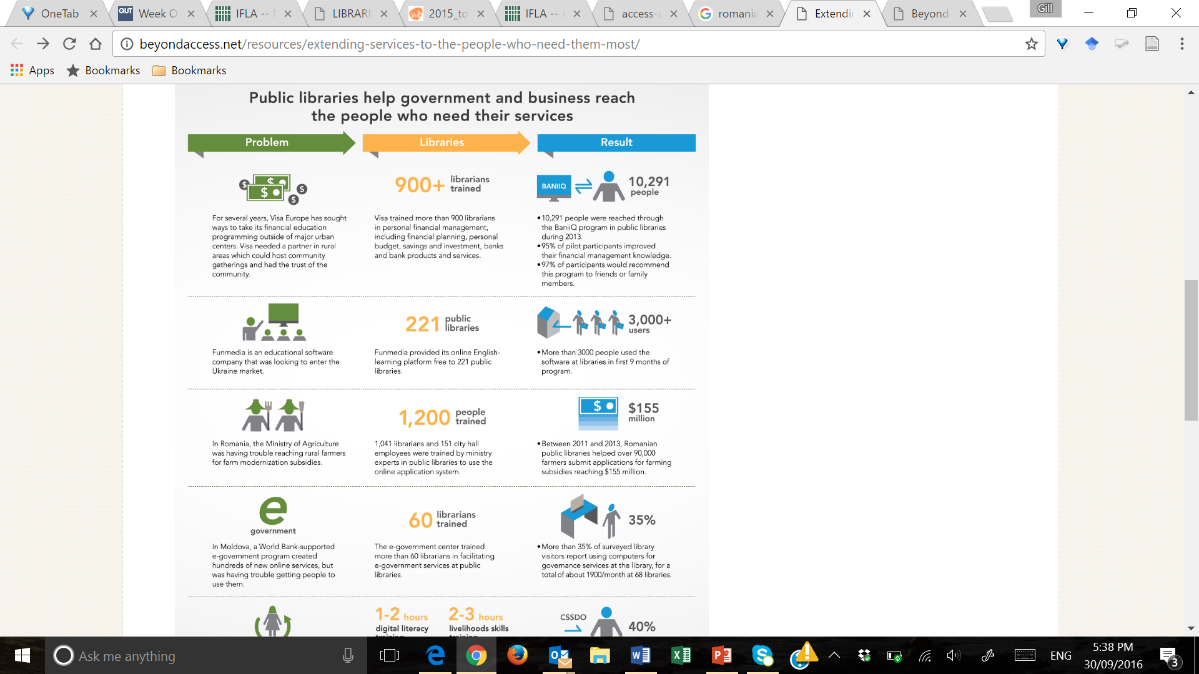

Slide 13
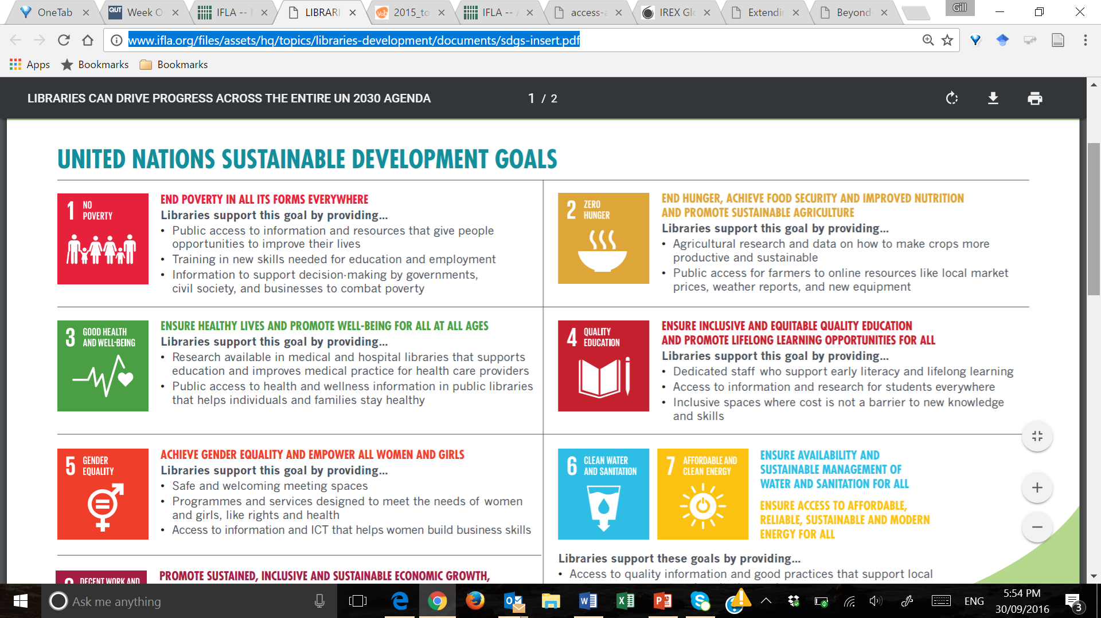
Other statements relating to Goal 2
http://www.ifla.org/files/assets/hq/topics/libraries-development/documents/sdgs-insert.pdf

Slide 14
Activity 2.4. How do your libraries already contribute to the SDGs?
Take a good look at the documents:
  The IFLA booklet: Access and opportunity for all
  The IFLA handout: Libraries can drive progress across the entire UN 2030 Agenda
Using the Activity 2.4 handout:
  Make a list of the programmes and services your library offers (or typical library programmes in your country)
  Review the list of SDGs and choose one or two key topics
  Map the library’s activities to the SDGs and/or targets
  Then think about the evidence you might need to present to report on the achievements you have made

Slide 16
Libraries are already contributing to SDG outcomes
By promoting universal literacy, including media and information literacy, and digital literacy skills
By closing the gaps in access to information and helping government, civil society and business to better understand local information needs
By providing a network of locations where government programmes and services can be delivered to those who need them
By advancing digital inclusion through access to ICT, and having dedicated staff to help people develop new digital skills
By serving as the heart of the research and academic community
By preserving and providing access to the world’s culture and heritage

Slide 17
IFLA raising awareness: ‘Connecting the next 4 billion'
Event hosted by IFLA, IREX and the New York Public Library, September 2015
To focus attention on the challenges ahead, beyond ratification of the SGDs
Highlight how access to information and library programmes and services can help tackle the challenges
Inclusive access to information and technology is imperative to meet the new development agenda
Community spaces like libraries are already implementing this vision

Slide 18
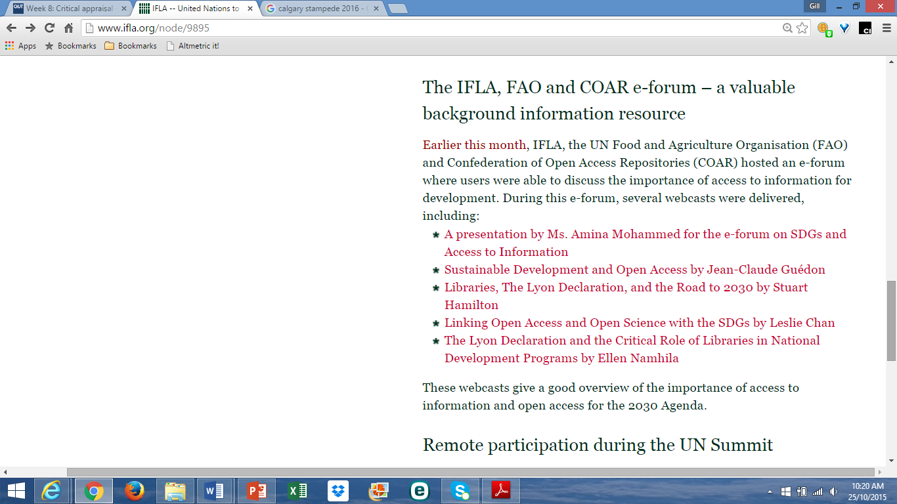
IFLA raising awareness: the IFLA, FAO & COAR e-forum
Online forum, 7-18 September 2015
Partnership between:
  IFLA
  UN Food and Agriculture Organisation (FAO)
  Confederation of Open Access Repositories (COAR)
The importance of access to information for development

Slide 19
Library associations can take the lead…
They can increase the community’s awareness of the SDGs
They can work towards making the SDGs mainstream in society
They can talk up the real value of library activities and demonstrate how these are aligned with the UN 2030 Agenda

Slide 20
Increase the community’s awareness
All UN member states are committed to the UN 2030 Agenda
Every country is being asked to make sure that everyone knows about the SDGs, and how they apply nationally and locally
Library staff can make a huge different here
Everyone working in libraries has a role in the UN 2030 Agenda to make sure that everyone who visits the library knows about the Goals
The national library association has the opportunity to play a leading role

Slide 21
Making the SDGs mainstream!
Develop resources to share information about the SDGs in your libraries
  https://sustainabledevelopment.un.org/topics
Learn more about what people in your country want:
  The World We Want https://www.worldwewant2015.org
  MyWorld data site http://data.myworld2015.org
UN Depository Libraries have an essential role in communicating information and research to help decision makers achieve the Goals.

Slide 22
Create an awareness campaign
To gain community support for your specific programmes
The more support you have, the more likely you are to be taken seriously
Get your message out to the whole community
The trustworthiness of your campaign will influence the media – the credibility of libraries will increase
You need to understand the local political situation!

Slide 23
Many options for communication
4.1.7 The Message
Planting seeds – being with family and friends who will talk to other people
One-on-one meetings
Group meetings
Public meetings
Submissions
Reports
Public surveys
Media: radio, TV, newspapers
Brochures, leaflets
Postcards
Posters
Newsletters
Websites
Social media
Letters – private and public
Emails
Phone

Slide 24
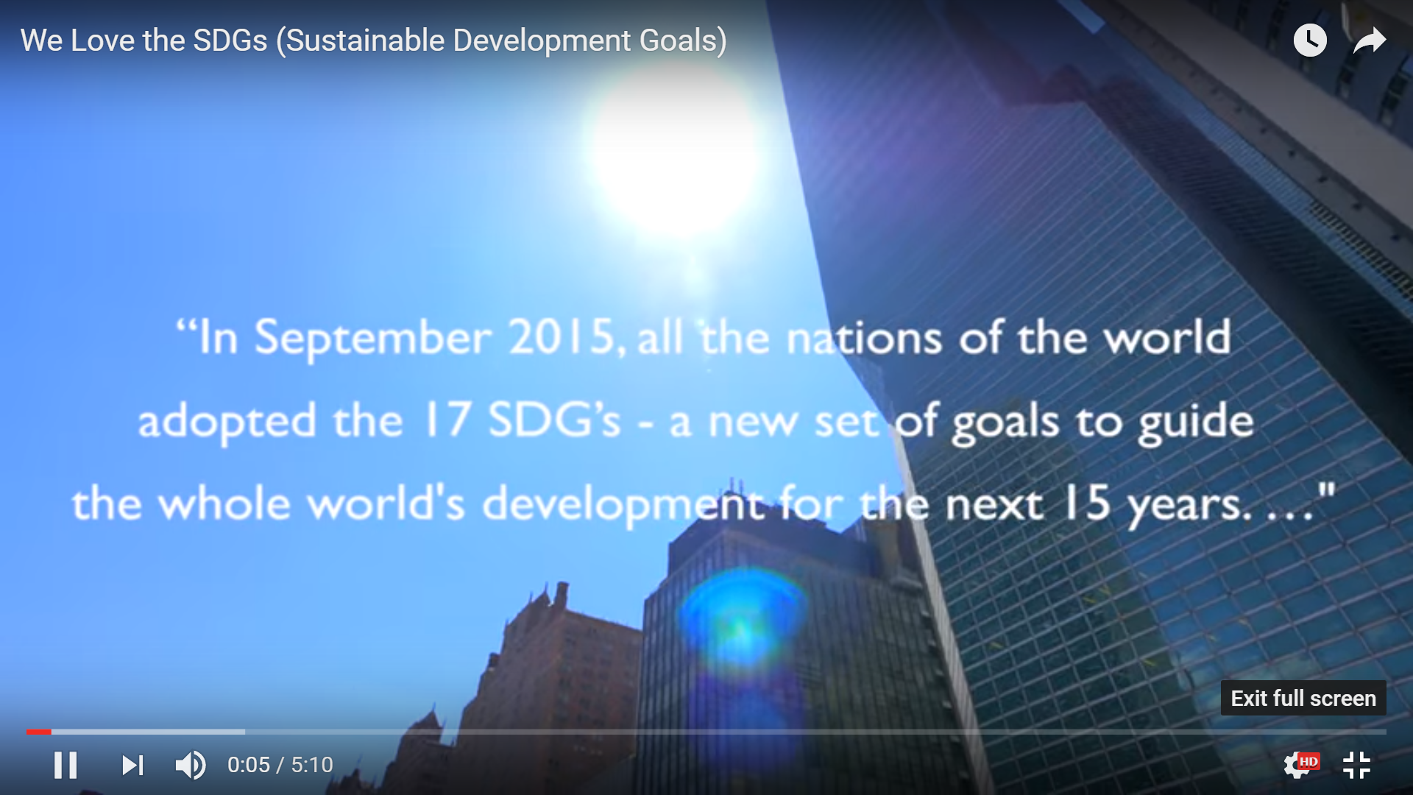
We love the SDGs! [5’10”]
https://www.youtube.com/watch?v=ieRkqZ11rLg&feature=youtu.be

Slide 25
Activity 2.5. Your awareness campaign
Working together in your country groups, please discuss how you will raise awareness about the UN 2030 Agenda
Using the Activity 2.5 worksheet, think about:
  The objectives of the awareness campaign
  Who will help you organise the campaign
  Who your target audiences will be
  Who you might want to partner with
  The type of activities you can undertake
  Your timelines for the campaign
  The communication strategies you can use

Slide 27
Back home
Keep these planning notes safe
Make sure you turn your ideas into action
Develop a cascade programme of awareness raising
IFLA will want to hear about all the awareness raising activities you are involved in!

Slide 28
Contributing directly to IFLA’s advocacy role
Increasing access to information and knowledge across society, assisted by the availability of information and communications technologies (ICTs), supports sustainable development and improves people’s lives
IFLA has been advocating over the past two years to ensure that the UN 2030 Agenda recognises the importance of:
  Access to information
  Access to ICTs
  Access to culture

Slide 29
Making the most of this opportunity
The SDGs are an important way to advance the role of libraries as all governments have agreed to meeting the SDGs
Library associations are well positioned to work across society – with citizens, with government and with other stakeholder groups
IFLA will also continue to advocate and build capacity through a number of other forums
The Lyon Declaration remains a key document

Slide 30
Summary
We considered some of the ways in which library programmes and services can directly contribute to the UN 2030 Agenda, eg:
  Goal 4: Quality education
  Goal 2: Sustainable agriculture
We started mapping your current library activities to the SDGs
You have begun to think about your awareness campaign about libraries, development and the UN 2030 Agenda
In Topic 3, we will look at what is involved in planning an advocacy campaign

Slide 31
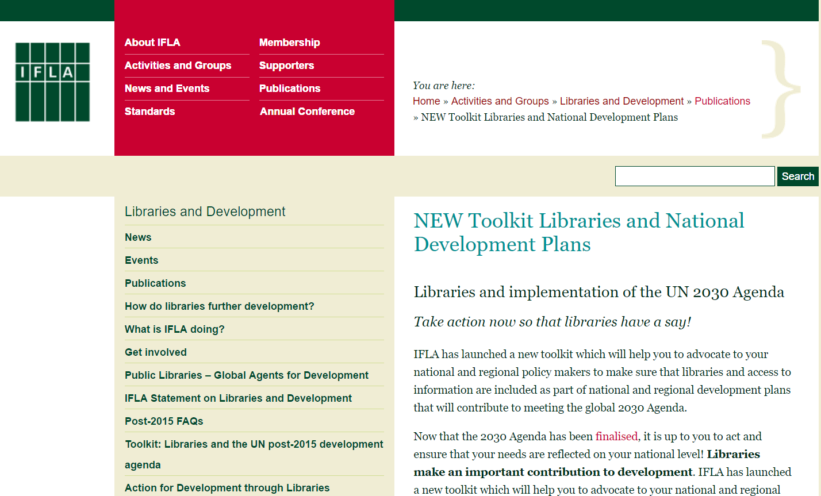
http://www.ifla.org/publications/node/10156

Slide 32
Resources
IFLA (2013). Statement on Libraries and Development
http://www.ifla.org/publications/ifla-statement-on-libraries-and-development
IFLA (2014). The Lyon Declaration on Access to Information and Development
www.lyondeclaration.org
IFLA (2016). Access and opportunity for all: How libraries contribute to the UN 2030 Agenda. http://www.ifla.org/files/assets/hq/topics/libraries-development/documents/access-and-opportunity-for-all.pdf
IFLA (2016). Toolkit: Libraries and National Development Plans [URL] – check Manual too
Beyond 2015: From policy to action toolkit (NB case studies)
http://www.beyond2015.org/sites/default/files/EN%20Beyond%202015%20Policy%20to%20Action%20Toolkit.pdf
Sustainable Development Solutions Network (SDSN) (2015). Getting started with the SDGs: A guide for stakeholders
http://unsdsn.org/wp-content/uploads/2015/12/151211-getting-started-guide-FINAL-PDF-.pdf
UN (2015). Transforming our world: The 2030 Agenda for sustainable development
https://sustainabledevelopment.un.org/content/documents/21252030%20Agenda%20for%20Sustainable%20Development%20web.pdf
Website: https://sustainabledevelopment.un.org/sdgs
Vision 2030 Jamaica: Executive Summary (note p.5)
http://www.vision2030.gov.jm/Portals/0/NDP/Executive%20Summary.pdf

