Slide 1

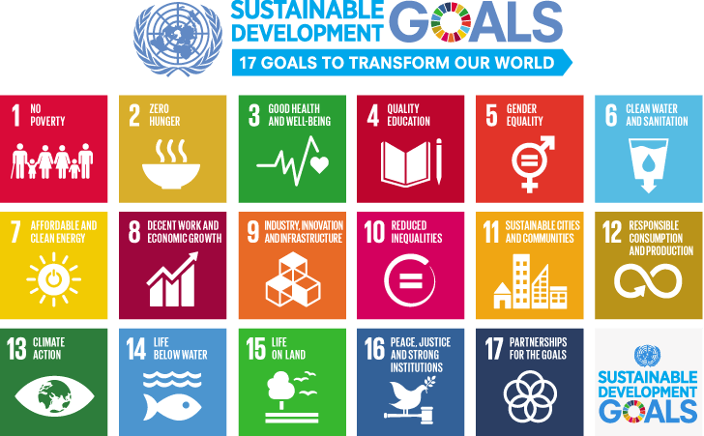

INTERNATIONAL ADVOCACY PROGRAMME
LIBRARIES, DEVELOPMENT,
AND THE UN 2030 AGENDA
TOPIC 1: THE UN 2030 AGENDA

Slide 2
For trainers
If you edit this file, please change the file name to show the region and the new date
  Delete the word [Master] from the file name
  Insert the region, eg Asia, Africa, Europe, LAC
  Change the date, using format YYYYMMDD
  Use underscore [ _ ] to link the elements of the file name
IFLA_IAP_Topic1_UN_2030_Agenda_[Region]_YYYYMMDD

Slide 3
Topic 1: The UN 2030 Agenda
Learning objectives
To understand the landscape of the UN Development Agenda
To be able to discuss the UN Millennium Goals and some of the achievements made
To build your knowledge of the UN 2030 Agenda and the Sustainable Development Goals (SDGs)
Note:
  The Programme Manual provides background information on the
  UN 2030 Agenda
  The IFLA Toolkit: Libraries and Implementation of the UN 2030 Agenda will also help you understand the context for the work IFLA is undertaking in the context of sustainable development
You are encouraged to read this material!

Slide 4
Overview of Topic 1: The UN 2030 Agenda
We review the UN Millennium Development Goals (2000-2015)
We introduce you to the UN 2030 Agenda and the global Sustainable Development Goals
We will help you to think about the SDGs which are relevant to your own country and/or region – and to the library sector

Slide 5
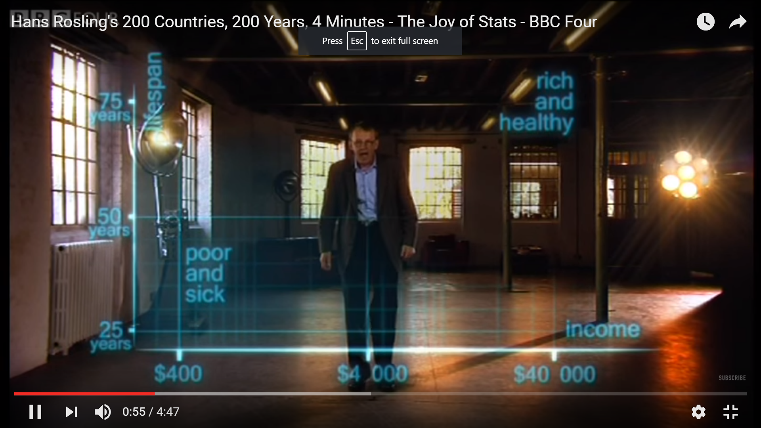
The world today
Hans Rosling provides insights into global development
https://www.youtube.com/watch?v=jbkSRLYSojo [4’47”]

Slide 6
Understanding the UN development agenda
At the beginning of the new millennium, in 2000, world leaders gathered at the UN to shape a broad vision to fight poverty in its many dimensions
That vision was translated into 8 Millennium Development Goals (MDGs)
The MDG framework has guided development work across the world for the past 15 years
Notes:
In this section we will explore the key elements for building successful strategic relationships; strategies for managing relationships when things go wrong and approaches for managing particular types of strategic relationships: association staff/officers, members and those external to the association – particularly partners and for fundraising.

Slide 7
Eight Millennium Development Goals
Goal 1: Eradicate extreme poverty and hunger
Goal 2: Achieve universal primary education
Goal 3: Promote gender equality and empower women
Goal 4: Reduce child mortality
Goal 5: Improve maternal health
Goal 6: Combat HIV/AIDS, malaria and other diseases
Goal 7: Ensure environmental sustainability
Goal 8: Develop a global partnership for development

Slide 8
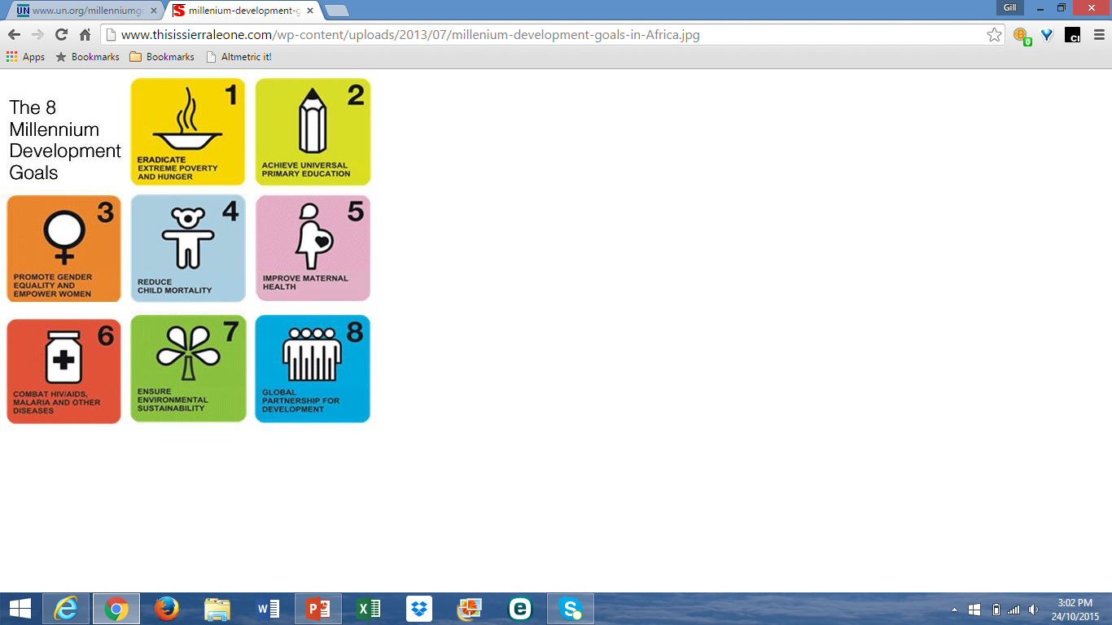
Some of the achievements

Slide 9
Slide to be deleted – for information only
[Trainers –
There is no need to work through all the following slides which show the achievements of the MDGs.
It is helpful just to show the overall impact of development goals
You might like to just highlight one or two achievements relevant to your region]

Slide 10
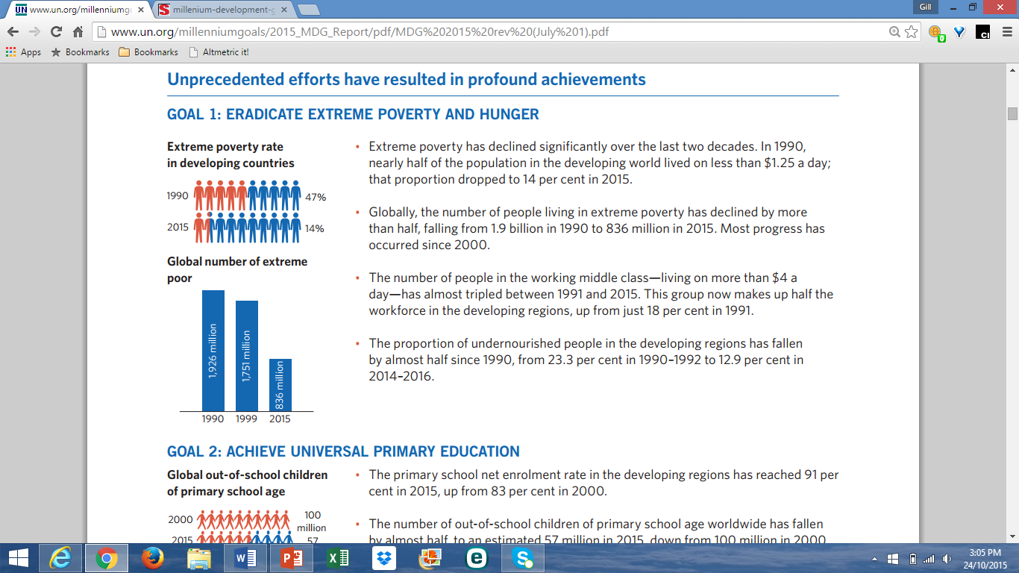

Slide 11
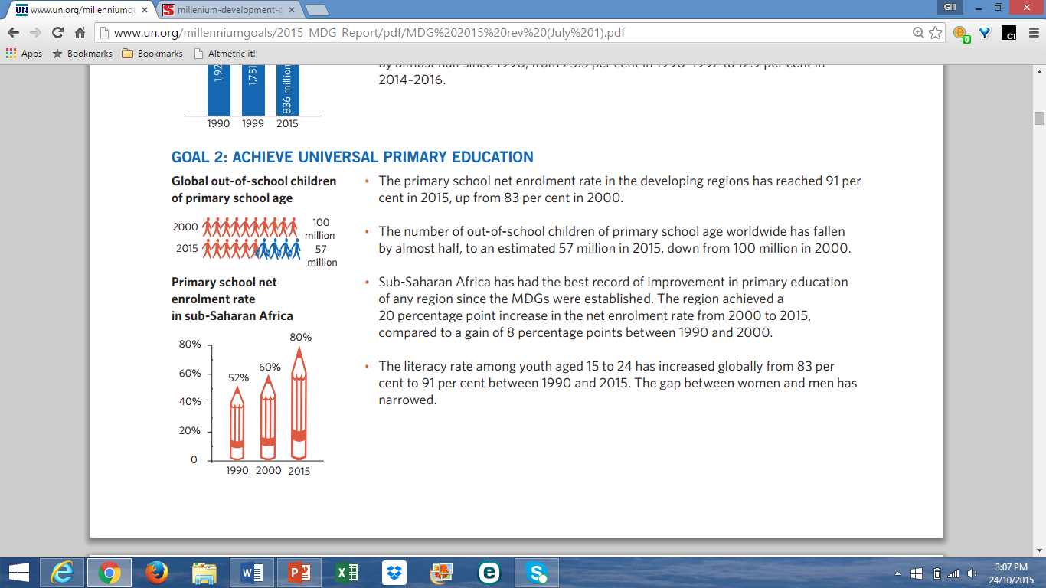

Slide 12
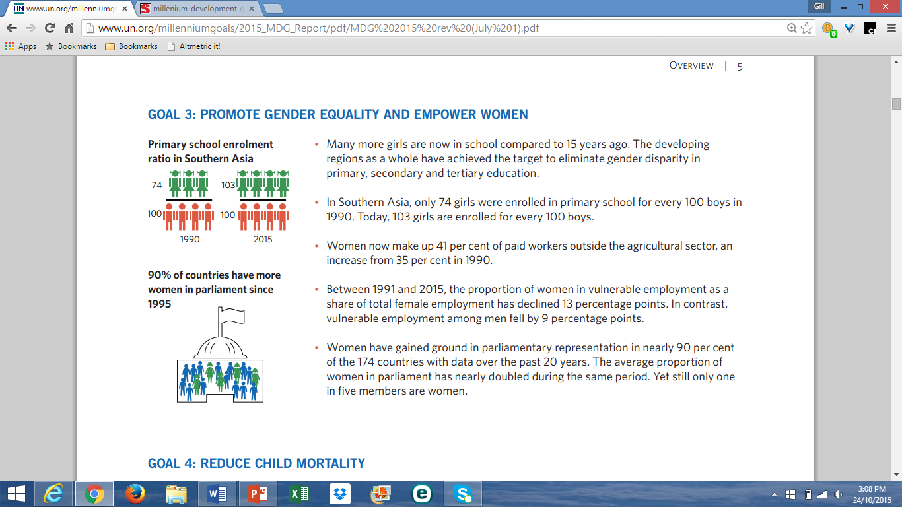

Slide 13
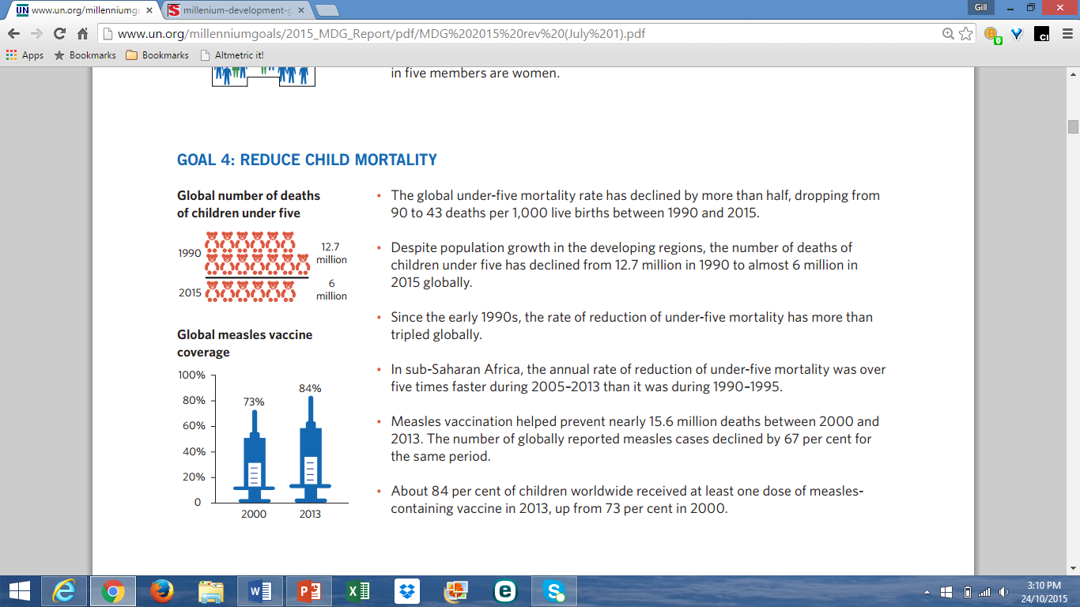

Slide 14
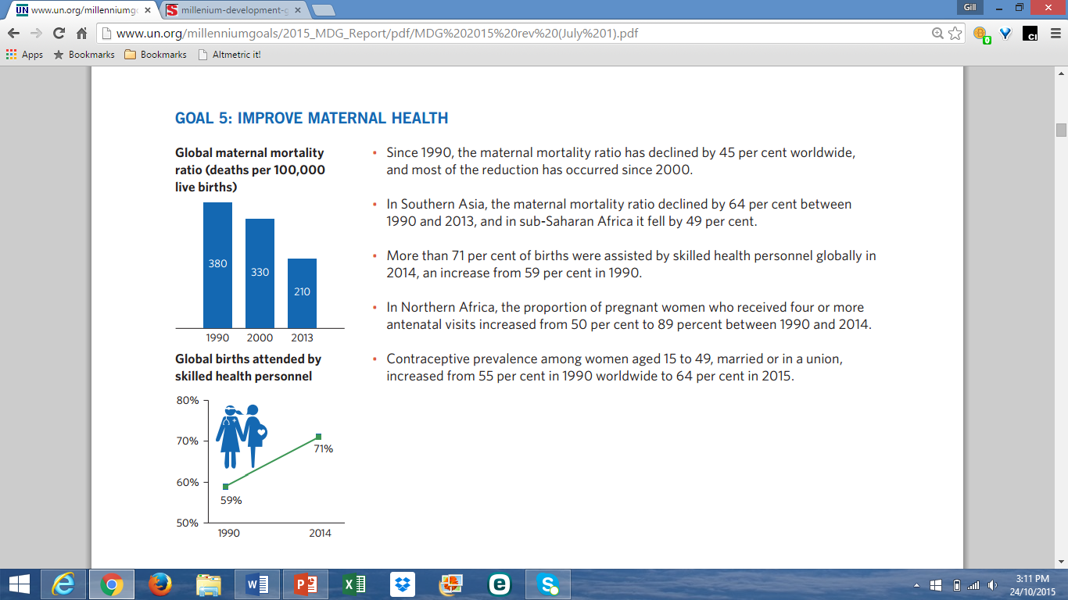

Slide 15
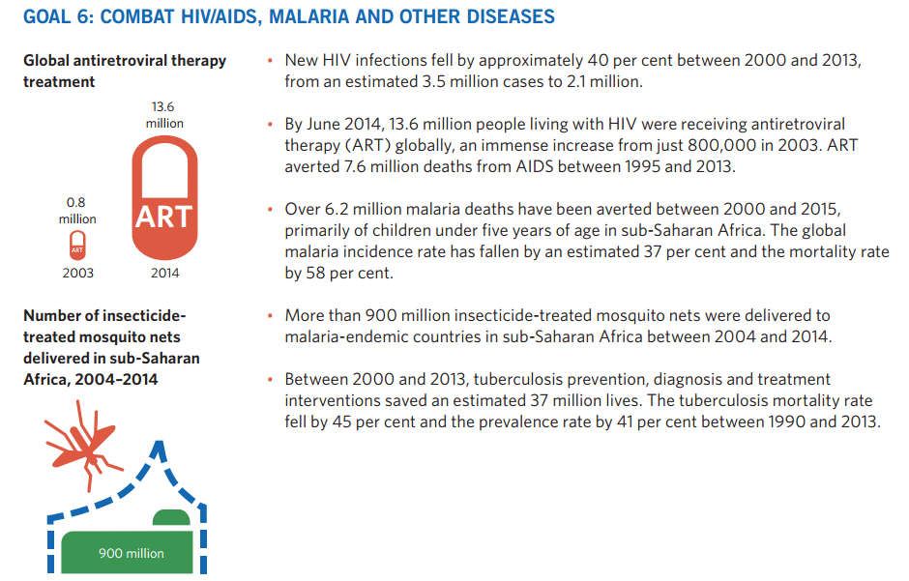

Slide 16
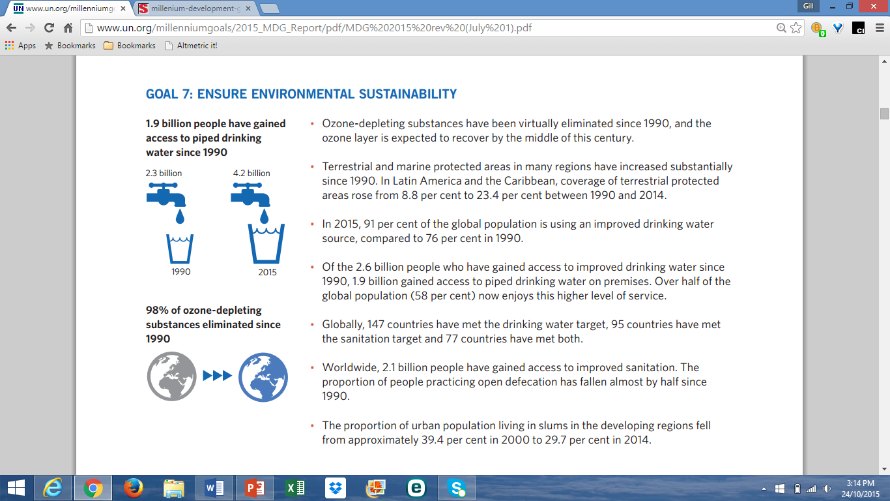

Slide 17
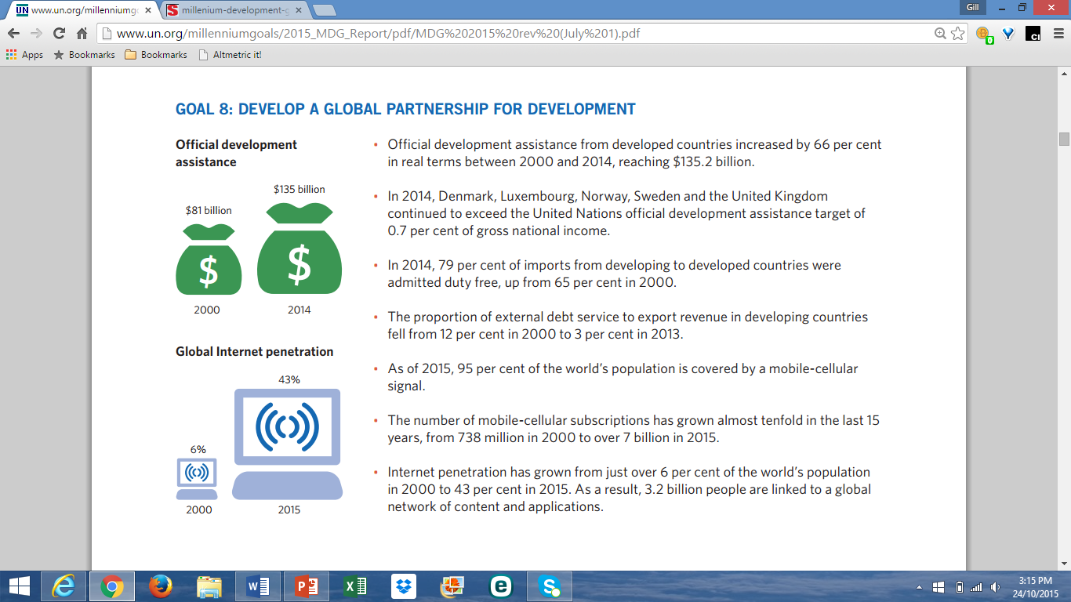

Slide 18
Significant achievements made, but many people are being left behind
Gender inequality persists
Big gaps exist between:
  The poorest and richest households
  Rural and urban areas
Climate change and environmental degradation undermine any progress achieved; poor people suffer the most
Conflict remains the biggest threat to human development
Millions of people still live in poverty and hunger, without access to basic services

Slide 19
However…
The successes of the MDG agenda prove that global action can work
It is argues that global action is the only path to ensure that the new development agenda leaves no-one behind
The world has the opportunity to build on the successes and to embrace new ambitions for the future we want
The new agenda should be “truly universal and transformative”
As the human race, we seek a sustainable future

Slide 20
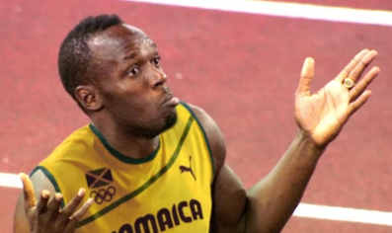
No point in going half way
https://www.youtube.com/watch?v=DdLqiTvFwJk [2’37”]

Slide 21
Three key questions for you…
How well known and accepted was the MDG agenda in your country or region?
To what extent were the political decision makers willing to commit themselves to implementing the MDGs?
Were the goals reflected in national development plans and did they have any influence on the actual orientation of policy?
(Loewe, 2006, pp.103ff.)

Slide 22
The origins of the UN 2030 Agenda
2012 UN Conference on Sustainable Development in
Rio de Janeiro (Rio+20)
Appeal made to formulate common goals and include these in the post-2015 development agenda
The MDGs did not consider environmental issues, eg
  Emissions of greenhouse gasses
  Access to clean drinking water
  Management of water resources
New focus on the concept of ‘sustainable development’
  Need to consider the relationship between nature and society
  Social, environmental and economic dimensions

Slide 23
Scoping the goals: democratic process
Involved all the member states of the UN
Cooperation with major NGOs and civil society agencies
Open forums around the world
Survey of over 4.5 million people about the most important goals and how they might be achieved
Collaborative wish for the world to create a better and more equal place to live in
Around 5 million people involved in the process

Slide 24
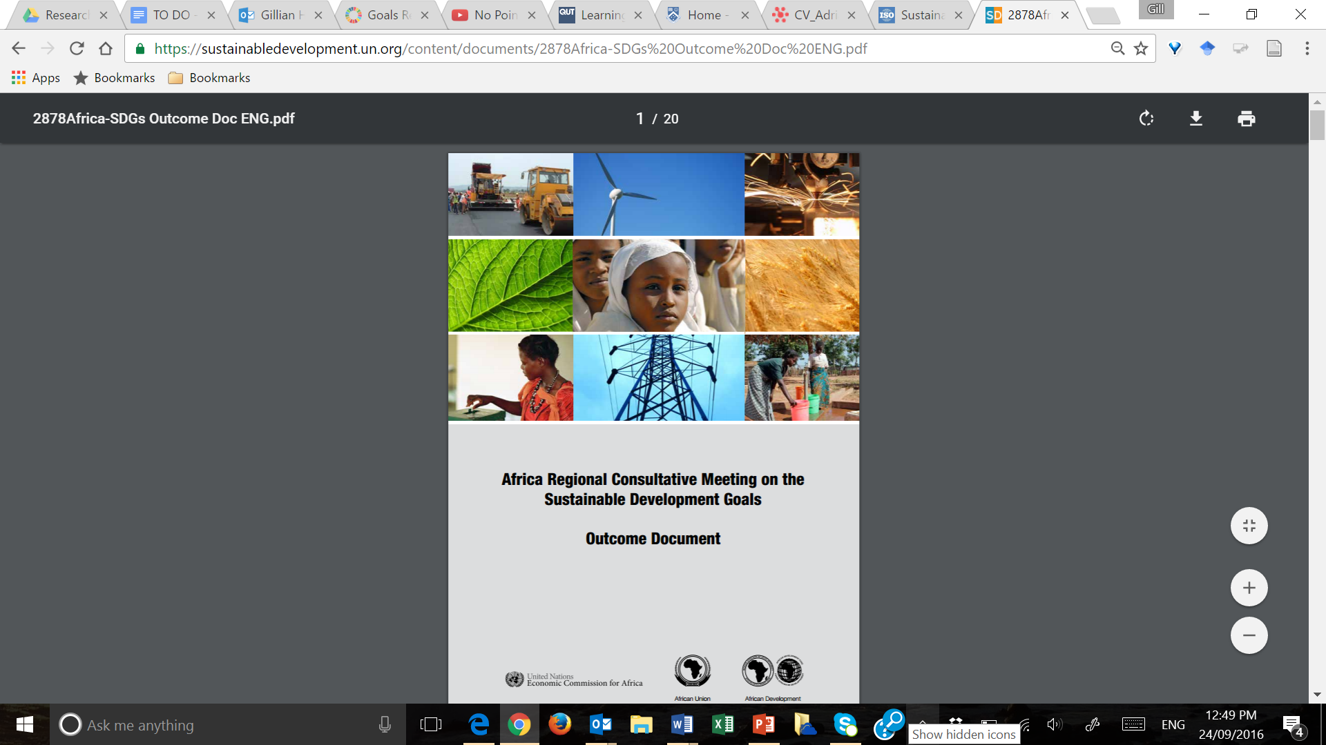
Regional consultation
https://sustainabledevelopment.un.org/content/documents/2878Africa-SDGs%20Outcome%20Doc%20ENG.pdf

Slide 25
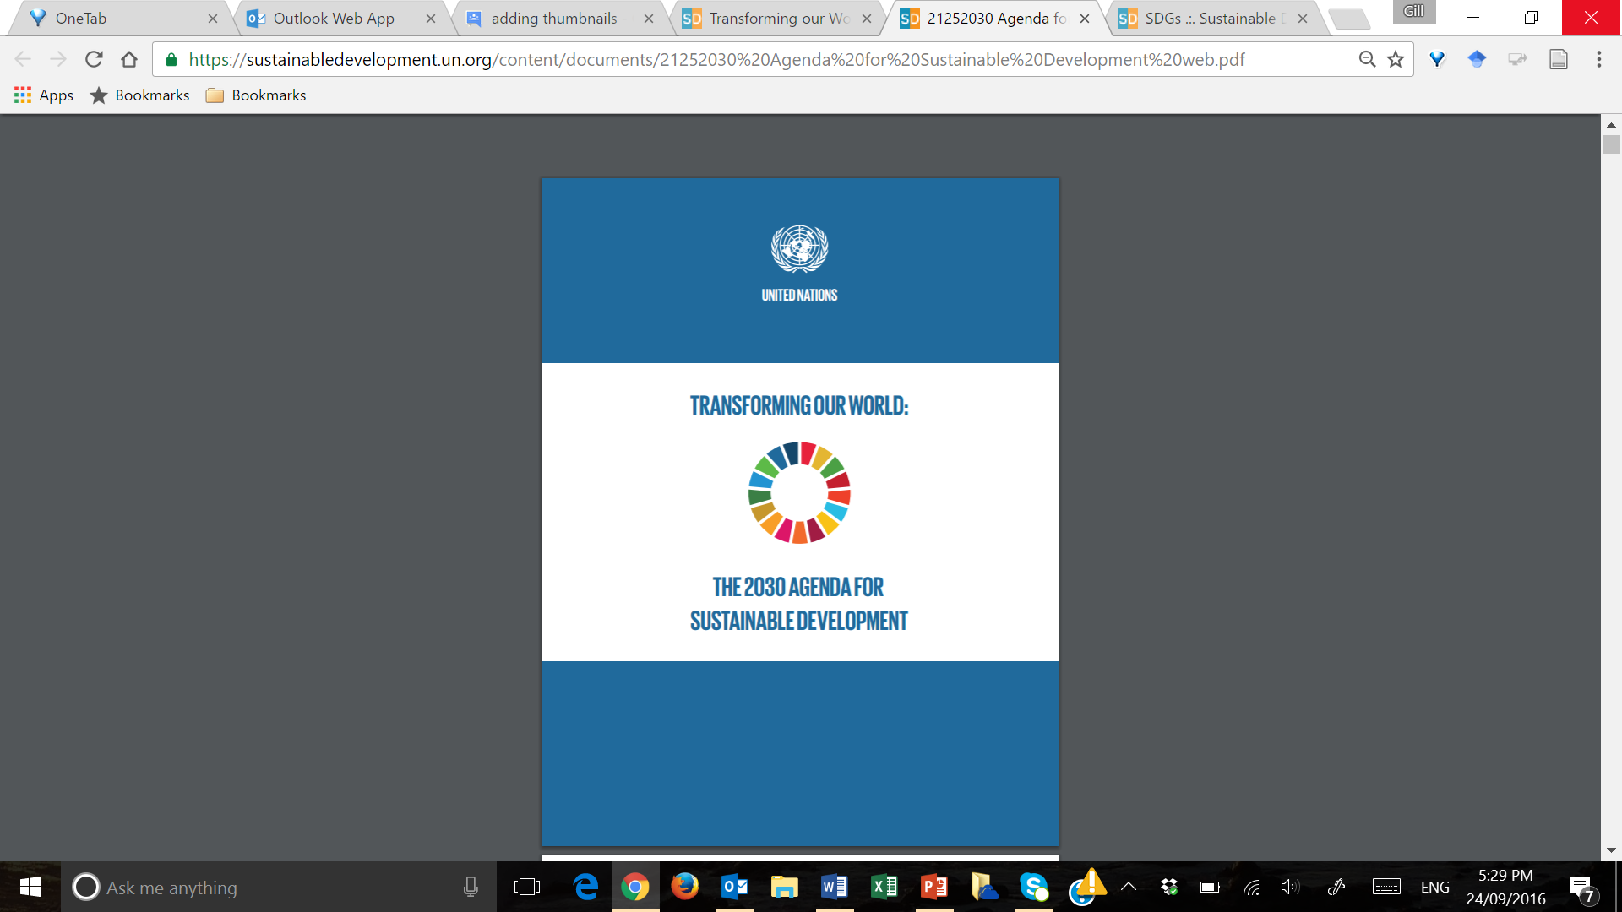
The international proposal: ‘Transforming our world’
https://sustainabledevelopment.un.org/content/documents/21252030%20Agenda%20for%20Sustainable%20Development%20web.pdf

Slide 26
The 2030 Sustainable Development Goals
The main goals focus on the 5 Ps
  People: the wellbeing of all people
  Planet: protection of the earth’s ecosystems
  Prosperity: continued economic & technological growth
  Peace: securing peace
  Partnership: improving international cooperation
These five aspects are interdependent
Therefore the SDGs demand integrated thinking
as well as integrated approaches to achieving the goals

Slide 27
The focus on People
End poverty in all its forms everywhere
End hunger, achieve food security and improved nutrition and promote sustainable agriculture
Ensure healthy lives and promote well-being for all at all ages
Ensure inclusive and equitable quality education and promote lifelong learning opportunities for all
Achieve gender equality and empower all women and girls

Slide 28
The focus on the Planet and on Prosperity
Ensure availability and sustainable management of water and sanitation for all
Ensure access to affordable, reliable, sustainable and modern energy for all
Promote sustained, inclusive and sustainable economic growth, full and productive employment and decent work for all
Build resilient infrastructure, promote inclusive and sustainable industrialization and foster innovation
Reduce inequality within and among countries
Make cities and human settlements inclusive, safe, resilient and sustainable

Slide 29
The Planet and Prosperity, cont.
Ensure sustainable consumption and production patterns
Take urgent action to combat climate change and its impacts
Conserve and sustainably use the oceans, seas and marine resources for sustainable development
Protect, restore and promote sustainable use of terrestrial ecosystems, sustainably manage forests, comat desertification, and halt and reverse land degradation and halt biodiversity loss

Slide 30
The focus on Peace
Promote peaceful and inclusive societies for sustainable development, provide access to justice for all and build effective, accountable and inclusive institutions at all levels
The focus on Partnerships
Strengthen the means of implementation and revitalise the global partnership for sustainable development

Slide 31
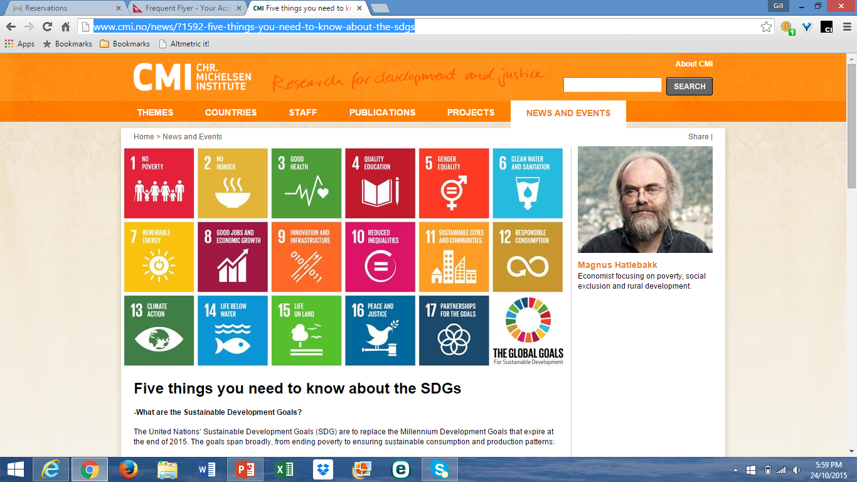
17 goals
169 targets
https://sustainabledevelopment.un.org/sdgs

Slide 32
Desired outcomes for the UN 2030 Agenda
  Improving policy coherence
      The SDGs are multi-dimensional: require linkages across policy areas
  Supporting inclusive growth and well-being
      Leaving no-one behind
Ensuring the planet’s sustainability
      Balance between socio-economic progress and sustaining the planet’s resources and ecosystems
Promoting partnerships
      Governments, international NGOs, private sector and civil society will need to team up: financial resources, technologies
  Having accurate data to inform the process and the progress

Slide 33
The value of timely, current, accurate data
Need to strengthen data collection, management and dissemination to capture evidence to inform decision making
Encompasses:
  Evidence-based policy for development
  Evidence-based management of development projects
  What gets measured, gets done
  Aligning demand with policy support
There are currently large data gaps, so significant improvements are needed
  To strengthen statistical capacity
  To use new technology to collect and disseminate data
  To achieve global consensus on the data required: standards

Slide 34
The significance of open data
Data for development should be made available to the public in open formats
Supports government transparency & accountability
Improves policy decisions
Increases citizen engagement
Promotes government efficiency and effectiveness
Visualisation and analysis tools
Data literacy skills to ensure data are used and interpreted correctly
Librarians have a role to play in developing these data literacy skills

Slide 35
Activity 1.1. Sustainable Development Goals
https://sustainabledevelopment.un.org/sdgs
In your regional groups, please take a look at the
17 SDGs
Just at the ‘top level’, think about the topics of the individual SDGs…
Which do you feel are the most important ones for your country and/or region, and why?
Please write your ideas on sticky notes
  Write each idea on a new sticky note, so that they can be placed in thematic groups

Slide 36


Slide 37
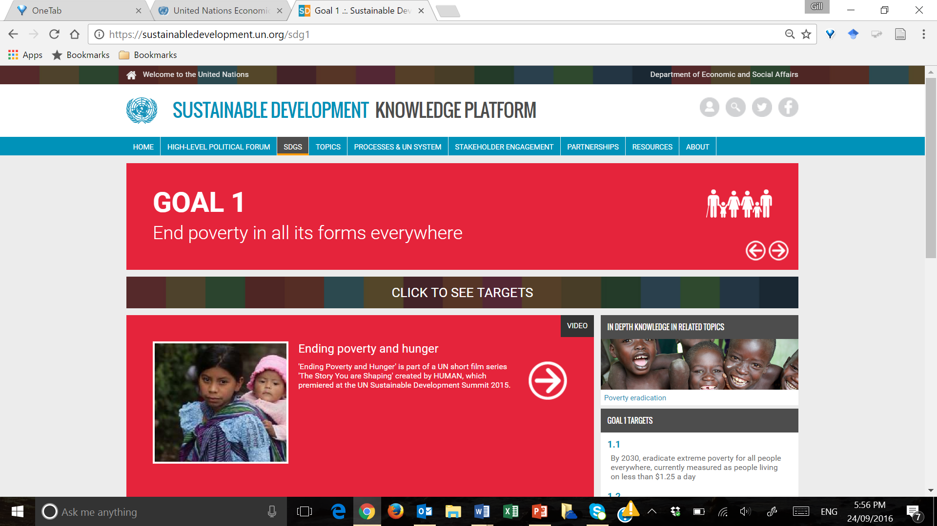
Activity 1.2. Which are the most relevant targets?
https://sustainabledevelopment.un.org/sdgs
Click here → → →
Taking one SDG which you feel is really important in your country and/or region, explore a bit further and try to determine which individual targets are the most relevant
Again, please use sticky notes to capture your ideas,
using a new sticky note for each idea

Slide 39
IFLA’s advocacy activities at the UN
Extensive negotiations over the past three years to develop the UN 2030 Agenda
Since 2012, IFLA has been engaged with the creation of the UN 2030 Agenda to advocate for:
  Ensuring access to information
  Safeguarding of cultural heritage
  Universal literacy
  Access to information and communication technologies (ICT)
These aspects are represented in the UN 2030 Agenda

Slide 40
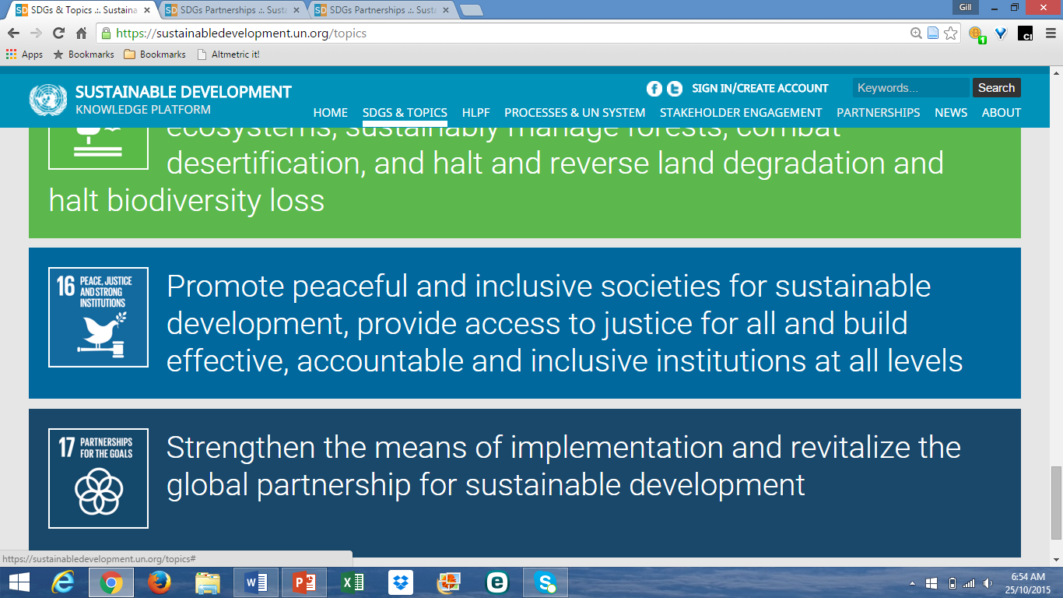
IFLA: focus on Goal 16
Goal 16.10
Ensure public access to information and protect fundamental freedoms, in accordance with national legislation and international agreements

Slide 41
Topic 1B: IFLA’s work at the UN
Trainers:
The supplementary file for Topic 1B can be used with groups where there is interest in understanding more about IFLA’s journey to having the concept of ‘access to information’ adopted in Goal 16.10
Participants could also work independently with this presentation after the workshop

Slide 42
Summary
We introduced you to the UN Development Agenda
The Millennium Development Goals (2000-2015)
The UN 2030 Agenda: new Sustainable Development Goals
We explored which SDGs might be most relevant to your region
Now we need to contextualise UN 2030 Agenda
in the world of libraries

Slide 43
Resources
Beyond 2015: From policy to action toolkit (NB case studies)
http://www.beyond2015.org/sites/default/files/EN%20Beyond%202015%20Policy%20to%20Action%20Toolkit.pdf
Loewe, M. (2006). Middle East / North Africa and the Millennium Development Goals: Implications for German development cooperation. Bonn: Deutsche Institut für Entwicklungspolitik.
https://www.die-gdi.de/uploads/media/Studies_19.pdf
Sustainable Development Solutions Network (SDSN) (2015). Getting started with the SDGs: A guide for stakeholders
http://unsdsn.org/wp-content/uploads/2015/12/151211-getting-started-guide-FINAL-PDF-.pdf
United Nations (2015). The Millennium Development Goals report. New York: UN.
http://www.un.org/millenniumgoals/2015_MDG_Report/pdf/MDG%202015%20rev%20(July%201).pdf
United Nations. General Assembly (2015). Transforming our world: The 2030 agenda for sustainable development.
https://sustainabledevelopment.un.org/post2015/transformingourworld
https://sustainabledevelopment.un.org/content/documents/21252030%20Agenda%20for%20Sustainable%20Development%20web.pdf
UN 2030 Agenda website: https://sustainabledevelopment.un.org/sdgs

