Slide 1

Towards a stronger and more sustainable library field in Asia-Oceania
IFLA Workshop, Bangkok, Thailand
14-16 November 2022

Slide 2

Opening and Welcome

Slide 3

By the end of this workshop, you should...
Have an understanding of what a sustainable library field means, and how you can apply this in your own work
Have new ideas about how you can engage with the United Nations and other international initiatives within your country and regionally
Be able to apply (IFLA) tools and references in your own strategic planning, in particular around gathering and applying data
Be ready to work with us in shaping an IFLA ‘offer’ that responds to the needs of the region
Have built your own networks!

Slide 4
By the end of this workshop, we should...
Know you and your national library fields better
Have ideas from you about where there are possibilities to work with the United Nations and other potential funders
Understand better how we can support a sustainable library field in Asia-Oceania
Have convinced you to extend your engagement in IFLA!

Slide 5
Meeting rules and norms
Please bring your full attention to this process and to what others are saying
Please ask questions if you don’t understand
Let us know if we are speaking too fast – we will slow down
Be understanding and help each other out
Assume good intentions, do not immediately make a judgement
Step up if you have something to say. Step back if you’ve been doing a lot of talking to give others a chance
Use the parking lot to capture topics we may not be able to address in this workshop or in any particular segment

Slide 6
Note
We’ll be using quite a lot of Mentimeter, so please make sure your device can work. Mentimeter does work well on smartphones
Please do wear masks, and don’t forget to change them at least every 4 hours

Slide 7
Our Agenda (Day 1)
Opening and welcome (almost over!)
Setting the scene and warming up
What do we mean when we talk about sustainability?
Libraries and sustainable development – a vector of advocacy
Defining advocacy goals
Practicing advocacy skills
Welcome dinner

Slide 8
Our Agenda (Day 2)
Information for Development: Mobilising Libraries to Support UN Goals in Asia-Pacific (Seminar at UN ESCAP) *** BRING YOUR ID! ***
What do we need to do in our field to ensure sustainability?
From priorities to plans
Dinner

Slide 9
Our Agenda (Day 3)
Evaluating and demonstrating value and impact
Library Map of the World – your advocacy tool
Highlights and reflections
Certificates and closing

Slide 10
Roles
Barbara and Nthabi: IFLA GB
IFLA HQ Staff: Moderators, additional support, keeping the show on the road
Table facilitators: Helping you through our programme
You: essential to the success of our time together!

Slide 11
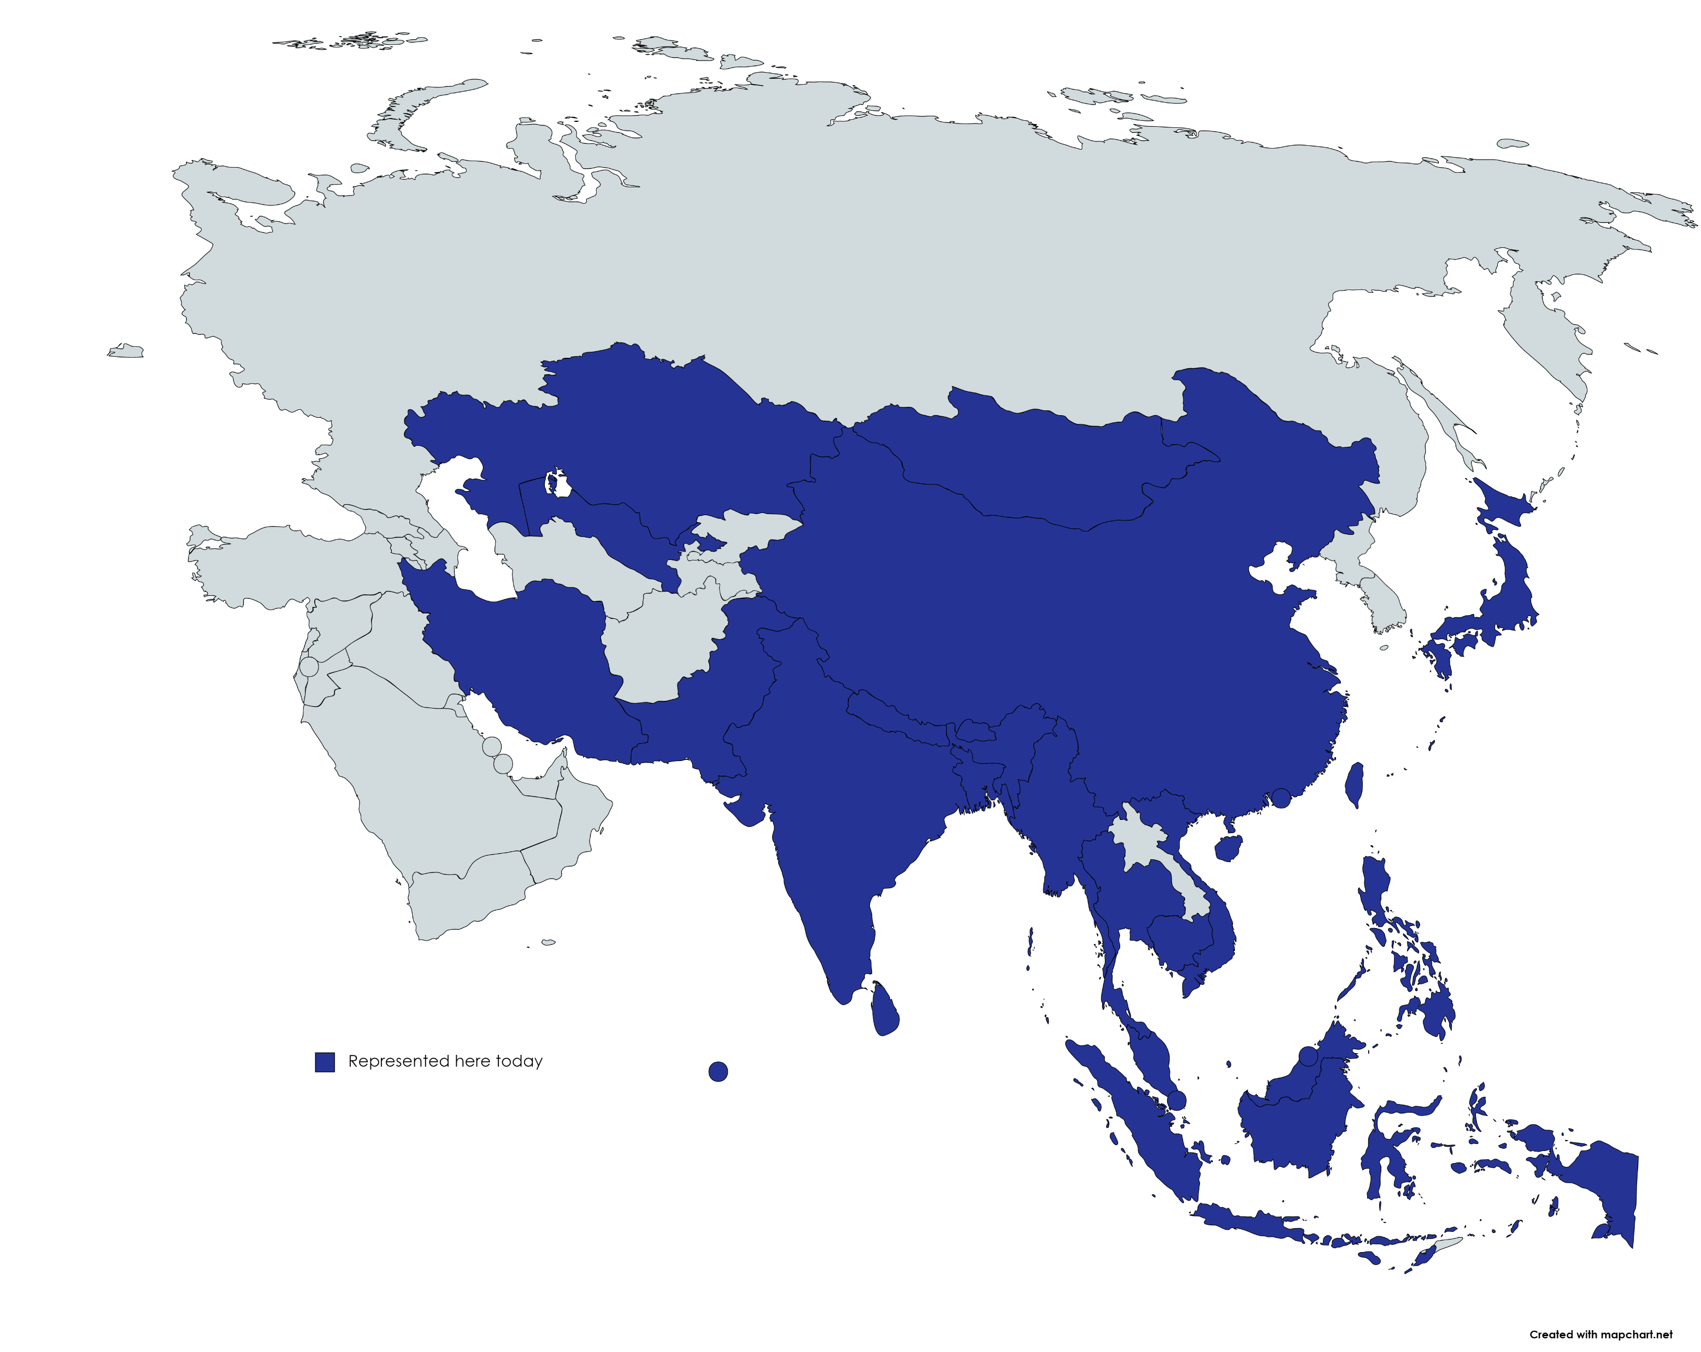

Slide 12
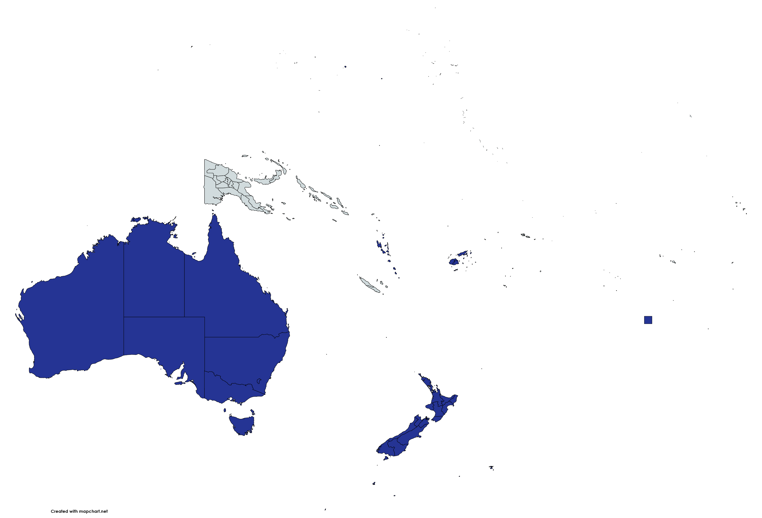

Slide 13
Warming up
Have you ever…

Slide 14
Been an IFLA volunteer?

Slide 15
Attended an IFLA Congress?

Slide 16
Nominated someone in an IFLA election?

Slide 17
Voted in an IFLA election?

Slide 18
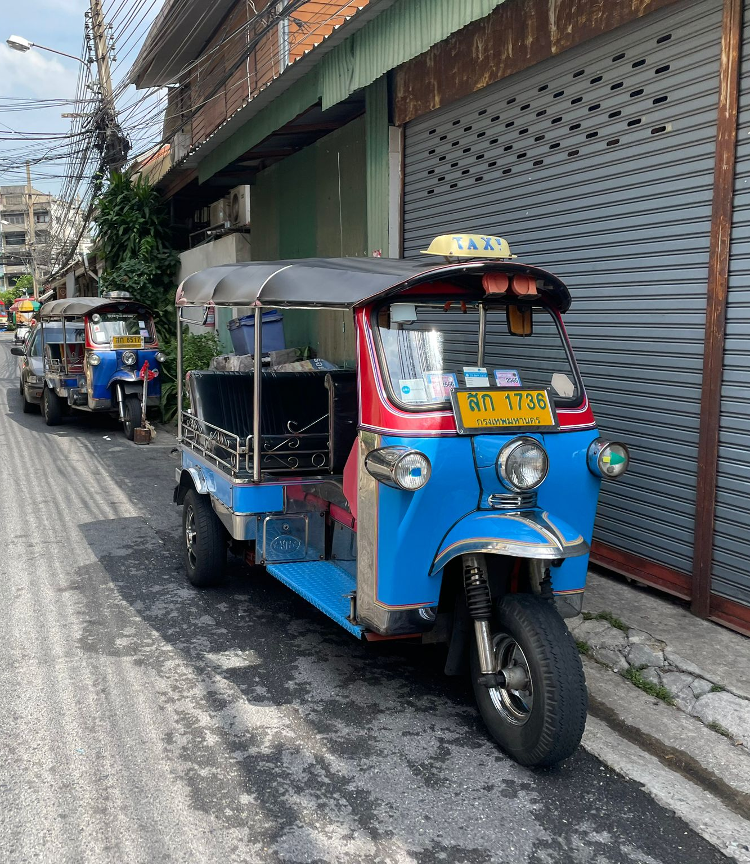
Ridden on
a tuk-tuk?

Slide 19
What score did you get?

Slide 20
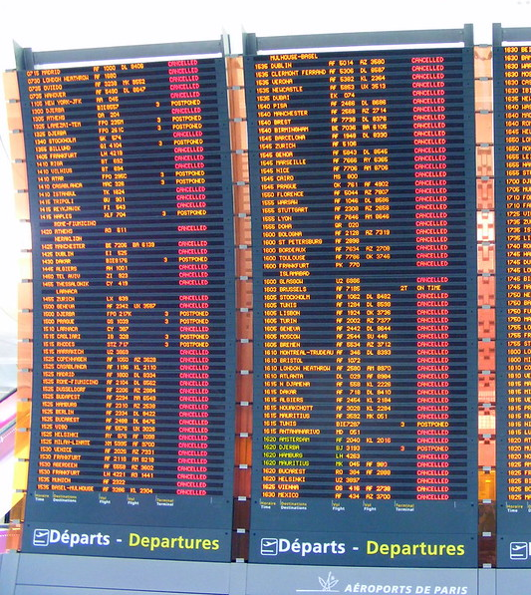
Your plane is cancelled and you get stuck in a foreign city for a day – what do you do?

Slide 21
Your plane is cancelled and you get stuck in a foreign city for a day – what do you do?

Slide 22
Introduce yourselves to your table in 1 minute, saying:
Who you are
Your engagement with IFLA
What you want to get from this meeting!

Slide 23
The road to Bangkok

Slide 24
Where we’re coming from…

Slide 25
The leading international body representing the interests of library and information services and their users

Slide 26
Independent, non-governmental, not-for-profit organisation
1,401 active members in 135 countries worldwide

Slide 27
65 committees
>1,100 experts
from 100 countries
Standards, guidelines, advocacy, support

Slide 28

IFLA HQ + Regional Offices + Language Centres
IFLA HQ
Regional Offices
Language Centres

Slide 29
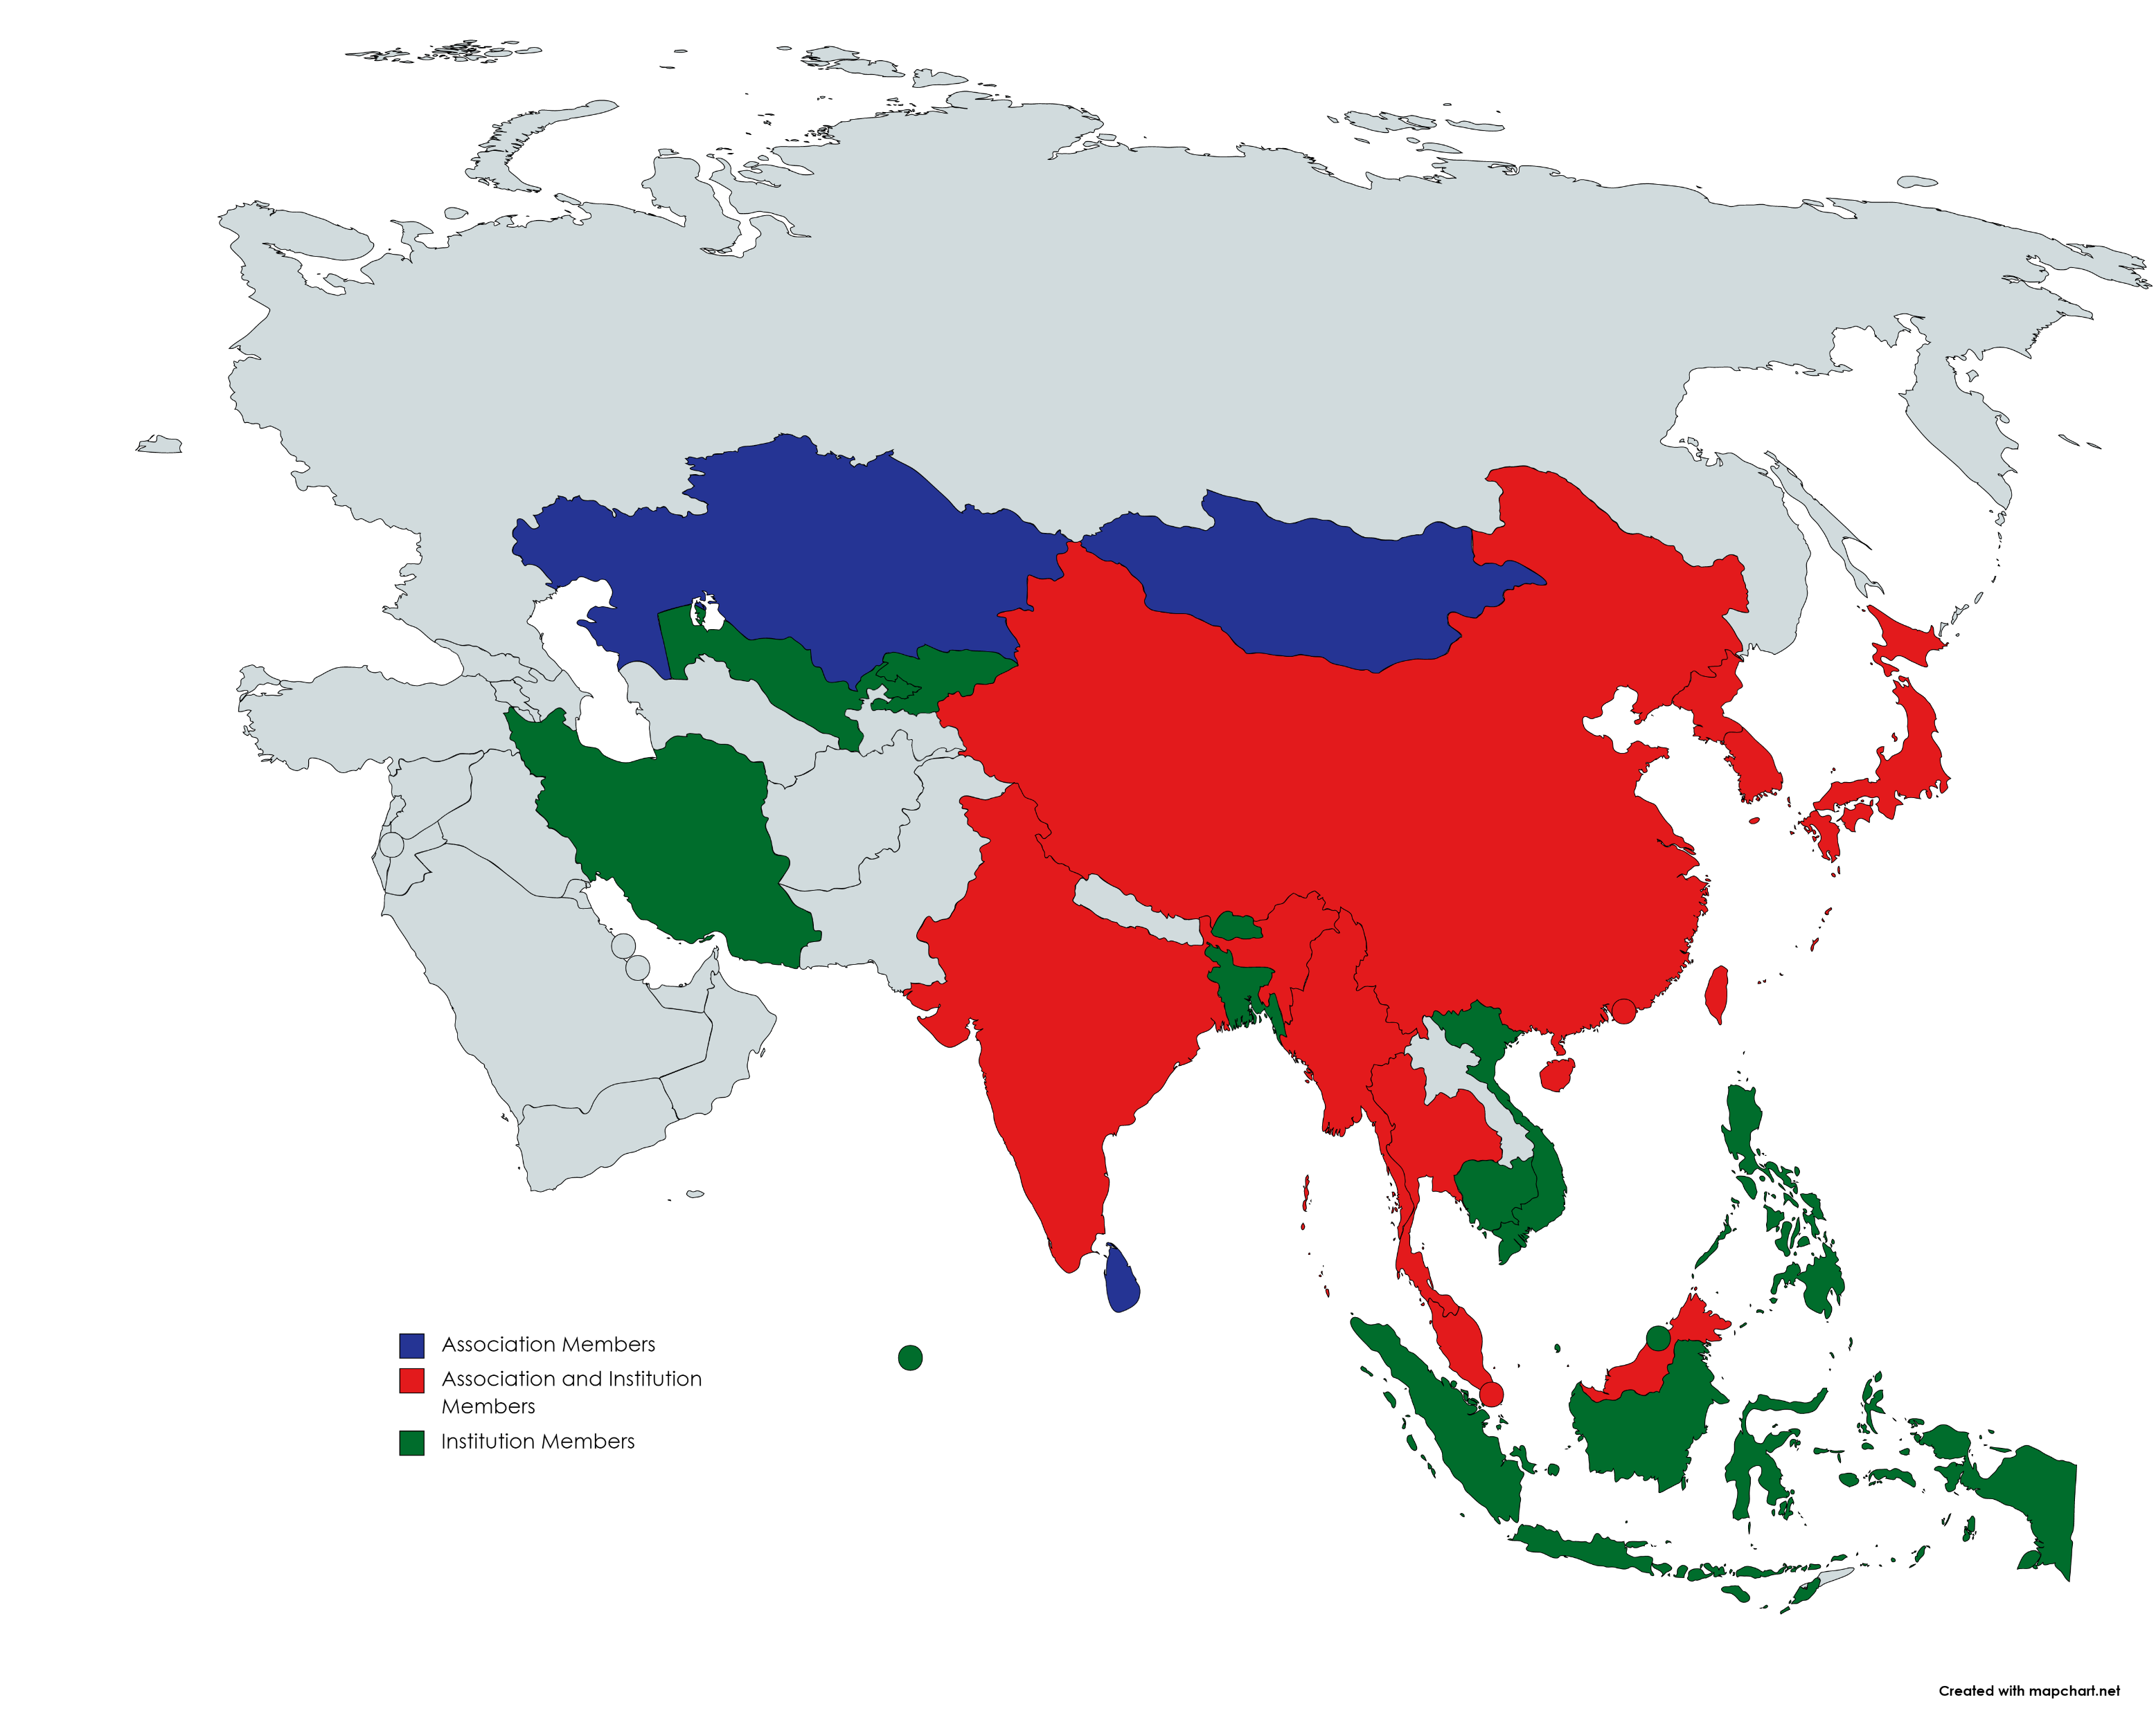
Association Members

Slide 30
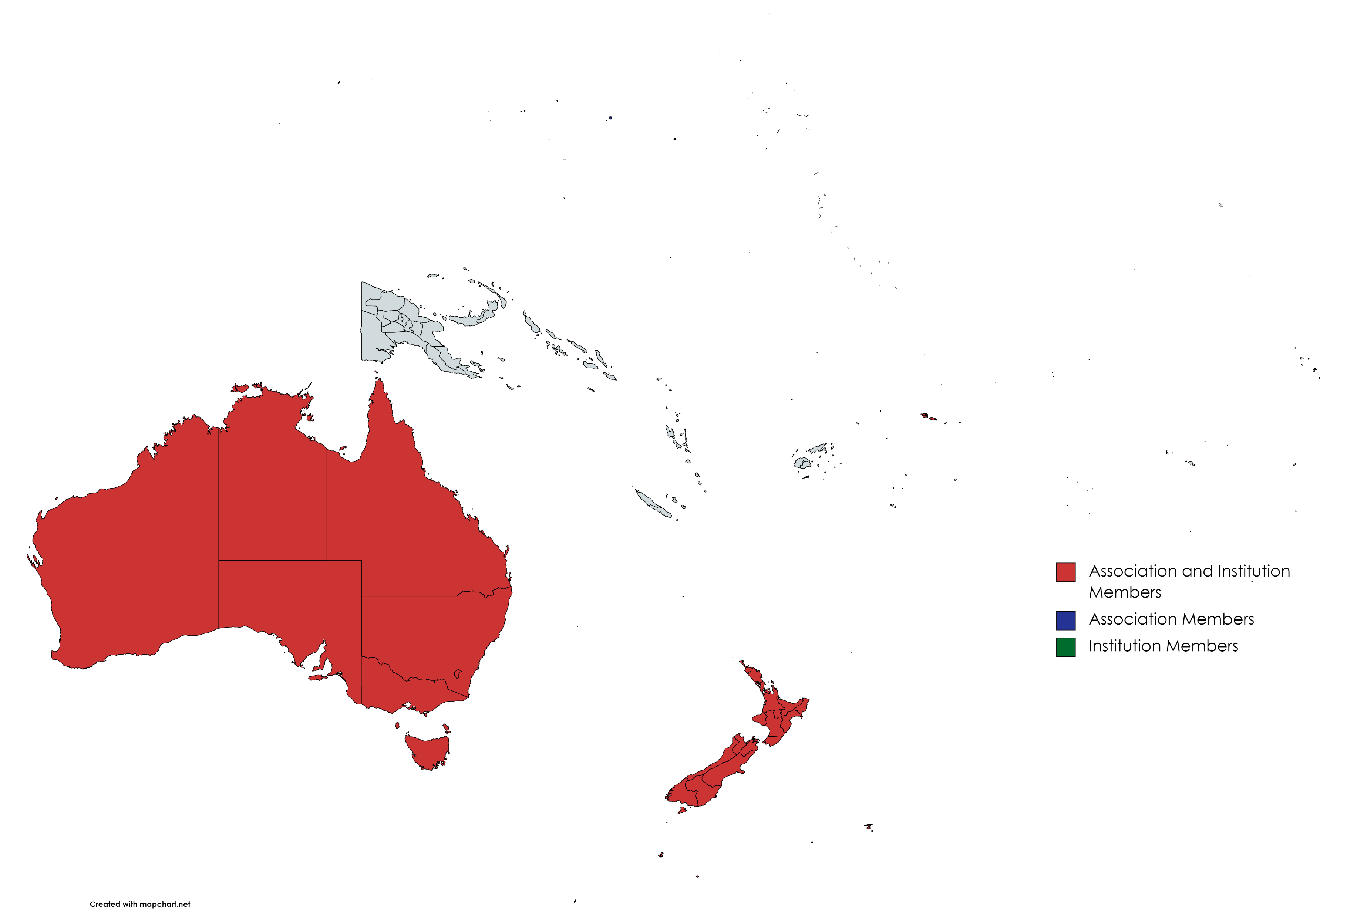

Slide 31
But…
We are facing rapid changes bringing both threats and opportunities for libraries
We cannot just sit back, complain, or hope that the internet will just go away
We go further by going together
We have plenty more to do to realise the potential of IFLA as an effective, inclusive, transparent organisation

Slide 32
Vision - Strategy - Action

Slide 33
The Vision process…
1 global kick-off meeting
6 regional workshops
185 national and volunteer workshops, >9000 participants
>21 000 online votes, from 190 countries
Nearly half a million years of library experience!

Slide 34
From Vision to Strategy
1 global kick-off meeting
6 regional workshops, including 26 from Asia Oceania!
163 national and volunteer workshops
>8000 ideas submitted to the IFLA Ideas Store

Slide 35
From Strategy to Action
IFLA’s own Strategy and its implementation (more on this later!)
Finding opportunities for alignment
Building strong and sustainable regional library fields

Slide 36
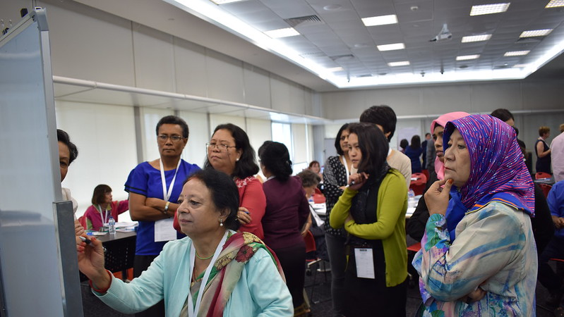
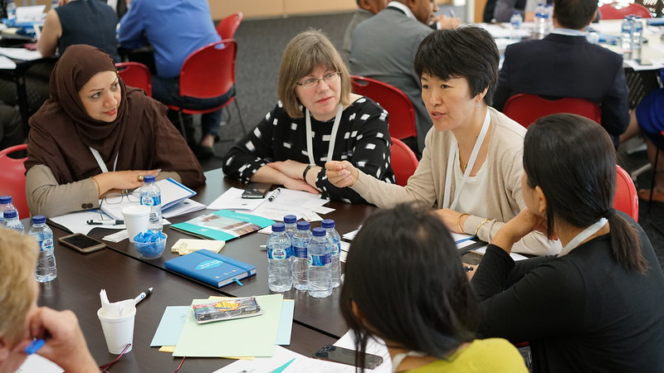
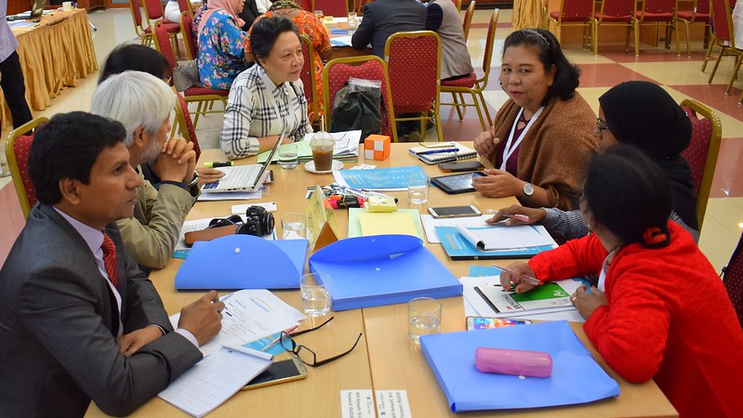
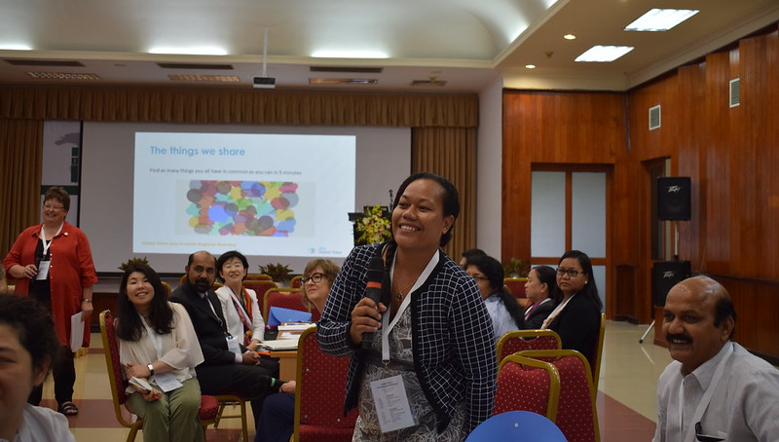

Slide 37

QUESTION
What did you take away from the Vision meetings?

Slide 38
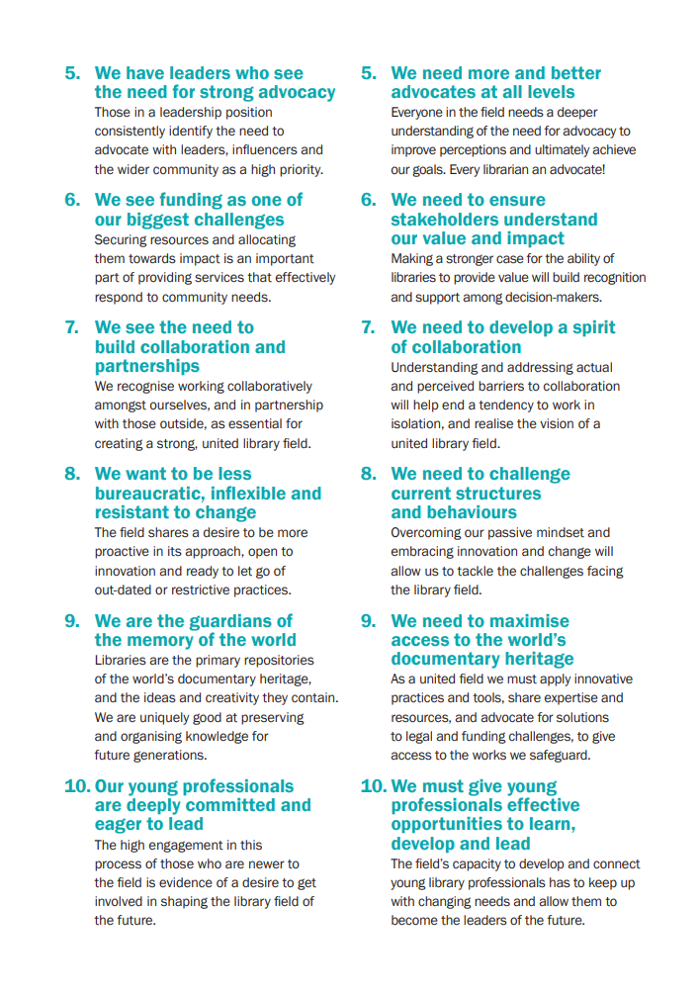
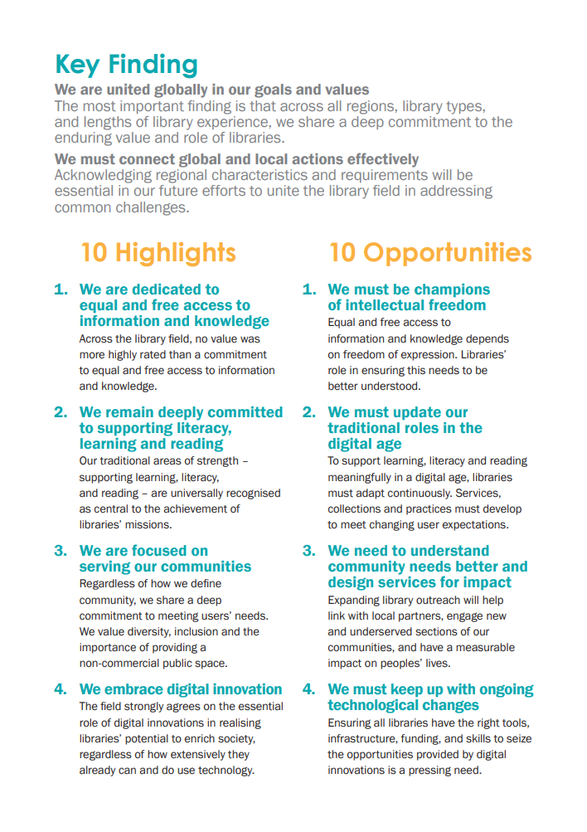

Slide 39
We are united globally in our goals and values
The most important finding is that across all regions, library types, and lengths of library experience, we share a deep commitment to the enduring value and role of libraries.
We must connect global and local actions effectively
Acknowledging regional characteristics and requirements will be essential in our future efforts to unite the library field in addressing common challenges.

Slide 40
We are dedicated to equal and free access to information and knowledge, but we must be champions of intellectual freedom
We remain deeply committed to supporting literacy, learning and reading, but we must update our traditional roles in the digital age
We are focused on serving our communities, but we need to understand community needs better and design services for impact
We embrace digital innovation, but we must keep up with ongoing technological changes
We have leaders who see the need for strong advocacy, but we need more and better advocates at all levels

Slide 41
We see funding as one of our biggest challenges, but we need to ensure stakeholders understand our value and impact
We see the need to build collaboration and partnerships, but we need to develop a spirit of collaboration
We want to be less bureaucratic, inflexible and resistant to change, but we need to challenge current structures and behaviours
We are the guardians of the memory of the world, but we need to maximise access to the world’s documentary heritage
Our young professionals are deeply committed and eager to lead, but we must give young professionals effective opportunities to learn, develop and lead

Slide 42
www.ifla.org/global-vision-report-summary/
bit.ly/3E5wmCp

Slide 43

EXERCISE
Which highlight/opportunity pairing resonates most with you?

Slide 44
EXERCISE: Which highlight/opportunity pairing resonates most with you?
Think for a couple of minutes yourself
Explain your choice to others on your table
Then think together about which is most important for the Asia-Oceania region

Slide 45

Share your findings!
Photo: Matt Botsford on Unsplash, unsplash.com/photos/OKLqGsCT8qs

Slide 46
Key opportunities at our last meeting
5. We need more and better advocates at all levels
2. We must update our traditional roles in the digital age
3. We need to understand community needs better and design services for impact
7. We need to develop a spirit of collaboration
4. We must keep up with ongoing technological changes

Slide 47




IFLA STRATEGY
2019 – 2024

Slide 48
Strategic Directions 2019 – 2024
ONE
Strengthen the Global Voice of Libraries
TWO
Inspire and Enhance Professional Practice
THREE
Connect and Empower the Field
FOUR
Optimise our Organisation

Slide 49
SD1: Strengthen the global voice of libraries
1.2
Build a strong presence
in international organizations
and meetings as a
valued partner
1.4
Shape public
opinion and debate around open access and library values, including intellectual freedom and human rights
1.1
Show the power
of libraries in achieving the Sustainable Development
Goals
1.3
Work with library associations and libraries to identify key legal and funding challenges to their work, and advocate
for action

Slide 50
SD2: Inspire and enhance professional practice
2.2
Deliver high quality campaigns, information and other communications products on a regular basis to engage and energise libraries
2.4
Provide tools and infrastructure that
support the work of libraries
2.1
Produce, communicate and distribute key resources and materials that inspire the profession
2.3
Develop standards, guidelines, and
other materials that foster best professional
practice

Slide 51
SD3: Connect and empower the field
3.2
Support virtual networking and connections
3.4
Provide targeted learning and professional development
3.1
Provide excellent opportunities for face-to-face networking and learning
3.3
Empower the field
at the national and regional levels

Slide 52
SD4: Optimise our organisation
4.2
Effectively mobilise our human resources and networks
4.4
Increase our visibility through excellent and innovative communications
4.1
Foster the long-term financial continuity and stability of the organisation
4.3
Increase, diversify and engage our
membership

Slide 53
The IFLA Strategy is…
A means of responding to the opportunities highlighted in the Global Vision
A reference point for all parts of IFLA in their work
A tool for our Members and beyond in their own strategy-building
A framework for building cooperation and realising synergies within the library field

Slide 54

Coffee Break
Photo by Mike Kenneally on Unsplash, unsplash.com/photos/TD4DBagg2wE

Slide 55

What do we mean by a sustainable library field?

Slide 56
The library field is…
Library and information workers, institutions (of all types), associations, and the services and infrastructures that support them

Slide 57
Brundtland Report, 1987
Sustainable development is: “development that meets the needs of the present without compromising the ability of future generations to meet their own needs”

Slide 58
Brundtland Report, 1987
Sustainable development is: “development that meets the needs of the present without compromising the ability of future generations to meet their own needs”

Slide 59
The ‘pillarisation’ of sustainability – complements or competitors?
Environmental sustainability
Economic sustainability
Social sustainability
… and cultural sustainability

Slide 60
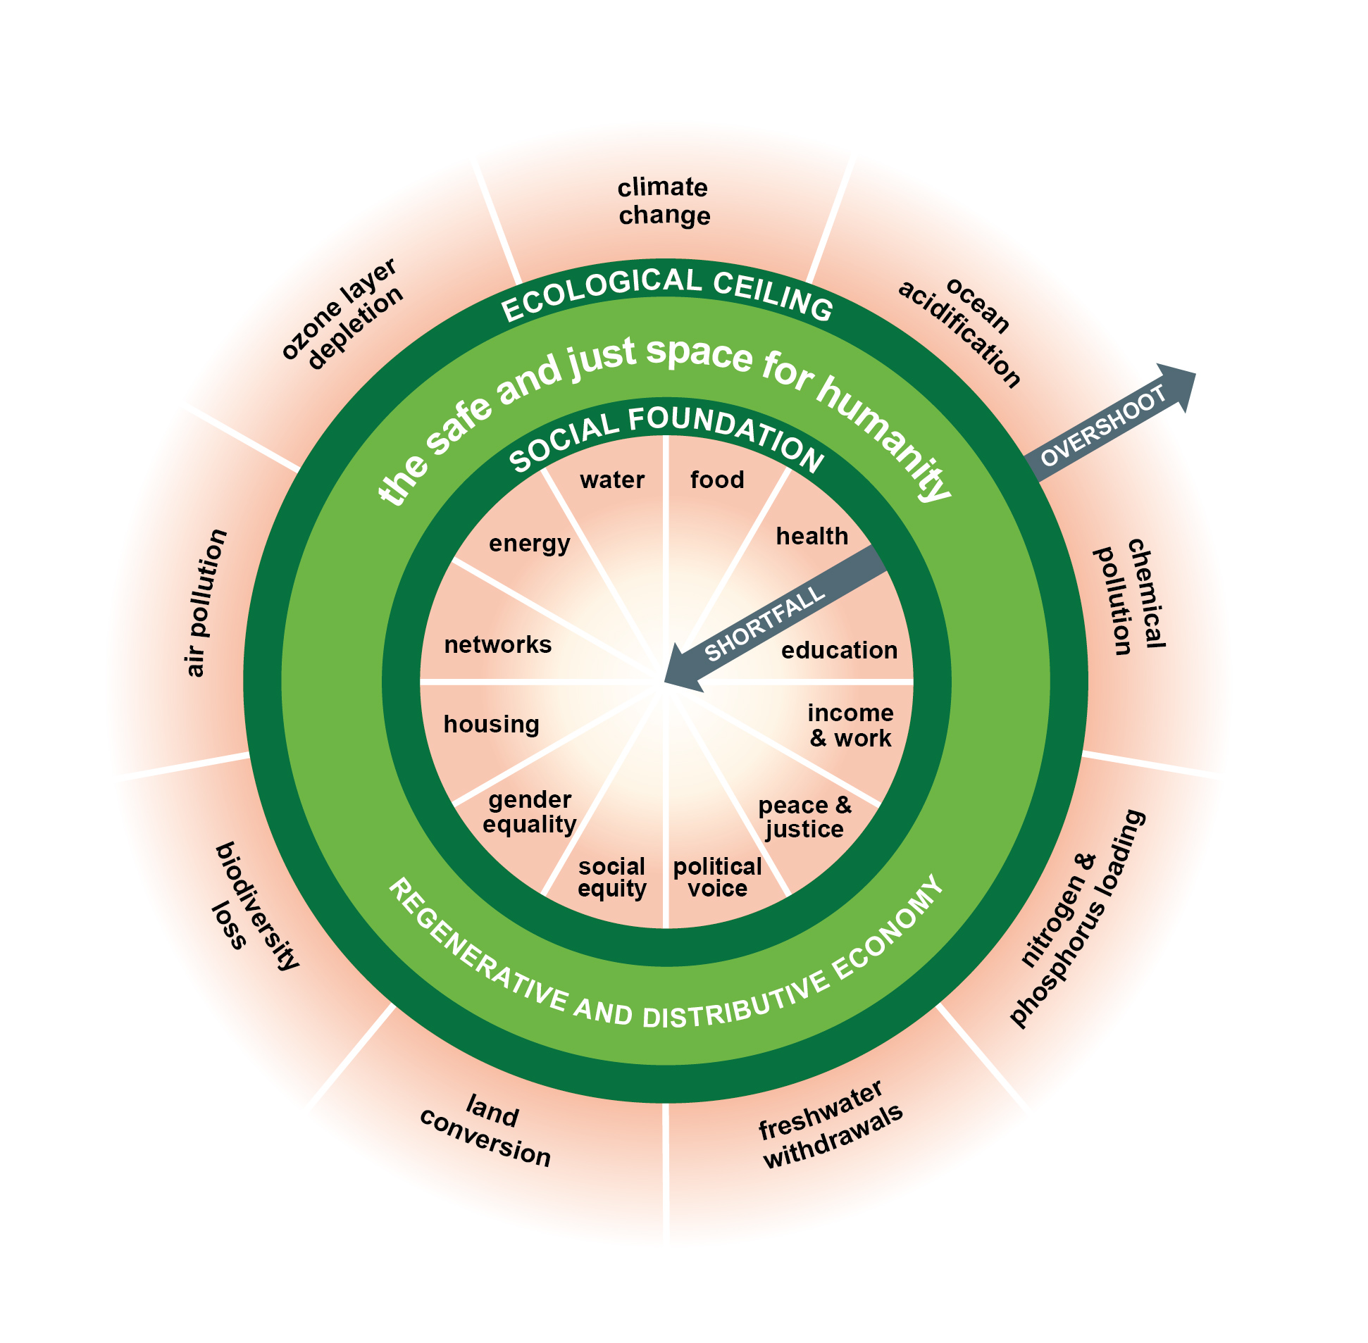
Doughnut economics and the limits to growth

Slide 61

Avoiding the under-supply of public goods
Photo by Ulvi Safari on Unsplash, unsplash.com/photos/tCj8uuABLBA

Slide 62
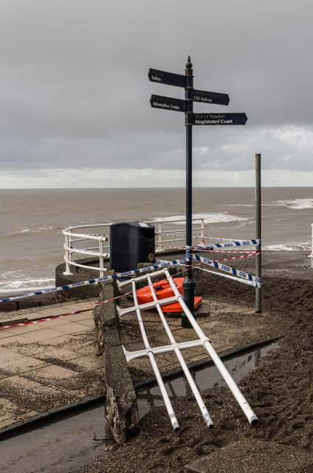
The importance of resilience
Photo: Ian Capper, CC-BY-SA 3.0, www.geograph.org.uk/photo/3804467

Slide 63
Strong and weak versions of sustainability
Weak: we can innovate our way to sustainability, i.e. do things better rather than cutting back
Strong: we have to make tough decisions if we want to preserve what matters and deliver what we need

Slide 64
We can talk about sustainability…
As an internal issue within our field
As an issue in our relationships with others (users, suppliers, supporters, partners)
As a global issue

Slide 65
EXERCISE
What does sustainability mean in the context of the library field?

Slide 66
EXERCISE: What does sustainability mean in the context of the library field?
Write down the words you think are most relevant in defining what sustainability means for libraries in your country
Write down your own ideas as a tweet
Compare on your table, and write a shared definition on your flipchart (240 characters)
Swap with a neighbouring table, and note – on post-its – what you like, and what you’d add

Slide 67
Share your findings!
Photo: Matt Botsford on Unsplash, unsplash.com/photos/OKLqGsCT8qs

Slide 68

Libraries, Sustainable Development and Advocacy

Slide 69

The UN Sustainable Development
Goals
Transforming Our World: the 2030 Agenda for Sustainable Development, agreed in 2015
Includes:
Sustainable Development Goals
Resource mobilisation
Follow-up mechanisms

Slide 70

17 Goals
169 Targets
232 Indicators

Slide 71
The SDGs are different because…
They are an agenda for all, not just developing countries
They define development broadly, including environmental issues
They take a holistic approach, focused on policy connections
They stress that everyone has a right to development (“Leave No-one Behind”)
They focus on partnerships
There are monitoring and follow-up mechanisms

Slide 72

SDG16: Promote peaceful and inclusive societies for sustainable development, provide access to justice for all and build effective, accountable and inclusive institutions at all levels
Target 16.10: Ensure public access to information and protect fundamental freedoms, in accordance with national legislation and international agreements

Slide 73




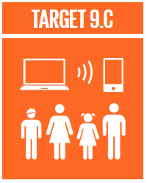







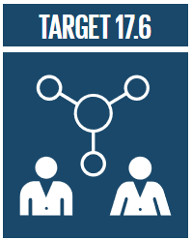


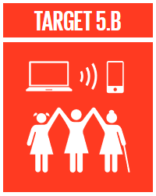


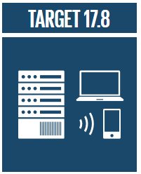
In total, 19 SDG targets talk about or imply the need to access information…
…but to achieve them, we need a coherent approach

Slide 74
Meaningful and inclusive access to information represents an accelerator of development across the 2030 Agenda, and should be at the heart of the Decade of Action

Slide 75
How have you engaged with the SDGs in your library field?

Slide 76

The SDGs as a tool for thinking – and speaking – about libraries

Slide 77
EXERCISE
Question 1: on which 5 SDGs are you currently working most?
Question 2: on which 5 SDGs should you be working most in the future?

Slide 79
EXERCISE
Discuss how libraries deliver on single SDGs
On tables, define the two most convincing ways in which libraries deliver on one of the top five SDGs defined earlier
And then define two ways in which libraries deliver on the SDGs across the board

Slide 81
Share your findings!
Photo: Matt Botsford on Unsplash, unsplash.com/photos/OKLqGsCT8qs

Slide 82
Looking Ahead to Tomorrow
UN ESCAP’s work on the SDGs in Asia-Oceania
UN ESCAP’s work on technology and innovation in Asia-Oceania
UNESCO’s work on education and lifelong learning in Asia-Oceania
UNESCO’s work on culture in Asia-Oceania

Slide 83

Lunch break
Photo: Max Griss on Unsplash, https://unsplash.com/photos/3ni86XCruis

Slide 84

Defining Advocacy Goals

Slide 85
Why we advocate?
Because we rely on the support of our funders and communities in order, in turn, to be able to give back to them

Slide 86
From
Libraries are the answer. What was the question again?
To
How can we show that libraries are the answer to the questions decision-makers (and those who influence them) are asking?

Slide 87
Securing and diversifying sources of support for libraries
As ‘external’ factors, libraries rely on both laws and funding in order to succeed
Decision-makers need to make trade-offs (sympathy isn’t enough)
Our future is safest when we can rely both on champions and broad alliances that support libraries

Slide 88
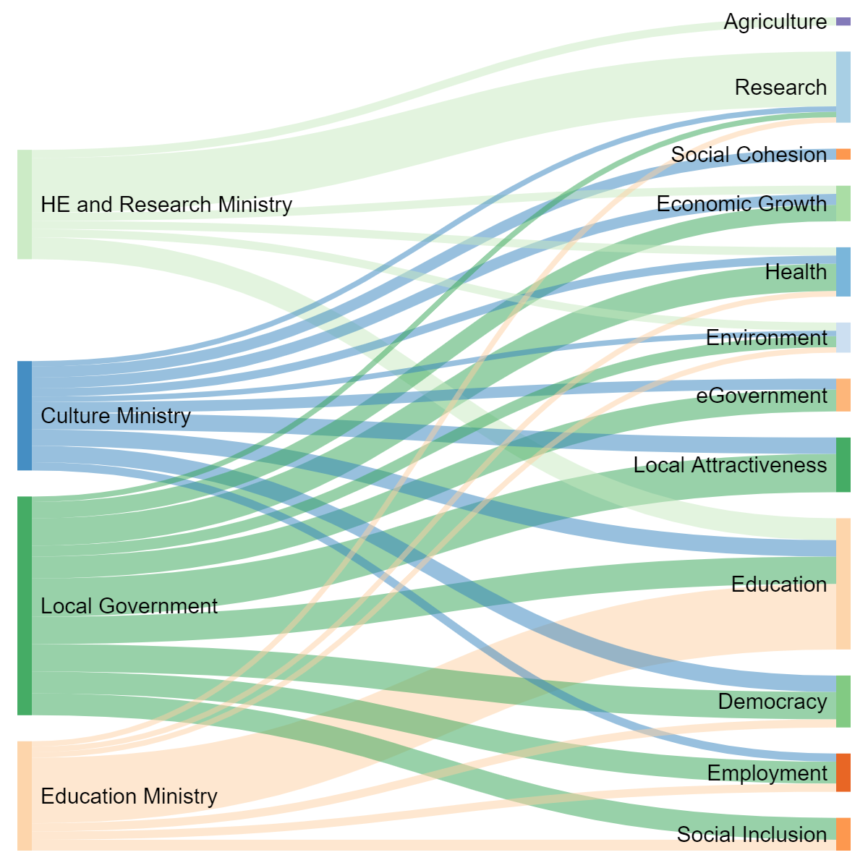
Contribution of different ministries/ agencies
Benefits in policy terms
*Figures are guesswork!

Slide 89
Celebrating advocacy successes
Share examples you know about where libraries have convinced decision-makers/funders of the need to support libraries, especially outside of our ‘traditional’ partners

Slide 90
Why engage with the UN system in Asia-Oceania (or anywhere else)?
Engage in projects that raise the profile/status of libraries (and sometimes bring funding)
Support reports and recommendations that can influence (and be used to influence) decision-makers
Build networks and gain insights

Slide 91
The topics we’ll be exploring tomorrow
Sustainable Development Goals
Technology and innovation
Education and lifelong learning
Culture

Slide 92
How can we show that libraries are the answer to the questions UN ESCAP and UNESCO in Asia-Oceania are asking?

Slide 93
EXERCISE
Tables 1, 3 and 5 visit the UN ESCAP website
Tables 2, 4 and 6 visit the website of UNESCO’s Bangkok Office
Individually identify areas where they are working and what they are doing, and where libraries can offer solutions
Work on your tables to identify three projects you think libraries could get involved in

Slide 94
Share your findings!
Photo: Matt Botsford on Unsplash, unsplash.com/photos/OKLqGsCT8qs

Slide 95
Balancing effort and impact

Slide 96
High effort
EFFORT
Where’s your action?
Low effort
IMPACT
Low impact
High impact

Slide 97
EXERCISE
Draw a graph on your flipchart for effort and impact
Write your projects on post-it notes
Assess where the three projects you have identified would stand on this

Slide 98
Share your findings!
Photo: Matt Botsford on Unsplash, unsplash.com/photos/OKLqGsCT8qs

Slide 99

Practicing Advocacy Skills

Slide 100
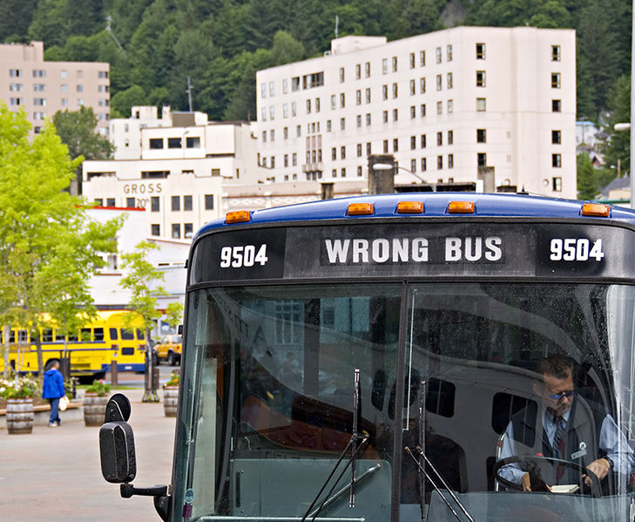
What advocacy isn’t
A solo activity
Just about lobbying
A single skill
Something that can be left to others
Photo: Seth Anderson, CC-BY-SA 2.0, bit.ly/3zb2vGb

Slide 101
8 Dimensions of Advocacy
Understanding the landscape
Coordinating your work
Mobilising the field
Gathering evidence
Communication
Building relations with decision-makers
Building advocacy partnerships
Evaluation and goal-setting

Slide 102
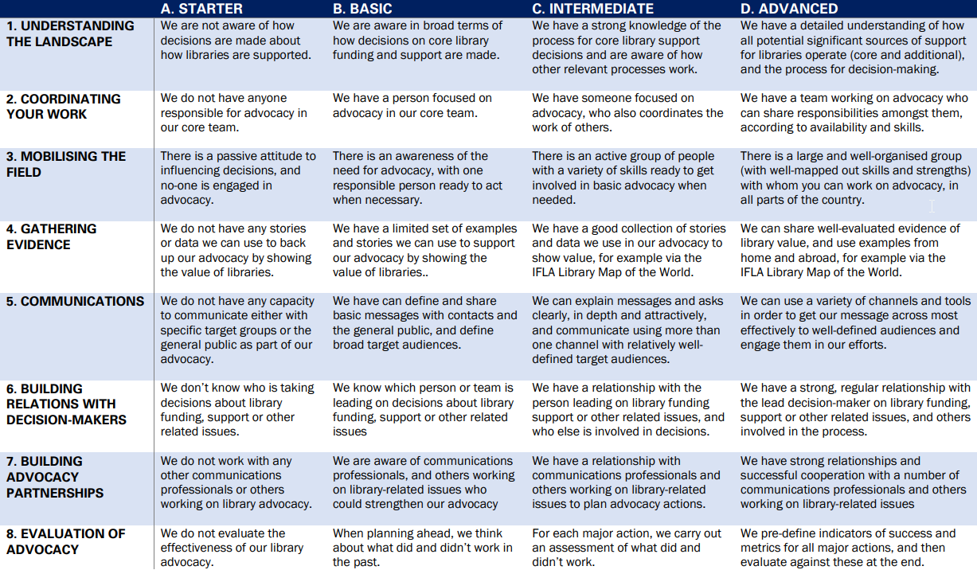

Slide 103
EXERCISE
Refresh your memory about the advocacy capacity grid
Share with colleagues on your table where you think your national library field stands. What are your strong points, where can you get stronger?
Discuss – what partnerships could you form to boost skills?

Slide 105
Share your findings!
Photo: Matt Botsford on Unsplash, unsplash.com/photos/OKLqGsCT8qs

Slide 106
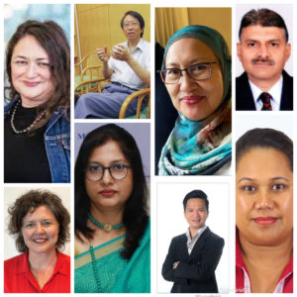
Check out also the resources from our Management of Library Associations Section!
https://www.ifla.org/mlas-npsig-2022-webinar-series/

Slide 107
EXERCISE
On your table, choose one of the projects you identified earlier
Choose someone to be the minister/official, and another their advisor/colleague. Everyone else is the library team
The role of the library delegation is to convince the minister to support library involvement in the project
Read the description of the minister’s role and personality – plan how you will approach the meeting
Hold a 3-4min meeting, and then assess how it went!

Slide 108
Share your findings!
Photo: Matt Botsford on Unsplash, unsplash.com/photos/OKLqGsCT8qs

Slide 109
Thank you!

Slide 110
Towards a stronger and more sustainable library field in Asia-Oceania
IFLA Workshop, Bangkok, Thailand
14-16 November 2022

