Slide 1

ISBDM Examples Task & Finish Group
Mirna Willer
Presented to the IFLA webinar “From ISBD to ISBDM”, 26 January 2023
IFLA webinar
From ISBD to ISBDM
26 January 2023

Slide 2
Examples in the current ISBD are not suitable for ISBD for Manifestation (ISBDM) because: - They assume a context of ‘resource’ that is too broad for the Manifestation entity. - They conflate transcription and recording, which are separated in ISBDM. - They embed prescribed punctuation that is not appropriate for ISBDM. Also: - The coverage of examples for different categories of Manifestation is uneven. - There is a preponderance of examples of printed volumes created with traditional Western publishing methods. - The only non-Latin scripts appear to be Chinese, Japanese, and Korean with few examples in Cyrillic. - No representation of any languages of indigenous minorities, or of any African languages.
IFLA webinar
From ISBD to ISBDM
26 January 2023

Slide 3
Aim of the ISBDM Examples Task & Finish Group: - To investigate the specific issues the ISBD for Manifestation Task Force has identified, and to make recommendations. - To propose examples for specific stipulations and areas of guidance. -To propose full examples for general categories of manifestation that provide context for specific stipulations and guidance, and context for operational metadata that is based on ISBD for Manifestation. -To report back to the ISBD for Manifestation Task Force.
IFLA webinar
From ISBD to ISBDM
26 January 2023

Slide 4
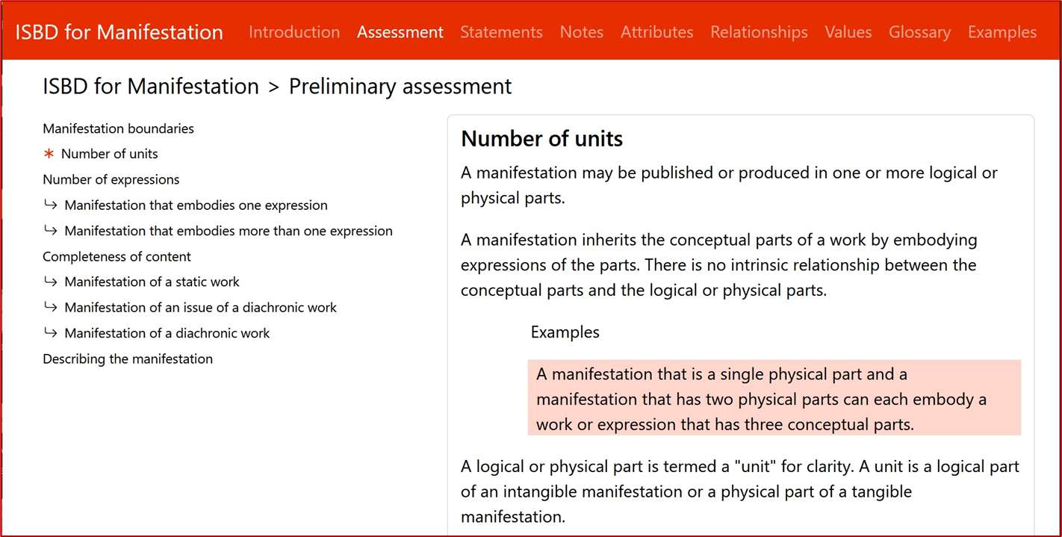
Issue no. 1: Is an ‘editorial note’ required to explain some examples?
IFLA webinar
From ISBD to ISBDM
26 January 2023
Notes:
Example of editorial or explanatory note that is not specific instance of a manifestation.

Slide 5
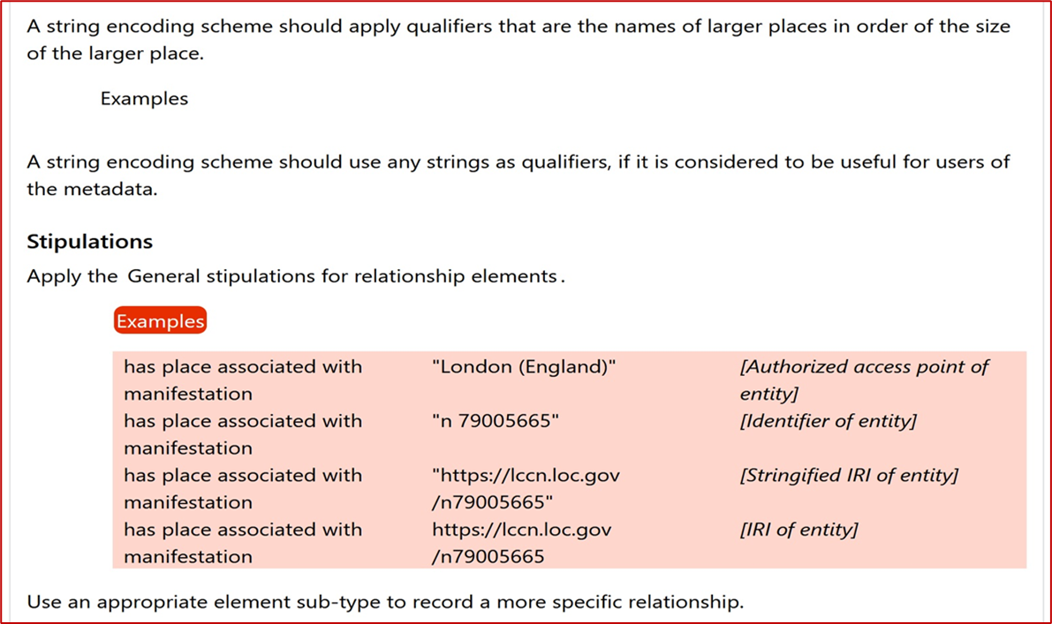
Issue no 2: Is it better for readability if the element label is repeated for each example, or is only given for the first example under a stipulation? [shifting the focus of context from ‘record’ to entity-based structured metadata]
IFLA webinar
From ISBD to ISBDM
26 January 2023
Notes:
Example of examples in context of stipulations; also shows the recording methods/types for related entities.

Slide 6
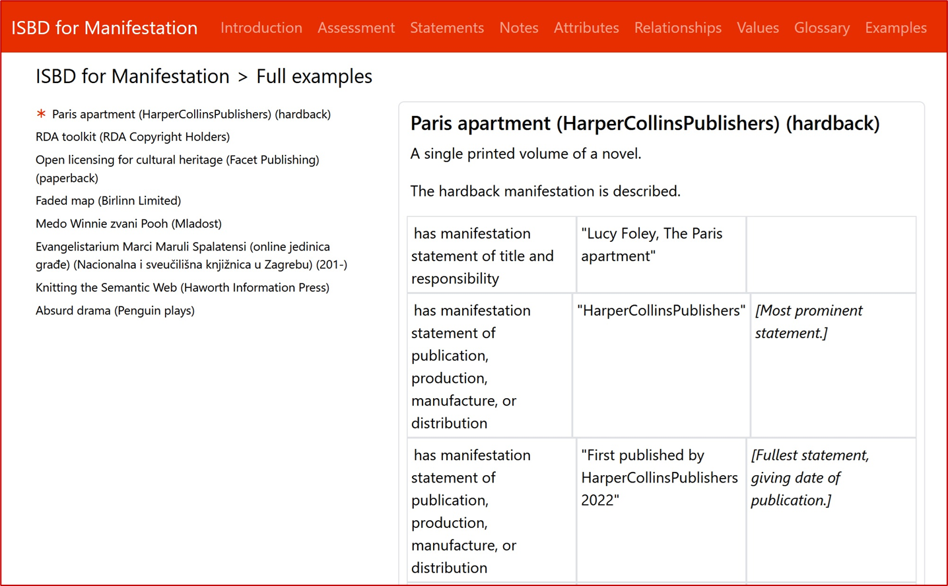
Issue no 3: Is it feasible to include a set of complete examples or „full” examples, i.e., a set of elements with values that apply to a specific manifestation? Issue 3.1: Can an extract of a complete example set be used as an example of a stipulation for a specific element to illustrate the context? Issue no. 3.2: Is it feasible to include reproductions of sources of information for manifestation statement and note elements for complete examples for manifestation statement and note elements? [Issue of copyright]
IFLA webinar
From ISBD to ISBDM
26 January 2023

Slide 7
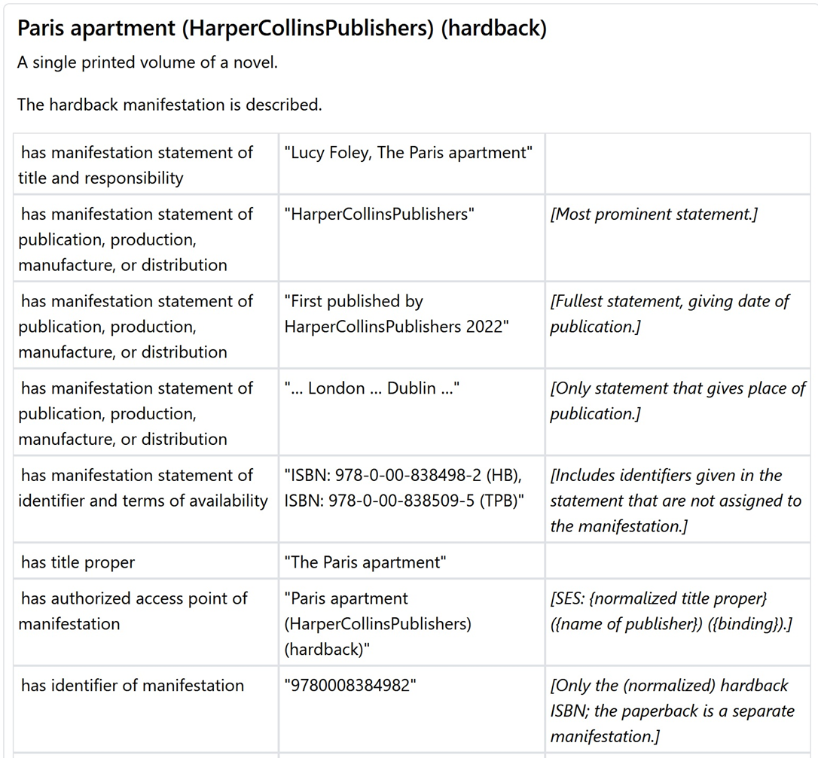
IFLA webinar
From ISBD to ISBDM
26 January 2023
Notes:
Full example: First part of full example.

Slide 8
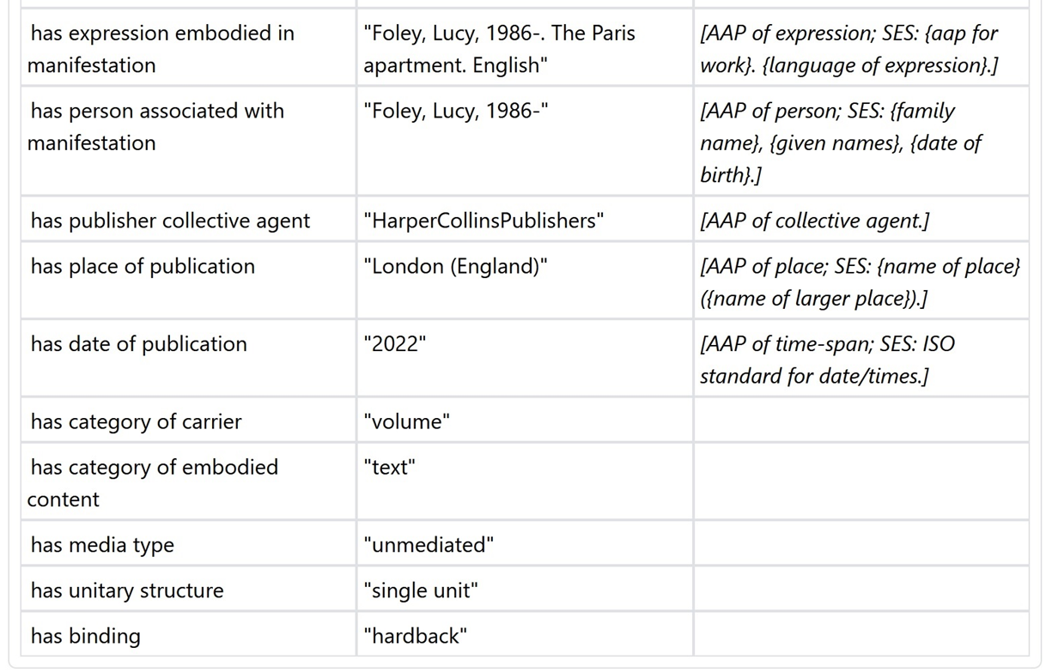
IFLA webinar
From ISBD to ISBDM
26 January 2023
Notes:
Full example: Last part of full example.

Slide 9
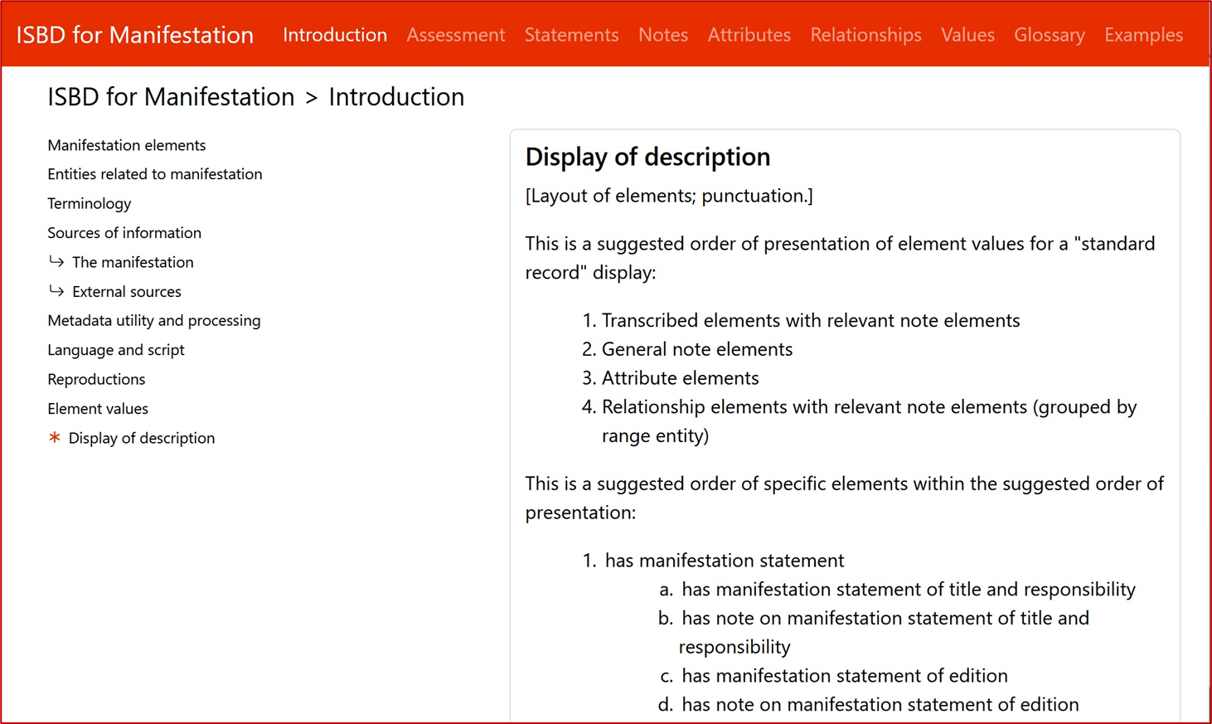
IFLA webinar
From ISBD to ISBDM
26 January 2023

Slide 10
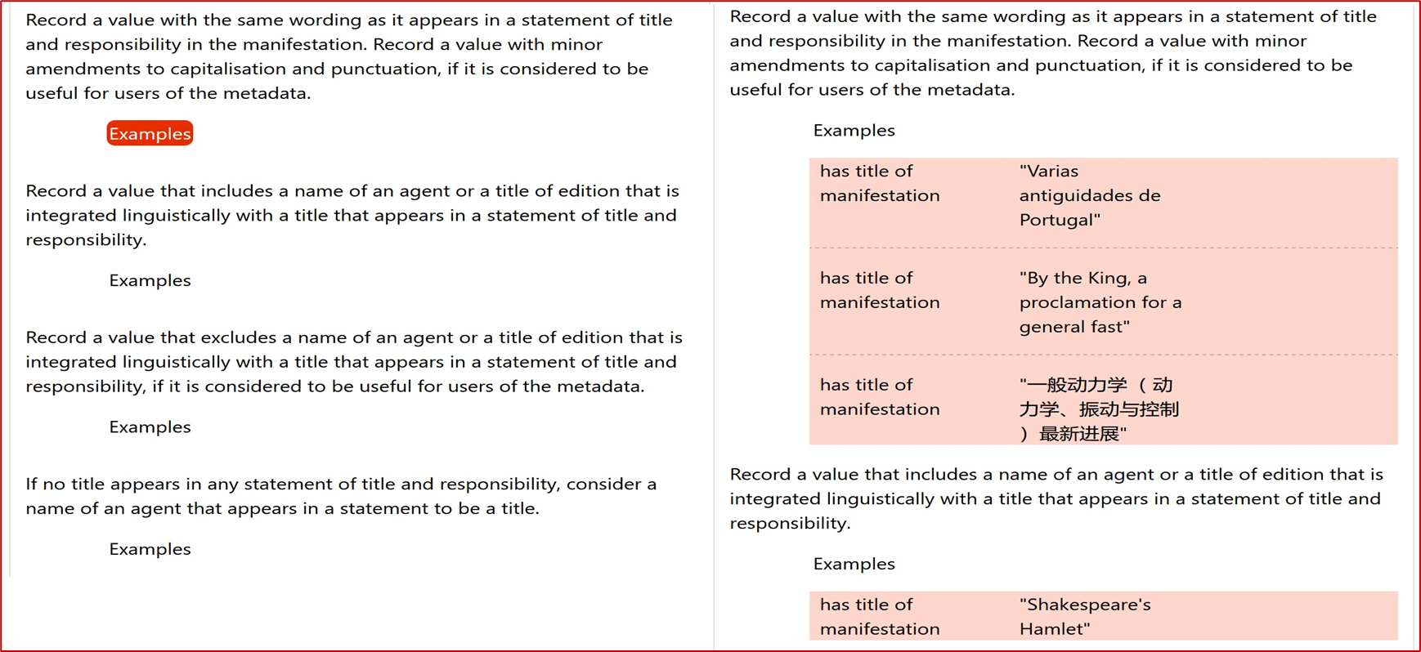
Issue no. 4: The publication format of the ISBDM: interactive online tool and/or PDF. Issue no. 4.1: There is a scaling problem for examples in a PDF version of ISBDM that is not applicable to an interactive online version.
IFLA webinar
From ISBD to ISBDM
26 January 2023
Notes:
A screenshot shows a collapsed and expanded contextual example.
The problem for a PDF version is that it becomes very large to expand all the examples at once, while in the interactive version there is no scaling problem.
There is no serious scaling problem for full examples, because a PDF version can be a set of separate publications.

Slide 11
Issue no. 4: The publication format of the ISBDM: interactive online tool and/or PDF. Issue no. 4.2: Interactivity: the user has more control in expanding/collapsing the contextual examples. Issue no. 4.3: Functionality: in an interactive online version, we can link the contextual example to a full example. This is very powerful for orientation and confirmation of overall context in operational cataloguing. Issue no. 4.4: Interactivity beyond ISBDM: coordination with PUC (Permanent UNIMARC Committee) can aim to make UNIMARC manuals and ISBDM stipulations and examples interact: click on an ISBDM 'element' example and see it encoded in UNIMARC, and vice-versa.
IFLA webinar
From ISBD to ISBDM
26 January 2023

Slide 12
Thank you!
IFLA webinar
From ISBD to ISBDM
26 January 2023

