Slide 1
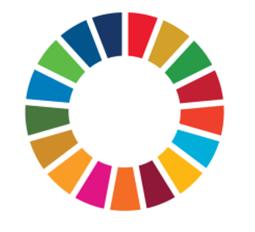

Libraries, Sustainability and the UN Sustainable Development Goals

Slide 2
What is sustainability?
Sustainable development is: “development that meets the needs of the present without compromising the ability of future generations to meet their own needs” (Brundtland Report, 1987)
Traditionally seen as having three pillars: economic, social and environmental (although we would argue that culture also needs to be recognised)
Libraries, Sustainability and the UN Sustainable Development Goals

Slide 3
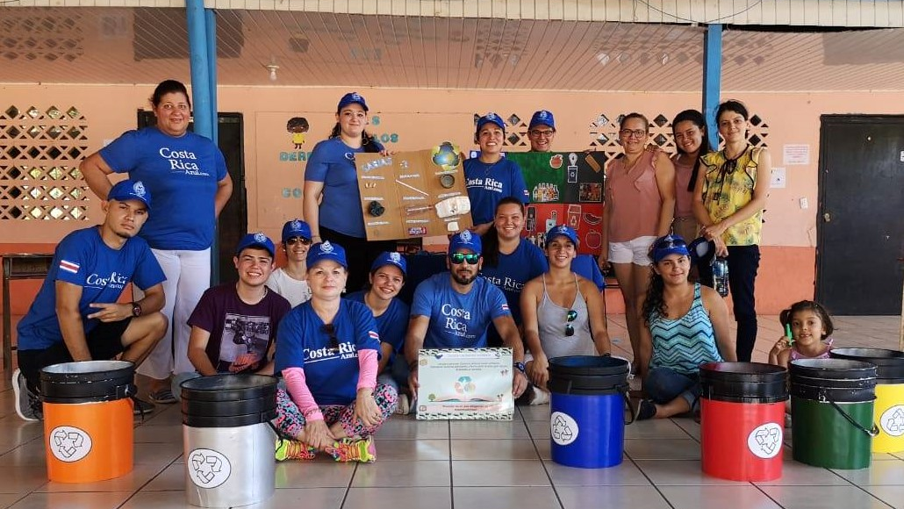
What is sustainability?
Information matters for sustainability because…
Access to information is a human right, and enables the delivery of other human rights
Equitable access to information addresses other divides which otherwise jeopardise sustainability – education, employment, democracy, culture – now and in future
Information is vital to support effective decision-making in favour of sustainability at all levels
Libraries, Sustainability and the UN Sustainable Development Goals
Libraries, Sustainability and the UN Sustainable Development Goals
Photo by COPROBI, CC-BY 4.0, bit.ly/3QHkfju

Slide 4
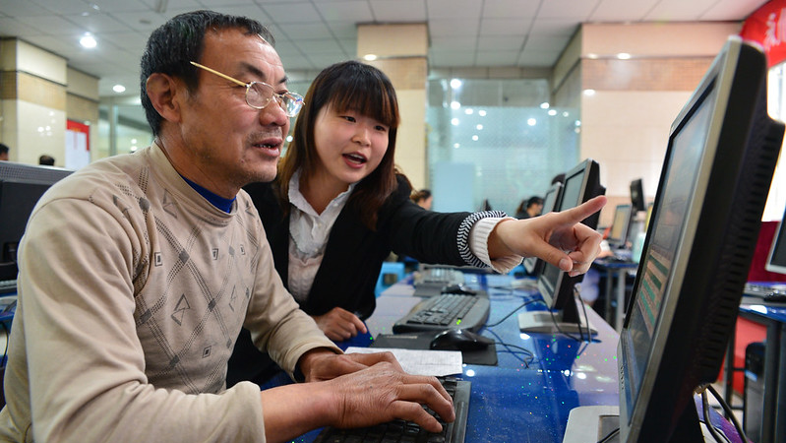
What is sustainability?
But for this, access must be meaningful
Connectivity: internet access is a must, if not everything
Equality: economic, social and other divides can undermine people’s ability to access and use information
Skills: people need these to use information effectively
Rights: people must be free to access, apply, create and share information freely
Libraries, Sustainability and the UN Sustainable Development Goals
Libraries, Sustainability and the UN Sustainable Development Goals

Slide 5
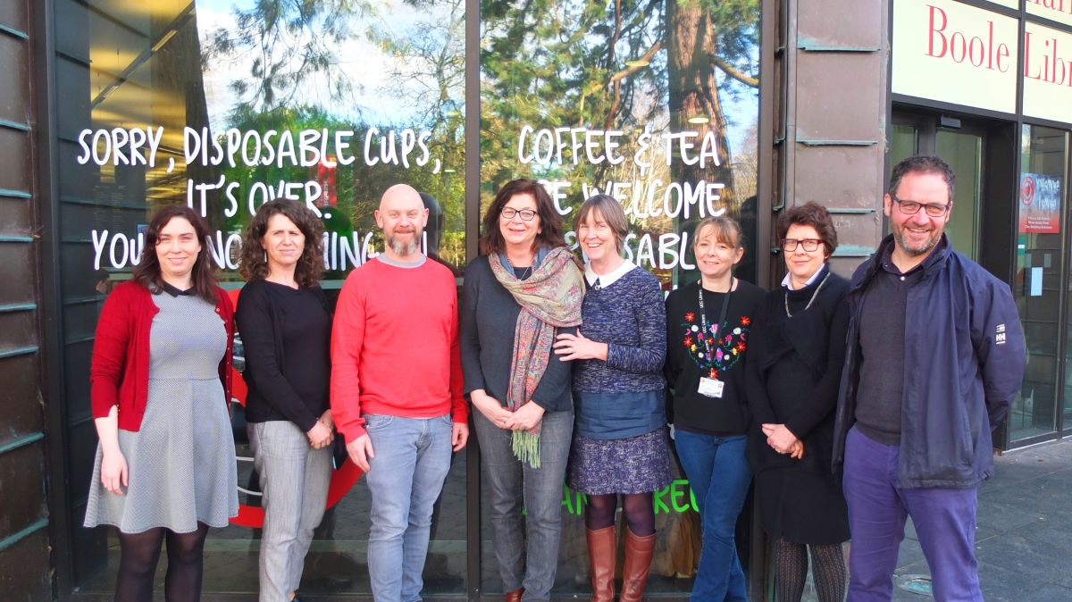
What is sustainability?
Libraries promote sustainability…
… in our communities: how can we promote inclusive development today and in the future?
.. in our profession: how can we be strong and inclusive today and tomorrow?
… in our professional organisations: how can we both deliver now and be ready for what is to come?
Libraries, Sustainability and the UN Sustainable Development Goals
Libraries, Sustainability and the UN Sustainable Development Goals
Photo: UCC, CC-BY 4.0: https://bit.ly/3rhJPzL

Slide 6
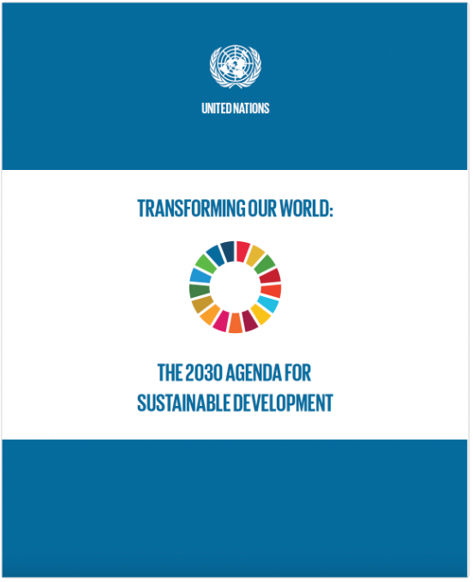
The UN Sustainable Development Goals
Transforming Our World: the 2030 Agenda for Sustainable Development, agreed in 2015
Includes:
Sustainable Development Goals
Resource mobilisation
Follow-up mechanisms
Libraries, Sustainability and the UN Sustainable Development Goals

Slide 7
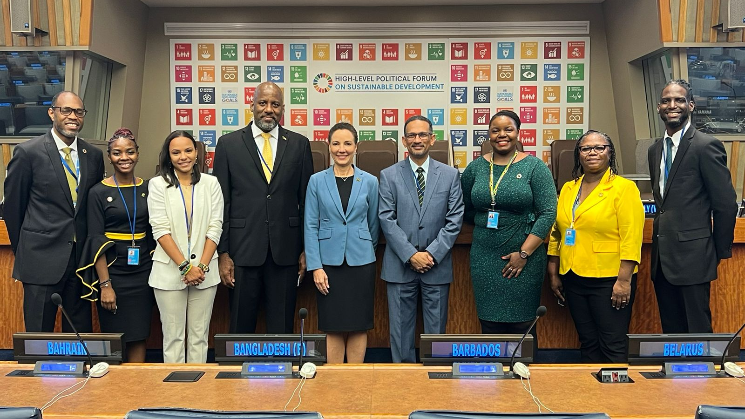
The UN Sustainable Development Goals
People
Planet Prosperity
Peace
Partnership
5 “P”s
Libraries, Sustainability and the UN Sustainable Development Goals
Libraries, Sustainability and the UN Sustainable Development Goals

Slide 8
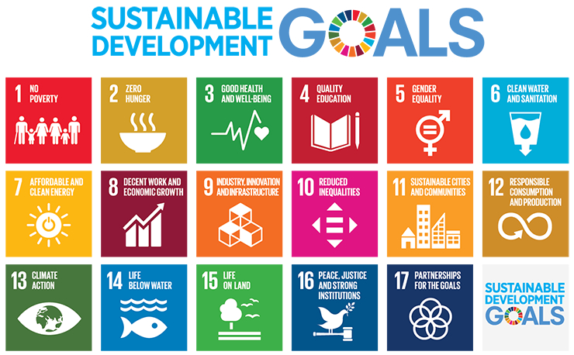
The UN Sustainable Development Goals
17 Goals
169 Targets
232 Indicators
Libraries, Sustainability and the UN Sustainable Development Goals

Slide 9

The UN Sustainable Development Goals
SDG16: Promote peaceful and inclusive societies for sustainable development, provide access to justice for all and build effective, accountable and inclusive institutions at all levels
Target 16.10: Ensure public access to information and protect fundamental freedoms, in accordance with national legislation and international agreements
Libraries, Sustainability and the UN Sustainable Development Goals

Slide 10
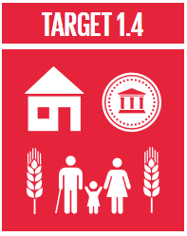
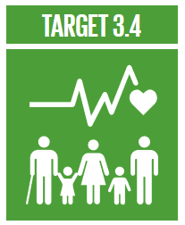
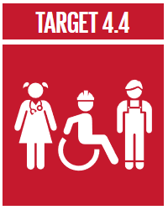
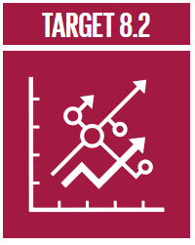
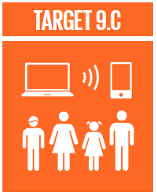
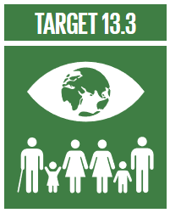
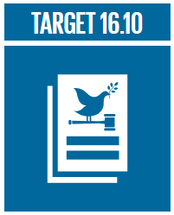

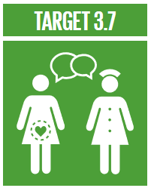
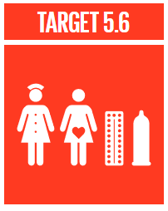
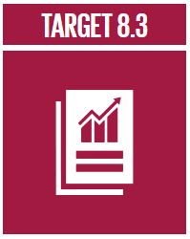
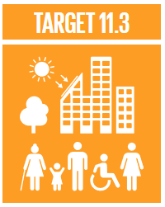
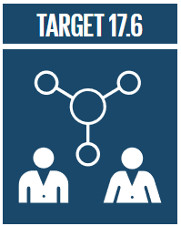
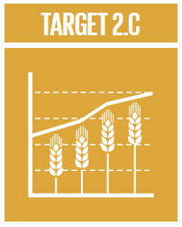
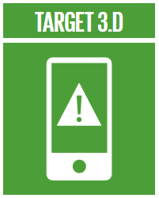
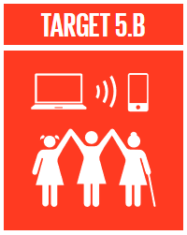
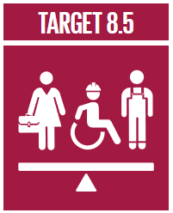
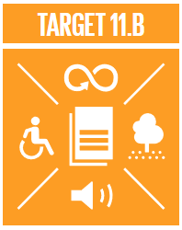
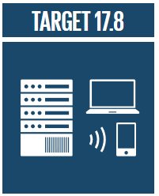

The UN Sustainable Development Goals
In total, 19 SDG targets talk about or imply the need to access information, but to achieve them, we need a coherent approach.
Libraries, Sustainability and the UN Sustainable Development Goals

Slide 11
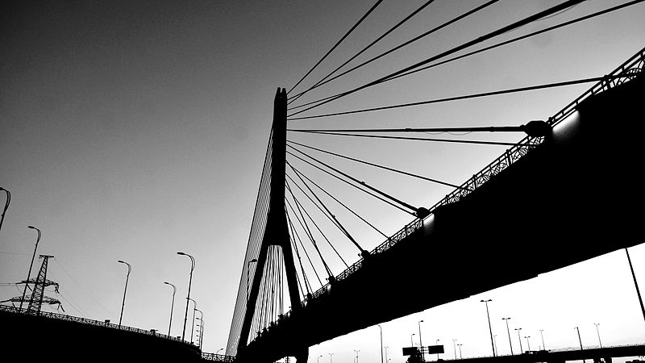
The UN Sustainable Development Goals
The SDGs are different because…
They are an agenda for all, not just developing countries
They define development broadly, including environmental issues
They take a holistic approach, focused on policy connections
They stress that everyone has a right to development (“Leave No-one Behind”)
They focus on partnerships
There are monitoring and follow-up mechanisms
Libraries, Sustainability and the UN Sustainable Development Goals
Libraries, Sustainability and the UN Sustainable Development Goals
Photo: Samir Cabbarov, CC-BY-SA 3.0, https://bit.ly/3q2GtzG

Slide 12
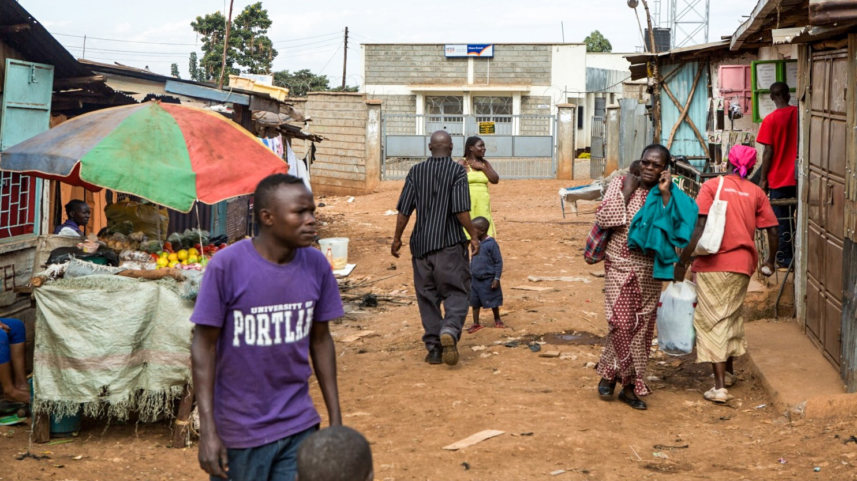
The UN Sustainable Development Goals
Development Accelerators and the Decade of Action
Successful development faces bottlenecks and accelerators
We need to identify these, and address them
Decade of Action declared already in 2019…
… but with the COVID-19 pandemic, there is a growing need to do things differently and “flip the script”
Libraries, Sustainability and the UN Sustainable Development Goals
Libraries, Sustainability and the UN Sustainable Development Goals
IFLA Library Map of the World SDG Story: Library in Kibera, Africa’s Largest Informal Settlement, Improves Access to Education. Photo: “knlsKibera Community Library located within the urban slum” by knlsKibera Community Library (CC BY 4.0) bit.ly/2yiSveS

Slide 13
Why the do the SDGs matter for libraries?
SDGs as an affirmation
SDGs as an engagement opportnity
SDGs as a shared language
SDGs as a thought tool
Libraries, Sustainability and the UN Sustainable Development Goals

Slide 14
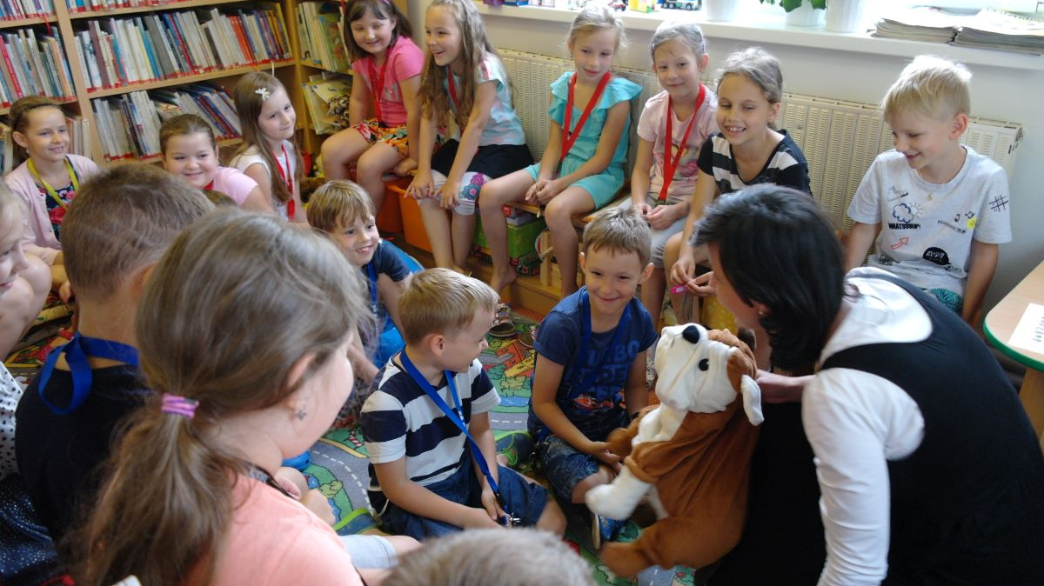
Why the do the SDGs matter for libraries?
SDGs as an affirmation
The SDGs establish Access to Information an explicit goal
The SDGs echo libraries’ emphasis on adapting solutions to the needs of individuals
The SDGs underline that all actors need to be engaged in implementation
Libraries, Sustainability and the UN Sustainable Development Goals
Libraries, Sustainability and the UN Sustainable Development Goals
Photo: Ivana Bizanova, CC-BY 4.0: bit.ly/3dSoskx

Slide 15
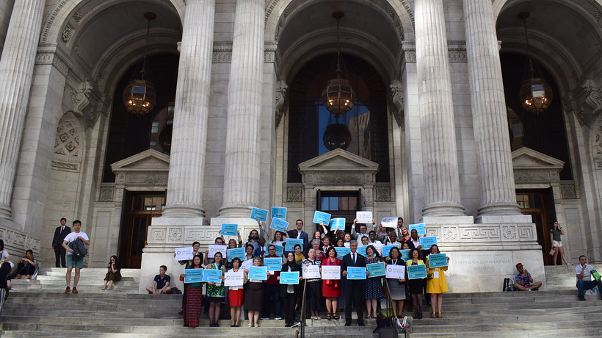
Why the do the SDGs matter for libraries?
SDGs as an engagement opportunity
Member States have committed to developing plans to implement the SDGs
Voluntary National and Local Reviews offer chances to provide input and engage, including with new contacts
Many countries have SDG committees or councils
The SDGs have become a key reference in many programmes, including development aid
Libraries, Sustainability and the UN Sustainable Development Goals
Libraries, Sustainability and the UN Sustainable Development Goals

Slide 16
Why the do the SDGs matter for libraries?
SDGs as a shared language
Even in countries where the UN and SDGs are not well known, the Goals use terminology that makes sense for governments
Using the langauge of the SDGs can make it easie to get others – inside and outside of government – to understand why libraries matter so much!
Libraries, Sustainability and the UN Sustainable Development Goals

Slide 17

Why the do the SDGs matter for libraries?
SDGs as a thought tool
The goals set out in the SDGs are also the goals of libraries
We can use the SDGs in our own planning
Through this, we can identify where we can have impact
Libraries, Sustainability and the UN Sustainable Development Goals

Slide 18
How are Libraries already delivering on the SDGs?
Libraries in all parts of the world are already taking actions and providing services that are making a reality of the SDGs
Libraries, Sustainability and the UN Sustainable Development Goals

Slide 19
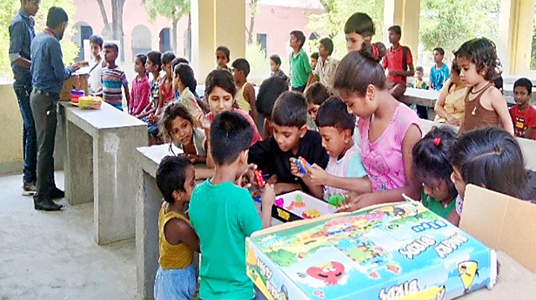
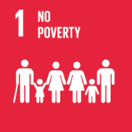
How are Libraries already delivering on the SDGs?
End poverty in all its forms, everywhere
In India, the Mobile Library Programme for primary and secondary schools provides access to library services for children in the most deprived areas, helping them learn new skills, and break free of a cycle of poverty.
Libraries, Sustainability and the UN Sustainable Development Goals
Libraries, Sustainability and the UN Sustainable Development Goals
Photo: Dr Rangashri Kishore , CC-BY 4.0: bit.ly/3eT7a9w

Slide 20
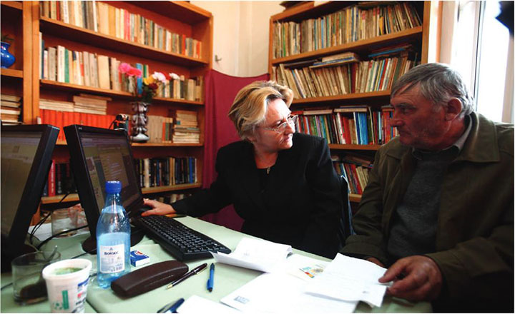
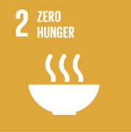
How are Libraries already delivering on the SDGs?
End hunger, achieve food security and improved nutrition and promote sustainable agriculture
In India, Cluj County Library provided local farmers and agricultural workers with the internet connections, skills and support to apply for $205 million in subsidies, seeing an increase in 224% in the number of applications filed over one year.
Libraries, Sustainability and the UN Sustainable Development Goals
Libraries, Sustainability and the UN Sustainable Development Goals
Photo: Cluj County Library, CC-BY 4.0: bit.ly/3Uaf3rc

Slide 21
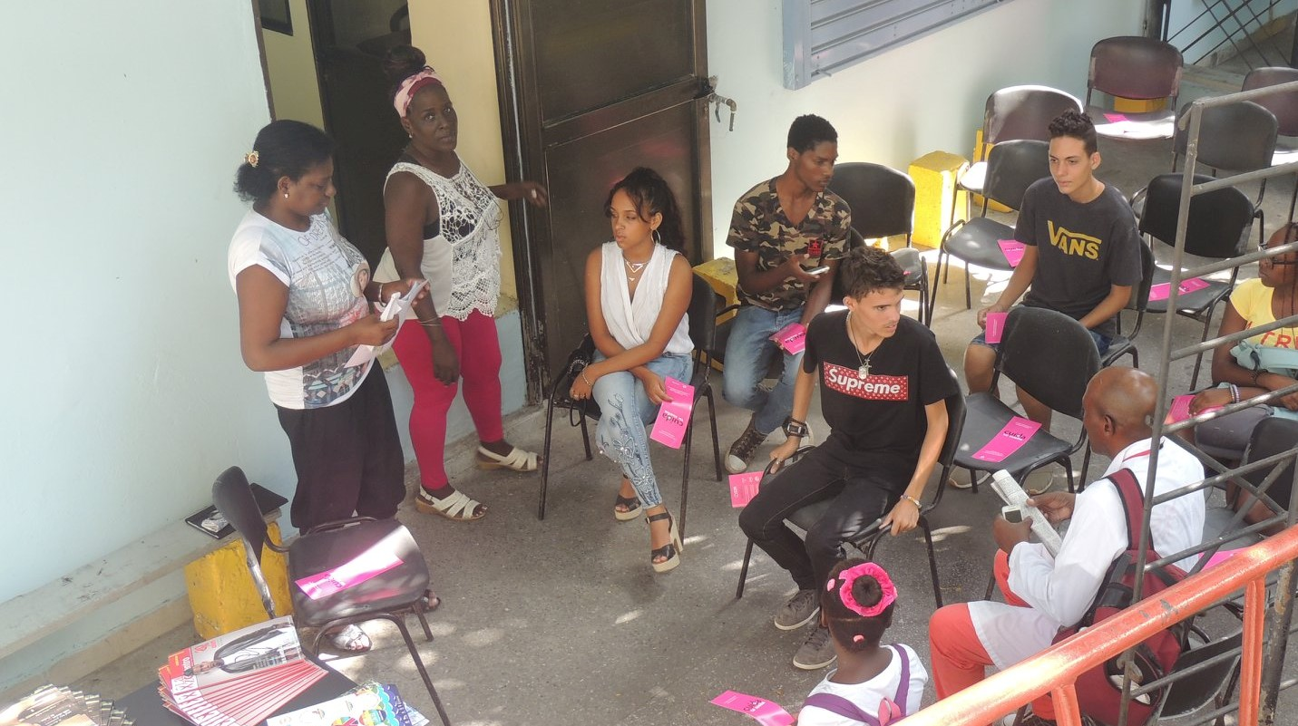
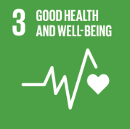
How are Libraries already delivering on the SDGs?
Ensure healthy lives and promote wellbeing for all at all ages
In Cuba, the Bibliosida programme ensures access to sexual health care information and education. Working with 52 Havana city libraries, as well as in communities, the programme has seen 2 550 students benefit from information and training serving to limit the spread of HIV
Libraries, Sustainability and the UN Sustainable Development Goals
Libraries, Sustainability and the UN Sustainable Development Goals
Photo: National Medical LIbrary, CC-BY 4.0: bit.ly/3RSzebB

Slide 22
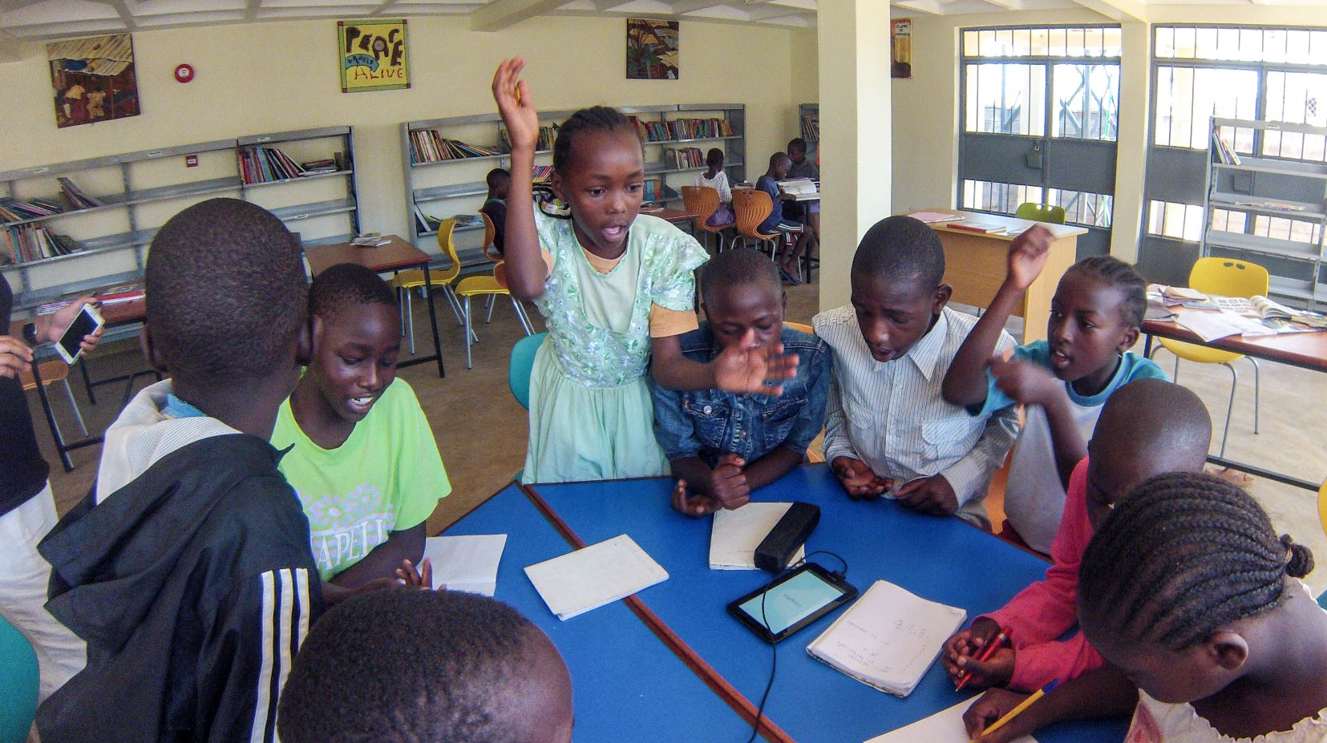
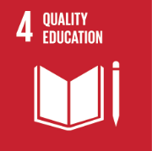
How are Libraries already delivering on the SDGs?
Ensure inclusive and equitable quality education and promote lifelong learning opportunities for all
The commuity library in Kibera, Africa’s largest informal settlement is an invaluable resource for schools by providing access to information, communication and technology. The Kids on the Tab programme guides children through science and mathematics, hugely boosting exam results at the end of the school year
Libraries, Sustainability and the UN Sustainable Development Goals
Libraries, Sustainability and the UN Sustainable Development Goals
Photo: knls Kibera Community Library, CC-BY 4.0: bit.ly/2nawDgu

Slide 23
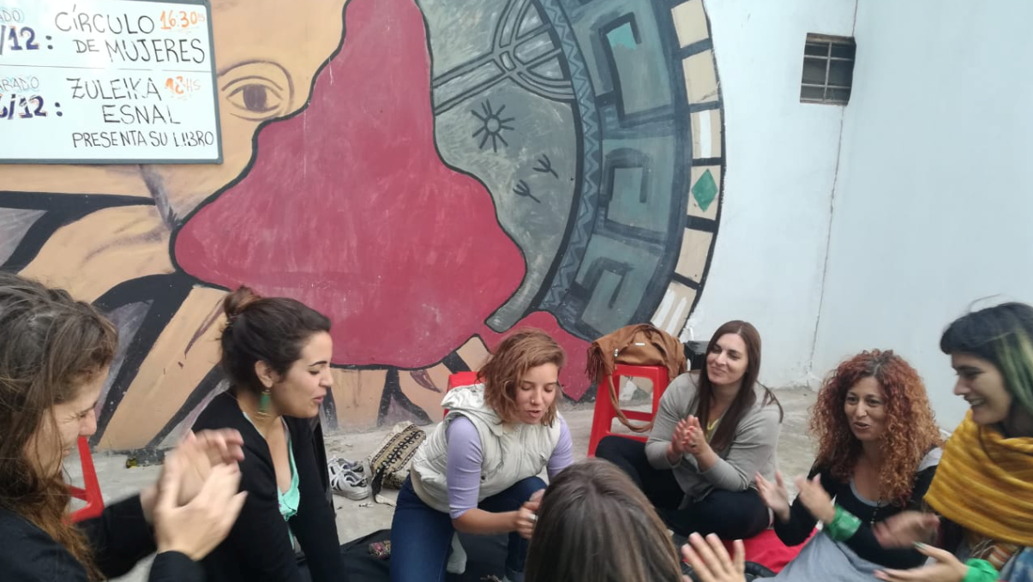
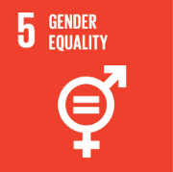
How are Libraries already delivering on the SDGs?
Achieve gender equality and empower all women and girls
In Argentina, the library in Matheu set up the Women’s Circle, looking to address the under-reporting of violence and providing support and rights education. Participants have developed their own networks and friendships, while the work of the Circle has led to judicial action and at least ten women being able to arrive at better outcomes.
Libraries, Sustainability and the UN Sustainable Development Goals
Libraries, Sustainability and the UN Sustainable Development Goals
Photo: Ariana Herenu, CC-BY 4.0: bit.ly/3BjIGO9

Slide 24
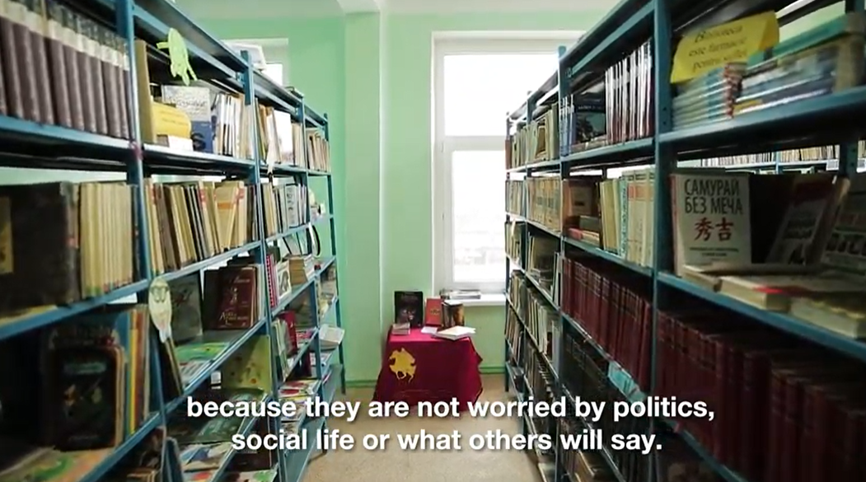
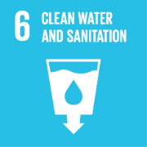
How are Libraries already delivering on the SDGs?
Ensure availability and sustainable management of wáter and sanitation for all
In Moldova, the library in Bilicenii Vechi took the lead in advocating for the renovation of an artisan well, combatting chronic challenges in accessing wáter in the village. Thanks to this initiative, the local kindergarten received clean wáter, also contributing to efforts to promote hygiene and sanitation.
Libraries, Sustainability and the UN Sustainable Development Goals
Libraries, Sustainability and the UN Sustainable Development Goals
Still from video: Maia Bolan, CC-BY 4.0: bit.ly/3U7pHPz

Slide 25
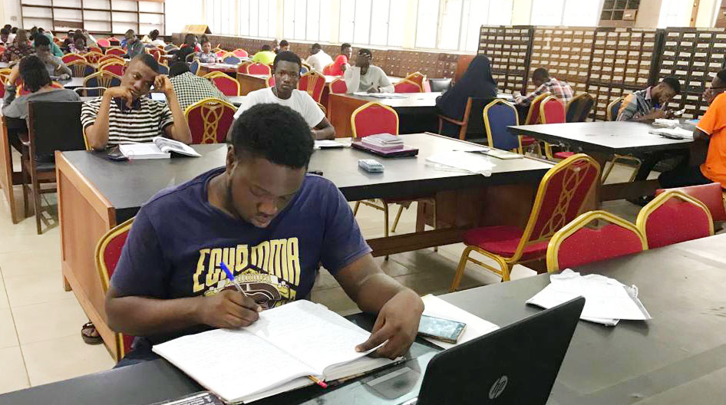
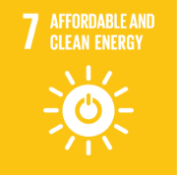
How are Libraries already delivering on the SDGs?
Ensure access to affordable, reliable, sustainable and modern energy for all
In Nigeria, the Kenneth Dike Library at the University of Ibadan chose to open its reading room 24 hours a day, providing a key option for students who otherwise had no reliable energy or light at night. This is strongly appreciated by students, who benefit from it to improve their study performance.
Libraries, Sustainability and the UN Sustainable Development Goals
Libraries, Sustainability and the UN Sustainable Development Goals
Photo: Patrick Agwu, CC-BY 4.0: bit.ly/3Bet66q

Slide 26
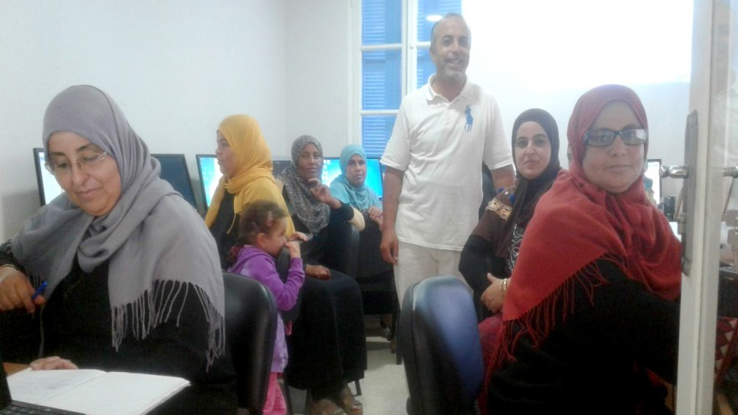
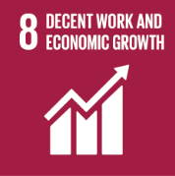
How are Libraries already delivering on the SDGs?
Promote sustained, inclusive and sustainable economic inclusive and equitable quality education and promote lifelong learning opportunities for all
In Tunisia, the library in the Erriadh district looked to address comparatively high female unemployment rates by supporting efforts to develop literacy in general, and digital literacy in particular. With high pass rates, this initiative helped participants both to use digital skills to expand their own businesses as well as taking on new and more productive jobs.
Libraries, Sustainability and the UN Sustainable Development Goals
Libraries, Sustainability and the UN Sustainable Development Goals
Photo: Erriadh Public Library, Tunisia, CC-BY 4.0: bit.ly/3eTOKFo

Slide 27
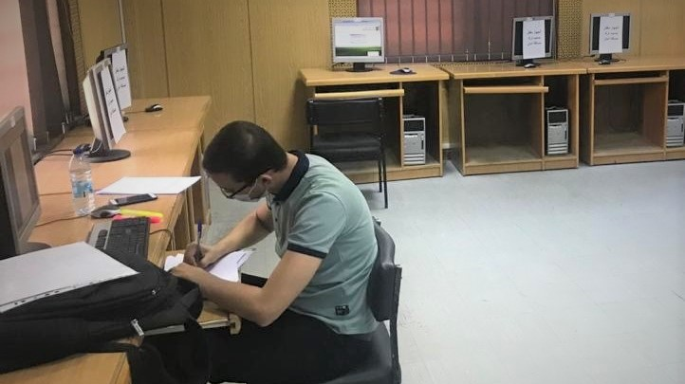

How are Libraries already delivering on the SDGs?
Build resilient infrastrucutre, promote inclusive and sustainable industrialisation and foster innovation
In Jordan, the University of Jordan has, since 2005, undertaken a programme of digitisation of over 86 000 theses, representing an important share of regional scholarship. These are shared with users across members of the Union of Arab Universities, providing a powerful resource for students and staff in support of their studies.
Libraries, Sustainability and the UN Sustainable Development Goals
Libraries, Sustainability and the UN Sustainable Development Goals
Photo: Zakariyah Al-Atiyat, CC-BY 4.0: bit.ly/3LfIsfE

Slide 28
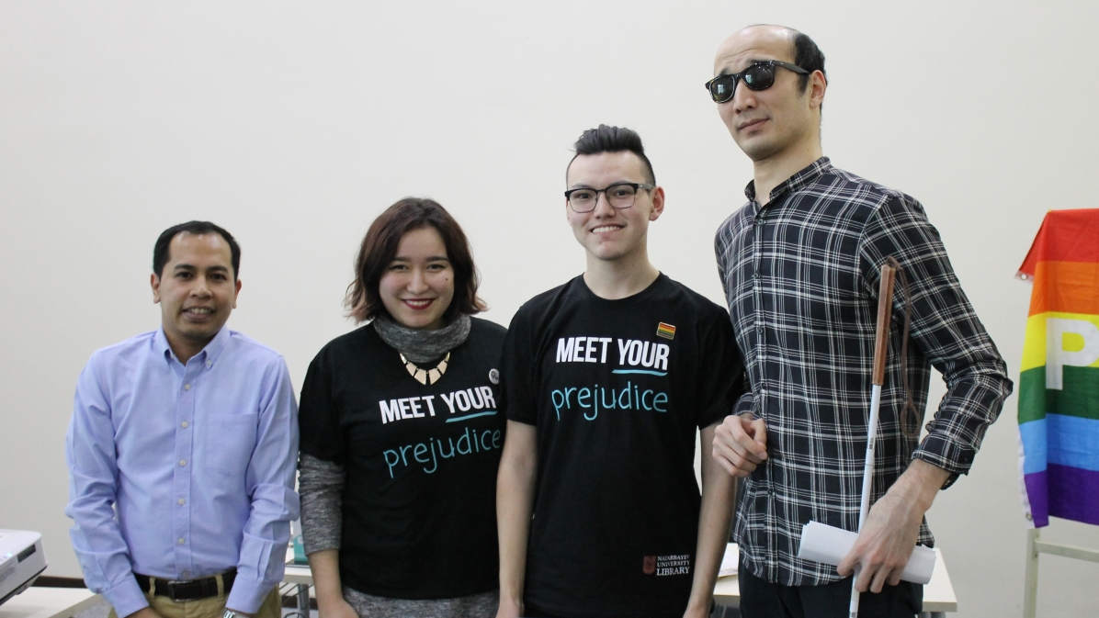
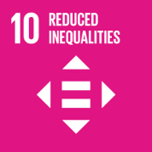
How are Libraries already delivering on the SDGs?
Reduce inequality within and among countries
In Kazakhstan, Nazarbayev Unviersity Library has run Human Library Events since 2016, as part of a programme to address discrimination and other social issues. In this, people ‘read’ other people instead of books, conquering stereotypes and pre-conceptions. Most visitors felt they could better understand their biases, while participants saw it as a safe space, and an opportunity to build a sense of community.
Libraries, Sustainability and the UN Sustainable Development Goals
Libraries, Sustainability and the UN Sustainable Development Goals
Photo: Marina Poyarkova, CC-BY 4.0: bit.ly/3LhQjcs

Slide 29
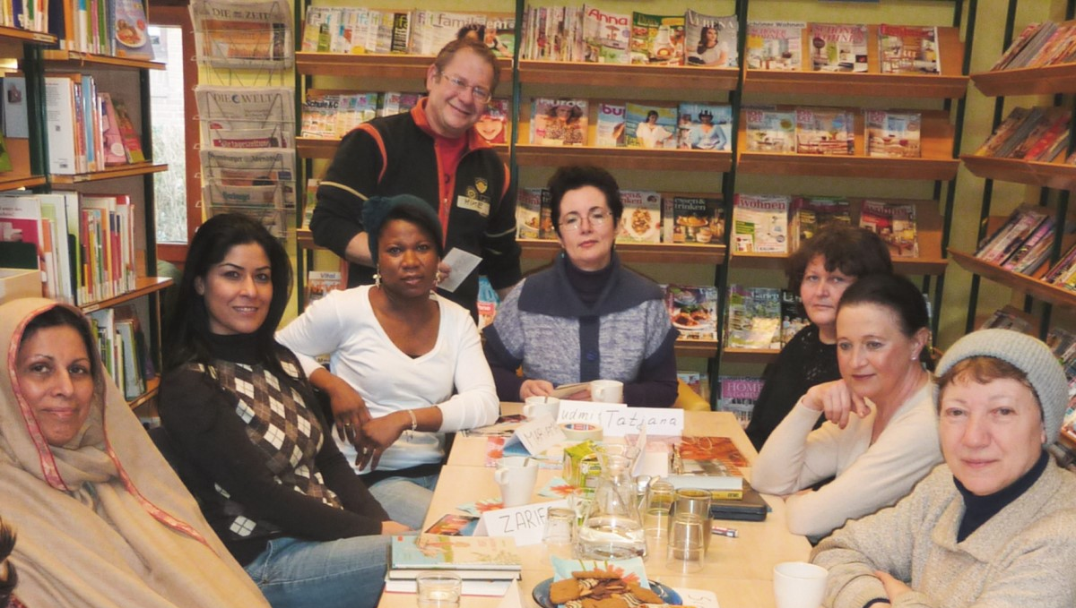
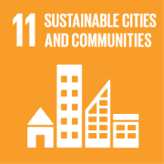
How are Libraries already delivering on the SDGs?
Make cities and human settlements inclusive, safe, resilient and sustainable
In Germany, Hamburg City Library plays a key role in the Refugee Help Forum, organising the largest volunteer language acquisition programme in the city, realing around 40 000 participants. Those taking part not only access tools and media allowing them to stay in touch with their country of origin, but also start to build connections in the local community, as well as vital skills for integration.
Libraries, Sustainability and the UN Sustainable Development Goals
Libraries, Sustainability and the UN Sustainable Development Goals
Photo: Bucherhallen Hamburg, CC-BY 4.0: bit.ly/3xu6ZYK

Slide 30


How are Libraries already delivering on the SDGs?
Ensure sustainable consumption and production patterns
In Ukraine, the Lviv Children’s Library wanted to tackle the region’s environmental issues, and so launched the Garbage Hero project. It offers lessons in green thinking and waste reduction using creative and playful techniques, and encourages participants to share lessons with friends. 70% of children reported that their families’ recycling habits had changed, and demand has risen for eco-bags and eco-books
Libraries, Sustainability and the UN Sustainable Development Goals
Libraries, Sustainability and the UN Sustainable Development Goals
Photo: Stichting Lezen, CC-BY 4.0: bit.ly/3bMQxqS

Slide 31


How are Libraries already delivering on the SDGs?
Take urgent action to combat climate change and its impacts
In Colombia, the Bilbao district public school library has worked to develop an environmental education programme for children. Through a new and greener space, designed to be attractive to children, as well as to reduce carbon emissions. The programme has led to noticeable changes in attitudes among young people, and become part of the curriculum in district schools.
Libraries, Sustainability and the UN Sustainable Development Goals
Libraries, Sustainability and the UN Sustainable Development Goals
Photo: Library of the Bilbao district public school, CC-BY 4.0, bit.ly/3BJJY6r

Slide 32


How are Libraries already delivering on the SDGs?
Conserve and sustianably use the oceans, seas and maritime resources for sustainable development
In Ecuador, the Library of the Charles Darwin Foundation on the Galapagos Islands established travelling libraries in order to serve learners and wider communities. Delivering both cultural content and scientific materials, these aim to support education, participation, and understanding of how to conserve the Islands’ unique nature, including the seas. The programme has been warmly received by beneficiaries who previously had few materials or conservation information.
Libraries, Sustainability and the UN Sustainable Development Goals
Libraries, Sustainability and the UN Sustainable Development Goals
Photo: Edgardo Civallero, CC-BY 4.0: bit.ly/3eVUi2s

Slide 33


How are Libraries already delivering on the SDGs?
Protect, restore and promote sustainable use of terrestrial ecosystems, sustainably manage forests, combat desertification, and halt and reverse land degradation and halt biodiversity loss
In Costa Rica, the Association of Librarians (COPROBI) responded to new government recommendations on improving the environment by developing its own Social Responsibility Programme. This included efforts to collect garbage on beaches, as well as to plant native trees as part of a park improvement project. These efforts provided a Good opportunity to engage with the wider community and partners, and have become part of COPROBI’s core work
Libraries, Sustainability and the UN Sustainable Development Goals
Libraries, Sustainability and the UN Sustainable Development Goals
Photo: COPROBI, CC-BY 4.0: bit.ly/3QMPIAK

Slide 34


How are Libraries already delivering on the SDGs?
Promote peaceful and inclusive societies for sustainable development, provide access to justice for all and build effective, accountable and inclusive institutions at all levels
In the Netherlands, libraries are equipping citizens with the digital skills needed to access eGovernment services. With around a quarter of the population still not fully able to engage with services online, the “Library and Basic Skills” programme has seen over 120 000 people trained over three years, and 25 000 assisted with online tax declarations. Beneficiaries have been very happy to receive this support thorugh local institutions such as libraries.
Libraries, Sustainability and the UN Sustainable Development Goals
Libraries, Sustainability and the UN Sustainable Development Goals
Photo: Gert Jan van Heyningen, CC-BY 4.0: bit.ly/3eTdyxv

Slide 35


How are Libraries already delivering on the SDGs?
Strengthen the Means of implementation and revitalise the Global Partnership for Sustainable Development
In Canada, Toronto Public Library collaborated with other parts of government in order to welcome and support Syrian refugees. As part of the #WelcomeRefugees programme, the library offered pre-arrival and ongoing, post-settlement support services. Much of these have taken place through Library Settlement Partnerships which have enbaled barrier-free outreach, training and skills development, and better information. Beneficiaries have highlighted how important libraries have been in developing language and other skills
Libraries, Sustainability and the UN Sustainable Development Goals
Libraries, Sustainability and the UN Sustainable Development Goals
Photo: Toronto Public Library, CC-BY 4.0: bit.ly/3BkhBKL

Slide 36
How is IFLA working with the SDGs?
Engaging at the High-Level Political Forum and Regional Sustainable Development Fora
Supporting engagement in Voluntary National Reviews
Producing and sharing articles and Research
Getting involved in planning the future
Libraries, Sustainability and the UN Sustainable Development Goals

Slide 37

How is IFLA working with the SDGs?
Engaging at the High-Level Political Forum
Key event in the SDG year, preceded by five regional sustainable development fora
Stocktaking on progress, presentation of VNRs
Unique access to decision-makers
Opportunity to learn and catch up on key debates and development
Libraries, Sustainability and the UN Sustainable Development Goals
Libraries, Sustainability and the UN Sustainable Development Goals

Slide 38

How is IFLA working with the SDGs?
Supporting Voluntary National Review (VNR) Engagement
VNRs (and Voluntary Local Reviews) review progress, identify priorities
VNRs should engage all stakeholders, including libraries!
35-40% of National Reviews in 2021/22 mentioned libraries
Chance to build links in government, civil society
IFLA supports members in getting involved
Libraries, Sustainability and the UN Sustainable Development Goals

Slide 39

How is IFLA working with the SDGs?
Producing and sharing articles and research
IFLA produces blogs and articles to strengthen the evidence base
Development and Access to Information Report
SDG Stories on our Library Map of the World, Library Stat of the Week Series!
Libraries, Sustainability and the UN Sustainable Development Goals

Slide 40

How is IFLA working with the SDGs?
Getting involved in planning the future
The 2030 Agenda is around its half way point, but what comes next?
We are already engaging in work around Transforming Education, and integrity ahead of key 2023 meetings
Through the Cuture2030Goal Campaign, we are calling for an explicit goal for culture
Libraries, Sustainability and the UN Sustainable Development Goals

Slide 41
How to get involved
Show you care and raise awareness
Engage in the Culture 2030 Goal campaign
Get involved in Voluntary National and Local Reviews
Share your stories
Integrate the SDGs into your own planning
Libraries, Sustainability and the UN Sustainable Development Goals

Slide 42

How to get involved
Show you care and raise awareness
Demonstrate your support
Share materials about the SDGs
Start an SDG book club
Engage with UN Information Centres
Libraries, Sustainability and the UN Sustainable Development Goals

Slide 43
How to get involved
Engage in the Culture 2030 Goal Campaign
Coalition of international cultural networks
Promoting integration of culture into SDG implementation now…
Calling for an explicit goal post-2030
Libraries, Sustainability and the UN Sustainable Development Goals

Slide 44

Get involved in Voluntary National/Local Reviews
These are supposed to take stakeholder input into account
Opportunity to work with a different range of partners
Around 60% of local and 35% of national reviews mention libraries
Libraries, Sustainability and the UN Sustainable Development Goals
Libraries, Sustainability and the UN Sustainable Development Goals

Slide 45

How to get involved
Share your stories!
Libraries, Sustainability and the UN Sustainable Development Goals
Libraries, Sustainability and the UN Sustainable Development Goals

Slide 46

How to get involved
Integrate the SDGs into your own planning
Use them as a structure to think through how you make a difference, and what more you can do
Define targets or goals based on the SDGs
These can be collective or individual activities!
Libraries, Sustainability and the UN Sustainable Development Goals
Libraries, Sustainability and the UN Sustainable Development Goals
Photo: Library of Congress, Argentina, CC-BY 4.0, bit.ly/3Drqyok

Slide 47

Questions for the future
How do we make the SDGs more central to Library planning, rather than just labelling our activities after the event?
How can we build stronger partnerships with the SDGs?
How can we become more central to SDG planning?
How to mobilise evidence for sustainable development?
What happens post-2030?
Libraries, Sustainability and the UN Sustainable Development Goals

