Slide 1

fa
Towards a stronger and more sustainable library field in Asia-Oceania
IFLA Workshop, Bangkok, Thailand
14-16 November 2022

Slide 2

Welcome back!

Slide 3

Reminder: Our Agenda (Day 2)
Reflections on the UN event
What do we need to do in our field to ensure sustainability?
From priorities to plans
Dinner

Slide 4

Your takeaways from the event at the UN?

Slide 5

What do we need to do in our field to ensure sustainability?

Slide 6
Barbara Lison
IFLA President 2021-23
“Libraries: Building a Sustainable Future”

Slide 7
Refresher
Our definitions of library field sustainability from Day 1

Slide 8

EXERCISE: Define and apply a library field sustainability index

Slide 9

EXERCISE: Define and apply a library field sustainability index
Brainstorm the factors of sustainability
Combine your ideas to get to 4-8 factors in total
Assign weightings of 1-5 to these factors
Score your national field, and the region on each factor (1-5), and multiply by the weightings
Discuss your findings and what they mean

Slide 10
Example (but for deciding where to go for dinner)
1) What matters for me (define my factors):
Taste
Quantity
Atmosphere
Price
Service
Can bring my dog

Slide 11
Example (but for deciding where to go for dinner)
2) Assign weightings, i.e. how much they matter for me (1 = not important, 5 = essential)
Taste (4)
Quantity (3)
Atmosphere (2)
Price (4)
Service (2)
Can bring my dog (5)

Slide 12
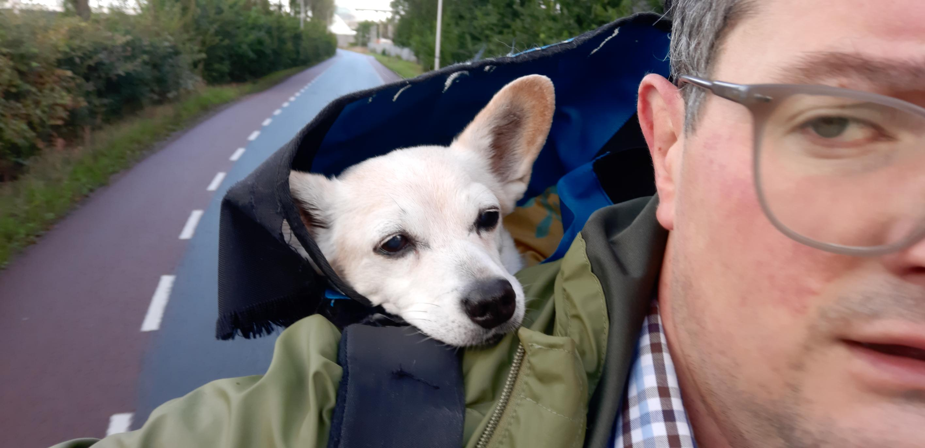

Slide 13
Example (but for deciding where to go for dinner)
3) Rate restaurants A and B on the factors
Factor | Restaurant A | Restaurant B
Taste | 4 | 2
Quantity | 3 | 4
Atmosphere | 3 | 3
Price | 3 | 4
Service | 4 | 2
Can bring the dog | 1 | 5

Slide 14
Example (but for deciding where to go for dinner)
4) Apply your index: score x weighting, and add these up
Factor | Restaurant A (score x weighting) | Restaurant B (score x weighting)
Taste | 4 x 4 = 16 | 2 x 4 = 8
Quantity | 3 x 3 = 9 | 4 x 3 = 12
Atmosphere | 3 x 2 = 6 | 3 x 2 = 6
Price | 3 x 4 = 12 | 4 x 4 = 16
Service | 4 x 2 = 8 | 2 x 2 = 4
Can bring the dog | 1 x 5 = 5 | 5 x 5 = 25
TOTAL | 56 | 71

Slide 15
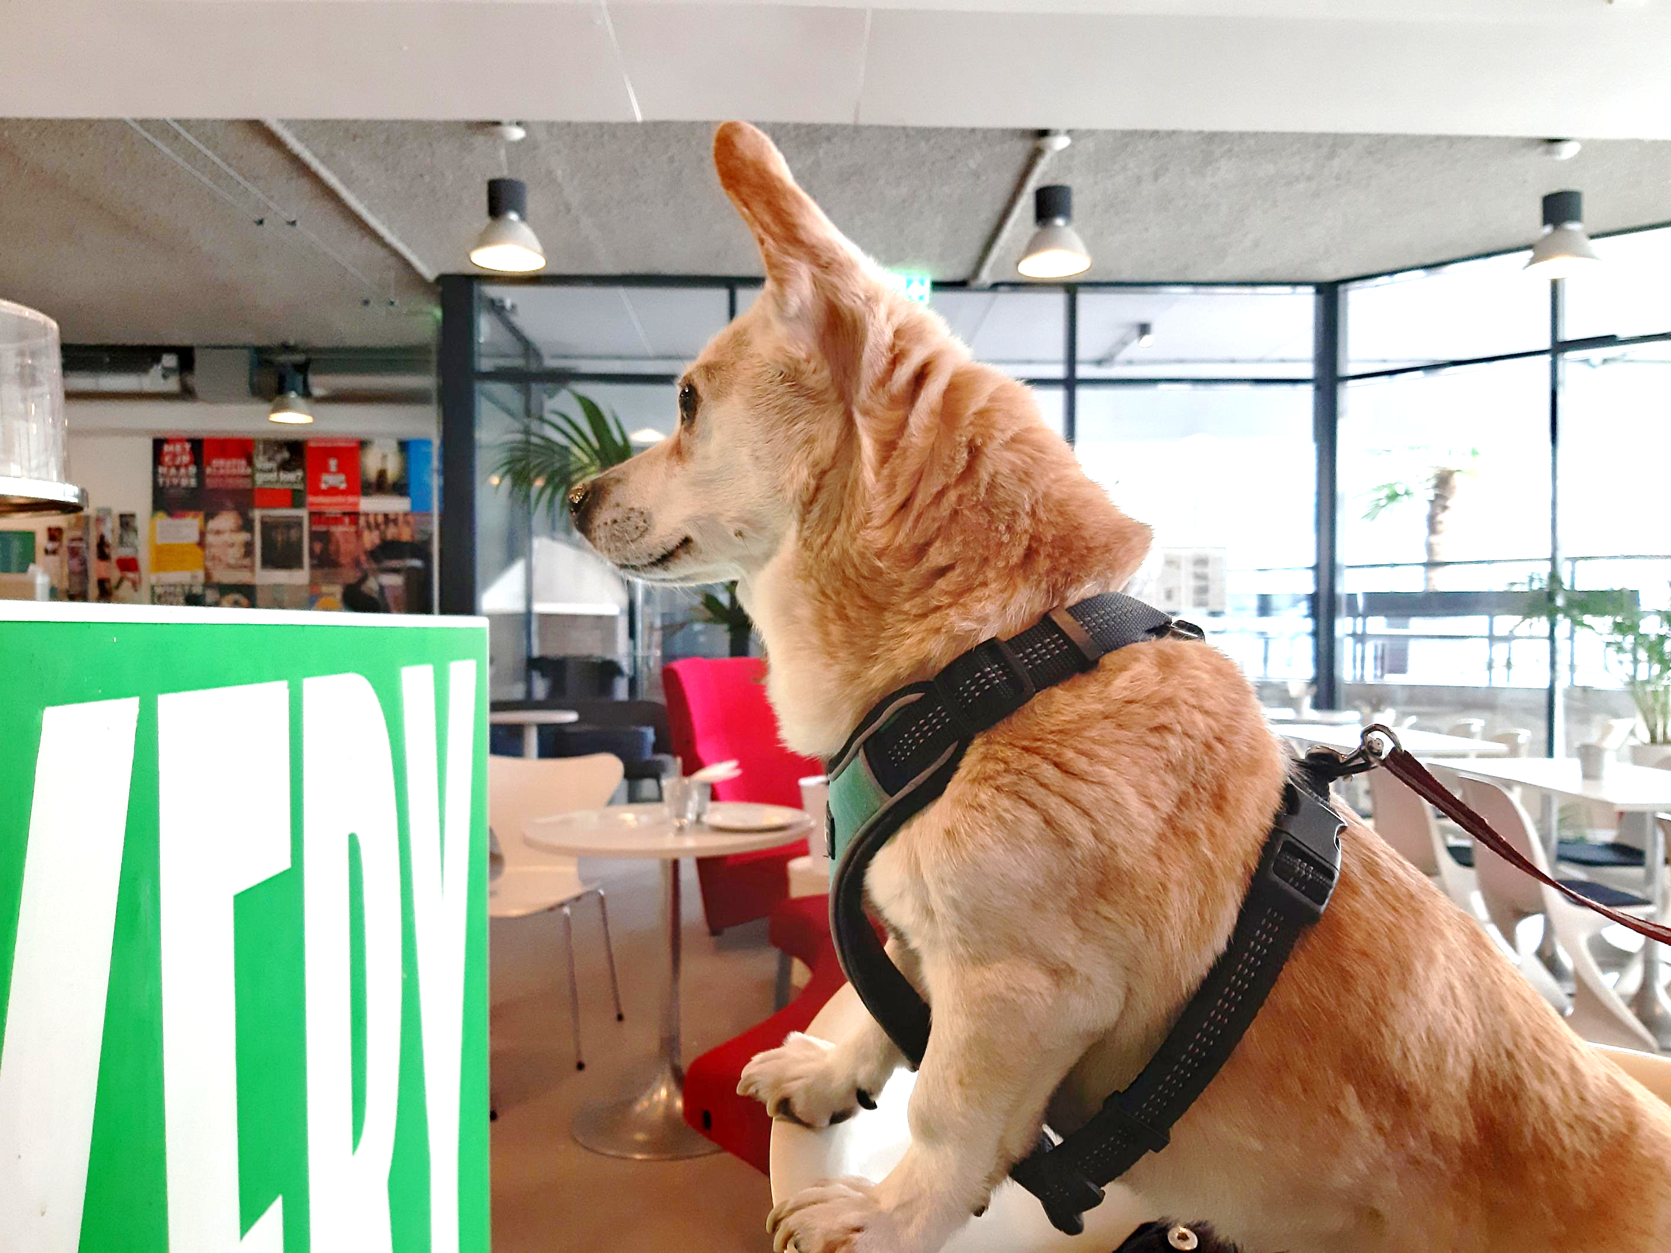

Slide 16
EXERCISE: Define and apply a library sustainability index
Brainstorm the ingredients of sustainability
Combine your ideas to get to 4-8 in total
Assign weightings of 1-5 to these factors
Score your national field, and the region on each factor (1-5), and multiply by the weightings
Discuss your findings and what they mean
Use the sheets handed out to you!

Slide 17

Share your findings!
Photo: Matt Botsford on Unsplash, unsplash.com/photos/OKLqGsCT8qs

Slide 18

Practicing Advocacy Skills

Slide 19

Coffee Break
Photo by Mike Kenneally on Unsplash, unsplash.com/photos/TD4DBagg2wE

Slide 20

From Priorities to Plans: Defining Impactful Actions

Slide 21
Through your library sustainability indexes, you have an idea of where you may need to act in order to maximise library sustainability... now to define actions

Slide 22
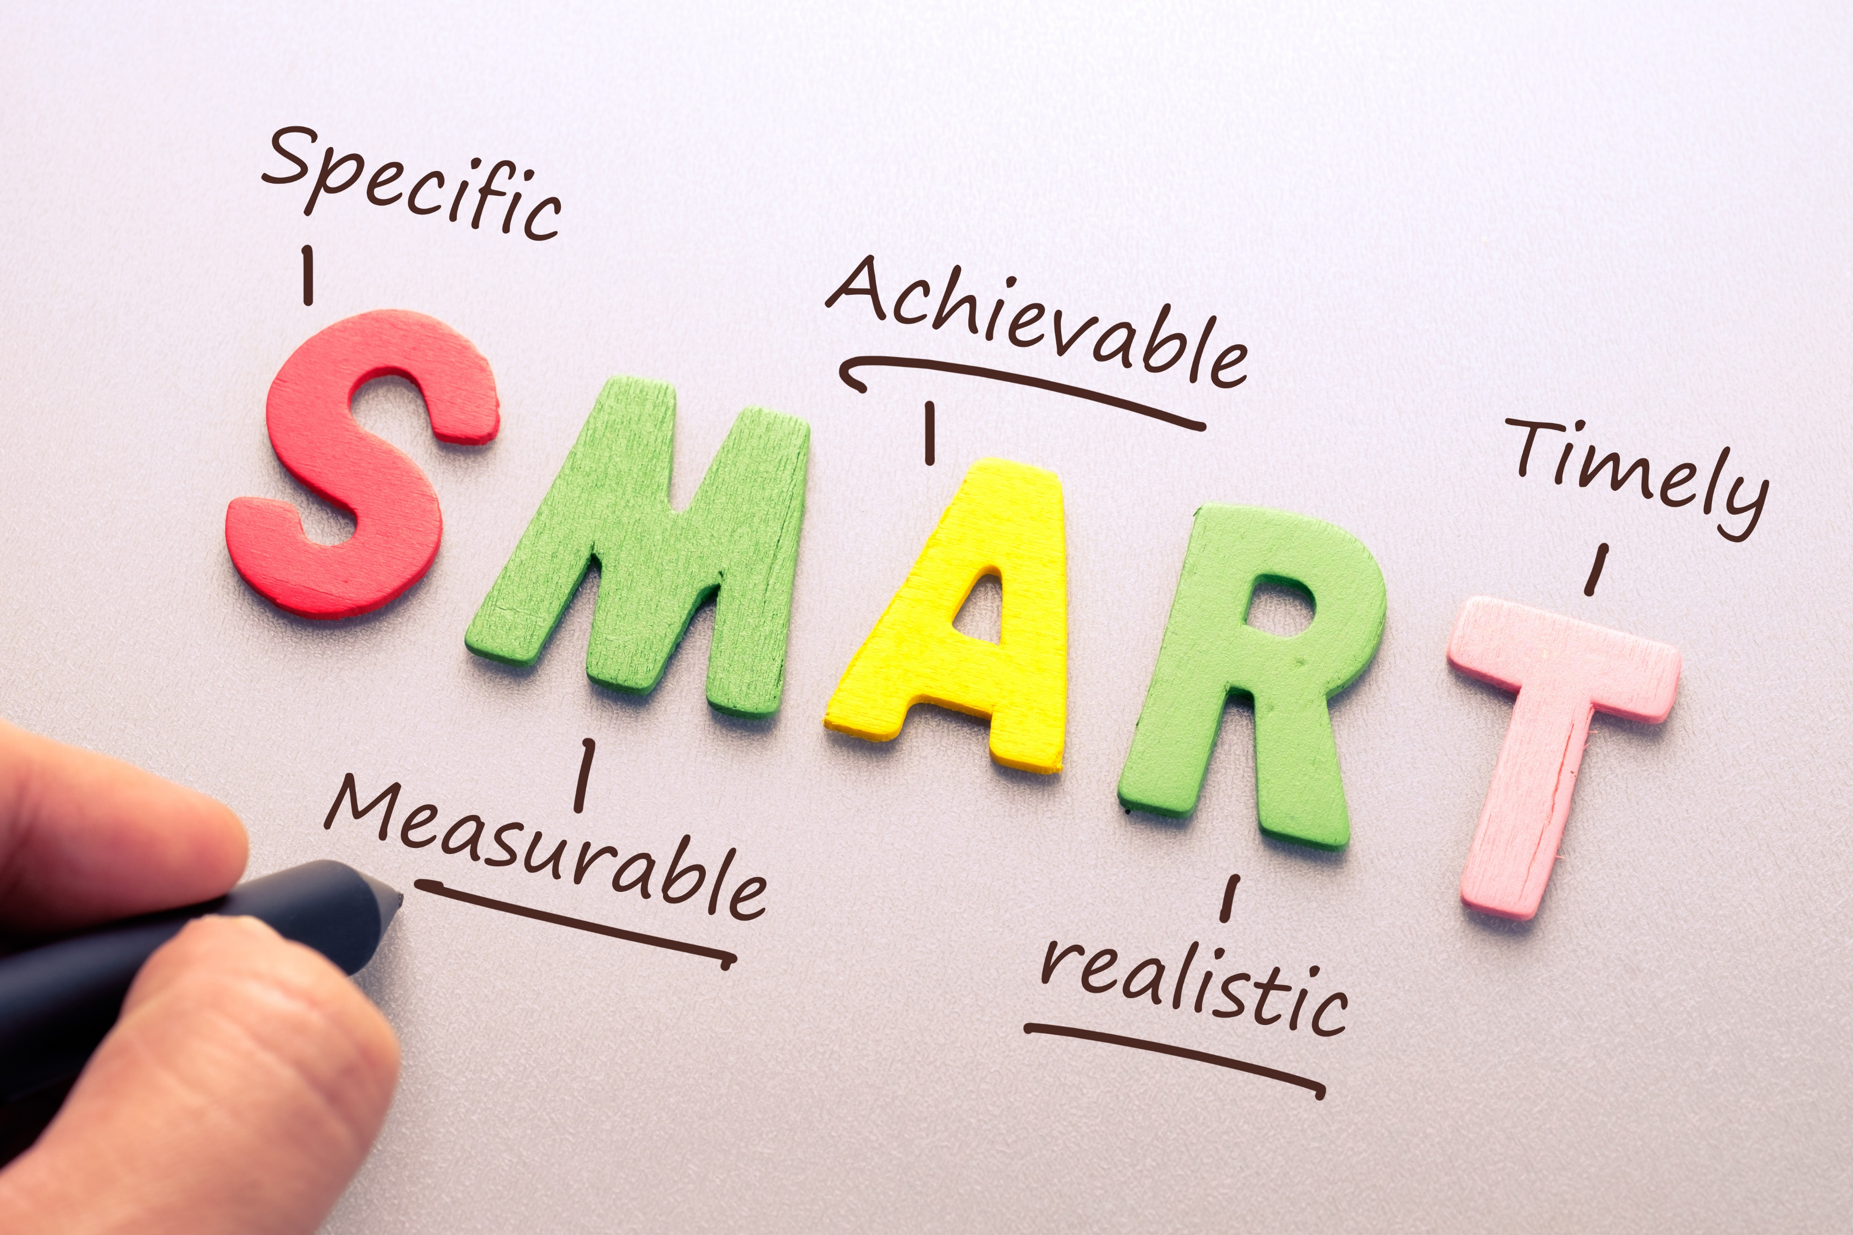
How to define an effective action

Slide 23
Develop
Coordinate
Manage
Support
Upgrade
Create
Implement
Produce
Provide
Maintain
Oversee
Plan
Evaluate
Engage
…
S = Specific
What action will you take?
What are you trying to accomplish? Why?
Who needs to be involved?
Where and when does it need to happen?

Slide 24

M = Measurable
What does success of the action will look like?
What data and evidence will measure the goal?
How much? How well?

Slide 25

A = Achievable
Is it doable?
Do you have the necessary skills, resources and tools?
If not, how can you obtain them?
Do you have the motivation to achieve the goal?
Is the amount of effort required feasible with what the action will achieve?

Slide 26

R = Relevant
Who do you need to take this action now?
How does your action align with other things you do?
Why is result important for your community, library field?

Slide 27

T = Time-bound
What is the timeframe for accomplishing the goal of the action?
What are the deadlines and milestones?
Is it realistic?

Slide 28

SMART action – Example 1
Initial statement:
To produce a country profile for the Library Map of the World

Slide 29
SMART action – Example 1 – Specific
There is no information on the Library Map website about the library environment in my country. I will work together with partners and volunteers to prepare and submit the content by the WLIC 2023

Slide 30
SMART action – Example 1 – Measurable
Creating content is time consuming, so I want to make sure the content is used. It’d like to have at least 500 visitors to our country profile within 12 months after its launch, to make sure that people are more aware about libraries in my country.

Slide 31
SMART action – Example 1 – Achievable
Compiling content requires human resources, time and English language skills. I will set up a team of volunteers and students and will manage them to achieve milestones; and I will keep everyone motivated.

Slide 32
SMART action – Example 1 – Relevant
The Library map is a hub of information about the library landscape in each country. It is important that my country is represented with up-to-date information, so that our achievements can be seen by stakeholders and inspire other librarians. This aligns with other actions we take to increase visibility of contribution of libraries to the sustainable development.

Slide 33
SMART action – Example 1 – Time-bound
In order to be able to submit the content by WLIC 2023, I need to set up a team as soon as possible and hold regular meetings to track progress. In addition, to achieve at least 500 user sessions in one year after launch, we need to think about a communications plan over the year following the launch of the country profile.

Slide 34
Example 1 – SMART action
To make people more aware about our library field, we will produce the country profile containing comprehensive information. We will prepare content and make sure it is published by WLIC 2023, and through communications, achieves 500 visits within a year.
What does success look like?
Country Profile published by WLIC 2023
500 visits to our country profile by the end of 2023
People will be more aware about our library field

Slide 35
SMART action – Example 2
Initial statement:
To engage with government in preparation of my country’s Voluntary National Review

Slide 36
SMART action – Example 2 – Specific
The SDGs represent a commitment by governments to promote and report on policies which will favor stronger, fairer, more sustainable growth. We want to engage with government in the preparation of the Voluntary National Review; we want libraries to be mentioned in this report.
This should lead to better recognition of libraries as key partners in delivering development.

Slide 37
SMART action – Example 2 – Measurable
I want to get libraries mentioned in the VNR at least once in relation to the SDGs. I want my association/library to be invited to at least one meeting, and follow-up online, leading to both opportunities to input into the creation of the official report and improve relationships with policy makers.

Slide 38
SMART action – Example 2 – Achievable
Governments have engaged to work with all stakeholders, including civil society, to deliver on the SDGs, and libraries are usually seen as friendly. We can use submissions to VNRs, meetings with officials, and cooperation with local UN offices to go further.

Slide 39
SMART action – Example 2 – Relevant
The SDGs as a whole are important because governments have committed to taking steps to deliver them, and to report on progress to their peers at the UN. Better recognition of libraries within this context could lead to libraries benefiting from new policies and laws in my country.

Slide 40
SMART action – Example 2 – Time-bound
We will need to act quickly to identify key contacts and opportunities by the end of the year, especially if we will undertake a VNR. We will respect the deadlines set by governments for contributions and consultation meetings in Spring 2023. We will be able to assess success once the report is published in July 2023.

Slide 41
Example 2 – SMART action
We will look to get libraries recognized as key partners in delivering the SDGs, in order to help secure the laws and funding our institutions need to serve our communities better. We will identify key opportunities and contacts for engagement, as part of the VNR process, using the opportunities this offers to highlight what libraries can contribute within the time frame set by the process. We will aim to get libraries’ role recognized in the official report and be invited to continue to deepen our relationship.
What does success look like?
At least one meeting held with officials
Formal contributions made to consultations
At least one significant reference to libraries in the official report
Greater recognition and support for libraries

Slide 42
SMART action – Example 3
Initial statement:
To provide advocacy training for librarians

Slide 43
SMART action – Example 3 – Specific
We need more and better library advocates in our country, but not every librarian has the skills or confidence to do this. Therefore, within the next 6 months, we will translate and adapt IFLA’s “10-Minute Library Advocate” series, will compile them into a training pack, and will pilot it through training of 30 members of our association. This should increase advocacy skills of librarians.

Slide 44
SMART action – Example 3 – Measurable
Translation and adaptation of IFLA’s materials will be time consuming, so we want to make sure that more librarians are aware that it is published and available to be downloaded and used for self-learning. We will make the 30 trainees into ambassadors for the material in order to promote it to a total of 300 other librarians and library workers, who will each download a copy for their own use during the first year after the training. This should lead to an overall increase in advocacy skills in the library community.

Slide 45
SMART action – Example 3 – Achievable
We would need about 3 months for translation and adaptation, and we can conduct the pilot training of selected librarians in another 3 months. We will engage with the library schools, both in order to accelerate translation (by students as an assignment of their English class), and teachers can be engaged in piloting the material with librarians.

Slide 46
SMART action – Example 3 – Relevant
Every librarian an advocate! It’s what we need to aim for. More and better advocates at all levels will help us to better demonstrate the value and contribution of libraries to our stakeholders.

Slide 47
SMART action – Example 3 – Time-bound
The timeframe of 6 months may sound ambitious, but we will be using “10-Minute Library Advocate” materials provided by IFLA. All we need to do is to translate and adapt it to the local context, e.g., adding local examples and resources. We will use time before the academic year to engage with the LIS school. After setting up a team, we will spend 3 months to translate/adapt the material and other 3 months to prepare for and deliver the pilot training.

Slide 48
Example 3 – SMART action
We need more and better library advocates in our country, but not every librarian has sufficient advocacy skills. Therefore, within 6 months, we will translate and adapt IFLA’s “10-Minute Library Advocate” series and pilot it by training of 30 members of our association. These trainees will act as ambassadors and spread the word about this training material for self-learning to other 300 librarians in our country, which should ultimately lead to increased advocacy skills.
What does success look like?
Translated and adapted advocacy training materials uploaded to our website by [month] 2023
300 downloads within the next year after publication on website
Increased advocacy skills among members of our association and other librarians

Slide 49
EXERCISE: Define an Impactful National Action
Individually – within a topic of advocacy or sustainability, reflect and identify one national action:
In your country, what would be the action with the biggest impact and the least amount of effort
What would success look like?

Slide 50
EXERCISE: Define an Impactful Collaborative Action
At your table – within a topic of advocacy or sustainability, discuss and identify one collaborative strategic action:
Can you make it SMARTer?
What would success look like?

Slide 51
Share your findings!
Photo: Matt Botsford on Unsplash, unsplash.com/photos/OKLqGsCT8qs

Slide 52
Thank you!

Slide 53
Towards a stronger and more sustainable library field in Asia-Oceania
IFLA Workshop, Bangkok, Thailand
14-16 November 2022

